Slide 1
Department of human Anatomy Functional Division of Nervous System
Objectives :
Explain the division of peripheral Nervous system (NS) or (PNS) with the function of each division
Define the Sympathetic system with its component
Define the parasympathetic system with its component
Dr. Ahmed Almusawi

Slide 2
Functional divisions of the ns
NS
SOMATIC
Efferent
(Motor)
→ skeletal muscles
AUTONOMIC
(Sympathetic & Parasympathetic)
Afferent
Sensory
(General & Special)
Efferent
→ smooth muscles, heart, glands
Afferent
(Visceral sensation)

Slide 3
The autonomic nervous system
Sympathetic : fight or flight…..Danger/ Stress
Parasympathetic: relax and maintain

Slide 4
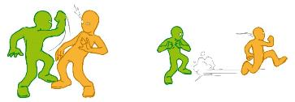
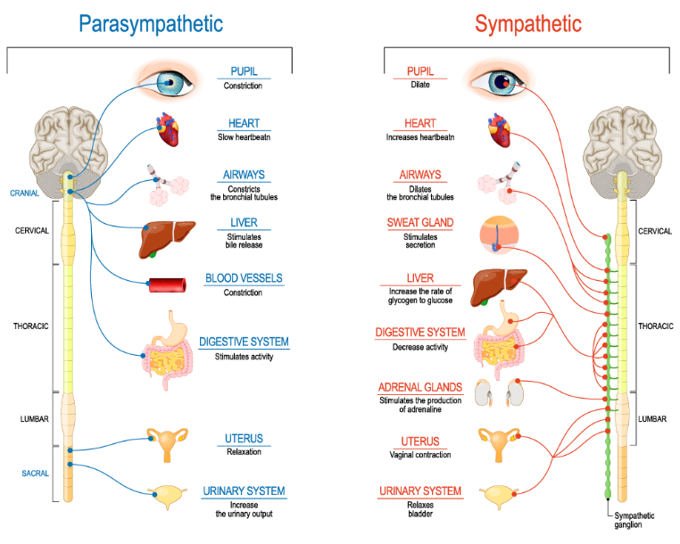
The fight or flight response vs Relaxation / maintenance

Slide 5
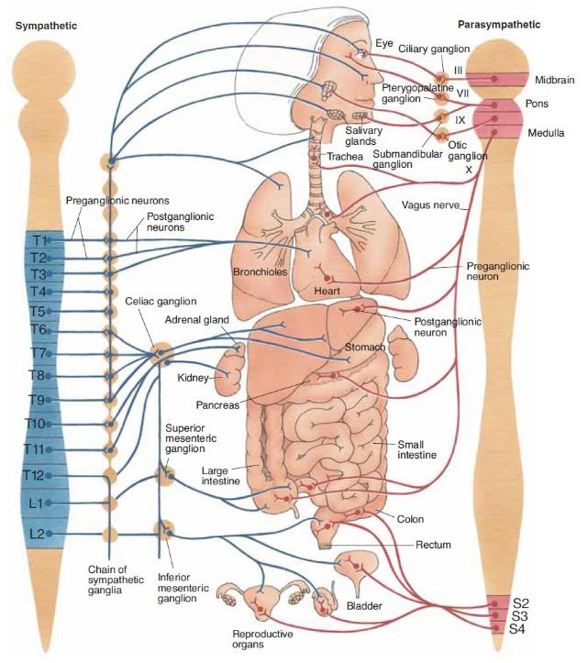
Sympathetic = Thoracolumbar
[T1-L2 (L3)]
Sympathetic trunk
All Spinal nerves
CN IX, X, XII
Organs
Short pregagnglionic
Long postganglionic
Parasympathetic = Craniosacral
[CN III, VII, IX, X
+ S2, S3, S4]
Ganglia
Organs
Long pregagnglionic
Short postganglionic

