Slide 1
Anterolateral compartment of leg
Dr. Ahmed Almusawi
PhD human anatomy

Slide 2
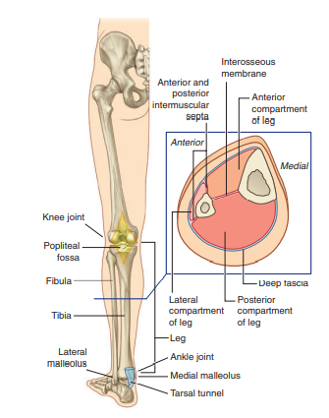
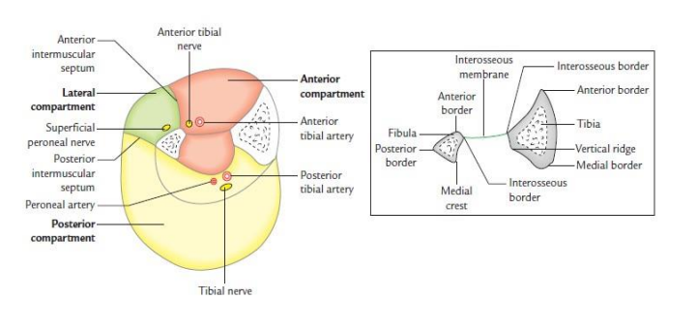
Facial compartments

Slide 3
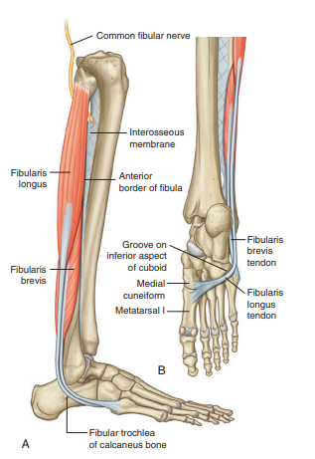
Muscle of lateral compartment
Posterior to lateral malleolus
Lateral side of the foot
curves forward under a bony tubercle (fibular trochlea) of the calcaneus
enters a deep groove of cuboid
cross the sole to be inserted into M.C and 1st MB

Slide 4
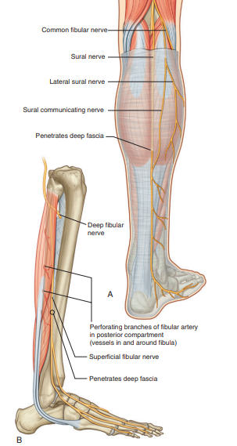
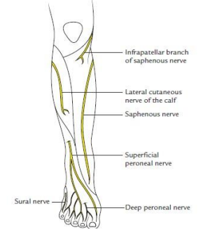
Nerve supply

Slide 5
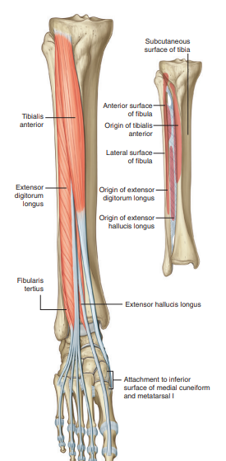
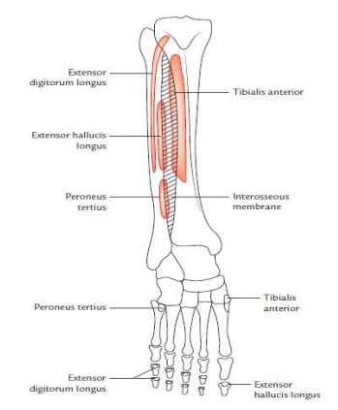
Anterior compartment of leg

Slide 6
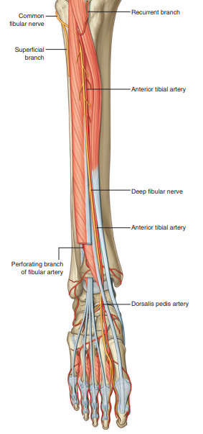
Blood and nerve supply
Recurrent branch
Muscular branches
Joined by perforating br. Of fibular artery
Distally give 2 branches
Anterior lateral malleolar artery
anterior medial malleolar artery
Dorsalis pedis artery

Slide 7
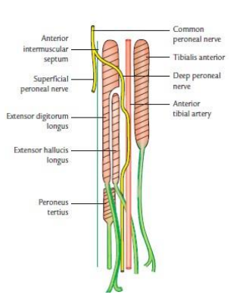
Deep fibular nerve
Muscular branches to anterior compartment
Muscular branches to dorsum of the foot and 1st two dorsal interossei
Cutaneous branch to space between 1st and 2nd toes

Slide 8
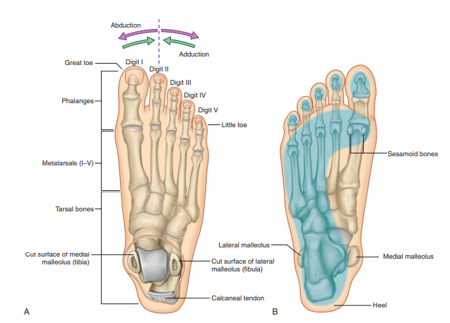
Dorsum of the foot

Slide 9
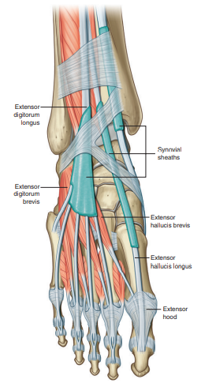
Dorsum of foot

Slide 10
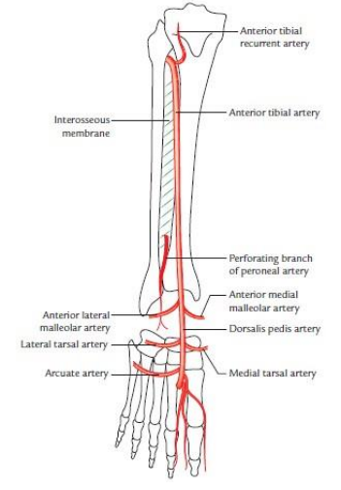
Dorsalis pedis artery

