Slide 1
Posterior thigh compartment and popliteal fossa
Dr. Ahmed Almusawi
M.B.Ch.B MSc. PhD

Slide 2
Objectives
Define the posterior compartment boundaries and content
Study the superficial innervation of post. Thigh compartment
Enumerate the muscles of post. Compartment then explain each muscle details
Define the blood supply of this compartment
Define the nerve supply
Define the popliteal fossa and explain the boundaries
Enumerate the contents of this fossa
Short notes about the popliteal artery and vein

Slide 3
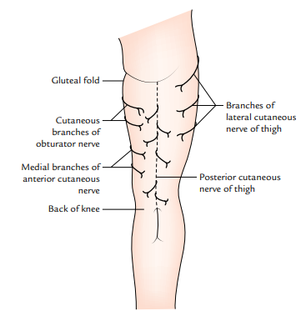
Cutaneous innervation

Slide 4
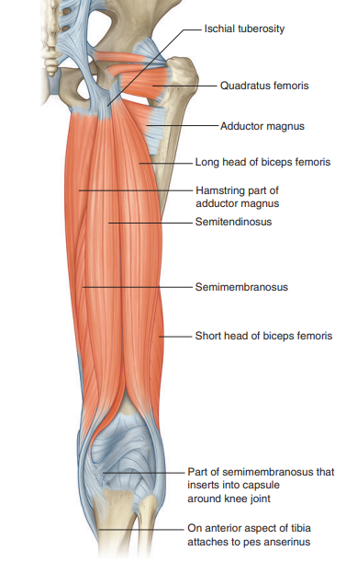
Pos. compartment muscles

Slide 5
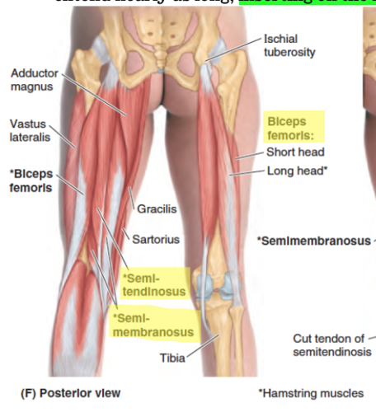
Pos. compartment muscles

Slide 6
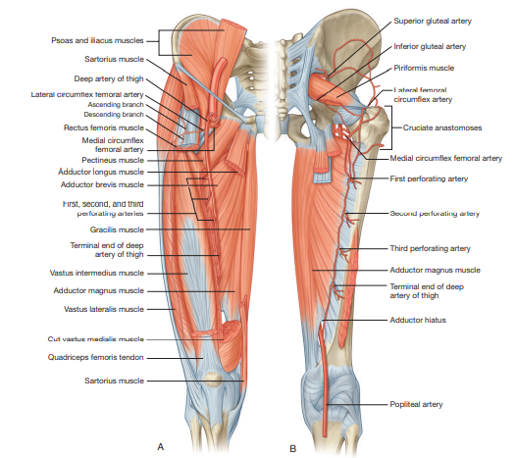
Deep branch of femoral artery

Slide 7
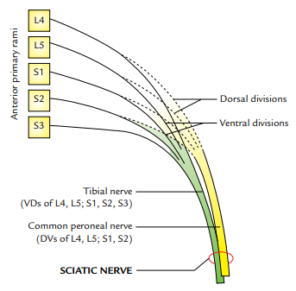
Sciatic nerve

Slide 8
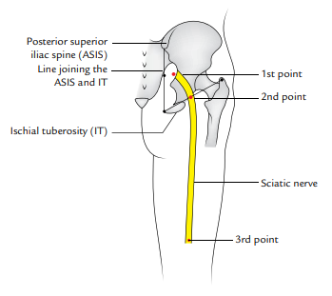
Surface anatomy

Slide 9
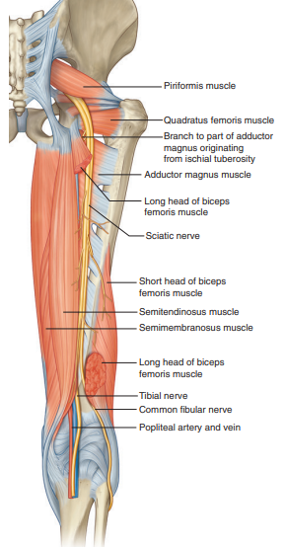
Sciatic nerve

Slide 10
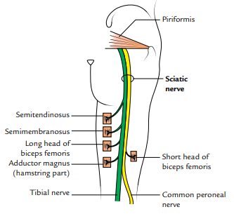

Slide 11
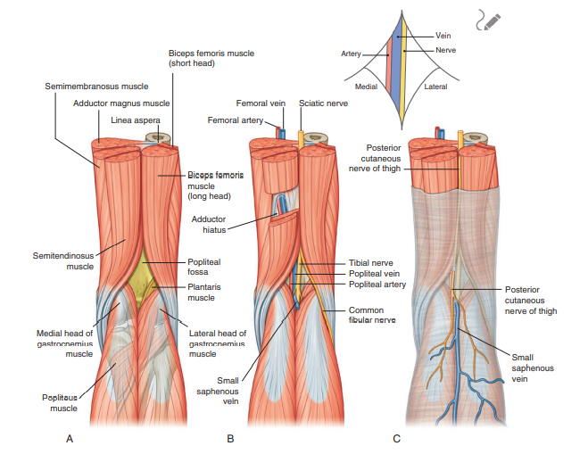
Popliteal fossa

Slide 12
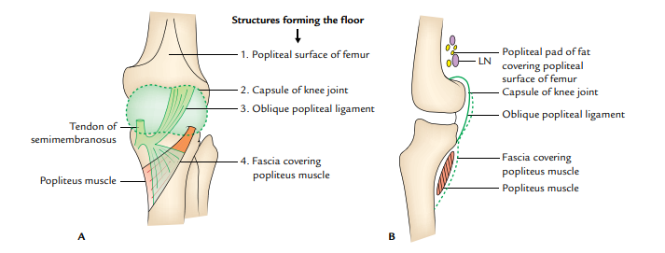
Floor of popliteal fossa

Slide 13
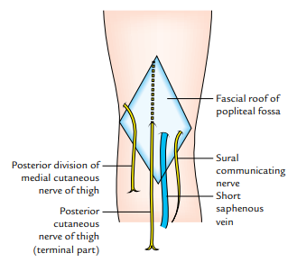
Roof

Slide 14
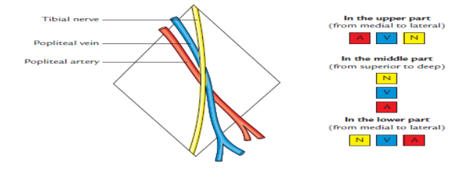
Relation

Slide 15
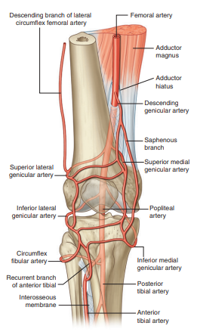
Popliteal artery

Slide 16
Thank you

