Slide 1

The hand: fascia, spaces, hoods and muscles
Al-Mustansiriyah university
College of medicine
Dept. of human anatomy
Dr. ahmed almusawi
Objectives:
Identify the palmer aponeurosis and its septa
Define the anatomical snuff box and its clinical importance
Study the digital fibrous sheath and synovial bursae
Define the extensor hood formation and its action
Enumerate the intrinsic muscles of the hand
Gray’s anatomy for students pp: 791-801

Slide 2
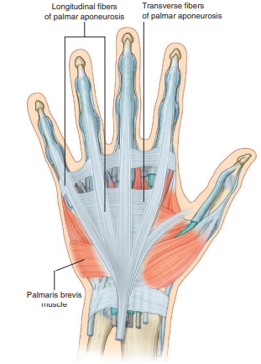
Palmar aponeurosis
The palmaris brevis deepens the cup of the palm by pulling on skin over the hypothenar eminence and forming a distinct ridge. This may improve grip.

Slide 3
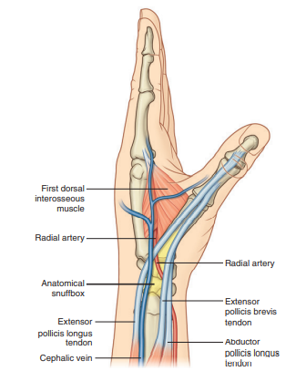
Anatomical snuffbox
The lateral border: tendons of the abductor pollicis longus and extensor pollicis brevis.
The medial border: tendon of the extensor pollicis longus.
The floor : the scaphoid and trapezium, and the distal ends of the tendons of the extensor carpi radialis longus and extensor carpi radialis brevis.
The radial artery,
Terminal parts of the superficial branch of the radial nerve
The anatomical snuffbox is an important clinical region. When the hand is in ulnar deviation, the scaphoid becomes palpable within the snuffbox. This position enables the physician to palpate the bone to assess for a fracture.
The pulse of the radial artery can also be felt in the snuffbox.

Slide 4
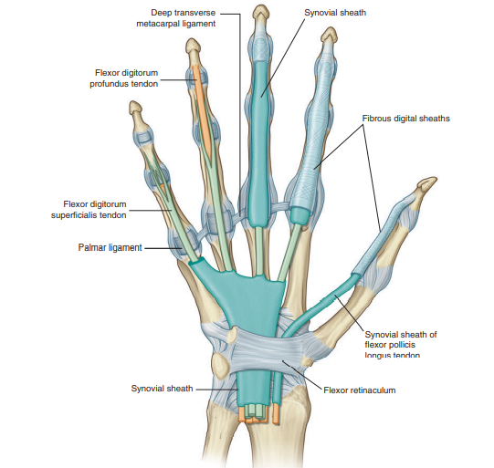
Fibrous digital sheaths
is the common synovial sheath for the eight tendons of flexor digitorum superficialis and flexor digitorum profundus.
extending from proximal to the flexor retinaculum to the point of insertion of flexor pollicis longus (i.e. the distal phalanx of the thumb).

Slide 5
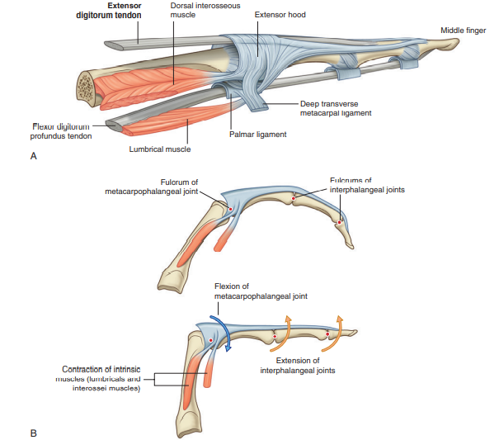
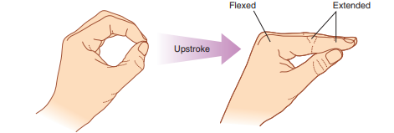
Extensor hoods
This ability to flex the metacarpophalangeal joints, while at the same time extending the interphalangeal joints, is entirely due to the intrinsic muscles. This type of precision movement is used in the upstroke when writing a t

Slide 6
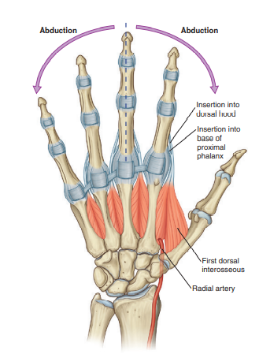
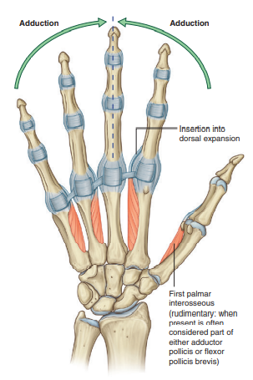
the intrinsic muscles of the hand/The interossei
All of the interossei are innervated by the deep branch of the ulnar nerve.

Slide 7
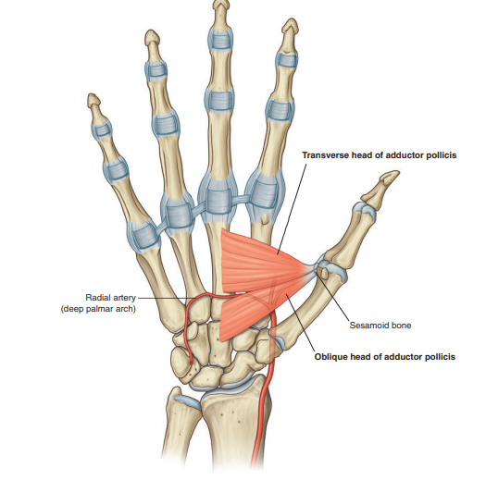
Adductor pollicis

Slide 8
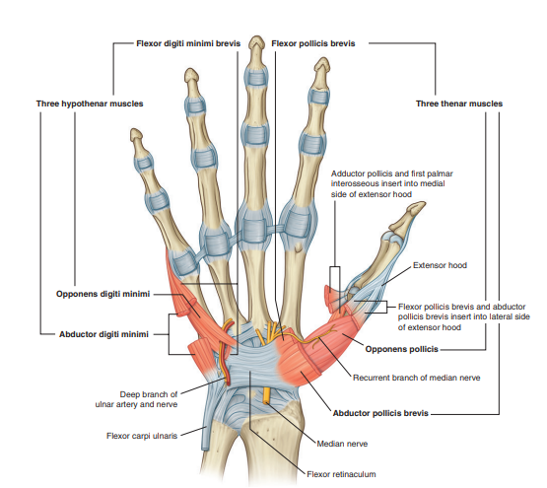
Thenar muscles/Hypothenar muscles

Slide 9
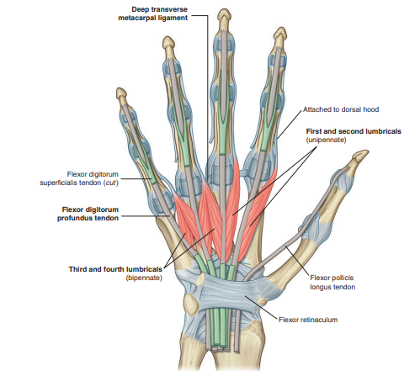
Lumbrical muscles

