Slide 1
Muscles of the shoulder region:
Al-Mustansiriyah university
College of medicine
Dept. of human anatomy
Dr. ahmed almusawi
Objectives:
Take a general knowledge about surface anatomy
Identify the sub-regions of the shoulder and their important surface landmarks
Study the muscles of the pectoral, lateral thoracic and axio-scapular regions
Summarize the movements of the scapula
Gray’s anatomy for students pp: 702-704 + 712-716

Slide 2
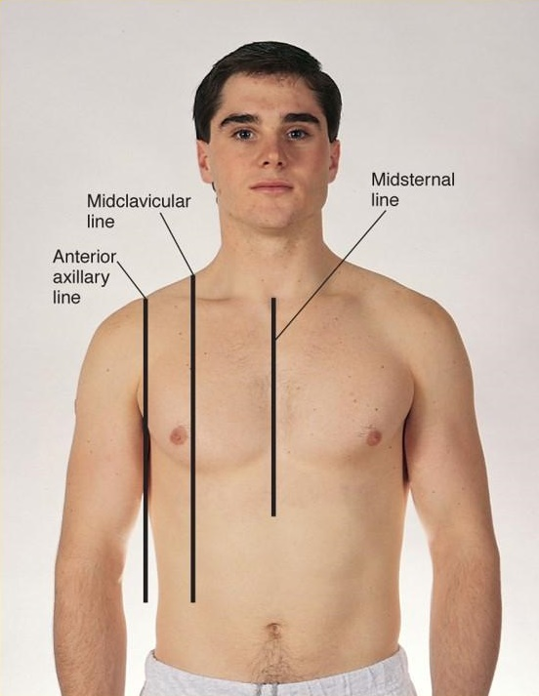
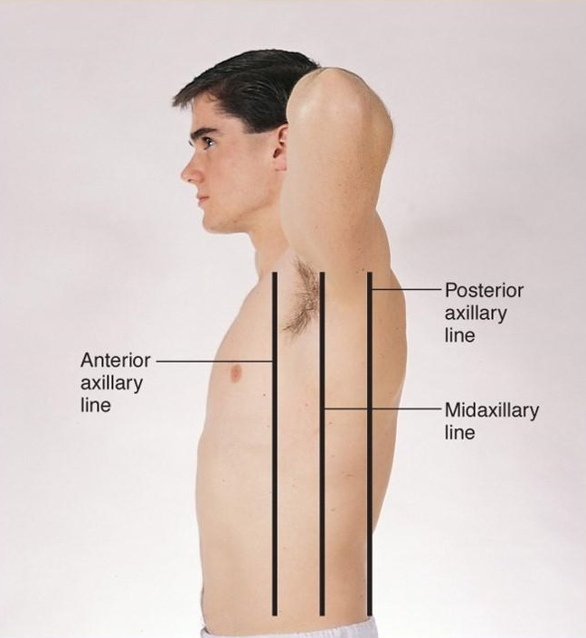
Surface Anatomy
Parasternal line

Slide 3
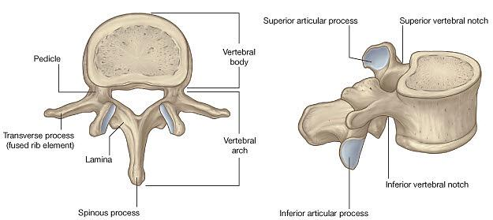
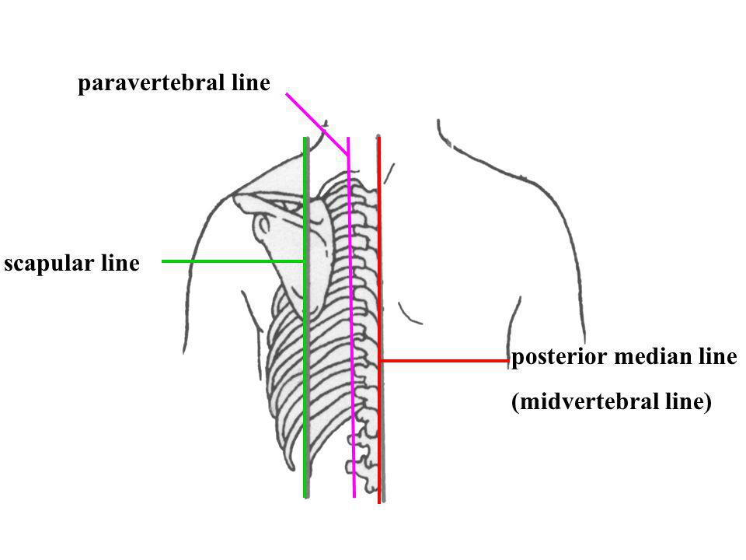
Surface Anatomy

Slide 4
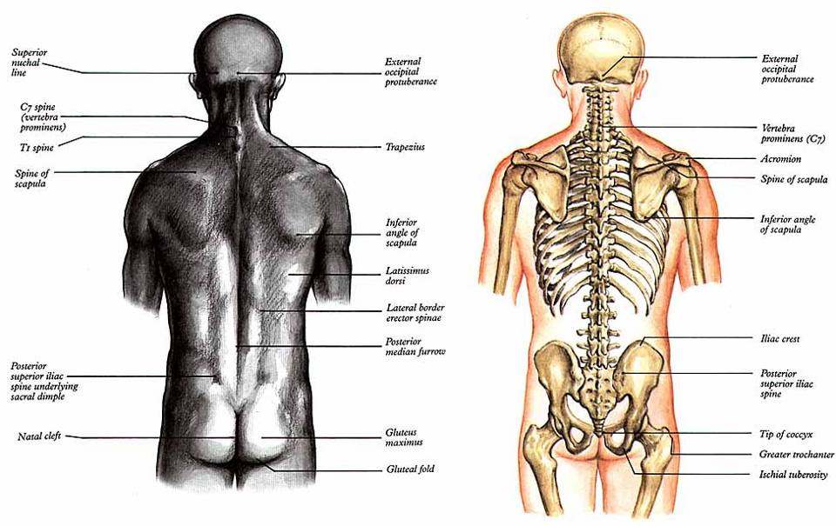
Surface Anatomy
T1
T2,3
T7

Slide 5
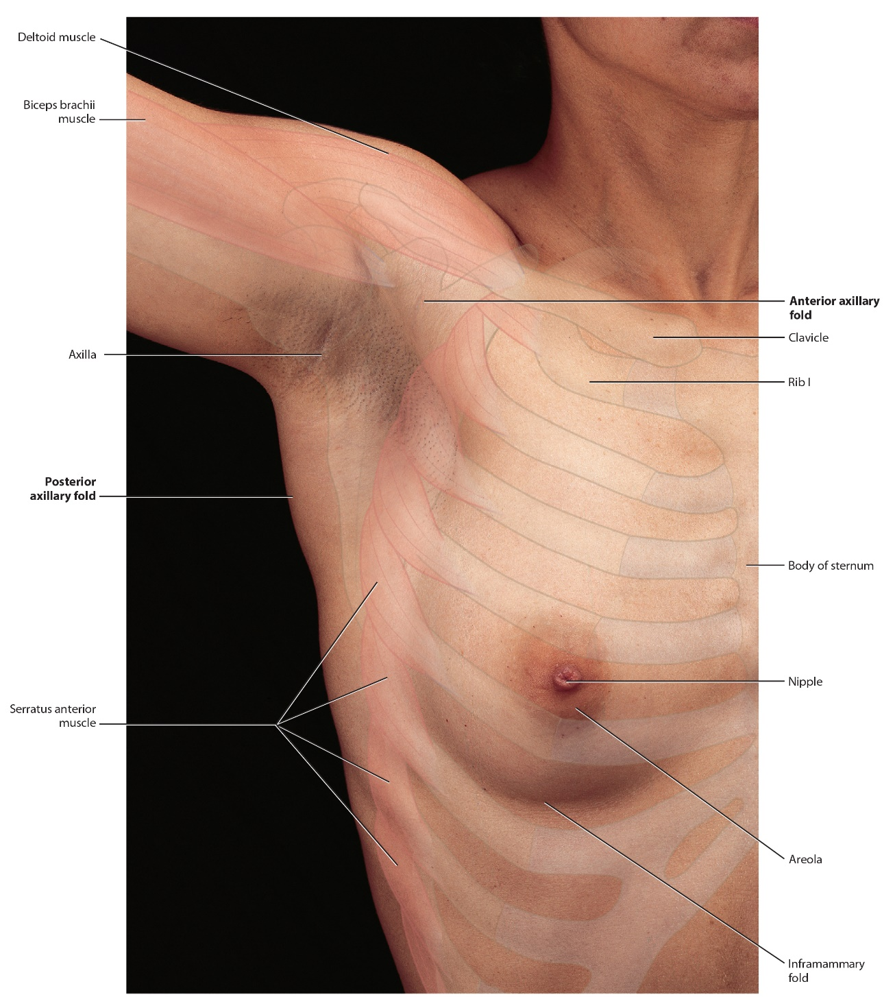
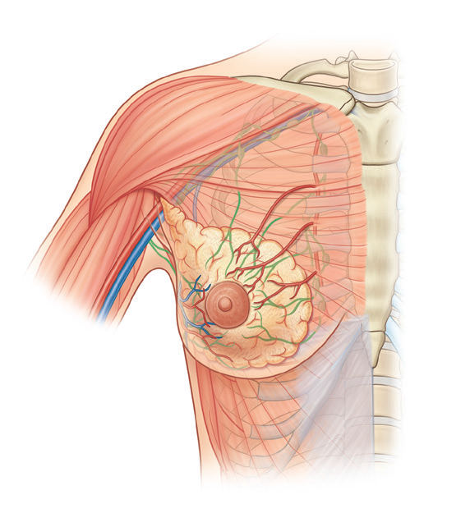
Subregions: Pectoral, Axilla, shoulder and scapular
Pectoral region (Ant.): Closely related to the breast
Axilla (Lat.): Related to the neck

Slide 6
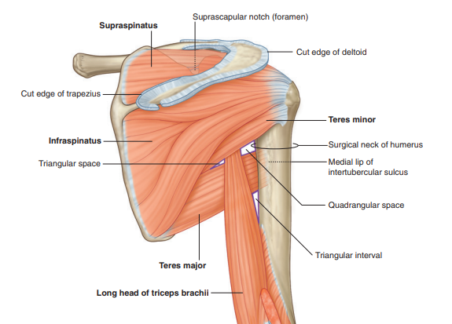
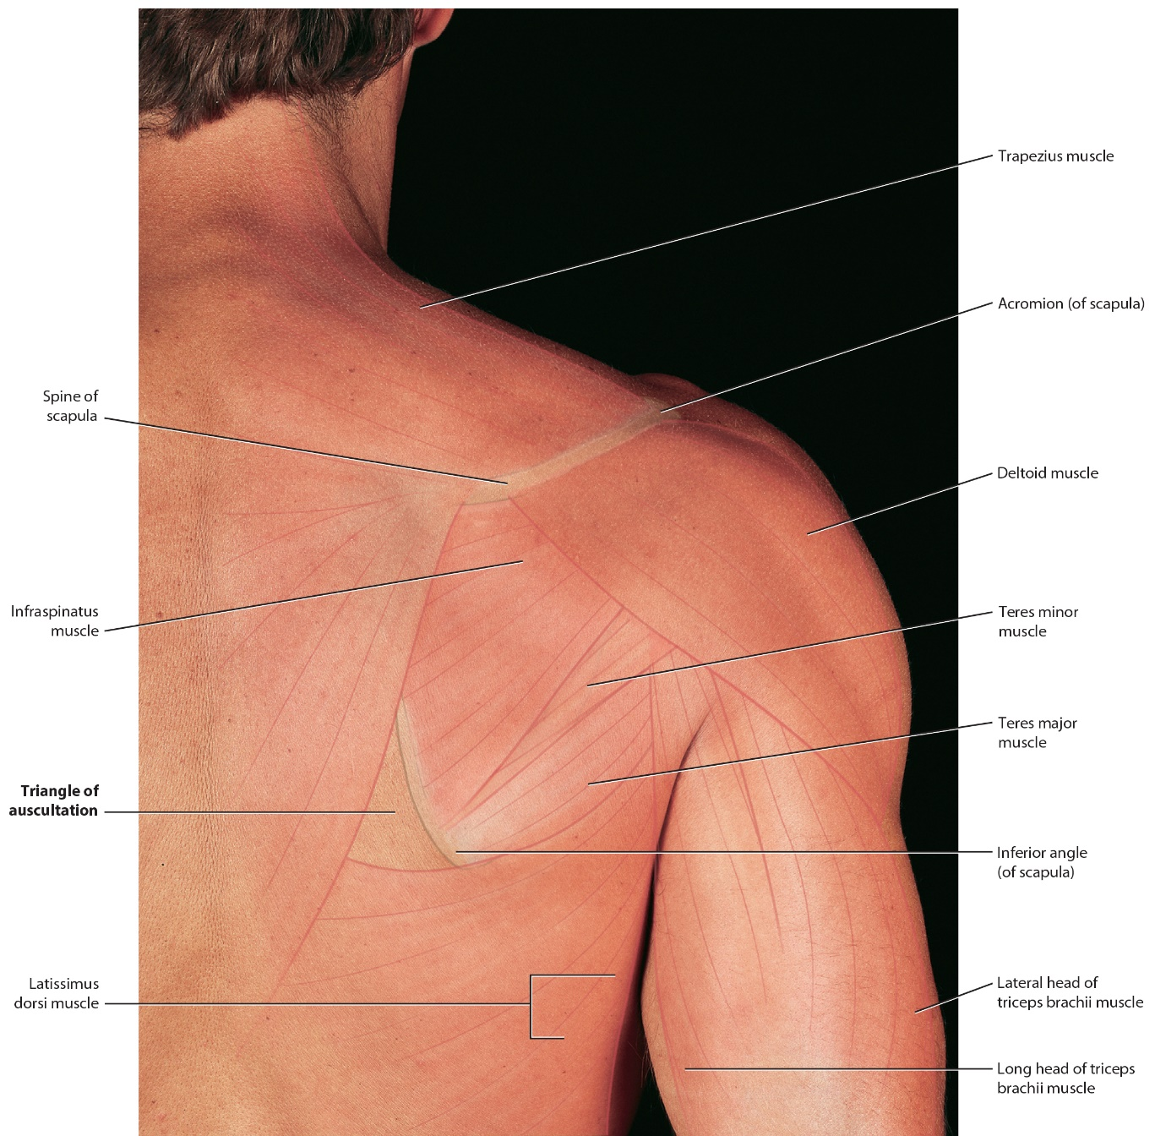
Subregions: Shoulder
3. The shoulder is the area of upper limb attachment to the trunk
4. Scapular region (post.):
Related to the back
4. posterior scapular region
occupies the posterior aspect of the scapula and is located deep to the trapezius and deltoid muscles
the supraspinatus, infraspinatus, teres minor, and teres major muscles

Slide 7
Movements of the scapula
Adduction = Retraction
Abduction = Protraction
Elevation = Up
Depression = Down
Lateral rotation= inferior angle moves outwards
Medial rotation= inferior angle moves inwards

Slide 8
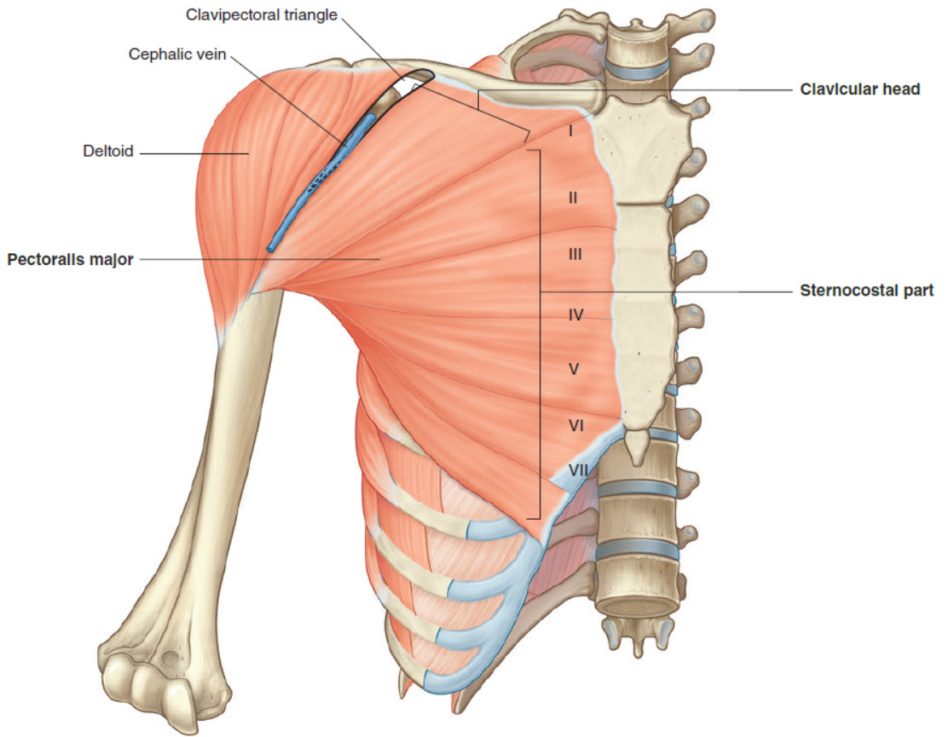
Pectoralis major
2 heads:
Clavicular (separated from deltoid by deltopectoral groove)
Sternocostal
Most powerful shoulder adductor (sternocostal head)
Flexes extended shoulder (clavicular head)
Rotates shoulder medially
Forms anterior wall of axilla
Supplied by 2 pectoral nerves (medial & lateral)

Slide 9
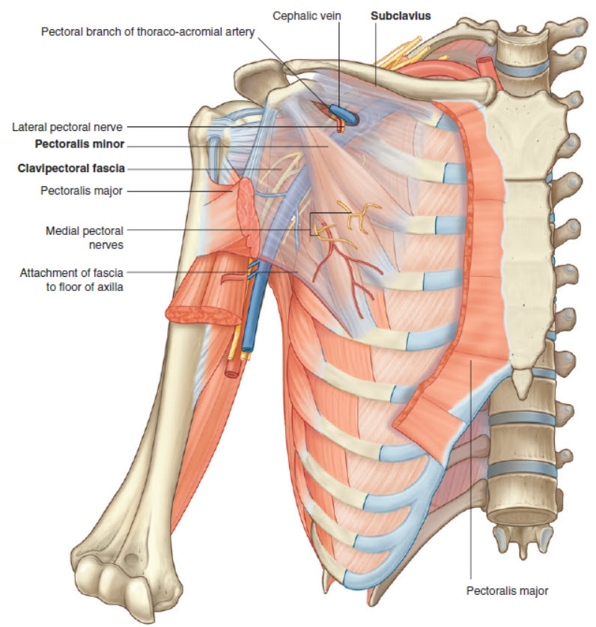
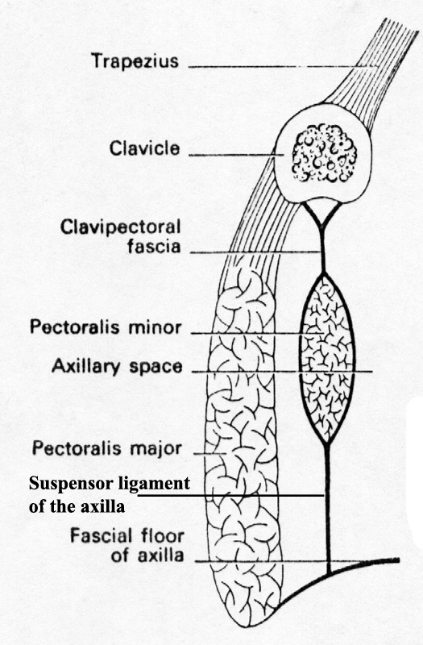
Pectoralis minor & Subclavius
P. minor: depresses, protracts & medially rotate scapula
Subclavius (stabilizes sternoclavicular joint)
Both covered by clavipectoral fascia (pierced by artery, vein & nerve)

Slide 10
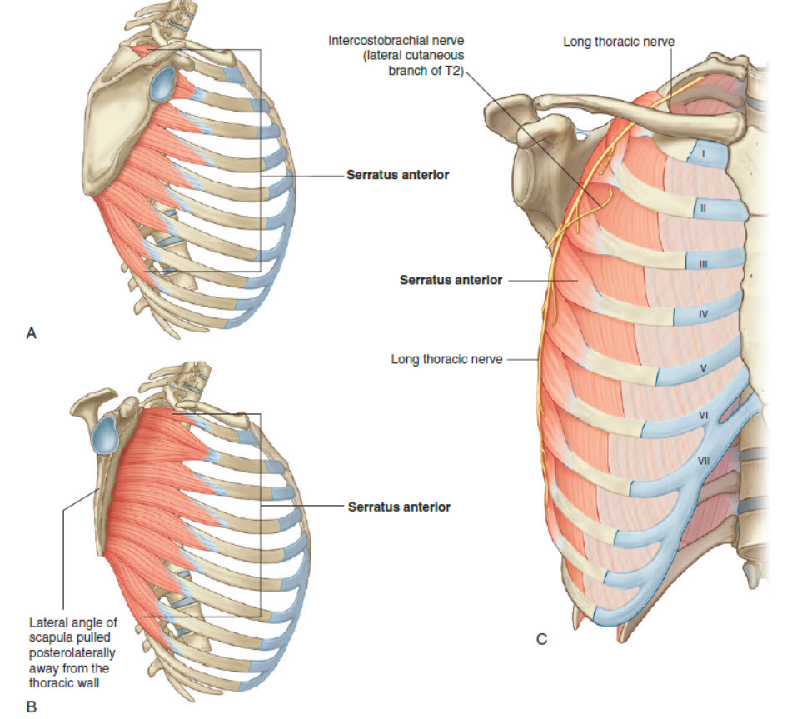
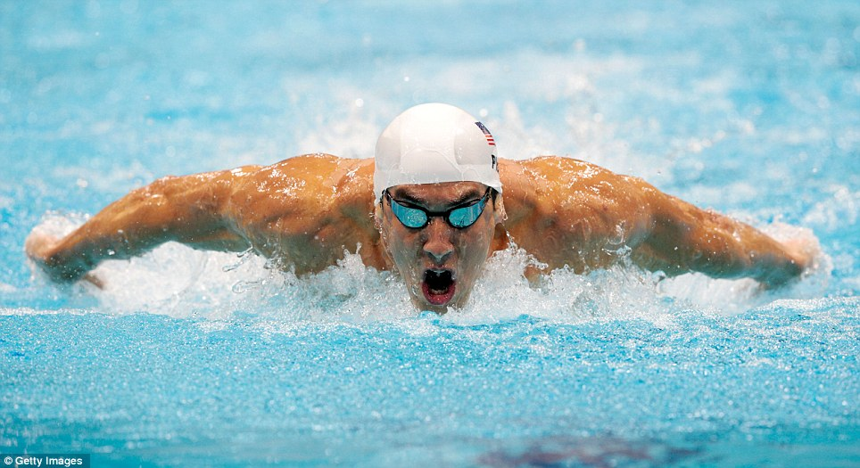
Serratus anterior
Has 8 digitations
Powerful protractor (swimmers muscle)
Keep the medial border and inferior angle opposed to costal surface

Slide 11
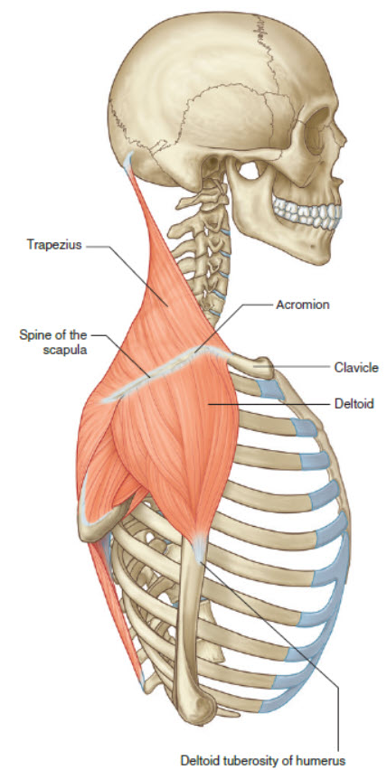
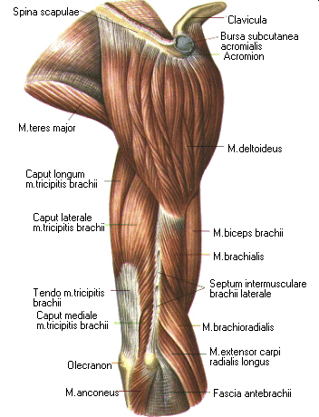
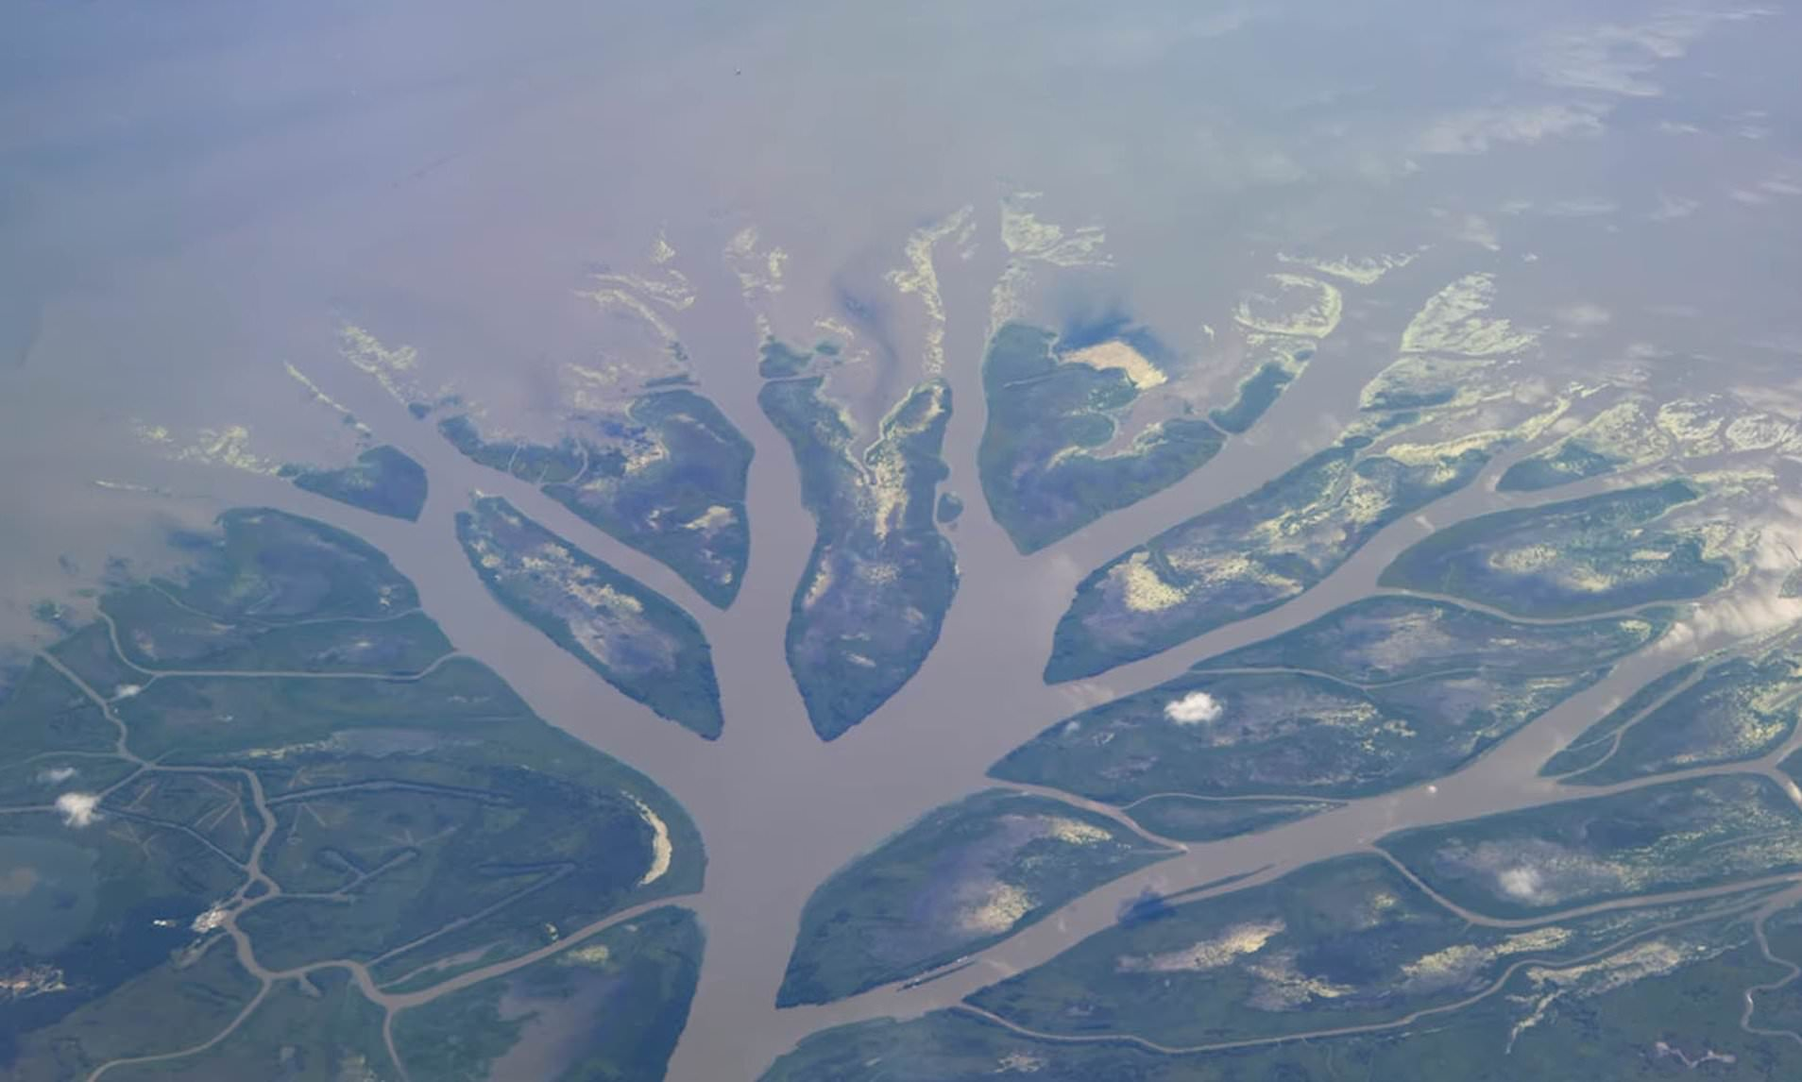
Deltoid
acts on shoulder (forms ball of shoulder)
Has 3 parts:
Anterior (flexion + medial rotation)
Middle (abduction)
Posterior (extension + lateral rotation)
i.e. performs all shoulder movements except adduction
Separated from trapezius by line of origin

Slide 12
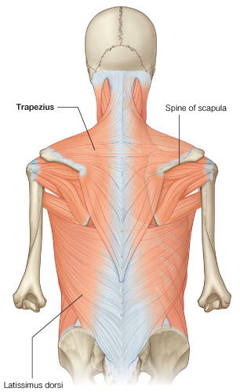
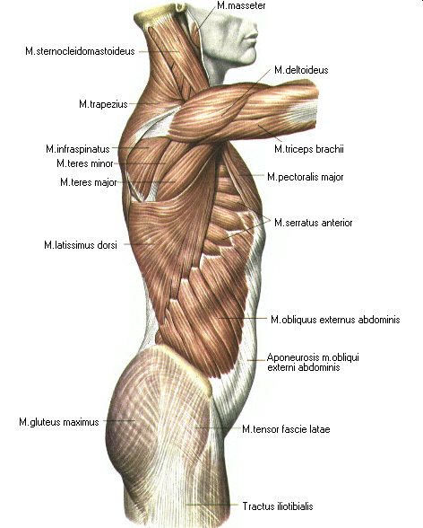
Posterior axio-scapular muscles (superficial)
Trapezius: has three parts:
Upper fibers: elevate
Middle fibers: retract
Lower fibers: Depress
Latissimus dorsi:
Extends the flexed shoulder (climbers muscle)
Spins from posterior to anterior
Deep fibers attach to inferior scapular angle
Upper+Lower: rotate laterally

Slide 13
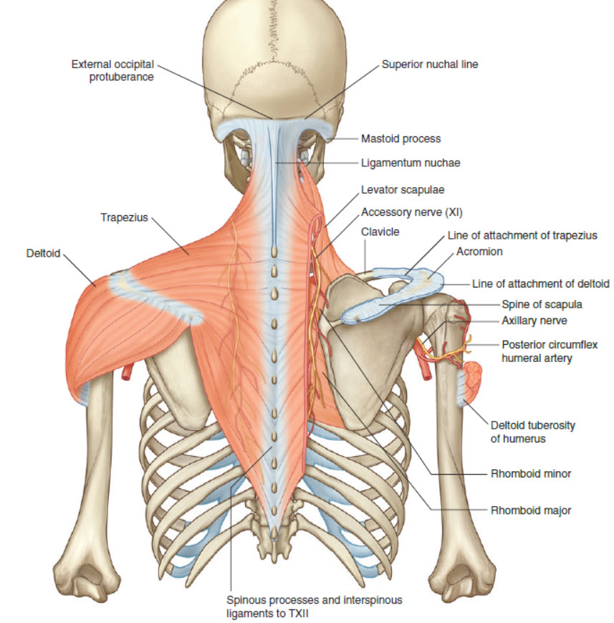
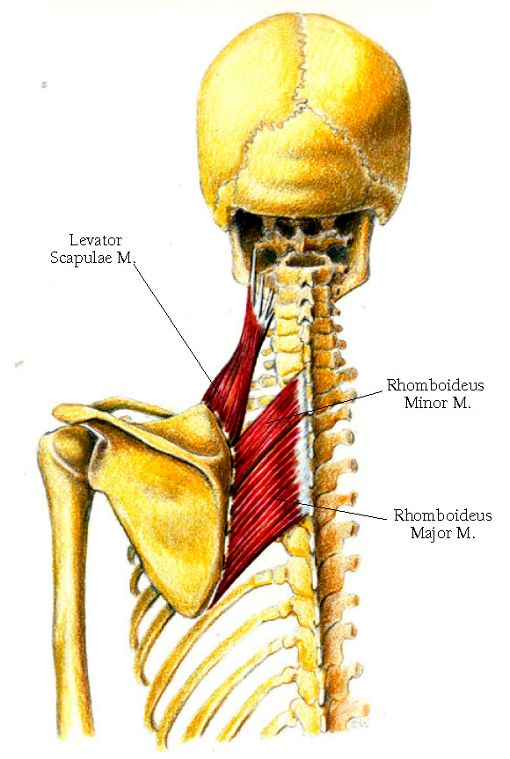
Posterior axio-scapular muscles (Deep)
Levator scapulae: only muscle from transverse processes .
Rhomboid major & Rhomboid minor: retractors & elevators
Insertion of the three muscles is along the medial scapular border posteriorly from above downwards.
All three are supplied by the same nerve: dorsal scapular nerve

Slide 14
Dorsal scapular region
Supraspintus
Infraspinatus
Teres Minor
Teres Major

Slide 16
Gateways

Slide 17
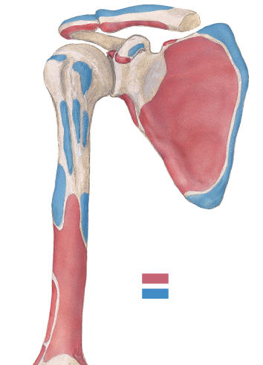
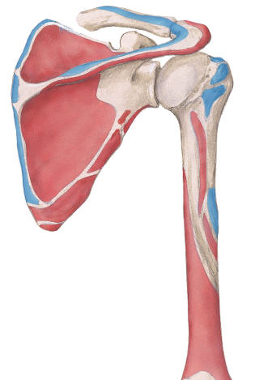
POSTERIOR
ANTERIOR

Slide 18
Levator scapulae Upper trapezius Rhomboids
Lower trapezius Latissimus dorsi Pectoralis minor Serratus anterior
Depression
Serratus anterior
Pectoralis minor

Slide 19
Middle trapezius Rhomboids Latissimus dorsi

Slide 20
Rhomboid major & minor Levator scapulae Pectoralis minor Latissimus dorsi
Upper+Lower trapezius Lower serratus anterior

Slide 21
Muscles
Muscles connect the scapula and clavicle to the trunk:
1. trapezius
2. levator scapulae
3. and rhomboids
muscles connect the clavicle, scapula, and body wall to the proximal end of the humerus
1. pectoralis major
2. pectoralis minor
3. latissimus dorsi
4. teres major
5. and deltoid

