Slide 1
The Hand pp. 782
Objectives:
Identify the bones & articulations of the hand
Study the anatomical snuff box & wrist retinacula with arrangement of structures around them
Study the nervous & arterial distribution of the hand And understand its resting & anatomical position

Slide 2
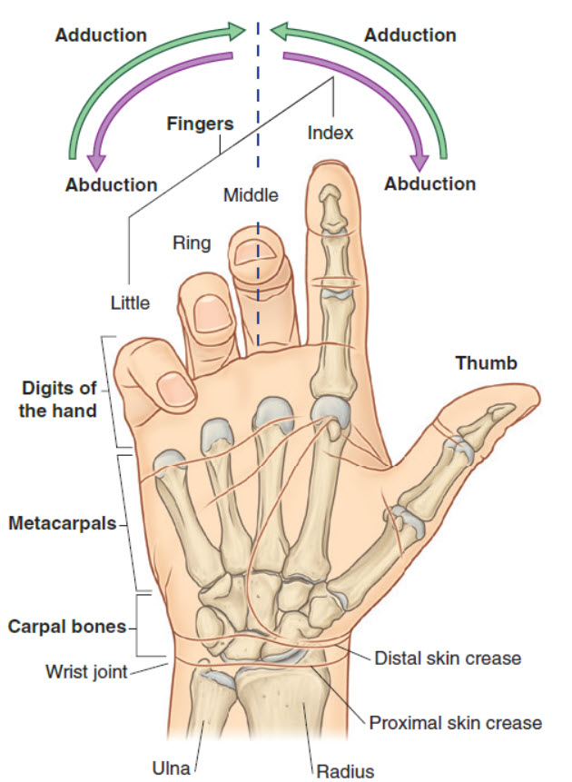
General overview

Slide 3
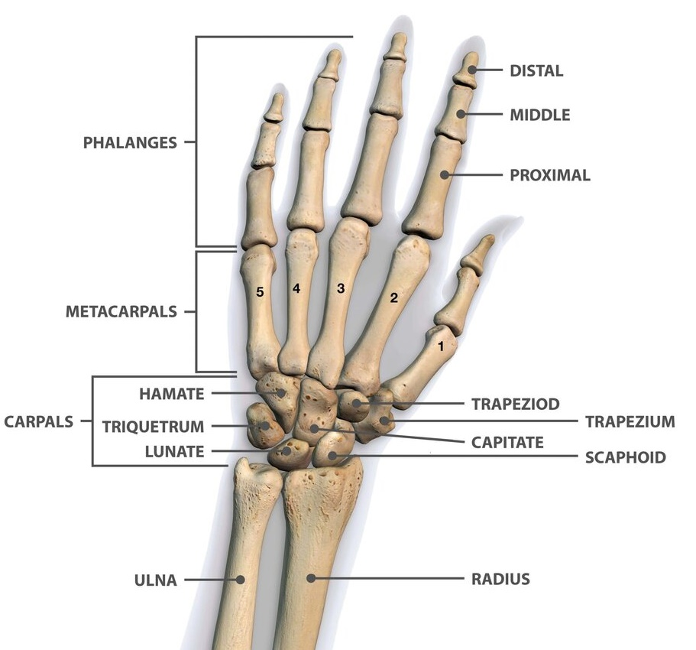
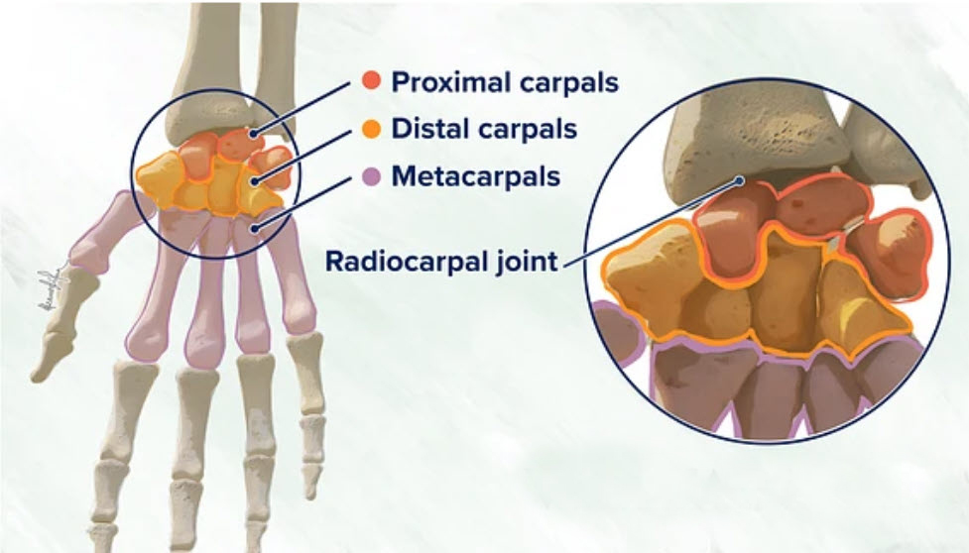
Carpal bones

Slide 4

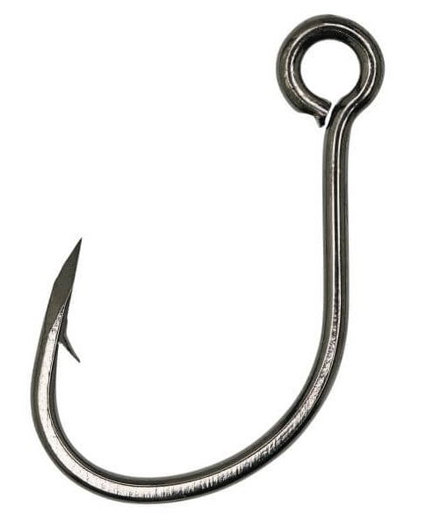
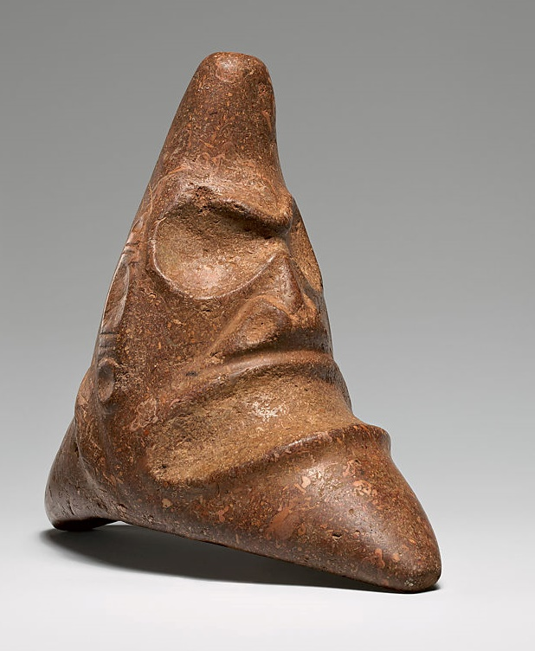
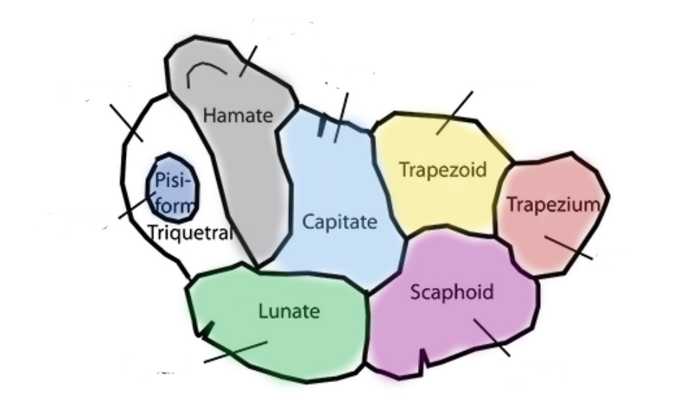
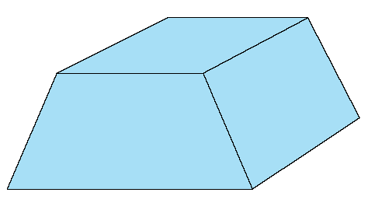
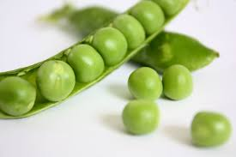
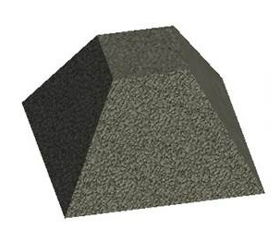
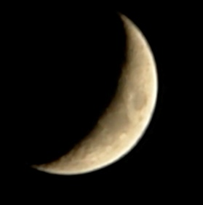

Carpal bones

Slide 5
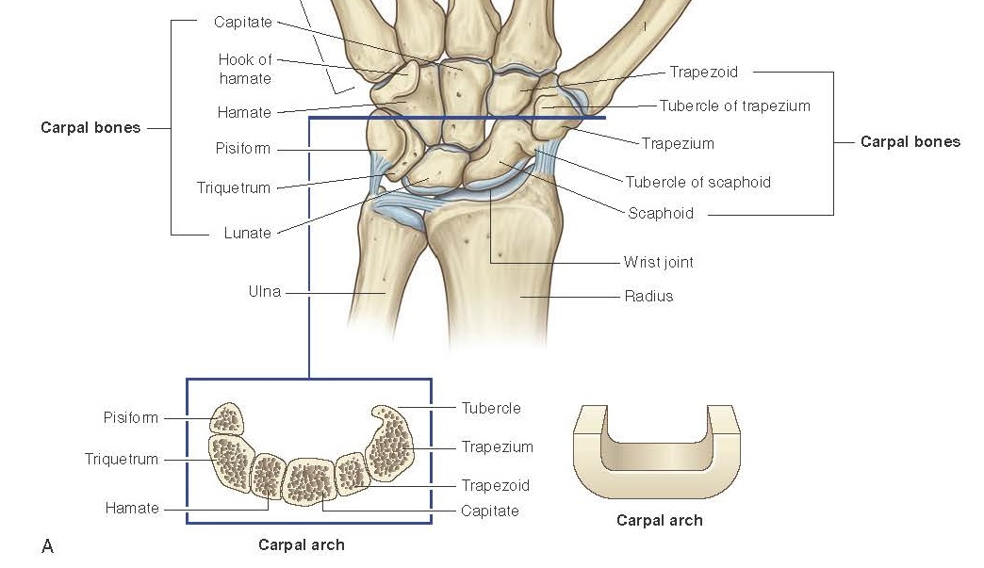
Carpal arch

Slide 6
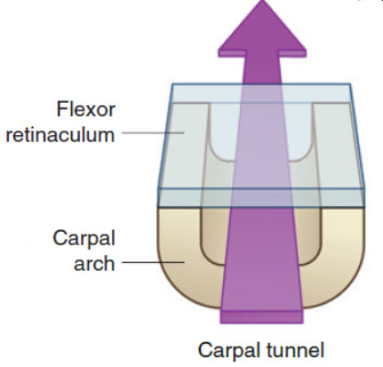
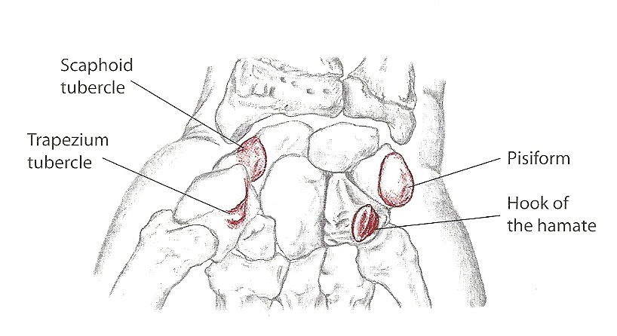
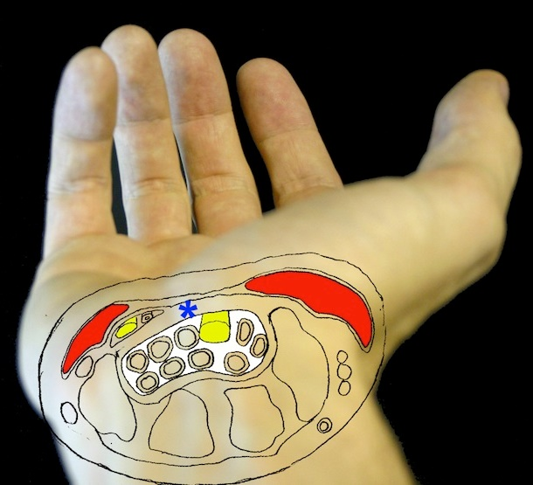
The Flexor retinaculum & Carpal Tunnel

Slide 7
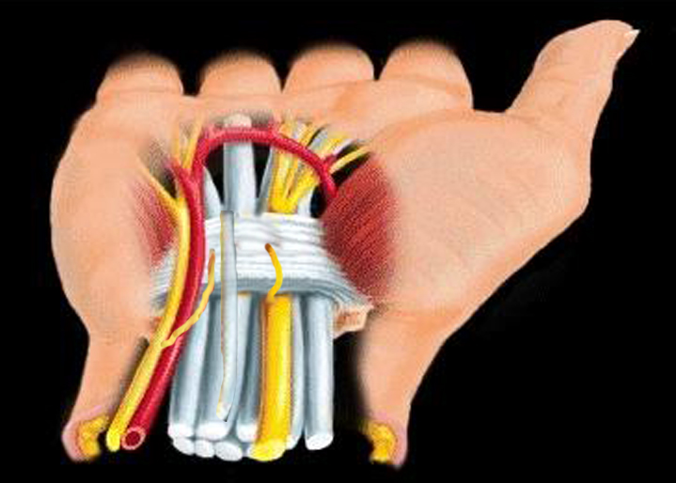
Flexor retinaculum of the wrist

Slide 8
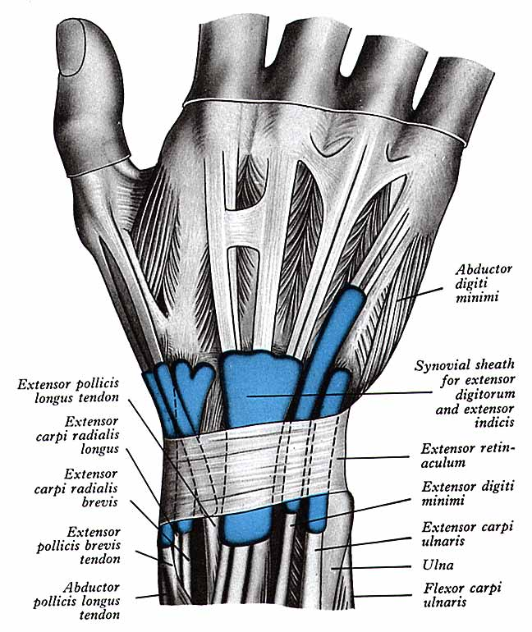
Extensor retinaculum of the wrist

Slide 9
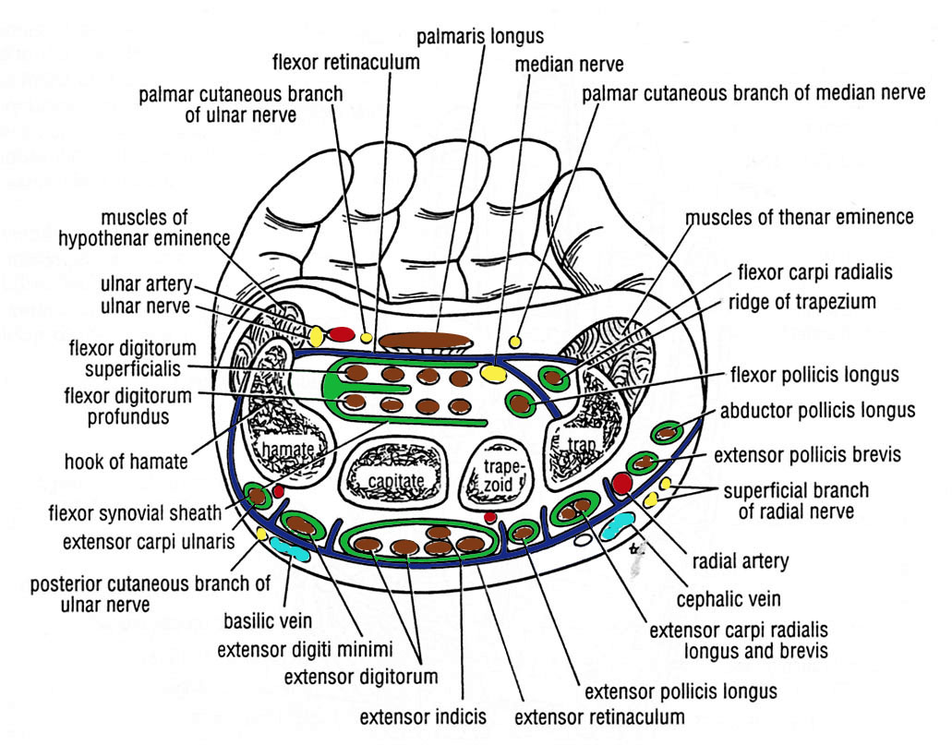
Thank you
Flexor retinaculum & Carpal tunnel structure arrangement:
A. Superficial (Anterior):
Ulnar n. 2. Ulnar a.
3. Palmar cut. br. of ulnar nerve
4. Palmaris longus tendon
5. Palmar cut. br. of median n.
B. Deep (posterior):
FDS 4 tendons
FDP 4 tendons
FPL tendon
FCR tendon (isolated)
Median nerve
Thanks to your commitment and strong work ethic, we know next year will be even better than the last.
We look forward to working together.
Contoso
sales@contoso.com

Slide 10
Thank you
Extensor retinaculum structure arrangement:
A. Superficial (Posterior):
Dorsal cut. br. of ulnar nerve
2. Basilic vein
3. Cephalic vein
4. Superficial br. Of radial nerve
B. Deep (posterior):
ECU tendon
EDM tendon
ED (4)+EI (1)
EPL tendon
ECRL & ECRB
APL+EPB+RA
Thanks to your commitment and strong work ethic, we know next year will be even better than the last.
We look forward to working together.
Contoso
sales@contoso.com

Slide 11
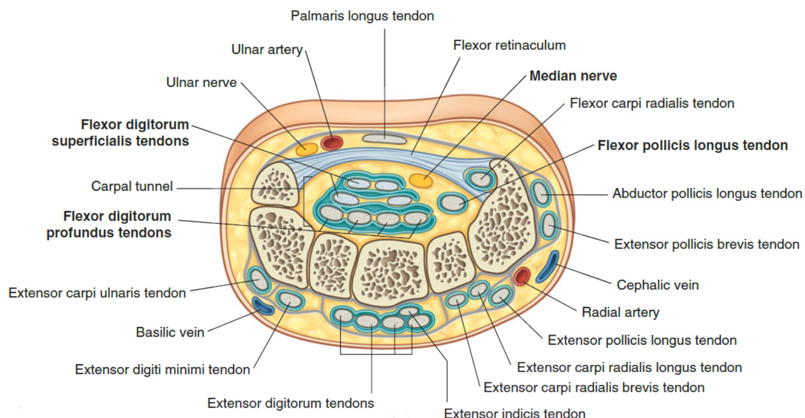

Slide 12
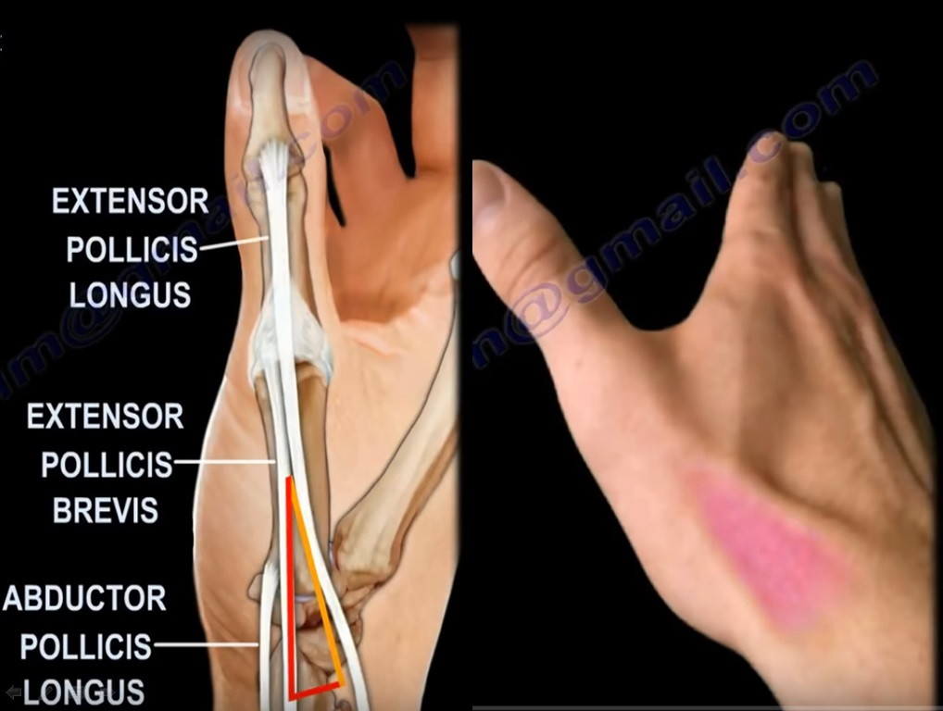
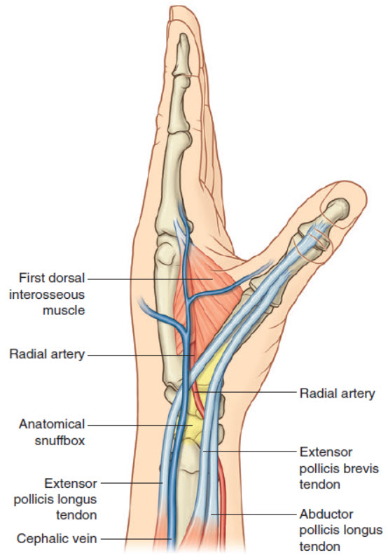
The Anatomical snuff-box
* Boundaries: EPL (medially) , EPB & APL (laterally)
*Floor: Scaphoid & trapezium
*Contents: Radial a., Superficial branch of radial nerve, Cephalic v.

Slide 13
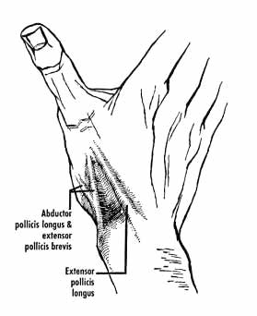
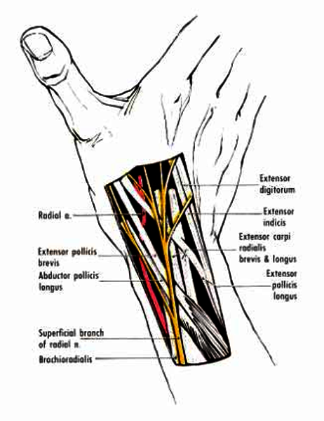
The Anatomical snuff-box
* Boundaries: EPL (medially) , EPB & APL (laterally)
*Floor: Scaphoid & trapezium
*Contents: Radial a., Superficial branch of radial nerve, Cephalic v.

Slide 14
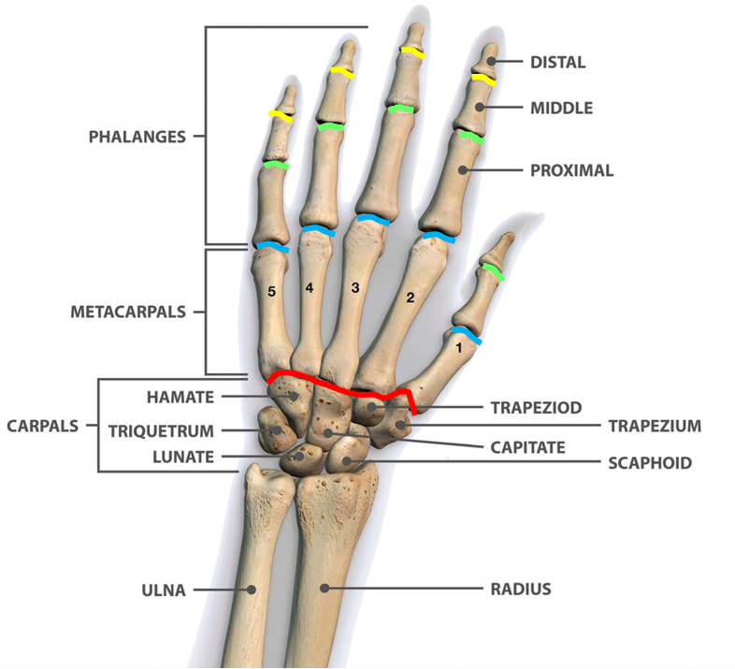
Joints
Radiocarpal (wrist)=
radial styloid process←→ Scaphoid & Lunate (Ellipsoid)
Intercarpal (Plane)
Carpometacarpal (Plane EXCEPT thumb: Saddle)
Intermetacarpal (Plane)
Metacarpophalangeal (Condylar)
Proximal & distal interphalangeal (Hinge)

Slide 15
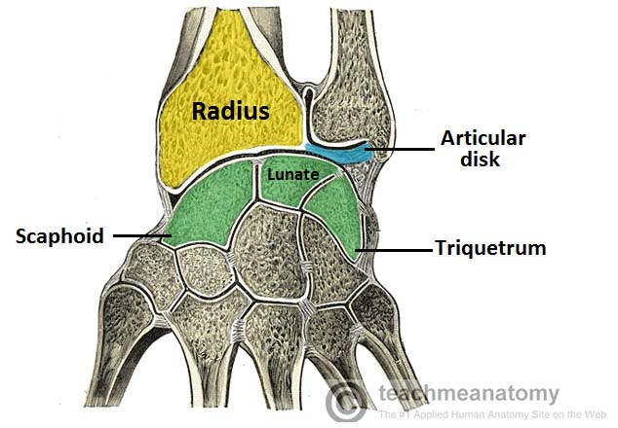
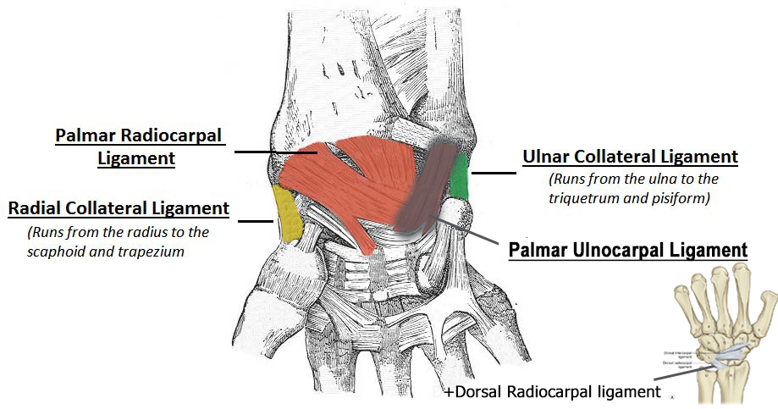
The wrist articulation
& Ligaments

Slide 16
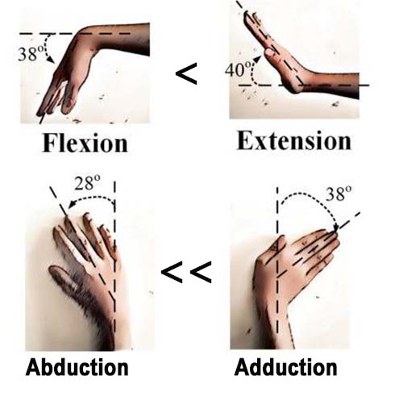
Wrist movements

Slide 17
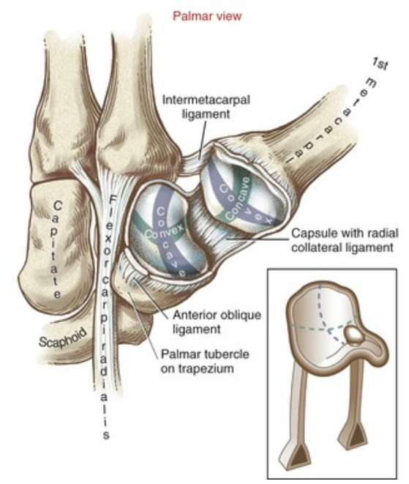
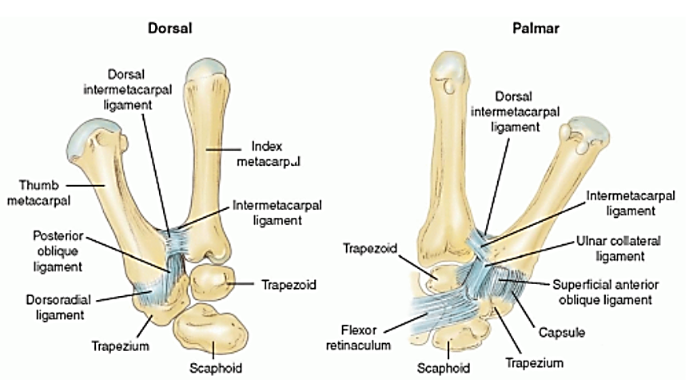
Carpometacarpal joint of the thumb

Slide 18
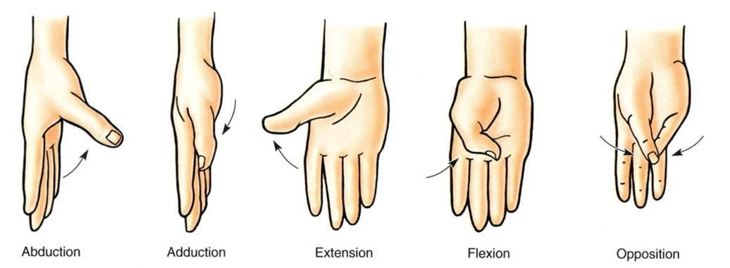
Carpometacarpal joint of the thumb
Adductor pollicis+
1st Palmar interosseous
EPL + EPB
FPL + FPB
Opponens pollicis +
Opponens digiti minimi

Slide 19
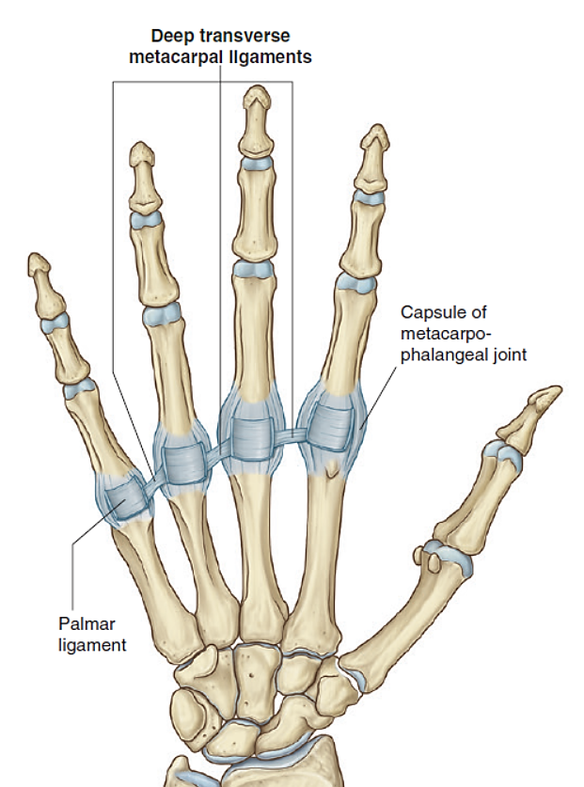
Metacarpophalangeal Joints

Slide 20
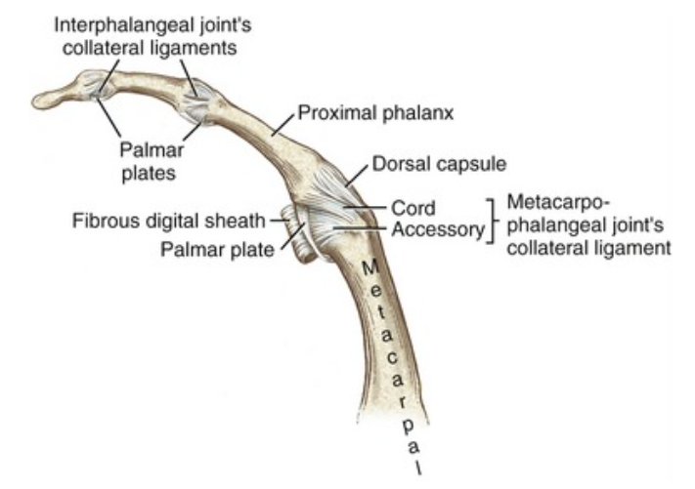
Interphalangeal Joints

