Slide 1
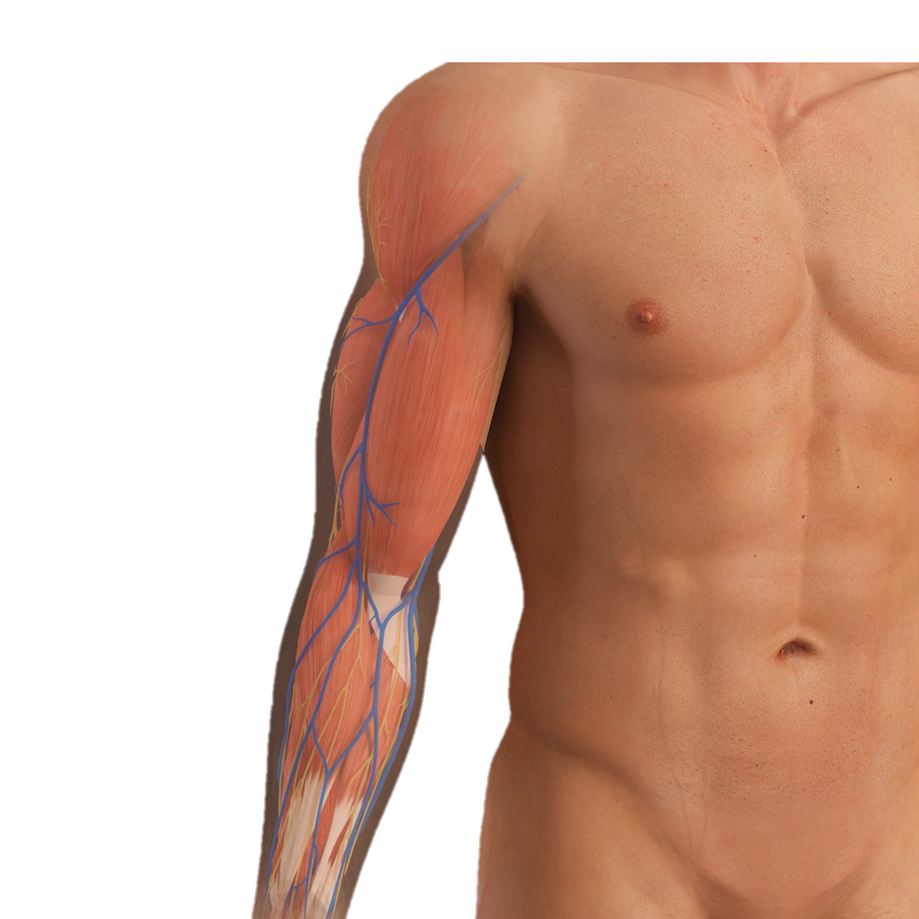
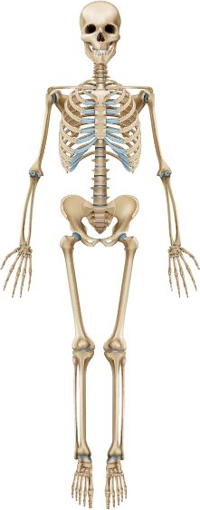
The cubital fossa & Elbow Joint complex
pp. 753-760

Slide 2
OBJECTIVES
Define the cubital fossa & its clinical importance
Identify the surface anatomy of the elbow region
Study the boundaries, roof, floor & contents of the cubital fossa
Identify the articulations at the elbow joint complex & recognize its stabilizing factors and movements
Take some notes of the common problems of the joints

Slide 3
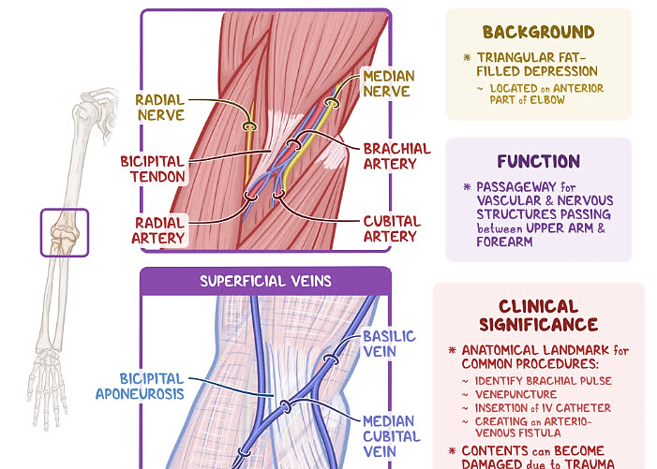
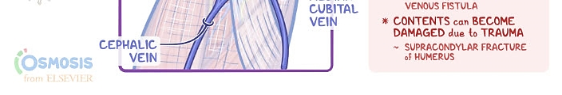
Definition

Slide 4
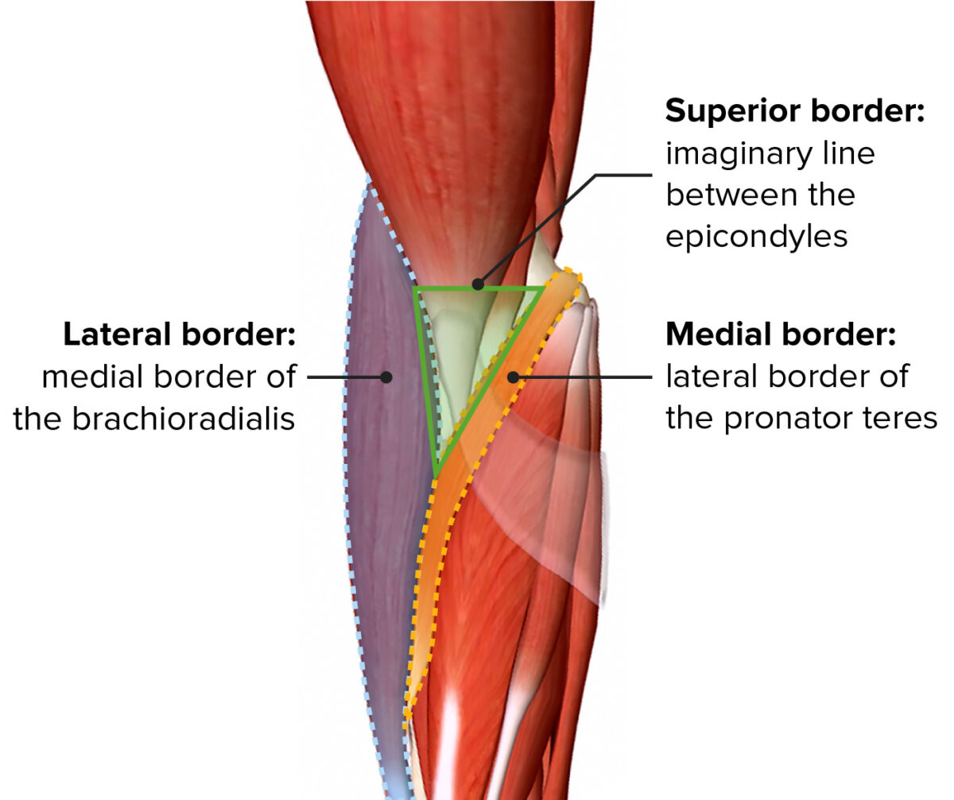
Boundaries

Slide 5
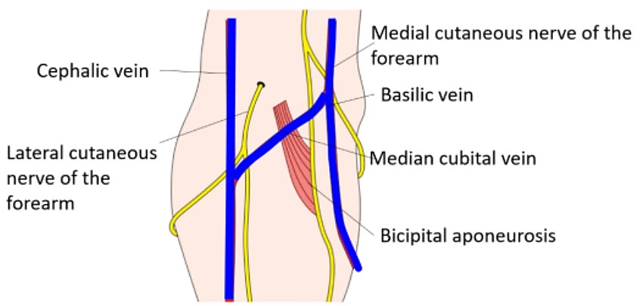
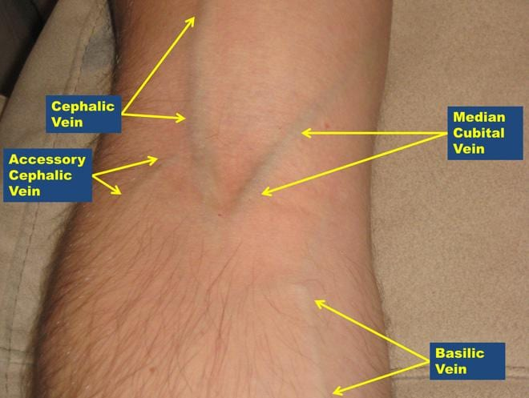
Roof
Skin & superficial fascia of the arm blending with that of the forearm & containing the bicipital aponeurosis with superficial vein & cutaneous nerves

Slide 6
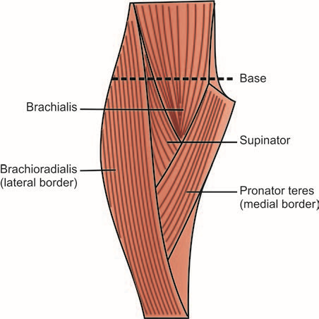
Floor
Proximally: Brachialis
Distally: Supinator

Slide 7
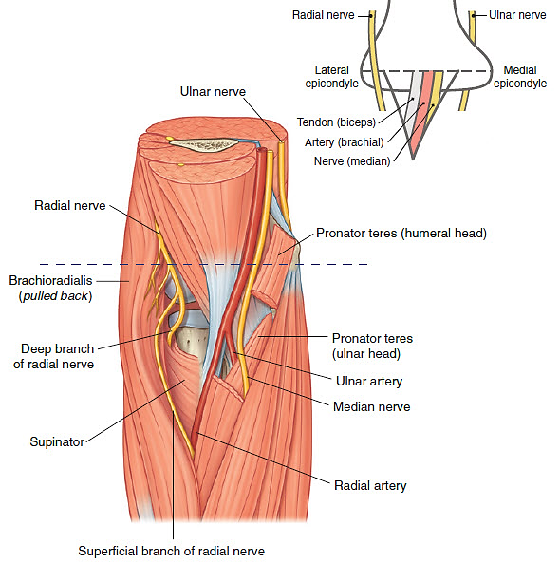
Contents
The ulnar nerve is NOT part of the fossa as it passes behind the medial humeral epicondyle
From Medial to lateral:
Median nerve: passing between the 2 heads of supinator
Brachial artery: dividing into ulnar & radial branches
Tendon of biceps brachii: passing towards the radial tuberosity.
Radial nerve: dividing into deep & superficial branches.

Slide 8
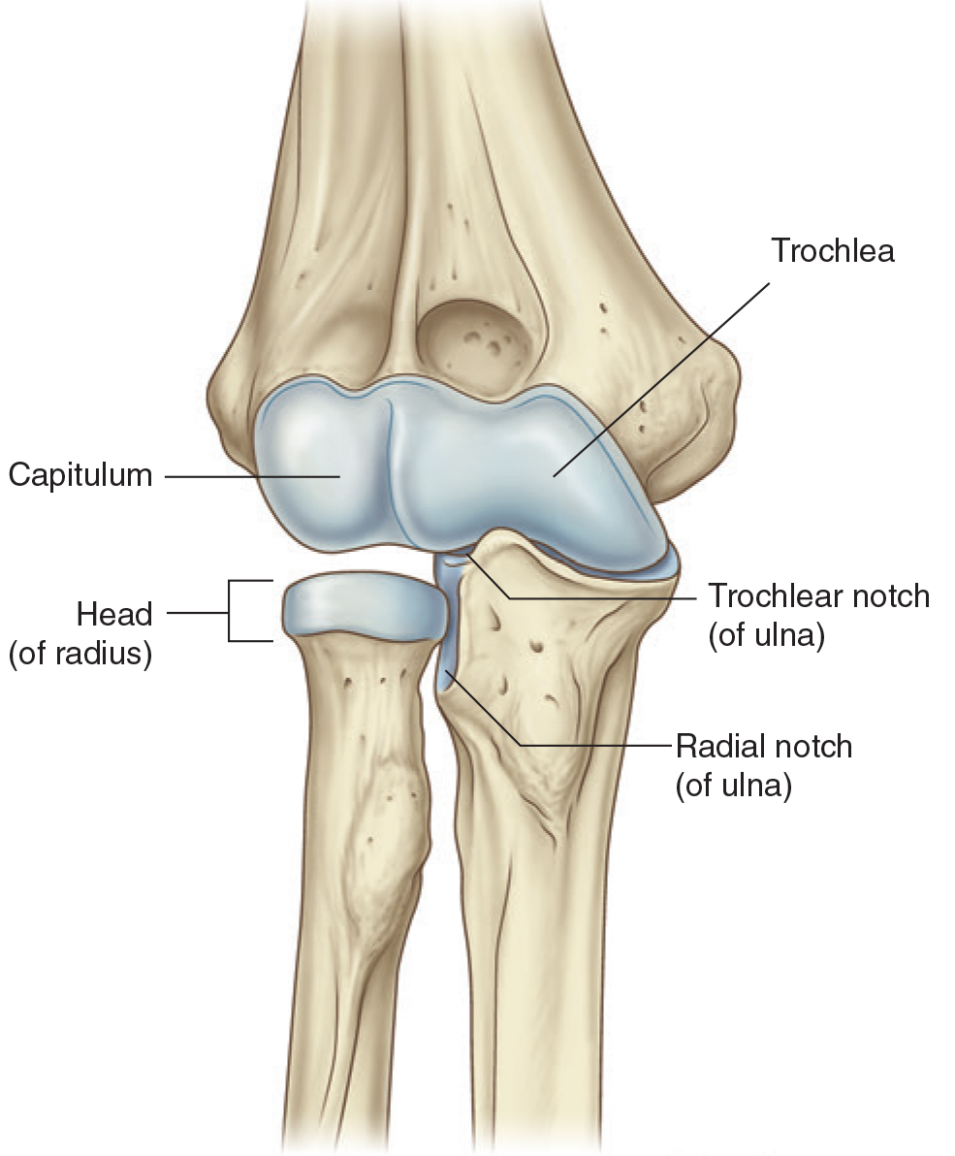
The Elbow Joint Complex
Ulnohumeral
trochlea of the humerus with the trochlear notch (hinge ± )
1
Radiohumeral
2
3
capitulum of the humerus with the radial head (hinge)
Proximal radio-ulnar
radial head with the radial notch of the ulna & anular ligament (pivot)

Slide 9
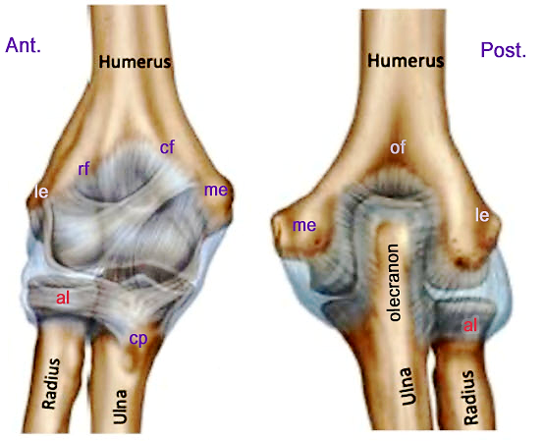
Fibrous capsule
Lax anteriorly & posteriorly
Descends ant. From epicondyles & edges of coronoid & radial fossae to coronoid process & anular lig.
Descends pos. from epicondyles & edges of olecranon fossa to olecranon & anular lig.
i.e. : the capsule is not attached to the radius

Slide 10
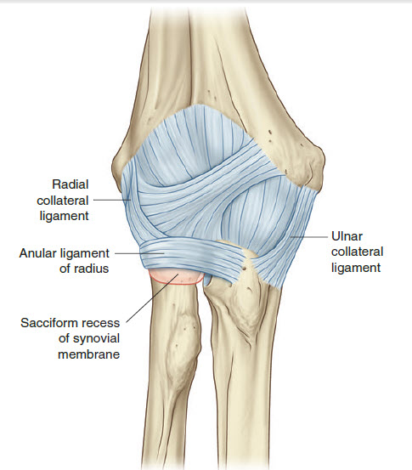
Ligaments
Ulnar (medial) collateral: limits medial deviation
Radial (lateral) collateral): limits lateral deviation
Anular (of radius): keeps radius in contact with ulna & capitulum.

Slide 11
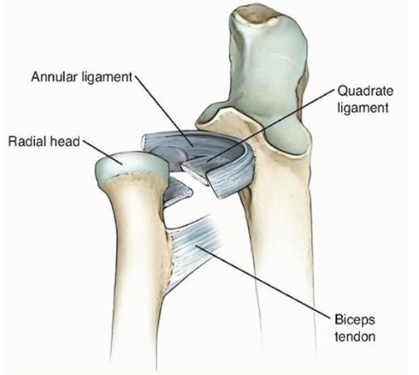
Ligaments
Quadrate lig.: joins radial neck to ulna & limits rotation.

Slide 12
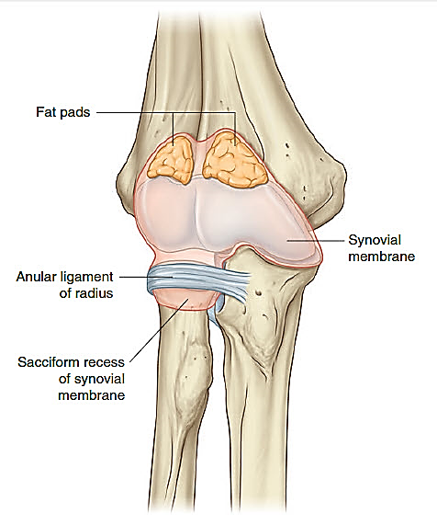
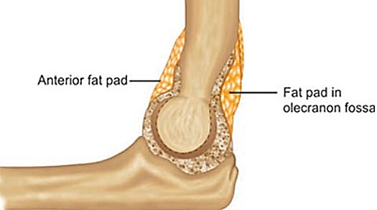
Synovial membrane & fat pads
Anterior
Synovial membrane continuous over all articular surfaces & proximal radius (1 complex)
Chocked by anular lig. forming the sacciform recess.
3 fat pads fill the fossae 2 ant. & 1 post.).

Slide 13
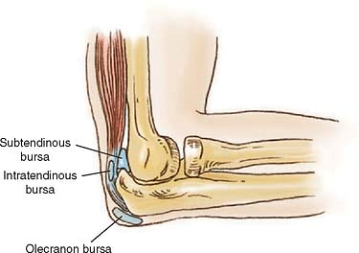
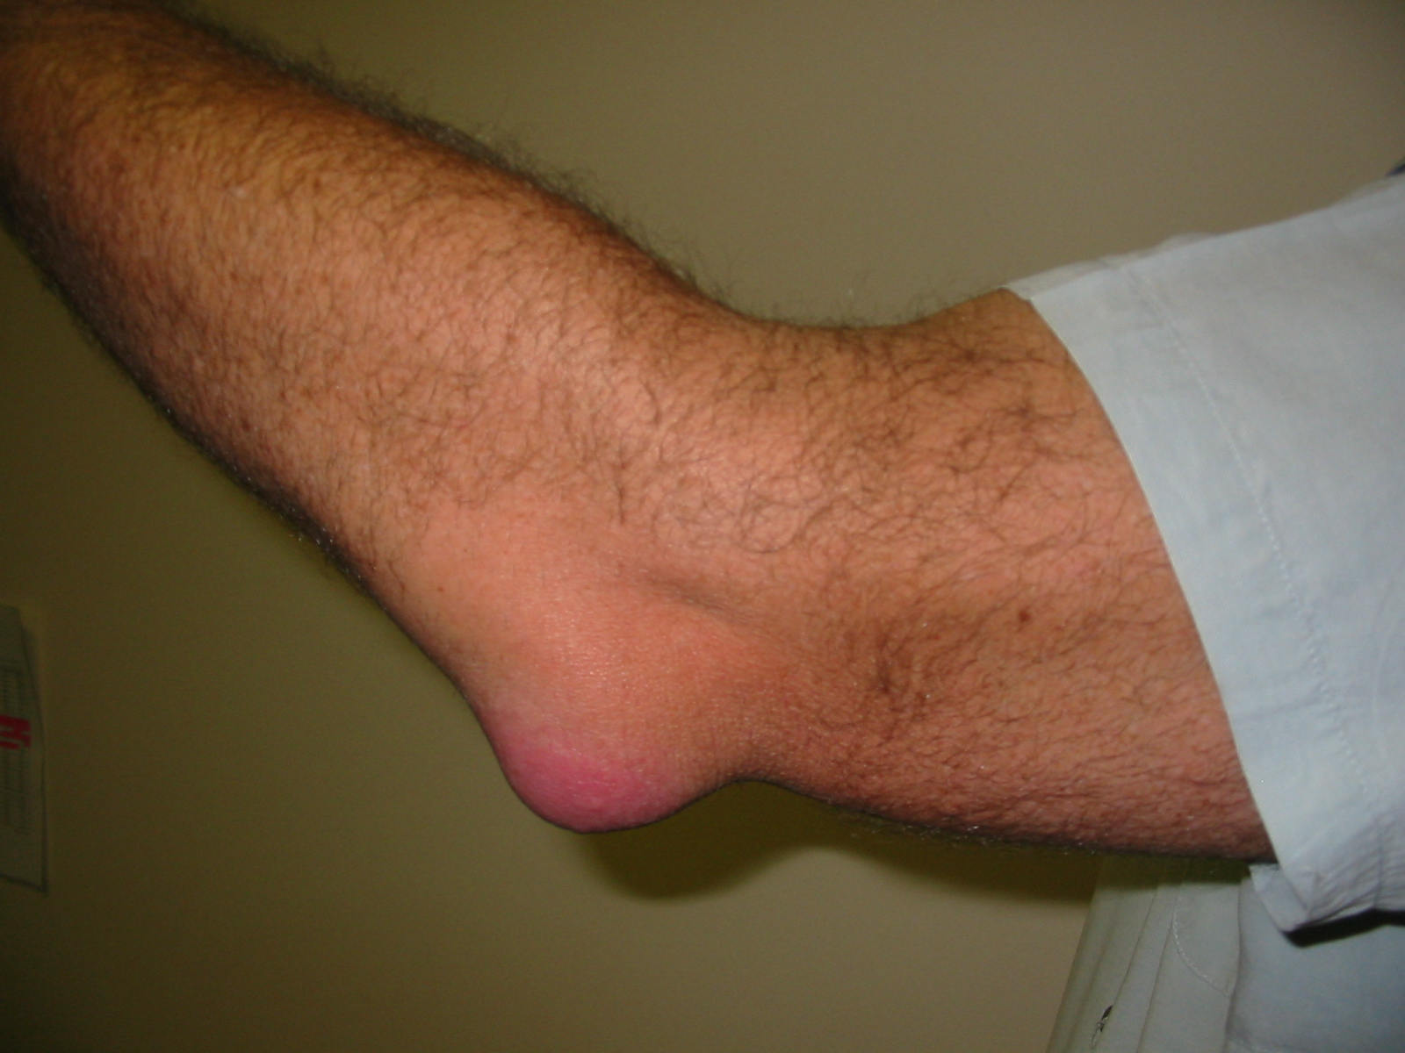
Bursae
Many bursae
Most important is olecranon bursa (sub tendinous & subcutaneous)
Olecranon bursitis (student’s elbow) = inflammation of the olecranon bursa caused by trauma, infection or prolonged pressure. The bursa is swollen and is often painful.

Slide 14
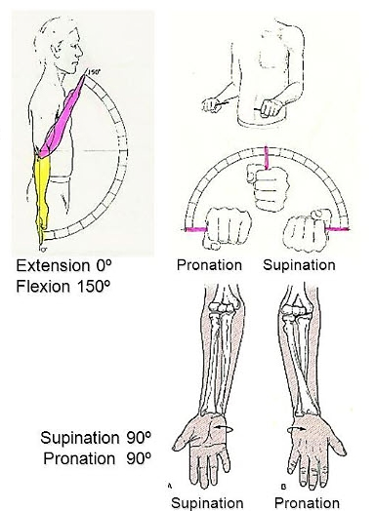
Movements
Flexion (ulnohumeral joint)
Brachialis Biceps brachii Brachioradialis Pronator teres
Extension (ulnohumeral joint)
Triceps brachii Anconeus (carrying angle)
Supination (proximal R-U joint & R-H joint)
Biceps brachii (in elbow flexion) Supinator
Pronation (proximal R-U joint & R-H joint)
Pronator teres Pronator quadratus

Slide 15
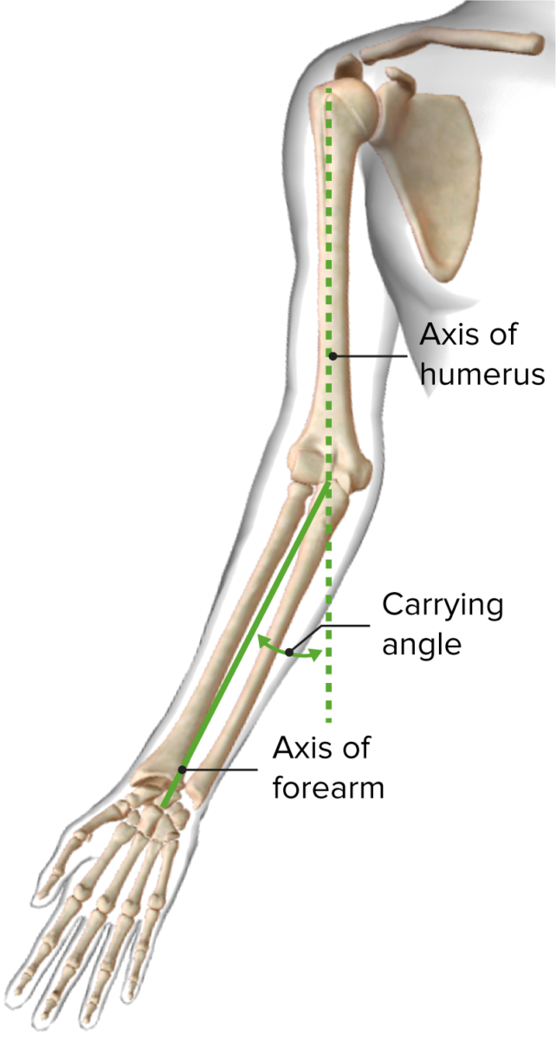
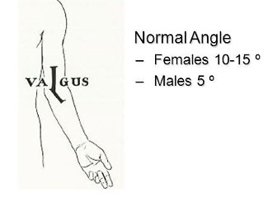
The carrying angle
Anterior
Caused by lateral deviation of the ulna on the humerus during extension because of:
Difference in trochlear lip size
Action of anconeus

Slide 16
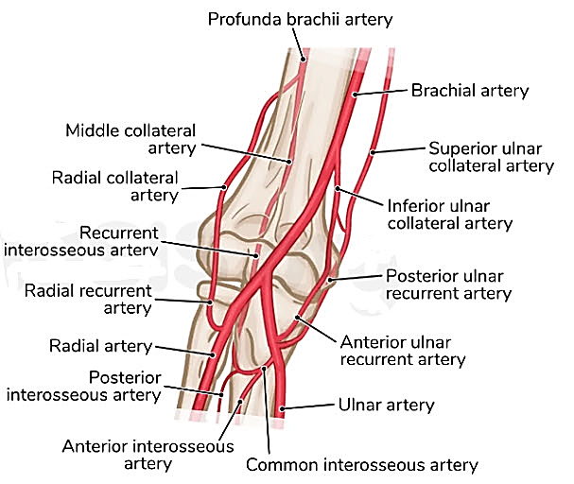
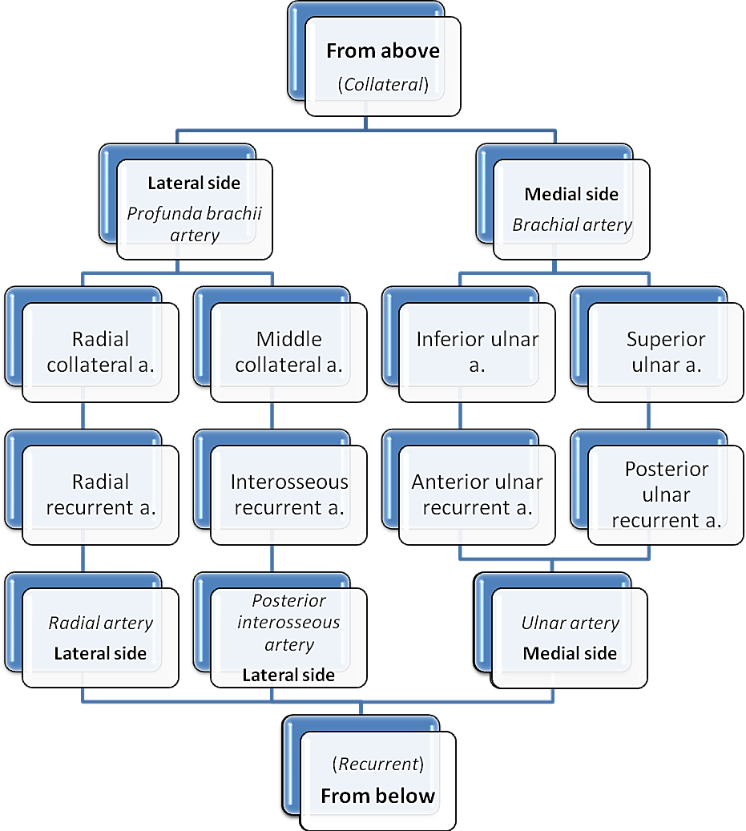
Arterial Anastomosis

Slide 17
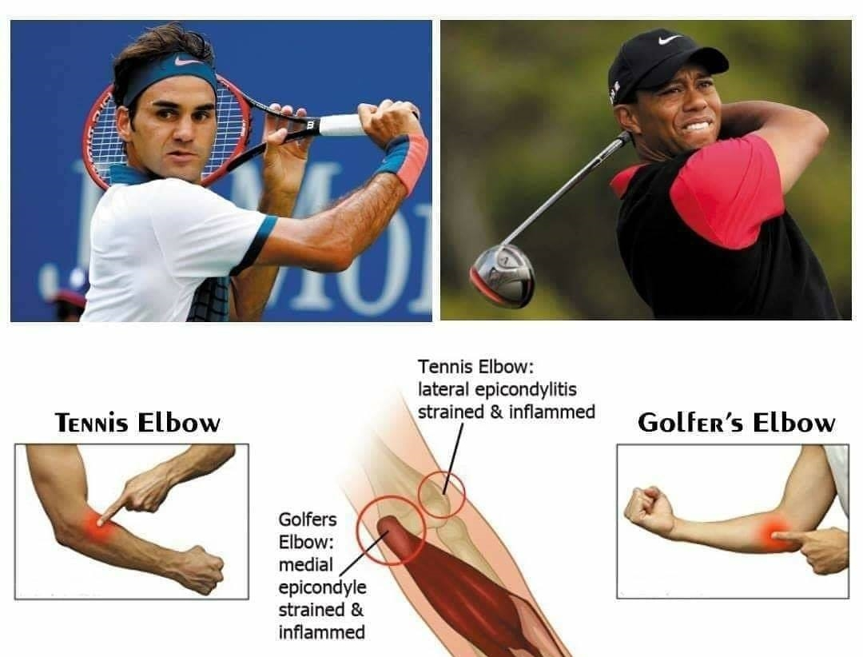
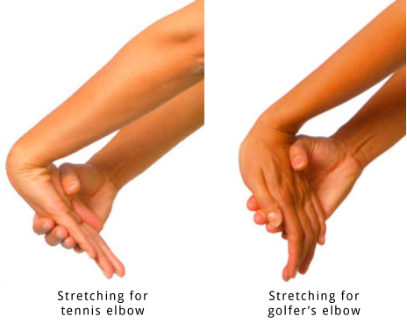
Common Conditions
Lateral (Golfer’s) & Medial (Tennis) epicondylitis (tendinitis)
Repetitive forceful flexion & extension causing inflammation of the common extensor tendons from the lateral epicondyle (Tennis elbow) or the common flexor tendons from the medial epicondyle (Golfer’s elbow).

Slide 18
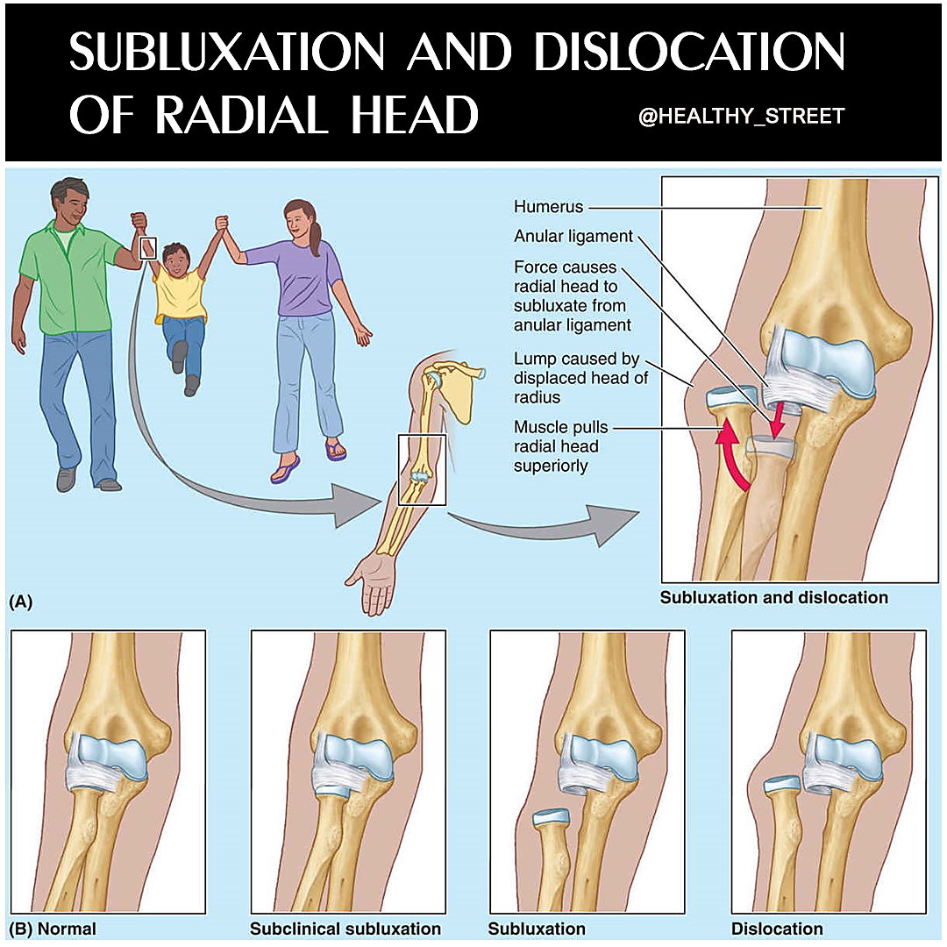
Common Conditions
Pulled Elbow (Nursemaid’s elbow)
Subluxation/Dislocation of radial head from anular ligament due to forceful distraction of the forearm.

