Slide 1
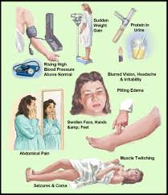
Hypertensive disorders during pregnancy case – based discussion
Prof.Fadia J Alizzi
Al- Mustansiriyah Medical College
Al- Yarmouk Teaching Hospital

Slide 2
23 year old primigravida woman attend ANC for regular check – up accidently her blood pressure shows to be 150/100 mmHg. Q1. What are the most important points in the history that you should consider ?
Case 1
Focused History :
When she discovered she is Hypertensive ( At which weeks of Gestation ) ?
How she discovered she is Hypertensive?
Type of Hypertension
Severity of hypertension (Maternal condition & fetal condition )

Slide 3
23 year old primigravida woman attend ANC for regular check – up accidently her blood pressure shows to be 150/100 mmHg. Q1. What are the most important points in the history that you should consider ?
Focused History :
When she discovered she is Hypertensive ( At which weeks of Gestation ) ?
How she discovered she is Hypertensive?
Type of Hypertension
Severity of hypertension (Maternal condition & fetal condition )

Slide 4
23 year old primigravida woman attend ANC for regular check – up accidently her blood pressure shows to be 150/100 mmHg. Q1. What are the most important points in the history that you should consider ?
Focused History :
When she discovered she is Hypertensive ( At which weeks of Gestation ) ?
At which weeks of gestation she discovered to be hypertensive?
< than 20 weeks → Chronic Hypertension
≥ 20 weeks → Hypertension related to pregnancy ( GHT or PE )

Slide 5
23 year old primigravida woman attend ANC for regular check – up accidently her blood pressure shows to be 150/100 mmHg. Q1. What are the most important points in the history that you should consider ?
Focused History :
When she discovered she is Hypertensive ( At which weeks of Gestation ) ?
How she discovered she is Hypertensive?
Type of Hypertension
Severity of hypertension (Maternal condition & fetal condition )

Slide 6
23 year old primigravida woman attend ANC for regular check – up accidently her blood pressure shows to be 150/100 mmHg. Q1. What are the most important points in the history that you should consider ?
Focused History :
2. How she discovered she is Hypertensive?
Accidently while she has visiting her doctor or during ANC
Maternal symptoms or signs:
Headache
Blurring of vision
Nausea &/or Vomiting
Chest pain or SOB
Epigastric pain or Right t hypochonderial pain
Abdominal pain
Decrease urine output
Generalized & /or non – dependent oedema

Slide 7
23 year old primigravida woman attend ANC for regular check – up accidently her blood pressure shows to be 150/100 mmHg. Q1. What are the most important points in the history that you should consider ?
Focused History :
2. How she discovered she is Hypertensive?
Accidently while she has visiting her doctor or during ANC
Maternal symptoms or signs
Fetal symptoms or signs
decrease fetal movement
US report show :
Oligohydramnious
IUGR

Slide 8
23 year old primigravida woman attend ANC for regular check – up accidently her blood pressure shows to be 150/100 mmHg. Q1. What are the most important points in the history that you should consider ?
Focused History :
When she discovered she is Hypertensive ( At which weeks of Gestation ) ?
How she discovered she is Hypertensive?
Type of Hypertension
Severity of hypertension (Maternal condition & fetal condition )

Slide 9
23 year old primigravida woman attend ANC for regular check – up accidently her blood pressure shows to be 150/100 mmHg. Q1. What are the most important points in the history that you should consider ?
Focused History :
3. Type of Hypertension
Less than 20 weeks → Chronic hypertension
20 weeks pregnancy & above → Send for Protein in urine
Positive → PE
Negative → Gestational hypertension ( Pregnancy Induced Hypertension = PIH)

Slide 10
23 year old primigravida woman attend ANC for regular check – up accidently her blood pressure shows to be 150/100 mmHg. Q1. What are the most important points in the history that you should consider ?
Focused History :
When she discovered she is Hypertensive ( At which weeks of Gestation ) ?
How she discovered she is Hypertensive?
Type of Hypertension
Severity of hypertension (Maternal condition & fetal condition )

Slide 11
23 year old primigravida woman attend ANC for regular check – up accidently her blood pressure shows to be 150/100 mmHg. Q1. What are the most important points in the history that you should consider ?
Focused History :
4. Severity of hypertension = Assessment
A. Maternal
Measurement of BP ( Mild , Moderate or Sever )
Drugs taken ( Type of hypertensive drugs and doses of drugs)
Clinical symptoms & conditions goes with severity
Biochemical indices goes with sever hypertension
B. Fetal
Decrease FM
US & Doppler ( IUGR – SEVERITY )

Slide 12
23 year old primigravida woman attend ANC for regular check – up accidently her blood pressure shows to be 150/100 mmHg. Q1. What are the most important points in the history that you should consider ?
Focused History :
4. Severity of hypertension = Assessment
A. Maternal
Measurement of BP ( Mild , Moderate or Sever )
Mild = Diastolic 90-99 / Systolic 140 -149
Moderate = Diastolic 100 -109/ systolic 150-159
Sever = Diastolic 100 and above / systolic 160 and above

Slide 13
23 year old primigravida woman attend ANC for regular check – up accidently her blood pressure shows to be 150/100 mmHg. Q1. What are the most important points in the history that you should consider ?
Focused History :
4. Severity of hypertension = Assessment
A. Maternal
Measurement of BP ( Mild , Moderate or Sever )
Drugs taken ( Type of hypertensive drugs and doses of drugs)
Clinical symptoms & conditions goes with severity
Biochemical indices goes with sever hypertension
B. Fetal
Decrease FM
US & Doppler ( IUGR – SEVERITY )

Slide 14
23 year old primigravida woman attend ANC for regular check – up accidently her blood pressure shows to be 150/100 mmHg. Q1. What are the most important points in the history that you should consider ?
Focused History :
4. Severity of hypertension = Assessment
A. Maternal
Measurement of BP ( Mild , Moderate or Sever )
Drugs taken ( Type of hypertensive drugs and doses of drugs)
Maximum dose of one drug
Maximum dose of second drug
Maximum dose of 3rd drug
Methyldopa
Labetalol
Ca-channal blocking agent

Slide 15
23 year old primigravida woman attend ANC for regular check – up accidently her blood pressure shows to be 150/100 mmHg. Q1. What are the most important points in the history that you should consider ?
Focused History :
4. Severity of hypertension = Assessment
A. Maternal
Measurement of BP ( Mild , Moderate or Sever )
Drugs taken ( Type of hypertensive drugs and doses of drugs)
Clinical symptoms & conditions goes with severity
Biochemical indices goes with sever hypertension
B. Fetal
Decrease FM
US & Doppler ( IUGR – SEVERITY )

Slide 16
23 year old primigravida woman attend ANC for regular check – up accidently her blood pressure shows to be 150/100 mmHg. Q1. What are the most important points in the history that you should consider ?
Focused History :
4. Severity of hypertension = Assessment
A. Maternal
Measurement of BP ( Mild , Moderate or Sever )
Drugs taken ( Type of hypertensive drugs and doses of drugs)
Clinical symptoms & conditions goes with severity
Symptoms
Headache
Blurring of vision
Epigastric pain or right hypochonderial pain
N& V
Decrease urine output
Sever condition
Eclamptic fit
Adult RDS
HELLP Syndrome
DIC
APH

Slide 17
23 year old primigravida woman attend ANC for regular check – up accidently her blood pressure shows to be 150/100 mmHg. Q1. What are the most important points in the history that you should consider ?
Focused History :
4. Severity of hypertension = Assessment
A. Maternal
Measurement of BP ( Mild , Moderate or Sever )
Drugs taken ( Type of hypertensive drugs and doses of drugs)
Clinical symptoms & conditions goes with severity
Biochemical indices goes with sever hypertension
B. Fetal
Decrease FM
US & Doppler ( IUGR – SEVERITY )

Slide 18
23 year old primigravida woman attend ANC for regular check – up accidently her blood pressure shows to be 150/100 mmHg. Q1. What are the most important points in the history that you should consider ?
Focused History :
4. Severity of hypertension = Assessment
A. Maternal
Measurement of BP ( Mild , Moderate or Sever )
Drugs taken ( Type of hypertensive drugs and doses of drugs)
Clinical symptoms & conditions goes with severity
Biochemical indices goes with sever hypertension
Thrombocytopenia
Hemolysis
Elevated liver enzymes (* 2 or 3)
Elevated blood urea & serum creatinine
HELLP Syndrome – lab results
DIC – LAB results

Slide 19
23 year old primigravida woman attend ANC for regular check – up accidently her blood pressure shows to be 150/100 mmHg. Q1. What are the most important points in the history that you should consider ?
Focused History :
4. Severity of hypertension = Assessment
A. Maternal
Measurement of BP ( Mild , Moderate or Sever )
Drugs taken ( Type of hypertensive drugs and doses of drugs)
Clinical symptoms & conditions goes with severity
Biochemical indices goes with sever hypertension
B. Fetal A. Maternal
Decrease FM
US & Doppler ( IUGR – SEVERITY )
Doppler
Increase resistance index
Decrease diastolic flow
Absent EDF
Reversed EDF

Slide 20
23 year old primigravida woman attend ANC for regular check – up accidently her blood pressure shows to be 150/100 mmHg. She was at her 36 weeks of gestation Q2. What is the most important investigation you will send her & Why ?
Case continue
What ?= protein in urine
Why ?= to know which type of hypertension she has

Slide 21
23 year old primigravida woman attend ANC for regular check – up accidently her blood pressure shows to be 150/100 mmHg. Q3. The result of protein in urine was positive : What is the type of hypertension & what is its severity? What is its severity ? What is your drug of choice if you decide to start antihypertensive drug to her?
Type ? = PE
What? = Depending on BP measurement it is moderate but we have to send for investigation to confirm that
Rx? = Treatment of moderate HT is controversy = better to treat
Methyldopa versus labetalol
Ca – channel blocking agent (Nifedipine)

Slide 22
26 year old primigravida woman presented to ER with history of tonic – clonic convulsion. She was pregnant in her 34 weeks gestation her blood pressure at the time of arrival was 170/110 1. What is your diagnosis? 2. What are your immediate managements 3. Is there any place for continuation of pregnancy ?
Case 2
What is your diagnosis? Eclamptic fit – sever PE
What are your immediate managements ?
Call for help
ABC= Maintain Airway , Breathing & Circulation by I.V. line
Immediate I.V. MGSO4 given slowly ( 5g/10min )
Blood test send for full Ix ( CBC , LFT ,RFT ,Coagulation profile & protein in urine).
Control BP by giving I.V. antihypertensive drugs ( hydralazine or labetalol)
Rapid assessment of FH ( Positive or negative)
→ After stabilization of maternal condition = consider delivery
3. No place for continuation of pregnancy = consider delivery regardless of weeks of gestation

Slide 23
26 year old primigravida woman presented to ER with history of tonic – clonic convulsion. She was pregnant in her 34 weeks gestation her blood pressure at the time of arrival was 170/110 1. What is your diagnosis? 2. What are your immediate managements 3. Is there any place for continuation of pregnancy ? 4. What is your mode of delivery?
Case 2
4. What is your mode of delivery?
If cervix is ripe & you expect rapid , safe & successful vaginal delivery → Go for VD.
If cervix is unripe & you don’t expect rapid , safe & successful vaginal delivery → Consider emergency CS

Slide 24
26 year old primigravida woman presented to ER with history of tonic – clonic convulsion. She was pregnant in her 34 weeks gestation her blood pressure at the time of arrival was 170/110 1. What is your diagnosis? 2. What are your immediate managements 3. Is there any place for continuation of pregnancy ? 4. What is your mode of delivery? 5. What type of anesthesia you recommend for delivery?
Case 2
5. What type of anesthesia you recommend for delivery?
Regional Anesthesia is recommended for both vaginal or CS provided :
her platelet count is more than 80,000 c/cmm and
no coagulopathy is their.

Slide 25
32 year old primigravida woman in her 32 weeks of pregnancy attend the ER with sever headache & blurring of vision of 2hrs duration. Her BP was 150/100 mmHg We send for IX which showed Hb 7.8g/dl platelet count 80,000 c/cmm SGOT & SGPT double increased protein in urine +++
Case 3
What is your diagnosis ?
HELLP Syndrome
2. What type of hypertension you consider this case & what is its severity ?
Sever PE
3. What are possible complications you may anticipate ?
Increase maternal mortality rate
Increase perinatal mortality rate
Increase risk of APH
Increase risk of DIC
4. What is your recommended action?
Stabilization of her emergency condition then consider delivery

Slide 26
25 year old primigravida woman attend the ER with sever abdominal pain & slight vaginal bleeding patient looks pale , sweaty O/E = her BP on arrival was 110/80 mmHg PR 120bpm & difficult to be felt Abdominal examination showed tense , tender abdomen with difficult to feel fetal part & FH was not detected
Case 4
Q1. What is your diagnosis?
APH due to placental abruption – Concealed type
Q2. What is the possible cause you think it could be & why ?
PE because although the patient looks in shock , the BP is still normal.
Q3. What is your immediate action?
Call for help
2 wide bore cannula – I.V. line
Send for full Ix
Give crystalloid fluid till blood is cross-matched & is available & rapidly restore the circulation by blood & blood products ( cryoprecipitate , FFP & Platelets) .
Consider delivery.

Slide 27
25 year old primigravida woman attend the ER with sever abdominal pain & slight vaginal bleeding patient looks pale , sweaty O/E = her BP on arrival was 110/80 mmHg PR 120bpm & difficult to be felt Abdominal examination showed tense , tender abdomen with difficult to feel fetal part & FH was not detected
Case 4
Q4. What are the complications you may encountered in this condition ?
Maternal complication
Hypovolemic shock
Coagulopathy
2. Fetal complications
Increase the risk of perinatal morbidity & mortality
Q5. what is your preferable method of delivery?
Since the FH is negative → consider vaginal delivery unless its not possible(contraindicated) or delivery is far away & the patient is Haemodynamically unstable.

Slide 28
25 year old primigravida woman attend the ER with sever abdominal pain & slight vaginal bleeding patient looks pale , sweaty O/E = her BP on arrival was 110/80 mmHg PR 120bpm & difficult to be felt Abdominal examination showed tense , tender abdomen with difficult to feel fetal part & FH was not detected
Case 4
Q6. If after delivery the patient develop primary PPH , what is the recommended uterotonic drugs to be used ?
Oxytocin
Misoprostol
Ergometrin is contraindicated if the woman had hypertension .

Slide 29
Hypertensive disorders during pregnancy Slide – Exam
Prof.Fadia Alizzi

Slide 30
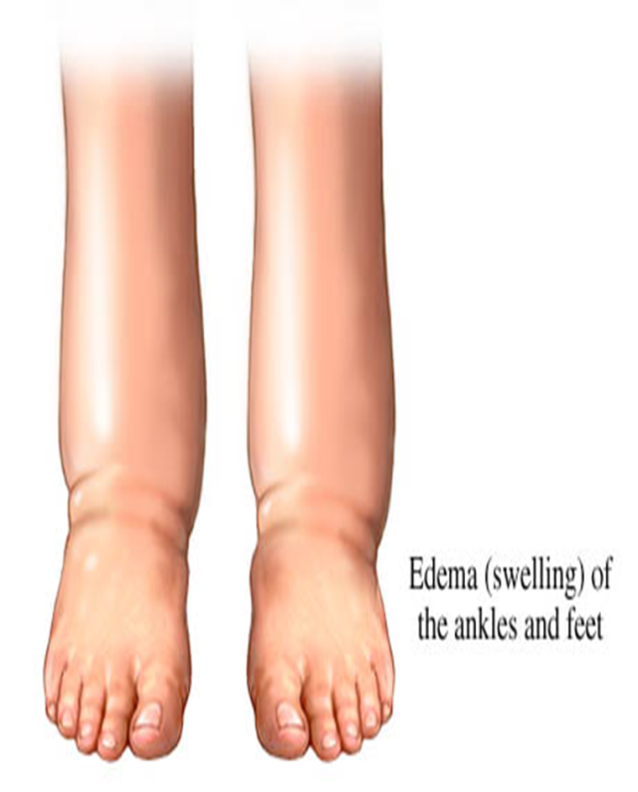
Slide no 1
what are the types of these Edema?
Which one is more significant?
Dependent versus non-dependent edema.
Non-dependent edema is more significant.

Slide 31
Slide no 2
Full the blanket with correct word?
Patellar reflex is normally ………. (present)
In PE , patellar reflex is ………… (exaggerated)
If the woman on MgSO4 , the first sign of its toxicity is ………….. ( diminished or disappearance of patellar reflex)

Slide 32
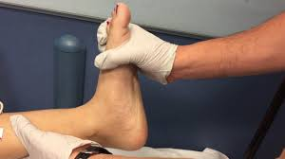
Slide no 3
Q1. name this test
Q2. what is its importance in PE?
Clonus test
The presence of clonus may indicate an increased risk of convulsions.

Slide 33
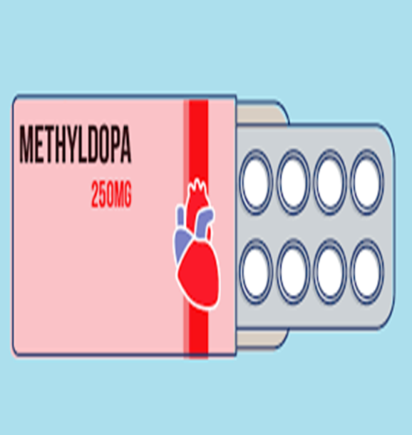
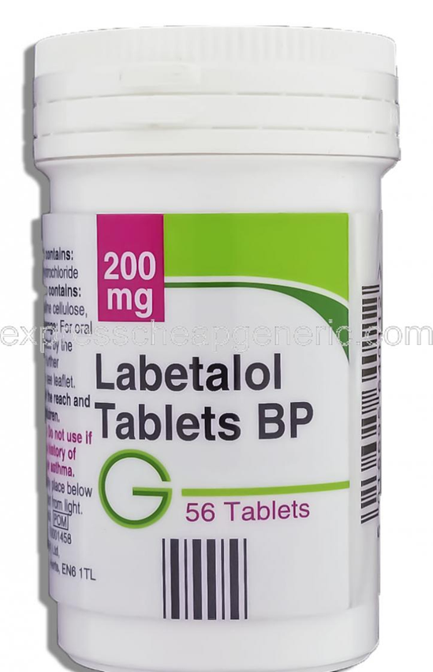
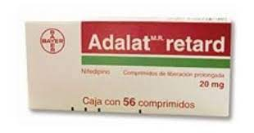
Slide no 4
The following are antihypertensive drugs
Q1. which one is recommended in PE?
Q2. Which one is contraindicated in PE?
Q1. Labetalol & Methyldopa
Captopril is contraindicated

Slide 34
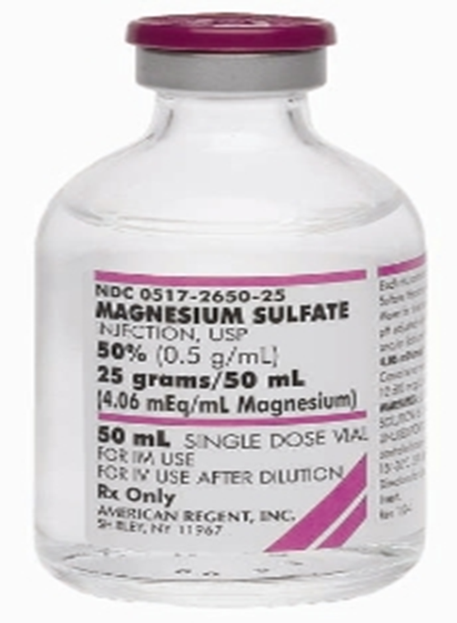
Slide no 5
Q1. give me 2 main indication of its use in obstetric ?
Q2. how to monitor the patient when we use it ?
Q3. what is its antidote?
1. 2 main indications are :
Treatment & prevention of PE
In threatened preterm labour
2. Monitoring by :
3. antidote:
calcium gluconate10%
10 ml over 10 min given iv.
1.measuring its level in the blood
2.monitering the following
a) respiratory rate.
b) urine output.
c) patellar reflexes
Role of 10

Slide 35
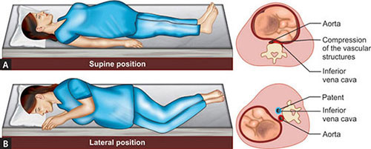
Slide no 6
Measurement of BP while the patient is lying in bed
Which position is recommended &
which one should be avoided & why?
Left lateral position is the best position to measure the BP while the patient lie in bed.
Supine position should be avoided to overcome the effect of gravid uterus on the IVC.

Slide 36
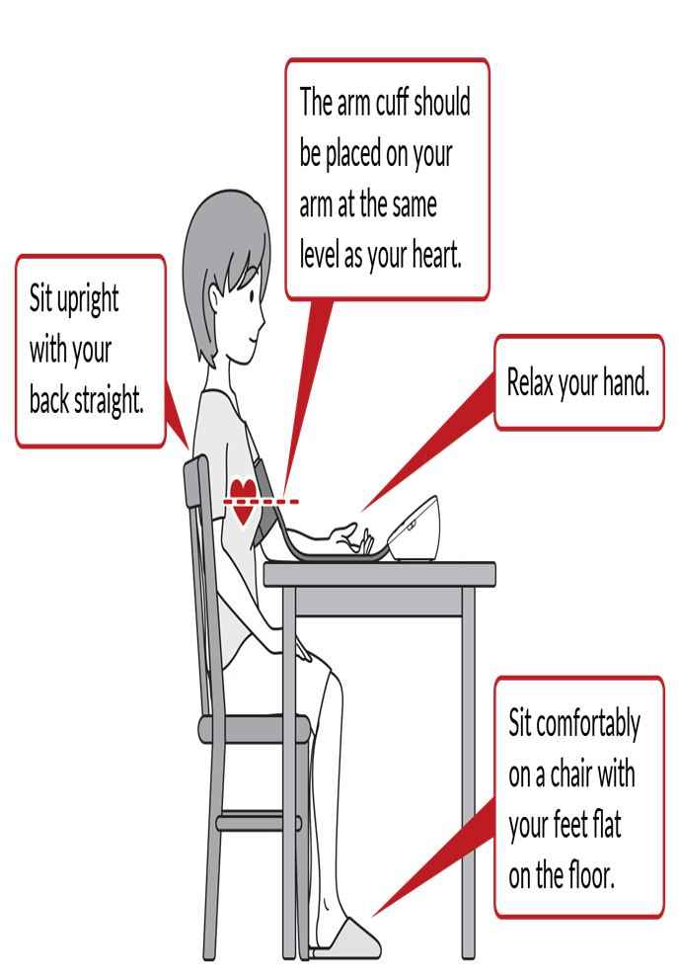
Slide no 7
In sitting position , what are important points you should consider in BP measurement ?
Women should have their BP measured after a period of rest in a quiet environment and be in a sitting position with their arm at the level of the heart using an appropriately sized cuff (ie, length 1.5 times the circumference of the arm).
Non severe elevated BP should be re-measured at the same visit, with at least a gap of 15 minutes from the first measurement

Slide 37
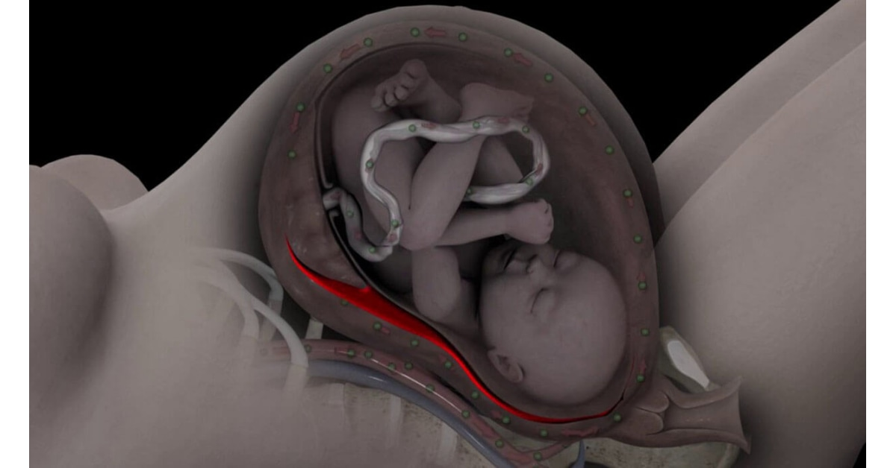
Slide no 8
23 years old primigravida woman on her 36th weeks of gestation & known to be PE case on antihypertensive drug
What is the complication of PE seen in this slide
What are the major risk of this condition (mention 3)?
Abruptio-placentae
Maternal & fetal risk
Hypovolemic shock
DIC
Fetal distress & death

Slide 38
Slide no 9
34 years old women in her 36 weeks of gestation, she is known to be hypertensive from her first trimester
On examination of symphyseal – fundal height it goes with 32 weeks
What are the possible causes
What are the further investigation you should send?
What is the type of hypertension in this scenario?
Causes: Oligohydramnious , IUGR
Investigation for assessment of fetal wellbeing
CTG
Obstetric US - BPP + Doppler
3. Chronic hypertension

Slide 39
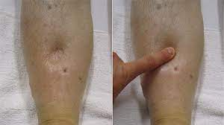
Slide no 10
Q1. What does this slide show?
Q2. How do you do it correctly in clinical practice ?
Pitting edema
Press on the shaft of tibia in its lower 1/3 for at least 30 sec.

Slide 40
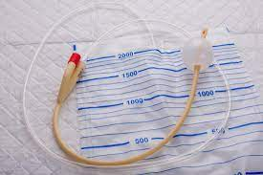
Slide no 11
Q1. name this instrument ?
Q2. when to use it in PE
Q3. when to remove ?
1.Indwelling Foley s catheter
2. In sever PE to monitor urine output especially woman on MgSO4
3. When the woman condition is stable and after discontinuation of MgSO4

Slide 41
Slide no 12
23 Years old woman presented to ER with headache & blurring of vision ; measurement of BP shows 170/110
You are measuring what in this case ?
If the test was positive , what type of hypertension it will be ?
urine dipstick test for protein in urine
Positive protein in urine indicate that the type of hypertension in preeclampsia.

Slide 42
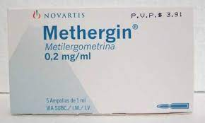
Slide no 13
25 years old primipara woman , she delivered vaginally before 2 hrs., she was known case of PE on antihypertensive drug:
What type of PPH she developed?
What is the main cause of it ?
What are the recommended uterotonic drugs to be used
What are the contraindicated one ?

Slide 43
Slide no 13
25 years old primipara woman , she delivered vaginally before 2 hrs., she was known case of PE on antihypertensive drug:
What type of PPH she developed?
What is the main cause of it ?
What are the recommended uterotonic drugs to be used
What are the contraindicated one ?
Primary PPH

Slide 44
Slide no 13
25 years old primipara woman , she delivered vaginally before 2 hrs., she was known case of PE on antihypertensive drug:
What type of PPH she developed?
What is the main cause of it ?
What are the recommended uterotonic drugs to be used
What are the contraindicated one ?
Uterine inertia

Slide 45
Slide no 13
25 years old primipara woman , she delivered vaginally before 2 hrs., she was known case of PE on antihypertensive drug:
What type of PPH she developed?
What is the main cause of it ?
What are the recommended uterotonic drugs to be used
What are the contraindicated one ?

Slide 46
Slide no 13
25 years old primipara woman , she delivered vaginally before 2 hrs., she was known case of PE on antihypertensive drug:
What type of PPH she developed?
What is the main cause of it ?
What are the recommended uterotonic drugs to be used
What are the contraindicated one ?

Slide 47
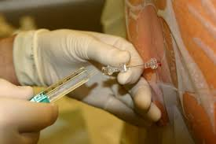
Slide no 14
Q1. what does this slide show?
Q2. if emergency CS is decided for sever PE patient , can we use it ?
What are the contraindications of its use in PE woman?
Regional ( spinal anesthesia)
In PE patient , this type of anesthesia is recommended provided there was no contraindications for its use
Coagulopathy & low platelet count ( less than 80,000)

Slide 48
Slide no 15
25 years old pregnant lady with sever uncontrolled PE & on her 37 weeks of gestation , Emergency CS decided for her since the cervix was un- ripe .
Investigation shows platelet count 50,000 cell / cmm
Anesthetist decide to give her this type of anesthesia
Do you agree ?
In PE patient , this type of anesthesia is recommended provided there was no contraindications for its use
Contraindications : Coagulopathy & low platelet count ( less than 80,000)

Slide 49
Slide no 15
25 years old pregnant lady with sever uncontrolled PE & on her 37 weeks of gestation , Emergency CS decided for her since the cervix was un- ripe .
Investigation shows platelet count 50,000 cell / cmm
Anesthetist decide to give her this type of anesthesia
Do you agree ?
In PE patient , this type of anesthesia is recommended provided there was no contraindications for its use
Contraindications : Coagulopathy & low platelet count ( less than 80,000)

Slide 50
Thank You
Q & A

