Slide 1
Assisted Reproductive Technology (ART)
Prof.Fadia J Alizzi
Consultant OBG & Reproductive Medicine
Al-Mustansiriyia Medical College / Al-Yarmouk Teaching Hospital

Slide 2
In-vitro fertilization(IVF)
Background
Steptoe and Edwards performed the first successful case in 1978.
IVF was originally designed for couples with tubal factor subfertility
now used for almost all cases of subfertility including :
Tubal disease
Endometriosis
Failed ovulation induction; whatever the causes (PCOS)
Male factors infertility
Unexplained infertility
Failed IUI; whatever the indications for it
Where donor eggs are needed
Originally, IVF was performed in the natural menstrual cycle, but the use of gonadotrophin-controlled ovarian stimulation (COS) made IVF a much more efficient process.
Indications

Slide 3
In-vitro fertilization(IVF)
Steps
Pituitary down-regulation
Controlled ovarian stimulation (COS)
Inhibition of premature ovulation
hCG trigger
Egg collection ( Ovum Pick UP – OPU)
Fertilization
Embryo culture
Embryo transfer
Embryo cryopreservation
Luteal phase support

Slide 4
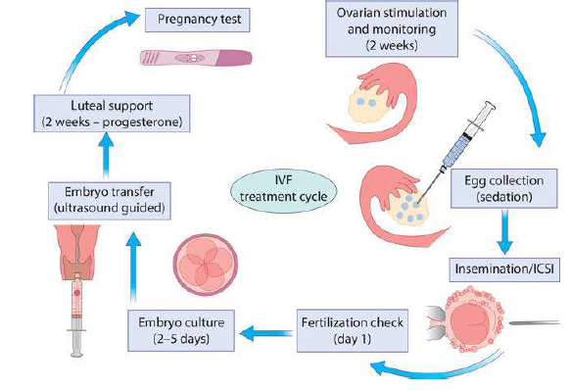
IVF- Steps
Pituitary down-regulation
Controlled ovarian stimulation (COS)
Inhibition of premature ovulation
hCG trigger
Egg collection ( Ovum Pick UP – OPU)
Fertilization
Embryo culture
Embryo transfer
Embryo cryopreservation
Luteal phase support

Slide 5
IVF- Steps
Pituitary down-regulation
Controlled ovarian stimulation (COS)
Inhibition of premature ovulation
hCG trigger
Egg collection ( Ovum Pick UP – OPU)
Fertilization
Embryo culture
Embryo transfer
Embryo cryopreservation
Luteal phase support
Pituitary down-regulation
The pituitary gland is down-regulated to prevent endogenous LH surges and premature ovulation.
A gonadotrophin-releasing hormone (GnRH) agonist is used to block the FSH and LF release from the pituitary.
GnRH antagonists:
can shorten treatment time and
reduce the incidence of ovarian hyperstimulation syndrome (OHSS).

Slide 6
IVF- Steps
Pituitary down-regulation
Controlled ovarian stimulation (COS)
Inhibition of premature ovulation
hCG trigger
Egg collection ( Ovum Pick UP – OPU)
Fertilization
Embryo culture
Embryo transfer
Embryo cryopreservation
Luteal phase support
Controlled ovarian stimulation
This is achieved using daily injection of gonadotrophin medications, which cause multiple follicle recruitment.
Close monitoring with
1. TVUSS:
predicts the number of follicles
predicts the timing of the egg collection.
measurement of endometrial thickness.
2. Blood levels may be taken to measure oestradiol levels, and are used by some to measure ovarian response to stimulation.

Slide 7
IVF- Steps
Pituitary down-regulation
Controlled ovarian stimulation (COS)
Inhibition of premature ovulation
hCG trigger
Egg collection ( Ovum Pick UP – OPU)
Fertilization
Embryo culture
Embryo transfer
Embryo cryopreservation
Luteal phase support
Inhibition of premature ovulation
Feedback from rising oestradiol associated with follicular development should lead to an LH surge from the pituitary, resulting in final oocyte maturation and ovulation.
In IVF this is blocked to allow scheduling of egg collection.
This is done by the administration of
GnRH agonists protocol
GnRH antagonist protocol.

Slide 8
IVF- Steps
Pituitary down-regulation
Controlled ovarian stimulation (COS)
Inhibition of premature ovulation
Triggering ( HCG ,agonist)
Egg collection ( Ovum Pick UP – OPU)
Fertilization
Embryo culture
Embryo transfer
Embryo cryopreservation
Luteal phase support
Triggering
hCG or Gonadotropin releasing hormone agonist administration is used as a surrogate for the endogenous LH surge.
It causes final maturation of the egg and allows scheduling of the egg collection procedure.

Slide 9
IVF- Steps
Pituitary down-regulation
Controlled ovarian stimulation (COS)
Inhibition of premature ovulation
Triggering ( HCG ,agonist)
Egg collection ( Ovum Pick UP – OPU)
Fertilization
Embryo culture
Embryo transfer
Embryo cryopreservation
Luteal phase support
Egg collection
Timing: This procedure is usually performed about 34-36 hours post triggering.
Procedure: Under anaesthesia a needle is inserted into the ovaries under TVUSS control, and follicular fluid is aspirated from each follicle that contains an oocyte, which is collected by the embryologist into the laboratory.

Slide 10
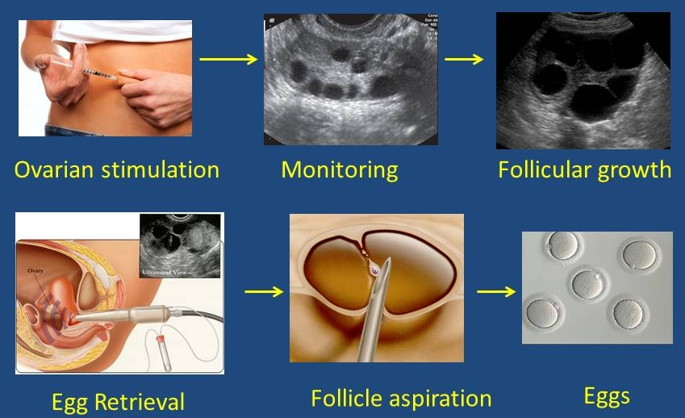
In-vitro fertilization(IVF)
Steps

Slide 11
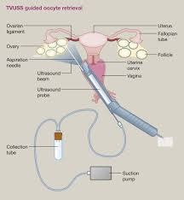
IVF- Steps
Egg collection
Timing: This procedure is usually performed about 34-36 hours post triggering.
Procedure: Under anaesthesia a needle is inserted into the ovaries under TVUSS control, and follicular fluid is aspirated from each follicle that contains an oocyte, which is collected by the embryologist into the laboratory.

Slide 12
IVF- Steps
Pituitary down-regulation
Controlled ovarian stimulation (COS)
Inhibition of premature ovulation
Triggering ( HCG ,agonist)
Egg collection ( Ovum Pick UP – OPU)
Fertilization
Embryo culture
Embryo transfer
Embryo cryopreservation
Luteal phase support
Fertilization
Fertilization is performed using prepared sperm.
2 ways :
Conventional IVF fertilization involves the insemination of around 100,000 sperm in a petri-dish with an egg.
Intracytoplasmic sperm injection, (ICSI) : individual sperm can be isolated and directly injected into the cytoplasm of the oocyte.
Indications of ICSI:
Poor sperm parameters
previous poor fertilization,
Fertilization is checked the next morning and is usually in the region of 60% for IVF and 70% for ICSI.

Slide 13
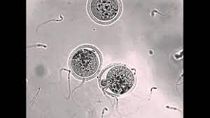
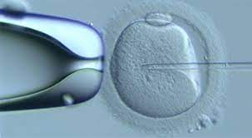
IVF- Steps
Fertilization
Fertilization is performed using prepared sperm.
2 ways :
Conventional IVF fertilization involves the insemination of around 100,000 sperm in a petri-dish with an egg.
Intracytoplasmic sperm injection, (ICSI) : individual sperm can be isolated and directly injected into the cytoplasm of the oocyte.
Indications of ICSI:
Poor sperm parameters
previous poor fertilization
Fertilization is checked the next morning and is usually in the region of 60% for IVF and 70% for ICSI.
Where the sperm quality or quantity is low but sperm are present, ICSI is required to help achieve a pregnancy.

Slide 14
IVF- Steps
Pituitary down-regulation
Controlled ovarian stimulation (COS)
Inhibition of premature ovulation
Triggering ( HCG ,agonist)
Egg collection ( Ovum Pick UP – OPU)
Fertilization
Embryo culture
Embryo transfer
Embryo cryopreservation
Luteal phase support
Embryo culture
Embryos are incubated under strict conditions of temperature, pH, humidity and oxygen concentration.
They may be transferred back into the uterus after 2, 3 or 5 days of development.
Embryos reaching the blastocyst stage on day 5 of development usually exhibit the best chance of implantation.
A variety of different protocols are available for embryo selection, including a morphological and a morpho-kinetic assessment.

Slide 15
IVF- Steps
Pituitary down-regulation
Controlled ovarian stimulation (COS)
Inhibition of premature ovulation
Triggering ( HCG ,agonist)
Egg collection ( Ovum Pick UP – OPU)
Fertilization
Embryo culture
Embryo transfer
Embryo cryopreservation
Luteal phase support
Embryo transfer
Embryos are transferred into the uterus using a soft plastic catheter.
The choice of how many embryos to transfer is the decision of the couple following expert medical and embryological advice; this may be constrained by local regulatory or funding parameters.
Embryo transfer is usually performed under transabdominal ultrasound control to ensure correct placement of the embryos

Slide 16
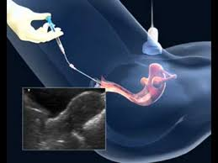
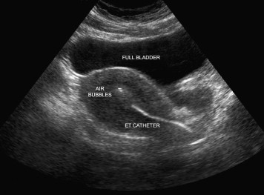
IVF- Steps
Embryo transfer
Embryos are transferred into the uterus using a soft plastic catheter.
The choice of how many embryos to transfer is the decision of the couple following expert medical and embryological advice; this may be constrained by local regulatory or funding parameters.
Embryo transfer is usually performed under transabdominal ultrasound control to ensure correct placement of the embryos

Slide 17
IVF- Steps
Pituitary down-regulation
Controlled ovarian stimulation (COS)
Inhibition of premature ovulation
Triggering ( HCG ,agonist)
Egg collection ( Ovum Pick UP – OPU)
Fertilization
Embryo culture
Embryo transfer
Embryo cryopreservation
Luteal phase support
Embryo cryopreservation
Spare embryos of good quality may be cryopreserved for future use.
Vitrification techniques now allow for success rates from frozen embryos to approximate success rates in fresh treatment cycles.
This makes the transfer of fresh single embryos with the vitrification of spare embryos more appealing to couples.

Slide 18
IVF- Steps
Pituitary down-regulation
Controlled ovarian stimulation (COS)
Inhibition of premature ovulation
Triggering ( HCG ,agonist)
Egg collection ( Ovum Pick UP – OPU)
Fertilization
Embryo culture
Embryo transfer
Embryo cryopreservation
Luteal phase support
Luteal phase support
The use of gonadotrophin agonists or antagonists to prevent a premature LH surge will lead to a reduction in the ability of the corpus luteum to produce progesterone.
Patients are therefore supplemented with progesterone following the egg collection.
There is no consensus on the ideal dose, route or duration of progesterone supplementation.
A pregnancy test is performed around 14 days after embryo transfer.

Slide 19
Male cause infertility
Surgical sperm retrieval
Indication : in the absence of naturally ejaculated sperm ( azoospermia) which may relate to
Obstructive Azoospermia: blockage of the vas deferens
Non-obstructive Azoospermia: testicular problems
SSR can be performed under sedation or general anaesthesia.
A fine needle is inserted into the epididymis or the testicular tissue to obtain sperm or testicular tissue with sperm, respectively.
The retrieved sperm can then be cryopreserved or injected into the oocyte as part of a fresh IVF/ICSI cycle.

Slide 20
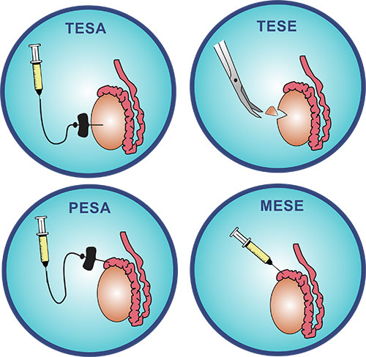
Male cause infertility
Surgical sperm retrieval(SSR)
Testicular Sperm Aspiration
Testicular Sperm Extraction
(Micro-TESE)
Percutaneous Epididymal Sperm Aspiration
Microsurgical Epididymal Sperm Aspiration

Slide 21
Ovarian Hyperstimulation Syndrome OHSS

Slide 22
Definition & Background
The syndrome can be strictly defined as the shift of serum from the intravascular space to the third space, mainly to the abdominal cavity, in the context of enlarged ovaries due to follicular stimulation
It is the most serious complication of controlled ovarian hyperstimulation (COH) for assisted reproduction
OHSS is an iatrogenic and potentially life-threatening condition that affects young, healthy women.
there is an important economic burden associated with OHSS due to absence from work, bed rest, or hospitalization and intensive medical management of severe cases

Slide 23
Size of the problem
remains a common complication among women (ART)
Clinicians must remain alert to the possibility of OHSS in all women undergoing fertility treatment and women should be counseled accordingly. [New 2016]
Incidence % | Severity of OHSS
20-33 | Mild
3-6 | Moderate
0.1-2 | Sever

Slide 24
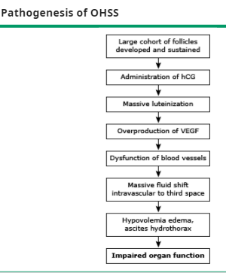
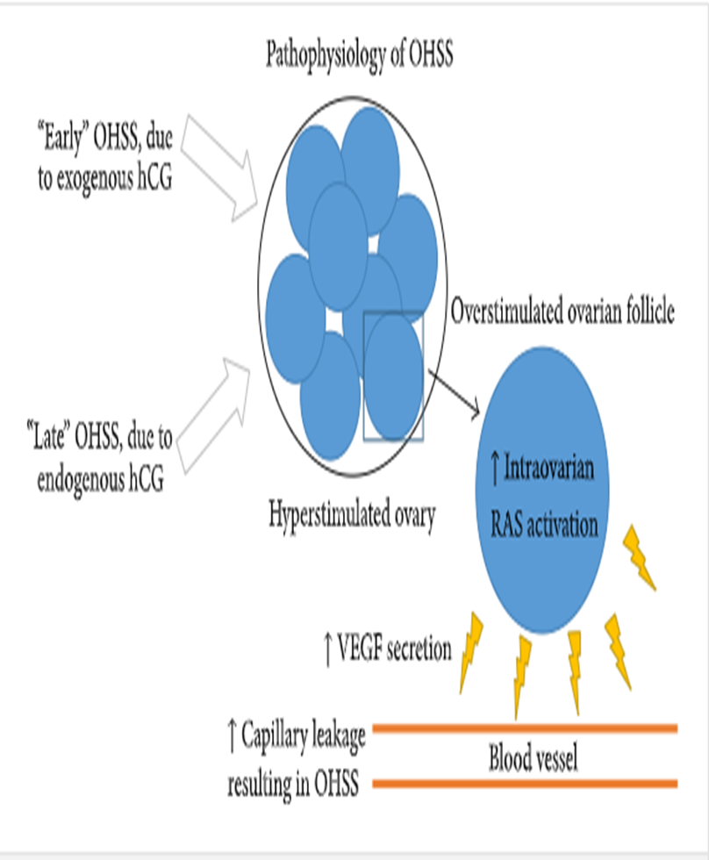
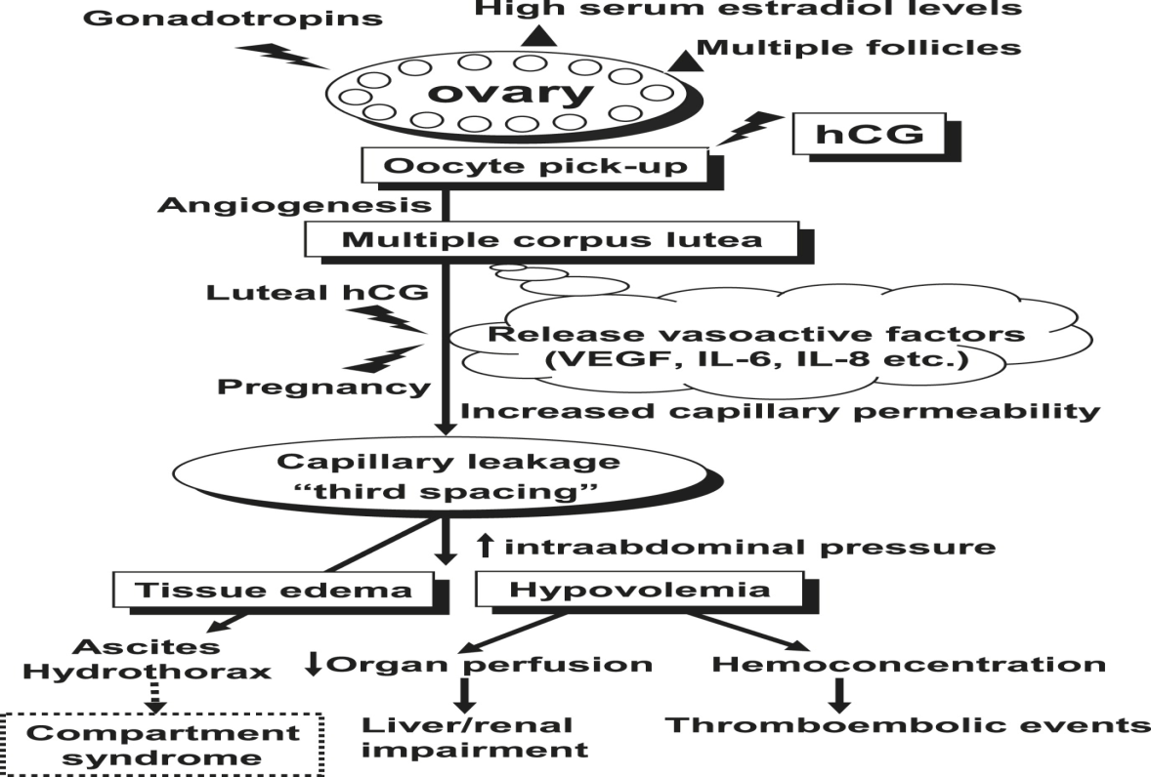

Slide 25
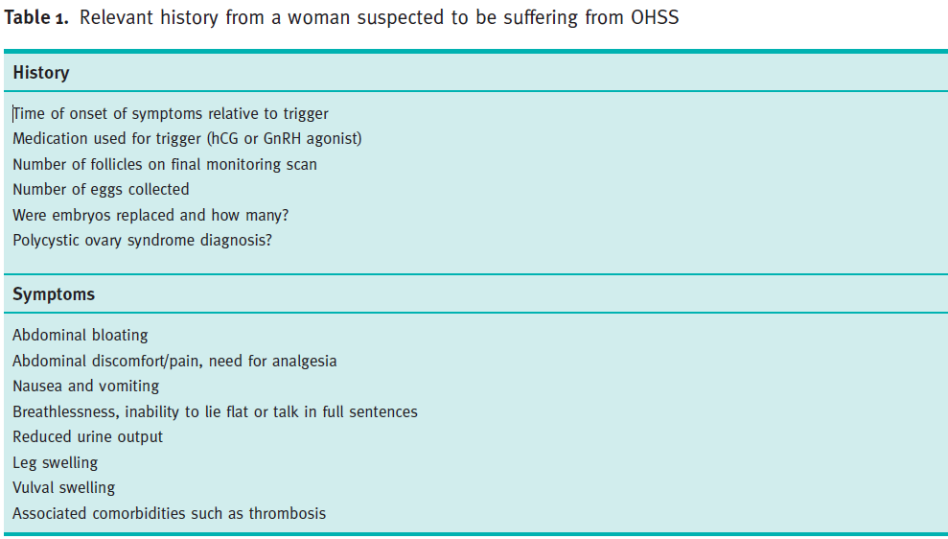

Slide 26
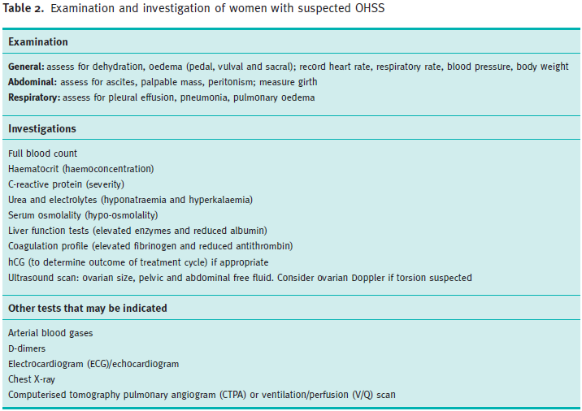

Slide 27
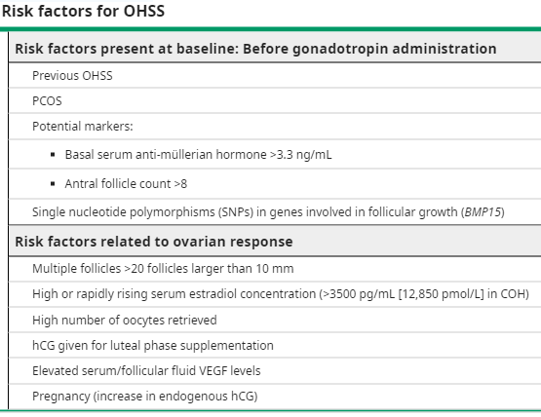

Slide 28
Types of OHSS
PT
+ve
HCG
Early OHSS
10 Days
Late OHSS
3
7
10
12
17
Exogenous HCG
3-7 days after triggering
Predicted by high no of Follicles & E2
Increase risk of miscarriage
Endogenous HCG ( Pregnancy )
12-17 days after triggering
Predicted by no. of GS
More prone to be sever
There are two clinical forms of OHSS, both hCG related:
the early-onset form (occurring on the first eight days after exogenous hCG administration)
the late-onset form (occurring nine or more days after hCG administration, related to pregnancy-induced hCG production)
Rarely, it may also occur spontaneously in pregnancy

Slide 29
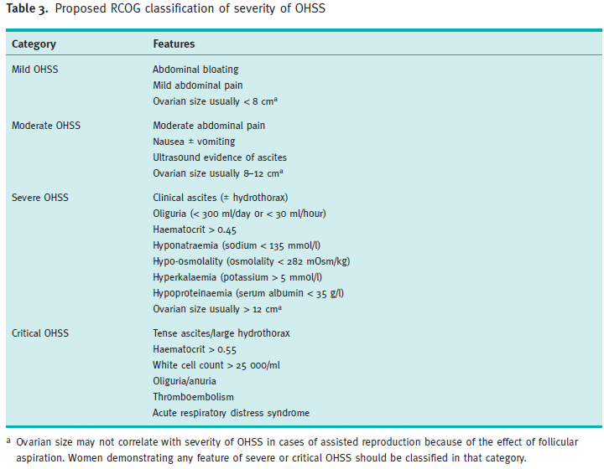

Slide 30
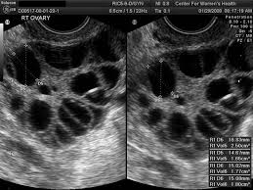
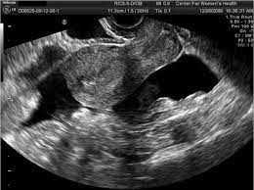
Radiographic features
Grade the severity ?
Imaging findings tend to be similar on ultrasound, CT and MRI.
Ultrasound
typically shows bilateral symmetric enlargement of ovaries (often >12 cm in size)
multiple cysts of varying sizes, giving the classic spoke-wheel appearance
associated ascites and pleural +/- pericardial effusion may also be present

Slide 31
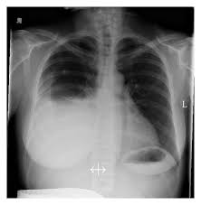
Radiographic features
Grade the severity ?
Imaging findings tend to be similar on ultrasound, CT and MRI.
Ultrasound
typically shows bilateral symmetric enlargement of ovaries (often >12 cm in size)
multiple cysts of varying sizes, giving the classic spoke-wheel appearance
associated ascites and pleural +/- pericardial effusion may also be present

Slide 32
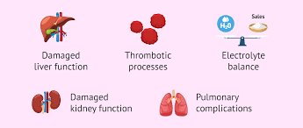
Complications
Thromboembolic complication 6.2% , pulmonary embolism 2%.
Ascites, Pleural effusion and pericardial effusion
Acute respiratory distress syndrome - 2%
Acute renal failure - 1%
Electrolyte abnormalities - Eg, hyponatremia, hyperkalemia
Elevated transaminase values - 26%
Ovarian accident ( torsion , rupture)

Slide 33
23 years old woman presented to infertility clinic nausea and abdominal discomfort for 3 days duration.
She gave a history of primary infertility of 2 years duration, she is known to be PCOS-with ovulatory cause of infertility since her HSG is normal as well as her partner SFA. She had Oral OI failure and conventional Gonadotropin protocol used with HCG trigger done 5 days ago
OHSS
What are you worry about ?
What is the severity of this condition & WHY ?
Mild OHSS
RCOG

Slide 34
How you will manage ?
Treatment is outpatient & supportive
outpatient management
Analgesia – Paracetamol and/or codeine. NSAIDs should not be used as they may compromise renal function.
Fluid management – Encourage to drink to thirst, rather than to excess (fluid intake of ≥ 1 L/day should be advised). Fluid intake and output monitoring.
Avoid strenuous exercise and sexual intercourse.
Luteal support – continue progesterone luteal support (Cyclogest 400 mg BD). However hCG luteal support should be stopped.
The patient should monitor their weight daily .
They should be seen every 2-3 days until symptoms resolve.
Mild OHSS can progress to become moderate or severe, particularly if pregnancy has occurred. Therefore, women with mild disease should be observed for worsening abdominal pain, weight gain (>1 kg/day), and increasing abdominal girth for at least two weeks or until menstrual bleeding occurs.
they should be provided with contact details to access advice

Slide 35
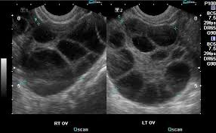
Case – continue …
While the patient on regular follow up , 2 weeks passed an the woman send for pregnancy test and its showed to be positive
she still complain from abdominal discomfort with nausea and twice time vomiting
Blood test:
hematocrit 42%
WBC 16,000
Decrease total protein
Normal RFT
Normal LFT

Slide 36
Case – continue …
While the patient on regular follow up , 2 weeks passed an the woman send for pregnancy test and its showed to be positive
she still complain from abdominal discomfort with nausea and twice time vomiting
What are you worry about ?
OHSS
What is the severity of this condition & WHY ?
moderate OHSS
RCOG

Slide 37
How you will manage ?
Management
Oral fluid intake of 1 to 2 liters per day.
Diuretics are contraindicated because they can worsen decreased intravascular volume.
Ambulate, but avoid other physical activity. Avoid sexual intercourse.
Bed rest is sometimes necessary
Daily weights, abdominal circumference measurements, and urinary output recordings.
Monitoring for signs of progression is performed at the time of initial presentation and every 48 hours thereafter (or daily if worsening symptoms develop):
Physical examination: Document weight, abdominal circumference, and urine output
TVUS
Laboratory testing (complete blood count [CBC], electrolytes, creatinine, serum albumin, and liver enzymes)

Slide 38
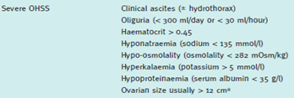
Case – continue …
On follow up with outpatient management , the patient came to ER with SOB and significant abdominal distension and repeated vomiting
What are you worry about ?
OHSS
What is the severity of this condition & WHY ?
Sever OHSS
RCOG

Slide 39
How you will manage ?
hospitalized in a facility with extensive OHSS experience: Inpatient care consists of supportive care, monitoring, and prevention and treatment
Multidisciplinary assistance should be sought for the care of women with critical OHSS and severe OHSS who have persistent hemoconcentration and dehydration
Women admitted with OHSS should be assessed at least once daily. More frequent assessment is appropriate for women with critical OHSS and those with complications
Antiemetic as required: metoclopramide, cyclizine or stemetil
Analgesia and antiemetic may be used in women with OHSS, avoiding nonsteroidal agents and medicines contraindicated in pregnancy
Fluid replacement by the oral route, guided by thirst, is the most physiological approach to correcting intravascular dehydration.
Women with persistent hemoconcentration despite volume replacement with intravenous colloids may need invasive monitoring and this should be managed with anaesthetic input
Diuretics should be avoided as they further deplete intravascular volume, but they may have a role in a multidisciplinary setting if oliguria persists despite adequate fluid replacement and drainage of ascites.
thromboprophylaxis in all hospitalized patients with OHSS is recommended
patients should also be monitored for signs of infection. If yes …use a third- or fourth-generation cephalosporin in combination with metronidazole

Slide 40
Preventive measures
In PCOS
Antagonist protocol
Agonist trigger
OPU
1
2
3
4
5
6
7
12
14
Freeze cycle
Assess
Risk factors
Individualized
COS
Add
Metformin from start
dostinix o.5mg/day for 8 days from day of HCG
Aspirin from start
20% Albumin around time of OPU
10ml -10% Ca in 200ml NS from day of OPU and day 1,2,3 after
Doxydar

