Slide 1
Infertility
Prof.Fadia J Alizzi
Consultant OBG & Reproductive Medicine
Al-Mustansiriyia Medical College / Al-Yarmouk Teaching Hospital

Slide 2
Objectives
At the end of this presentation, the student:
will know the basic evaluation of couple with infertility
How to Counsel the couple with infertility
Know the possible underlying causes of infertility
How to manage according to the causes
Possible complication of ovulation induction; mainly OHSS

Slide 3
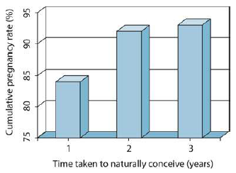
Infertility - Definition
Why one year ?
Is a failure to conceive after 12 months of regular unprotected intercourse.
Natural conception

Slide 4
Why one year ?
Chance of natural conception
A healthy couple having frequent intercourse have about an 18–20% chance of conceiving in a single menstrual cycle.
Over 80% of couples in the general population will conceive within 1 year if:
a) Woman is aged under 35(37) years and
b) Couple does not use contraception.
c) Have regular sexual intercourse.
Of those who do not conceive in the first year, about half will do so in the second year (cumulative pregnancy rate over 90%) .

Slide 5
Types of subfertility
Primary Subfertility: couples that have never conceived
Secondary Subfertility: couples that have previously conceived together (even if pregnancy was not eventful)
Incidence
Exact incidence in Iraq, not known?
In population studies, it was estimated that infertility affects up to 15% of couples and that subfertility is thought to affect about one in seven couples.

Slide 6
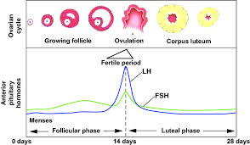
Natural conception
Menstrual cycle length –fixed secretory phase ± 1 day = fertile period

Slide 7
Factors influencing conception:
Maternal & paternal age
Both frequency and timing of sexual intercourse***
Smoking can decrease the quality and quantity of eggs and sperm.
The role of alcohol and caffeine remains controversial ???
Body mass index (BMI) exerts a strong influence on fertility( over & under wt.) of both partner
Stress
Frequency and timing of sexual intercourse
Frequency : three times a week are three times more likely to conceive than couples having intercourse once a week. Maximum ‘efficiency’ is probably intercourse at least every alternate day.
Timing :Increased frequency of intercourse should be encouraged in the peri- ovulatory period.
Eggs are thought to be fertilizable for about 12–24 hours post- ovulation
sperm can survive in the female reproductive tract for up to 72 hours.

Slide 8
When to investigate ?
An infertility evaluation is usually initiated:
after one year of regular unprotected intercourse in women under age 35 years
after six months of unprotected intercourse in women age 35 years and older.
The evaluation may be initiated sooner in women with:
Irregular menstrual cycles (oligomenorrhoea or amenorrhea)
known risk factors for infertility such as
Endometriosis
History of Pelvic inflammatory disease (PID)
Reproductive tract malformations.
Women with low ovarian reserve
known male factor subfertility
Pre-treatments for cancer in women and men at reproductive age or have fertility concerns.

Slide 9
When to Investigate ?
An infertility evaluation is usually initiated:
after one year of regular unprotected intercourse in women under age 35 years
after six months of unprotected intercourse in women age 35 years and older.
The evaluation may be initiated sooner in women with
MC abnormalities : amenorrhoea, oligomenorrhoea
women with low ovarian reserve
known male factor subfertility
endometriosis
history of pelvic inflammatory disease (PID).
reproductive tract malformations.
Ovarian causes
Male cause
Tubal & Uterine causes

Slide 10
Causes of subfertility
Both male & female
&
Unexplained infertility
Ovarian causes
Tubal & Uterine causes
Male cause

Slide 11
Causes of subfertility
WHO
UK
% | Causes
25 | Ovulatory disorders
15 | Endometriosis
12 | Pelvic adhesions
11 | Tubal blockage
11 | Other tubal abnormalities
7 | Hyperprolactinaemia
8 | Male Factors
Secondary% | Primary % | Causes
20 | 25 | Unexplained
15 | 25 | Ovulatory
40 | 20 | Tubal Disease
20 | 30 | Male factors
5 | 10 | Uterine or Peritoneal

Slide 12
How to Evaluate ?
Essential components of an initial workup include a review of the medical history, physical examination, prepregnancy evaluation and additional tests as indicated.
Remember the causes
1. Female cause:
• Ovulatory cause
• Tubal cause
• Endometriosis
• Uterine cause
2. Male cause
3. Both male & female cause
4. Un-explained infertility

Slide 13
How to Evaluate ?
Essential components of an initial workup include a review of the medical history, physical examination, prepregnancy evaluation and additional tests as indicated.
Remember the causes
Female cause of infertility
1. Female cause:
• Ovulatory cause
• Tubal cause
• Endometriosis
• Uterine cause
2. Male cause
3. Both male & female cause
4. Un-explained infertility
History
Examination
investigation

Slide 14
History
Age
Type of infertility (primary , secondary)
Duration of infertility
Menstrual history (cycle length and characteristics)
Dysmenorrhea ( primary , secondary )
Dyspareunia ( superficial , deep )
Discharge ( STD , PID , abnormal pap smear )
Drugs ( Ovulation induction , Contraception , antidepressant ,steroids, anti- psychotic, antiemetic)
Sexual history, including sexual dysfunction and frequency of coitus.

Slide 15
History
Obstetric history:
Type of conception(spontaneous/assisted)
Parity (NVD/CS, History of PPH, Postpartum sepsis)
Abortion(time ,type, with or without curettage)
Medical history and medication : fitness & safety of pregnancy
Surgical history (pelvic surgery, health defining surgery as cardiac disease, etc.)
Hereditary history, including family members with infertility, birth defects, genetic mutations, or intellectual disability. Women with fragile X pre-mutation may develop premature ovarian failure, while males may have learning problems, developmental delay, or autistic features.

Slide 16
History
Personal and lifestyle history including
Address because of its importance in the follow up.
Occupation
Exercise
Stress
Dieting/changes in weight
Smoking and alcohol use.
Review of all the investigation and previous treatment given for her to enhance fertility.

Slide 17
Examination
BMI and general built
Secondary sexual characters
Signs of androgen excess (hirsutism, acne, male pattern baldness, Virilization
Endocrine disorders as thyroid gland examination and acromegaly
Galactorroeaha (must not be stimulated or physically expressed by doctor)
Abdominal examination for scars from previous abdominal surgery. Large pelvic masses including ovarian cysts and fibroids, palpable abdominally.
Per-vaginal examination:
Tenderness or masses in the adnexa or posterior cul-de-sac (pouch of Douglas) are consistent with chronic PID or endometriosis.
Vaginal/cervical structural abnormalities or discharge suggest the presence of a Müllerian anomaly, infection, or cervical factor.
Uterine enlargement, irregularity, or lack of mobility is signs of a uterine anomaly, leiomyoma, endometriosis, or pelvic adhesive disease.

Slide 18
Investigations
General investigation : Blood tests: Complete blood count (CBC) and blood sugar.
Hormonal Assay .
Transvaginal ultrasound (TVUS) is recommended (see below).
Tubal potency testing may be necessary.
Screening for infection (what & when?)
Rubella
Chlamydia testing should be offered prior to any uterine instrumentation.
If ART is to be offered, viral screening for (HIV) and hepatitis B and C

Slide 19
Female subfertility
ovulatory causes
Assessment of ovulatory function
Women who have regular menses approximately every 28 days with molimina symptoms prior to menses (breast tenderness, bloating, fatigue, etc.) are most likely ovulatory.
Ovulation is most easily documented by a mid-luteal phase serum progesterone level, which should be obtained approximately one week before the expected menses
The use of urinary ovulation prediction kit. These kits detect luteinizing hormone (LH) and are highly effective for predicting the timing of the LH surge that reliably indicates ovulation.
Serial ultrasounds to follow the development and ultimately the disappearance of a follicle (the most accurate method of documenting ovulation )
endometrial biopsy to document secretory changes in the endometrium are too expensive or invasive for routine diagnostic assessment of ovulation.
Others:

Slide 20
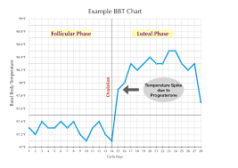
ovulatory causes
BBT-biphasic chart
During the follicular phase of the menstrual cycle, BBT reaches its lowest point approximately 1 d before ovulation due to higher levels of estrogen
after ovulation, higher levels of progesterone released by the corpus luteum BBT rises sharply after ovulation to about 0.5 to 1 °C throughout the luteal phase
this phenomenon is termed as Biphasic Temperature Pattern

Slide 21
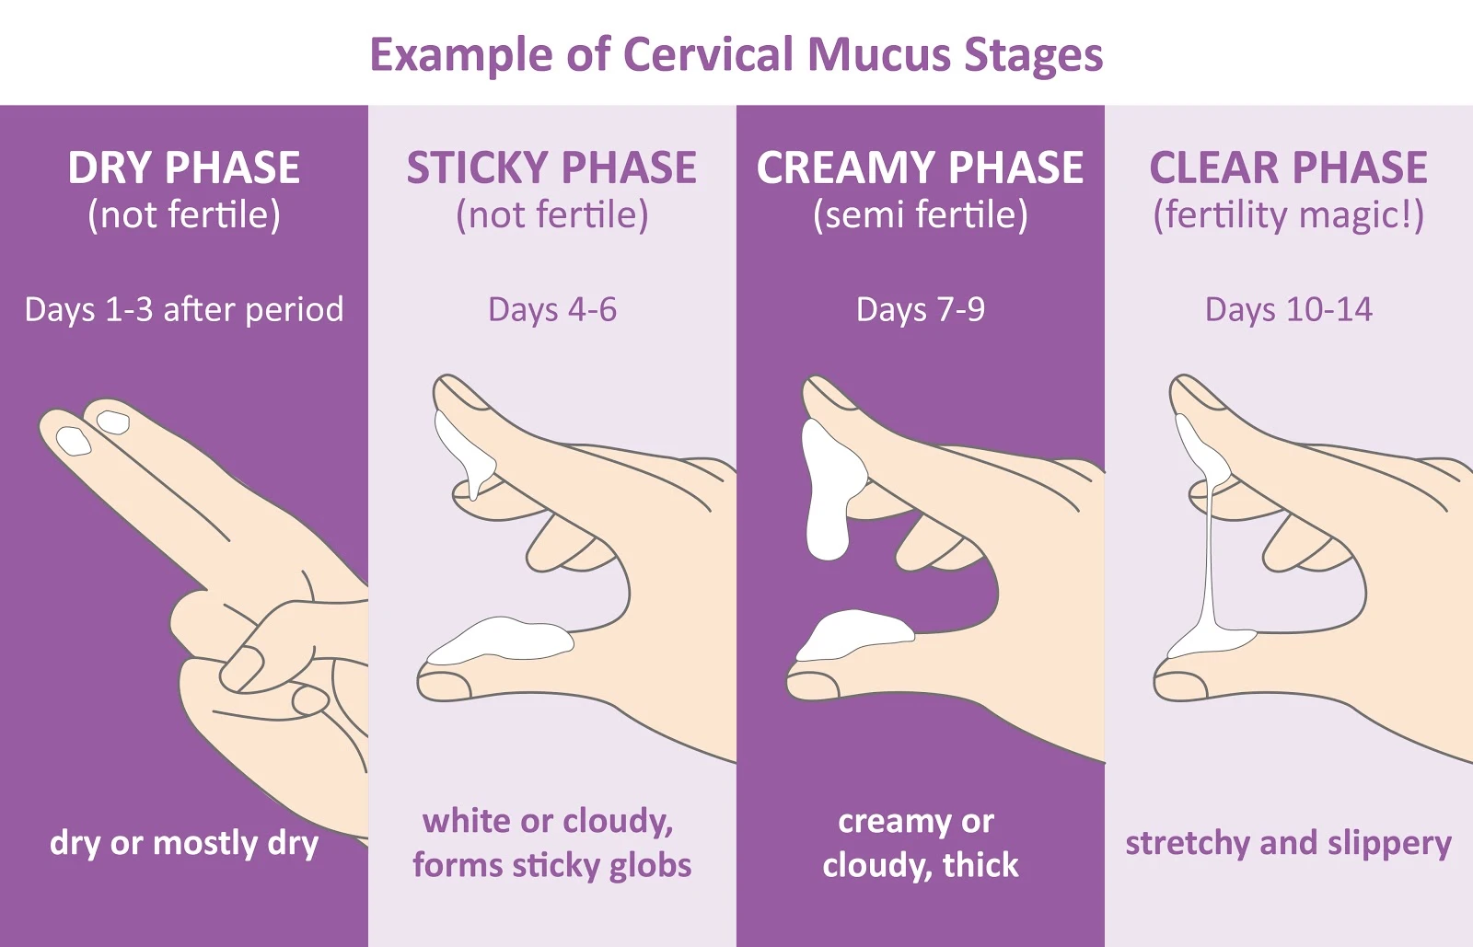
Ovulatory causes
cervical mucus and fertile discharge
Under the influence of estrogens, cervical mucus becomes abundant, clear, and stretchable, and somewhat like egg white. The stretchability of the mucus is described by its Spinnbarkeit
This type of discharge signals that ovulation is approaching.
Fertile cervical fluid helps sperm move up the cervix to fertilize an egg. It also keeps the sperm healthy during the journey.

Slide 22
Female subfertility
ovulatory causes
Assessment of ovulatory function:
Disorders of ovulation account for approximately 30–40% of the problems identified in infertile women.
They may present with oligomenorrhoea or amenorrhea.
Classification of ovulatory problems was done by WHO into 3 groups
Group I Hypothalamic pituitary failure (Hypogonadotropic hypogonadism).
Group II Hypothalamic pituitary dysfunction (Normogonadotropic, e.g. PCOD).
Group III Ovarian failure (Hypergonadotropic hypogonadism).

Slide 23
WHO – Classification of Ovulatory Disorders

Slide 24
Female subfertility
ovulatory causes
The World Health Organization (WHO) categorizes ovulation disorders into three groups(+ 1) based on serum measurements of :
Follicle stimulating hormone (FSH)
Luteinizing hormone (LH)
S. estradiol ( E2)
Serum FSH and LH should be checked in the early follicular phase between days 2 - 5 of the MC.
The levels of these hormones cannot be interpreted in the absence of serum estradiol and all three tests are needed to assess hypothalamic–pituitary–ovarian function.

Slide 25
Female subfertility
Tubal problems
Normal tubal function requires both patency and a healthy anatomy and physiology for gamete and embryo transport.
causes of tubal blockage are
PID : chlamydia is the commonest causative organism
Endometriosis
Pelvic surgery : peri-tubal adhesion

Slide 26
Female subfertility
Uterine problems
Fibroids can interfere with fertility, but their impact depends on their size and location.
Endometrial polyps can reduce the chance of implantation, although this tends not to be absolute.
Endometrial scarring (Asherman’s syndrome) from surgery or infection can be associated with lighter periods and a significantly reduced chance of conception.
Adenomyosis : focal or diffuse
Congenital uterine anomalies, such as a septum

Slide 27
Investigations
Female investigations
Hormonal Assay
Transvaginal ultrasound (TVUSS) should be performed where possible.
Tubal potency testing may be necessary.
Screening for infection .
Chlamydia testing should be offered prior to any uterine instrumentation.
If ART is to be offered, viral screening for (HIV) and hepatitis B and C

Slide 28
Female Investigations
Hormonal Assay
Early follicular phase follicular-stimulating hormone (FSH), oestradiol and luteinizing hormone (LH).
Anti-Müllerian hormone (AMH) is proving particularly helpful in the assessment of ovarian reserve and is independent of the menstrual cycle, which is practical.
A mid- luteal progesterone measurement should be taken to confirm ovulation.
In women with an irregular menstrual cycle send for thyroid function & serum prolactin
If there are symptoms & signs of hyperandrogenemia send for serum testosterone and other androgen hormones .

Slide 29
Female Investigations
U/S - TVU
Transvaginal ultrasound (TVUSS) should be performed where possible. This provides an accurate assessment of:
Pelvic anatomy, including uterine size, shape, position and morphology
The presence of any fibroids, ovarian size,
Antral follicle count (AFC) an important parameter of ovarian reserve.
Pathology such as hydrosalpinges and endometriotic cysts
Access to the ovaries for Assisted Reproductive Technology (ART)

Slide 30
Female Investigations
Tubal patency test
Tubal patency and an assessment of the uterine cavity are traditionally investigated by:
Hysterosalpingography (HSG) using X-ray
Hysterocontrast sonography (HyCoSy) using ultrasound
Saline infusion sonography (SIS)
3D hysterocontrast sonography
Patients deemed at high risk of pelvic pathology benefit from a more invasive laparoscopy and hysteroscopy as a dual diagnostic and potentially therapeutic procedure.
It is crucial to remember that tubal patency is not equivalent to tubal function. Currently, there is as yet no effective test to check for tubal function.

Slide 31
Female Investigations
Tubal patency test
Timing & Technique
The examination is typically scheduled early in the follicular phase of the cycle, after menstrual flow has ceased and before day 10, as the endometrium is very thin at this point in the cycle.
Anesthesia or strong analgesia is not required
Proper antiseptic
Use antibiotic after the procedure if no STD screening done before (doxycycline)
Infection & pregnancy is absolutely contraindicated

Slide 32
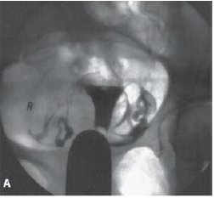
HSG
HSG
Normal HSG
HSG is the evaluation of the uterine cavity, fallopian tubes, and adjacent peritoneal cavity following the injection of contrast material through the cervical canal
It is performed as a real-time outpatient examination under fluoroscopy with iodinated water-soluble contrast material (10 to 30 ml).

Slide 33
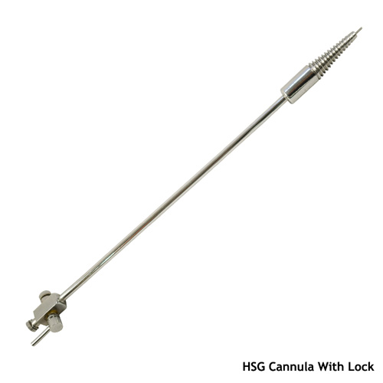
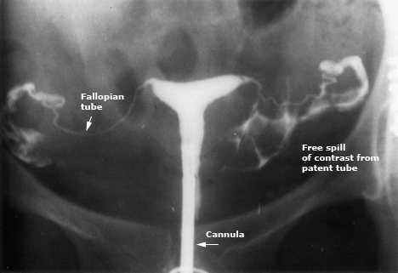
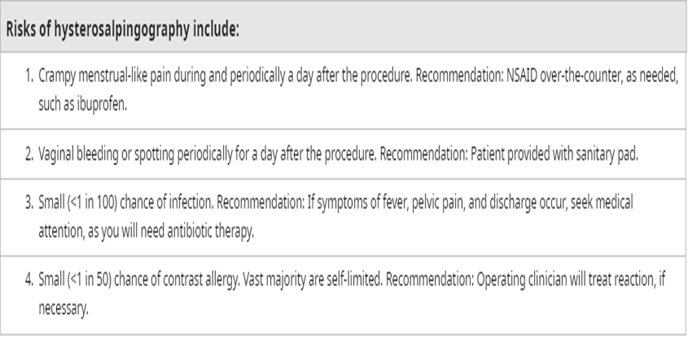
HSG
HSG - cannula
Normal HSG

Slide 34
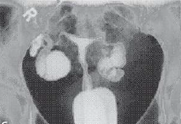
HSG
Normal HSG
HSG – Blocked tube

Slide 35
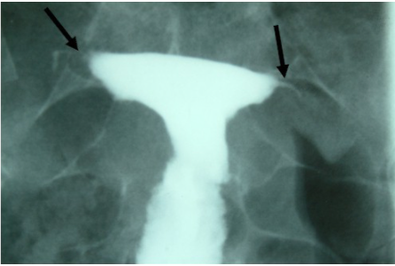
HSG
What dose this slide show?
The answer
Hysterosalpingogram demonstrates occlusion at the isthmus of both fallopian tubes (arrows)

Slide 36
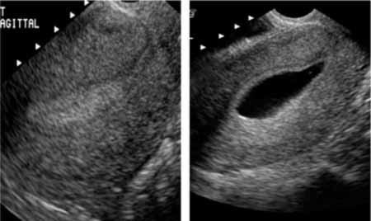
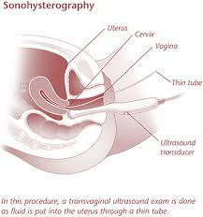
SIS
SIS
Normal SIS
It is easily and rapidly performed at minimal cost, well-tolerated by patients, and is virtually devoid of complications.
refers to a procedure in which fluid is instilled into the uterine cavity transcervically to provide enhanced endometrial visualization during TVU

Slide 37
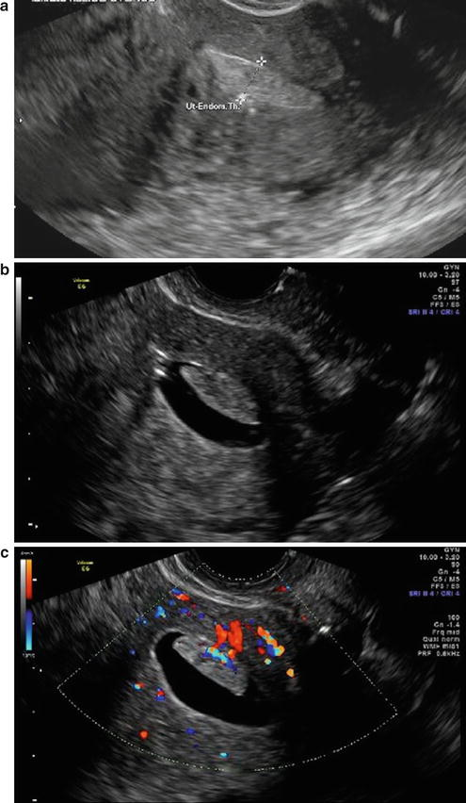
SIS
What dose this slide show?
Answer
TVU shows heterogenous endometrium
SIS shows possibility of poly vs. FIGO 0 fibroid
SIS with feeder vessel give the possibility of polyp more

Slide 38
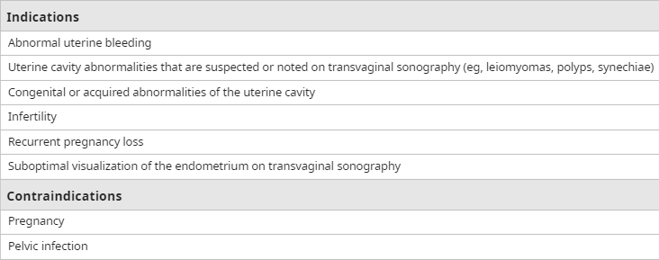
Indications & Contraindication of SIS

Slide 39
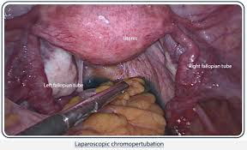
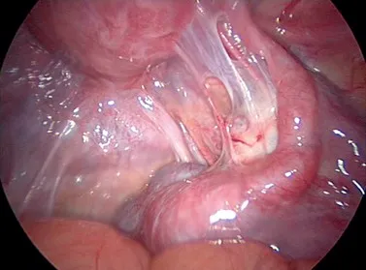
Laparoscopy
The role of laparoscopy in the evaluation of infertility is controversial.
Laparoscopy is invasive and expensive.
Laparoscopy may be indicated in women in whom endometriosis or pelvic adhesions/tubal disease is suspected based on physical examination, HSG, or history
When we perform laparoscopy, we also perform chromotubation to assess tubal patency and hysteroscopy to evaluate the uterine cavity.

Slide 40
How to Evaluate ?
Essential components of an initial workup include a review of the medical history, physical examination, prepregnancy evaluation and additional tests as indicated.
Remember the causes
Male cause of infertility
1. Female cause:
• Ovulatory cause
• Tubal cause
• Endometriosis
• Uterine cause
2. Male cause
3. Both male & female cause
4. Un-explained infertility
History
Examination
investigation

Slide 41
Causes of subfertility
Male subfertility
The causes of male infertility can be divided into four main areas :
Endocrine and systemic disorders (usually related to secondary [Hypogonadotropic hypogonadism) – 2 - 5%.
Primary testicular defects in spermatogenesis – 65 -80 % (of which the majority have idiopathic dysspermatogenesis, an isolated defect in spermatogenesis without an identifiable cause).
Sperm transport disorders – 5%.
Idiopathic male infertility – 10 - 20 %. Idiopathic male infertility
Genetic causes of male factor infertility include
Aneuploidy of sex chromosomes (Klinefelter XXY most commonly)
Structural abnormalities of the autosomes, such as inversions, deletions or balanced translocations.
Microdeletions of the azoospermic factor (AZF) regions of the Y chromosome are associated with low sperm counts and motility.

Slide 42
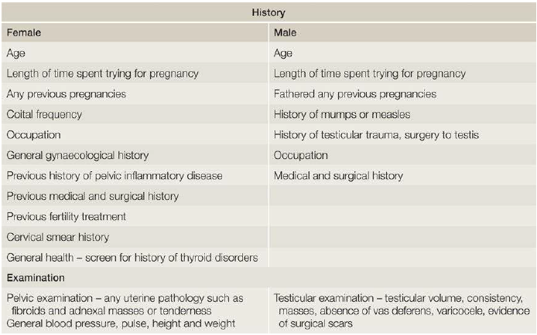
History and examination

Slide 43
Investigations
Male investigations
SFA
Hormonal assay ( FSH,LH , S. testosterone &S.prolactine) is indicated in the cases of very low sperm count or azoospermia
Scrotal and transrectal ultrasound & Imaging of accessory glands and ducts
Testicular biopsy ?????
Less evidence-based tests include measuring deoxyribonucleic acid (DNA) fragmentation levels in the sperm.
Genetic study : in azoospermia mainly
karyotype
cystic fibrosis screen.
Microdeletions of the AZFa and AZFb regions of the Y chromosome are not tested for routinely, because they are not ameliorable to treatment. However, they carry a poor prognosis for surgical sperm retrieval procedures and may be tested for in this context in the presence of azoospermia.

Slide 44
Male investigations
Seminal Fluid Analysis ( SFA)
The only routine investigation on the male side
Most centers recommend between a 2-4 ( up to 7 days)day abstinence from ejaculation before providing the semen sample
If possible, the patient should collect the sample by masturbation at the doctor's office. If not possible, then the sample may be collected at home and delivered to the laboratory within an hour of collection.
If the initial SFA is abnormal it should be repeated 3 months later, to allow adequate time for spermatogenesis, because occasionally an abnormal SFA will result from insults such as viral infections.
Some clinics will also assess total motile count, the presence of round cells or leucocytes to assess for inflammation and the presence of sperm antibodies

Slide 45
Male investigations
SFA
Semen analysis is the key laboratory assessment of the male partner of an infertile couple.
The standard semen analysis consists of the following:
Semen volume and pH
Microscopy for:
Sperm concentration, count, motility, and morphology
Debris and agglutination
Leukocyte count
Immature germ cells

Slide 46
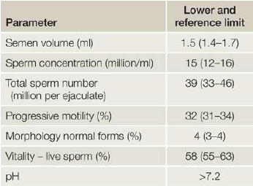
Male investigations
SFA
World Health Organization parameters for semen analysis (2010) – 5th centile

Slide 47
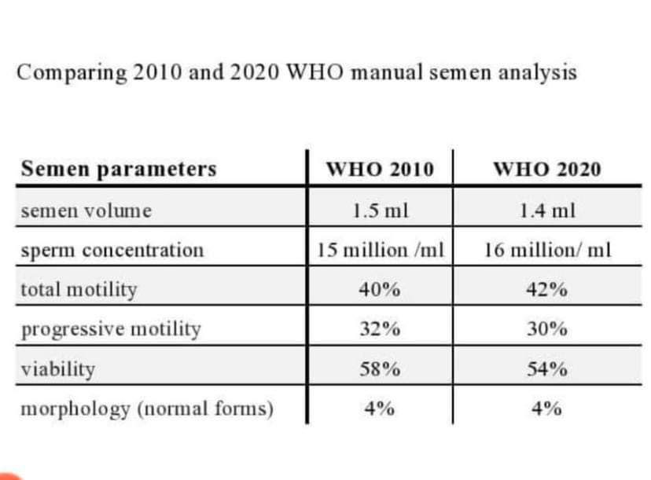
Male investigations
SFA

Slide 48
Male investigations
SFA
Nomenclatures used :
Oligozoospermia = low number of sperm cells in the ejaculate compared with reference ranges
Azoospermia = no sperm cells in the ejaculate
Asthenozoospermia = decrease in sperm motility
Teratozoospermia =increase in spermatozoa with abnormal morphology
Aspermia =inability to produce or ejaculate semen

Slide 49
Male investigations
Hormonal assay
when to send for hormonal assay ( FSH, LH , Serum testosterone, S. prolactin)
Sperm concentration <10 million/mL
Severe oligozoospermia or azoospermia
men with severe oligozoospermia or azoospermia require genetic testing

Slide 50
Hormonal assay interpretation
FSH & LH & serum Testosterone
TSH
Serum prolactin
Testicular
Pre-testicular
Post-Testicular
Men with normal endocrine testing who also have azoospermia should be evaluated for ejaculatory duct obstruction or idiopathic

Slide 51
Male investigations
Genetic study
Chromosomal anomalies — Karyotyping is recommended for infertile men with elevated serum FSH and LH concentrations and a sperm concentration less than 10 million/mL . Klinefelter syndrome is the most common sex chromosome anomaly. These men typically have small, firm testes
Y-chromosome microdeletions, X-chromosome defects, and epigenetics — Approximately 10 to 18 percent of infertile men with sperm concentrations less than 5 million/mL have microdeletions of the Y chromosome. These Y-chromosome deletions (and risk of male infertility) may be transmitted from father to son by ICSI
CFTR gene — Men with cystic fibrosis transmembrane conductance regulator (CFTR) gene mutations present with obstructive azoospermia with or without manifestations of cystic fibrosis; normal testicular volume; no vas deferens on palpation of the external genitalia; and normal serum LH, FSH, and testosterone concentrations. In this setting, a family history of cystic fibrosis should be obtained, and both the male and female partner should be tested for CFTR gene mutations

Slide 52
Management
The management of the couple’s subfertility should be evidence based and relies on an accurate diagnostic evaluation of the history, clinical examination and investigations.
Management may be expectant, medical, surgical or a combination of these.
Fertility treatment should be individualized to optimize the treatment result

Slide 53
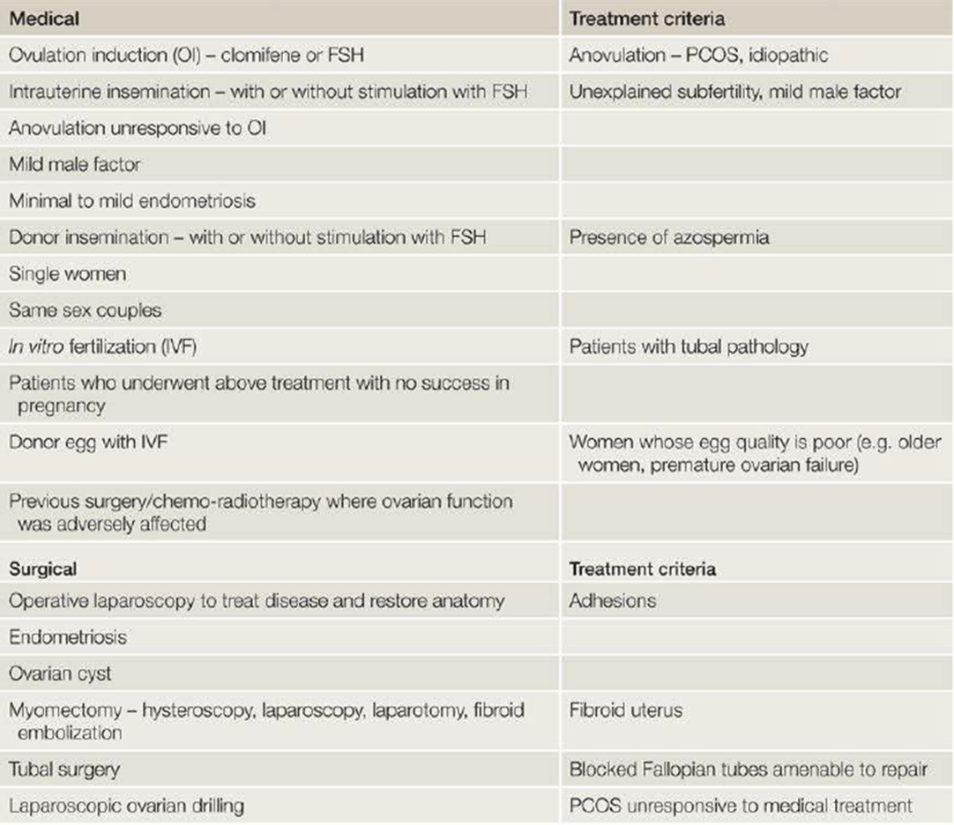
Summary of the medical and surgical management of subfertility

Slide 54
WHO – Classification of Ovulatory Disorders

Slide 55
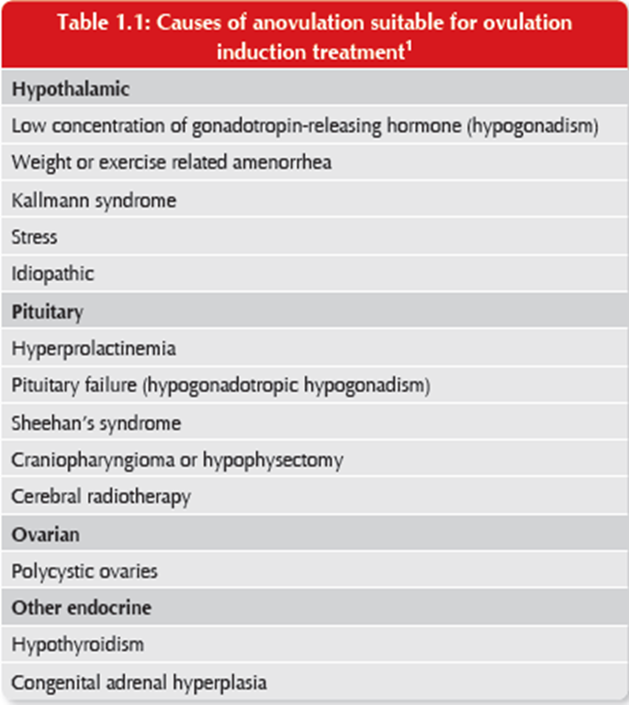
WHO – Classification of Ovulatory Disorders

Slide 56
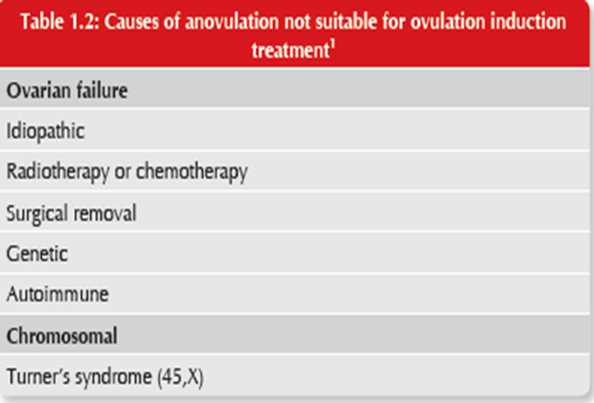
WHO – Classification of Ovulatory Disorders

Slide 57
Ovulatory - disorders
Type of treatment | Type | WHO
Treat the underlying cause if any? Gn treatment ( FSH & LH) Oral agent has no or minimal role ? | Hypothalamic-pituitary failure (HH) | I
Oral Ovulogens ± Metformin Gn Both ? | Hypothalamic pituitary dysfunction | II
No place for OI | Ovarian failure | III
Treat the underlying cause if any? Treat Hypothyroidism Dopamine agonist ± OI | Hyperprolactinaemia | IV

Slide 58
Treatment of Anovulatory causes of infertility according to WHO classification
Type 1
Hypogonadotropic hypogonadism
Treatment :
Pulsatile GnRH therapy
Gonadotropin therapy (FSH&LH)
HMG
Recombinant FSH&LH
Type 2
Normogonadotropic Normogonadism
Treatment :
Life style modification
Exercise
Diet
Drugs (orlistat)
Bariatric surgery
2. Ovulation induction
Oral agent± IUI:
SERM: CC
Insulin sensitizing agent: metformin
AI: Letrozole
Injectable :
FSH(R,U.HMG)
3. Surgery: LOD
4. IVF
Type 1
Hypergonadotropic
Hypogonadism
Treatment :
IVF with donor

Slide 59
IUI
Simple
Non invasive
lack of serious complications
Increase cumulative pregnancy over months:
Success range from 7 – 20% / Cycle
Success rate: > 50% of women aged under 40 years will conceive within 6 cycles of IUI.
Of those who do not conceive within 6 cycles of IUI, about half will do so with a further 6 cycles (cumulative pregnancy rate over 75%).
Fresh sperm is associated with higher conception rates than frozen–thawed sperm. However, IUI even using frozen–thawed sperm is associated with higher conception rates than intra- cervical insemination

Slide 60
Indications of IUI
PCOS
Stage 1 &11 endometriosis
Unexplained infertility
Male subfertility
Cervical factor
1st line
Oral - Ovulogens
if no response
or failure of > 1
cycle IUI
2nd line
Gn alone or in combination

Slide 61
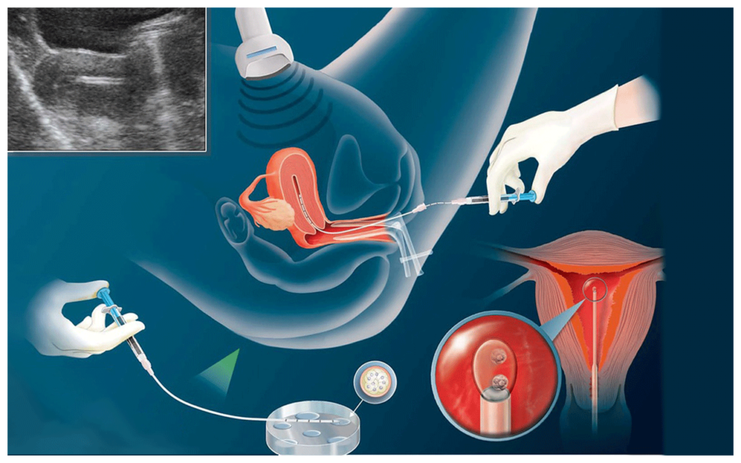
IUI

Slide 62
Surgical treatment
minimal access surgery (MAS) vs. Open surgery
Laparoscopic ablation of endometriosis can help improve natural conception rates.
removal of hydrosalpinges is associated with a significant improvement in in-vitro fertilization (IVF) success rates
Myomectomy
Polypectomy
Adhesiolysis
Treatment of Asherman syndrome
tubal microsurgery in reversal of sterilization, proximal or distal tubal microsurgery
Removal of septum

