Slide 1
Basic Evaluation of Woman with Infertility
Prof.Fadia J Alizzi
Consultant OBG & Reproductive Medicine
Al-Mustansiriyia Medical College / Al-Yarmouk Teaching Hospital

Slide 2
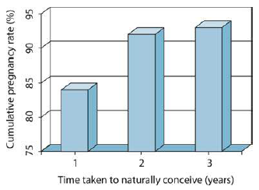
Infertility - Definition
Is a failure to conceive after 12 months of regular unprotected intercourse.
Natural conception

Slide 3
Infertility - Definition
Why one year ?
Is a failure to conceive after 12 months of regular unprotected intercourse.
Natural conception

Slide 4
Natural conception
Why one year ?
There is cumulative increase in pregnancy rates over time as couples try for conception.
Within 6 months 70%
after 12 months 80%
after 24 months 90%

Slide 5
Why one year ?
Chance of Natural Conception
A healthy couple having frequent intercourse have about an 18–20% chance of conceiving in a single menstrual cycle.
Over 80% of couples will conceive within 1 year if:
a) Woman is aged under 35(37) years and
b) Couple does not use contraception.
c) Have regular sexual intercourse.
Of those who do not conceive in the first year, about half will do so in the second year (cumulative pregnancy rate over 90%) .
Vaginal sexual intercourse every 2 to 3 days optimises the chance of pregnancy.

Slide 6
Types of subfertility
Primary Subfertility: couples that have never conceived
Secondary Subfertility: couples that have previously conceived together (even if pregnancy was not eventful)
Incidence
Exact incidence in Iraq, not known?
In population studies, it was estimated that infertility affects up to 15% of couples and that subfertility is thought to affect about one in seven couples.

Slide 7
When to Investigate ?
An infertility evaluation is usually initiated:
after one year of regular unprotected intercourse in women under age 35 years
after six months of unprotected intercourse in women age 35 years and older.
The evaluation may be initiated sooner in women with
MC abnormalities : amenorrhoea, oligomenorrhoea
women with low ovarian reserve
known male factor subfertility
endometriosis
history of pelvic inflammatory disease (PID).
reproductive tract malformations.
Ovarian causes

Slide 8
When to Investigate ?
An infertility evaluation is usually initiated:
After one year of regular unprotected intercourse in women under age 35 years
After six months of unprotected intercourse in women age 35 years and older.
The evaluation may be initiated sooner in women with
MC abnormalities : amenorrhoea, oligomenorrhoea
women with low ovarian reserve
known male factor subfertility
Endometriosis
history of pelvic inflammatory disease (PID).
reproductive tract malformations.
Male cause

Slide 9
When to Investigate ?
An infertility evaluation is usually initiated:
After one year of regular unprotected intercourse in women under age 35 years
After six months of unprotected intercourse in women age 35 years and older.
The evaluation may be initiated sooner in women with
MC abnormalities : amenorrhoea, oligomenorrhoea
women with low ovarian reserve
known male factor subfertility
Endometriosis
History of pelvic inflammatory disease (PID).
Reproductive tract malformations.
Tubal & Uterine causes

Slide 10
Causes of subfertility
Both male & female
&
Unexplained infertility
Ovarian causes
Tubal & Uterine causes
Male cause

Slide 11
Causes of subfertility
WHO
UK
% | Causes
25 | Ovulatory disorders
15 | Endometriosis
12 | Pelvic adhesions
11 | Tubal blockage
11 | Other tubal abnormalities
7 | Hyperprolactinaemia
8 | Male Factors
Secondary% | Primary % | Causes
20 | 25 | Unexplained
15 | 25 | Ovulatory
40 | 20 | Tubal Disease
20 | 30 | Male factors
5 | 10 | Uterine or Peritoneal

Slide 12
How to Evaluate ?
Essential components of an initial workup include a review of the medical history, physical examination, prepregnancy evaluation and additional tests as indicated.
Remember the causes
1. Female cause:
• Ovulatory cause
• Tubal cause
• Endometriosis
• Uterine cause
2. Male cause
3. Both male & female cause
4. Un-explained infertility

Slide 13
How to Evaluate ?
Essential components of an initial workup include a review of the medical history, physical examination, prepregnancy evaluation and additional tests as indicated.
Remember the causes
Female cause of infertility
1. Female cause:
• Ovulatory cause
• Tubal cause
• Endometriosis
• Uterine cause
2. Male cause
3. Both male & female cause
4. Un-explained infertility
History
Examination
investigation

Slide 14
History
Age
Type of infertility (primary , secondary)
Duration of infertility
Menstrual history (cycle length and characteristics)
Dysmenorrhea ( primary , secondary )
Dyspareunia ( superficial , deep )
Discharge ( STD , PID , abnormal pap smear )
Drugs ( Ovulation induction , Contraception , antidepressant ,steroids, anti- psychotic, antiemetic)
Sexual history, including sexual dysfunction and frequency of coitus.

Slide 15
History
Obstetric history:
Type of conception(spontaneous/assisted)
Parity (NVD/CS, History of PPH, Postpartum sepsis)
Abortion(time ,type, with or without curettage)
Medical history and medication : fitness & safety of pregnancy
Surgical history (pelvic surgery, health defining surgery as cardiac disease, etc.)
Hereditary history, including family members with infertility, birth defects, genetic mutations, or intellectual disability. Women with fragile X pre-mutation may develop premature ovarian failure, while males may have learning problems, developmental delay, or autistic features.

Slide 16
History
Personal and lifestyle history including
Address because of its importance in the follow up.
Occupation
Exercise
Stress
Dieting/changes in weight
Smoking and alcohol use.
Religion (donation consideration?)

Slide 17
History
Results of previous evaluation and therapy for infertility:
Previous evaluation results if performed:
Previous TVU and hormonal assay
Tubal patency test
Laparoscopy report
Hysteroscopy report
Previous treatments:
Type and doses of drugs ( oral or injectable ovulation induction drugs)
Number of cycles treatment
IVF/ICSI treatment(Report from center for each treatment cycle)
The cause of IVF-trial if any
No of IVF cycle
Successful or not
Type of protocol( agonist or antagonist)
Type & dose of gonadotropin
Type & dose of trigger
Type &dose of luteal phase support
Number & type of embryo
Fresh or freeze cycle
With or without PGS/PGD
Any complication (OHSS)

Slide 18
Examination
BMI and general built
Secondary sexual characters
Signs of androgen excess (hirsutism, acne, male pattern baldness, Virilization
Endocrine disorders as thyroid gland examination and acromegaly
Galactorroeaha (must not be stimulated or physically expressed by doctor)
Abdominal examination for scars from previous abdominal surgery. Large pelvic masses including ovarian cysts and fibroids, palpable abdominally.
Tenderness or masses in the adnexa or posterior cul-de-sac (pouch of Douglas) are consistent with chronic pelvic inflammatory disease or endometriosis.
Vaginal/cervical structural abnormalities or discharge suggest the presence of a Müllerian anomaly, infection, or cervical factor.
Uterine enlargement, irregularity, or lack of mobility is signs of a uterine anomaly, leiomyoma, endometriosis, or pelvic adhesive disease.

Slide 19
Investigations
Blood tests: Complete blood count (CBC) and blood sugar.
Transvaginal ultrasound (TVUS) is recommended.
Hormonal Assay .
Tubal potency testing may be necessary.
Screening for infection
Rubella
Chlamydia testing should be offered prior to any uterine instrumentation.
If ART is to be offered, viral screening for (HIV) and hepatitis B and C

Slide 20
Infertility cases based discussion

Slide 21
Cases based discussion according to the cause of infertility
Both male & female
&
Unexplained infertility
Ovarian causes
Tubal & Uterine causes
Male cause

Slide 22
Ovulatory Causes
WHO
Prolactin | TSH | S E2 | LH | FSH | Cause | Name | WHO Class.
- | - | ↓ | ↓ | ↓ | decreased hypothalamic secretion of GnRH or pituitary unresponsiveness to GnRH. | Hypogonadotropic hypogonadal anovulation (hypothalamic amenorrhea) | WHO Class 1
- | - | - | - ↑ | - | HPO- Dysfunction PCOS | Normogonadotropic normoestrogenic anovulation | WHO Class 11
- | - | ↓ | ↑ | ↑ | premature ovarian failure ovarian resistance | Hypergonadotropic hypoestrogenic anovulation | WHO Class 111
↑ | ↑ - | ↓ - | ↓ - | ↓ - | Physiologic Pathologic | Hyperprolactinaemic anovulation | WHO Class 1V

Slide 23
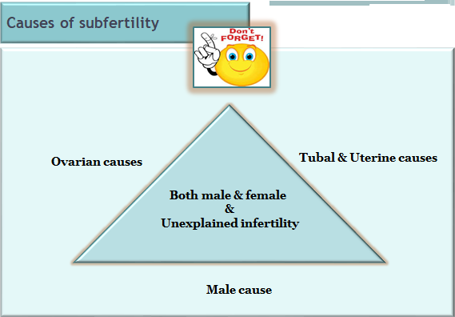
22 years old woman, presented to infertility clinic with primary infertility of 2 years duration, she had amenorrhoea for the last 4 months , her BMI is 18 , her partner SFA was normal & her HSG was normal as well
Ovarian causes

Slide 24
22 years old woman, presented to infertility clinic with primary infertility of 2 years duration, she had amenorrhoea for the last 4 months , her BMI is 18 , her partner SFA was normal & her HSG was normal as well
Ovarian causes
Interpret data
1st step = exclude pregnancy
Withdraw the cycle by progesterone (PCT)
If PCT negative means the patient has low estrogen ; add estrogen to withdraw the cycle
Do hormonal assay at cycle day (2-5)
PCT was negative – add estrogen = withdrawal of blood
Hormonal assay

Slide 25
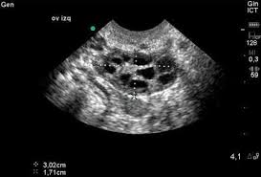
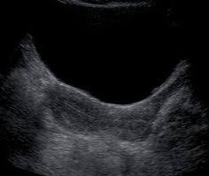
22 years old woman, presented to infertility clinic with primary infertility of 2 years duration, she had amenorrhoea for the last 4 months , her BMI is 18 , her partner SFA was normal & her HSG was normal as well
Level | Hormone
2.2 IU/L | FSH
1.8 IU/L | LH
35 pg/ml | S.E2
2 ng/ml | AMH
4 IU/L | TSH
11 ng /ml | S.prolactine
Hypogonadotropic
Hypogonadism

Slide 26
22 years old P3 woman, presented to infertility clinic with secondary infertility of 2 years duration, she had amenorrhoea for the last 1 year , her last delivery ended by sever PPH that needs 6pints of blood & blood products & she couldn’t lactate her last baby; her partner SFA was normal & her HSG was normal as well
Ovarian causes

Slide 27
22 years old P3 woman, presented to infertility clinic with secondary infertility of 2 years duration, she had amenorrhoea for the last 1 year , her last delivery ended by sever PPH that needs 6pints of blood & blood products & she couldn’t lactate her last baby; her partner SFA was normal & her HSG was normal as well
Ovarian causes
Interpret data
1st step = exclude pregnancy
Withdraw the cycle by progesterone (PCT)
If PCT negative means the patient has low estrogen ; add estrogen to withdraw the cycle
Do hormonal assay at cycle day (2-5)
PCT was negative – add estrogen = withdrawal of blood
Hormonal assay

Slide 28
22 years old woman, presented to infertility clinic with primary infertility of 2 years duration, she had amenorrhoea for the last 4 months , her BMI is 18 , her partner SFA was normal & her HSG was normal as well
Level | Hormone
1.2 IU/L | FSH
1 IU/L | LH
25 pg/ml | S.E2
15IU/L | TSH
5ng /ml | S.prolactine
Sheehan syndrome

Slide 29
28 years old woman, presented to infertility clinic with primary infertility of 3 years duration, she had amenorrhoea for the last 3 months , her BMI is 30, she had hirsutism & acne, her partner SFA was normal & her HSG was normal as well
Ovarian causes

Slide 30
28 years old woman, presented to infertility clinic with primary infertility of 3 years duration, she had amenorrhoea for the last 3 months , her BMI is 30, she had hirsutism & acne, her partner SFA was normal & her HSG was normal as well
Ovarian causes
Interpret data
1st step = exclude pregnancy
Withdraw the cycle by progesterone (PCT)
If PCT negative means the patient has low estrogen ; add estrogen to withdraw the cycle
Do hormonal assay at cycle day (2-5)
PCT was positive = withdrawal of blood
Hormonal assay & TVU

Slide 31
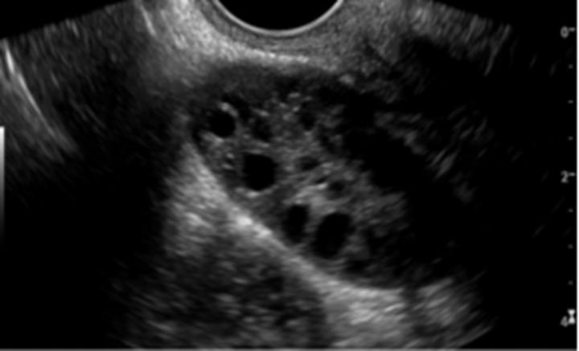
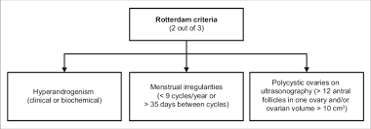
28 years old woman, presented to infertility clinic with primary infertility of 3 years duration, she had amenorrhoea for the last 3 months , her BMI is 30, she had hirsutism & acne, her partner SFA was normal & her HSG was normal as well
1
2
Level | Hormone
4.2 IU/L | FSH
8.5 IU/L | LH
50 pg/ml | S.E2
4.5ng/ml | AMH
4 IU/L | TSH
11 ng /ml | S.prolactine
3
PCOS
No. F≥12 (20) of 2-9mm

Slide 32
38 years old woman, presented to infertility clinic with primary infertility of 3 years duration, she had amenorrhoea for the last 3 months , her partner SFA was normal & her HSG was normal as well
Ovarian causes

Slide 33
38 years old woman, presented to infertility clinic with primary infertility of 3 years duration, she had amenorrhoea for the last 3 months , her partner SFA was normal & her HSG was normal as well
Ovarian causes
Interpret data
1st step = exclude pregnancy
Withdraw the cycle by progesterone (PCT)
If PCT negative means the patient has low estrogen ; add estrogen to withdraw the cycle
Do hormonal assay at cycle day (2-5)
PCT was negative – add estrogen = withdrawal of blood
Hormonal assay

Slide 34
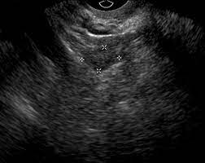
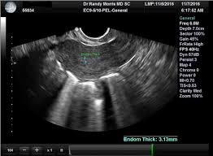
38 years old woman, presented to infertility clinic with primary infertility of 3 years duration, she had amenorrhoea for the last 3 months , her partner SFA was normal & her HSG was normal as well
PT.VALUE | HORMONE
40IU/L | FSH
0.o1ng /ml | AMH
20 pg/ml | S.E2
3 .5 Miu/L | TSH
15 ng/mL | S.PROLACTINE
Premature
ovarian
failure

Slide 35
25 years old woman presented to endocrinology unit complains from oligomenorrhoea, amenorrhea, galactorrhea, decreased libido & infertility for one year duration , PT negative , no CNS manifestation
Ovarian causes

Slide 36
25 years old woman presented to endocrinology unit complains from oligomenorrhoea, amenorrhea, galactorrhea, decreased libido & infertility for one year duration , PT negative , no CNS manifestation
Ovarian causes
Interpret data
1st step = exclude pregnancy
Withdraw the cycle by progesterone (PCT)
If PCT negative means the patient has low estrogen ; add estrogen to withdraw the cycle
Do hormonal assay at cycle day (2-5)
PCT was negative – add estrogen = withdrawal of blood
Hormonal assay

Slide 37
25 years old woman presented to endocrinology unit complains from oligomenorrhoea, amenorrhea, galactorrhea, decreased libido & infertility for one year duration , PT negative , no CNS manifestation
PT.VALUE | HORMONE
2.5 IU/L | FSH
2.2 ng /ml | AMH
35 pg/ml | S.E2
3 .8 Miu/L | TSH
65 Ng /mL | S.PROLACTINE
Hyperprolactinaemia

Slide 38
Ovulatory – disorders Rx
Type of treatment | Type | WHO
Treat the underlying cause if any? Gn treatment ( FSH & LH) Oral agent has no or minimal role ? | Hypothalamic-pituitary failure (HH) | I
Oral Ovulogens ± Metformin Gn Both ? | Hypothalamic pituitary dysfunction | II
No place for OI? | Ovarian failure | III
Treat the underlying cause if any? Treat Hypothyroidism Dopamine agonist ± OI | Hyperprolactinaemia | IV

Slide 39
Cases based discussion according to the causes of infertility
Both male & female
&
Unexplained infertility
Ovarian causes
Tubal & Uterine causes
Tubal Patency Test
What ?
Why?
When?
Male cause

Slide 40
When & Why to do TPT ?
An infertility evaluation is usually initiated:
after one year of regular unprotected intercourse in women under age 35 years
after six months of unprotected intercourse in women age 35 years and older.
The evaluation may be initiated sooner in women with
amenorrhoea, oligomenorrhoea
women with low ovarian reserve
known male factor subfertility
endometriosis
History of pelvic inflammatory disease (PID).
Pelvic surgery & adhesion
reproductive tract malformations.

Slide 41
Fallopian tube abnormalities / Pelvic adhesions
Causes
Congenital:
Acquired :
PID ( chlamydial or gonorrhea )
Moderate & severe endometriosis
Adhesions from * previous surgery or *non-tubal infection (eg, appendicitis, inflammatory bowel disease), pelvic tuberculosis, salpingitis isthmica nodosa.
Proximal tubal blockage may result from plugs of mucus and amorphous debris or spasm of the uterotubal ostium, but does not reflect true anatomic occlusion
Fallopian tube polyp.
Agenesis
Hypoplasia
Accessory Fallopian tube

Slide 42
Uterine problems
Fibroids can interfere with fertility, but their impact depends on their size and location.
Endometrial polyps can reduce the chance of implantation, although this tends not to be absolute.
Endometrial scarring (Asherman’s syndrome)
Adenomyosis : focal or diffuse
Congenital uterine anomalies, such as a septum
Cervical factors

Slide 43
What are the tests?
Tubal patency and an assessment of the uterine cavity are investigated by:
Hysterosalpingography (HSG) using X-ray
Hysterocontrast sonography (HyCoSy) using ultrasound
HyFoSy
Saline infusion sonography (SIS)
3D hysterocontrast sonography
MRI+HSG
CT + HSG
Patients at high risk of pelvic pathology benefit from laparoscopy and hysteroscopy as a dual diagnostic and potentially therapeutic procedure.

Slide 44
Tubal Patency Test
HSG
Definition:
HSG is the evaluation of the uterine cavity, fallopian tubes, and adjacent peritoneal cavity following the injection of contrast material through the cervical canal
It is performed as a real-time outpatient examination under fluoroscopy with iodinated water-soluble contrast (10-30 ml) material.
Evaluation of the
Inner contour of the uterus and fallopian tubes.
The width/length of the cervix
Shape of the uterine cavity
Outline of the cornua and lumen for each fallopian tube
Contrast spill (or absence) from the tubes
Information about peritoneal adhesions around the tubes
Timing
Less than 12 days of cycle = 6- 11 days
When to retain to sexual life after HSG ----- immediately ?

Slide 45
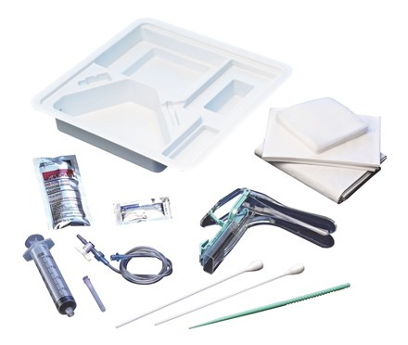
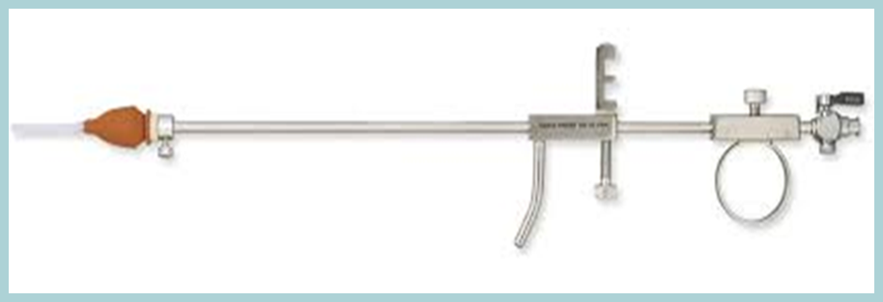
Tubal Patency Test
HSG - Set & Procedure
Dorsal lithotomy
BME
Speculum
Swabs
Blunt dilator
Long forceps to
pass a 5-F flexible
balloon-tipped catheter
(1.0 -1.5 cc)
OR
Jarcho cannula and tenaculum

Slide 46
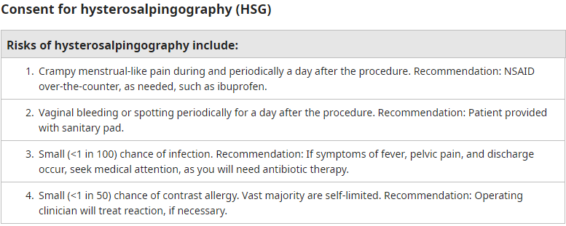
Tubal Patency Test
HSG

Slide 47
Tubal Patency Test
HSG
Contraindications
Pregnancy
Active undiagnosed vaginal bleeding
Active pelvic infection (even if the patient is receiving antibiotic therapy)
History of a moderate or severe reaction to iodinated contrast
Active menstruation is a relative contraindication.

Slide 48
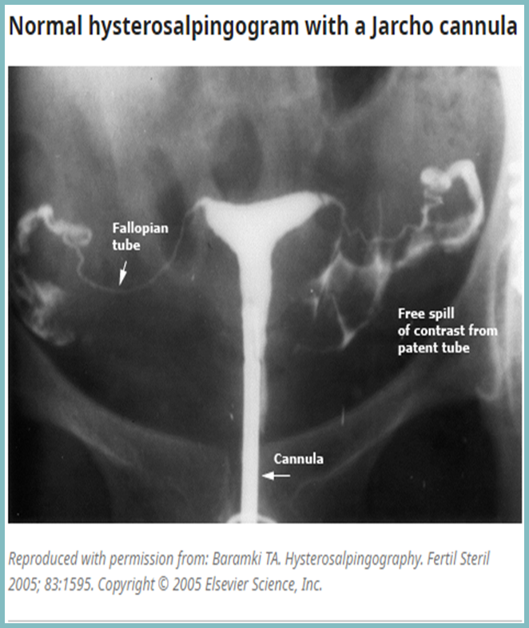
HSG
HSG
Normal HSG
HSG is the evaluation of the uterine cavity, fallopian tubes, and adjacent peritoneal cavity following the injection of contrast material through the cervical canal
It is performed as a real-time outpatient examination under fluoroscopy with iodinated water-soluble contrast material (10 to 30 ml).

Slide 49
30 years old woman Para 1, previous CS, presented to infertility clinic with secondary infertility of 3 years duration, she had regular MC , her partner SFA was normal
What's next?
Tubal cause
TPT –
HSG

Slide 50
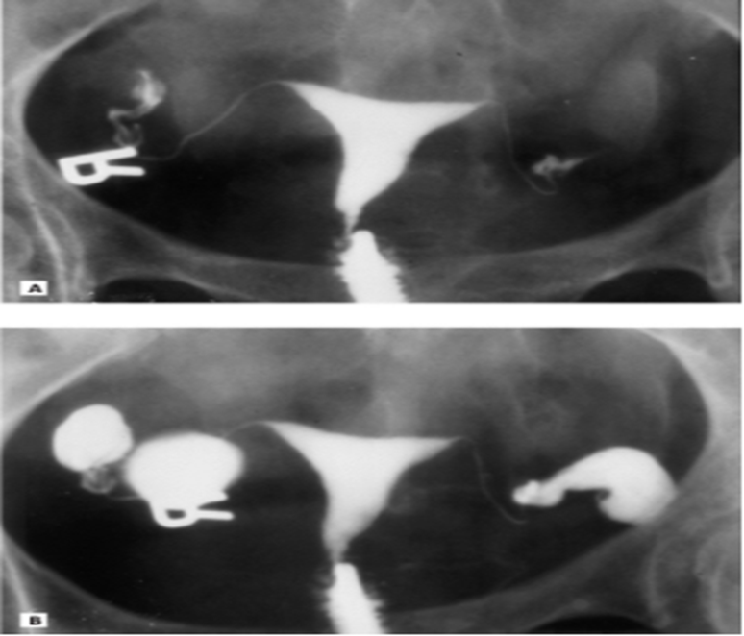
30 years old woman Para 1, previous CS, presented to infertility clinic with secondary infertility of 3 years duration, she had regular MC , her partner SFA was normal
HSG view
normal uterine cavity filling
but no definite spillage from the tubes & bilateral hydrosalpinx can be seen

Slide 51
32 years old woman Para 2 VD + Abortion 2 with history of one vigorous curettage 1 year ago , presented to infertility clinic with secondary infertility of 1 years duration, she had amenorrhoea with slight infrequent VB , her partner SFA was normal
What's next?
Uterine cause
TPT –
HSG

Slide 52
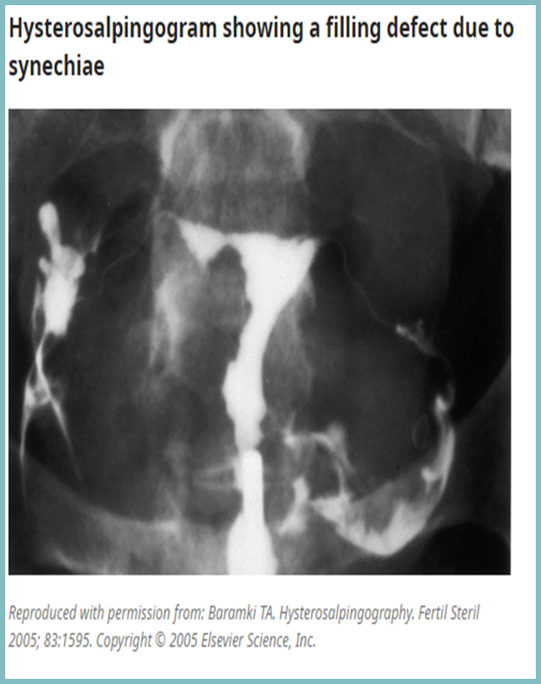
32 years old woman Para 2 VD + Abortion 2 with history of one vigorous curettage 1 year ago , presented to infertility clinic with secondary infertility of 1 years duration, she had amenorrhoea with slight infrequent VB , her partner SFA was normal
interpret data
History of 2nd infertility after vigorous curettage with slight infrequent cycle is highly suggestive of Asherman syndrome

Slide 53
Cases based discussion according to the cause of infertility
Both male & female
&
Unexplained infertility
Ovarian causes
Tubal & Uterine causes
Male cause

Slide 54
Male subfertility
The causes of male infertility can be divided into four main areas :
Endocrine and systemic disorders (usually related to secondary [Hypogonadotropic] hypogonadism) – 2 - 5%.
Primary testicular defects in spermatogenesis – 65 -80 % (of which the majority have idiopathic dysspermatogenesis, an isolated defect in spermatogenesis without an identifiable cause).
Sperm transport disorders – 5%.
Idiopathic male infertility – 10 - 20 %. Idiopathic male infertility
should be distinguished from idiopathic dysspermatogenesis. Idiopathic male infertility describes an infertile man with a normal semen analysis and no apparent cause for infertility, whereas infertile men with idiopathic dysspermatogenesis have abnormal semen analyses.

Slide 55
Investigations
Male investigations
SFA
Hormonal assay ( FSH,LH , S. testosterone &S.prolactine) is indicated in the cases of very low sperm count or azoospermia
Scrotal and transrectal ultrasound & Imaging of accessory glands and ducts
Testicular biopsy ?????
Less evidence-based tests include measuring deoxyribonucleic acid (DNA) fragmentation levels in the sperm.
Genetic study : in azoospermia mainly
karyotype
cystic fibrosis screen.
Microdeletions of the AZFa and AZFb regions of the Y chromosome are not tested for routinely, because they are not ameliorable to treatment. However, they carry a poor prognosis for surgical sperm retrieval procedures and may be tested for in this context in the presence of azoospermia.

Slide 56
Male investigations
Seminal Fluid Analysis ( SFA)
The only routine investigation on the male side
Most centers recommend between a 2-4 ( up to 7 days)day abstinence from ejaculation before providing the semen sample.
If possible, the patient should collect the sample by masturbation at the doctor's office. If not possible, then the sample may be collected at home and delivered to the laboratory within an hour of collection.
If the initial SFA is abnormal it should be repeated 3 months later, to allow adequate time for spermatogenesis, because occasionally an abnormal SFA will result from insults such as viral infections.

Slide 57
Male investigations
SFA
Semen analysis is the key laboratory assessment of the male partner of an infertile couple.
The standard semen analysis consists of the following:
Semen volume and pH
Microscopy for:
Sperm concentration, count, motility, and morphology
Debris and agglutination
Leukocyte count
Immature germ cells

Slide 58
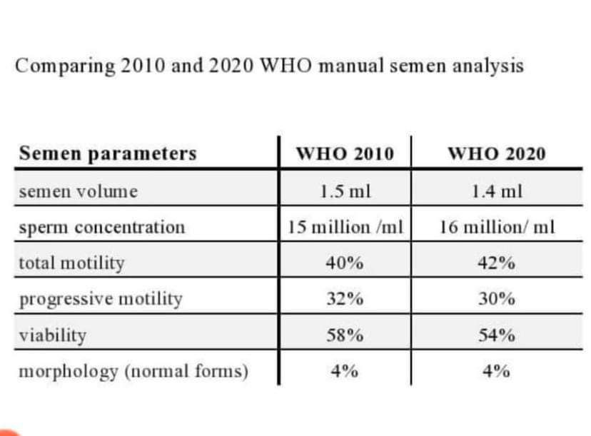
Male investigations
SFA

Slide 59
Male investigations
SFA
Nomenclatures used :
Oligozoospermia = low number of sperm cells in the ejaculate compared with reference ranges
Azoospermia = no sperm cells in the ejaculate
Asthenozoospermia = decrease in sperm motility
Teratozoospermia =increase in spermatozoa with abnormal morphology
Aspermia =inability to produce or ejaculate semen

Slide 60
Male investigations
Hormonal assay
when to send for hormonal assay ( FSH, LH , Serum testosterone, S. prolactin)
Sperm concentration <10 million/mL
Severe oligozoospermia or azoospermia
men with severe oligozoospermia or azoospermia require genetic testing

Slide 61
28 years old woman attend infertility seeking for pregnancy for 2 years , she had regular MC , her HSG normal and her partner SFA shows:
Volume 2ml
Sperm concentration /ml 12million
Total motility 20%
Progressive motility 12%
Viability 60%
Morphology normal 40%
Oligozoospermia

Slide 62
28 years old woman attend infertility seeking for pregnancy for 2 years , she had regular MC , her HSG normal and her partner SFA shows:
Volume 2ml
Sperm concentration /ml 20million
Total motility 20%
Progressive motility 12%
Viability 60%
Morphology normal 40%
Asthenozoospermia

Slide 63
28 years old woman attend infertility seeking for pregnancy for 2 years , she had regular MC , her HSG normal and her partner SFA shows:
Volume 2ml
Sperm concentration /ml 20million
Total motility 20%
Progressive motility 12%
Viability 60%
Morphology normal 3%
Teratozoospermia

Slide 64
28 years old woman attend infertility seeking for pregnancy for 2 years , she had regular MC , her HSG normal and her partner SFA shows:
Volume 2ml
Sperm concentration zero
Total motility
Progressive motility
Viability
Morphology normal
Azoospermia

Slide 65
28 years old woman attend infertility seeking for pregnancy for 2 years , she had regular MC , her HSG normal and her partner SFA shows:
Volume 2ml
Sperm concentration zero
Total motility
Progressive motility
Viability
Morphology normal
Azoospermia
Send the male for hormonal assay

Slide 66
28 years old woman attend infertility seeking for pregnancy for 2 years , she had regular MC , her HSG normal and her partner SFA shows:
Volume 2ml
Sperm concentration zero
Total motility
Progressive motility
Viability
Morphology normal
Hormonal assay interpretation :
Low FSH,LH & S.T=HH
Normal FSH,LH & S.T=NN
High FSH,LH & Low S.T= Hypergonadotropic hypogonadism
Azoospermia

Slide 67
Slide - Exam

Slide 68
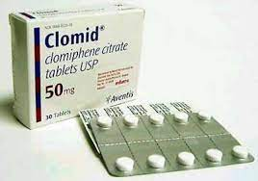
Slide no 1
What does this drug used for ?
It belong to which drug family ?
How its given ?
4. What are the main 2 risk of using ovulation induction drugs?
Used as OI drug in PCOS
Nonsteroidal selective estrogen receptor modulator (SERM)
2nd – 5th day cycle daily for five days in a dose of 2.5-7.5 mg with US follow up
2 main risk:
Multiple pregnancy
OHSS

Slide 69
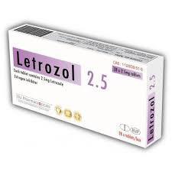
Slide no 2
What does this drug used for ?
It belong to which drug family ?
How its given ?
Ovulation induction in PCOS woman . It used in breast cancer
nonsteroidal aromatase inhibitors
2nd – 5th day cycle daily for five days in a dose of 2.5-7.5 mg with US follow up

Slide 70
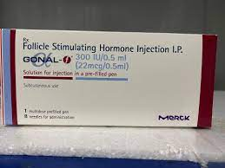
Slide no 3
What does this drug used for ?
It belong to which drug family ?
How its given ?
Ovulation induction used in WHO 1 & 2 ovulatory dysfunction (PCOS woman) .
Gonadotropin
In special protocol with high caution due to the risk of Multiple pregnancy & OHSS

Slide 71
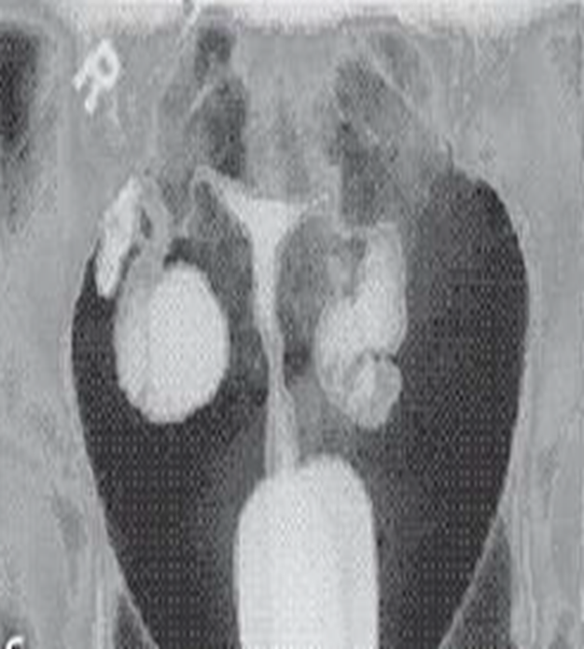
Slide no 4
27 years old woman presented with history of secondary infertility of 3 years duration
What does this slide show?
HSG view shows
Normal uterine cavity
Bilateral tubal blockage

Slide 72
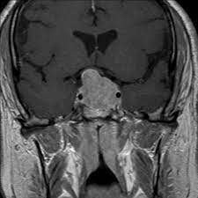
Slide no 5
22years old woman presented with history of 3 months amenorrhea , headache & blurring of vision
What does this brain MRI show?
What is the drug of choice in this condition ?
Pituitary macroadenoma
Dopamine agonist : cabergoline

Slide 73
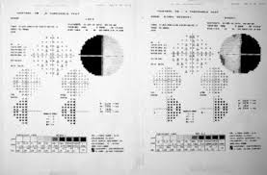
Slide no 6
22years old woman presented with history of 3 months amenorrhea , headache & blurring of vision
What does this slide show?
What is the drug of choice in this condition ?
Visual field defect in pituitary macroadenoma
Cabergoline: Cabergoline is a synthetic ergoline derivative and a long-acting dopamine receptor agonist

Slide 74
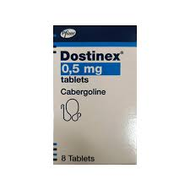
Slide no 7
What does this drug belong to ?
What is the main indication for its use ?
Cabergoline: Cabergoline is a synthetic ergoline derivative and a long-acting dopamine receptor agonist
Main indication for it is hyperprolactinaemia

Slide 75
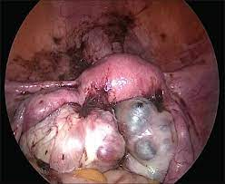
Slide no 8
28 years old with presented to infertility clinic with history of primary amenorrhea of 3 years; she gave a history of dysmenorrhea & deep dyspareunia
What does this slide show?
Stage this disease
What is your next step for her to help her conceive?
Laparoscopical view shows massive adhesion with endometriosis
Stage 4
IVF

Slide 76
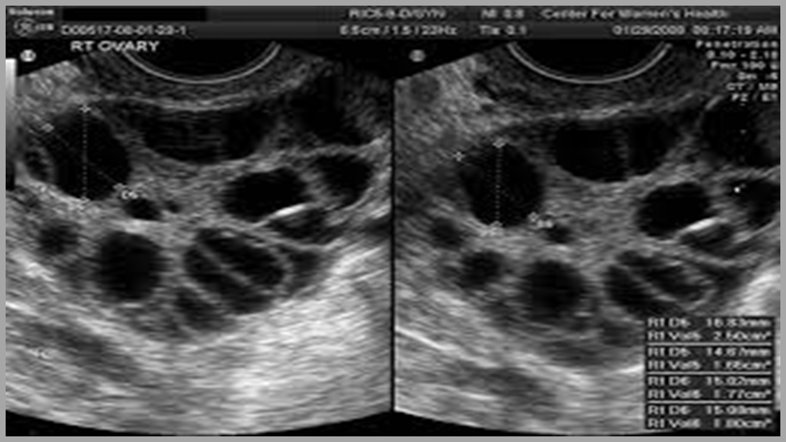
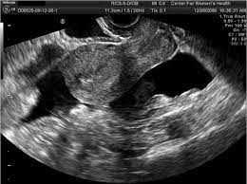
Slide no 9
26 years old woman presented to ER with abdominal pain, SOB , nausea & vomiting for 3 days duration after ET
What is this slide show
What is the name of this complication
How you can overcome it?
typically shows bilateral symmetric enlargement of ovaries (often >12 cm in size) with ascites
Late OHSS
Freeze all policy

Slide 77
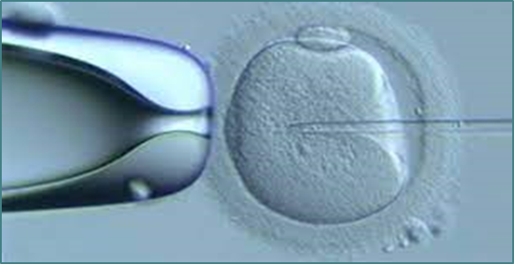
Slide no 10
What does this slide show ?
What are the main indications ?
Intracytoplasmic sperm injection(ICSI) : individual sperm can be isolated and directly injected into the cytoplasm of the oocyte.
Indications of ICSI:
Poor sperm parameters
previous poor fertilization

