Slide 1
Dystocia & Abnormal Progress of Labour
Prof.Fadia J Alizzi
Consultant OBG & Reproductive Medicine
Al-Mustansiriyia Medical College / Al-Yarmouk Teaching Hospital

Slide 2
Objective
At the end of this presentation, the student should know:
Definition & types of abnormal labour
Causes of abnormal labour .
Abnormalities of the various stages( first and second) and phases of labour ( latent and active phase).
What does uterine dysfunction means and its types (hypertonic, hypotonic)
How to interpret abnormal labour by using Partograph
Cases based discussion

Slide 3
Normal labour
Normal labor : is characterized by regular and painful uterine contractions that conclude in progressive labor ( cervical effacement & dilation ).
Stages of labour :
First stage : begins with the onset of labor and ends when the cervix is fully dilated (10 cm). It has 2 phases :
Latent phase
Active phases: it has 3 phases :
Acceleration phase
Phase of maximum slope
Deceleration phase
Second stage: begins when dilation of the cervix is complete and ends with delivery of the infant.
Third stage : begins immediately after delivery of the infant and ends with delivery of the placenta

Slide 4
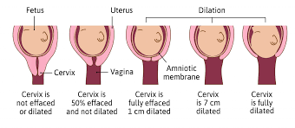
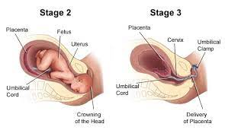
Stages of labour

Slide 5
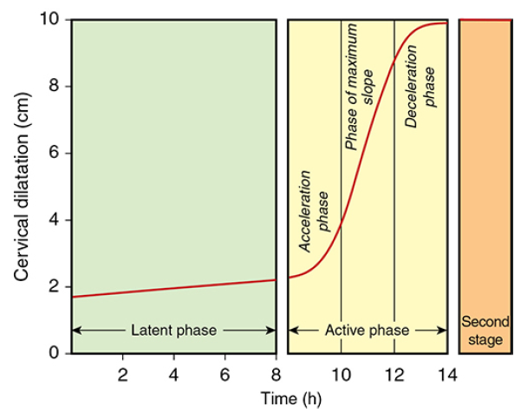
Stages of labor

Slide 6
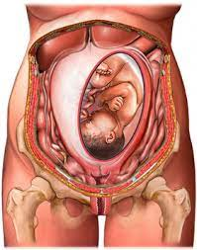
Progress in labour
power
passenger
Progress in labour is dependent on the ‘3 Ps’
Powers ( uterine contraction)
Passages ( bony pelvis & maternal pelvic soft tissue)
Passenger ( the fetus)
Abnormalities in one or more of these factors can slow the normal progress of labour
The use of a partogram to plot the progress of labour improves the detection of poor progress.
Passages

Slide 7
Case scenario with Partograph
Nora Ahmad is 25 years old primigravida woman. Admitted to labour room at 1:00 am complaining from labour pain & clear watery vaginal discharge before one hour before admission
PR 82bpm
BP 110/70
Temp 37 C
Base line FHR 140bpm
Abd. examination: LL , Cephalic , 3/5 palpable per abdomen; she has 3 contraction / 10 min of moderate strength lasting 40sec/min
PV examination : 4 cm cervical dilation , RM with clear colour & 70% effaced cervix , -1 to 0 station Adequate pelvis

Slide 8
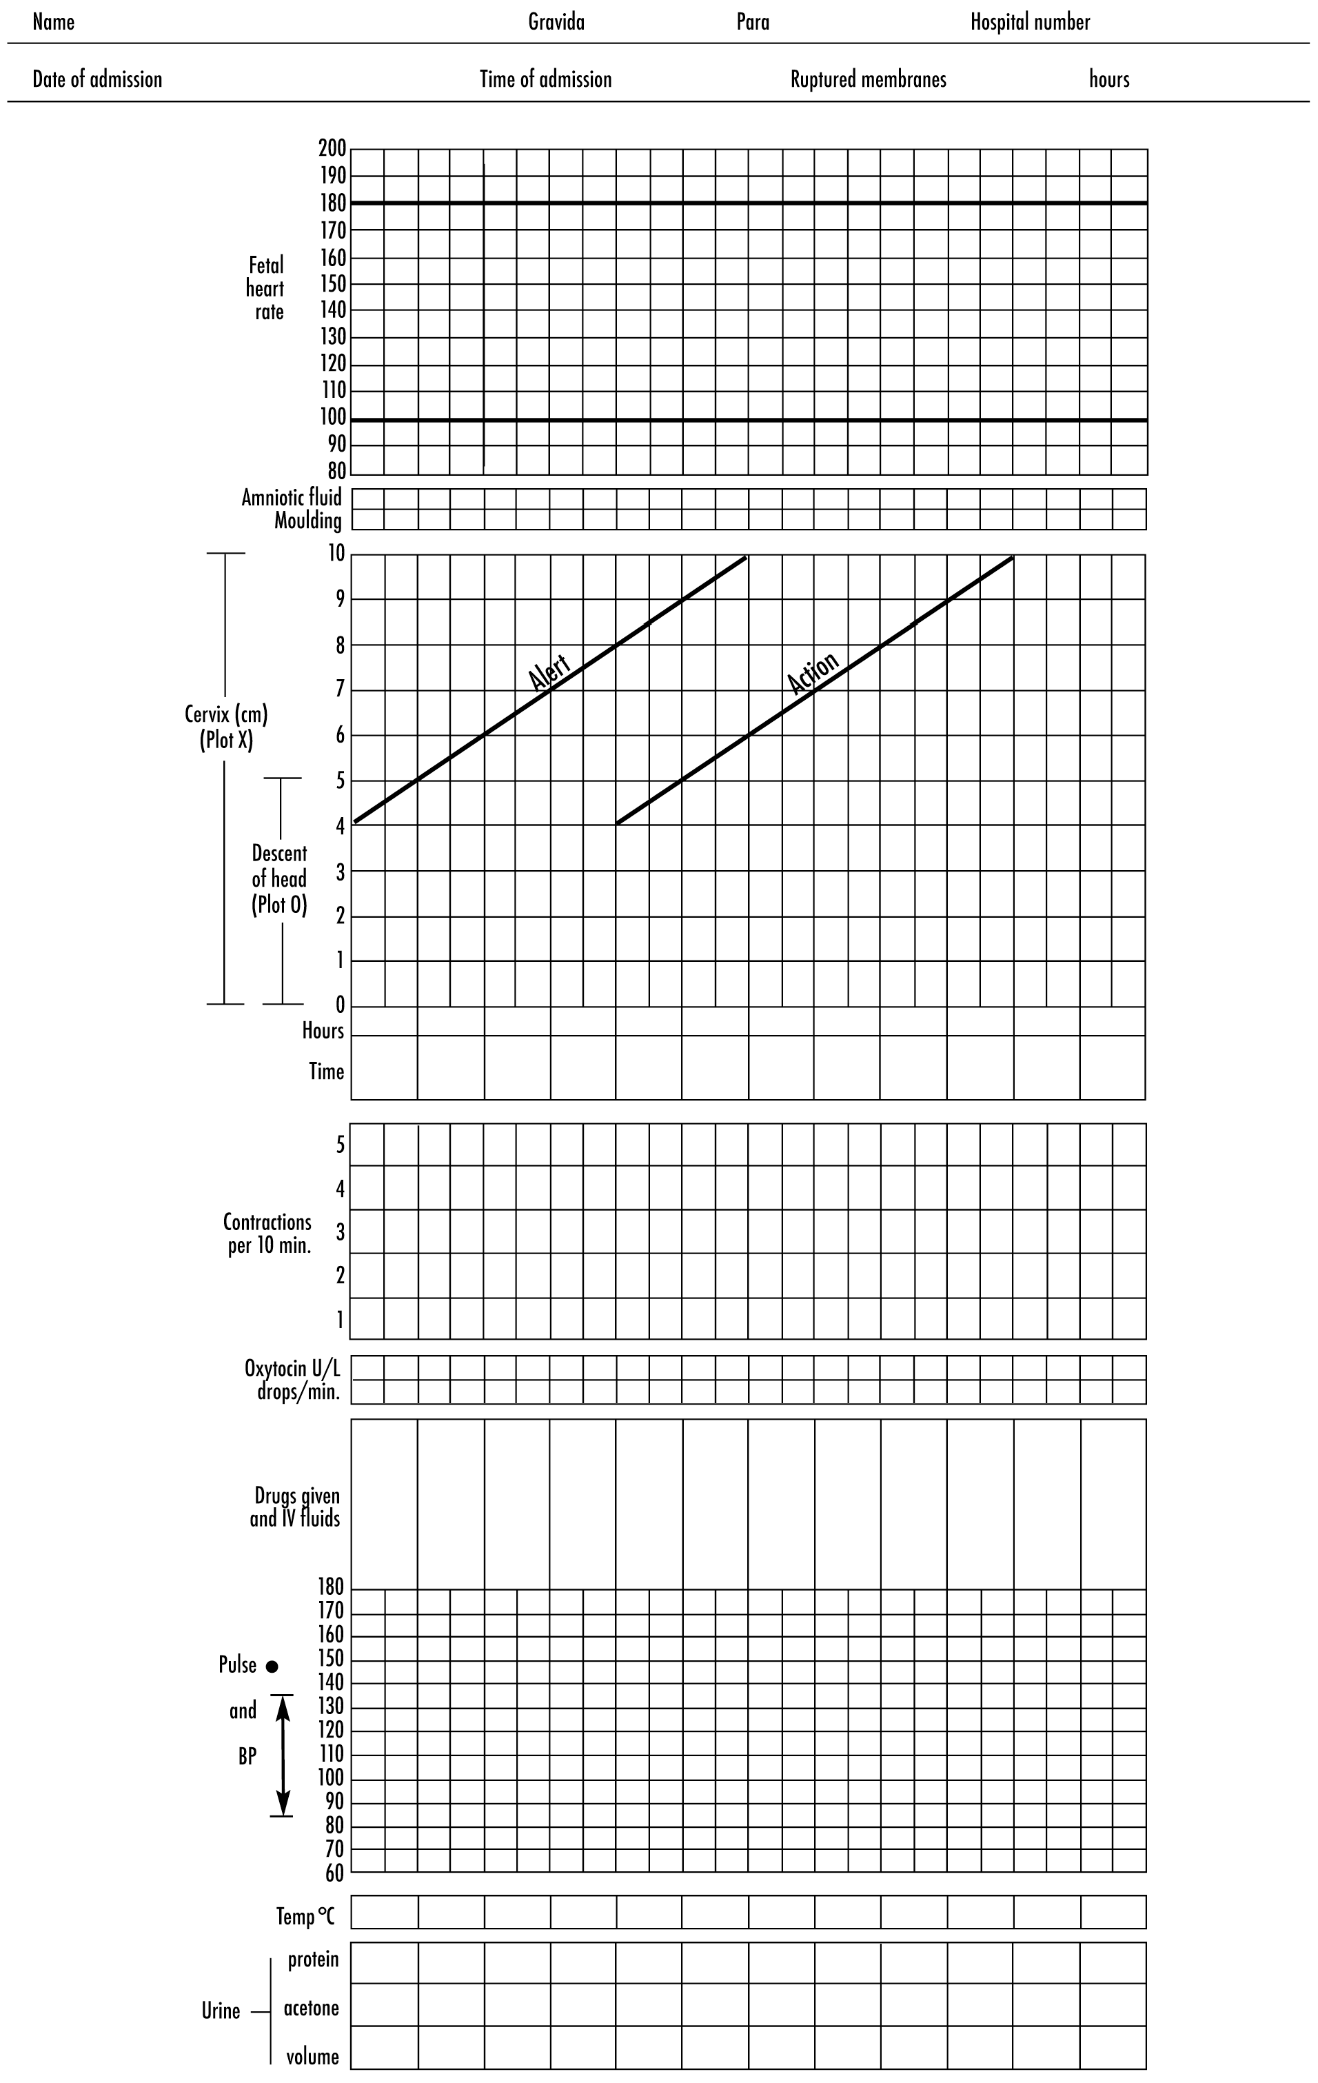

Slide 9
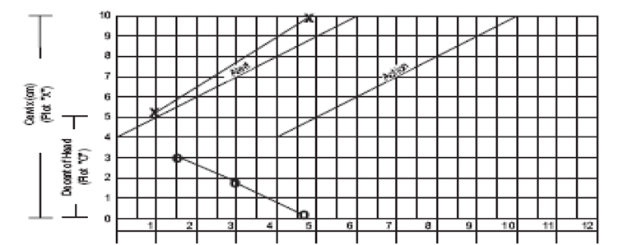
Normal Partograph

Slide 10
Abnormal Labour
Abnormal labor patterns may be seen in
Latent phase : prolonged latent phase
Active phase of labour ( the first stage, second stage or third stage of labor)
Labour abnormalities may be:
Abnormally slow (Dystocia of labor is defined as difficult labor or abnormally slow progress of labor or called dysfunctional labor)
Abnormally rapid ( precipitate labour)

Slide 11
Abnormally slow labour (Dystocia)
Dystocia : means difficult labour; characterized by abnormally slow progress of labour.
May be seen in the latent or active phase of labour ( the first stage, second stage or third stage of labor)
Its is caused by one of the 3 P or more than one P
Slow progress may occur in the first or second-stage abnormalities are described either as:
Protraction disorders (which means that delivery is progressing but is lower than normal)
Arrest disorders (complete cessation in progress).
Abnormal third-stage labor meriting intervention is placenta retention beyond 30 minutes.

Slide 12
Prolonged latent phase
Occurs when the latent phase is longer than the arbitrary time limits (>20 hours in the nullipara and >14 hours in the multipara).
It is more common in primiparous women and probably results from a delay in the chemical processes that occur within the cervix that soften it and allow effacement.
It can be extremely frustrating and tiring for the woman.
Prolonged latent phase does not usually lead to any clinically significant adverse events for mother or the infant.

Slide 13
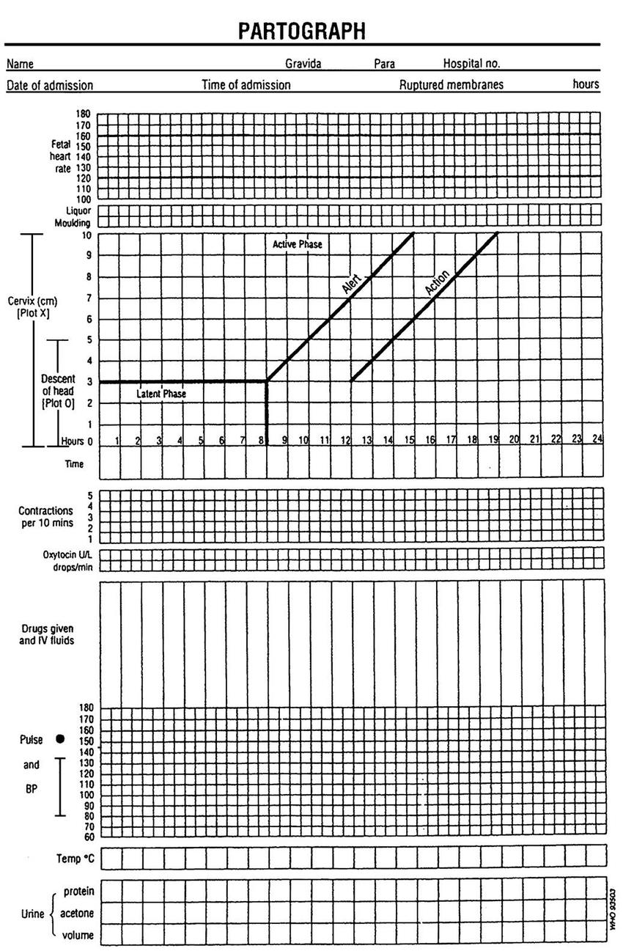
√

Slide 15
Prolonged latent phase
Management :
Intervention in the form of artificial rupture of membranes (ARM) or oxytocin infusion will increase the likelihood of poor progress later in the labour and the need for caesarean birth.
It is best managed away from the labour suite with simple analgesics, mobilization and reassurance.
The partogram should not be commenced until the latent phase of labour is complete.

Slide 16
Active-phase Disorders
In active labor, disorders are divided into:
Slow progress—a protraction disorder : protraction defined as <1 cm/hour cervical dilation for a minimum of 4 hours (Women at ≥6 cm dilation, dilating less than approximately 1 /hour).
Arrest disorder: defined as no dilation for ≥2 hours.
Active-phase arrest is best reserved for women with cervical dilation ≥6 cm and ruptured membranes who
Fail to progress despite 4 hours of adequate uterine activity
Despite at least 6 hours of oxytocin administration but inadequate contractions.
Primary arrest : It is the term used to describe poor progress in the active first stage of labour (<2 cm cervical dilatation/4 hours).More common in primiparous women.
Secondary arrest :It occurs when progress in the active first stage is initially good but then slows or stops altogether .Typically seen after 7 cm dilatation

Slide 17
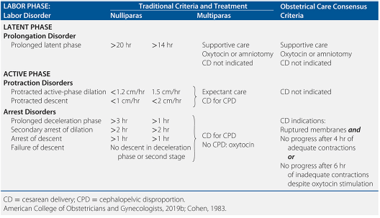
Abnormal Labor Patterns, Diagnostic Criteria, and Methods of Treatment

Slide 18
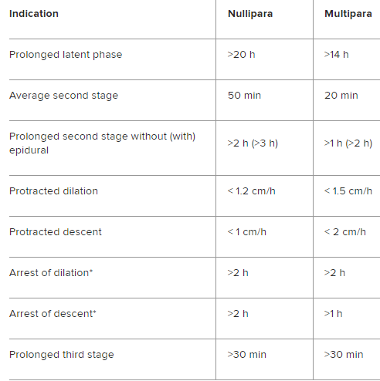
Abnormal labour

Slide 19
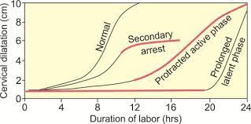
Pattern of normal & abnormal progress in partogram

Slide 20
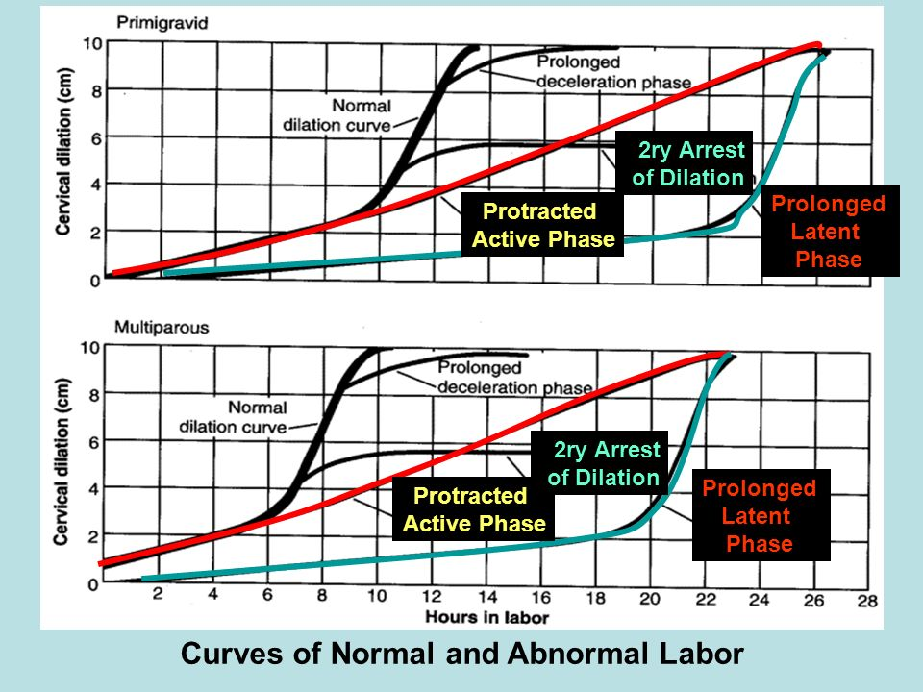
Pattern of normal & abnormal progress in partogram

Slide 21
Causes of abnormal labour
Power
Uterine monitoring can be either external or internal.
External monitoring by CTG : provides information only about the frequency & duration of contractions
Internal monitoring: performed by threading a pressure catheter through the cervix, around the presenting part of the fetus, and into the uterine cavity. This method provides information on both the strength and frequency of contractions

Slide 22
Monitoring of uterine contraction
External monitoring
Internal monitoring

Slide 23
Causes of abnormal labour
Power
An adequate contraction = 3- 4 contraction / 10 minutes , each one last for 40 seconds and above & of sufficient strength to make cervical changes ( effacement & dilatation).
Uterine contractions can be measured in Montevideo units: To calculate Montevideo units, total vertical displacement above resting uterine tone is multiplied by contraction frequency over a 10- minute period (an intrauterine pressure catheter must be used).
Contractions are considered adequate when they reach 200 Montevideo units or greater.
Inadequate uterine contractions, defined as <180 Montevideo units

Slide 24
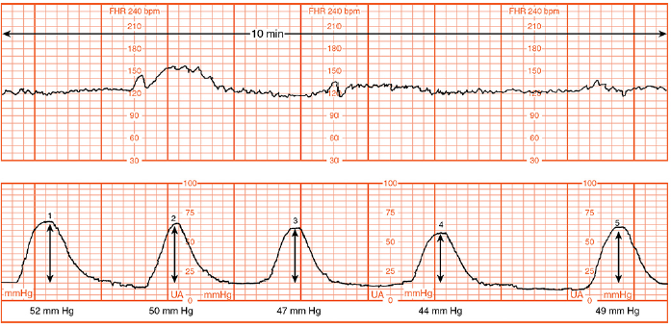
Monitoring of uterine contraction
Montevideo units are calculated by subtracting the baseline uterine pressure from the peak contraction pressure for each contraction in a 10-minute window and adding the pressures generated by each contraction. In the example shown, there were five contractions producing pressure changes of 52, 50, 47, 44, and 49 mm Hg, respectively. The sum of these five contractions is 242Montevideo units.

Slide 25
Causes of abnormal labour
Power
In abnormal labor, two physiological types of uterine dysfunction may develop:
Hypotonic uterine dysfunction: is the more common type; basal tone is normal and uterine contractions have a normal gradient pattern (synchronous). However, pressure during a contraction is insufficient to dilate the cervix
Hypertonic uterine dysfunction or incoordinate uterine dysfunction: either basal tone is elevated appreciably or the pressure gradient is distorted.

Slide 26
Causes of abnormal labour
Passages
The bony pelvis may cause delay in the progress of labour (CPD).
Abnormalities of the uterus and cervix can also delay labour:
Unsuspected fibroids in the lower uterine segment can prevent descent of the fetal head.
Cervical dystocia: a term used to describe a noncompliant cervix that effaces but fails to dilate because of severe scarring or rigidity, usually as a result of previous cervical surgery such as a cone biopsy.

Slide 27
Causes of abnormal labour
Passages
Any contraction of the pelvic diameters that diminishes pelvic capacity can create dystocia
Diminished pelvic capacity :
Pelvic inlet
Midpelvis
Pelvic outlet
May be contracted solely or in combination

Slide 28
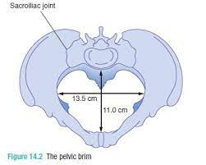
Normal vs. Contracted pelvic inlet
The antero-posterior (obstetrical conjugate) : diameter of the inlet is <10 cm
The transverse diameter of the inlet is <12 cm
Diagonal conjugate <11.5 (obstetrical conjugate + 1.5cm)
Normal inlet
Contracted inlet

Slide 29
Contracted Midpelvis
This finding is more common than inlet contraction.
It frequently causes transverse arrest of the fetal head, which potentially can lead to a difficult mid- forceps operation or to cesarean delivery.
Average midpelvis measurements are as follows:
Transverse, or interischial spinous = 10.5 cm
Antero-posterior, from the lower border of the symphysis pubis to the junction of S4 and S5= 11.5 cm
Posterior sagittal, from the midpoint of the interspinous line to the same point on the sacrum =5 cm.
Contraction sometimes can be inferred if the spines are prominent, the pelvic sidewalls converge, or the sacro-sciatic notch is narrow.

Slide 30
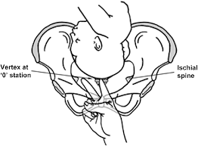
Contracted Midpelvis

Slide 31
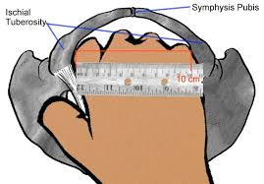
Contracted Outlet
This finding usually is defined as an interischial tuberous diameter of 8 cm or less

Slide 32
Causes of abnormal labour
Passenger
A firm application of the fetal presenting part on to the cervix is necessary for good progress in labour.
Face presentation may apply poorly to the cervix and the resulting progress in labour may be poor, although vaginal birth is still possible.
Brow presentation is associated with the mento-vertical: Diameter presenting, which is simply too large to fit through the bony pelvis unless flexion occurs or there is hyperextension to a face presentation
Shoulder presentations

Slide 33
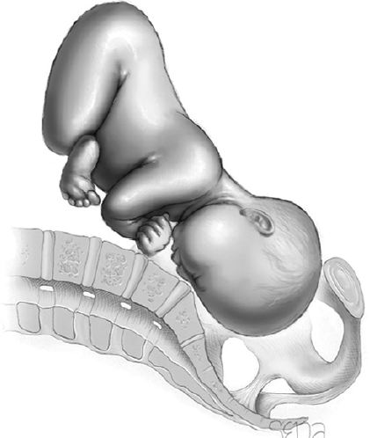
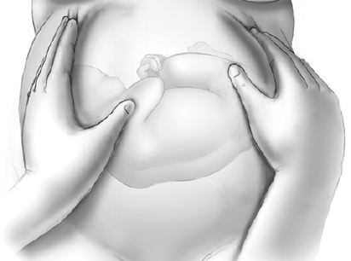
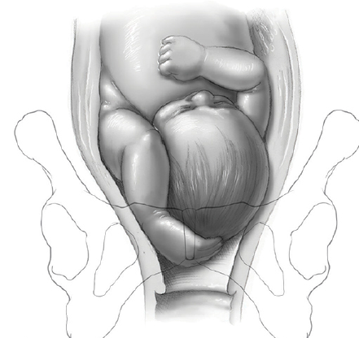
Passenger Big baby or Malpresentation
Brow Presentation
Face Presentation
Transverse Lie (Shoulder presentation)
Compound Presentation

Slide 34
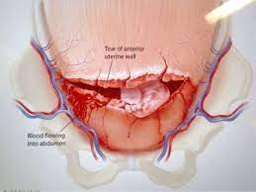
Complications with dystocia
Maternal complications:
Uterine rupture
Postpartum hemorrhage from atony is increased with prolonged and augmented labors.
Genital tract tears : cervical & vaginal tears
Maternal infection, either intrapartum chorioamnionitis or postpartum endomyometritis
Fistula formation due to pressure necrosis follows a very prolonged first or more common second stage ; It present several days after delivery as vesicovaginal, vesicocervical, or rectovaginal fistulas
Lower-extremity nerve injury in the mother can follow prolonged second-stage labor. Fortunately, deficits are mainly sensory, and most resolve within 6 months of delivery.

Slide 35
Complications with dystocia
Fetal complications:
Fetal distress & low APGAR score
Birth asphyxia
Peripartum fetal sepsis rises with longer labors.
Caput succedaneum and molding develop commonly.
Mechanical trauma such as nerve injury, fractures, and cephalohematoma also are more frequent

Slide 36
Management of abnormal labour
Poor progress in the first stage of labour
Poor progress in the first stage of labour has been defined as cervical dilatation of less than 2 cm in 4 hours
Usually associated with failure of descent and rotation of the fetal head.
It may relate to the powers, the passages or the passenger

Slide 37
Dysfunctional uterine activity (‘powers’)
This is the most common cause of poor progress in labour.
It is more common in primigravida & in older women
Characterized by weak, irregular and infrequent contractions.
The assessment of uterine contractions is carried out by:
Most commonly by clinical examination
External uterine tocography (CTG) .
Intrauterine pressure catheters :these do give a more accurate measurement of the pressure being generated by the contractions, but they are invasive and rarely necessary.

Slide 38
Dysfunctional uterine activity (‘powers’)
A frequency of four to five contractions per 10 minutes is usually considered ideal.
Fewer contractions than this does not necessarily mean progress will be slow, but more frequent examinations may be indicated to detect poor progress earlier.
When poor progress in labour is suspected, it is usual to recommend repeat vaginal examination at 2 hours rather than 4 hours after the last.
If delay is confirmed, the woman should be offered ARM
If there is still poor progress in a further 2 hours, use oxytocin infusion to augment the contractions.
The infusion is commenced at a slow rate initially and increased every 30 minutes, according to a well-defined protocol.

Slide 39
Dysfunctional uterine activity (‘powers’)
Continuous EFM is necessary as excessively frequent strong contractions may cause fetal compromise
Women should be offered an epidural before oxytocin is started, along with ongoing hydration and emotional support.
If progress fails to occur despite 4–6 hours of augmentation with oxytocin, a caesarean section will usually be recommended.

Slide 40
Poor progress in the second stage of labour
Birth of the baby is expected to take place within 3 hours of the start of the active second stage (pushing) in nulliparous women and 2 hours in parous women.
Delay is diagnosed if delivery is not imminent after 2 hours of pushing in a nulliparous labour and 1 hour for a parous woman.
The causes of second stage delay can again be classified as abnormalities of the
Powers
passages
passenger.

Slide 41
Causes of poor progress in 2nd stage of labour
Power : Secondary dysfunctional uterine activity (‘powers’) is a common cause of second stage delay, and may be exacerbated by epidural analgesia.
Passages: Delay in the second stage can occur because of a narrow mid pelvis (android pelvis), which prevents internal rotation of the fetal head (‘passages’). This may result in arrest of descent of the fetal head at the level of the ischial spines in the transverse position(deep transverse arrest ). It may also occur due to a resistant perineum, particularly in a nulliparous woman.
Passenger : Delay can also occur because of a persistent OP position of the fetal head (‘passenger’). In this situation, the head will either have to undergo a long rotation to OA or be delivered in the OP position (i.e. face to pubes).

Slide 42
Management
Continued pushing with encouragement.
Regular reviews of progress and fetal wellbeing.
Oxytocin to augment contractions.
Episiotomy for a resistant perineum.
Instrumental vaginal birth (forceps or ventouse/vacuum).
Caesarean section.

Slide 43
Cephalopelvic disproportion (‘passages’ & ‘passenger’)
CPD implies anatomical disproportion between the fetal head and maternal pelvis.
It can be due to a large head, small pelvis or a combination of the two relative to each other:
1. Pelvic causes:
Small pelvis in women of short stature (<1.60 m) & large baby
previous fracture of the pelvis
Maternal metabolic bone disease
2. Fetal causes of CPD: fetal anomaly
Obstructive hydrocephalus
Fetal thyroid & neck tumours may cause extension at the fetal neck

Slide 44
Relative CPD
It is more common and occurs with malposition of the fetal head.
The OP position is associated with deflexion of the fetal head and presents a larger skull diameter to the maternal pelvis .
Oxytocin can be given carefully to a primigravida with mild to moderate CPD as long as the CTG is normal.
Relative disproportion may be overcome if the malposition is corrected (i.e. rotation to a flexed OA position).
Oxytocin must never be used in a multiparous woman where CPD is suspected.

Slide 45
Findings suggestive of CPD
Fetal head is not engaged.
Progress is slow or arrests despite efficient uterine contractions.
Vaginal examination shows severe moulding and caput formation.
Head is poorly applied to the cervix.
Haematuria.

Slide 46
Precipitous labor and delivery
Precipitous labor and delivery is extremely rapid labor and delivery.
Its complete delivery of the fetus in <3 ( 4) hours
Causes :
It may result from an abnormally low resistance of the soft parts of the birth canal.
abnormally strong uterine and abdominal contractions
rarely from a lack of pain with contractions to cue advanced labor.

Slide 47
Precipitous labor and delivery
Complications:
Maternal complications
Complications are few if the cervix is effaced appreciably and compliant, if the vagina has been stretched previously, and if the perineum is relaxed.
Genital tract tears : cervical, vaginal , perineal tears
Frequently followed by uterine atony
Amnionic-fluid embolism
Fetal complications: fetal hypoxia, intracranial injury, low Apgar scores & during unattended birth, the newborn may fall to the floor and be injured.

Slide 48
Precipitous labor and delivery
Managements:
Oxytocin administration should be stopped.
Analgesia is unlikely to modify these forceful contractions significantly.
The use of tocolytic agents such as magnesium sulfate or terbutaline is unproven in these circumstances.
A single, intramuscular 250- ug terbutaline dose may be reasonable in an attempt to resolve a non-reassuring fetal heart rate pattern. This is balanced against the risk of associated uterine atony if delivery is imminent.

Slide 49
Case Scenario
25 years old G4P3A0 woman, admitted to labour room . She had labour like pain with history of watery vaginal of 1 hr. before admission
Interpret the Partogram below
What was the indication for emergency CS?

Slide 50
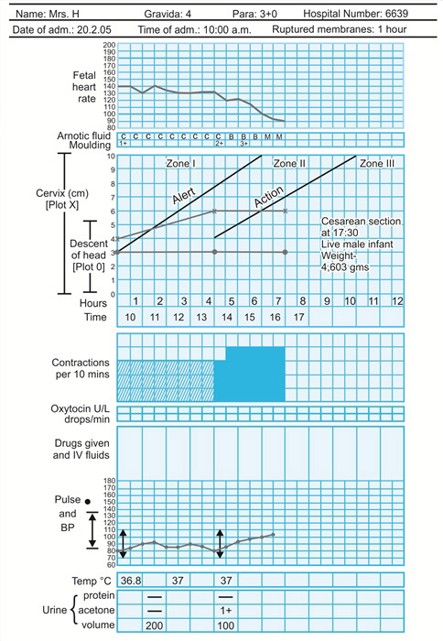

Slide 51
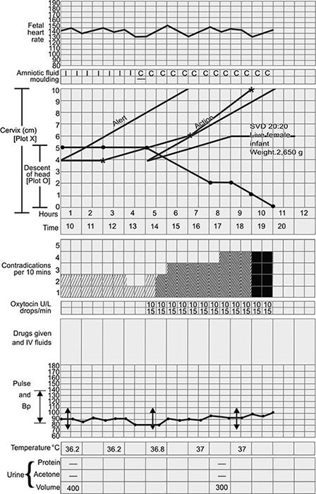
QUIZ = Read this Partograph

Slide 52
Case scenario with Partograph
Home-work
Nora Ahmad is 25 years old primigravida woman. Admitted to labour room at 1:00 am complaining from labour pain & clear watery vaginal discharge before one hour before admission
PR 82bpm
BP 110/70
Temp 37 C
Base line FHR 140bpm
Abd. examination: LL , Cephalic , 3/5 palpable per abdomen; she has 3 contraction / 10 min of moderate strength lasting 40sec/min
PV examination : 4 cm cervical dilation , RM with clear colour & 70% effaced cervix , -1 to 0 station Adequate pelvis

Slide 54
Thank you

