Slide 1
Intrapartum Evaluation of Fetal Wellbeing
Prof.Fadia J Alizzi
Consultant OBG & Reproductive Medicine
Al-Mustansiriyia Medical College / Al-Yarmouk Teaching Hospital

Slide 2
Objectives
At the end of this lecture the students will be able to:
How to assess fetal wellbeing during labour ( intrapartum).
What are the test available to assess fetal wellbeing
Identify fetus at risk in utero
Interpret data of CTG & Fetal blood sampling ( Measurement of pH)
Management of fetal distress during labour
Case based discussion & slide test

Slide 3
Physiology of the fetal heart rate
Fetal heart rate is predominantly a product of the intricate balance of the autonomic nervous system, with influences extrinsic to the heart, such as humoral factors.
Mechanisms of fetal heart rate control include the SA & AV nodes and cardiac conducting tissue.
The fetal parasympathetic nervous system reaches maturity by term, whereas sympathetic nervous system development is still ongoing. As pregnancy progresses, this maturation of vagal innervation manifests as a decline in resting fetal heart rate and an increase in baseline variability.
Other factors networked in fetal heart rate control include baroreceptors, chemoreceptors, circulating catecholamines, and other endocrine factors.

Slide 4
Relationship of fetal hypoxia & acidosis to FHR
Correct functioning of the fetomaternal circulation, uteroplacental exchange, and fetal factors have implications for fetal oxygenation. Any inadequacy of these factors may cause fetal compromise, which will be exaggerated in labour, where with every uterine contraction a period of reduced uteroplacental perfusion ensues.
The fetus is conditioned to thrive in a mildly hypoxic and acidic environment. Oxygen exchange between the mother and the fetus is facilitated by this relative gradient.
The insufficient supply of oxygen leads to changes in fetal pH- which then subsequently results in signs of distress in the fetus.
One such sign is a change in fetal heart rate, caused by the impact of hypoxia and acidosis on the control mechanisms

Slide 5
Relationship of fetal hypoxia & acidosis to FHR
Correct functioning of the fetomaternal circulation, uteroplacental exchange, and fetal factors have implications for fetal oxygenation. Any inadequacy of these factors may cause fetal compromise, which will be exaggerated in labour, where with every uterine contraction a period of reduced uteroplacental perfusion ensues.
The fetus is conditioned to thrive in a mildly hypoxic and acidic environment. Oxygen exchange between the mother and the fetus is facilitated by this relative gradient.
The insufficient supply of oxygen leads to changes in fetal pH- which then subsequently results in signs of distress in the fetus.
One such sign is a change in fetal heart rate, caused by the impact of hypoxia and acidosis on the control mechanisms
Hypoxia
Metabolic
acidosis

Slide 6
Intrapartum Evaluation of fetal wellbeing
Methods of evaluation of fetal wellbeing during labour ( Intrapartum assessment ) are :
Fetal movement ?
CTG
Transabdominal ultrasound scanning
Internal monitoring :
Fetal scalp electrode & Fetal electrocardiography
Fetal blood pH & /or Lactate
Fetal Pulse Oximetry
Promising

Slide 7
Antenatal vs. Intrapartum Methods of Evaluation
Methods of evaluation of fetal wellbeing during pregnancy ( Antenatal assessment ) are :
1. Maternal perception of fetal movement ( Subjective test)
2. Cardiotocography (CTG) :
Non Stress Test (NST)
Contraction Stress Test
3. Ultrasound : Biophysical Profile (BPP)
4. Doppler US:
Maternal :Uterine artery Doppler US
Fetal Doppler US : ( Umbilical artery & Middle cerebral artery )
Methods of evaluation of fetal wellbeing during labour ( Intrapartum assessment ) are :
Fetal movement ?
CTG
Transabdominal ultrasound scanning
Internal monitoring :
Fetal scalp electrode & Fetal electrocardiography
Fetal blood pH &/or lactate
Fetal Pulse Oximetry

Slide 8
Cardiotocography (CTG)
Cardiotocography (CTG) is used during pregnancy & labour to monitor fetal heart rate and uterine contractions.
An abnormal CTG during labour may indicate the need for fetal blood sampling and potential intervention.
It shows 2 important things:
Contraction of the uterus
Fetal heart rate trace

Slide 9
How to read a CTG
To interpret a CTG you need a structured method of assessing its various characteristics.
The most popular structure can be remembered using the acronym DR C BRAVADO:
DR: Define risk
C: Contractions
BRa: Baseline rate
V: Variability
A: Accelerations
D: Decelerations
O: Overall impression
DR C BRAVADO

Slide 10
DR: Define risk
DR C BRAVADO
Every woman attend labour wither she is high or low risk should have admission CTG:
Low risk intrapartum fetal monitoring : use of intermittent auscultation (pinard or hand-held Doppler) at specific intervals ( One minute monitoring / 30minute ) , with the aim of escalating monitoring if concerning features arise
High risk intrapartum fetal monitoring: use intermittent (One minute monitoring / 15 minute) or continuous CTG monitoring according to the woman condition .

Slide 11
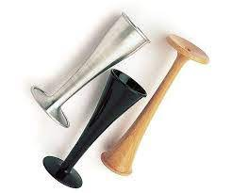
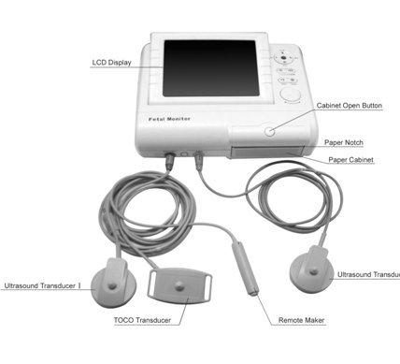
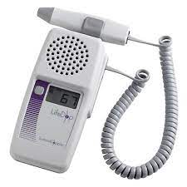
Methods of assessment

Slide 12
DR: Define risk
DR C BRAVADO
High risk groups
Maternal medical illness
Gestational diabetes
Hypertension
Asthma
Obstetric complications
Multiple gestation
Post-date gestation
Previous cesarean section
Intrauterine growth restriction
Premature rupture of membranes
Congenital malformations
Oxytocin induction/augmentation of labour
Pre-eclampsia
Other risk factors
Absence of prenatal care
Smoking
Drug abuse

Slide 13
Contractions
DR C BRAVADO
Record the number of contractions present in a 10 minute period.
Each big square on the CTG chart is equal to one minute, so look at how many contractions occurred within 10 big squares.
Individual contractions are seen as peaks (bell-shaped) on the part of the CTG monitoring uterine activity.
Assess contractions for the following:
Number
Duration: How long do the contractions last?
Intensity: How strong are the contractions (assessed using palpation)?

Slide 14
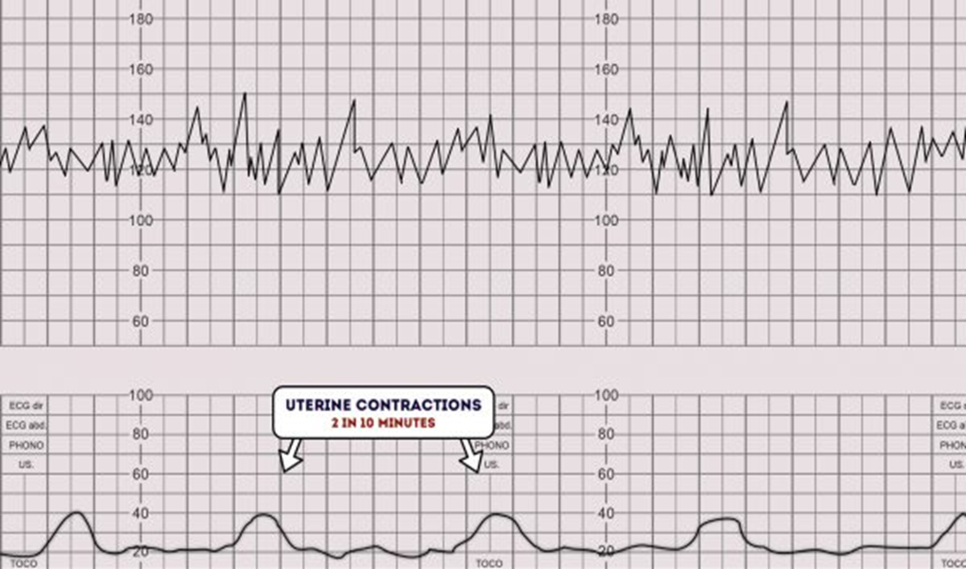
Contractions

Slide 15
Contractions
DR C BRAVADO
Tachysystole : represents an excessive frequency of contractions and is defined as the occurrence of more than five contractions in 10 minutes, in two successive 10-minute periods or averaged over a 30-minute period.
Hyperstimulation : refers to an exaggerated response to uterine stimulants, presenting as an increase in frequency of the contractions, strength of uterine contraction, increased uterine tone between contractions and/or prolonged contractions for over 2 minutes.
These may lead to fetal heart rate changes. Therefore, any increased uterine activity (frequency, duration or strength) associated with CTG changes should be considered as uterine hyperstimulation.

Slide 16
Baseline rate
DR C BRAVADO
Components of the fetal heart rate trace that are assessed by CTG include:
Baseline rate
FH variability
Accelerations
Decelerations

Slide 17
Baseline rate
DR C BRAVADO
1. Baseline heart rate:
The baseline must be for a minimum of 2 minutes in a ten-minute segment. Otherwise, the baseline for that segment is described as indeterminate
Normal baseline: 110 and 160 bpm (110-150 bpm)
Tachycardia: a baseline value
above 160 bpm lasting more than 10 minutes.
Bradycardia: a baseline value below
110 bpm lasting more than 10 minutes.

Slide 18
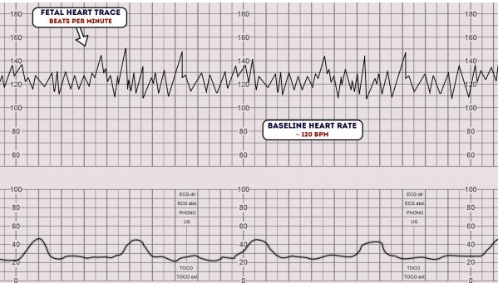
Fetal heart rate

Slide 19
Fetal heart rate
Causes of feta tachycardia
Fetal hypoxia
Chorioaminitis
Hyperthyroidism
Fetal or maternal anaemia
Fetal tachyarrhythmia
Causes of feta bradycardia
Prolonged cord compression
Cord prolapse
Epidural and spinal anaesthesia
Maternal seizures

Slide 20
Variability
DR C BRAVADO
Baseline variability refers to the variation of fetal heart rate from one beat to the next.
Variability occurs as a result of the interaction between the nervous system, chemoreceptors, baroreceptors and cardiac responsiveness. It is, therefore, a good indicator of how healthy a fetus is at that particular moment in time.
Normal variability indicates an intact neurological system in the fetus.
Normal variability is between 5-25 bpm.
Persistent absence of variability is considered a pre-terminal feature and carries with it high probability of a hypoxic fetus

Slide 21
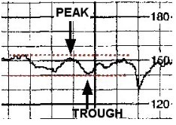
Variability
DR C BRAVADO
To calculate variability you need to assess how much the peaks & troughs of the heart rate deviate from the baseline rate (in bpm) or average bandwidth amplitude of the signal in 1-minute segments
The tracing shows an amplitude range of ~ 10 BPM (moderate variability ).

Slide 22
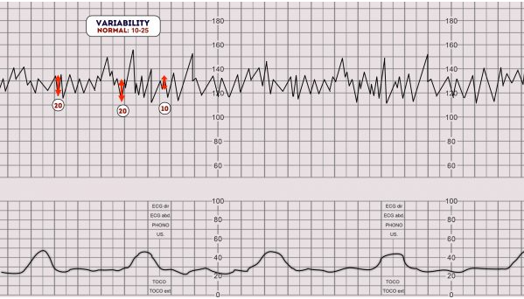
Variability
DR C BRAVADO

Slide 23
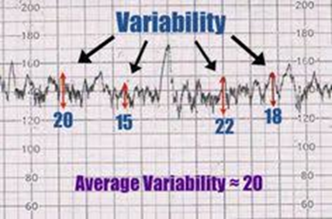
Variability
Grades of fluctuation are based on amplitude range (peak to trough):
Absent variability = Amplitude range undetectable
Minimal ( reduced) = < 5 BPM
Moderate ( normal ) = 6 to 25 BPM
Marked (Increased) (Saltatory pattern) = > 25 BPM
Normal or not ?

Slide 24
Variability
DR C BRAVADO
Variability can be categorized as either reassuring, non-reassuring or abnormal.
1. Reassuring: 5 – 25 bpm
2. Non-reassuring:
less than 5 bpm for between 30-50 minutes
more than 25 bpm for 15-25 minutes
3. Abnormal:
less than 5 bpm for more than 50 minutes
more than 25 bpm for more than 25 minutes
sinusoidal

Slide 25
Variability
DR C BRAVADO
Reduced variability can be caused by any of the following:
Fetal sleeping: this should last no longer than 40 minutes (this is the most common cause)
Fetal acidosis (due to hypoxia): more likely if late decelerations are also present
Fetal tachycardia
Drugs: opiates, benzodiazepines, methyldopa and magnesium sulphate
Prematurity: variability is reduced at earlier gestation (<28 weeks)
Congenital heart abnormalities

Slide 26
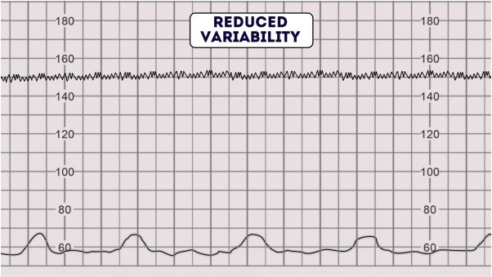
Variability
DR C BRAVADO

Slide 27
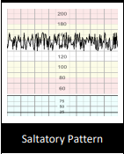
Variability:
DR C BRAVADO
Increased Variability (Saltatory Pattern): a bandwidth value exceeding 25 bpm lasting more than 30 minutes. A Saltatory pattern for more than 30 minutes may indicate hypoxia even without decelerations

Slide 28
Variability:
DR C BRAVADO
A sinusoidal CTG pattern is rare, however, if present it is very concerning as it is associated with high rates of fetal morbidity and mortality.
A sinusoidal CTG pattern has the following characteristics:
A smooth, regular, wave-like pattern
Frequency of around 2-5 cycles a minute
amplitude of 5−15 bpm,
Stable baseline rate around 120-160bpm
No beat to beat variability
A sinusoidal pattern usually indicates one or more of the following:
Severe fetal hypoxia
Severe fetal anaemia
Fetal/maternal haemorrhage

Slide 29
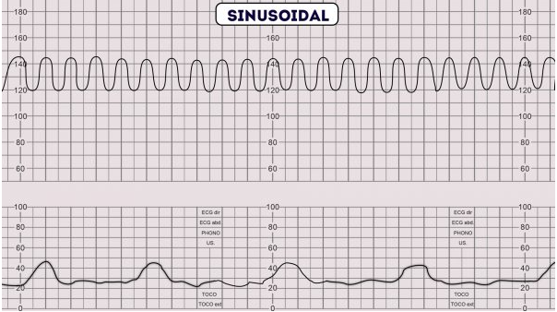
Variability:
DR C BRAVADO

Slide 30
Accelerations
DR C BRAVADO
Accelerations: Abrupt& transient (onset to peak in less than 30 seconds) increases in FHR above the baseline, of more than 15 bpm in amplitude, and lasting more than 15 seconds. these tend to be associated with fetal activity
Although their presence is reassuring, absence in an otherwise normal CTG should not cause concern.

Slide 31
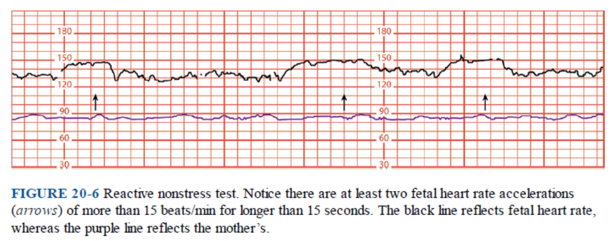
Accelerations
DR C BRAVADO

Slide 32
Decelerations:
DR C BRAVADO
Decreases in the FHR below the baseline, of more than 15 bpm in amplitude, and lasting more than 15 seconds.
Decelerations are considered to be a reflex response to protect the myocardial workload when a fetus is exposed to a hypoxic or a mechanical stress, to help maintain an aerobic metabolism within the myocardium
Types of Deceleration:
Early Decelerations
Late deceleration
Variable deceleration
Prolonged decelerations

Slide 33
Early Decelerations
Early Decelerations: Decelerations that are gradual (onset to nadir ≥30s) that return to the baseline. The nadir occurs with the peak of a contraction.
Early decelerations are uniform in shape and mirror the contraction.
They are likely to be seen in the late first stage and second stage of labour and are believed to be caused by fetal head compression. they should recover with relaxation of the uterus
They do not indicate fetal hypoxia/acidosis.

Slide 34
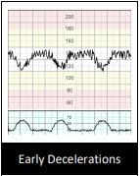
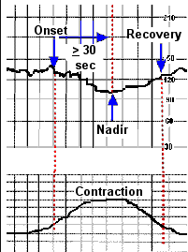
Early Decelerations

Slide 35
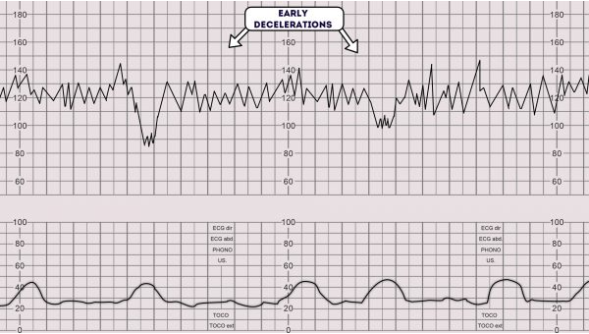
Early Decelerations

Slide 36
Variable Decelerations
Abrupt decrease in FHR of > 15 beats per minute measured from the most recently determined baseline rate. The deceleration lasts > 15 seconds and less than 2 minutes . This a rapid drop (onset to nadir in <30s) is followed by a rapid recovery to the baseline
The morphology of one deceleration may vary from the next, thus giving rise to its nomenclature. They can be further classified as uncomplicated (<60 s) or complicated (>60 s).
Variable decelerations constitute the majority of decelerations during labour & occurs with umbilical cord compression & are considered a sign of fetal hypoxia
They are seldom associated with fetal hypoxia/acidosis, unless they evolve to exhibit a U-shaped component( rather than V) with a reduced or an increased variability within the deceleration , and/or their individual duration exceeds 3 minutes .

Slide 37
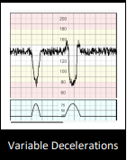
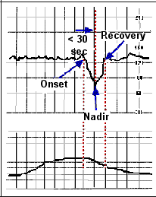
Variable Decelerations

Slide 38
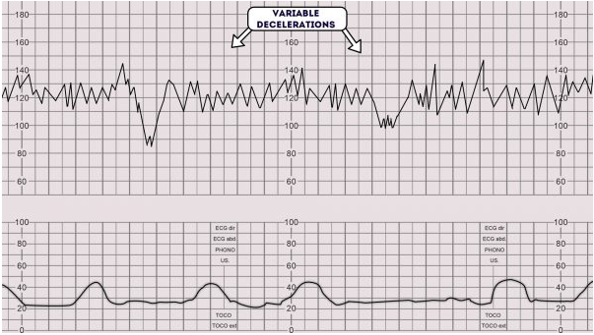
Variable Decelerations

Slide 39
Late Decelerations
When contractions are adequately monitored, late decelerations start more than 30 seconds after the onset of a contraction, have a nadir after the acme, and a return to the baseline after the end of the contraction ( i.e. gradual onset and/or a gradual return to the baseline
This type of deceleration indicates there is insufficient blood flow to the uterus and placenta. As a result, blood flow to the fetus is significantly reduced causing fetal hypoxia and acidosis.
Causes of reduced uteroplacental blood flow include:1
Maternal hypotension
Pre-eclampsia
Uterine hyperstimulation

Slide 40
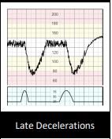
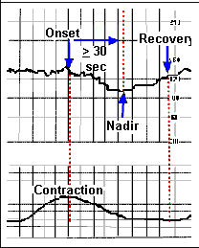
Late Decelerations

Slide 41
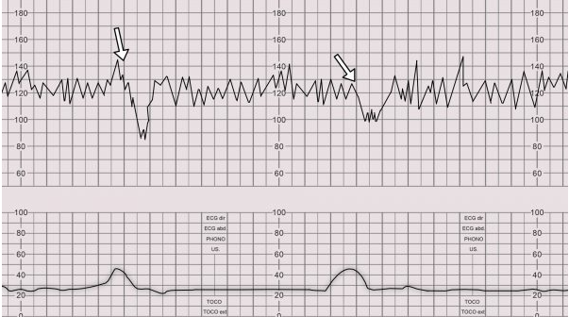
Late Decelerations

Slide 42
Prolonged Deceleration
Prolonged decelerations: Decelerations lasting more than 3 minutes.
It indicate hypoxemia & usually prompts urgent delivery of the fetus
Decelerations exceeding 5 minutes, with FHR maintained at less than 80 bpm and reduced variability within the deceleration, are frequently associated with acute fetal hypoxia/acidosis and require urgent intervention.

Slide 43
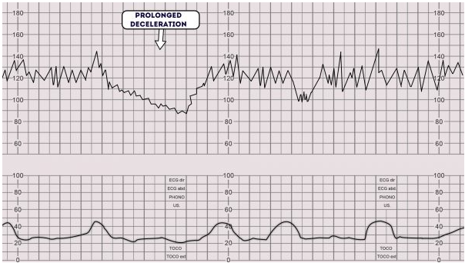
Prolonged Deceleration

Slide 44
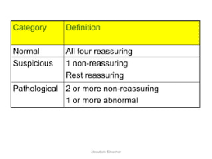
Over all assessment
DR C BRAVADO
Once you have assessed all aspects of the CTG you need to determine your overall impression.
The overall impression can be described as either reassuring, suspicious or abnormal

Slide 45
Classification of CTGs
DR C BRAVADO
1. Normal antenatal CTG trace (reassuring) : All features are
Baseline fetal heart rate (FHR) is between 110-160 bpm
Variability of FHR is between 5-25 bpm
Decelerations are absent or early
Accelerations x2 within 20 minutes
2. Suspicious (non-reassuring ) : 1 non-reassuring feature & 2 reassuring features
3. Abnormal (Pathological): 1 abnormal feature OR 2 non-reassuring features
Need for urgent intervention: Acute bradycardia, or a single prolonged deceleration for 3 minutes or more

Slide 46
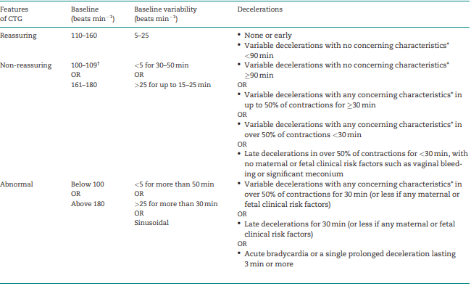
Classification of CTGs
NICE - GUIDELINE

Slide 47
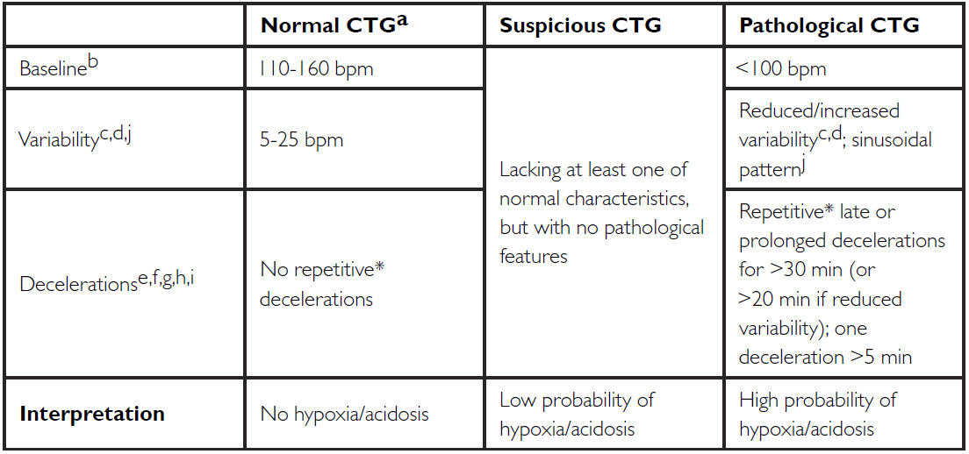
Classification of CTGs
FIGO GUIDELINE

Slide 48
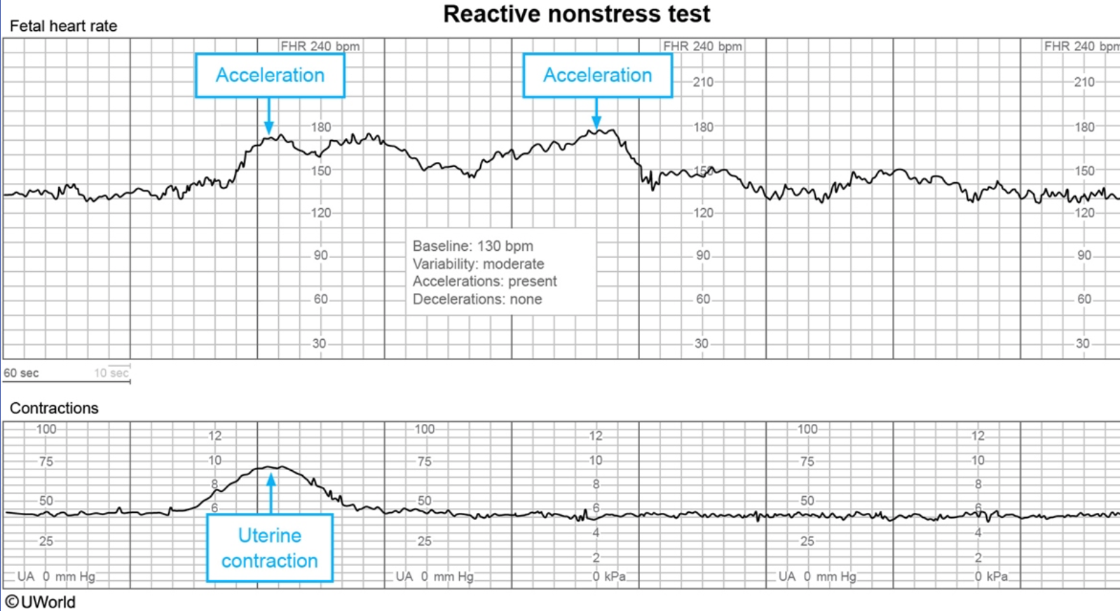
Over all assessment
DR C BRAVADO

Slide 49
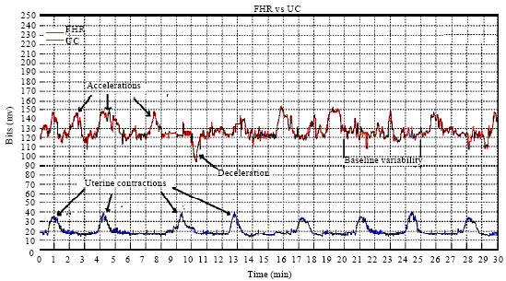
Over all assessment
DR C BRAVADO

Slide 50
Over all assessment
DR C BRAVADO

Slide 51
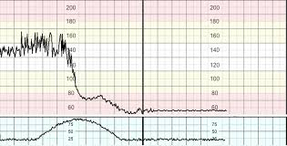
Over all assessment
DR C BRAVADO

Slide 52
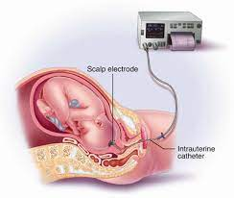
Fetal scalp electrode & Fetal electrocardiography
The fetal scalp electrode is placed on the fetal scalp.
The fetal heart rate is derived from the R-R interval of the fetal electrocardiographic (f ECG) trace picked up by the device.
The placement can be difficult, carries the risk of infection, and has the potential to become displaced
It may allow more reliable recording of
fetal heart rate where trans-abdominal
detection has been substandard.

Slide 53
Fetal blood sampling
This involves taking fetal scalp blood into capillary tubes for analysis of fetal pH &/ or lactate.
Digital fetal scalp simulation during the procedure can cause fetal heart accelerations, which may be a reassuring sign
Indication: when uncertainty exists regarding the significance of CTG findings ; To avoid unnecessary operative deliveries
Limitations of this procedure : Acquiring samples
Can be time consuming
Can be difficult
May fail to yield an adequate sample for analysis ( failure rate 10-20%)
It can be falsely reassuring in the presence of chorioamnionitis or thick meconium

Slide 54
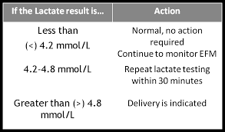
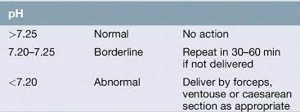
Fetal blood sampling
An alternative method in FBS is measuring lactate.
It requires a smaller amount of blood
The analysis is done within minutes
failure rate is low (1.3–1.7%)
theoretically only metabolic academia is detected

Slide 55
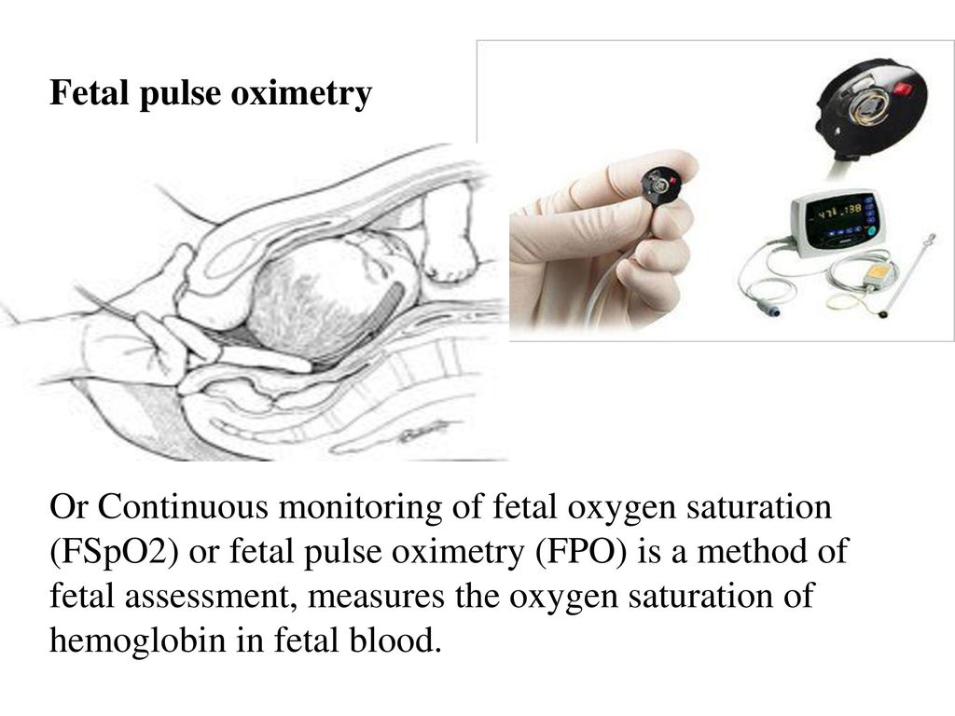
Fetal Pulse Oximetry
Continuous fetal pulse oximetry is an emerging technology for intrapartum fetal assessment. With transcervical placement of an infrared sensor against the fetal cheek, it is possible to monitor fetal oxygen saturation continuously and thus, potentially, identify the truly compromised fetus more accurately.

Slide 56
Transabdominal ultrasound scanning
It is now commonplace in the setting of fetal distress in labour.
Advantages :
visualize fetal cardiac activity rapidly
Helps in decision making before and during an operative vaginal delivery (e.g. forceps, vacuum cup). The use of ultrasound to correctly identify fetal head position and orientation can help select an appropriate and safe technique for assisted delivery.

Slide 57
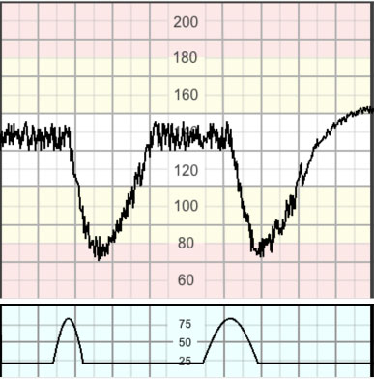
23 years old woman at her 39 weeks of gestation; she is in the labour room in active labour on Oxytocin infusion. She has more than five contractions /10 minutes; her CTG shows below What is you’re your management :
Management:
Stop Oxytocin
Administer O2 by tight face mask
Avoiding supine position
Starting IV fluids
Administering tocolytics if hyperstimulation persists (terbutaline 0.25 mg SC )
Expediting delivery if hypoxia persists despite tocolysis (AVD / CS)
Late deceleration

Slide 58
23 years old woman at her 39 weeks of gestation; she is in the labour room in active labour on Oxytocin infusion. She has more than five contractions /10 minutes; her CTG shows below What is you’re your management :
Mode of delivery depends on Fetal scalp pH:
If late decelerations persist for more than 30 minutes despite the above maneuvers, fetal scalp pH is indicated. Scalp pH > 7.25 is reassuring, pH 7.2-7.25 may be repeated in 30 minutes.
Deliver for pH < 7.2 or minimal baseline variability with late or prolonged decelerations and inability to obtain fetal scalp pH
Late deceleration

Slide 59
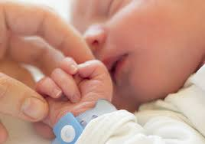
Aim is to have a healthy baby
Thank you

Slide 60
Not a Handicap one
Please help me

