Slide 1
Antenatal Evaluation of Fetal Wellbeing
Prof.Fadia J Alizzi
Consultant OBG & Reproductive Medicine
Al-Mustansiriyia Medical College / Al-Yarmouk Teaching Hospital

Slide 2
Background
The primary goal of antenatal evaluation is to identify fetuses at risk for intrauterine injury and death so that intervention and timely delivery can prevent progression to stillbirth.
Ideally, antenatal tests would decrease fetal death without putting large numbers of healthy fetuses at risk for premature delivery and the associated morbidity and mortality.
Despite widespread use of many tests, limited evidence exists to demonstrate effectiveness at improving perinatal outcomes with application of these tests

Slide 3
Objectives
At the end of this lecture the students will be able to:
How to assess fetal wellbeing during pregnancy.
What are the test available to assess fetal wellbeing
Identify fetus at risk in utero
Interpret data of CTG, US & Doppler
Case based discussion & slide test

Slide 4
Antenatal Methods of Evaluation
Methods of evaluation of fetal wellbeing during pregnancy ( Antenatal assessment ) are :
1. Maternal perception of fetal movement ( Subjective test)
2. Cardiotocography (CTG) :
Non Stress Test (NST)
Contraction Stress Test
3. Ultrasound : Biophysical Profile (BPP)
4. Doppler US:
Maternal :Uterine artery Doppler US
Fetal Doppler US : ( Umbilical artery & Middle cerebral artery )

Slide 5
Maternal Assessment of Fetal Activity
Fetal movement counting: is an evaluation method which pregnant women quantify the fetal movements they feel .
Its easy method , cheep & can be repeated freely
Decreased FM alerts the mother of a deteriorating fetal condition. She can then bring this to the attention of health care providers who can evaluate further and intervene as needed to prevent fetal death.
Kicks Count: The most commonly recommended counting technique is the count-to-ten method where the woman is instructed each day to count and record the time she feels the 10th fetal movement.

Slide 6
Maternal Assessment of Fetal Activity
Factors influence the perception of movement, including:
Worsening fetal condition
Maternal activity & position
Maternal obesity
Medications
Gestational age
Placental location
Amniotic fluid volume.
Fetal movement also varies normally over the course of the day, peaking between (9pm - 1 am) when maternal glucose levels are falling.

Slide 7
Cardiotocography (CTG)
Cardiotocography (CTG) is used during pregnancy to monitor fetal heart rate and uterine contractions.
It is most commonly used in the third trimester and its purpose is to monitor fetal well-being and allow early detection of fetal distress.
An abnormal CTG may indicate the need for further investigations and potential intervention.
It shows 2 important things:
Contraction of the uterus
Fetal heart rate trace

Slide 8
Cardiotocography (CTG)
The device used in CTG is known as a cardiotocograph.
It involves the placement of two transducers onto the abdomen of a pregnant woman.
One transducer records the fetal heart rate using ultrasound
2nd transducer monitors the contractions of the uterus by measuring the tension of the maternal abdominal wall (providing an indirect indication of intrauterine pressure).

Slide 9
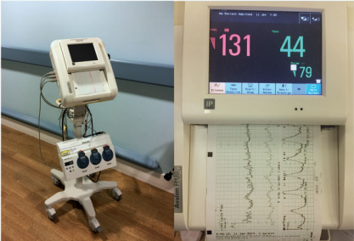
Cardiotocography (CTG)

Slide 10
Cardiotocography (CTG):
1. Contractions
Record the number of contractions present in a 10 minute period.
Each big square on the CTG chart is equal to one minute, so look at how many contractions occurred within 10 big squares.
Individual contractions are seen as peaks on the part of the CTG monitoring uterine activity.
Assess contractions for the following:
Number
Duration: How long do the contractions last?
Intensity: How strong are the contractions (assessed using palpation)?

Slide 11
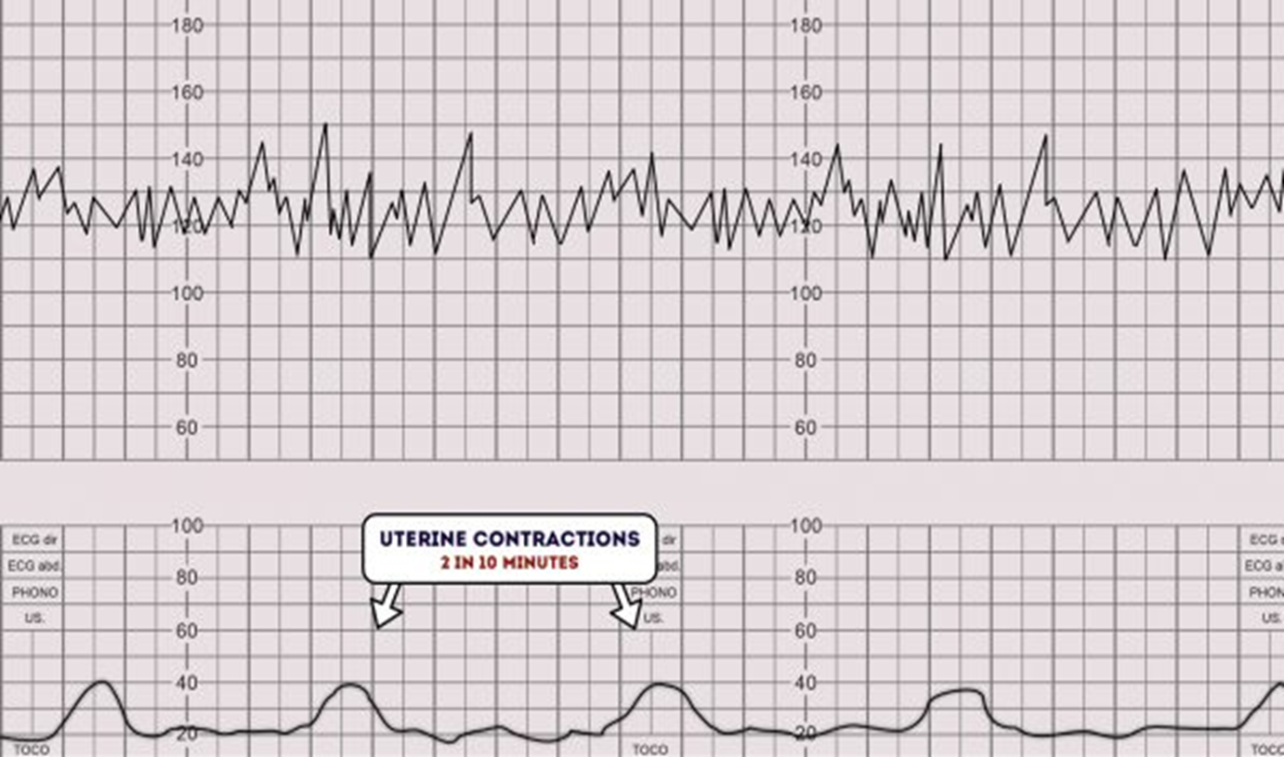
Contractions

Slide 12
Cardiotocography (CTG):
2. Fetal heart rate trace
Components of the fetal heart rate trace that are assessed by CTG include:
Baseline rate
FH variability
Accelerations
Decelerations
The relationship between fetal heart rate and fetal movements (NST) or the relationship between fetal heart rate & timing of uterine contractions (contraction stress test CST)

Slide 13
Non Stress Test (NST)
The relationship between fetal heart rate and fetal movements
Method used to test fetal wellbeing before the onset of labor
The NST recognizes the coupling of fetal neurological status to cardiovascular reflex responses. It is one of the factors that tends to disappear earliest during progressive fetal compromise
It is a non-invasive test used for the surveillance of high-risk pregnancies when the fetus is judged clinically to be at risk for hypoxemia or increased risk of death.
It is used from 32 weeks of gestation to term to evaluate fetal health
A reactive NST is highly predictive of low risk for fetal mortality in the subsequent 72 to 96 hours and is still predictive at 1 week.

Slide 14
Non Stress Test (NST)
The NST involves 20 minutes of monitoring the FHR while assessing the number, amplitude, and duration of accelerations that usually correlate with fetal movement.
Normal ( Reactive) NST :A reactive test is one in which there are at least two accelerations that peak 15 beats/min above the baseline and last for at least 15 seconds before returning to baseline “15 × 15.”
If non reactive , the test should be extended for at least 40 minutes to account for the fetus sleep cycle, and vibroacoustic stimulation can be used to stimulate fetal movement
A nonreactive NST is one that lacks sufficient fetal heart rate accelerations over 40 minutes.
If still not reactive further test is recommended ( CST/BPP)

Slide 15
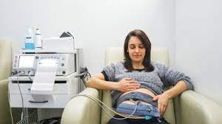
Non Stress Test (NST)/positioning
Sitting position
Left – lateral position

Slide 16
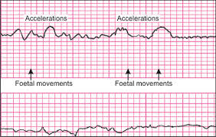
Non Stress Test (NST)

Slide 17
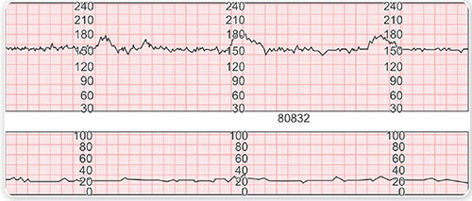
Non Stress Test (NST)

Slide 18
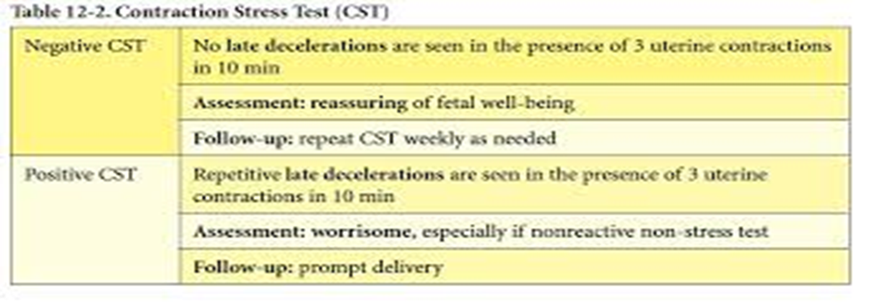
Contraction Stress Test ( CST)
Limited place in clinical practice because it may be risky
Contraction is induced either by oxytocin or nipple stimulation
A positive‌ CST is one in which late decelerations occur with more than 50% of contractions

Slide 19
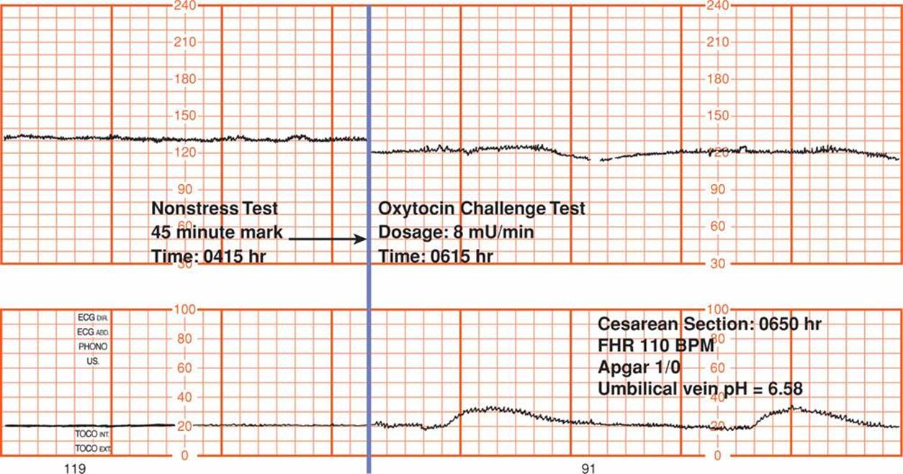
Contraction Stress Test ( CST)

Slide 20
US - Biophysical Profile (BPP)
The BPP is a composite test that collects 5 indicators of fetal well-being by real-time ultra-sonography, including:
Fetal heart rate reactivity (non-stress test NST)
Breathing movements
Gross body movements
Muscular tone
Quantitative estimation of amniotic fluid volume.
Two points are awarded for each parameter when present, and zero (0) when absent after 30 minutes of ultrasound observation.

Slide 21
Biophysical Profile (BPP)
The BPP is more time consuming and requires more technical skill to perform than the NST.
The false-negative rate of the BPP was calculated in a study with 19,221 high-risk pregnancies and was very low at 0.07%
factors affect BPP parameters including:
Hypoxemia
Gestational age
Administration of steroids
Administration of magnesium sulfate
Labor
Excessive transducer pressure on maternal abdomen

Slide 22
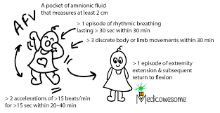
Biophysical Profile (BPP)

Slide 23
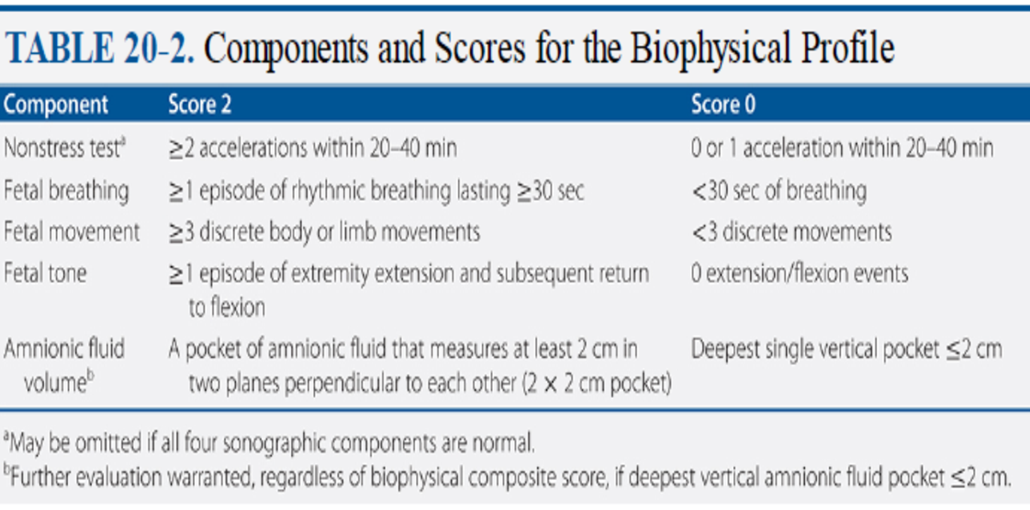
Biophysical Profile (BPP)
How to interpret BPP
Reassure if the score is 8 or 10
A score of 6 raises concern, and the BPP should be repeated in 6 to 24 hours, especially in fetuses over 32 weeks' gestation. If the score does not improve, delivery should be considered, depending on gestational age and individual circumstances.
Scores of 4 or below are worrisome, and delivery should be considered, again depending on gestational age and clinical context

Slide 24
Modified BPP
This test consists of a combination of a NST as well as an ultrasound to estimate the amniotic fluid index (AFI).
Typically further evaluation is performed when an abnormal result is obtained with the modified BPP.
Modified BPP requires less time and expertise to perform and has a similarly reassuring false-negative rate and potentially a lower false-positive rate than the NST
A normal test has a reactive NST and an AFI greater than 5 (and less than 25).
An abnormal test lacks one or both of these findings.

Slide 25
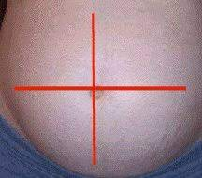
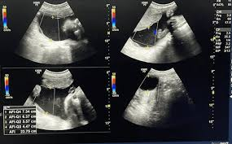
Amniotic fluid index (AFI).
The AFI is the sum of the maximum vertical pockets of umbilical-cord-free amniotic fluid in each of the four quadrants of the uterus
A normal amniotic fluid index is 5 cm t- 25 cm using the standard assessment method.
Less than 5 cm is considered Oligohydramnios
greater than 25 cm is considered Polyhydramnios

Slide 26
Fetal Doppler Ultrasound
Fetal Doppler evaluation uses ultrasound to measure blood flow velocities in the fetal vessels.
Flow is most often quantified either by pulsatility index (PI) or resistant index (RI) . These indices reflect the downstream vascular resistance by quantifying the differences between the peak systolic and the end-diastolic velocity within blood vessels of interest in each cardiac cycle.
Three arteries are usually used to assess fetal wellbeing
Uterine artery
The umbilical
Middle cerebral artery

Slide 27
Uterine artery Doppler US
Doppler US of the uterine artery is used in
The first trimester to screen for early-onset preeclampsia and other adverse pregnancy outcomes such as fetal growth restriction
In the second and third trimesters, Doppler US of the uterine artery may be used in the evaluation of pregnancies complicated by fetal growth restriction.
Normal uterine artery doppler means low resistance with continuous diastolic flow; notching should disappear by 13 weeks
An abnormal waveform is characterized by increased resistance and persistence of a diastolic notch beyond the late second trimester

Slide 28
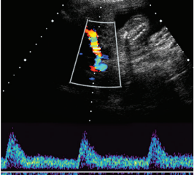
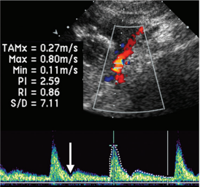
Uterine artery Doppler US
Normal
Abnormal

Slide 29
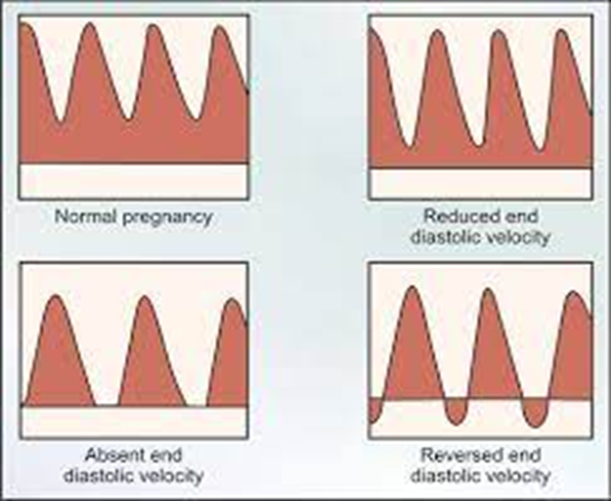
Umbilical artery Doppler US
Umbilical artery Doppler study should be included in the protocols for fetal monitoring in high-risk pregnancies thought to be at risk of placental insufficiency.
Normally growing fetuses have high-velocity diastolic flow.
Growth-restricted fetuses often have
Diminished end diastolic flow
Absent end diastolic flow
In severe cases reversed end diastolic flow.

Slide 30
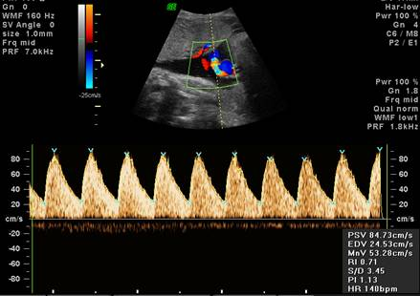
Umbilical artery Doppler US
Normal umbilical end diastolic flow

Slide 31
Umbilical artery Doppler US

Slide 32
Middle cerebral artery Doppler US
Fetal middle cerebral arterial (MCA) Doppler assessment is an important part of assessing fetal cardiovascular distress, fetal anaemia or fetal hypoxia.
It it is a very useful adjunct to umbilical artery Doppler assessment.
It is also used in the additional work up of:
intra-uterine growth restriction (IUGR)
twin to twin transfusion syndrome (TTTS)
Fetal anaemia
Rh – Isoimmunization

Slide 33
Middle cerebral artery Doppler US
In the normal situation the fetal MCA has a high resistance flow which means there is minimal antegrade flow in fetal diastole.
In pathological states this can turn into a low resistance flow mainly as a result of the fetal head sparing theory
Cerebroplacental ratio (CPR) : >1:1 is normal and <1:1 is abnormal
It can occasionally show end-diastolic flow reversal, a non-pathological finding that is usually due to increased intracranial pressure mostly by probe compression

Slide 34
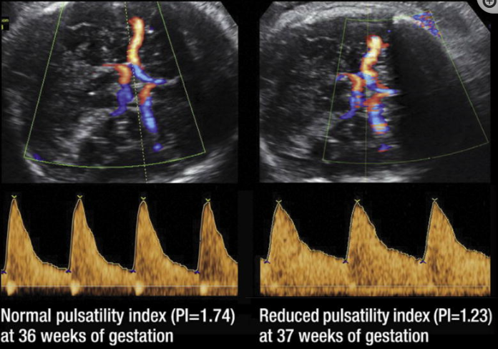
Middle cerebral artery Doppler US

Slide 35
Indications for Antenatal Testing
1. Maternal indications
Hypertensive disorders
Hyperthyroidism
Hemoglobinopathies
Cyanotic heart disease
Systemic lupus erythematosus
Chronic renal disease
Diabetes mellitus
Antiphospholipid syndrome
2. Pregnancy-related indications
Pregnancy-induced hypertension
Decreased fetal movement
Oligohydramnios
Polyhydramnios
Intrauterine growth restriction
Postterm pregnancy
Isoimmunization
Previous fetal demise
Multiple gestation
Gestational diabetes
Preterm premature rupture of membranes
Chronic abruption

Slide 36
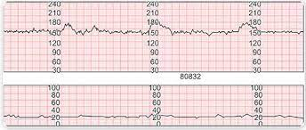
Slide – Exam
32 years old pregnant lady , she is pregnant at her 38 weeks of gestation ; she attend the clinic complaining from decrease fetal movement .
Is this NST reactive or not ?

Slide 37
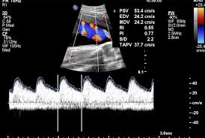
Slide – Exam
23 years old pregnant lady , she is pregnant at her 38 weeks of gestation ; she attend the clinic complaining from decrease fetal movement . US done for her & revealed small for gestational age
Is this umbilical artery Doppler normal or not ?

Slide 38
Aim is to have a healthy baby
Thank you

