Slide 1
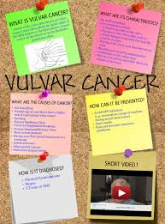

IVASIVE DISEASE OF THE VULVA
5th class 2022-2023
Assesstant Prof
Dr .dina akeel

Slide 2
Epidemiology and etiology
Vulval cancer is uncommon, with just 1,000 new diagnoses every year in the UK. It was previously a disease that exclusively affected older women, but recent years have witnessed rising incidence rates among young women in their 4th, 5th and 6th decades of life. Almost 90% of vulval cancers are squamous cell carcinomas, with malignant melanoma, basal cell carcinoma and adenocarcinoma of the Bartholin gland making up the remainder..

Slide 3
Epidemniology:
It is generally accepted that squamous cell carcinoma of the vulva is a disease of two separate etiologies: high-risk HPV associated cancers, which arise on a background of multifocal high-grade vulval intraepithelial neoplasia (VIN 3), often in younger women; and non-HPV-associated tumours, affecting older women and associated with the premalignant vulval condition lichen sclerosus

Slide 4
Aetiology
The etiology remains unknown. Oncogenic HPVs are, however, strongly associated with some vulva cancers and non-neoplastic epithelial disorders (lichen sclerosis) with others. Currently available data suggest two hypotheses. First, the classic de novo neoplasm in the elderly frequently seen in association with conditions such as lichen sclerosis (but no evidence of a direct causes yet)

Slide 5
. The second type is more often associated with VIN, particularly multifocal disease and disease elsewhere in the lower genital tract. This ‘infectious like’ type is presumed to be HPV linked

Slide 6
Clinical Features
Itching is the most common symptom, although some patients present with palpable or visible abnormalities of the vulva. Approximately half of the patients are asymptomatic.. Most lesions are elevated, but the color may be white, red, pink, gray, or brown. Approximately 20% of the lesions have a “warty” appearance, and the lesions are multicentric in about two-thirds of cases.

Slide 7
SPREED
Local invasion: into the underlying and surrounding tissues ; into the vagina, and the anus and deep may reach to the bone
vulval cancer spreads predominantly via lymphatic system(lymphatic embolization to regional lymph nodes)
The lymph drains from the vulva to the inguinal and femoral gland in the groin and then to the external iliac glands.

Slide 8
Drainage to both groins occurs from:
1-midline structure .
2-unilateral structures-( the perineum and the clitoris)
3-some contra lateral spread may take place from other parts of the vulva spread to the controlateral groin occurs in about 25% of those cases with ipsilateral positive groin nodes
Lesion less (than 1mm carry low risk of lymphatic invasion)
Hematogenous spread to distant sites like lung, liver, bone ,rarely occur in absence of lymphatic spread .

Slide 9
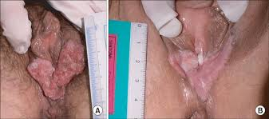
FIGO STAGING OF VULVAL CANCER (1995)
1a Confined to vulva and or perineum, 2cm or less maximum diameter, groin nodes not palpable
stromal invasion no greater than 1mm.
1b As for 1a but stromal invasion more than 1 mm
2 Confined to vulva and or perineum, more than 2 cm maximum diameter ,groin nodes not palpable
3 Extends beyond the vulva, vagina ,lower urethra or anus or unilateral groin node lymph node metastasis
4a Involves the mucosa of rectum or bladder upper urethra, or bilateral regional lymph node metastasis and /or pelvic bone
4b Any distant metastasis including pelvic lymph node

Slide 10
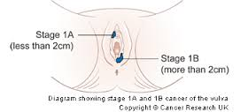
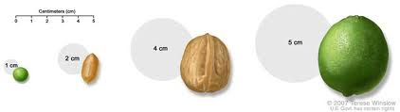
≤2cm

Slide 11
DAIGNOSIS AND ASSESSMENT
Patients with vulval cancer are managed by specialist gynecological oncology MDTs in cancer centers, where there is sufficient experience and expertise in the management of this relatively rare condition
A biopsy is needed to confirm the diagnosis.

Slide 12
Most patients do not require preoperative imaging, apart from a chest X-ray to confirm suitability for surgery. Imaging of the groins is unreliable in the detection of groin node metastases, although the high negative predictive power of an MRI scan of the groins can sometimes spare very unfit, elderly women from the morbidity associated with full groin lymphadenectomy.

Slide 13
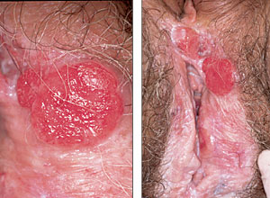

Slide 14
TREATMENT
Surgery is main stay of treatment
1-Radical vulvectomy and bilateral inguinofemoral lymphadenectomy with or without pelvic lymph adnectomy
Reduced the mortality from 80% to40% to control the lymphatic spread, remove large area of normal skin in the groins .
The purpose of this operation is to remove the vulva, its adjacent structures, a margin of normal tissue, and the inguinal lymph nodes from the anterior superior iliac spine to the abductor canal in the leg
Primary wound closure was rarely achieved.

Slide 15
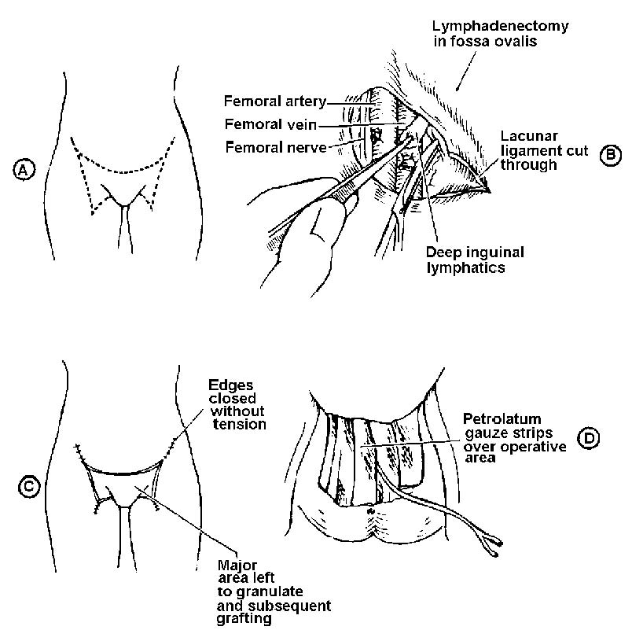

Slide 16
En-bloc excision
2-Modifications of this, en-bloc excision were devised to allow primary closure and reduce the considerable morbidity
But morbidity still high
Impaired psychosexual function was common

Slide 17
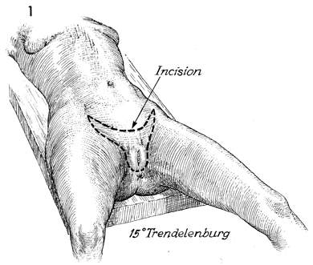

Slide 18
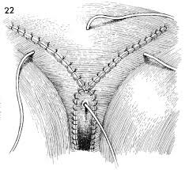

Slide 19
Three separate incisions
3-Then replaced by operation using three separate incisions(vulval and groin incision) this greatly reduced the morbidity of surgery and decrease wound break down
(this depended on the principle that lymphatic metastases developed initially by embolization)

Slide 20
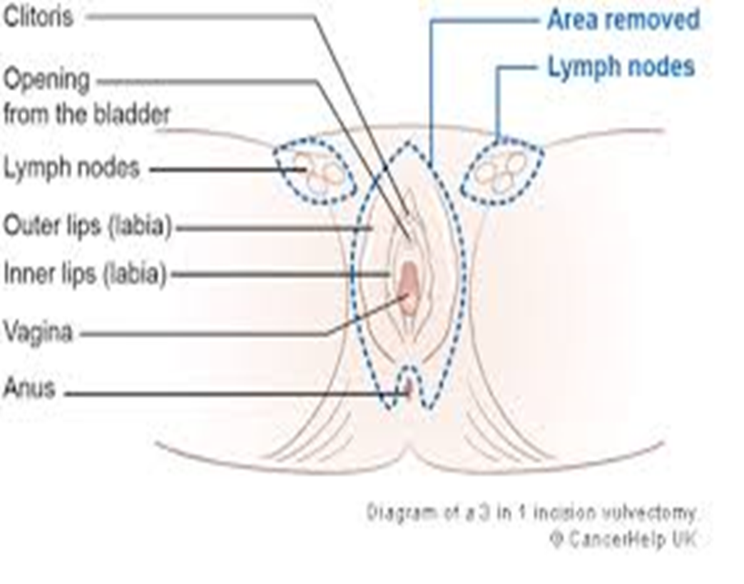
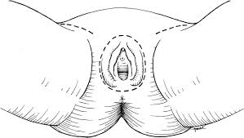

Slide 21
4-Sentinel node
4-Current research is focusing on identification of a sentinel node or nodes (by injecting blue dye around the primary tumour so lymph node identified and resected.
so full groin dissection could be avoided.

Slide 22
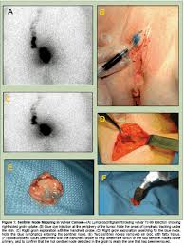
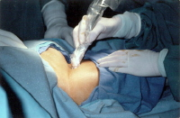

Slide 23
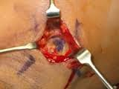
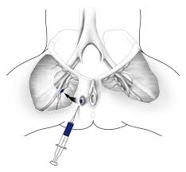

Slide 24
Treatment of early vulval cancer:
Patient with stage Ia do not need groin dissection.
wide local excision of tumor with free margin
No t need dissection

Slide 25
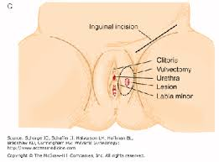
All patients require at least an ipsilateral inguinal –femoral lymphadenectomy EXCEPT STAGE 1a
1%
If -ve

Slide 26
-Patients with stage Ib and IIa(lesion confined to the vulva) wide and deep local excision (Rdical local excision)is effective as radical vulvectomy in preventing local recurrence.
Surgical margin should be at least 1cm free at histopathological examination ,with either unilateral or bilateral groin node dissection,if the ipsilateral side +ve then 25%the other side will positive and about a 1% risk for involvement of the controlateral nodes if the ipsilateral nodes are negative
10%chance of local recurrence with either treatment. (local or radical)

Slide 27
Patient with midline lesions invading less than 1mm from mid line ,bilateral groin dissection is not necessary ,Wide local excision,
if larger more than 1mm then bilateral groin dissection
In patients with midline lesions, less than 1 cm from the midline, an attempt should be made to identify sentinel nodes in each groin. If a sentinel lymph node is not found bilaterally, then a full inguinofemoral dissection is indicated on the side without the sentinel node.

Slide 28
COMPLICATIONS OF SURGERY:
1-Wound breakdown and infection with triple incision this become minor problem
2-Osteitis pubis rare need intensive prolonged antibiotic therapy
3-Thromboembolic disease :reduce by preoperative epidural analgesia to ensure good venous return with subcutaneous heparin begun 12-24 hours before the operation seems to reduce this risk
4- 2nd haemorrhage
5-Chronic leg oedema may be in 15%

Slide 29
6-Numbness and par aesthesia over the anterior thigh are common due to the division of small cutaneous branches of the femoral nerve
7- loss of body image and impaired sex function

Slide 30
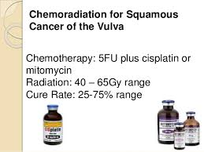
Pateints with advance vulval cancer:
If proximal urethra ,anus ,rectovaginal septum involved by the tumor ,preoperative radiation or chemoradiaiton should be used to shrink the primary tumor followed by more conservative surgery and avoid the stoma bilateral groin node dissection ,or at least removal of any large ,positive nodes is usually performed before radiation therapy.

Slide 31
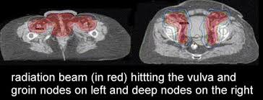
Radiotherapy:
1 - May have a place in reducing the size prior to surgery.
2-Radiotherapy used when more than one nodal micrometastaseis (≤5mm in diameter )one or more macrometastases, or evidence of extranodal spread should receive post operative radiation to both groins and to pelvis nodes .
3-In treatment of tumor involving midline structure clitoris ,anus…..

Slide 32
Prognosis:
Patients with positive nodes have a 5 years survival rate of about 50%
patients with -ve node 90% 5 years survival rate

Slide 33
THANK YOU

