Slide 1
Carbohydrate Metabolism
(Lec-8)
Dr. Walaa AL-Jedda
2022-2023

Slide 2
Gluconeogenesis
Gluconeogenesis : The formation of glucose or glycogen from non carbohydrate source.
Some tissues, such as the brain, red blood cells, kidney medulla, lens and cornea of the eye, tests and exercising muscle, require a continuous supply of glucose as a metabolic fuel.

Slide 3
Liver glycogen, can meet these needs for only ten to eighteen hours in the absence of dietary intake of carbohydrates.
During a prolonged fast, hepatic glycogen stores are depleted, and glucose is formed from precursors such as lactate, pyruvate, glycerol and
α - ketoacids.

Slide 4

During an overnight fast, approximately (90%) of gluconeogenesis occurs in the liver, with the kidneys providing (10%) of the newly synthesized glucose molecules
However, during prolonged fasting, the kidneys become major glucose producing organs, contributing an estimated 40% of the total glucose production.

Slide 5
Biomedical importance of gluconeogenesis
1-Gluconeogenesis meets the requirements of glucose in the body when carbohydrates are not available in sufficient amounts from the diet.
Even in conditions, where fat is utilized for energy still certain "basal level" of glucose is required to meet the need for : glucose for special uses

Slide 6
- Source of energy for nervous tissues and erythrocytes,
- Required for maintaining level of intermediates of TCA cycle.
- Source of glyceride-glycerol-p required for adipose tissue.
- It is a precursor of milk sugar (lactose) for lactating mammary gland.
- It serves as only fuel for skeletal muscles in anaerobic conditions.

Slide 7
2- Gluconeogenesis mechanisms are required to clear the products of metabolism of other tissues from the blood, like:
-Lactic acid produced by muscles and erythrocytes.
-Glycerol which is continuously produced by adipose tissues by lipolysis of TG (triacyl glycerol).

Slide 8
Substrate for gluconeogensis
1-Glucogenic amino acids.
2- Glycerol
3- Lactate and Pyruvate
4- Propionic acid:

Slide 9
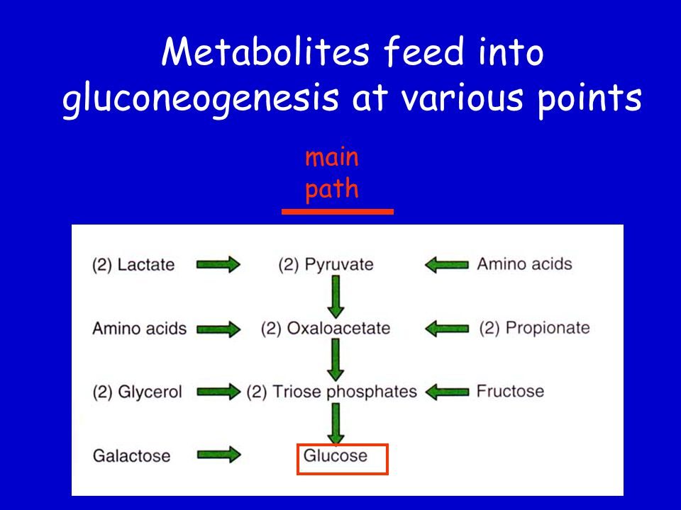

Slide 10
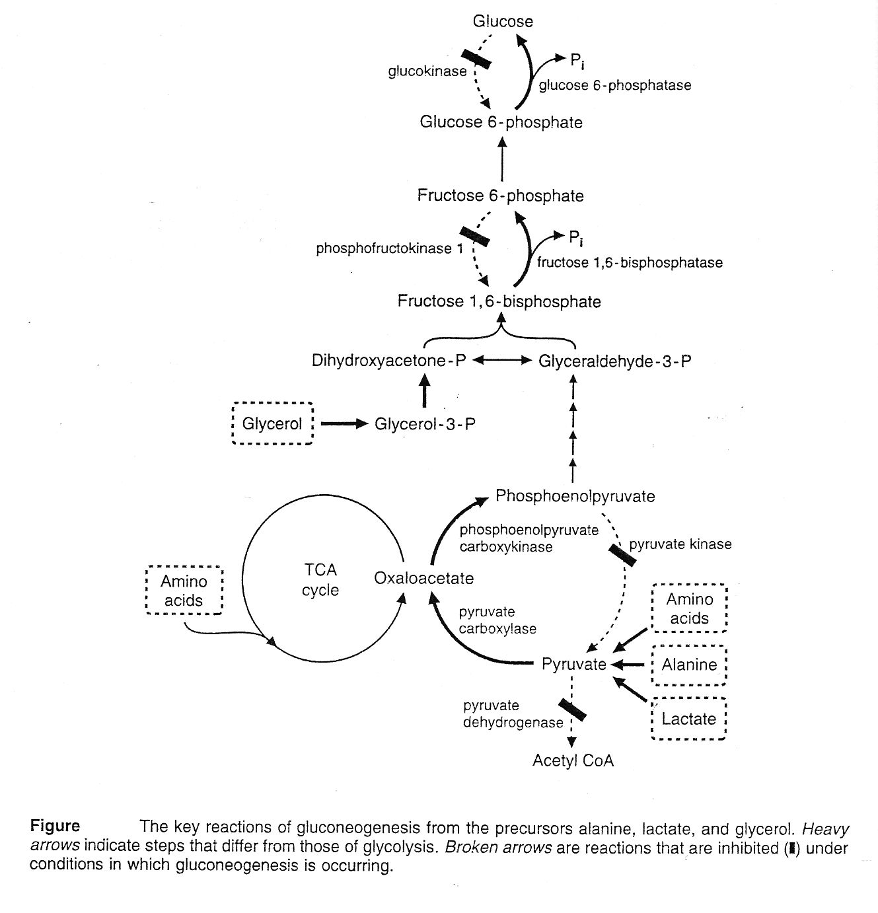
2.

Slide 11
Reactions of gluconeogenesis
1- Conversion of pyruvate to phosphoenol pyruvate (PEP) in the liver:
*Pyruvate which is produced from lactate, alanine and other amino acids, is first converted to oxaloacetate (OAA) by pyruvate carboxylase, a mitochondrial enzyme that requires biotin and ATP.
*OAA can not directly cross the inner mitochondrial membrane. Therefore, it converted to malate or to aspartate, which can cross the mitochondrial membrane and converted to OAA in the cytosol.

Slide 12
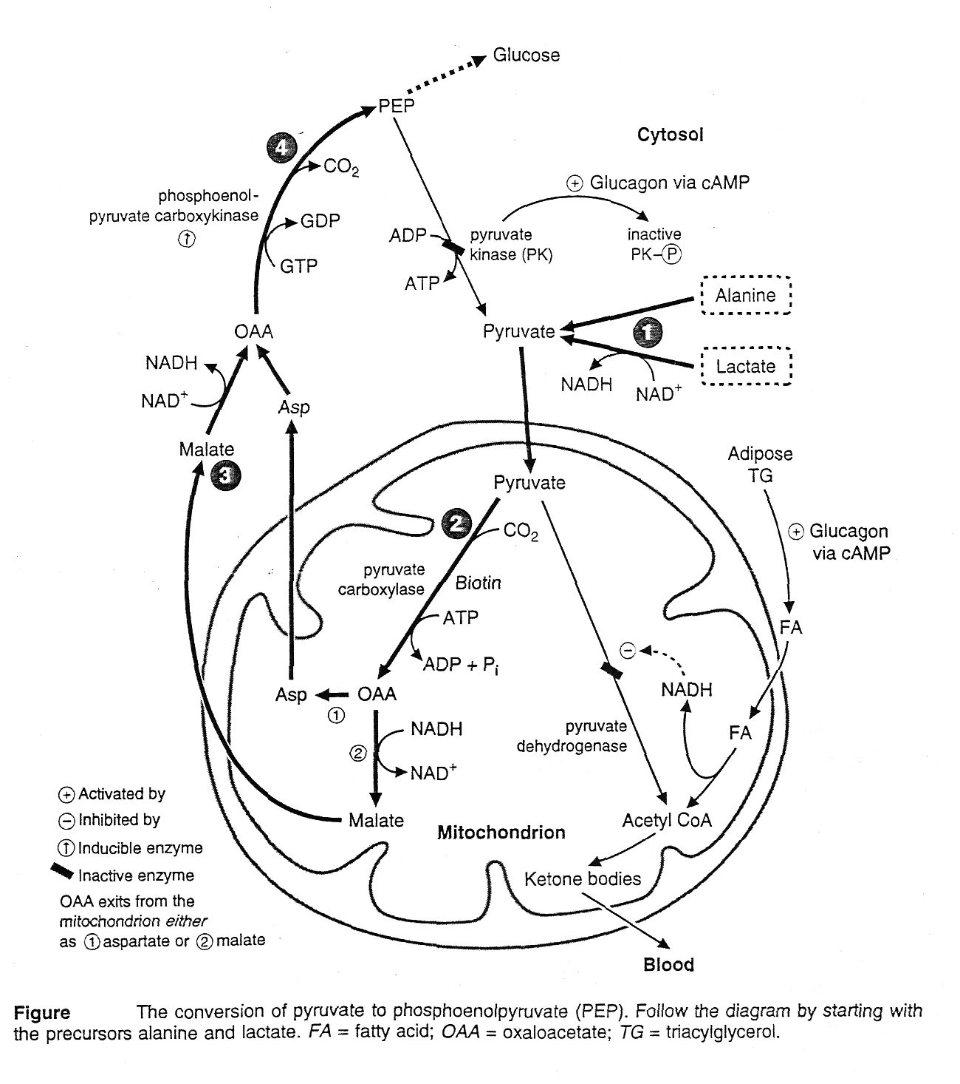
3.

Slide 13
OAA is decarboxylated by phosphoenol pyruvate carboxykinase, to form PEP. This reaction requires GTP.

Slide 14
2- Conversion of fructose 1, 6 – bisphosphate to fructose -6-phosphate
Fructose 1, 6 – bisphosphate is converted to fructose 6-p in a reaction that releases inorganic phosphate and is catalyzed by fructose 1, 6 phosphatase.

Slide 15
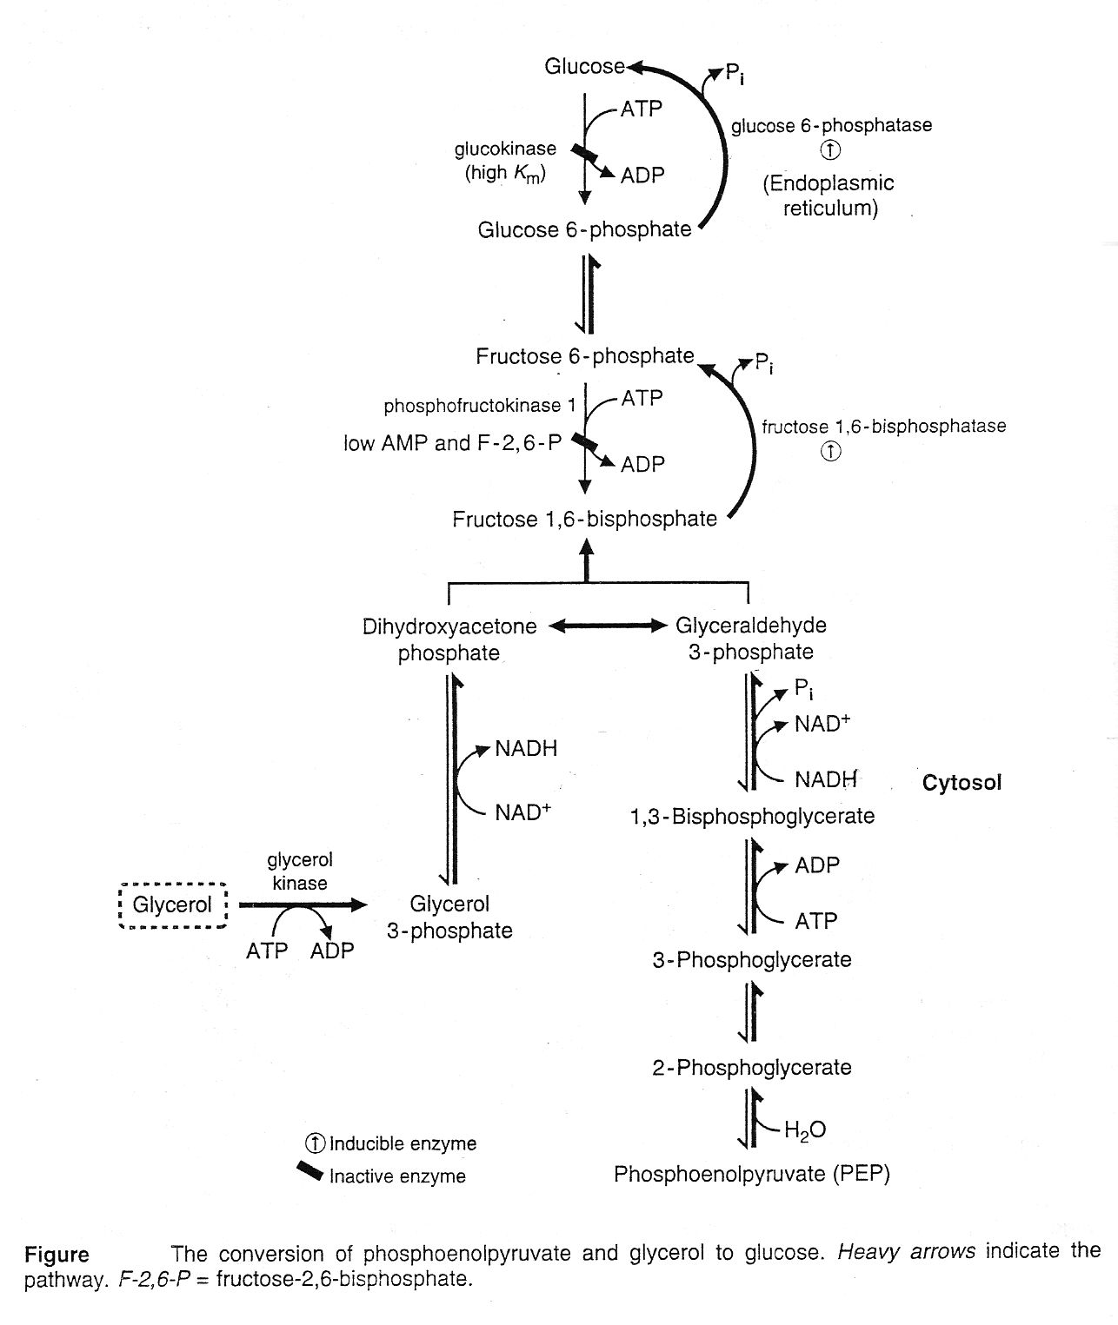
4.

Slide 16

3- Conversion of G-6-P to glucose.
A- G-6-p releases inorganic phosphate, which produces free glucose enters the blood.
The enzyme is glucose -6 phosphatase.
B- Glucose -6-phosphatase is involved both in gluconeogenesis and glycogenolysis.

Slide 17
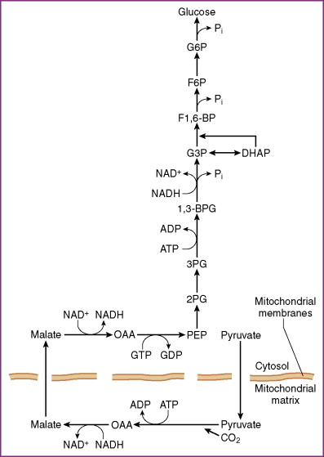

Slide 18
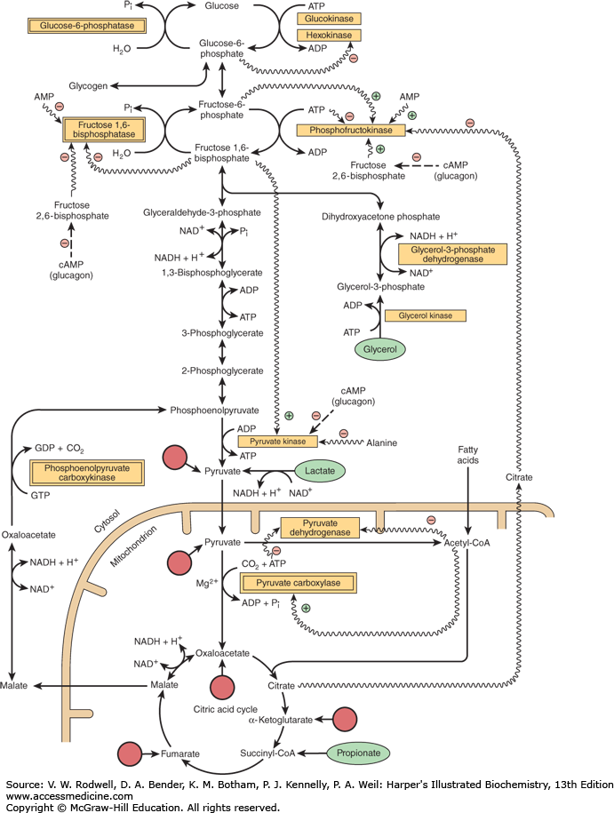

Slide 19
Regulation of Gluconeogenesis:
1- Hormones:
A - glucagon: under fasting condition, glucagon is elevated and stimulates gluconeogenesis.
B - glucocorticoides: they stimulate gluconeogenesis by increasing protein catabolism in the peripheral tissues and increasing hepatic uptake of amino acids.
C - insulin: reduces gluconeogenesis as it represses the phosphoenol - pyruvate carboxykinase (PEPCK) and glucose -6- phosphatase enzymes.

Slide 20
2- Substrate availability : The availability of gluconeogenic precursors, particularly glucogenis amino acids, significantly influences the rate of hepatic glucose synthesis.
3- Allosteric activation : hepatic pyruvate carboxylase by acetyl CoA occurs during fasting.
When acetyl CoA accumulates, this leads to activation of pyruvate carboxylase and inhibit pyruvate dehydrogenase so pyruvate is divert toward gluconeogenesis away from TCA cycle.

Slide 21
4- Allosteric inhibition by AMP.
Fructose 1,6–bisphosphatase is inhibited by AMP, but is activated by citrates.
5- High carbohydrate diet : which reduces gluconeogenesis by increasing the insulin/glucagon ratio and thereby reducing the activities of all four key regulating enzymes.

Slide 22
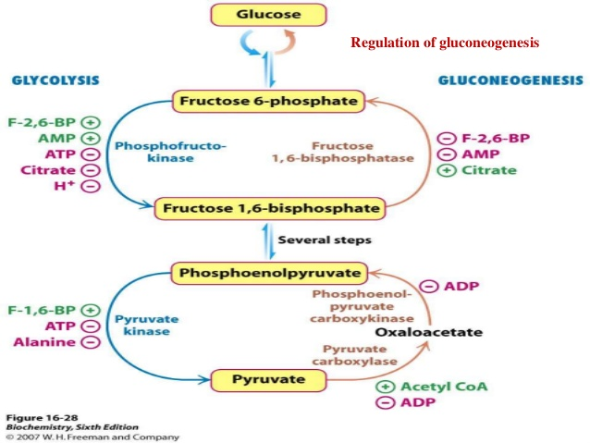

Slide 23
Energy requirements for gluconeogenesis
1- From pyruvate.
(6) moles of high energy phosphate (ATP) are required for synthesis of 1 mole of glucose.
2- From glycerol.
(2) moles of high energy phosphate (ATP) are required for synthesis of 1mole of glucose.

Slide 24
