Slide 1
Heart failure and pulmonary embolism
Dr MAZ

Slide 2
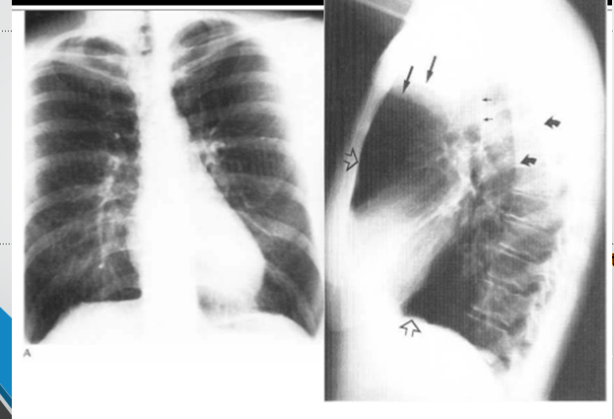
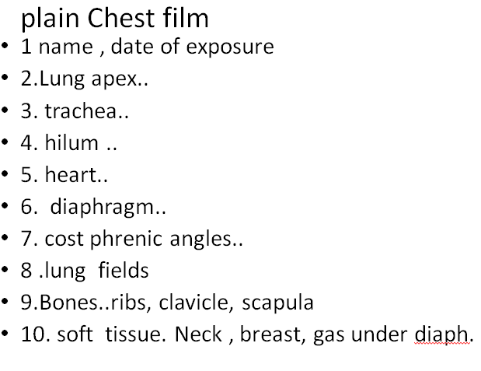
Normal chest pa and Lat. view

Slide 3
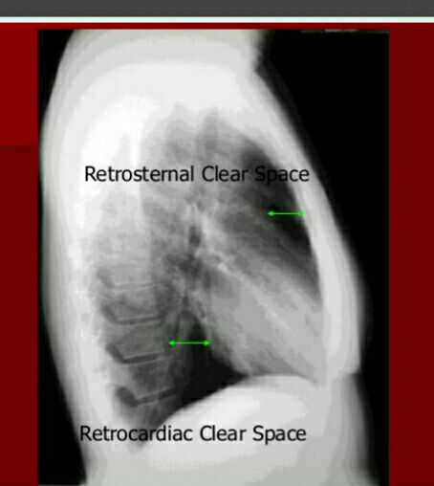

Slide 4
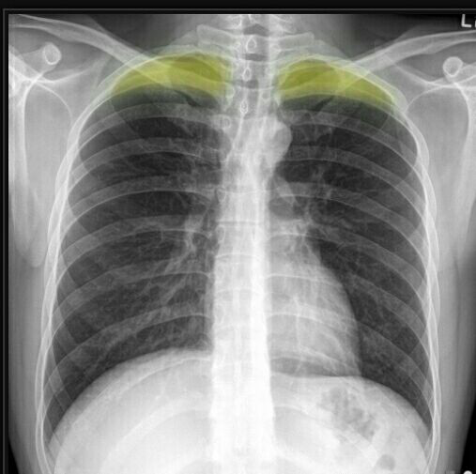
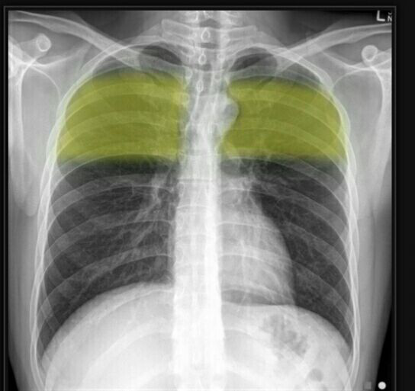
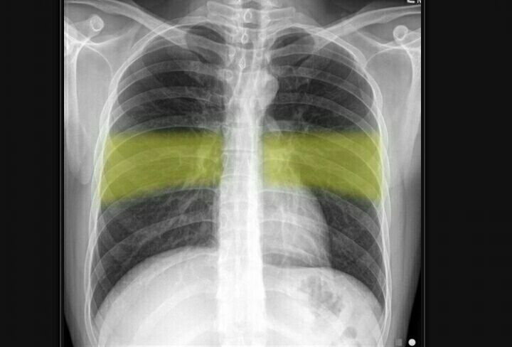
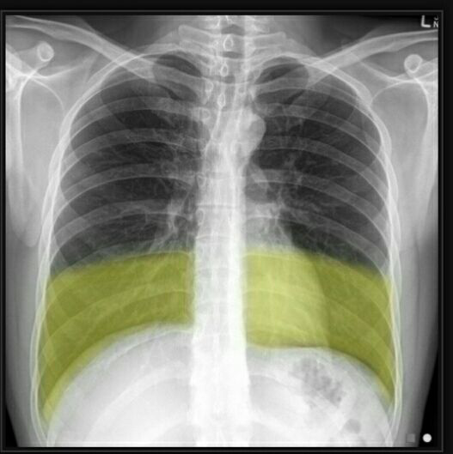
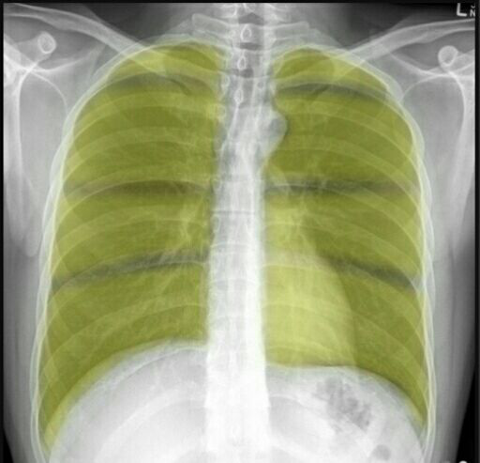
Lung zone
Apex
Upper lung zone
Middle lung zone (the region of the hilum )
Lower lung zone

Slide 5
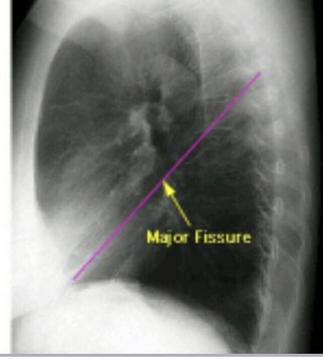
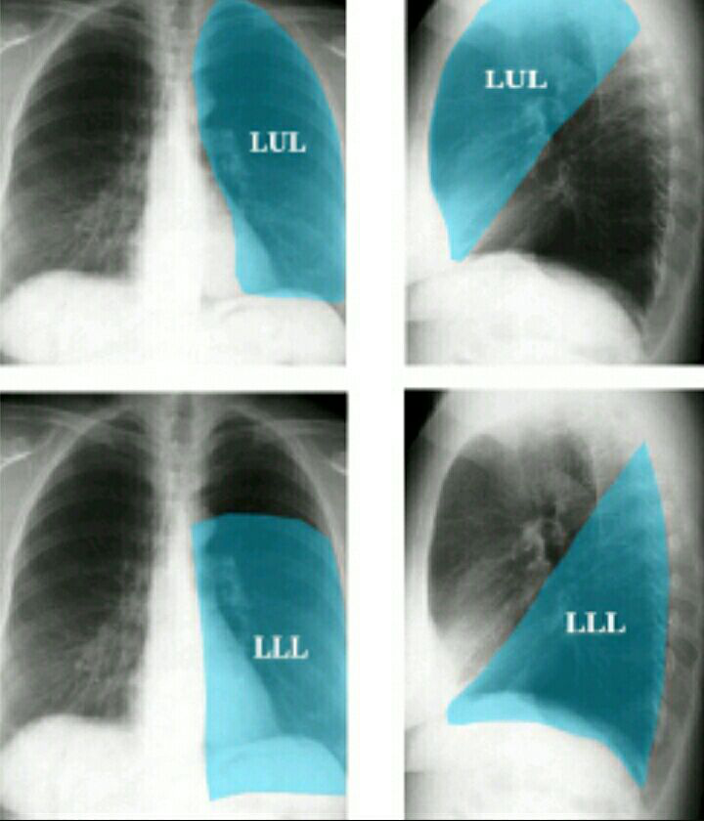
Left lung

Slide 6
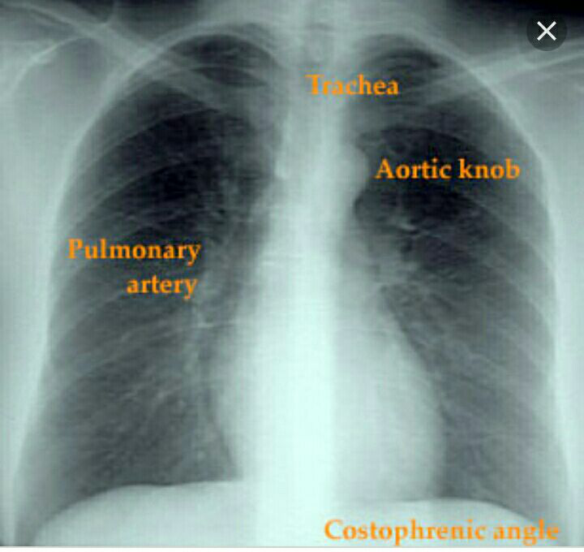
Normal chest

Slide 7
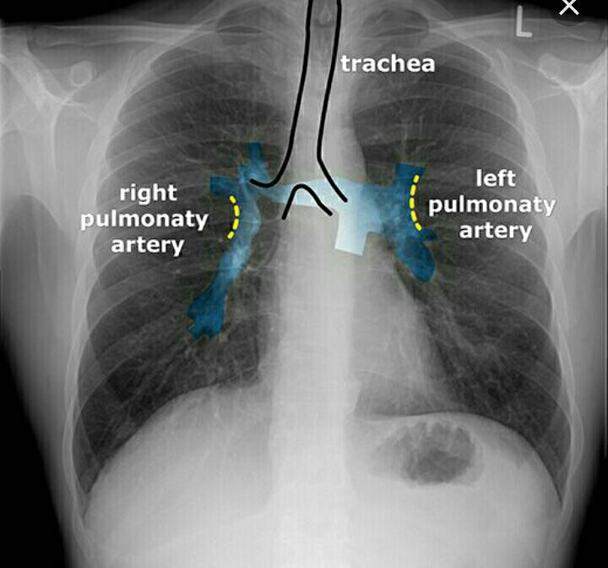
Normal chest

Slide 8
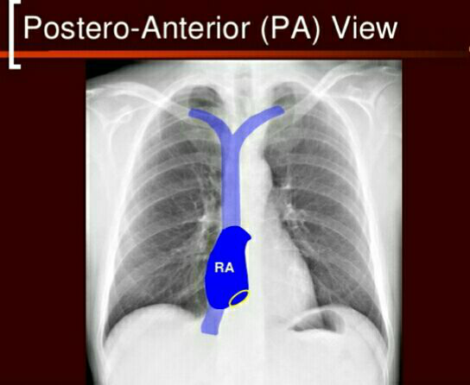
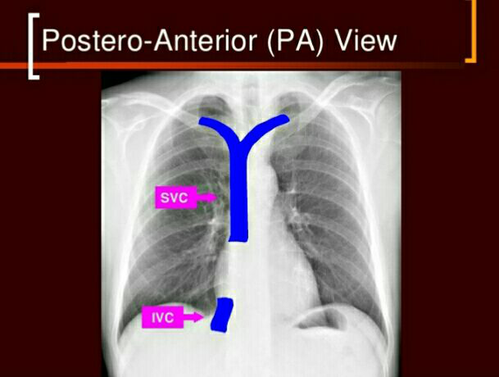

Slide 9
Pulmonary odema and congestive heart failure
Vascular redistribution and upper lobe blood diversion.( pulmonary plethora ),which represent a. prominent pulmonary vessels and increase caliber .
b. reaching lung apex
c. reaching the outer third of the pulmonary space.
Fluid leak from the loaded vessels to adjacent interstetium forming septal lines (interstitial odema)
Fluid leak from interstetium to alveoli ( alveolar odema )
Fluid leak to pleural space (pleural effusion).

Slide 10
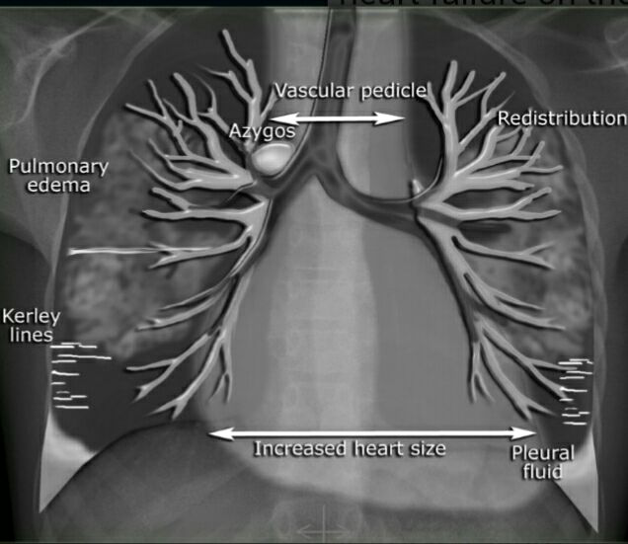

Slide 11
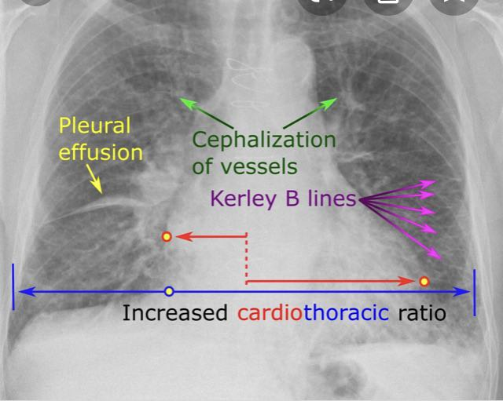

Slide 12
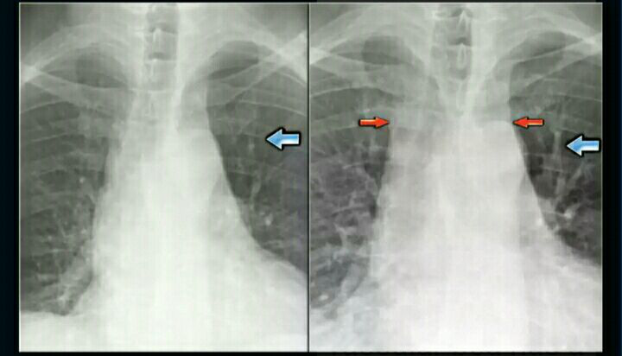
Redistribution ( upper lobe blood diversion

Slide 13
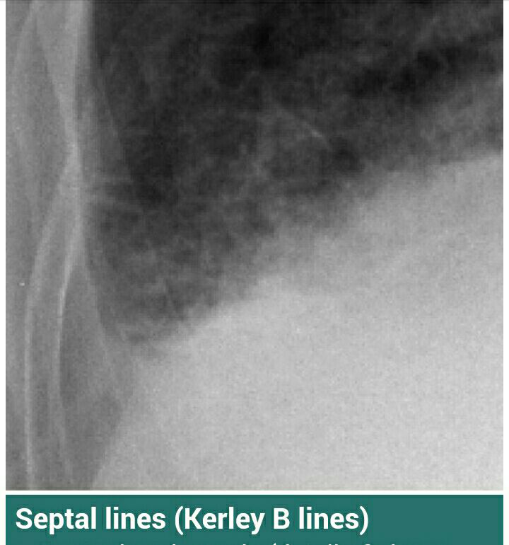
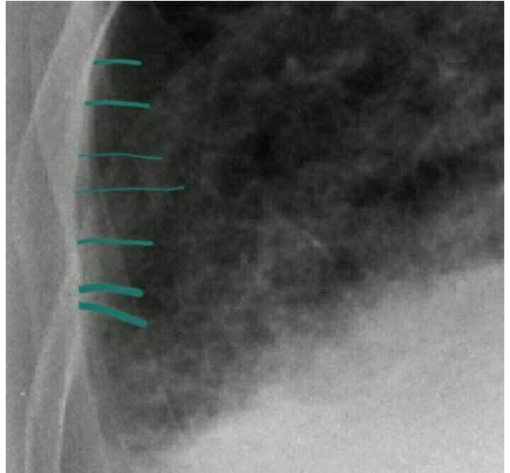

Slide 14
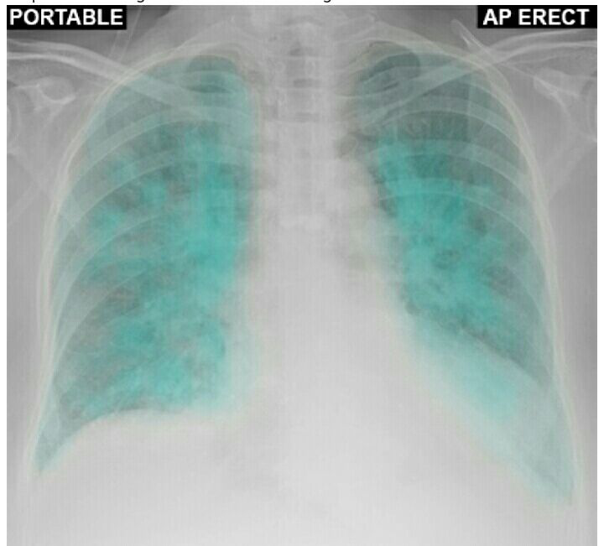
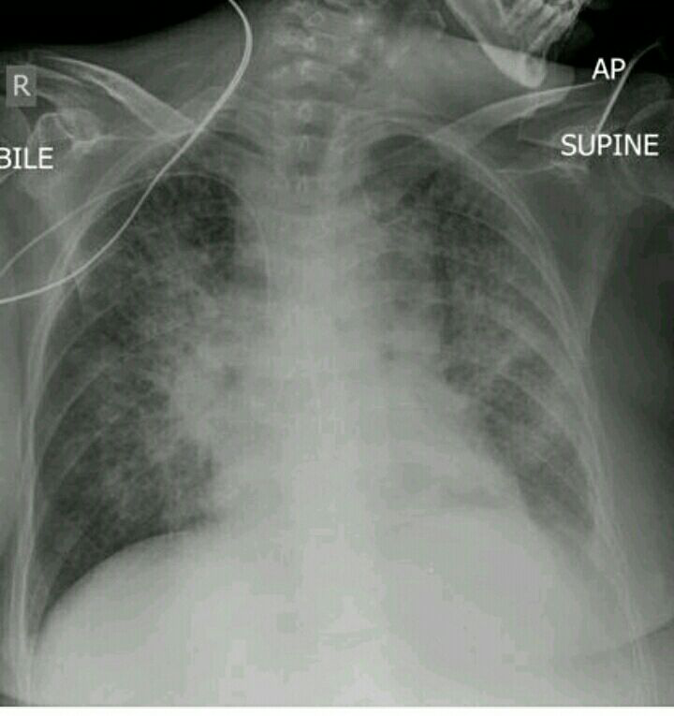
Alveolar odema

Slide 15
Alveolar odema

Slide 16
Pleural effusion

Slide 17
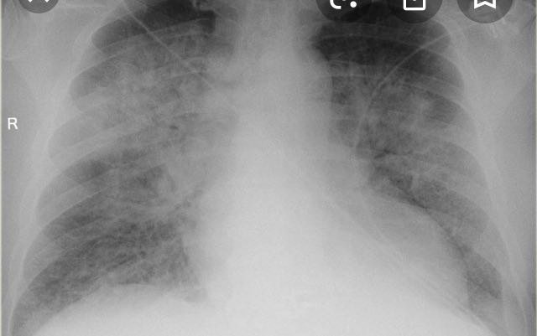

Slide 18
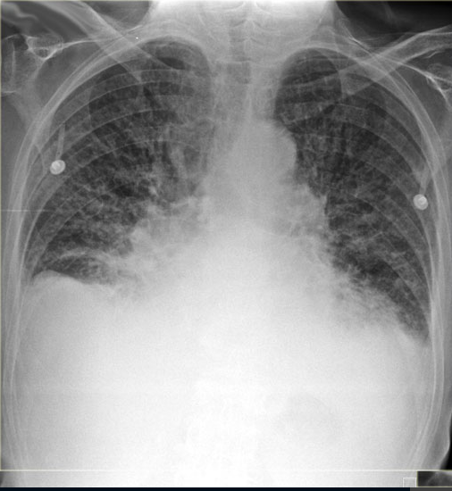
Congestive heart failure

Slide 19
Pulmonary embolism
Hx. Post op., trauma , fracture ,DVT , birth control pills , previous PE , .
Imaging evaluation ,need CT scan with high dose i.v contrast…normal CXR do not exclude occurrence of early PE.
CT scan showing filling defect

Slide 20
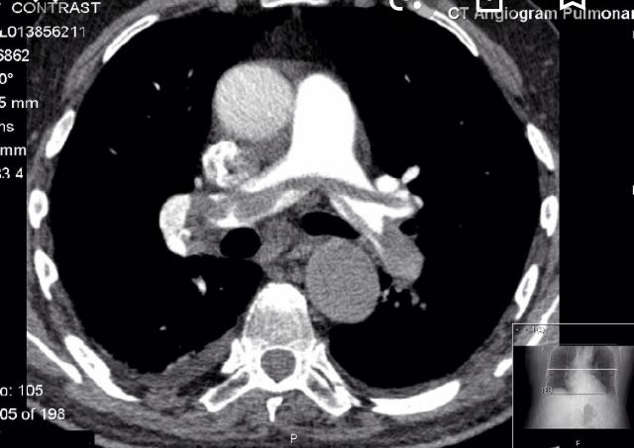
Pulmonary embolism

Slide 21
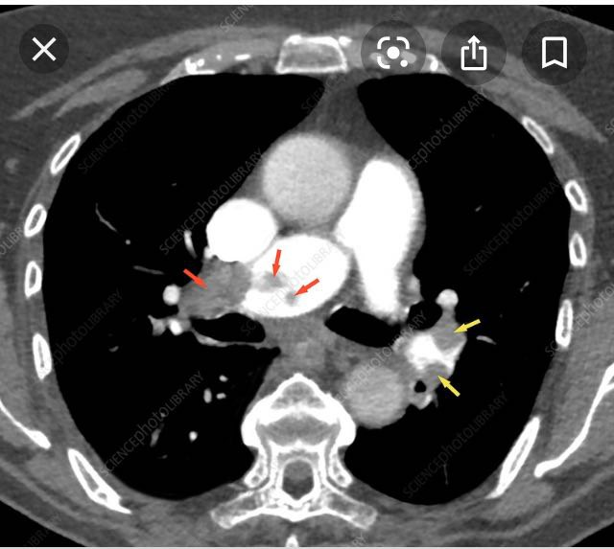

Slide 22
Aortic aneurysm
balloon like bulge in the aorta , it may rupture or dissect ( splitting layer of the arterial wall , allowing blood to leak in between them )
Symptoms
Sudden chest pain , low BP, SOB, loss of consciousness

Slide 23
Risk factors
high BP , atherosclerosis, trauma , infection , smoking
Ex. A 78 yrs old male presented with a sudden onset of severe central chest pain radiating to the back ,
Past medical history is only significant for hypertension

Slide 24
Other risk factors
Connective tissue disease Marfan syndrome.
bicuspid aortic valve
Coractation of the aorta
Pregnency
Surgery

Slide 25
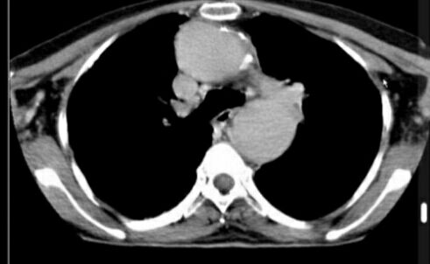
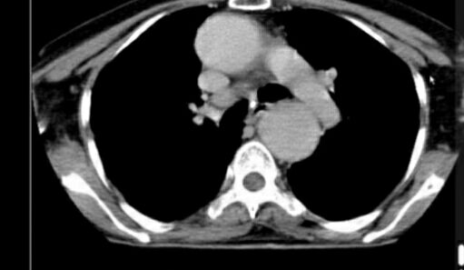
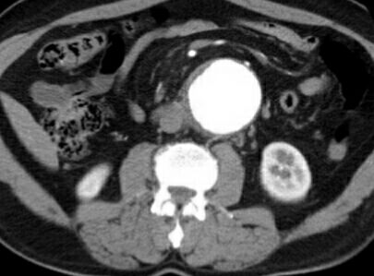
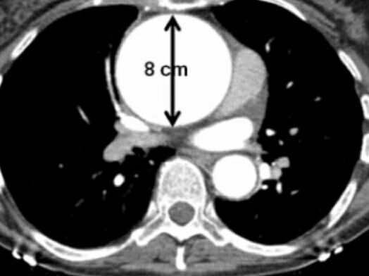
Aortic aneurysm

Slide 26
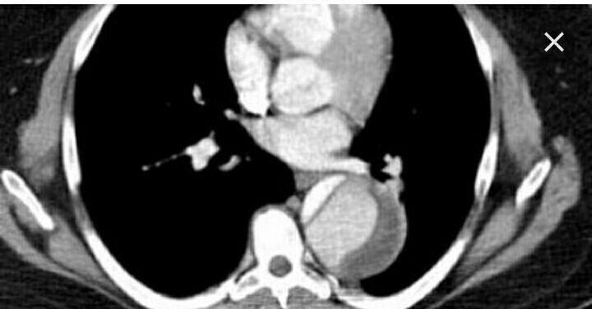
Dissecting Aortic aneurysm

