Slide 1
Pediatric radiology
Dr . Muna AGZ

Slide 2
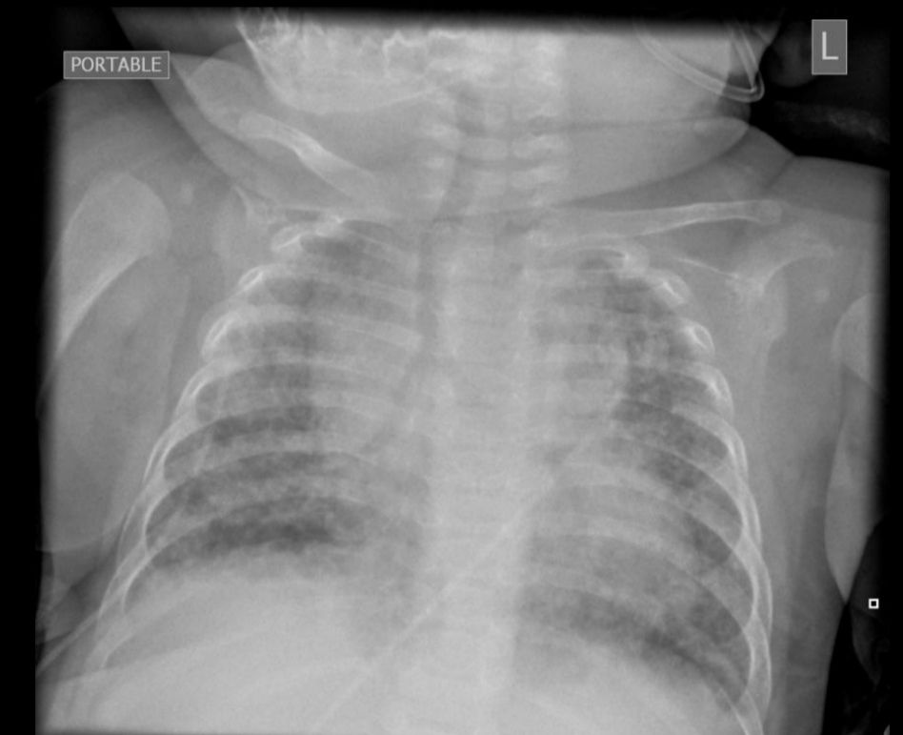
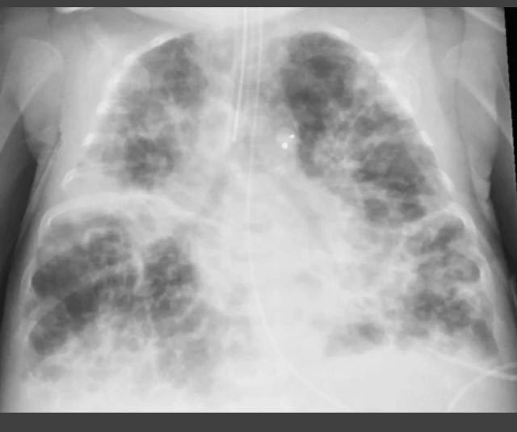
Premature, low birth wt. neonate ,hospitalized , with increasing distress, on mechanical ventilation

Slide 3
NEW bpd vs OLD bpd
New… arrest of alveolar development
Born before 28 wks, treated with surfactant , no necrotizing bronchiolitis. Defuse fibrosis , homogenous lung involvement .
Old …. Born after 28 wks , there limited surfactant lead to necrotizing bronchiolitis with variable damage alveolar structure small airway occlusion ,heterogeneous lung involvement
If the patient has had at least 28 days oxygen supplement, criteria ar met for BPD

Slide 4
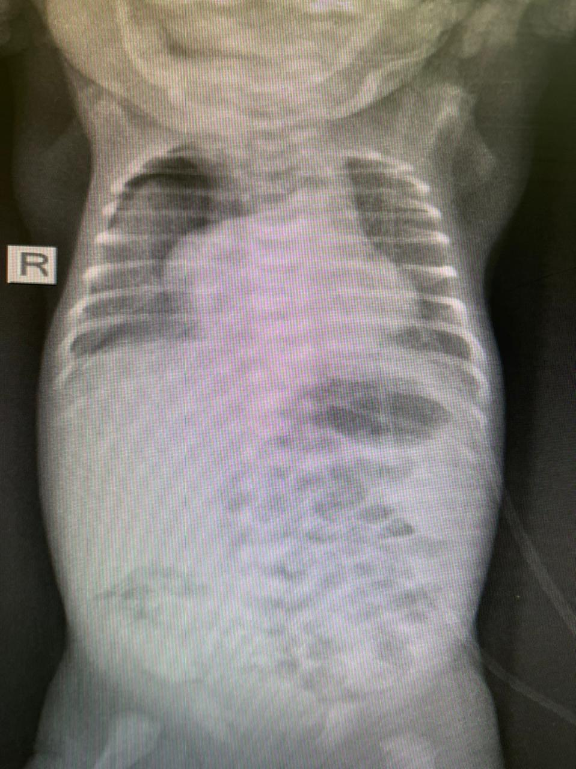

Slide 5
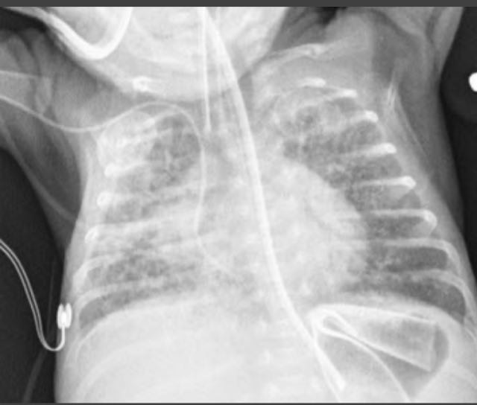

Slide 6
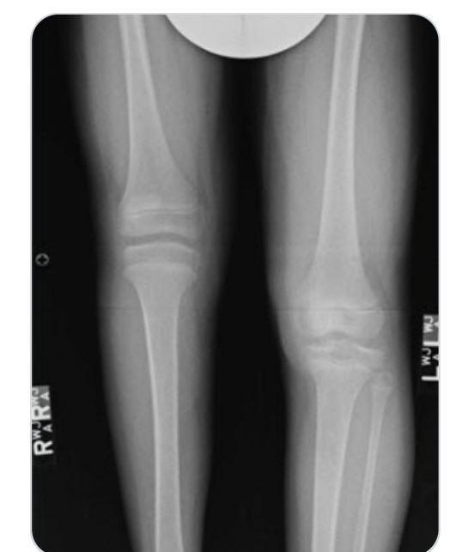

Slide 7
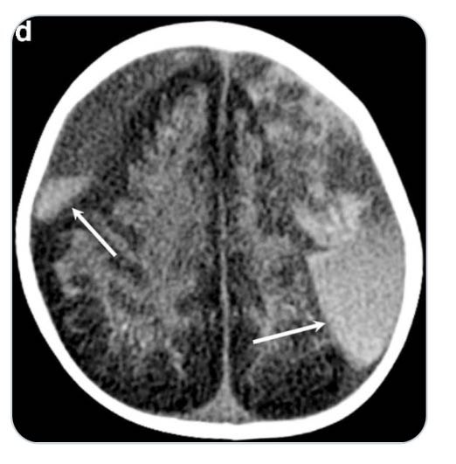
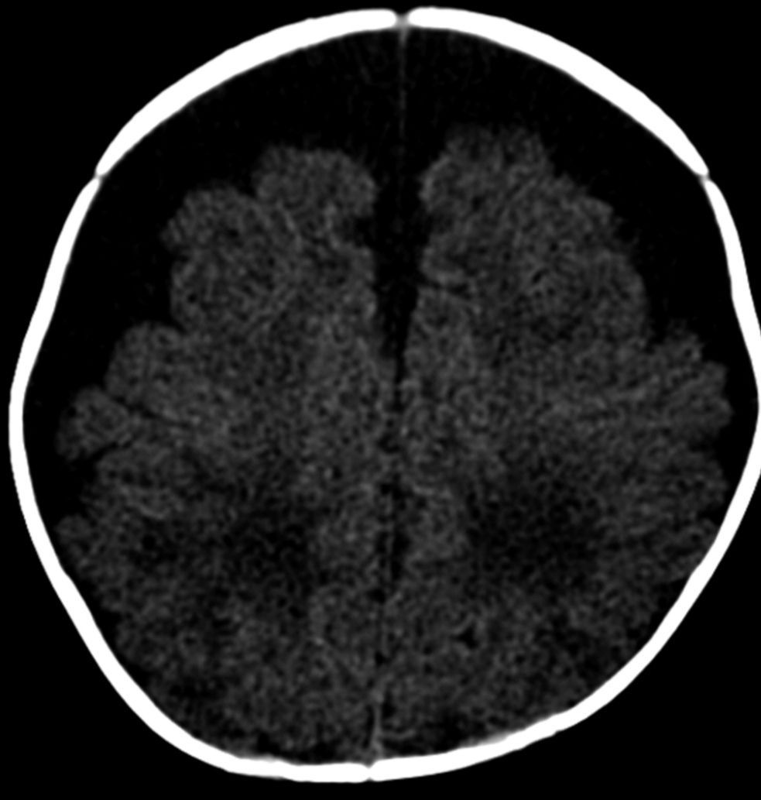
Subdural collection

Slide 8
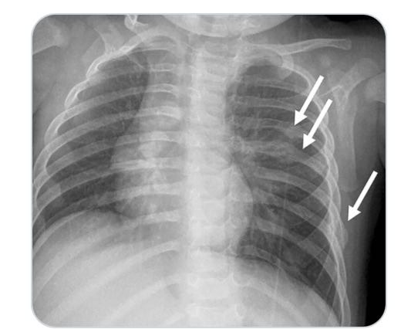
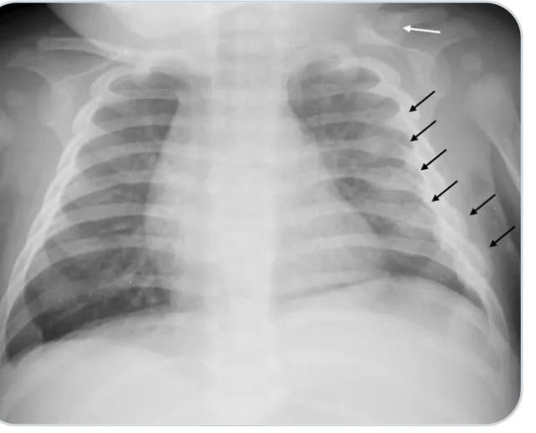

Slide 9
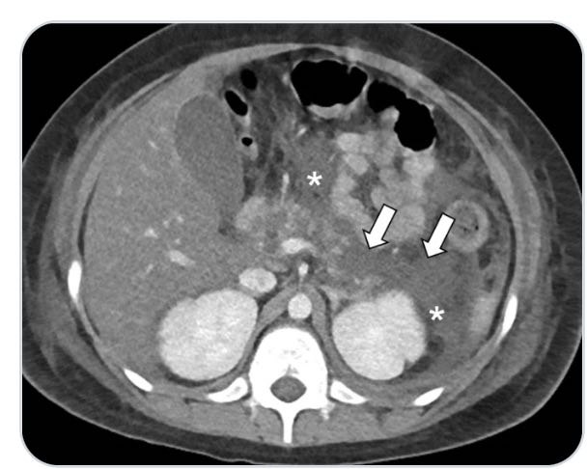

Slide 10
