Slide 1
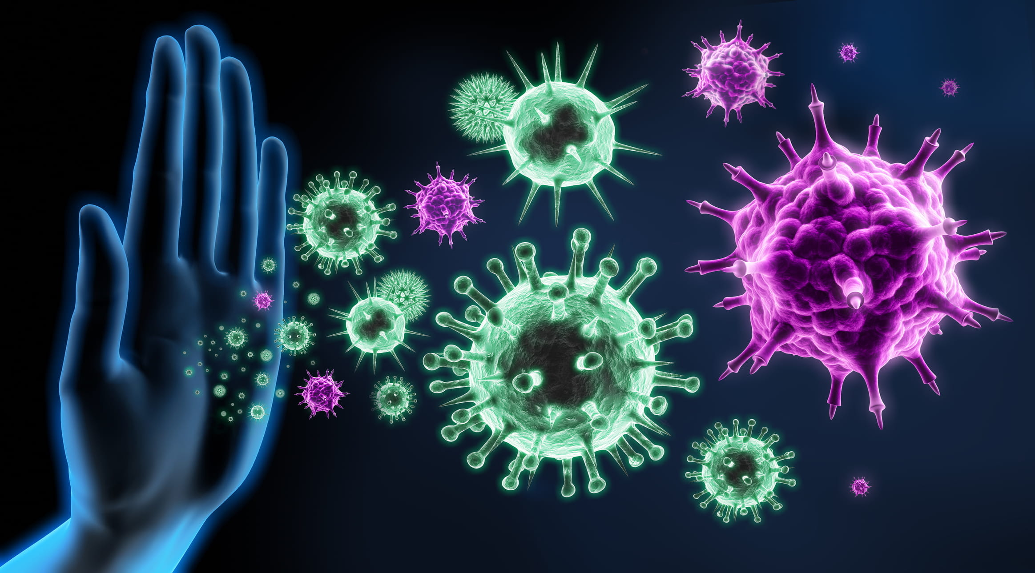
Principles of Communicable Diseases Epidemiology L-4/22-23
PROF Dr . NAJLAA FAWZI

Slide 2
Objectives
- Designate the principles of passive immunity
-Recognize the principles of prevention of infectious diseases.
-Describe the key elements for control of infectious diseases(cases, contact, reservoir, and community)

Slide 3
PASSIVE IMMUNIZATION
(SEROPROPHYLAXIS)
Passive immunization needed for rapid, but temporary protection of susceptible, either after exposure to infection or before expected exposure (occasionally).
The duration of immunity induced is short and variable (1-6 weeks).
Passive immunization has a limited value in the mass control of disease, it is recommended for non-immune persons under special circumstances.
Three types of preparations are available for passive immunity
A. normal human immunoglobulin
B. specific [hyper immune] human immunoglobulin
C. antisera or antitoxins

Slide 4
Application of immunoglobulin:
1-After exposure ; associated with either
* Sero prevention ; when given early in incubation period
* Sero attenuation ; when given later in incubation period.
* Not effective; if given late in incubation.
2-Before expected exposure; travelers from free to endemic areas can be given seroprophylaxis for expected infection; hepatitis A.

Slide 5
Specific immunoglobulin's are available for Sero-prophylaxis; antiviral (mumps, hepatitis A,B, measles, rubella, rabies. antitoxic (diphtheria & tetanus), and antipertussis (for exposed susceptible infants).
Serotherapy: tetanus ,diphtheria and rabies have specific antitoxin immunoglobulin that can be used for both prophylaxis & therapy in bigger doses. But there is no antiviral Serotherapy.

Slide 6
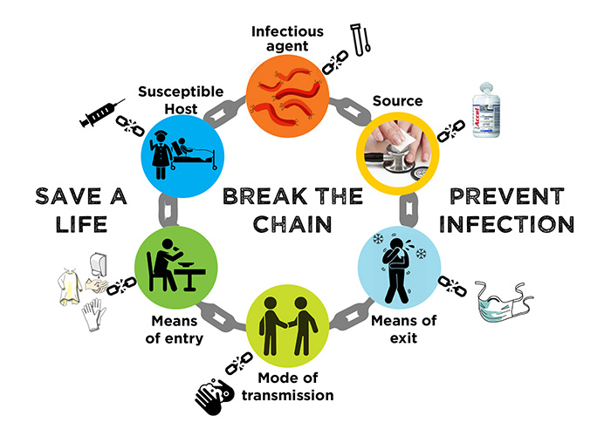
prevention & control of infectious diseases

Slide 7
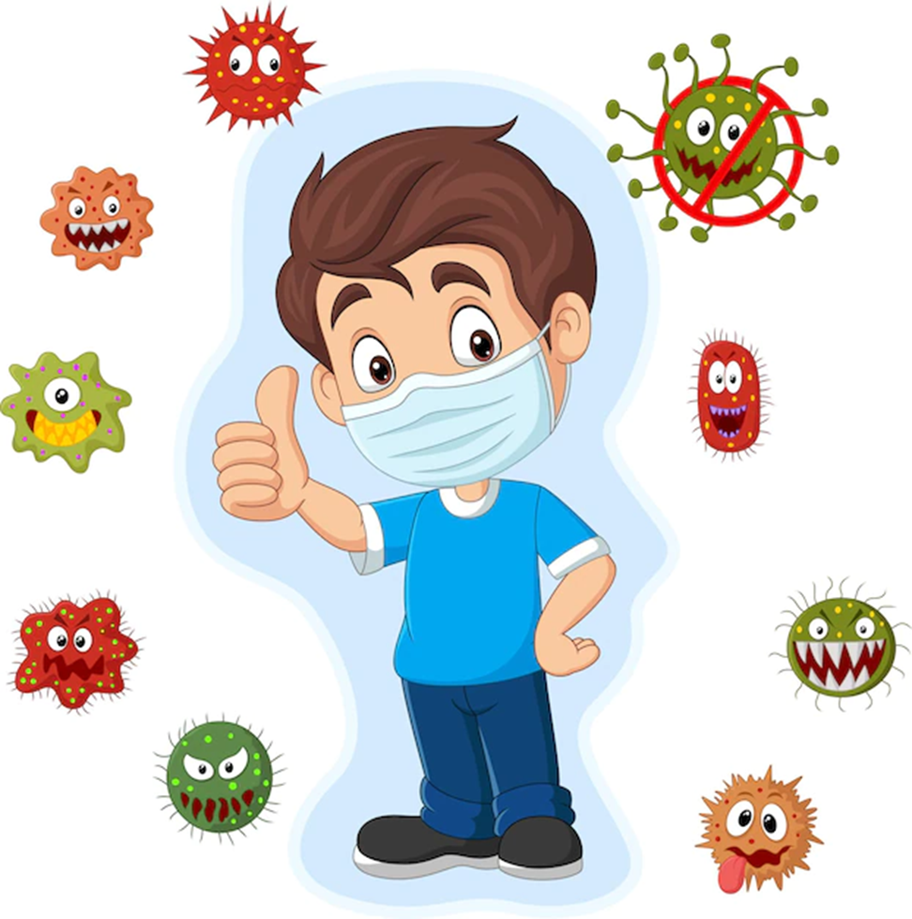
CONCEPTS OF PREVENTION
The goals of medicine are to promote health, to preserve
health,
to restore health when it is impaired, and to
minimize
suffering and distress.
These goals are embodied in the word
prevention

Slide 8
Determinants of prevention
Successful prevention depends upon:
A knowledge of causation
Dynamics of transmission
Identification of risk factors and risk groups
Availability of prophylactic or early detection and treatment measures
An organization for applying these measures to appropriate
persons or groups
Continuous evaluation of and development of procedures
applied

Slide 9
PREVENTION of INFECTIOUS DISEASES
Primary prevention means preventing the occurrence of infectious diseases, and so having no cases. Primary prevention can be achieved by general & specific measures.
1-General preventive measures:
a- Sanitation of the environment: clean, pollution free.
b- Clean, proper behavior and habits of the public through health education.
c- Health promotion of the public, with adequate nutrition, to raise the general body resistance.
2- Specific preventative:
a-Immunization; active & seroprophylaxis
b- Chemoprophylaxis.

Slide 10
Control of Infectious Diseases
The term disease control describes ongoing operations aimed at Reducing:
The incidence of disease
The duration of disease and as a result the risk of transmission
The effects of infection, including both the physical and psychosocial complications
The financial burden to the community.

Slide 11
Control means the measures to be taken for existing infectious diseases, with following objectives:
1-Case finding [ detect cases]
2-Management of cases, and protecting them against hazards and sequelae of disease.
3-Protecting susceptible contacts and other groups who may be exposed to infection
4-Preventing or minimizing spread of disease in the involved community

Slide 12
Control of infectious diseases (the 4 “C”s)
Control
Cases
Contacts
Community
Carriers
Diagnosis
Notification
Isolation
Disinfection
observation
detection
Epidemiological
Investigation &
control
Treatment
Follow up
Release

Slide 13
1- Control of cases
a- Case – finding clinical diagnosis, and laboratory confirmation if necessary.
b- Notification: cases, of definite or suspected diagnosis, must be notified to the local health authority . This will depend on nature of disease.
Value of notification:
To take prevention & control measures for the cases, and contacts and the community if necessary.
To help tracing source and channels of infection, in outbreak or epidemic.
To collect significant statistical data.

Slide 14
C-Isolation
isolation is the act of separating a sick individual with a contagious disease from healthy individuals without that contagious disease in order to protect the general public from exposure of a contagious disease.
Isolation is defined as “separation” , for the period of communicability of infected persons or animals from others in such places under such conditions , as to prevent or limit the direct or indirect transmission of the infectious agent from those infected to those who are susceptible ,or who may spread the agent to others’’.

Slide 15
Isolation is a routine procedure in hospitals and healthcare facilities.
Isolation is usually voluntary, but in a public health emergency, officials have the authority to isolate people who are sick.

Slide 16
Isolation of patients is indicated for infectious disease having the following epidemiological features:
1-High morbidity and mortality
2-High infectivity
3-No significant extra human reservoir
4-Infectious cases easily recognizable
5-Chronic carriers are not a significant part
of the reservoir.
The infectious case must be isolated, either at home or hospital or special places, according to the nature of disease& home condition, period of isolation varies according to nature of disease.
It is usually for the period of communicability .

Slide 17
Value of Isolation
To stop activity and movement of the case in the community, thus prevent spread of infection.
To protect the case against the risk of secondary infection, when exposed to contacts & visitors.
Categories of isolation:
There are seven isolation categories (Strict Isolation, Respiratory Isolation, Protective Isolation, Enteric Precautions, Wound and Skin Precautions, Discharge Precautions, and Blood Precautions)

Slide 18
d-Disinfection:
is the process of destroying pathogenic
organisms outside the body, by
direct exposure
to chemical
or physical agents.
Types of disinfection are :
1- Prophylactic
2-Concurrent
3-Terminal
Prophylactic Disinfection
As preventive measure to prevent the onset of disease such as chlorination of water, scrubbing and washing hands of health care providers, sterilization of instruments before using for surgery.

Slide 19
Concurrent disinfection: is carried out during
disease for:
the course of
Excreta and discharge,
used in nursing,
any object or material
soiled articles & fomites.
Terminal disinfection: disinfection for the last time, after transferring the case to hospital, or cure or death.

Slide 20
e-Treatment:
Specific therapy for bacterial disease, chemotherapy& antitoxins.
Nursing and proper feeding
Symptomatic treatment
Prevention & control of sequelae and complications [2nd bacterial infection, dehydration…]

Slide 21
f-Release:
The case can leave isolation, and return to school
or work if:
Clinical recovery { becoming clinically free}
Satisfactory general condition
Becoming bacteriologically free, in diseases having convalescent carriers

Slide 22
2-Control of Contacts
A contact is the person who has been in association with the case at any time during the i.p and until discovered and isolated.
Forms of Contacts: house holds including family contacts; work, school.
The local health center is responsible for control of contacts of notified cases.
1-Enlistment: special [contact list] is filled for names& personal data.
2-Examination: for case-finding if any; general condition, body temp, & any manifestations.
3-No exposure to isolated cases.
4-Surveillance, segregation ,quarantine or isolation according to disease:

Slide 23
a-Surveillance
in most infectious diseases, contacts are put under supervision, every day for the incubation period of the disease, for case-finding, mean while, they go to work& school.
the practice of close
, other
Personal
SURVEILLANCE
medical or
supervision of contacts
to permit quick recognition
of infection or
illness but without restricting their movements.

Slide 24
b-Segregation:
Contacts of the following diseases are excluded
from school or work ( not isolated)
Diseases having contact carriers e.g. Typhoid & diphtheria. Food handlers & school personnel contacts are excluded from work, and bacteriologic ally examined until prove not to be carriers.
Diseases which are highly infectious in the early days, measles, susceptible contacts are excluded from school, and so will not be at school, otherwise spread infection, if get diseased.

Slide 25
C-quarantine
A quarantine is used to separate and restrict the movement of persons; it is a 'state of obligatory isolation‘
This is often used in connection to disease and illness, such as those who may possibly have been exposed to a communicable disease.
Quarantined people may stay at
don’t spread disease to healthy people.
home or another location so they
Quarantine can be voluntary, but in
have the authority to quarantine people who have been exposed to
an infectious disease.
a public health emergency, officials

Slide 26
Quarantined individuals will be sheltered, fed, and cared for at home, in a selected emergency facility, or in a specialized hospital, depending on the disease and the available resources.
They will also be among the first to receive all available medical interventions to prevent and control disease, including:
Vaccination.
Antibiotics.
Early and rapid diagnostic testing and symptom monitoring.
Early treatment if symptoms appear.

Slide 27
c-Isolation
Contacts of cholera [non endemic areas], pneumonic plague& pneumonic anthrax are isolated each for a certain period of time; since these diseases are serious, and so if any of the contacts is diseased, he will be isolation, and not exposed to others to infection.
5- Specific protection:
By immunization or chemoprophylaxis,
if available.

Slide 28
3-Community Control Measures
Sporadic cases of endemic infectious diseases can be readily controlled by control measures for cases& contacts, but if epidemic or outbreak appears or threatens to occur, prevention & control measures are needed to protect the at risk community.
Community Control Measures Include
a-Case finding and control of cases & contacts.
b-Epidemiologic investigation, to trace source& channels of infection.
c-Extreme control measures, been taken, if necessary e.g. closing schools and public places .

Slide 29
ERADICATION of INFECTIOUS DISEASE
Eradication literally means to "tear out by roots“.
Eradication of disease indicates termination of all
transmission of
, eradication is
infection by extermination of the
infectious agent
an absolute
process, and not a
relative goal.
Getting rid of the causative organism and consequently disease, in certain area or country or the world; no reported cases, nor reservoirs of infection. It achieved for a limited number of infectious diseases.
Today, smallpox is the only disease that has been eradicated.
The
feasibility of eradicating polio
appears to be greater than other disease
like measles.

Slide 30
ELIMINATION of INFECTIOUS DISEASE
elimination is used to describe
interruption of
The term
transmission of
disease, as for
example, elimination of
measles, polio and
diphtheria
from large
geographic regions in world.
It means that existing endemic disease so controlled to reach the level of ' no reported cases'. This is usually by protection of at risk group or population, while the causative agent not necessarily eliminated.

Slide 31
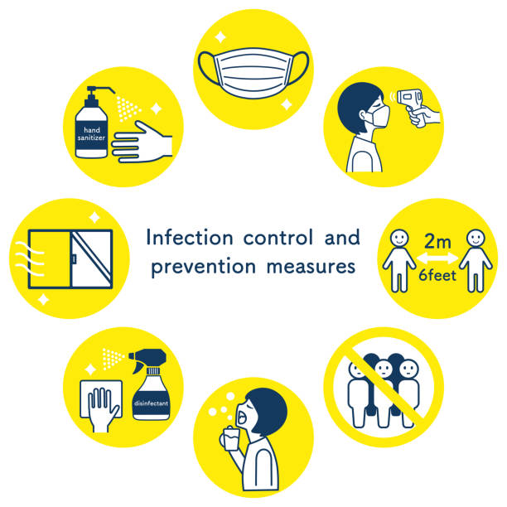
ANY QUESTION ?

