Slide 1
ا.م.د الاء ابراهيم
Obstetric history and examination

Slide 2
Introduction
Taking a history and performing an obstetric examination are different compared with the history and examination in other specialties
KEY LEARNING POINTS
Always introduce yourself and say who you are.
Make sure you are wearing your identity badge.
Wash your hands or use alcohol gel.
Be courteous and gentle.
Always ensure the patient is comfortable and warm.
Always have a chaperone present when you examine patients.
Tailor your history and examination to find the key information you need.

Slide 3
History template:
Demographic details
Name.
Age.
Occupation.
Make a note of ethnic background.
Presenting complaint or reason for attending.
This pregnancy
Gestation, LMP or EDD.
Dates as calculated from ultrasound.
Single/multiple (chorionicity).
Details of the presenting problem (if any) or reason for attendance (such as
problems in a previous pregnancy).
What action has been taken?
Is there a plan for the rest of the pregnancy?
Have there been any other problems in this pregnancy? bleeding, contractions or loss of fluid vaginally?

Slide 4
Dating the pregnancy:
The median duration of pregnancy is 280 days (40 weeks) and this gives the estimated date of delivery (EDD). This assumes that: The cycle length is 28 days.
Ovulation generally occurs on the 14th day of the cycle. The cycle was a normal cycle (i.e. not straight after stopping the oral contraceptive pill or soon after a previous pregnancy).
The EDD is calculated by taking the date of the LMP, counting forward by 9 months and adding 7 days. If the cycle is longer than 28 days, add the difference between the cycle length and 28 to compensate.
In most antenatal clinics, there are pregnancy calculators (wheels) that do this for you, differ a little and may give dates that are a day or two different from those previously calculated.

Slide 5
However, almost all women have an ultrasound scan in the late first trimester or early second trimester: to establish dates to ensure that the pregnancy is ongoing and to determine the number of fetuses. If performed before 20 weeks can be used for dating the pregnancy. After this time, the variability in growth rates of different fetuses makes it unsuitable for use in defining dates. It has been shown that ultrasound-defined dates are more accurate than those based on a certain LMP.
Ultrasound using the crown–rump measurement between 10 weeks 0 days and 13 weeks 6 days, and the head circumference from 14 to 20 weeks.
Accurate dating is important in later pregnancy for assessing fetal growth and reduces the risk of premature elective deliveries.

Slide 6
Past obstetric history:
List the previous pregnancies and their outcomes in order.
Gynecological history
Periods: regularity.
Contraceptive history.
Previous infections and their treatment.
When was the last cervical smear? Was it normal? Have there ever been any that
were abnormal? If yes, what treatment has been undertaken?
Previous gynecological surgery.
Past medical and surgical history
Relevant medical problems.
Any previous operations: type of anesthetic used, any complications.
Psychiatric history
Postpartum blues or depression.
Depression unrelated to pregnancy.
Major psychiatric illness.

Slide 7
Family history
Diabetes, hypertension, genetic problems, psychiatric problems, etc.
Social history
Smoking/alcohol/drugs.
Marital status.
Occupation, partner’s occupation.
Drugs
All medication, Folate supplementation.
Allergies
To what? What problems do they cause?

Slide 8
Obstetric examination:

Slide 9
Maternal weight and height
The measurement of weight and height at the initial examination is important to identify women who are significantly underweight or overweight.
Women with a body mass index (BMI) [weight (kg)/height (m2 of <20 are at higher risk of fetal growth restriction and increased perinatal mortality.
In the obese woman the risks of gestational diabetes and hypertension are increased.
Additionally, fetal assessment, both by palpation and ultrasound, is more difficult.
Obesity is also associated with increased birth weight and a higher perinatal mortality rate.

Slide 10
Urinary examination
All women should be offered routine screening for asymptomatic bacteriuria by midstream urine culture early in pregnancy.
General medical examination
A woman presents with a problem, or in women in certain at-risk groups, there may be a need to undertake a much more thorough physical examination.
Cardiovascular examination
A woman has previously lived in an area where rheumatic heart disease is prevalent and/or has a known history of heart murmur or heart disease, she should undergo cardiovascular examination during pregnancy.
Breast examination
encouraged to perform self-examination at regular intervals.

Slide 11
Examination of the pregnant abdomen
Always have a chaperone with you to perform this examination
Ask about pain and areas of tenderness.
Place her in a semi-recumbent position on a couch or bed.
In late pregnancy women should never lie completely flat; the a left lateral tilt will avoid aortocaval compression.
The abdomen should be exposed from just below the breasts to the symphysis

Slide 12
Inspection
Assess the shape of the uterus and note any asymmetry.
Look for fetal movements.
Note any signs of pregnancy such as striae gravidarum (stretch marks) or linea nigra (the faint brown line running from the umbilicus to the symphysis pubis).
Look for scars.
The common areas to find scars are:suprapubic (caesarean section, laparotomy for ectopic pregnancy or ovarian masses); sub-umbilical (laparoscopy);
right iliac fossa (appendicectomy); right upper quadrant (cholycystectomy).

Slide 13
Palpation: The purpose of palpating the pregnant abdomen is to assess:
1.The number of babies.
2.The size of the baby.
3.The lie of the baby.
4.The presentation of the baby.
5.Whether the baby is engaged.

Slide 14
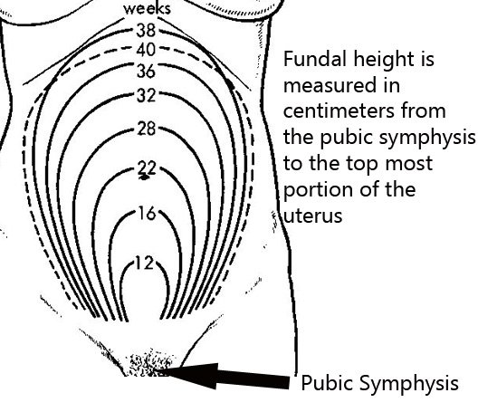
Fundal hight examination:
Stand on the right side of the woman to examine her in a systematic manner
The attention of the woman may be diverted by conversation
Your hand must be warm and should be placed on the abdomen till the uterus is relaxed before the palpation is actually begun.
To measure the fundal height, place the ulnar (medial/inner) border of the left hand on the woman’s abdomen, parallel to the symphysis pubis. Start from the xiphisternum (the lower end of the sternum/breastbone), and gradually proceed downwards towards the symphysis pubis, lifting you hand betwstep-downstep down, till your finally feel a bulge/resistance, which is the uterine fun dus

Slide 15
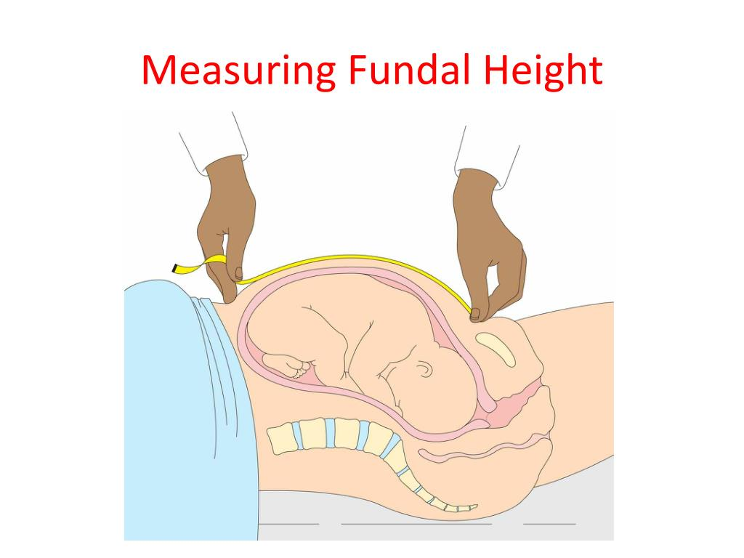
6.Symphysis–fundal height measurement(SFH):
should be measured and recorded at each antenatal appointment from 24 weeks’ gestation. Place the tape measure on the symphysis pubis and, with the centimetre marks face down, measure to the top of the fundus.
Turn the tape measure over and read the measurement.
Plot the measurement on an SFH chart.
The mean fundal height measures approximately 20 cm at 20 weeks and increases by 1 cm per week so that at 36 weeks the fundal height should be approximately 36 cm.
A large SFH raises the possibility of:
A multiple pregnancy.
Macrosomia.
Polyhydramnios.

Slide 16
Fetal lie, presentation and engagement
After measuring the SFH, next palpate to count the number of fetal poles.
A pole is a head or a bottom. If you can feel one or two, it is likely to be a singleton pregnancy.
If you can feel three or four, a twin pregnancy is likely.
Sometimes large fibroids can mimic a fetal pole; remember this if there is a history of fibroids.
If there is a pole over the pelvis, the lie is longitudinal regardless of whether the other pole is lying more to the left or right.
An oblique lie is where the leading pole does not lie over the pelvis, but just to one side;
a transverse lie is where the fetus lies directly across the abdomen.

Slide 17
The Leopold Maneuvers are used to determine fetus’ presentation and position.
The maneuvers have 4 specific actions along with the assessment of the maternal pelvis’ shape to determine if complications will occur during the delivery and if the patient will require a Cesarean section.

Slide 18
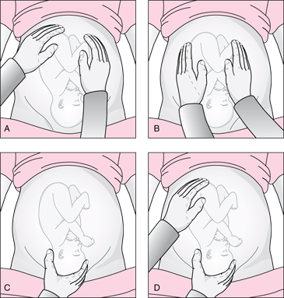
1.Maneuver One: Fundal Grip: Using both hands and facing the patient, palpate the upper abdomen, determine the shape, size, mobility, and consistence she feels, the head is firm, hard, round and moves separately from the trunk; and the buttocks is symmetric and feels soft.
2. Maneuver Two: Umbilical Grip: the location of the fetus’ back must be identified. While still facing the patient, placing the right hand on one side of the patient’s abdomen while using the left hand to explore the woman’s uterus on the right side. Repeat this step on the opposite side using the opposite hand, observe that the fetal back is smooth and firm. The extremities of the fetus should feel like protrusions and small irregularities.
3. Maneuver Three: Pawlick’s Grip: Identify the part of the fetus that is above the inlet. Use the fingers and thumb on the right hand to grasp the lower abdomen area located above the pubic symphysis. The findings should validate what is determined in the first maneuver.

Slide 19
4.Maneuver Four: Pelvic Grip:
This step should be done while facing the patient’s feet.
The process involves locating the fetus’ brow, gently move the fingers on both hands toward the pubis by sliding the hands over the sides of the patient’s uterus.
A well-flexed fetal head is located on the opposite side of the fetal back. If the head is extended, the back of the head is felt on the side that the back is located. A head that cannot be felt has likely descended.
At the same time as feeling for the presenting part, assess whether it is engaged or not.

Slide 20
If the whole head is palpable and it is easily movable, the head is likely to be ‘free’.
This equates to 5/5th palpable and is recorded as 5/5.
As the head descends into the pelvis, less can be felt.
When the head is no longer movable, it has ‘engaged’ and only 1/5th or 2/5th will be palpable.
If the fetus has been active during your examination and the mother reports that the baby is active, it is not necessary to auscultate the fetal heart using a hand-held Doppler device.

Slide 21
Pelvic examination
Routine pelvic examination during antenatal visits is not necessary.
However,there are circumstances in which a vaginal examination is necessary (in most cases a speculum examination is all that is needed). These include:
Excessive or offensive discharge.
Vaginal bleeding (in the known absence of a placenta praevia).
To perform a cervical smear.
To confirm potential rupture of membranes.
To confirm and assess the extent of female genital mutilation (FGM) in women
who have been subjected to this.

Slide 22
A digital examination may be performed when an assessment of the cervix is required. This can provide information about the consistency and effacement of the cervix that is not obtainable from a speculum examination.
The contraindications to digital examination are:
Known placenta praevia or vaginal bleeding when the placental site is unknown and the presenting part unengaged.
Prelabour rupture of the membranes (increased risk of ascending infection).
The patient should be positioned as before, two fingers of the gloved right hand are gently introduced into the vagina and advanced until the cervix is palpated. Before induction of labour, a full assessment of the Bishop’s score can be made.

Slide 23


