Slide 1
Hepatitis viruses

Slide 2
Viruses cause hepatitis:
Primary hepatotropic: Different viruses can cause (nearly) the same symptoms. e.g., the hepatitis viruses A-E
Secondary hepatotropic viruses: herpes viruses( EBV, CMV, herpes simplex ), rubella virus, enteroviruses, yellow fever viruses

Slide 3
Viral Hepatitis - Historical Perspectives
“Infectious”
A
Enterically
transmitted
E
Viral hepatitis
NANB
Parenterally
transmitted
“Serum”
B
D
C
F, G, TTV
? other
Notes:
2

Slide 4
¹Sexual transmission seems likely but is poorly documented

Slide 6
Hepatitis A Virus
Notes:
6

Slide 7
Hepatitis A Virus
Naked RNA virus
Related to enteroviruses, formerly known as enterovirus 72, now put in its own family: heptovirus
One stable serotype only
Difficult to grow in cell culture

Slide 8
Hepatitis A - Clinical Features
Incubation period: Average 30 days
Range 15-50 days
Jaundice by <6 yrs, <10% age group: 6-14 yrs, 40%-50% >14 yrs, 70%-80%
Complications: Fulminant hepatitis Cholestatic hepatitis Relapsing hepatitis
Chronic sequelae: None
Notes:
7

Slide 9
HAV Infection
Symptoms
Total anti-HAV
Titer
ALT
Fecal
HAV
IgM anti-HAV
0
1
2
3
4
5
6
12
Months after exposure
Acute infection is diagnosed by the detection of HAV-IgM in serum by EIA.
Past Infection, i.e., immunity, is diagnosed by the detection of HAV-IgG by EIA.

Slide 10
Hepatitis A Virus Transmission
Close personal contact (e.g., household contact, sex contact, child day care centers)
Contaminated food, water (e.g., infected food handlers, raw shellfish)
Blood exposure (rare) (e.g., injecting drug use, transfusion)
Notes:
11

Slide 11
Hepatitis A in Various Body Fluids
Feces
Serum
Body Fluid
Concentration
Saliva
Urine
10⁰
10²
10⁴
10⁶
10⁸
10¹⁰
Infectious Doses per ml
Notes:
10

Slide 12
Pathogenesis & Immunity
The pathogenesis of HAV infection is not completely understood. The virus probably replicates in the gastrointestinal tract and spreads to the liver via the blood. Hepatocytes are infected, but the mechanism by which cell damage occurs is unclear. HAV infection of cultured cells produces no cytopathic effect. It is likely that attack by cytotoxic T cells causes the damage to the hepatocytes. The infection is cleared, the damage is repaired, and no chronic infection ensues. Hepatitis caused by the different viruses cannot be distinguished pathologically.
The immune response consists initially of IgM antibody, which is detectable at the time jaundice appears. It is therefore important in the laboratory diagnosis of hepatitis A. The appearance of IgM is followed 1 to 3 weeks later by the production of IgG antibody, which provides lifelong protection.

Slide 13
Laboratory Diagnosis
Acute infection is diagnosed by the detection of HAV-IgM in serum by EIA.
Past Infection i.e. immunity is determined by the detection of HAV-IgG by EIA.
Cell culture – difficult and take up to 4 weeks, not routinely performed
Direct Detection – EM, RT-PCR of faeces. Can detect illness earlier than serology but rarely performed.

Slide 14
Hepatitis A Vaccination Strategies
Epidemiologic Considerations
Killed vaccine(formaldehyde- inactivated):GIVE IMMUNITY after one month give 20 years immunity
Two doses, an initial dose followed by a booster 6 to 12 months later, should be given. No subsequent booster dose is recommended. Many cases occur in community-wide outbreaks
no risk factor identified for most cases
highest attack rates in 5-14 year olds
children serve as reservoir of infection
Persons at increased risk of infection
travelers
homosexual men
injecting drug users
Notes:
18

Slide 15
Hepatitis B Virus
Notes:
28

Slide 16
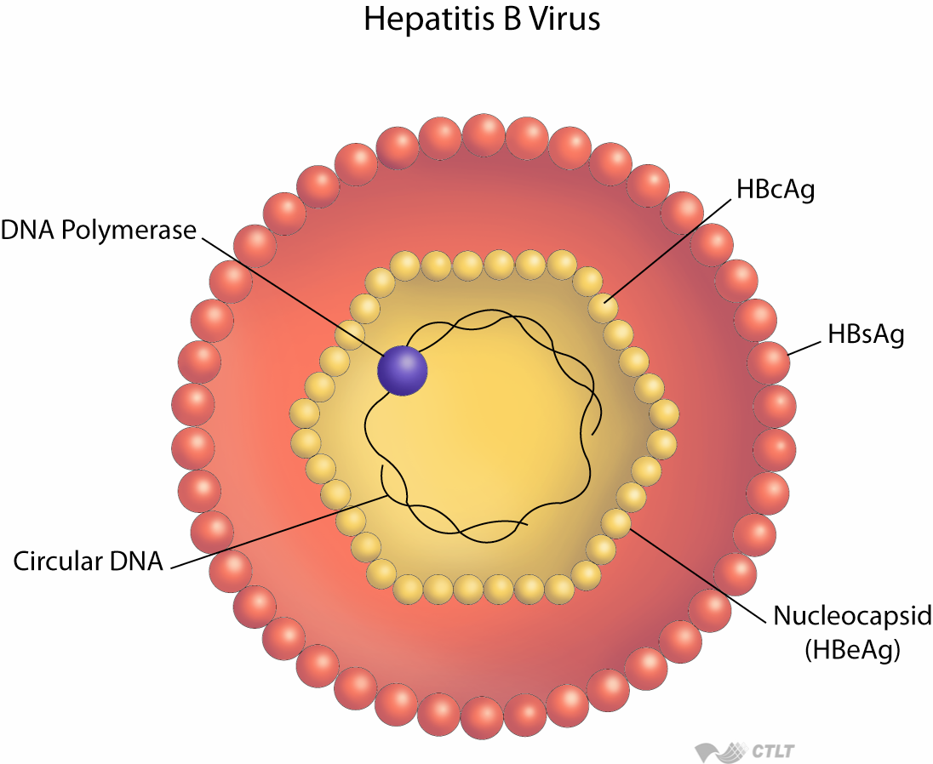
Hepatitis Viruses of Humans
Hepatitis A virus (HAV)
Hepatitis B virus (HBV)
Hepatitis C virus (HCV), non-A, non-B hepatitis virus
Hepatitis D virus (delta agent, HDV)
Enteric non-A, non-B hepatitis virus (HEV)
Hepatitis G virus
Other hepatitis viruses?For example, short-incubation-period HV?

Slide 17
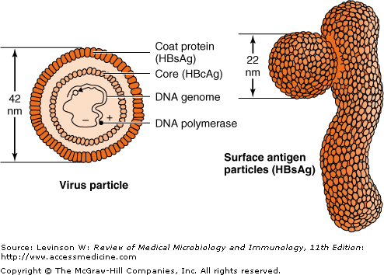

Slide 18
Hepatitis B Virus - Virology
Double stranded DNA virus , the + strand not complete
Replication involves a reverse transcriptase.
Complete Dane particle 42 nm, 28 nm electron dense core, containing HBcAg and HBeAg. The coat and the 22 nm free particles contain HBsAg
At least 4 phenotypes of HBsAg are recognized; adw, adr, ayw and ayr.
The HBcAg is of a single serotype
. There are eight genotypes of HBV (A–H) which are geographically distributed
It has not yet been possible to propagate the virus in cell culture.

Slide 19
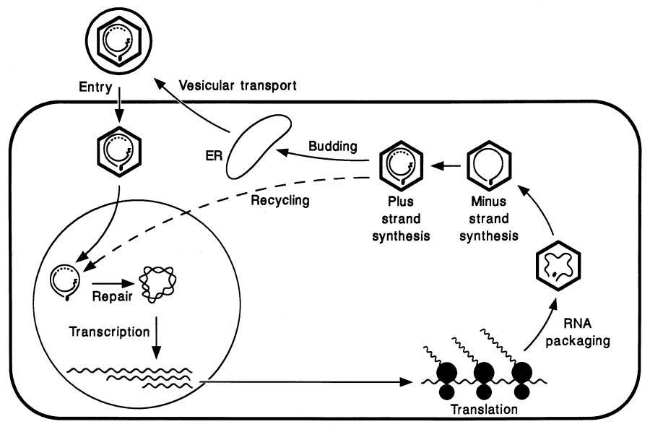
Hepadnaviral Life Cycle
RNA pol II

Slide 20
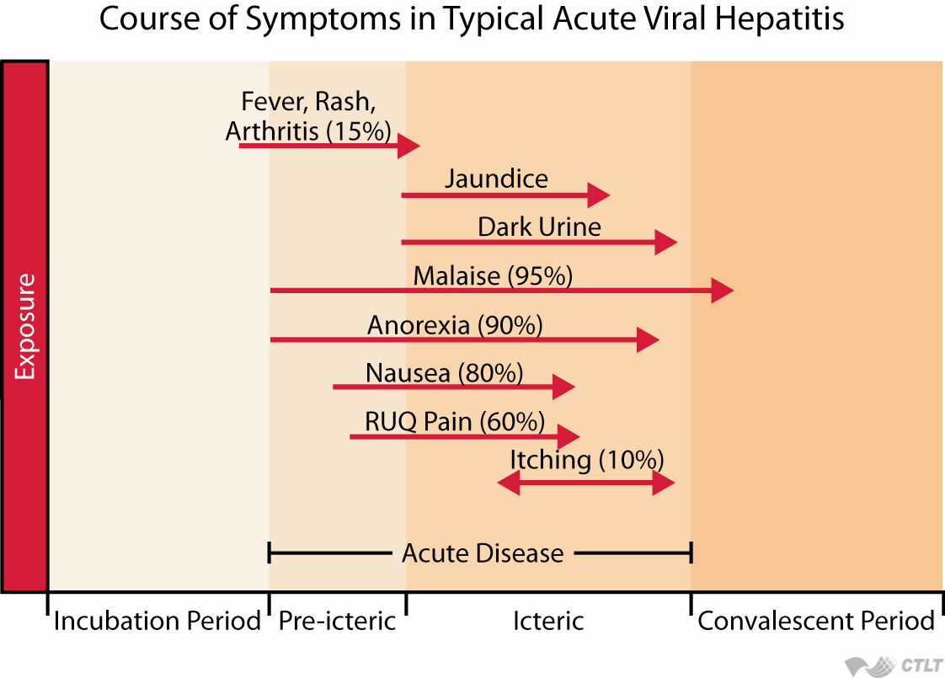

Slide 21
Pathogenesis & Immunity
After entering the blood, the virus infects hepatocytes, and viral antigens are displayed on the surface of the cells. Cytotoxic T cells mediate an immune attack against the viral antigens, and inflammation and necrosis occur. Immune attack against viral antigens on infected hepatocytes is mediated by cytotoxic T cells. The pathogenesis of hepatitis B is probably the result of this cell-mediated immune injury, because HBV itself does not cause a cytopathic effect. Antigen–antibody complexes cause some of the early symptoms, e.g., arthralgias, arthritis, and urticaria, and some of the complications in chronic hepatitis, e.g., glomerulonephritis, cryoglobulinemia, and vasculitis

Slide 22
Hepatitis B - Clinical Features
Incubation period: Average 60-90 days
Clinical illness (jaundice): <5 yrs, <10% 5 yrs, 30%-50%
Chronic infection: <5 yrs, 30%-90% 5 yrs, 2%-10%
Notes:
29

Slide 23
About 5% of patients with HBV infection become chronic carriers; in contrast, there is no prolonged carrier state in patients with HAV infection. A chronic carrier is someone who has HBsAg persisting in their blood for at least 6 months. The chronic carrier state is attributed to a persistent infection of the hepatocytes, which results in the prolonged presence of HBV and HBsAg in the blood. The main determinant of whether a person clears the infection or becomes a chronic carrier is the adequacy of the cytotoxic T-cell response. HBV DNA exists primarily as an episome in the cytoplasm of persistently infected cells; a small number of copies of HBV DNA are integrated into cell DNA.

Slide 24
Spectrum of Chronic Hepatitis B Diseases
1Chronic Persistent Hepatitis - asymptomatic
2. Chronic Active Hepatitis - symptomatic exacerbations of hepatitis
3. Cirrhosis of Liver
4. Hepatocellular Carcinoma

Slide 25
A high rate of hepatocellular carcinoma occurs in chronic carriers. The HBV genome has no oncogene, and hepatocellular carcinoma appears to be the result of persistent cellular regeneration that attempts to replace the dead hepatocytes. Alternatively, malignant transformation could be the result of insertional mutagenesis, which could occur when the HBV genome integrates into the hepatocyte DNA. Integration of the HBV DNA could activate a cellular oncogene, leading to a loss of growth control.
Chronic carriage is more likely to occur when infection occurs in a newborn than in an adult, probably because a newborn's immune system is less competent than that of an adult's. Approximately 90% of infected neonates become chronic carriers. Chronic carriage resulting from neonatal infection is associated with a high risk of hepatocellular carcinoma.

Slide 27
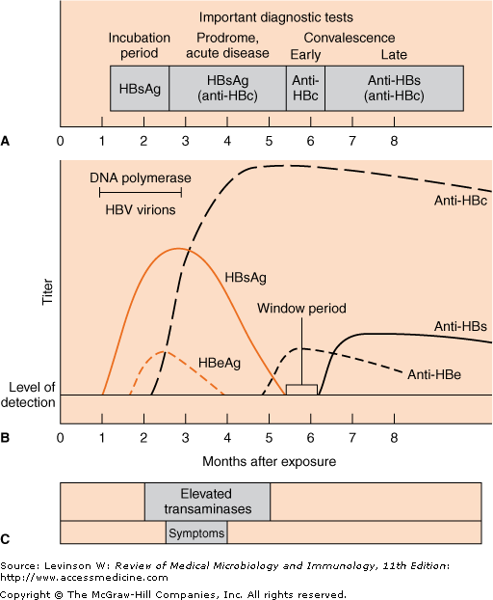

Slide 28
Acute Hepatitis B Virus Infection with Recovery
A battery of serological tests are used for the diagnosis of acute and chronic hepatitis B infection:
HBsAg - used as a general marker of infection
anti-HBc IgM - marker of acute infection
anti-HBcIgG - past or chronic infection
HBeAg - indicates active replication of virus and therefore infectiveness.
Anti-HBe - virus no longer replicating. However, the patient can still be positive for HBsAg which is made by integrated HBV.
HBV-DNA -indicates active replication of the virus, more accurate than HBeAg especially in cases of escape mutants. Used mainly for monitoring response to therapy.
Symptoms
HBeAg
anti-HBe
Total anti-HBc
Titer
IgM anti-HBc
HBsAg
anti-HBs
0
4
8
12
16
20
24
28
32
36
52
100
Weeks after Exposure
Progression to Chronic HBV Infection
Acute (6 months)
Chronic (Years)
HBeAg
anti-HBe
Titer
HBsAg
HBsAb is not detectable in the chronic carrier state. Note that HBsAb is, in fact, being made but is not detectable in the laboratory tests because it is bound to the large amount of HBsAg present in the blood. HBsAb is also being made during the acute disease but is similarly undetectable because it is bound in antigen–antibody complexes
Total anti-HBc
IgM anti-HBc
0
4
12
24
36
52
Weeks after Exposure
Years

Slide 29
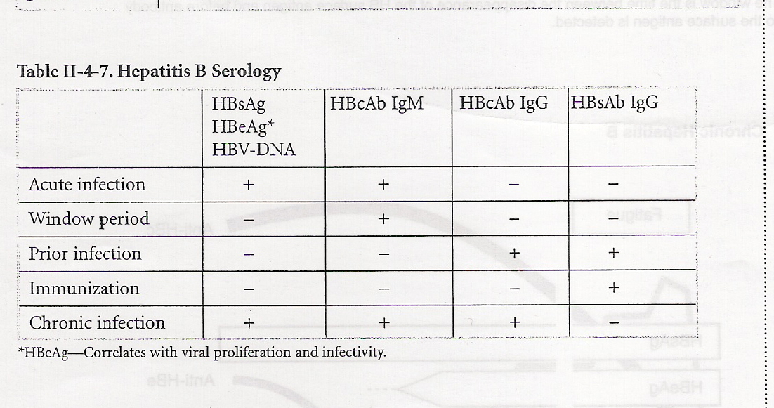

Slide 31
Concentration of Hepatitis B Virus in Various Body Fluids
Low/Not
High
Moderate
Detectable
blood
semen
urine
serum
vaginal fluid
feces
wound exudates
saliva
sweat
tears
breastmilk
Notes:
1
1
1

Slide 32
Hepatitis B Virus
Modes of Transmission
Sexual - sex workers and homosexuals are particular at risk.
Parenteral - IVDA, Health Workers are at increased risk.
Perinatal - Mothers who are HBeAg positive are much more likely to transmit to their offspring than those who are not. Perinatal transmission is the main means of transmission in high prevalence populations.
Notes:
2
2
2

Slide 33
Prevention
Vaccination - highly effective recombinant vaccines are now available. Vaccine can be given to those who are at increased risk of HBV infection such as health care workers. It is also given routinely to neonates as universal vaccination in many countries.
Widespread immunization with the HBV vaccine has significantly reduced the incidence of hepatocellular carcinoma in children. A vaccine called Twinrix that contains both HBsAg and inactivated HAV provides protection against both hepatitis B and hepatitis A.

Slide 34
Hepatitis B Immunoglobulin - HBIG may be used to protect persons who are exposed to hepatitis B. It is particular efficacious within 48 hours of the incident. It may also be given to neonates who are at increased risk of contracting hepatitis B i.e. whose mothers are HBsAg and HBeAg positive.
Other measures - screening of blood donors, blood and body fluid precautions.

Slide 35
Hepatitis C virus
Genome cloned in 1989
Member of the Flaviviridae family
Leading cause of liver transplantation in the US
Sustained responses in only 50% of treated patients
No vaccine available
High sequence divergence - 6 major genotypes

Slide 36
Hepatitis C Virus
Genome resembled that of a flavivirus positive stranded RNA genome
HCV has been classified into a total of six genotypes (type 1 to 6) on the basis of phylogenetic analysis
Genotype 1 and 4 has a poorer prognosis and response to interferon therapy,

Slide 37
HCV genome organization
postive strand RNA genome
Virion components
RNA replication machinery
structural
nonstructural
5’
(U/UC)
3’
C
E1
E2
p7
NS2
NS3
4A
4B
5A
5B
Signal peptidase
NS3-4A Ser protease

Slide 38
HCV has at least six genotypes and multiple subgenotypes based on differences in the genes that encode one of its two envelope glycoproteins. This genetic variation results in a "hypervariable" region in the envelope glycoprotein. The genetic variability is due to the high mutation rate in the envelope gene coupled with the absence of a proofreading function in the virion-encoded RNA polymerase. As a result, multiple subspecies (quasispecies) often occur in the blood of an infected individual at the same time.

Slide 39
HCV replicates exclusively in the cytoplasm
via an RNA intermediate
Viral entry & uncoating
(+)
Translation & processing
(+)
HCV RNA
replication
(-)
Virus particle
assembly
Replicative
intermediate
(+)
Nucleus

Slide 40
Summary of Replicative Cycle
The replication of HCV is uncertain because it has not been grown in cell culture. Other flaviviruses replicate in the cytoplasm and translate their genome RNA into large polyproteins, from which functional viral proteins are cleaved by a virion-encoded protease. It is likely that HCV replication follows this model.
The replication of HCV in the liver is enhanced by a liver-specific micro-RNA. This micro-RNA acts by increasing the synthesis of HCV mRNA. (Micro-RNAs are known to enhance cellular mRNA synthesis in many tissues.)

Slide 41
Transmission & Epidemiology
Humans are the reservoir for HCV. It is transmitted primarily via blood. At present, injection drug use accounts for almost all new HCV infections. Transmission via blood transfusion rarely occurs because donated blood containing antibody to HCV is discarded. Transmission via needle-stick injury occurs, but the risk is lower than for HBV. Sexual transmission and transmission from mother to child occur but are inefficient modes.

Slide 42
Pathogenesis & Immunity
HCV infects hepatocytes primarily, but there is no evidence for a virus-induced cytopathic effect on the liver cells. Rather, death of the hepatocytes is probably caused by immune attack by cytotoxic T cells. HCV infection strongly predisposes to hepatocellular carcinoma, but there is no evidence for an oncogene in the viral genome or for insertion of a copy of the viral genome into the DNA of the cancer cells.
Alcoholism greatly enhances the rate of hepatocellular carcinoma in HCV-infected individuals. This supports the idea that the cancer is caused by prolonged liver damage and the consequent rapid growth rate of hepatocytes as the cells attempt to regenerate rather than by a direct oncogenic effect of HCV. Added support for this idea is the observation that patients with cirrhosis of any origin, not just alcoholic cirrhosis, have an increased risk of hepatocellular carcinoma. (A report in 1998 that the core protein of HCV causes hepatocellular carcinoma in mice may lead to a greater understanding of oncogenesis by HCV.)
Antibodies against HCV are made, but approximately 75% of patients are chronically infected and continue to produce virus for at least 1 year. (Note that the rate of chronic carriage of HCV is much higher than the rate of chronic carriage of HBV.) Chronic active hepatitis and cirrhosis occur in approximately 10% of these patients. For patients who clear the infection, it is not known whether reinfection can occur or whether there is lifelong immunity

Slide 43
Hepatitis C - Clinical Features
Incubation period: Average 6-7 wks
Clinical illness (jaundice): 30-40% (20-30%)
Chronic hepatitis: 70%
Persistent infection: 85-100%
Immunity: No protective antibody
response identified
HCV infection also leads to significant autoimmune reactions, including vasculitis, arthralgias, purpura, and membranoproliferative glomerulonephritis. HCV is the main cause of essential mixed cryoglobulinemia. The cryoprecipitates often are composed of HCV antigens and antibodies
Notes:
8
8
8

Slide 44
Chronic Hepatitis C Infection
The spectrum of chronic hepatitis C infection is essentially the same as chronic hepatitis B infection.
All the manifestations of chronic hepatitis B infection may be seen, albeit with a lower frequency i.e. chronic persistent hepatitis, chronic active hepatitis, cirrhosis, and hepatocellular carcinoma.

Slide 45
Hepatitis C Virus Infection
Typical Serologic Course
anti-HCV
Symptoms
Titre
ALT
Normal
0
1
2
3
4
5
6
1
2
3
4
Months
Years
Time after Exposure
Notes:
10
10
10

Slide 46
Risk Factors Associated with Transmission of HCV
Transfusion or transplant from infected donor
Injecting drug use
Hemodialysis (yrs on treatment)
Accidental injuries with needles/sharps
Sexual/household exposure to anti-HCV-positive contact
Multiple sex partners
Birth to HCV-infected mother
Notes:
11
11
11

Slide 47
Laboratory Diagnosis
HCV antibody - generally used to diagnose hepatitis C infection. Not useful in the acute phase as it takes at least 4 weeks after infection before antibody appears. Positive ELISA should be confirmed by RIBA(Recombinant western blot) .
HCV-RNA - various techniques are available e.g. PCR and branched DNA. May be used to diagnose HCV infection in the acute phase. However, its main use is in monitoring the response to antiviral therapy.
HCV-antigen - an EIA for HCV antigen is available. It is used in the same capacity as HCV-RNA tests but is much easier to carry out.

Slide 48
Prognostic Tests
Genotyping – genotype 1 and 4 have a worse prognosis overall and respond poorly to interferon therapy.
Viral Load – patients with high viral load are thought to have a poorer prognosis. Viral load is also used for monitoring response to IFN therapy. A number of commercial and in-house tests are available.

Slide 49
Treatment
Interferon - may be considered for patients with chronic active hepatitis. The response rate is around 50% but 50% of responders will relapse upon withdrawal of treatment.
Ribavirin - there is less experience with ribavirin than interferon. However, recent studies suggest that a combination of interferon and ribavirin is more effective than interferon alone.
Patients coinfected with HCV and HIV should be prescribed "HAART" (highly active antiretroviral therapy) with caution because recovery of cell-mediated immunity (immune reconstitution) can result in an exacerbation of hepatitis. Consideration should be given to treat the HCV infection prior to starting HAART.

Slide 50
Prevention of Hepatitis C
Screening of blood, organ, tissue donors
High-risk behavior modification
Blood and body fluid precautions
Notes:
15
15
15

Slide 51
Hepatitis D (Delta) Virus
δ antigen
HBsAg
RNA
Notes:
19
19
19

Slide 52
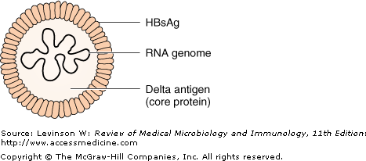

Slide 53
Hepatitis D Virus
The delta agent is a defective virus which shows similarities with the viroids in plants.
The agent consists of delta antigen surrounded by an outer coat of HBsAg.
The genome of the virus is very small and consists of a single-stranded RNA

Slide 54
Hepatitis D - Clinical Features
Coinfection
severe acute disease.
low risk of chronic infection.
Superinfection
usually develop chronic HDV infection.
high risk of severe chronic liver disease.
may present as an acute hepatitis.
Notes:
20
20
20

Slide 55
Hepatitis D Virus Modes of Transmission
Percutanous exposures
injecting drug use
Permucosal exposures
sex contact
Notes:
21
21
21

Slide 56
Treatment & Prevention
Alpha interferon can mitigate some of the effects of the chronic hepatitis caused by HDV but does not eradicate the chronic carrier state. There is no specific antiviral therapy against HDV. There is no vaccine against HDV, but a person immunized against HBV will not be infected by HDV because HDV cannot replicate unless HBV infection also occurs.

Slide 57
Hepatitis D - Prevention
HBV-HDV Coinfection
Pre or postexposure prophylaxis to prevent HBV infection.
HBV-HDV Superinfection
Education to reduce risk behaviors among persons with chronic HBV infection.
Notes:
25
25
25

Slide 58
Hepatitis E Virus
Notes:
26
26
26

Slide 59
Hepatitis E Virus
unenveloped RNA virus,
+ve stranded RNA genome
very labile and sensitive
Can only be cultured recently
Lab. Diagnosis: Acute infection is diagnosed by the detection of HEV-IgM in serum by ELISA.

Slide 60
Hepatitis E - Clinical Features
Incubation period: Average 40 days
Case-fatality rate: Overall, 1%-3% Pregnant women, 15%-25%
Illness severity: Increased with age
Chronic sequelae: None identified
Notes:
27
27
27

Slide 61
Hepatitis E Virus Infection
Typical Serologic Course
Symptoms
ALT
IgG anti-HEV
Titer
IgM anti-HEV
Virus in stool
0
1
2
3
4
5
6
7
8
9
10
11
12
13
Weeks after Exposure
Notes:
28
28
28

Slide 62
Hepatitis E -
Epidemiologic Features
Most outbreaks associated with faecally contaminated drinking water.
Several other large epidemics have occurred since in the Indian subcontinent and the USSR, China, Africa and Mexico.
Minimal person-to-person transmission.
Prevention and Control Measures for Travelers to HEV-Endemic Regions :Avoid drinking water (and beverages with ice) of unknown purity, uncooked shellfish, and uncooked fruit/vegetables not peeled or prepared by traveler.
Notes:
29
29
29

Slide 63
.
Hepatitis G virus (HGV)

Slide 64
Hepatitis G virus (HGV), also known as GB virus C, is a newly discovered member of the Flaviviridae family and is therefore distantly related to hepatitis C virus (HCV).
It is transmitted by transfusion, from mother to infant, and probably with low efficiency by sexual contact .
Persistent HGV infection, defined as detection of viremia (HGV RNA) in serum, is present in 1% to 2% of healthy volunteer blood donors.
Remarkably, HGV does not seem to cause clinically significant hepatitis.
Hepatitis G virus may reduce mortality in late HIV &may reduce HIV viral loads

Slide 65
In 1996, hepatitis G virus (HGV) was isolated from patients with posttransfusion hepatitis. HGV is a member of the flavivirus family, as is HCV. However, unlike HCV, which is clearly the cause of both acute hepatitis and chronic active hepatitis and predisposes to hepatocellular carcinoma, HGV has not been documented to cause any of these clinical findings. The role of HGV in the causation of liver disease has yet to be established, but it can cause a chronic infection lasting for decades. Approximately 60% to 70% of those infected clear the virus and develop antibodies.
HGV is transmitted via sexual intercourse and blood. It is carried in the blood of millions of people worldwide. In the United States, it is found in the blood of approximately 2% of random blood donors, 15% of those infected with HCV, and 35% of those infected with HIV. Patients coinfected with HIV and HGV have a lower mortality rate and have less HIV in their blood than those infected with HIV alone. It is hypothesized that HGV may interfere with the replication of HIV. (HGV is also known as GB virus C.)

Slide 66
Hepatitis TT virus (TTV) :Hepatitis TT virus (TTV) A novel virus associated with posttransfusion hepatitis of unknown etiology was first characterized in 1997 .The virus (referred to as TT virus for the initials of the patient in whom it was isolated and subsequently from "Torquetenovirus",

Slide 67
Hepatitis Viruses: Therapy
• Hepatitis B: interferon alpha, lamivudine;
• Hepatitis C: interferon alpha +/- ribavirin,
peglated interferon + ribavirin

Slide 68
Thank you

