Slide 1
Viral Pathogenesis
Viral pathogenesis is the process by which a viral infection leads to disease.
Viral pathogenesis is an abnormal situation of no value to the virus.
The majority of viral infections are subclinical. It is not in the interest of the virus to severely harm or kill the host.
The consequences of viral infections depend on the interplay between a number of viral and host factors.

Slide 2

Pathogenesis and Control of Viral Disease
Viral Pathogenesis (1)

Slide 3
Factors in Viral Pathogenesis
Effects of viral infection on cells (Cellular Pathogenesis)
Entry into the Host
Course of Infection (Primary Replication, Systemic Spread, Secondary Replication)
Cell/Tissue Tropism
Cell/Tissue Damage
Host Immune Response
Virus Clearance or Persistence

Slide 4
Virus-host cell interactions
Four main scenarios:
1. Multiplication of the virus and destruction of the host
cell
2. Elimination of the virus from the cell and infection
aborted without any recognizable effect on the cells
3. Survival of the infected cell in an unchanged state –
but it continues to carry the virus in a latent state
4. Survival of the infected cell in a dramatically altered or
transformed state eg transformation of a normal cell to
one having the properties of a cancerous cell

Slide 5
Effects on cells
Abortive infection
Lytic infection
Persistence
Transformation
Alteration of cellular metabolism

Slide 6
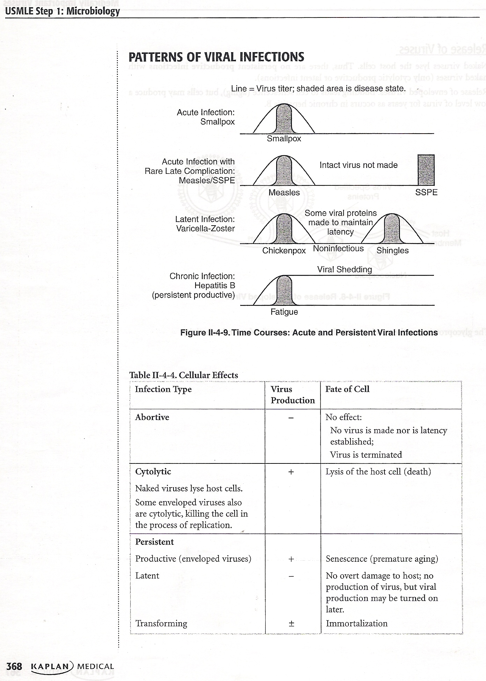

Slide 7
Cellular Pathogenesis
Cells can respond to viral infections in 3 ways: (1) No apparent change, (2) Death, and (3) Transformation
Direct cell damage and death from viral infection may result from
  diversion of the cell's energy
  shutoff of cell macromolecular synthesis
  competition of viral mRNA for cellular ribosomes
  competition of viral promoters and transcriptional enhancers for cellular transcriptional factors such as RNA polymerases, and inhibition of the interferon defense mechanisms.
Indirect cell damage can result from
  integration of the viral genome
  induction of mutations in the host genome
  inflammation
  host immune response.

Slide 8
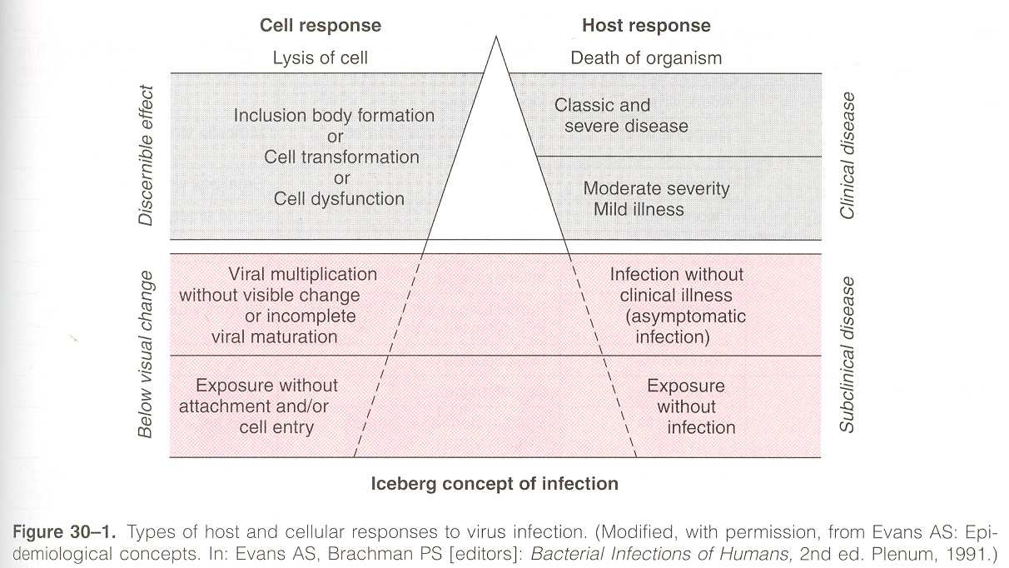

Slide 9
More than 300 viruses are known to infect humans and to cause as many as 50 different syndromes.
Steps in Viral Pathogenesis
A- Viral entry and primary replication.
B- Viral Spread and Cell Tropism.
C- Cell Injury and Clinical Illness.
D- Recovery From Infection.
E- Virus Shedding.

Slide 10
Entry
Mucous membranes or skin
  Respiratory
  Oral
  Sexual
  Ocular
  Percutaneous
    needles, wounds, bites

Slide 11
Viral Entry
Skin - Most viruses which infect via the skin require a breach in the physical integrity of this effective barrier, e.g. cuts or abrasions. Many viruses employ vectors, e.g. ticks, mosquitos or vampire bats to breach the barrier.
Conjunctiva and other mucous membranes - rather exposed site and relatively unprotected
Respiratory tract - In contrast to skin, the respiratory tract and all other mucosal surfaces possess sophisticated immune defence mechanisms, as well as non-specific inhibitory mechanisms (cilliated epithelium, mucus secretion, lower temperature) which viruses must overcome.
Gastrointestinal tract - a hostile environment; gastric acid, bile salts, etc. Viruses that spread by the GI tract must be adapted to this hostile environment.
Genitourinary tract - relatively less hostile than the above, but less frequently exposed to extraneous viruses (?)

Slide 12
1. modes of transmissions
1) Horizontal transmission: Transmission
between person of any age after birth, usually
excluding via the maternal milk.

Slide 13
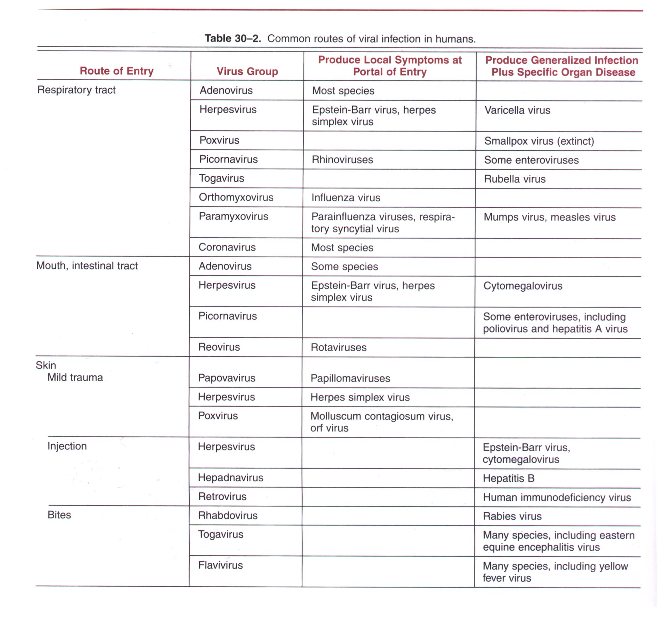
modes of transmissions
1) Horizontal transmission 2-1

Slide 14
Viral dissemination
The localization of a virus is determined at several phases of
infection:
• Penetration at the portal of entry,
• Systemic spread by viraemia or the neural route,
• Invasion of local organs or tissues.
Cellular Susceptibility (cellular receptors)
Most viruses are quite selective in the cell types that are
infected in vivo and this selectivity plays a significant role in
localization

Slide 15
2) Vertical transmission: Spread of infection parent to the young via the placenta or genital tract.
Transmission via the maternal milk is sometime included.

Slide 16
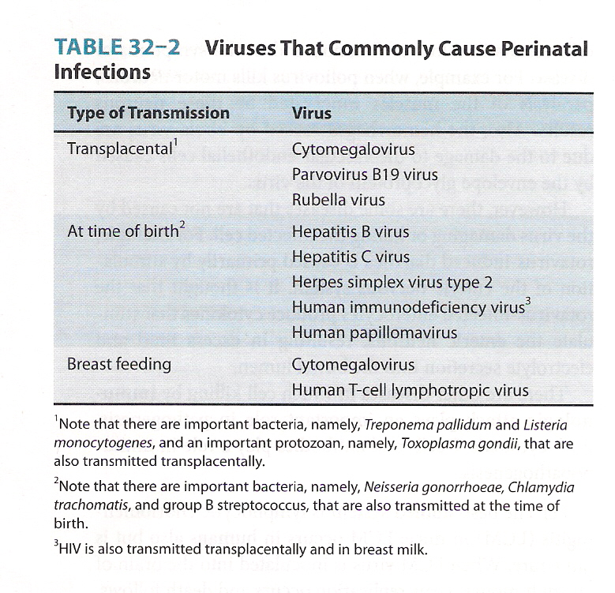

Slide 17
Course of Viral Infection
Primary Replication
  The place of primary replication is where the virus replicates after gaining initial entry into the host.
  This frequently determines whether the infection will be localized at the site of entry or spread to become a systemic infection.
Systemic Spread
  Apart from direct cell-to-cell contact, the virus may spread via the blood stream and the CNS.
Secondary Replication
  Secondary replication takes place at susceptible organs/tissues following systemic spread.

Slide 18
Cycle of infection
Entry
Shedding
Primary site
Local
Lymphatic
Neuronal
Blood (viremia)
Spread
Secondary sites
Shedding

Slide 19
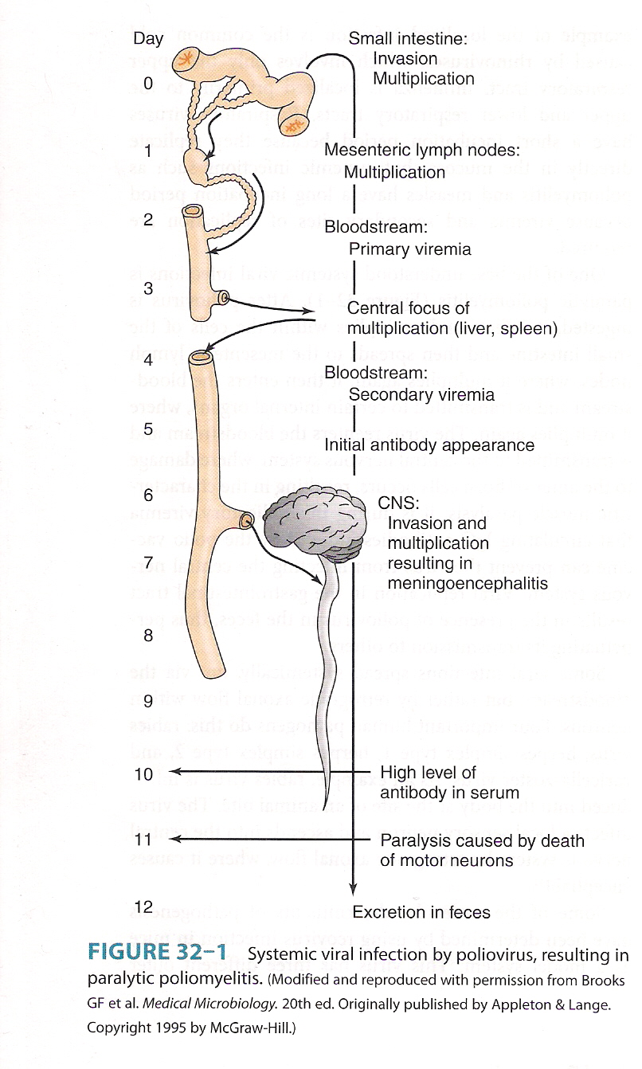

Slide 20
Shedding
Acute viral infections are characterized by brief
periods of intensive virus shedding into respiratory
aerosols, faeces, urine or other bodily secretions or
fluids
Shedding may occur in the gastrointestinal and
respiratory tracts, skin, mucous membranes, oral and
genital fluids, semen and milk, blood and urine
Persistent viruses are often shed at relatively low
titres, but this may be adequate for transmission over
the prolonged duration of infection

Slide 21
Shedding
Routes
  Respiratory
  Gastrointestinal (oral-fecal)
  Urogenital
  Skin
Mechanisms
  Indirect contact
    Aerosols
    Fomites
  Direct contact
    Lesions
    Saliva
    Sex
    Animal or insect bites
    Maternal-neonatal

Slide 22
Viremia
Presence of viruses in the blood stream – biphasic
  Primary (prodromal phase of infection)
  Secondary replication in target organs

Slide 23
Cell free viremia
Free virus particles in plasma
Accessible to antibodies and immune cells
    Parvoviruses
    Enteroviruses
    Togaviruses
    Flaviviruses

Slide 24
Cell associated viremia
Virus is hidden in blood cells
  Protected against antibodies
  Slow virus clearing
Monocytes , Macrophages
  Herpesviruses Poliovirus
  Retroviruses Measles virus

Slide 25
Cell Damage
Viruses may replicate widely throughout the body without any disease symptoms if they do not cause significant cell damage or death.
Retroviruses do not generally cause cell death, being released from the cell by budding rather than by cell lysis, and cause persistent infections.
Conversely, Picornaviruses cause lysis and death of the cells in which they replicate, leading to fever and increased mucus secretion in the case of Rhinoviruses, paralysis or death (usually due to respiratory failure) for Poliovirus.

Slide 26
Virulence
Strains of viruses differ greatly in their ability to cause disease. For example, there are strains of poliovirus that have mutated sufficiently such that they have lost the ability to cause polio in immunocompetent individuals, i.e., they are attenuated. These strains are used in vaccines. The viral genes that control the virulence of the virus are poorly characterized, and the process of virulence is poorly understood.

Slide 27
Immune Response
The immune response to the virus probably has the greatest impact on the outcome of infection.
In the most cases, the virus is cleared completely from the body and results in complete recovery.
In other infections, the immune response is unable to clear the virus completely and the virus persists.
In a number of infections, the immune response plays a major pathological role in the disease.
In general, cellular immunity plays the major role in clearing virus infection whereas humoral immunity protects against reinfection.

Slide 28
Viral Clearance or Persistence
The majority of viral infections are cleared but certain viruses may cause persistent infections. There are 2 types of chronic persistent infections.
True Latency - the virus remains completely latent following primary infection e.g. HSV, VZV. Its genome may be integrated into the cellular genome or exists as episomes.
Persistence - the virus replicates continuously in the body at a very low level e.g. HIV, HBV, CMV, EBV.

Slide 29
Summary
Viral Pathogenesis depends on the complex interplay of a large number of viral and host factors.
Viral factors include cell tropism and cellular pathogenesis.
The immune response is the most important host factor, as it determines whether the virus is cleared or not.
Sometimes, the immune response itself is responsible for the damage.

Slide 30
Thank you

