Slide 1

Future start Now
Keep Mom Happy Once

Slide 2

HMO in Milk
Sabah Mohsin Al-maamuri
Assistant Prof. Pediatrics
College of medicine
Al-Mustansiriyah University
FICPS 2021

Slide 3
Greatest gifts only by God
Breast Milk
  Most suitable nutrition for infants
  Has a unique composition
  Offers health benefits to infants
Sabah Mohsin Al-maamuri Assistant Prof. Pediatrics FICPS 2021

Slide 4

DHA
Vitamin D
HMO
LCPUFA
AA
LUTEIN
ZINC
IRON
CHOLINE
Folate
Iodine
SPHINGOMYELIN
ALPHA-LACTALBUMIN
VITAMIN B

Slide 5

History of HMO
1900
1930
1954
  Breastfed infants have a survival advantage
  Differences in the stool bacterial composition of breastfed and formula-fed infants discovered
  Mothers milk discovered to have an unidentified carbohydrate fraction
  Bifidogenic factor in human breast milk consists of oligosaccharides
  Discovery and characterisation of the most abundant oligosaccharides in human breast milk
Human breastmilk ¹
  Most suitable nutrition for infants
  Has a unique composition
  Offers health benefits to infants

Slide 6
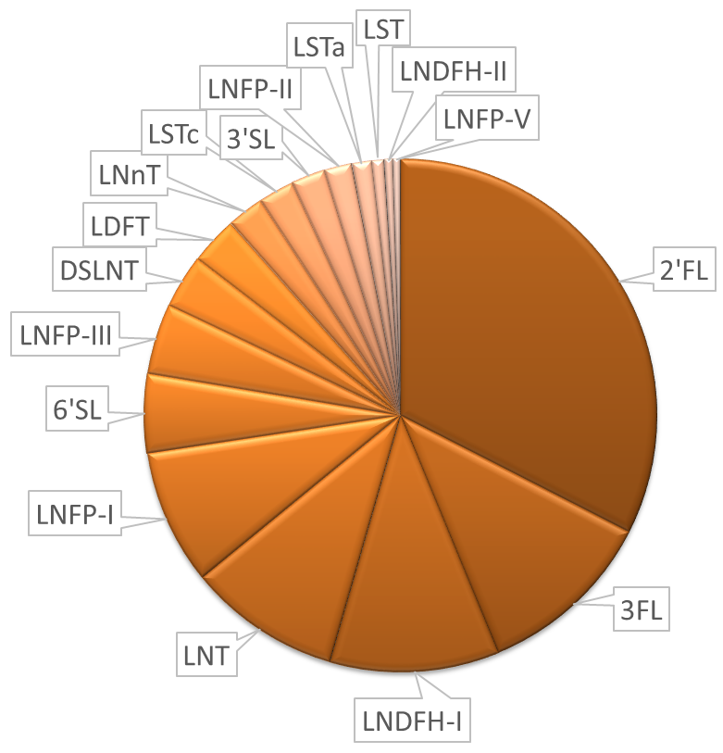
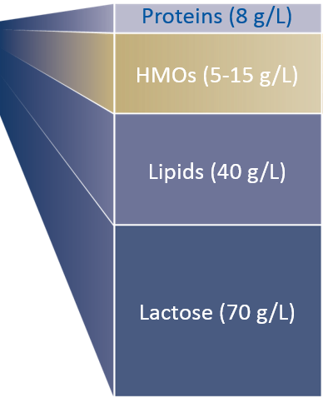


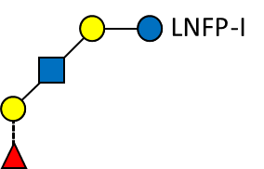
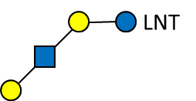


Gross Composition of Breastmilk
Human
breastmilk
Solid components
HMO
5 to 15 g/l in breastmilk
>130 structures described, of which about 15 make up the bulk (>80%)
Not generally present in farmed animal milks
Macro- & Micro-nutrients and HMO
Water

Slide 7



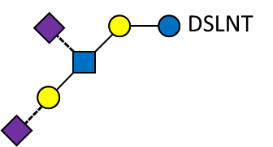
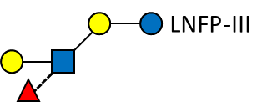
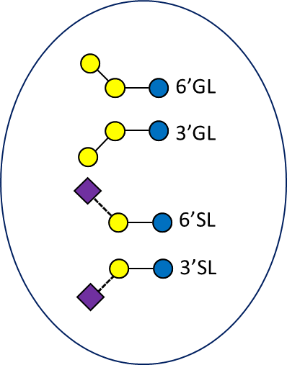
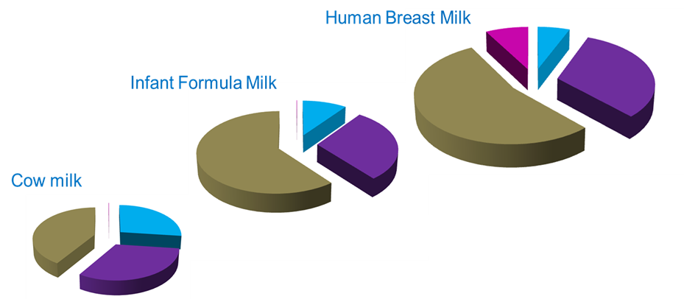
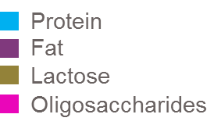
Gross Compositional Comparison
5-15 g/L HMO
8 g/L protein
40 g/L Fat
70 g/L
Lactose
 | Human milk | Bovine milk
Oligosaccharides (g/l) | 10-15 | ∼ 0.05
Number of identified oligosaccharides | >200¹ | ∼ 40
% neutral fucosylated | 50-80%² | ∼ 1%
% sialylated acidic | 10-20% | ∼ 70%
0.05 – 0.2 g/L OS

Slide 8
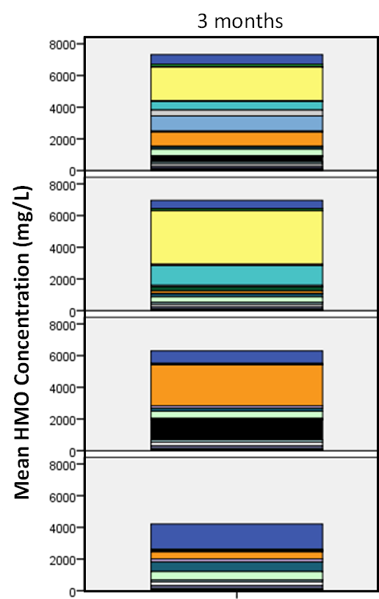
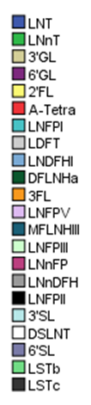
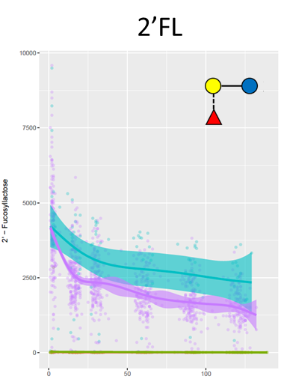
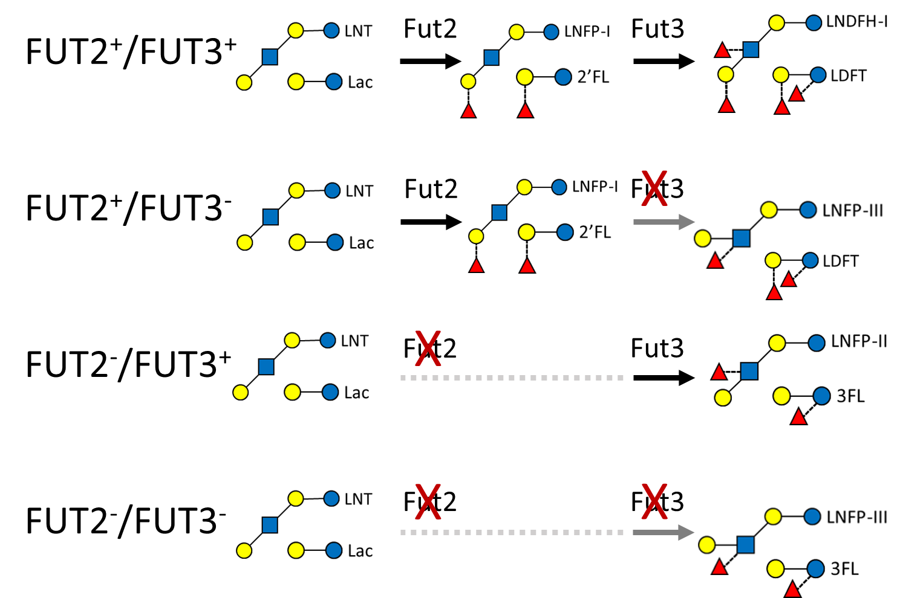
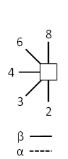
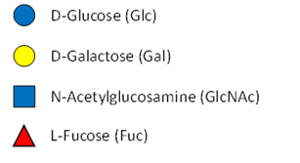
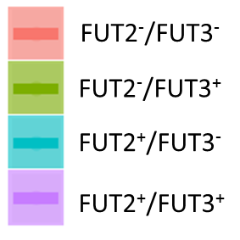
HMO composition varies depending on maternal Secretor and Lewis status
Days postpartum
Key:
Notes:
FUT2 Secretor
FUT3 Lewis
References:

Slide 9

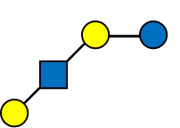




HMO composition varies depending on stage of lactation
The oligosaccharide amount and composition in human milk varies^{1,2,4}
    between individuals (interpersonal variation)
    diurnally
    by infant gestational age
    over the course of lactation
    with the mother’s nutritional status.
  The most extreme interpersonal variations are based on women’s secretor and Lewis blood group status that is determined by genetic factors.^{1,2}
Austin et al. (2016) Nutrients 8:pii: E346

Slide 10
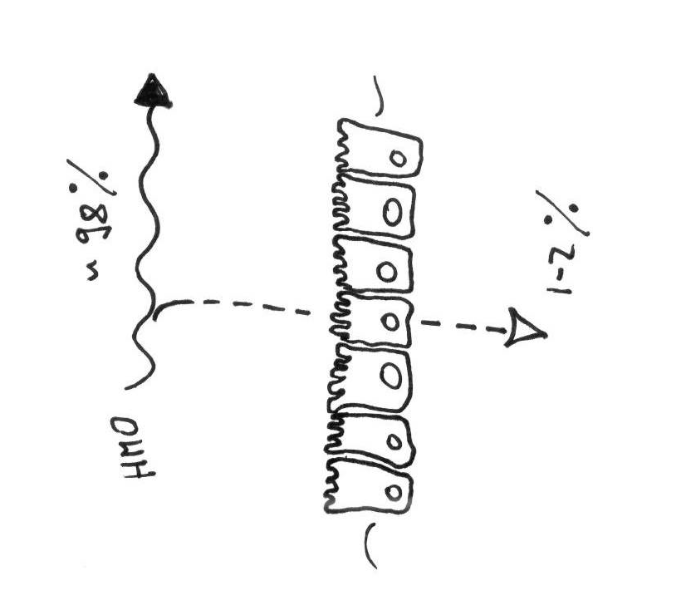



HMO Biology
Production of HMOs requires 10% of the mother’s total energy expenditure for milk production
The majority of HMOs remain intact in gut lumen and have no nutritive value
So what do HMO do?

Slide 11
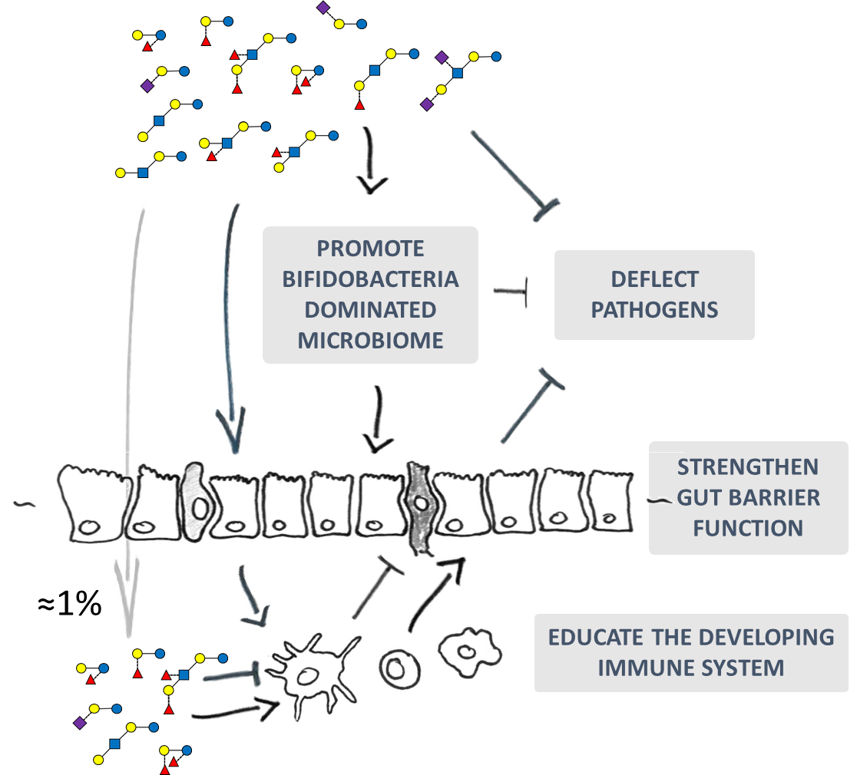
HMO Biology
HMO,
A multifunctional breast milk component
NURTURE BENEFICIAL MICROBIOTA
STRENGTHEN
GUT BARRIER FUNCTION
1
1
1
ACT AS TRAP
FOR PATHOGENS
EDUCATE THE DEVELOPING
IMMUNE SYSTEM

Slide 12
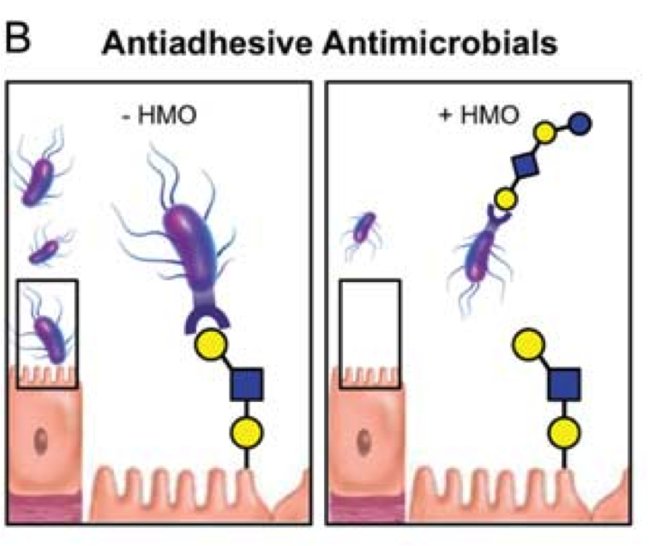
HMOs block pathogens from doing harm
HMOs function as soluble receptor analogs (decoys) that compete for bacterial binding against the intestinal mucosa¹
Many pathogens need to attach to the mucosal surface to cause infectious disease.¹
HMOs (especially fucosylated structures) resemble the host epithelial cell surface glycans (= receptors) to which pathogens adhere.^{2,3}
Pathogens (bacteria, viruses and their toxins) are deceived by the structural similarity and attach to the HMOs.⁴ HMOs thus serve as soluble decoy receptors to prevent pathogen binding to the host cell and thereby reduce the risk of infectious disease.¹
HMOs serve as decoys for pathogens.¹
1 Bode et al. Adv Nutr 2012; 2 Smilovitz et al. Annu Rev Nutr 2014; 3 Sprenger et al. Eur J Nutr 2016; 4 Jantscher-Krenn et al. Minerva Pediatr 2012

Slide 13
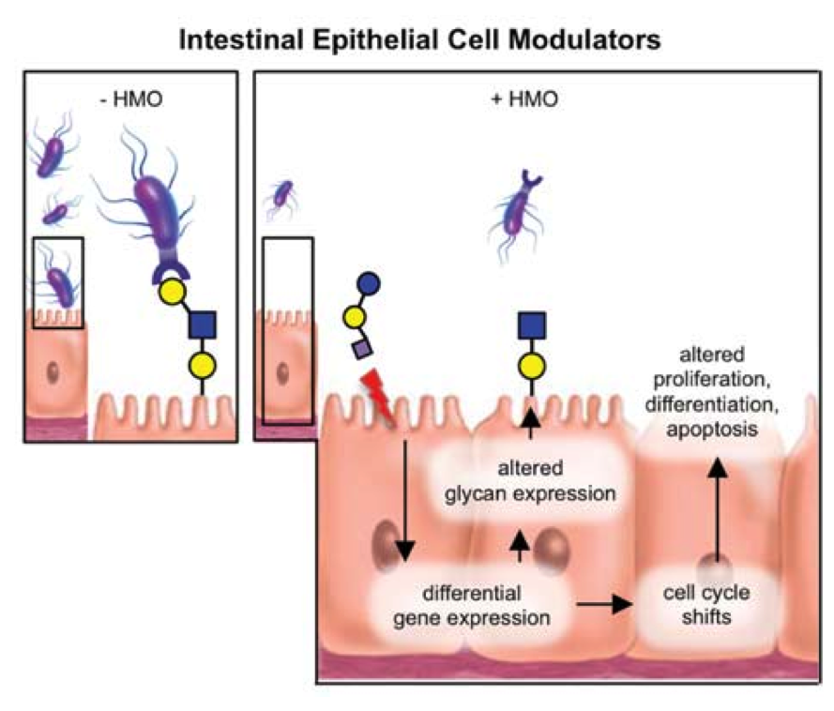
HMOs strengthen the gut barrier function
The surface of intestinal epithelial cells, like that of any living cell, is covered in glycans. They represent the first and crucial interface to the intestinal epithelial cell’s environment.¹
HMOs can directly interact with intestinal epithelial cells and modulate their glycan expression.^{2,3}
Modulating the glycans (diffrentiation, proliferation, apoptosis) of the host cell ,increasing resistance to infection.³
This effect is structure-specific and has not been shown with other types of oligosacharides such as FOS/GOS.
HMOs improve host defense by strengthening intestinal barrier function.¹
1 Angeloni et al. Glycobiology 2005; 2 Bode, Glycobiology 2012; 3 Jantscher-Krenn et al. Minerva Pediatr 2012

Slide 14
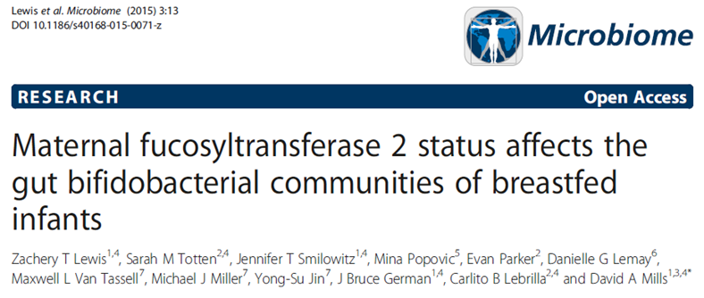
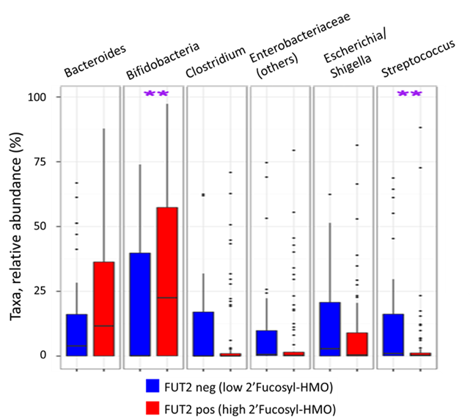
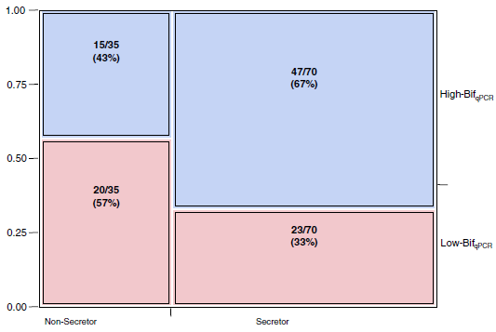
Presence of 2’Fucosyl-HMO in breast milk
Greater abundance of bifidobacteria in infant gut microbiota to 4 mo
FUT2 neg
FUT2 pos
Lewis et al. (2015) Microbiome 3:13
Smith-Brown et al. (2016) PlosONE 11:e0161211

Slide 15
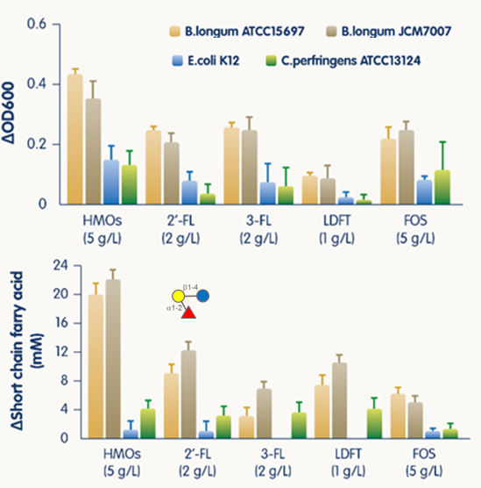
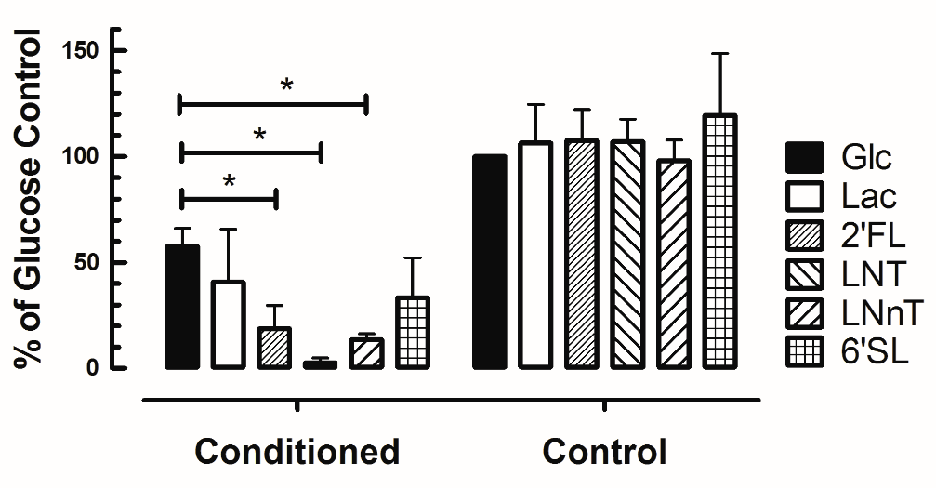
HMO stimulate bifidobacteria growth and metabolic activity
2’Fucosyl-HMO (2’FL) stimulate bifidobacteria growth and metabolic activity
HMO stimulated bifidobacteria metabolites reduce inflammatory signals and
pathogen invasion in a cell model
NFkB stimulation by Salmonella
Salmonella invasion
Yu et al. (2012) Glycobiology 23:169
Sprenger et al. NRC unpublished
Notes:
Stimulation of Bifidobacteria growth and metabolic activity leading to protection from pathogen induced inflammation and invasion
Literature and own data on …
Leads to next question: HMO and immune protection

Slide 16
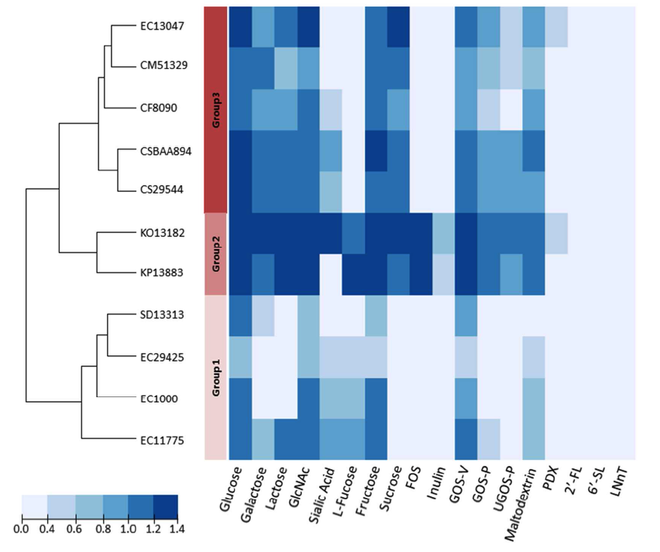
Selected Enterobacteriaceae do not grow on selected HMOs – in vitro
Results
None of the selected Enterobacteriaceae strains grew on the HMOs 2´FL, 6´SL, or LNnT, however, several strains were capable of utilizing galacto-oligosaccharides.¹
Several Enterobacteriacea strains including potentially pathogenic strains grew well on FOS, GOS and mono- and disaccharides.¹
EC1000: Escherichia coli EC1000, CF8090: Citrobacter f reundii, CSBAA894 and CS29544: Cronobacter sakazakii, CM51329: Cronobacter muytjensii, EC13047: Enterobacter cloacae subsp., EC11775: Escherichia coli O1:K1:H7, EC29425: Escherichia coli K12, KP13883: Klebsiella pneumoniae subsp., KO13182: Klebsiella oxytoca, SD13313: Shigella dysenteriae
2´FL = 2'-fucosyllactose
6´SL = 6'-sialyllactose
LNnT = lacto-N-neotetraose
HMOs
1 Hoeflinger et al. Agric Food Chem 2015; 2 Mai et al. PloS One 2011; 3 Underwood et al. Pediatr Research 2015

Slide 17

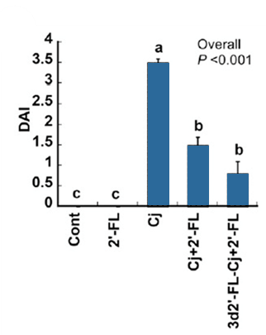
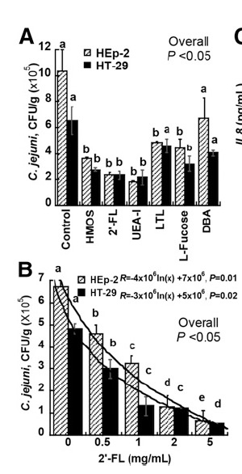
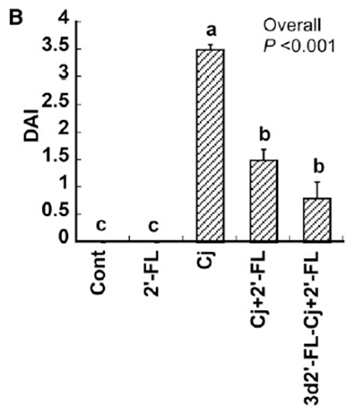
HMO protect from Campylobacter by preventing adhesion
→ Structure-Function specific effect of HMO
Adhesion
Disease Activity Index
Ruiz-Palacios et al., (2003) JBC 278:14112
Yu et al. (2016) J Nutr 146:1980

Slide 18

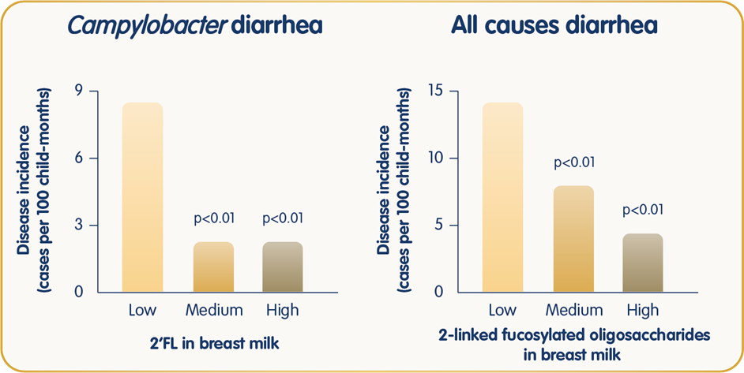
Higher
2’Fucosyl-HMO and 2’FL in breast milk
Lower incidence of
infectious diarrhea in infants at 9 mo
Morrow et al. (2004) J of Pediatrics 145:297

Slide 19
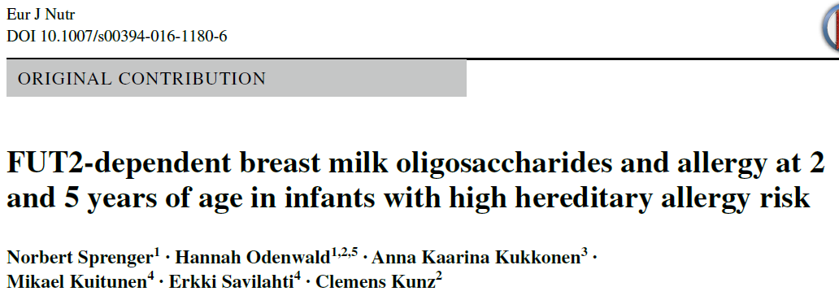
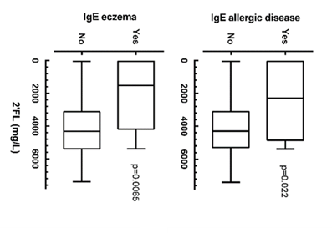
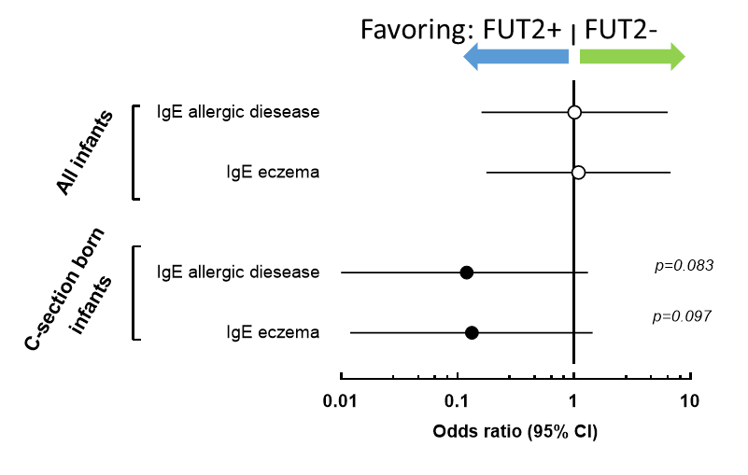
Presence of 2’Fucosyl-HMO and 2’FL levels in breast milk
Possibly related to
lower risk for IgE allergy onset at 2 years in
C-section born infants with genetic allergy risk
Sprenger et al. (2017) Eur J Nutr 56:1293

Slide 20
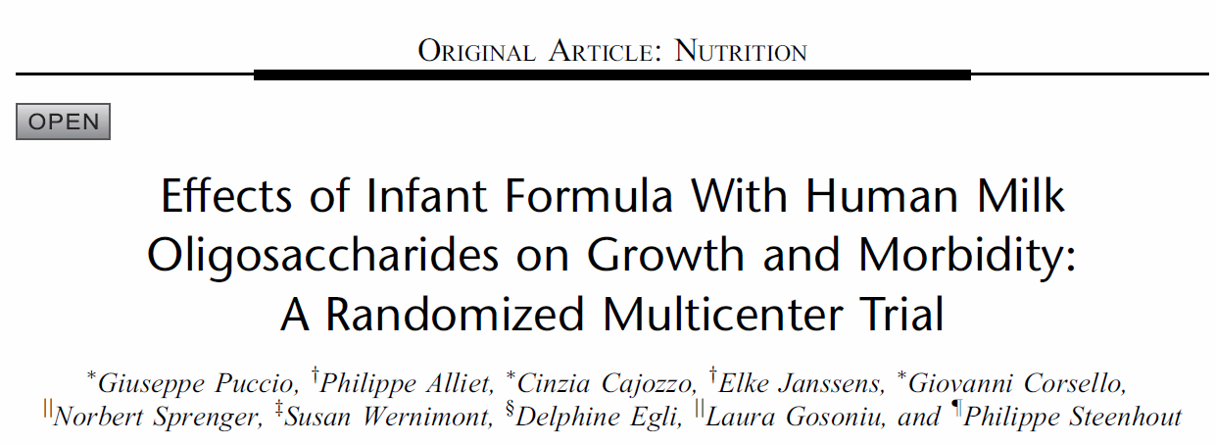
What Is Known
* Human milk contains structurally diverse oligosaccharides, which may support gastrointestinal and immune functions in breast-fed infants.
* Numerous studies have reported a lower incidence of infections, including respiratory tract infections, in breast-fed infants compared with those fed infant formula.
What Is New
* Infant formula supplemented with 2′fucosyllactose and lacto-N-neotetraose, 2 oligosaccharides commonly found in human milk, is safe, well-tolerated and supports age-appropriate growth.
* Secondary outcome findings of lower morbidity (particularly bronchitis) and medication use (antipyretics and antibiotics) were reported in infants fed supplemented formula, associations that warrant confirmation in future studies.
Puccio G et al. (2017) J Pediatr Gastroenterol Nutr.;64(4):624

Slide 21
Infants tolerated well the Test formula (2’FL+LNnT)
Behavioural patterns
Formula with 2’FL and LNnT supported similar parent-reported infant behavioral patterns (restlessness, irritability and colic) with the control group
Significantly fewer night-time wake-ups (P = .036) were reported in the formula-fed group (with 2’FL and LNnT at 2 months of age); however, this difference did not persist after 2 months of age
Among Caesarean-born infants, parents reported significantly fewer episodes of colic (P = .035) in infants receiving formulas with 2′FL and LNnT
Collectively, these tolerance findings suggest that 2’FL and LNnT added to infant formula are well tolerated and may confer improved GI comfort
Puccio G et al. (2017) J Pediatr Gastroenterol Nutr.;64(4):624

Slide 22
Infants fed a formula with 2’FL+LNnT (Test) have lower risk for infectious illnesses and related medication use
Reduced morbidity and medication use
Fewer reports of infections and infestations, lower respiratory tract illnesses, notably bronchitis through 12 months
Less antibiotics use through 12 months
Less antipyretics use through 4 months
Puccio G et al. (2017) J Pediatr Gastroenterol Nutr.;64(4):624
URT, upper respiratory tract; LRT, Lower respiratory tract.
Analyzed using Fisher’s exact tests and reported as odds ratios with 95% CIs and p values; *p<0.05, **p<0.01
Notes:
.

Slide 23
Infants fed a formula with 2’FL+LNnT (Test) have lower risk for infectious illnesses and related medication use
Number of infants with at least one event
Reported Event |  | Test (n=88) | Control (n=87) | OR (95% CI) | p values
Bronchitis | 0-4 mo | 2 (2.3%) | 11 (12.6%) | 0.16 (0.02-0.78) | p ≤ 0.01
 | 0-6 mo | 6 (6.8%) | 19 (21.8%) | 0.26 (0.08-0.74) | p ≤ 0.01
 | 0-12 mo | 9 (10.2%) | 24 (27.6%) | 0.30 (0.11-0.73) | p ≤ 0.01
LRT AE cluster | 0-4 mo | 7 (8%) | 13 (14.9%) | 0.49 (0.16-1.42) | ns
 | 0-6 mo | 13 (14.8%) | 21 (24.1%) | 0.54 (0.23-1.25) | ns
 | 0-12 mo | 17 (19.3%) | 30 (34.5%) | 0.45 (0.21-0.95) | p < 0.05
Antibiotics | 0-4 mo | 25 (28.4%) | 34 (39.1%) | 0.62 (0.31-1.22) | ns
 | 0-6 mo | 30 (34.1%) | 43 (49.4%) | 0.53 (0.27-1.02) | p < 0.05
 | 0-12 mo | 37 (42%) | 53 (60.9%) | 0.47 (0.24-0.89) | p < 0.05
Antipyretics | 0-4 mo | 14 (15.9%) | 26 (29.9%) | 0.44 (0.2-0.98) | p < 0.05
 | 0-6 mo | 23 (26.1%) | 31 (35.6%) | 0.64 (0.32-1.28) | ns
 | 0-12 mo | 28 (31.8%) | 35 (40.2%) | 0.69 (0.36-1.35) | ns
LRT, Lower respiratory tract. AE, Adverse Event.
Analyzed using Fisher’s exact tests and reported as odds ratios (OR) with 95% CIs and p values; *p<0.05, **p<0.01; ns, not statistical significant
Puccio G et al. (2017) J Pediatr Gastroenterol Nutr.;64(4):624

Slide 24
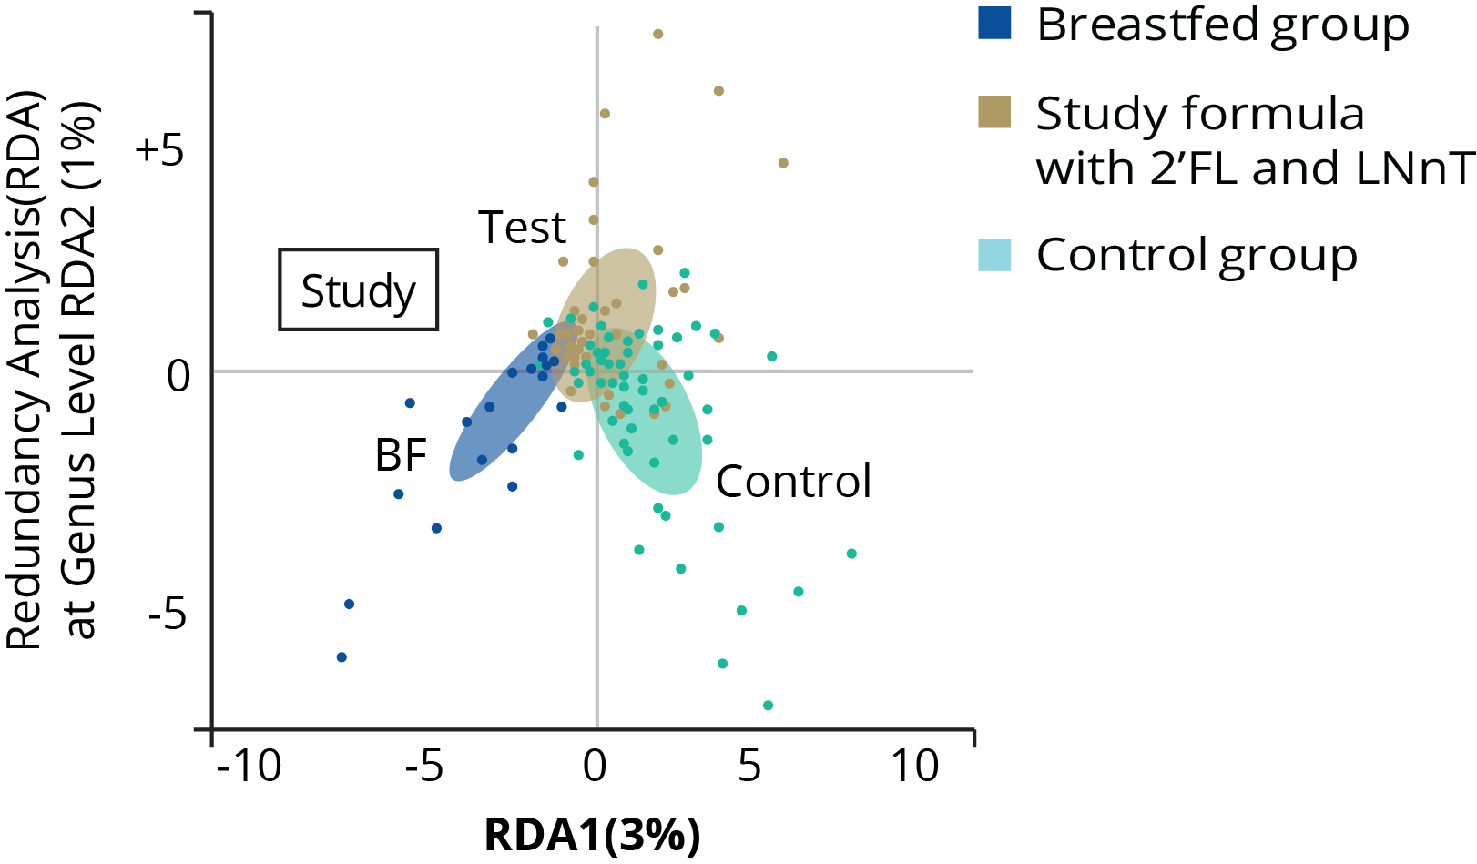
Infants fed a formula with 2’FL+LNnT (Test) have a gut microbiota close to that observed in breastfed infants (BF)
Gut Microbial Diversity (RDA Genus)
Gut microbial diversity
Formula with 2ʹFL and LNnT supported gut microbial diversity at genus level different from that of the control group (p<.001) and closer to that of breastfed infants, at 3 months of age
Redundancy analysis (RDA); filled ellipses identify the centroids of each feeding group; centroids of the control and BF groups are clearly separated, whereas centroids of the study and BF groups are partially overlapped.
Steenhout et al. (2016) FASEB J vol. 30 no. 1 Supplement 275.7

Slide 25

Let Corrects the future Now
Thank you
Sabah Mohsin Al-maamuri Assistant Prof. Pediatrics FICPS 2021

