Slide 1
3ed year sickle cell anemia
Ass. Prof. Abeer Anwer Ahmed

Slide 2
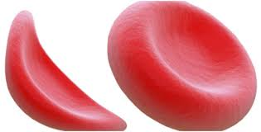
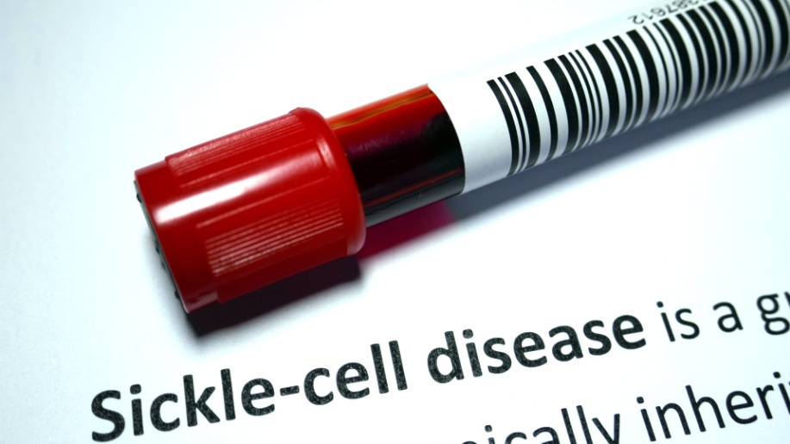
Sickle cell anaemia
Ass. Prof. Abeer Anwer Ahmed

Slide 3
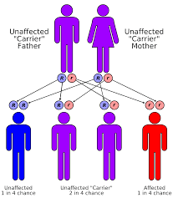
Sickle cell disease is a group of haemoglobin disorders resulting from the inheritance of the sickle β‐globin gene.
Sickle cell disease (SCD) is an
autosomal recessive

Slide 4
The sickle β‐globin abnormality is caused by substitution of valine for glutamic acid in position 6 in the β chain

Slide 5
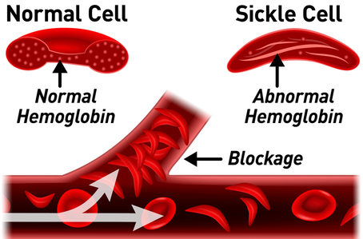
Hb S(Hb α2β2S) is insoluble and
forms crystals when exposed to
low oxygen tension Deoxygenated sickle haemoglobin polymerizes into long fibres, each consisting of seven intertwined double strands with cross‐linking
The red cells sickle and may block different areas of the microcirculation or large vessels causing infarcts of various organs.

Slide 6
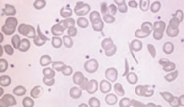

Slide 7
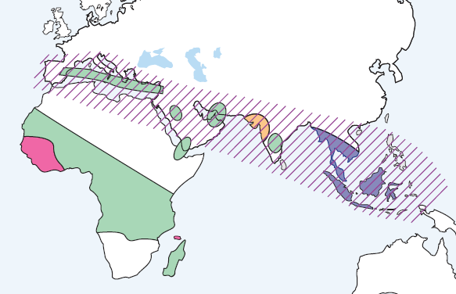
Epidemiology
The prevalence of the SCD is high in sub-Saharan Africa, Mediterranean Basin, Middle East and India because of the level of protection that the sickle cell trait provides against severe Malaria.

Slide 8
Clinical features
Homozygous disease
severe haemolytic anaemia punctuated by crises.
The symptoms of anaemia are often mild in relation to
the severity of the anaemia because Hb S gives up oxygen (O2) to tissues relatively easily compared with Hb
The clinical expression of Hb SS is very variable, some patients an almost normal life, free of crises, but others develop severe crises even as infants and may die in early childhood or as young
adults

Slide 9
crises
Vaso‐occlusive crises
Aplastic crises
Haemolytic crises

Slide 10
Vaso‐occlusive crises
Painful : These are the most frequent.
precipitated by :
Infection
Acidosis
dehydration
deoxygenation (e.g. altitude, operations, obstetric delivery,
stasis of the circulation, exposure to cold, violent exercise).
Infarcts causing severe pain occur in the bones (hips, shoulders and vertebrae are commonly affected)
The ‘hand– foot’ syndrome (painful dactylitis caused by infarcts of the small bones) is frequently the first presentation of the disease and may lead to digits of varying lengths

Slide 11
painful swollen fingers (dactylitis) in a child

Slide 12
hand–foot’ syndrome

Slide 13
Visceral:
These are caused by sickling within organs causing infarction and pooling of blood, often with a severe exacerbation of anaemia.
-The acute sickle chest syndrome is the most common cause of death
both in children and adults.
It presents with dyspnoea, falling arterial PO2, chest pain and pulmonary infiltrates on chest X‐ray.

Slide 14
-Splenic sequestration is typically seen in infants and presents with an enlarging spleen, falling haemoglobin and abdominal pain.
Treatment is with transfusion.
Attacks tend to be recurrent and splenectomy is often needed.
-Priapism and liver and kidney damage due to repeated small infarcts are other complications

Slide 15
Aplastic crises
These occur as a result of:
- infection with parvovirus
- folate deficiency
characterized by:
a sudden fall in haemoglobin
and reticulocytes.
usually requiring transfusion

Slide 16
Haemolytic crises
These are characterized by :
-an increased rate of haemolysis and
-fall in haemoglobin
-but rise in reticulocytes
- and usually accompany a painful crisis

Slide 17
Other organ damage
The most serious is of the brain (a stroke occurs in 7% of all patients) or spinal cord.
Up to a third of children have had a
silent cerebral infarct by the age of 6 years.
Ulcers of the lower legs are common, as a result of vascular stasis and local ischaemia

Slide 18
necrosis and ulceration

Slide 19
-spleen is enlarged in infancy and early childhood but later is often reduced in size as
a result of infarcts (autosplenectomy).
-Pulmonary hypertension
-Infections are frequent partly due to hyposplenism.
Pneumonia, urinary tract infections and Gram‐negative septicaemia are common. Osteomyelitis may also occur, usually from Salmonella spp.

Slide 20
Laboratory findings
1 The haemoglobin is usually 60–90 g/L – low in comparison
to mild or no symptoms of anaemia.
2 Sickle cells and target cells occur in the blood .
Features of splenic atrophy (e.g. Howell–Jolly bodies) may
also be present.
3 Screening tests for sickling are positive when the blood is
deoxygenated .
4 HPLC or haemoglobin electrophoresis :in Hb
SS, no Hb A is detected. The amount of Hb F is variable
and is usually 5–15%, larger amounts are usually associated
with a milder disorder.

Slide 21
Sickle cell anaemia: peripheral blood film showing deeply staining sickle cells, target cells and polychromasia.

Slide 22
Sickle cell trait
This is a benign condition with no anaemia and normal appearance of red cells in a blood film. Haematuria is the most common symptom and is thought to be caused by minor infarcts of the renal papillae.
Hb S varies from 25–45% of the
total haemoglobin
Care must be taken with anaesthesia,
pregnancy and at high altitudes.

Slide 23
Thank you

