Slide 1
Chronic myeloid leukaemia
Ass.Prof.Abeer Anwer Ahmed

Slide 2
Chronic myeloid leukaemia BCR‐ABL1+ (CML) is a clonal
disorder of a pluripotent stem cell. The disease accounts for around 15% of leukaemias and may occur at any age. The
diagnosis of CML is rarely difficult and is assisted by the characteristic presence of the Philadelphia (Ph) chromosome.
This results from the t(9;22) (q34;q11) translocation between chromosomes 9 and 22, as a result of which part of the oncogene ABL1 is moved to the BCR gene on chromosome 22 and part of chromosome 22 moves to chromosome 9

Slide 3
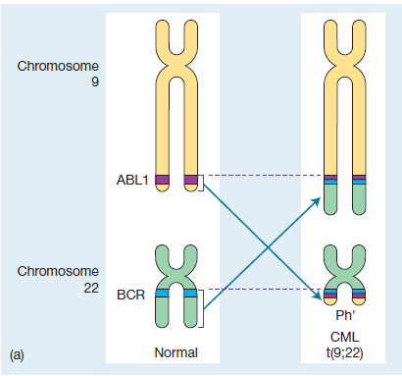
There is translocation of part of the long arm of chromosome 22 to the long arm of chromosome 9 and reciprocal translocation of part of the long arm of chromosome 9 to chromosome 22 (the Philadelphia chromosome). This reciprocal translocation brings most of the ABL1‐gene into the BCR region on chromosome 22 (and part of the BCR gene into juxtaposition with the remaining portion of ABL on chromosome 9).

Slide 4
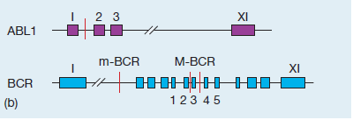
The breakpoint in ABL1 is between exons 1 and 2.
The breakpoint in BCR is at one of the two points in the major breakpoint cluster region (M‐BCR) in chronic myeloid leukaemia (CML) or in some cases of Ph+ acute lymphoblastic leukaemia (ALL).

Slide 5
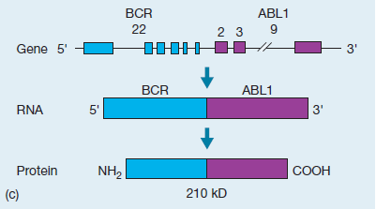
This results in a 210‐kDa fusion protein product derived from the BCR‐ABL1 fusion gene.
In other cases of Ph+ ALL, the breakpoint in BCR is at a minor breakpoint cluster region (m‐BCR) resulting in a smaller BCR‐ABL1 fusion gene and a 190‐kDa protein

Slide 6
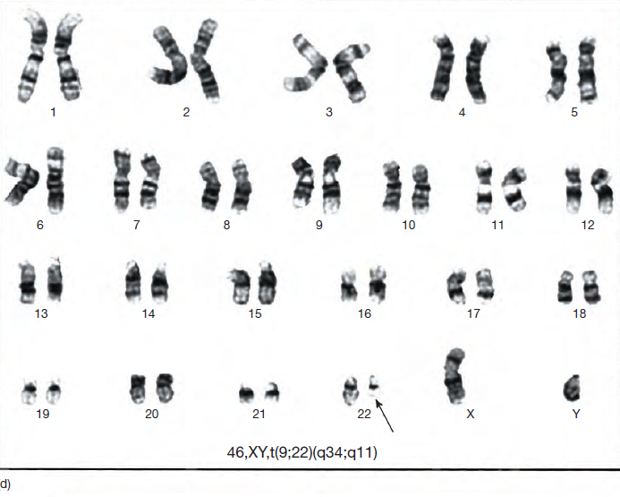
Karyotype showing the t(9;22) (q34;q11) translocation. The Ph chromosome is arrowed

Slide 7
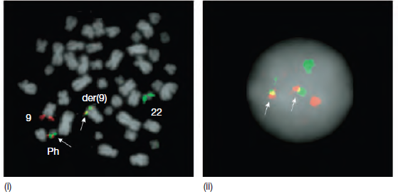
Visualization of the Ph chromosome on: (i) dividing (metaphase); and
(ii) quiescent (interphase) cells by fluorescence in situ hybridization (FISH) analysis
(ABL probe in red and BCR probe in green) with fusion signals (red/green which shows as yellow) on the Ph (BCR‐ABL1) and der(9)
(ABL1‐BCR) chromosomes

Slide 8
Chronic myeloid leukaemia (CML) and myelodysplastic/myeloproliferative neoplasms
Type
BCR‐ABL1 rearrangement positive CML
BCR‐ABL1 rearrangement negative CML
Chronic neutrophilic leukaemia
Chronic eosinophilic leukaemia
Chronic monocytic leukaemia
Chronic myelomonocytic leukaemia
Juvenile myelomonocytic leukaemia
Refractory anaemia with ringed sideroblasts and
thrombocytosis
NB All the diseases except BCR‐ABL1 positive CML are rare.

Slide 9
The abnormal chromosome 22 is the Ph chromosome. In
the Ph translocation 5′ exons of BCR are fused to the 3′ exons
of ABL1
The resulting chimeric BCR‐ABL1 gene codes for a fusion protein of size 210 kDa (p210).
This has tyrosine kinase activity in excess of the normal 145‐kDa ABL1 product.
The Ph translocation is also seen in a minority
of cases of acute lymphoblastic leukaemia (ALL) and in some
of these the breakpoint in BCR occurs in the same region as in
CML.
However, in other cases the breakpoint in BCR is further
upstream, in the intron between the first and second exons,
leaving only the first BCR exon intact.
This chimeric BCRABL1 gene is expressed as a p190 protein which, like p210, has enhanced tyrosine kinase activity

Slide 10
In most patients the Ph chromosome is seen by karyotypic examination of tumour cells, but in a few
the Ph abnormality cannot be seen under the microscope but
the same molecular rearrangement is detectable by more sensitive techniques: fluorescence in situ hybridization (FISH) or by reverse transcriptase PCR (RT‐PCR) for
BCR‐ABL1 transcripts.
This Ph‐negative BCR‐ABL1‐positive CML behaves clinically like Ph‐positive CML. As the Ph chromosome
is an acquired abnormality of haemopoietic stem cells
it is found in cells of both the myeloid (granulocytic, erythroid and megakaryocytic) and lymphoid (B and T cell) lineages.

Slide 11
The main cause of death in CML is transformation to a blast phase, which may be preceded by an accelerated phase. These
are discussed later in this chapter.
BCR-ABL1‐negative chronic myeloid leukaemia is classified
with the myelodysplastic/myeloproliferative syndromes

Slide 12
Clinical features
This disease occurs in either sex (male : female ratio of (1.4 : 1)
most frequently between the ages of 40 and 60
years.
However, it may occur in children and neonates, and in the very old.
In up to 50% of cases the diagnosis is made
incidentally from a routine blood count

Slide 13
1 Symptoms related to hypermetabolism (e.g. weight loss,
lassitude, anorexia or night sweats).
2 Splenomegaly is nearly always present and may be massive.
In some patients splenic enlargement is associated with
considerable discomfort, pain or indigestion.
3 Features of anaemia may include pallor, dyspnoea and tachycardia.
4 Bruising, epistaxis, menorrhagia or haemorrhage from other
sites because of abnormal platelet function.
5 Gout or renal impairment caused by hyperuricaemia from
excessive purine breakdown may be a problem.
6 Rare symptoms include visual disturbances and priapism

Slide 14
Laboratory findings
1 Leucocytosis is the main feature and may reach levels greater
than 200 × 109/L .A complete spectrum of
myeloid cells is seen in the peripheral blood. The levels of
neutrophils and myelocytes exceed those of blast cells and
promyelocytes .
2 Increased circulating basophils are a characteristic feature.
3 Normochromic normocytic anaemia is usual.
4 Platelet count may be increased (most frequently), normal
or decreased.
5 Bone marrow is hypercellular with granulopoietic predominance.
6 Presence of the BCR‐ABL1 gene fusion by RT‐PCR analysis
and in 98% of cases Ph chromosome on cytogenetic
analysis .
7 Serum uric acid is usually raised

Slide 15
Chronic myeloid leukaemia: peripheral blood film showing various stages of granulopoiesis including promyelocytes, myelocytes, metamyelocytes and band and segmented neutrophils.

Slide 16
Prognostic scores (stages)
Attempts have been made to stage CML at presentation
in order to predict prognosis. The most frequently used is
the Sokal score, which takes account of :
age,
blast cell percentage,
spleen size
and platelet count.
However the rate of response to a tyrosine kinase inhibitor is now a more useful
measure.

Slide 17
Treatment
Treatment of chronic phase
Tyrosine kinase inhibitors (TKI) are the mainstay of the treatment of CML and several different drugs are now available.
α‐Interferon
This was often used after the white cell count had been controlledby hydroxycarbamide but
has now been replaced by IM
Allogeneic SCT is a potentially curative treatment for CML but because of the risks associated with the procedure, it is
usually reserved for TKI failures

Slide 19
Definition of the response to TKIs as first‐line treatment in CML As examples, BCR‐ABL1 ≤10% refers to the fact that the BCR‐ABL1 transcript level has been reduced to less than 10% of the ABL1 level.
Ph+ ≤35% indicates that the number of Philadelphia‐positive chromosomes in cells in the bone marrow is less than 35% of the total number that are examined

Slide 20
response to TKIs

Slide 21
Accelerated phase disease and blastic transformation
Acute transformation (greater than 20% blasts in blood or marrow) may occur rapidly over days or weeks
More commonly there is an accelerated phase with anaemia,
thrombocytopenia (platelets less than 100 × 109/L), increase in blood basophils to greater than 20% or marrow blast cells 10–19% with blast cells in the blood

Slide 22
The spleen may be enlarged despite control of the blood count and the marrow may be fibrotic.
New clonal chromosomal or molecular abnormalities
may appear.
The patient may be in this phase for several months, during which the disease is less easy to control than in the chronic phase.
In approximately one‐fifth of cases of acute transformation this is lymphoblastic and patients may
be treated in a similar way to ALL, with a number of patients returning to the chronic phase for months or even a year or two

Slide 23
In the majority, transformation is into
acute myeloid leukaemia
or mixed types.
These are more difficult to treat and
survival is rare beyond 1 year.
TKI are valuable in the management of blastic transformation but resistance to treatment
usually occurs within a few weeks.
Allogeneic SCT is a valuable option where possible.

Slide 24
Chronic myeloid leukaemia: acute myeloblastic transformation. Peripheral blood film showing frequent myeloblasts

Slide 25
Chronic neutrophilic leukaemia
These patients have no inflammatory or other causes of neutrophilia and no evidence for any other myeloproliferative disease.
They may have mild splenomegaly.
Activating mutations in the gene encoding the receptor for colony stimulating factor 3 (CSF3R) are found in most patients and kinase inhibitors
may be useful. The prognosis is variable

Slide 26
Chronic eosinophilic leukaemia
Chronic eosinophilic leukaemia is a clonal persistent eosinophilia
(greater than 1.5 × 109/L).
There may be an interstitial lesion in chromosome 4 resulting in FIP1L1‐PDGFRA fusion gene (in which case there is a response to tyrosine kinase inhibitors)
or other less frequent cytogenetic or molecular defects.
There may be greater than 5% but less than 20% blasts in the
marrow.
The cells may infiltrate various organs causing damage
(e.g. endomyocardial fibrosis, lung, CNS, skin and gastrointestinal
tract). If clonality cannot be shown and blasts are less than
5%, the condition is diagnosed as hypereosinophilic syndrome

