Slide 1
Endometrial hyperplasia and CA د.الاء ابراهيم

Slide 2
Objective:
1. Demonstrate the types, risk factors of endometrial hyperplasia and ca endometrium.
2. Define the stages of endometrial cancer.
3. interpret the clinical finding at examination and summarize the result of investigation.
4. Interpret the management according to the stages.

Slide 3
Definition:
Endometrial hyperplasia is defined as irregular proliferation of the endometrial glands with an increase in the gland to stroma ratio when compared with proliferative endometrium.
• The incidence of endometrial hyperplasia is estimated to be at least three times higher than endometrial cancer and if left untreated it can progress to cancer.
• The most common presentation of endometrial hyperplasia is abnormal uterine bleeding.
This include; heavy menstrual bleeding, intermenstrual bleeding, irregular bleeding, unscheduled bleeding on hormone replacement therapy (HRT) and postmenopausal bleeding.

Slide 4
The risk factors
What are the risk factors for endometrial hyperplasia?
1.unopposed by progesterone.
2.Increased body mass index (BMI).
3. Anovulation associated with the polycystic ovary syndrome(PCOS).
4. Estrogen-secreting ovarian tumours, e.g. granulosa cell tumours (with up to 40% prevalence of endometrial hyperplasia).
5. Drug-induced endometrial stimulation, e.g. the use of systemic estrogen replacement therapy or long-term tamoxifen.
6. Immunosuppression.
7. Infection.

Slide 5
Classification:
How should endometrial hyperplasia be classified?
• The revised 2014 World Health Organization (WHO) classification is recommended.
This separates endometrial hyperplasia into two groups based upon the presence of cytological atypia: (i) hyperplasia without atypia.
(ii) atypical hyperplasia.
• Classification systems for endometrial hyperplasia were developed based upon histological characteristics and oncogenic potential.

Slide 6
Diagnosis:
It requires histological examination of the endometrial sampling by outpatient endometrial biopsy.
✓ Obtained by using outpatient suction devices aspirate endometrial tissue from the uterine cavity or by inpatient endometrial sampling, such as dilatation and curettage performed under general anesthesia.
✓ Endometrial sampling is also fundamental in monitoring regression, persistence or progression.
• Diagnostic hysteroscopy should be considered to facilitate or obtain an endometrial sample, especially where outpatient sampling fails or is nondiagnostic.
Direct visualization and biopsy of the uterine cavity using hysteroscopy should be undertaken where endometrial hyperplasia has been diagnosed within a polyp or other discrete focal lesion.
• Transvaginal ultrasound may have a role in diagnosing endometrial hyperplasia in pre and post menopausal women; that detects an irregularity of the endometrial profile.

Slide 7
How should endometrial hyperplasia without atypia be managed?
• Women should be informed that the risk of endometrial hyperplasia without atypia
progressing to endometrial cancer is less than 5% over 20 years and that the majority will regress spontaneously during follow-up.
• Reversible risk factors such as obesity and the use of HRT should be identified and addressed if possible.
Treatment:
Both continuous oral and local intrauterine [LNG-IUS] progestogens are effective in achieving regression of endometrial hyperplasia without atypia, Continuous progestogens should be used (medroxyprogesterone 10–20 mg/day or norethisterone10–15 mg/day) for women who decline the LNG-IUS. should be for a minimum of 6 months in order to induce histological regression.

Slide 8
What should the initial management of atypical hyperplasia be?
• Women with atypical hyperplasia should undergo a total hysterectomy because of the risk of underlying malignancy or progression to cancer.
• Postmenopausal women with atypical hyperplasia should be offered bilateral salpingo-oophorectomy together with the total hysterectomy.

Slide 9
Endometrial cancer:
The typical age-incidence curve for endometrial cancer shows that most cases are diagnosed after the menopause, with the highest incidence around the seventh decade of life.
Etiology:
The Estrogen—Persistent stimulation of endometrium with unopposed estrogen is the single most important factor. such as functioning ovarian tumors (granulosa cell) or polycystic ovarian syndrome (PCOS) and Unopposed estrogen replacement therapy in postmenopausal women.
Age—About 75 percent are postmenopausal with a median age of 60 and10 percent of women with postmenopausal bleeding have endometrial cancer.
Parity—nulliparity is associated in about 30 percent.
Late menopause—The chance of carcinoma increases, if menopause fails to occur beyond 52 years.
Corpus cancer syndrome — encompasses – obesity, hypertension and diabetes Obesity leads to high level of free estradiol as the sex hormone binding globulin level is low.
Use of cyclic progestin reduces the risk. Prior use of combined oral contraceptives reduces the risk significantly (50%).
Tamoxifen is antiestrogenic as well as weakly estrogenic. It is used for the treatment of breast cancer. Increased risk of endometrial cancer is noted when it is used for a long time due to its weak estrogenic effect.
Family history or personal history of colon, ovarian or breast cancer increases the risk of endometrial cancer. Genetic inheritance (Lynch 11 syndrome family).
Fibroid is associated in about 30 percent cases.
Endometrial hyperplasia precedes carcinoma in about 25 percent cases.

Slide 10
Pathology:
Naked eye—The uterus may be smaller, normal or even enlarged (due to myohyperplasia, myometrial involvement, pyometra or associated fibroid).
Two varieties are found: 
Localized: The usual site is on the fundus. It is either sessile or pedunculated. Myometrial involvement is late
 Diffuse: The spread is through the endometrium. The myometrium is commonly invaded; may invade to reach the serosal coat.
Microscopic appearances:The following varieties are noted:
Adenocarcinoma (endometrioid 80%).
Adenocarcinoma with squamous elements.
Papillary serous carcinoma (5–10%).
Mucinous adenocarcinoma (5%).
Clear cell adenocarcinoma (5%).
Secretory carcinoma (1%).
Squamous cell carcinoma.
Mixed carcinoma.

Slide 11
Spread:
Direct: As it is slow growing, it is confined to the stroma for a long time but eventually, it spreads in all directions. Thus, it may infiltrate the myometrium and spread to the parametrium or into the peritoneal cavity. It may spread downwards to involve the cervix in about 15 percent.
Lymphatic: The lymphatic spread is usually late and involves pelvic, paraaortic (through infundibulopelvic ligament) and rarely inguinal and femoral nodes. It is the most important prognostic factor. The tubes and ovaries are involved (3–5%) either by direct spread or by lymphatics.
Lymph node metastasis depends on the degree of tumor differentiation, myometrial invasion, tumor size and the surgical pathological stage of the disease.
Hematogenous: it occurs late. The common sites of metastases are lungs, liver, bones and brain.

Slide 12
Staging:
Staging: The staging is based on endometrial histology and surgical evaluation, adopted by FIGO. Approximately 75 percent patients present with stage I disease.
Although this is a surgical classification, MRI may be offered
FIGO staging of carcinoma of the uterus
1 Confined to uterine body
1a Less than 50% invasion of myometrium
1b More than 50% invasion
2 Tumour invading cervical stroma
3 Local and or regional spread of
3a Invades serosa of uterus
3b Invades vagina and/or parametrium
3c Metastases to pelvic and/or para aortic LN.
4 Tumour invades bladder ± bowel

Slide 14
Clinical features:
Patient profile: The patient is usually a nullipara, likely to be postmenopausal. There may be history of delayed menopause. She may be obese; likely to have hypertension or diabetes.
Symptoms:
1.Postmenopausal bleeding (75%). In premenopausal women, there may be irregular and excessive bleeding. At times, there is watery and offensive discharge due to pyometra.
2.Pain is not uncommon. It may be colicky due to uterine contractions in an attempt to expel the polypoidal growth.
3.Few patients (< 5%) remain asymptomatic.
Signs: There may be varying degrees of pallor.
Pelvic examination: Speculum examination reveals the cervix looking healthy and the blood or purulent offensive discharge escapes out of the external os.
Bimanual examination reveals—The uterus is either atrophic, normal or may be enlarged due to spread of the tumor, associated fibroid or pyometra. The uterus is usually mobile unless in late stage, when it becomes fixed.
Rectal examination corroborates the bimanual findings.
Regional lymph nodes and breasts are examined carefully.

Slide 15
Diagnosis: The following guidelines are prescribed:
A case of postmenopausal bleeding is considered to be due to endometrial carcinoma unless proved otherwise.
x History and clinical examination are to be recorded, as mentioned earlier.
x Endometrial biopsy – using a Sharman curette or a soft, flexible, plastic suction cannula (pipelle) has been done with reliability (90%). This is done as an outpatient procedure. Histology is the definitive diagnosis.
x Ultrasound and color Doppler (TVS): Findings suggestive of endometrial carcinoma are —
(i) Endometrial thickness > 4 mm.
(ii) Hyperechoic endometrium with irregular outline.
(iii) Increased vascularity with low vascular resistance.
(iv) Intrauterine fluid. However, it cannot replace definitive biopsy.
x Hysteroscopy—It helps in direct visualization of endometrium and to take target biopsy.

Slide 16
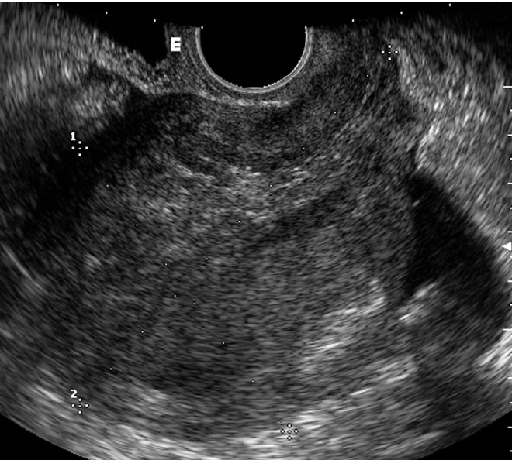

Slide 18
Fractional curettage—It is not only the definite method of diagnosis but can detect the extent of growth.
 Computed Tomography (CT) scan of pelvis and abdomen may be used to detect lymph node metastases.
 Magnetic Resonance Imaging (MRI) can detect myometrial invasion.
 Surgical staging: Increased inaccuracy of clinical staging and the importance of prognostic factors.

Slide 19
Management
As the majority of patients present with stage 1 disease, surgery is the most common treatment for endometrial cancer.
1.The surgery; The extent of surgery will depend on a number of factors including; grade of disease(G1 well differentiated ,G2 moderately differentiated ,G3 poorly differentiated, MRI stage and the patient’s co morbidities.
The standard surgery is a total hysterectomy, bilateral sapingo- oophorectomy. This can be performed abdominally or laparoscopically (Total, vaginally assisted or robotically If the patient is low grade (grades 1-2) or MRI staging suggests disease less than stage 1B, then this surgery is adequate.
Gross cervical involvement or If MRI staging suggests cervical involvement, a radical hysterectomy with bilateral salpingo-oophorectomy and pelvic wash with pelvic and paraortic node dissection can be performed . If the tumour is high grade (grade 3) or papillary serous, many centres will perform pelvic and para-aortic node dissection as the risk of nodal disease (to either pelvis or para-aorticchain) can be as high as 30%.

Slide 20
Radiotherapy has been proven to be effective for patients that are not candidate for surgery whose disease limited to the uterus .
Combined radiation and surgery: Radiation (external and intracavitary) followed in 6 weeks by total abdominal hysterectomy and bilateral salpingo-oophorectomy.
or Initial surgery (modified radical hysterectomy) followed by external and intravaginal radiation.
Adjuvant rediotherapy (brachytherapy and pelvic radiation) reduces loco-regional recurrence in cases with high risk endometrial cancer.
In locally advanced disease: Adjuvant chemotherapy followed by pelvic radiation is done. Combination chemotherapy is commonly used.
Drugs comprise: adriamycin, cisplatin and cyclophosphamide.

