Slide 2
Sickling in whole blood
The sickling phenomenon may be demonstrated in a thin
wet film of blood (sealed with a petroleum jelly/paraffin
wax mixture or with nail varnish). If haemoglobin S
is present, the red cells lose their smooth, round shape
and become sickled. This process may take up to 12 h in
haemoglobin S trait, whereas changes are apparent in homozygotes
and compound heterozygotes after 1 h at 37 °C.
These changes can be hastened by the addition of a
reducing agent such as sodium dithionite as follows:

Slide 3
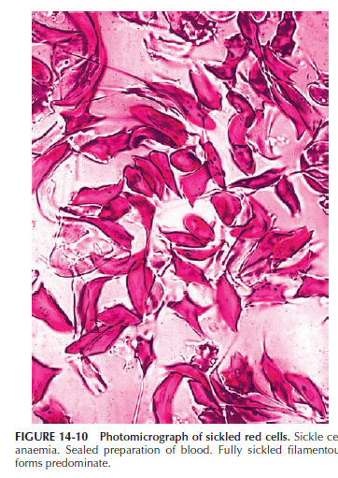

Slide 4
Reagents
• Disodium hydrogen phosphate (Na2HPO4). 0.114 mol/l (16.2 g/l)
• Sodium dithionite (Na2S2O4). 0.114 mol/l (19.85 g/l).
Prepare freshly just before use.
• Working solution. Mix 3 volumes of Na2HPO4 with 2 volumes
of Na2S2O4 to obtain a pH of 6.8 in the resultant
solution. Use immediately

Slide 5
Method
Add 5 drops of the freshly prepared reagent to 1 drop of
anticoagulated blood on a slide. Seal between slide and
coverslip with a petroleum jelly/paraffin wax mixture or
with nail varnish. Sickling takes place almost immediately
in sickle cell anaemia and should be obvious in sickle cell
trait within 1 h (Fig. 14-10). A test on a positive control
containing haemoglobin A plus haemoglobin S must be
performed at the same time.

Slide 6
Haemoglobin S solubility test
Principle
Sickle cell haemoglobin is insoluble in the deoxygenated
state in a high molarity phosphate buffer. The crystals that
form refract light and cause the solution to be turbid

Slide 7
Reagents
• Phosphate buffer. Anhydrous dipotassium hydrogen
phosphate, 215 g; anhydrous potassium dihydrogen
phosphate, 169 g; sodium dithionite, 5 g; saponin, 1 g;
water to 1 litre.
Note: Dissolve the K2HPO4 in water before adding the
KH2PO4, then add the dithionite and finally the saponin.
This solution is stable for 7 days. Store refrigerated.

Slide 8
Method
1. Pipette 2 ml of reagent into three 12 × 75 mm test tubes.
2. Allow the reagent to warm to room temperature.
3. Add 10 μl of packed cells (from EDTA-anticoagulated
blood) to one tube, 10 μl of packed cells from a known
sickle cell trait subject as a positive control to the second
tube and 10 μl packed cells from a normal subject
as a negative control to the final tube.
4. Mix well and leave to stand for 5 min.
5. Note: The blood reagent mixture should be light pink
or red. A light orange colour indicates that the reagent
has deteriorated.
6. Hold tube 2.5 cm in front of a white card with narrow
black lines and read for turbidity, in comparison with
the positive and negative control samples.
7. If the test appears to be positive, centrifuge at 1200 g
for 5 min. A positive test will show a dark red band at
the top, whereas the solution below will be pink or
colourless.

Slide 9
Interpretation and comments
A positive solubility or sickling test indicates the presence
of haemoglobin S and as such is useful in differentiating
it from haemoglobins D and G, which migrate with haemoglobin S on CAE at alkaline pH, and similarly for the
confirmation of the nature of a variant haemoglobin provisionally
identified as S by HPLC or IEF.

Slide 10
Positive results are
also obtained on samples containing the rare haemoglobins
that have both the haemoglobin S mutation and an additional mutation in the β chain.
A positive solubility test
merely indicates the presence of a sickling haemoglobin
and does not differentiate between homozygotes, compound heterozygotes and heterozygotes.

Slide 11
In an emergency it may be necessary to decide if an individual suffers from
sickle cell disease before the haemoglobin electrophoresis
or HPLC results are available.
In these circumstances,if the solubility test is positive, a provisional diagnosis of sickle cell trait can be made if the red cell morphology is normal on the blood film.
If the blood film shows any sickle cells or numerous target cells, irrespective of the Hb, a provisional diagnosis of sickle cell disease should be made; many patients with sickle cell/haemoglobin C compound heterozygosity will have a normal Hb.
Remember
that the sickle test is likely to be negative in infants with
sickle cell disease.

Slide 12
False-positive results
-in severe leucocytosis,
-in hyperproteinaemia (such as multiple myeloma)
- in the presence of an unstable haemoglobin,
especially after splenectomy.
The use of packed cells,
as described in this method, minimises the problem of false-positive results caused by hyperproteinaemia and
hyperlipidaemia.

Slide 13
False-negative results
can occur in patients with :
-a low Hb and the use of packed cells will overcome this problem.
-if old or outdated reagents are used and if the dithionite/buffer mixture is not freshly made.
-in infants younger than age 6 months
-in other situations (e.g. post-transfusion) in which the haemoglobinS level is <20%.
All sickle tests, whether positive or negative, must
be confirmed by electrophoresis or HPLC at the earliest
opportunity

