Slide 1
Anaemia of chronic disorders
One of the most common anaemias occurs in patients with
a variety of chronic inflammatory and malignant diseases

Slide 2
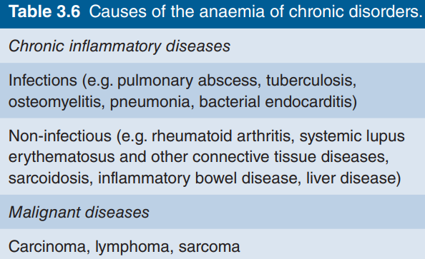

Slide 3
The characteristic features
1 Normochromic, normocytic or mildly hypochromic (MCV
rarely <75fL) indices and red cell morphology.
2 Mild and non‐progressive anaemia (haemoglobin rarely
<90 g/L) – the severity being related to the severity of the
disease.
3 Both the serum iron and TIBC are reduced.
4 The serum ferritin is normal or raised.
5 Bone marrow storage (reticuloendothelial) iron is normal
but erythroblast iron is reduced

Slide 4
The pathogenesis
decreased release of iron from macrophages to plasma because of raised serum hepcidin levels
reduced red cell lifespan and an inadequate erythropoietin response to anaemia caused by
the effects of cytokines such as IL‐1 and tumour necrosis factor (TNF) on erythropoiesis.

Slide 5
The anaemia is corrected by successful treatment of the
underlying disease and does not respond to iron therapy.
Erythropoietin injections improve the anaemia in some cases.
In many conditions this anaemia is complicated by anaemia
resulting from other causes (e.g. iron, vitamin B12 or folate deficiency, renal failure, bone marrow failure, hypersplenism, endocrine abnormality leucoerythroblastic anaemia), discussed later

Slide 6
Sideroblastic anaemia
This is a refractory anaemia defined by the presence of many pathological ring sideroblasts in the bone marrow
These are abnormal erythroblasts containing numerous iron granules arranged in a ring or collar around the nucleus instead of the few randomly distributed iron granules seen when normal erythroblasts are stained for
Iron
There is also usually erythroid hyperplasia with ineffective erythropoiesis

Slide 7
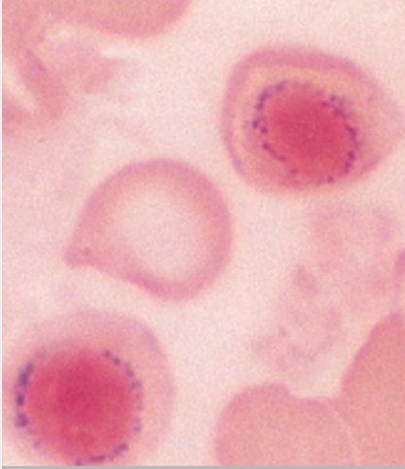

Slide 8
Sideroblastic anaemia is diagnosed when
15% or more of marrow erythroblasts are ring sideroblasts.
They can be found at lower numbers in a variety of haematological conditions.

Slide 9
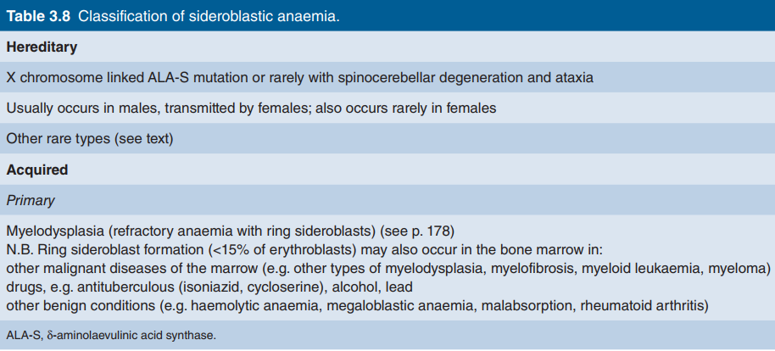

Slide 10
hereditary forms the anaemia
is usually characterized by a markedly hypochromic and microcytic blood picture.
The most common mutations are in the ALA‐S gene which is
on the X chromosome.
Pyridoxal‐6‐phosphate is a coenzyme
for ALA‐S.
Other rare types include an X‐linked disease with
spinocerebellar degeneration and ataxia, mitochondrial defects (e.g. Pearson’s syndrome when there is also pancreatic insufficiency), thiamine‐responsive and other autosomal defects

Slide 11
In some patients, particularly with the hereditary type,
there is a response to pyridoxine therapy.
Folate deficiency may occur and folic acid therapy may also be tried.
Other treatments, e.g. erythropoietin, may be tried in the myelodysplasia form
In many severe cases,
repeated blood transfusions are the only method of maintaining a satisfactory haemoglobin concentration

Slide 12
Lead poisoning
Lead inhibits both haem and globin synthesis at a number
of points.
In addition it interferes with the breakdown of
RNA by inhibiting the enzyme pyrimidine 5′ nucleotidase,
causing accumulation of denatured RNA in red cells, the RNA giving an appearance called basophilic stippling on the ordinary (Romanowsky) stain
The anaemia may
be hypochromic or predominantly haemolytic, and the bone marrow may show ring sideroblasts.
Free erythrocyte protoporphyrin is raised.

Slide 13
Differential diagnosis of hypochromic anaemia
The clinical history is particularly important as the source
of the haemorrhage leading to iron deficiency or the presence
of a chronic disease may be revealed. The country of origin and
the family history may suggest a possible diagnosis of thalassaemia or other genetic defect of haemoglobin. Physical examination may also be helpful in determining a site of haemorrhage,
features of a chronic inflammatory or malignant disease, koilonychia or, in some haemoglobinopathies, an enlarged spleen or
bony deformities.

Slide 14
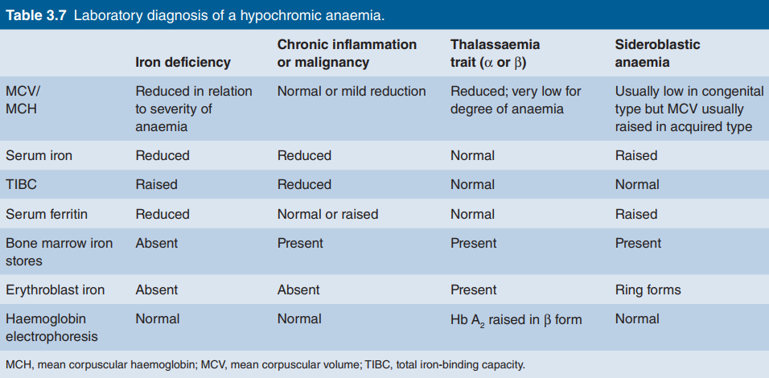

Slide 15
In thalassaemia trait the red cells tend to be small, often
with an MCV of 70 fL or less, even when anaemia is mild or
absent; the red cell count is usually over 5.5 × 1012/L. Conversely, in iron deficiency anaemia the indices fall progressively with the degree of anaemia and when anaemia is mild
the indices are normal or only just reduced below normal
(e.g. MCV 75–80 fL). In the anaemia of chronic disorders
the indices are also not markedly low, an MCV in the range
75–82 fL being usual.

Slide 16
It is usual to perform a serum iron and TIBC measurement,
or alternatively serum ferritin estimation, to confirm a diagnosis of iron deficiency. Haemoglobin high‐performance liquid
chromatography (HPLC) or electrophoresis with an estimation
of Hb A2
and Hb F is carried out in all patients suspected of
thalassaemia or other genetic defect of haemoglobin

Slide 17
β‐Thalassaemia trait is
characterized by a raised Hb A2
above 3.5%, but in α‐thalassaemia trait there is no abnormality on simple haemoglobin
studies so the diagnosis is usually made by exclusion of all other
causes of hypochromic red cells and by the presence of a red
cell count >5.5 ×1012/L. DNA studies can be used to confirm
the diagnosis.

Slide 18
Bone marrow examination is essential if a diagnosis of
sideroblastic anaemia is suspected
but is not usually needed in
diagnosis of the other hypochromic anaemias.

Slide 19
Thank you

