Slide 1
L5-Iron overload
Ass.prof. Abeer Anwer Ahmed

Slide 2
There is no physiological mechanism for eliminating excess iron from the body, so iron absorption is normally regulated to avoid accumulation.
Iron overload (haemosiderosis) occurs
in disorders associated with excessive absorption or in patients with severe refractory anaemias who receive regular blood transfusion.
Excessive iron deposition in tissues may result in serious
damage to organs, particularly the heart, liver and endocrine organs

Slide 3
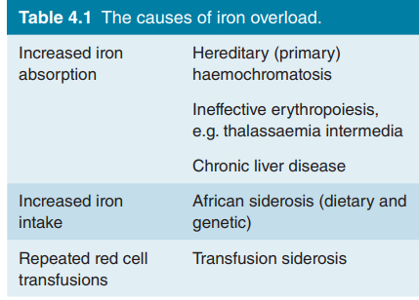

Slide 4
Severe iron overload ( > 5 g excess)
Excess iron absorption
Hereditary haemochromatosis
Massive ineffective erythropoiesis (e.g. β - thalassaemia intermedia,
sideroblastic anaemia, congenital dyserythropoietic anaemia)
Increased iron intake
Sub - Saharan dietary iron overload (in combination with a genetic
determinant of increased absorption)
Excess parenteral iron therapy
Repeated red cell transfusions
Congenital anaemias (e.g. β - thalassaemia major, sickle cell
anaemia, red cell aplasia)
Acquired refractory anaemias (e.g. myelodysplasia, aplastic
anaemia)

Slide 5
Modest iron overload ( < 5 g excess)
Chronic liver disease (e.g. alcoholic cirrhosis)
Porphyria cutanea tarda
Rare genetic disorders of iron metabolism (e.g. atransferrinaemia,
acaeruloplasminaemia, DMT1 mutations)

Slide 6
Focal iron overload ** May occur in association with general body iron defi ciency
Pulmonary haemorrhage, idiopathic pulmonary haemosiderosis
Chronic haemoglobinuria (e.g. paroxysmal nocturnal
haemoglobinuria)

Slide 7
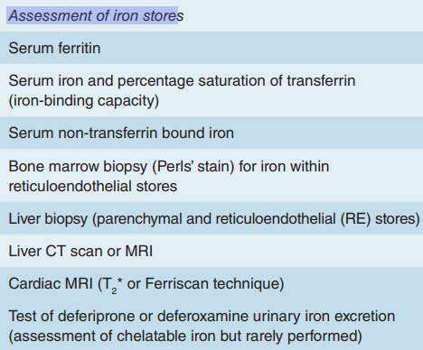
Assessment of iron overload.

Slide 8
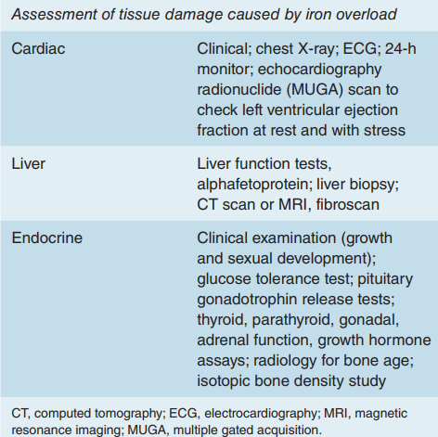

Slide 9
Hereditary haemochromatosis
Hereditary haemochromatosis (also called genetic or primary haemochromatosis)
is a group of diseases in which there is excessive absorption of iron from the gastrointestinal tract leading to iron overload of the parenchymal cells of the liver ,endocrine organs and, in severe cases, the heart.

Slide 10
Most patients are homozygous for a missense mutation in the HFE gene which leads to insertion of a tyrosine
residue rather than cysteine in the mature protein (C282Y).
The allele has a prevalence of approximately 1 in 300 within the white North European population.
Only a small proportion of people who are homozygous for the mutation actually present
with clinical features of the disease, and these usually show a
serum ferritin greater than 1000μg/L

Slide 11
A second mutation resulting in a histidine to aspartic acid substitution H63D is found
with the C282Y mutation in approximately 5% of patients but
homozygotes for the H63D mutation do not have the disease

Slide 12
HFE is involved in hepcidin synthesis and therefore hereditary haemochromatosis caused by HFE mutation is due to low
serum hepcidin levels
Low serum hepcidin levels
lead to high levels of ferroportin and therefore increased iron
absorption and increased release of iron from macrophages.
Iron overload therefore develops and damages parenchymal
cells such that patients may present in adult life with hepatic
disease (fibrosis, cirrhosis, hepatocellular carcinoma), endo-crine disturbances such as diabetes mellitus, hypothyroidism or impotence, melanin skin pigmentation (Fig. 4.2) and arthropathy (resulting from pyrophosphate deposition)

Slide 13
Diagnosis
suspected by :
increased levels of serum iron, serum transferrin
saturation and ferritin.
It is confirmed by:
testing for the HFE mutation.
Liver biopsy may quantify the degree of iron overload and assess liver damage.
MRI can also be used to measure liver and cardiac iron

Slide 14
Treatment
with regular venesection, initially at 1–2‐week
intervals, with each unit of blood removing 200–250mg iron.
There are differences of opinion as to whether patients without
evidence of organ dysfunction due to iron overload should
be treated but usually this is done when the ferritin is raised.
Venesection is monitored by serum ferritin and the aim is to
restore this to normal.

Slide 15
Rarer forms of genetic haemochromatosis
are caused by
mutations in the genes for hemojuvelin, transferrin receptor 2 and hepcidin
All three are involved in hepcidin
synthesis and the mutations are associated with low levels of hepcidin in serum.
They often present as severe iron overload with cardiomyopathy in children, adolescents or young
adults.

Slide 16
Genetic iron overload in Asian populations
is usually due to these rare mutations rather than mutation of HFE.
On the other hand, ferroportin gene mutations usually cause reticuloendothelial but not parenchymal cell iron overload but may rarely cause parenchymal overload, depending on the site of the mutation in the ferroportin gene.
Mutations of the ferritin light chain gene cause a raised monoclonal serum ferritin with
cataracts resulting from ferritin deposition in the eye but no tissue iron overload.

Slide 17
African iron overload
This occurs in sub‐Saharan Africa through a combination of:
increased iron absorption due to a genetic defect, possibly in the ferroportin gene,
and consumption of beverages with high
iron content due to the use of iron cooking pots.

Slide 18
Thalassaemia intermedia
Moderately severe forms of thalassaemia may lead to increased iron levels even in patients who do not need regular blood transfusions.
This is due to increased absorption and may lead to increased levels of iron in the liver.
Iron chelation is indicated if
the liver iron concentration is above 5mg/g dry weight, where serum ferritin reaches 800μg/L or when the iron leads to organ damage

Slide 19
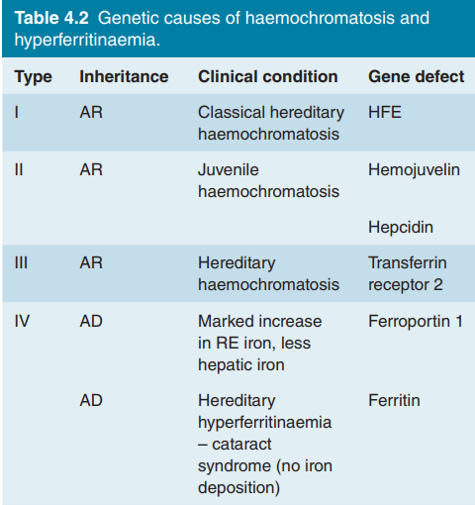

Slide 20
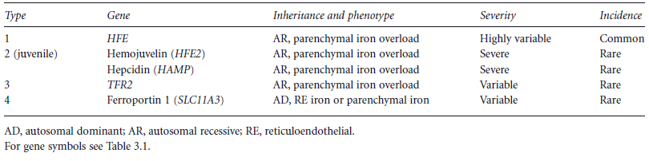
Classification of genetic haemochromatosis
.

Slide 21
Transfusional iron overload
This develops in patients with chronic anaemia who need to have regular blood transfusions. Each 500mL of transfused blood contains approximately 250mg iron and iron overload is
inevitable unless iron chelation therapy is given

Slide 22
To make matters worse, iron absorption from food is increased
in β‐thalassaemia major and many other anaemias secondary to
ineffective erythropoiesis because of inappropriately low serum
hepcidin levels. This is thought to be due to release of proteins
from early erythroblasts that inhibit hepcidin synthesis

Slide 23
Non‐transferrin bound iron may appear in plasma,
because transferrin is 100% saturated, and cause widespread iron deposition in parenchymal tissues
Iron damages the liver and the endocrine organs
with failure of growth, delayed or absent puberty, diabetes mellitus, hypothyroidism and hypoparathyroidism. Skin pigmentation as a result of excess melanin and haemosiderin gives a slate grey appearance even at an early stage of iron overload.
Most importantly, iron can damage the heart

Slide 24
In the absence of intensive iron chelation, death occurs in the second or third decade in thalassaemia major, usually from congestive heart failure or cardiac arrhythmias.
T2* MRI is a valuable measure of cardiac and liver iron loading
It can detect increased cardiac iron before sensitive tests detect impaired cardiacfunction. The shorter the relaxation time, the greater the cardiac iron burden and the greater risk of cardiac failure or arrhythmia

Slide 25
Serum ferritin and liver iron correlate poorly
with cardiac iron .
Moreover serum ferritin is raised in viral hepatitis and other inflammatory disorders and
should therefore be interpreted in conjunction with more accurate tests of iron status such as T2* MRI or liver biopsy.

Slide 26
Iron chelation therapy
Iron chelation therapy is used to treat transfusional iron overload and three effective drugs are available.
Thalassaemia major is the most frequent indication worldwide but chelation is also
used for heavily transfused patients with the other anaemias

Slide 27
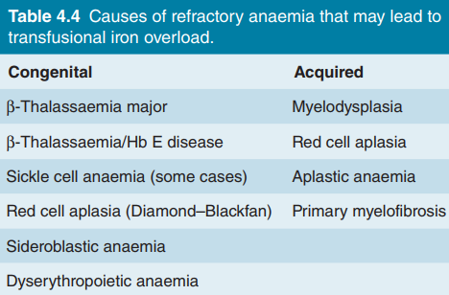

Slide 28
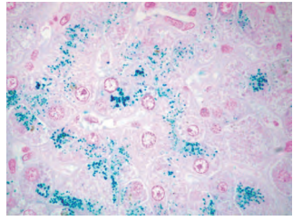

Slide 29
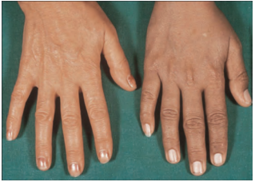

Slide 30
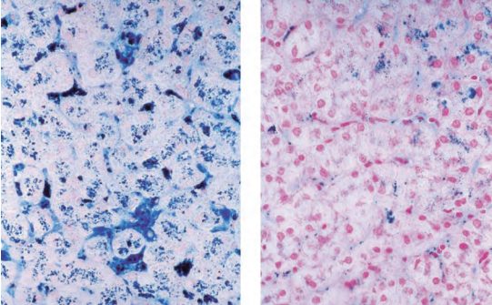

Slide 31
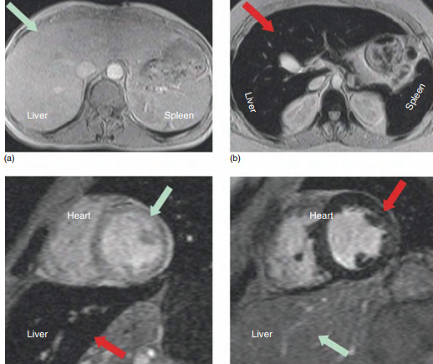

Slide 32
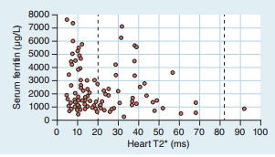

Slide 33
