Slide 1
general aspects of anaemia
Ass.prof.Abeer Anwer

Slide 2
Clinical features of anaemia
The major adaptations to anaemia are in the cardiovascular system (with increased stroke volume and tachycardia) and
in the haemoglobin O2 dissociation curve.
In some patients
with quite severe anaemia there may be no symptoms or signs,
whereas others with mild anaemia may be severely incapacitated.

Slide 3
The presence or absence of clinical features can be considered under four major headings
1. Speed of onset Rapidly progressive anaemia causes more
symptoms than anaemia of slow onset because there is less
time for adaptation in the cardiovascular system and in the
O2 dissociation curve of haemoglobin.
2. Severity Mild anaemia often produces no symptoms or
signs but these are usually present when the haemoglobin
is less than 90 g/L. Even severe anaemia (haemoglobin concentration as low as 60 g/L) may produce remarkably few
symptoms, when there is very gradual onset in a young subject
who is otherwise healthy.
Notes:
3rd bullet: Retrospective observational studies of hemodialysis and HF patients suggest that anemia is independent risk factor for mortality

Slide 4
3. Age The elderly tolerate anaemia less well than the young
because normal cardiovascular compensation is impaired.
4. Haemoglobin O2dissociation curve Anaemia, in general, is
associated with a rise in 2,3‐DPG in the red cells and a shift
in the O2 dissociation curve to the right so that oxygen is given
up more readily to tissues. This adaptation is particularly
marked in some anaemias that either raise 2,3‐DPG directly
(e.g. pyruvate kinase deficiency or that are associated
with a low‐affinity haemoglobin (e.g. Hb S)

Slide 5
Symptoms
If the patient does have symptoms these are usually shortness of breath, particularly on exertion, weakness, lethargy, palpitation and headaches.
In older subjects, symptoms of cardiac failure, angina pectoris or intermittent claudication or confusion may be present. Visual disturbances because of retinal haemorrhages
may complicate very severe anaemia, particularly of rapid onset

Slide 6
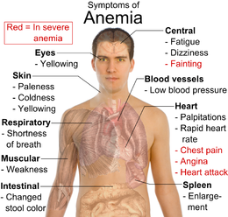

Slide 7
Signs
These may be divided into general and specific.
General signs:
include pallor of mucous membranes or nail beds, which occurs
if the haemoglobin level is less than 90 g/L Conversely,
skin colour is not a reliable sign.
A hyperdynamic circulation may be present with tachycardia, a bounding pulse, cardiomegaly and a systolic flow murmur especially at the apex.
Particularly in the elderly, features of congestive heart failure may be present.

Slide 8
Specific signs
are associated with particular types of
anaemia, e.g.
koilonychia (spoon nails) with iron deficiency,
jaundice with haemolytic or megaloblastic anaemias,
leg ulcers with sickle cell and other haemolytic anaemias,
bone deformities with thalassaemia major.
The association of features of anaemia with excess infections
or spontaneous bruising suggest that neutropenia or
thrombocytopenia may be present, possibly as a result of bone marrow failure.

Slide 9
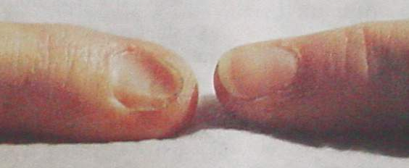
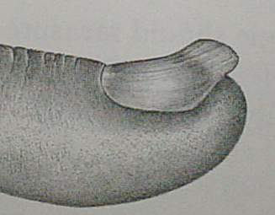
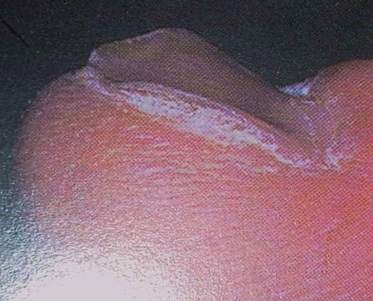
Koilonychia - spoon shaped nail

Slide 10
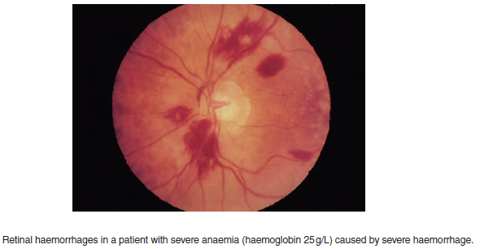
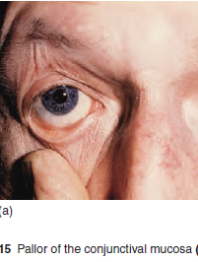

Slide 11
Classification and laboratory findings in anaemia
Red cell indices
The most useful classification is that based on red cell indices
and divides the anaemia into:
microcytic, normocytic and macrocytic .
As well as suggesting the nature of the primary defect, this approach may also indicate an underlying abnormality before overt anaemia
has developed.
In two common physiological situations, the mean corpuscular
volume (MCV) may be outside the normal adult
range. In the newborn for a few weeks the MCV is high
but in infancy it is low (e.g. 70 fL at 1 year of age) and rises
slowly throughout childhood to the normal adult range.
In normal pregnancy there is a slight rise in MCV, even
in the absence of other causes of macrocytosis (e.g. folate
deficiency).

Slide 12
Morphological Classification
Anemia
Macrocytic
Normocytic
Microcytic
Megaloblastic
Non-megaloblastic
IDA
Genetic
Anomaly
Vitamin B12 deficiency
Folic acid deficiency
Hepatic disease
Drug-induced anemia
Hypothyroidism
Reticulocytosis
Recent blood loss
Hemolysis
Bone marrow failure
Anemia of chronic disease
Sickle cell
Thalassemia
Notes:
- Anemia can be classified on the basis of the morphology of the RBCs, etiology, or pathophysiology
- This scheme of classification is based on the size of RBC which is measured by Mean cell volume (MCV). As per MCV, cells are considered macrocytic if they are larger than normal, microcytic if hey are smaller than normal, and normocytic if their size falls within normal limits

Slide 14
Other laboratory findings
Although the red cell indices will indicate the type of anaemia,
further useful information can be obtained from the initial
blood sample.
Leucocyte and platelet counts
Measurement of these helps to distinguish ‘pure’ anaemia from
‘pancytopenia’ (subnormal levels of red cells, neutrophils and
platelets), which suggests a more general marrow defect or
destruction of cells (e.g. hypersplenism).
In anaemias caused by haemolysis or haemorrhage, the neutrophil and platelet counts are often raised;
In infections and leukaemias, the leucocyte count is also often raised and there may be abnormal leucocytes or neutrophil precursors present.

Slide 15
Reticulocyte count
The normal percentage is 0.5–2.5%, and the
Ab solutecount 50–150 × 109/L
This should rise in
anaemia because of erythropoietin increase, and be higher
the more severe the anaemia. This is particularly so when
there has been time for erythroid hyperplasia to develop in
the marrow as in chronic haemolysis.
After an acute major haemorrhage there is an erythropoietin response in 6 hours,
the reticulocyte count rises within 2–3 days, reaches a
maximum in 6–10 days and remains raised until the haemoglobin
returns to the normal level.
If the reticulocyte count is not raised in an anaemic patient this suggests
impaired marrow function or
lack of erythropoietin stimulus

Slide 16
Factors impairing the normal reticulocyte response to anaemia.
Marrow diseases, e.g. hypoplasia, infiltration by carcinoma,
lymphoma, myeloma, acute leukaemia, tuberculosis
Deficiency of iron, vitamin B12 or folate
Lack of erythropoietin, e.g. renal disease
Reduced tissue O2 consumption, e.g. myxoedema, protein
deficiency
Ineffective erythropoiesis, e.g. thalassaemia major,
megaloblastic anaemia, myelodysplasia, myelofibrosis
Chronic inflammatory or malignant disease

Slide 17
Blood film
It is essential to examine the blood film in all cases of anaemia.
Abnormal red cell morphology or red cell inclusions.
may suggest a particular diagnosis.
During the blood film examination, white cell abnormalities are sought,
platelet number and morphology are assessed and
the presence or absence of abnormal cells (e.g. normoblasts, granulocyte precursors or blast cells) is noted.

Slide 20
Bone marrow examination
This is needed when the cause of anaemia or other abnormality
of the blood cells cannot be diagnosed from the blood count,
film and other blood tests alone.
It may be performed by
aspiration
or trephine biopsy

Slide 21
The detail of the developing cells can be examined (e.g. normoblastic or megaloblastic),
the proportion of the different cell lines assessed (myeloid : erythroid ratio, the proportion of granulocyte precursors to red cell precursors in the bone marrow, normally 2.5 : 1 to 12 : 1),
and the presence of cells foreign to the marrow (e.g. secondary carcinoma) observed.
The cellularity of the marrow can also be viewed provided fragments
are obtained.
An iron stain is performed routinely so that the amount of iron in reticuloendothelial stores (macrophages)
and as fine granules (‘siderotic’ granules) in the developing
erythroblasts can be assessed.
An aspirate sample may also be used for a number of other
specialized investigations

Slide 22
A trephine biopsy
provides a solid core of bone including
marrow and is examined as a histological specimen after fixation
in formalin, decalcification and sectioning.
Usually immunohistology is performed depending on the diagnosis suspected
A trephine biopsy specimen is less valuable
than aspiration when individual cell detail is to be examined
but provides a panoramic view of the marrow from which
overall marrow architecture, cellularity and presence of fibrosis
or abnormal infiltrates can, with immunohistology, be reliably
determined.

Slide 25
Ineffective erythropoiesis
Erythropoiesis is not entirely efficient because approximately
10–15% of developing erythroblasts die within the marrow
without producing mature cells. This is termed ineffective
erythropoiesis and it is substantially increased in a number of
chronic anaemias .
The serum unconjugated bilirubin (derived from breaking down haemoglobin) and lactate dehydrogenase (LDH, derived from breaking down cells) are usually raised when ineffective erythropoiesis is marked.
The reticulocyte count is low in relation to the degree of anaemia
and to the proportion of erythroblasts in the marrow.

Slide 26
Assessment of erythropoiesis
Total erythropoiesis and the amount of erythropoiesis that is effective
in producing circulating red cells can be assessed by :
Examining the bone marrow,
haemoglobin
level and reticulocyte count.
Total erythropoiesis is assessed from the marrow cellularity and the myeloid : erythroid ratio.This ratio falls and may be reversed when total erythropoiesis is selectively increased.
Effective erythropoiesis is assessed by the reticulocyte
count. This is raised in proportion to the degree of anaemia
when erythropoiesis is effective, but is low when there is ineffective
erythropoiesis or an abnormality preventing normal
marrow response

