Slide 1
imaging in Obstetric and gynecology
Dr Muna AZ

Slide 3
Educational learning objectives in obstetric ultrasound
Obstetric ultrasound …
Identify the role of pelvic U/S in normal fetal first and second trimester basic measurements of growth and development .
Define fetal growth restriction and IUGR.
Describe pathological disorders ( blighted ova, molar pregnancy and ectopic ).

Slide 4
Obstetric U/S
When is the 1st U/S undertaken? the patient is not sure about the LMP
After day 14 from a missing cycle
If express pain or bleeding

Slide 5
Patient preparation
TAU need full bladder in early pregnancy 4- 12wks GA
TVA no need for a full bladder

Slide 6
3 D nuchal line

Slide 7
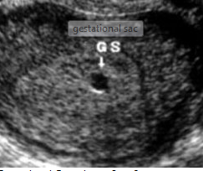
4 wks TVU

Slide 8
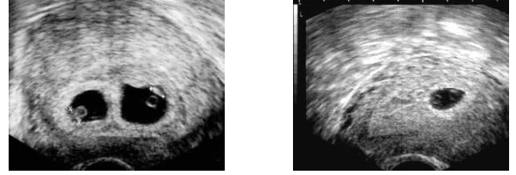
5 wks TVU may show fetal heart beat .

Slide 10
No, it doesn't always mean a problem existing
The reason could be …
Large abdomen
Inaccurate LMP
It is best detected with TVU in early wks. ,or u should re evaluate after a wk. interval

Slide 13
When can an U/S determine the sex of the baby ?
Between 18 to 20 wks : it is possible to determine the sex , but influence by the position of the fetus, and stage of pregnancy may by determined even more earlier

Slide 14
Second trimester U/S
A routine study to assess fetal anatomy and the presence of anomalies
Measurements of
BPD bi-parietal diameter
FL femoral length
HC head circumference
AC abdominal circumference

Slide 15
Check the location of the placenta , The amount of liquor
Congenital anomalies
Baby s sex

Slide 16
Trans abdominal U/S in late second and third trimester

Slide 17
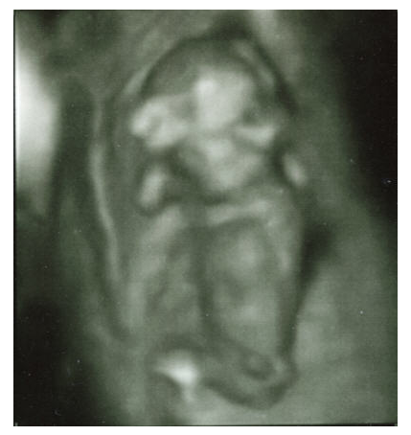
Second Trimester

Slide 18
Third trimester
Check fetal position and lie
Amount of liquor and amniotic fluid index (AFI) which is the quantitative estimate of amniotic fluid and an indicator of fetal well being ..it should be around 14 cm from 14 to 35 wks if < 6cm it is oligo hydramniuos …termination should be considered if < 4 cm .
Fetal wt
placental position ( normally ,should be at least 4 cm proximal to cervical oss )
Doppler study of the placental fetal circulation if indicated

Slide 19
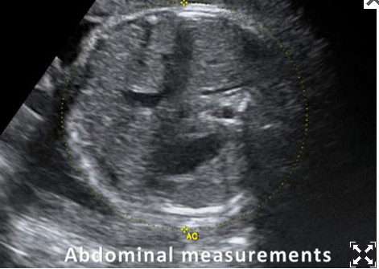
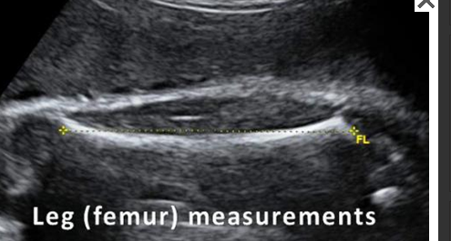

Slide 20
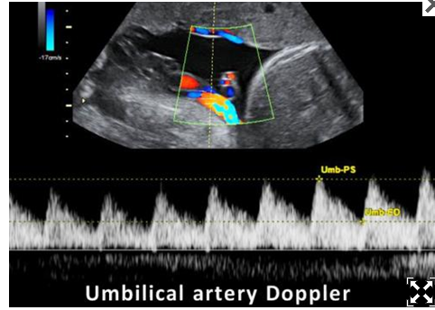

Slide 21
why is Doppler study used during pregnancy?
The study used to view the blood flow in to the uterus.
To check fetal umblical blood flow .
Restriction of blood flow can lead to ..
Low birth wt
Smaller for date .
Developmental anomalies .
in post date , check placental fetal insufficiency .

Slide 22
Blighted ova
Intra uterine pregnancy with empty GS occur when the early embryo stope growing … the reason is often un known but it may be due to chromosomal abormalites in the fertilized egg
present with early vaginal bleeding ( possibly 2 -3 wks after the last LMP )
With or with out lower abdominal pain.
Sometimes discovered incidentally during routine U/S

Slide 23
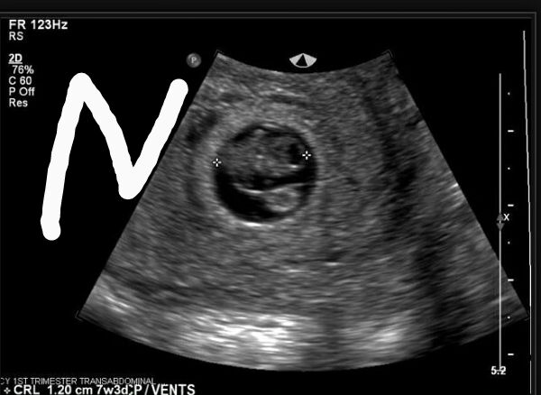
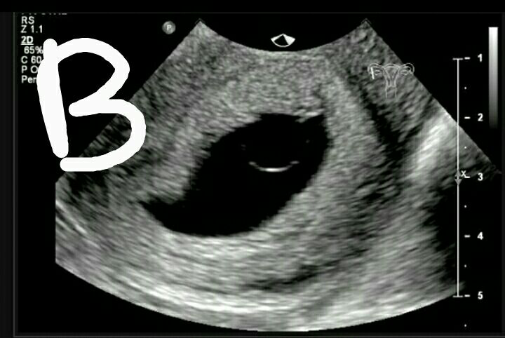
Ultrasound diagnosis
when a mean sac diameter ( MSD ) equal to or > 25 mm with no embryo seen….or follow up scan 10 days – two wks after the initial scan showing no embryo with or without a yolk sac.

Slide 24
SEE U

