Slide 1
Gynecology imaging
Dr Muna AGZ

Slide 2
Ultrasound in gynecology
Observations . ..
Identify the bladder
Uterus size , position anti-verted A/V , retro-verted R/V
Myometrium
Endometrial thickness and lining ( normal smooth ,or irregular )
Look at the ovaries on both sides ( about 3 x 2.5 x1.5 cm during reproductive age)... …but smaller in young girls and in menopause .
If any adnexial masses ( an area of connective tissue which connect the uterus to the ovaries and fallopian tubes ).

Slide 3
7. Color Doppler …vascular flow in pelvic vessels
8 .check the region of pouch of dogluse for free fluid

Slide 4
The uterus
Has a normal inverted pear shape , . The endometrium is smooth and regular with measurements ranging from 3 – 12 mm during the menstrual cycle

Slide 5
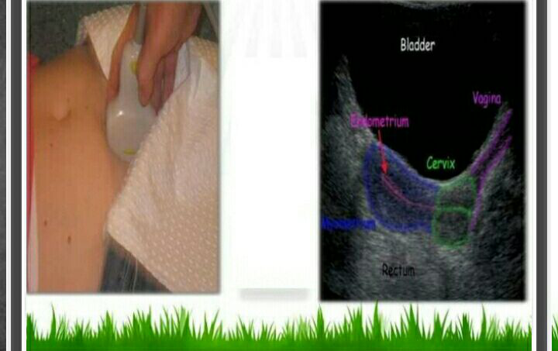
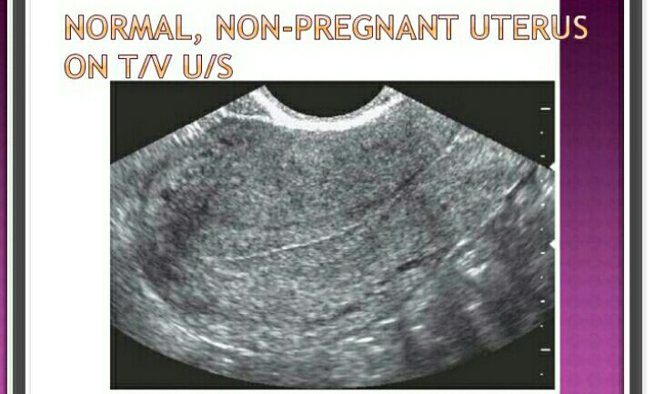

Slide 6
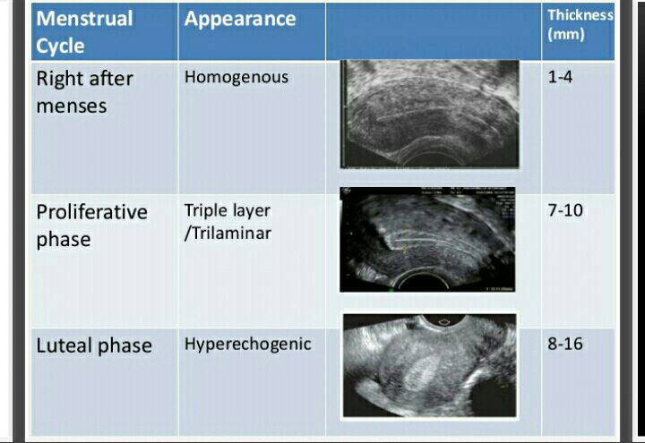
Ultrasound measurements of ET during menstrual cycle

Slide 7
The ovaries
The average range in size 3.5 x 2.5 x 1.5 cm . Vol. about 20 cucm
After menopause the ovary is generally smaller in size volume about 10 cucm
Small ovaries at menopause ,which do not show up on US study probably getting too small and are not likely to be cancerous

Slide 8
Anatomically , each ovary showing stroma and follicles , during child bearing age , these follicles vary in size during menstrual cycle , each ovary show variable component of stromal or follicular pattern ,

Slide 9
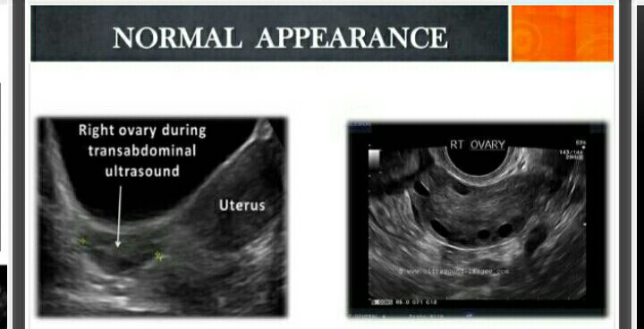

Slide 10
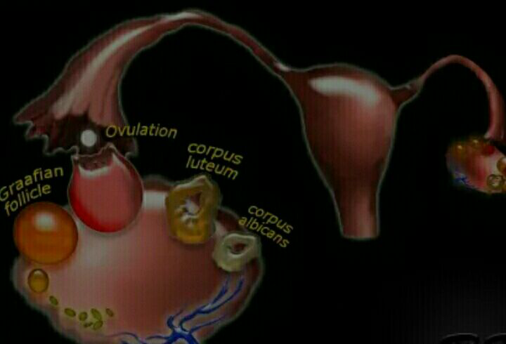
Follicular patterns of distribution
Normal ….multiple follicles of variable size distributed within the ovarian matrix ( stroma )…during menstrual cycle …there will be change in size of one or more follicles to become a dominant follicle (DF) which grow and rupture to release the oocytes at mid cycle .

Slide 12
Ultrasound ovulation monitoring
u may start at day 3 or day 5 of the mens. Cycle and repeat U/s every other day…check the no. and shape of follicles seen in each ovary
Others start at day 11 of cycle and monitor every other day
the ova enlarge 2 or 3 mm / day ..

Slide 13
Once it reach 16 mm which is seen at the time of ovulation
Start monitoring every day …DF = 18 – 23 mm
If being larger it will have less chance to be fertilized or it may turn in to a follicular cyst which may dis appear at the next cycle

Slide 14
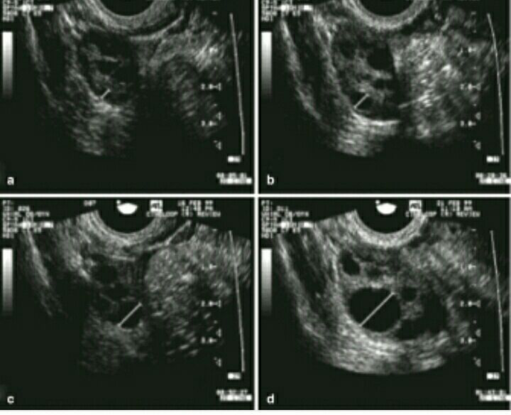

Slide 17
2. Hemorrhagic cyst …when follicular cyst bleed.
3. Endometrial cyst (endometrioma ) …endometrial tissue grow in the ovaries . Effect young ladies .
4.Polycyctic ovary syndrome … with multiple follicles showing peripheral distribution + enlarged ovaries but may have normal volume ovaries.
5. Dermoid cyst (mature teratoma )

Slide 18
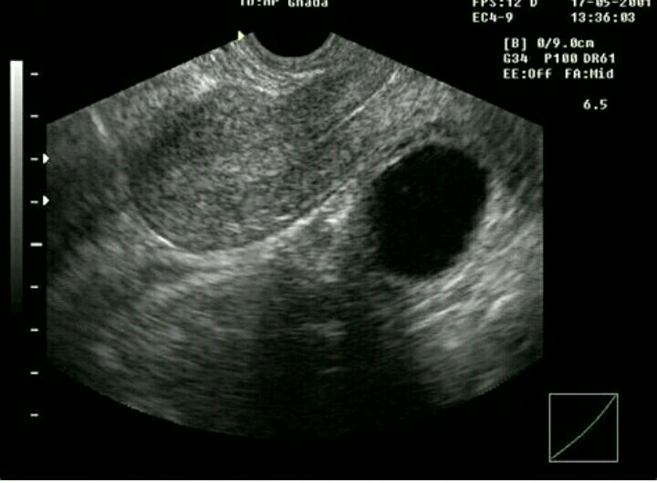
Simple cyst .. echo free fluid contents, thin wall

Slide 19
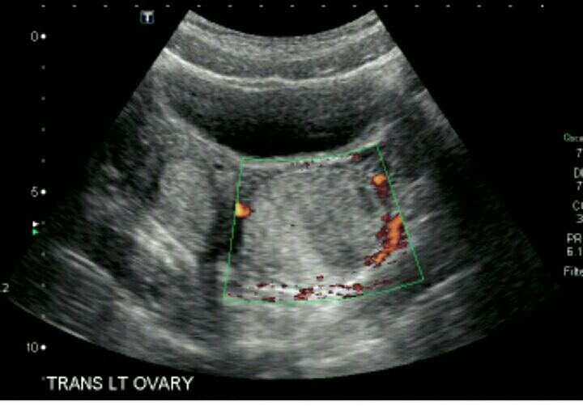
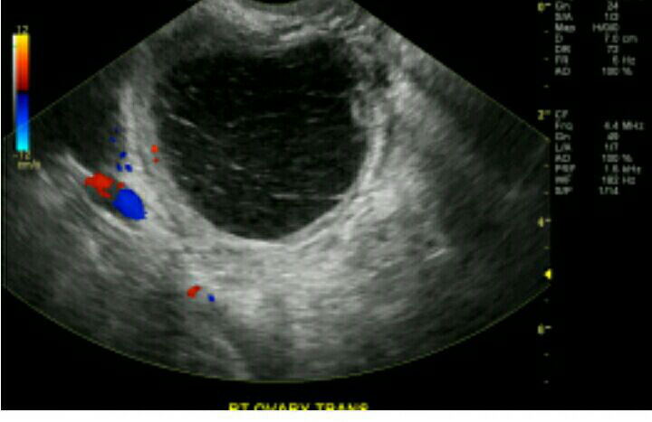
Hemorrhagic cyst … layering of echo debris , variable wall thickness

Slide 20
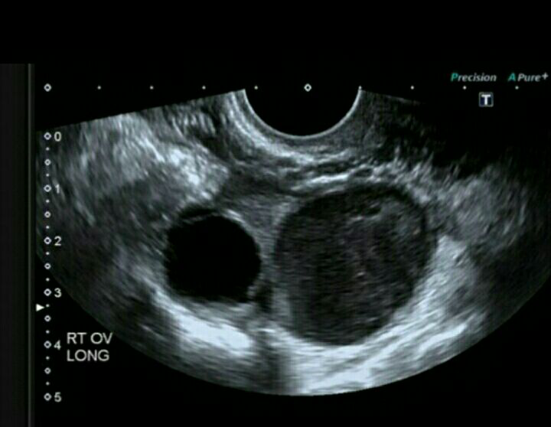
Endometrial cyst –variable appearance …unilocular , multilocular , cystic –solid component , pure solid lesions

Slide 21
Polycystic ovary syndrome

Slide 22
PCO
Is the presence of more than 12 follicles in each ovary , but each being less than 10 mm ,with large ovarian volume .
There is no test that definitely diagnose PCO , but medical history of wt. gain , menstrual periods irregularities and physical sign examination of pattern of hair distribution , acne and insulin resistance

Slide 23
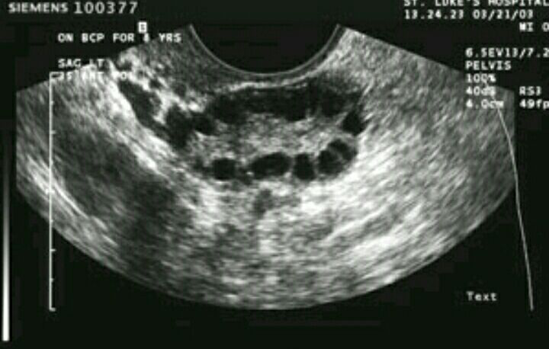
Poly cystic ovary

Slide 24
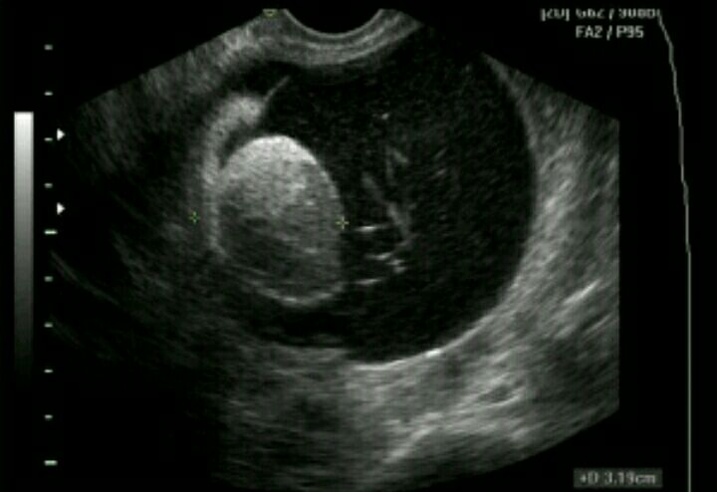
Dermoid cyst …. Variable appearance …it show fatty material best seen on MRI

Slide 25
what about Ovarian cyst diagnosed during pregnancy ?
The cyst should be managed conservatively by routine U/S …spacing between each study is based upon the growth rate at each examination …reevaluation may be around every one month
1.Corpus luteal cyst during pregnancy is a physiological cyst which secret progesterone …it may persist as far as 12 wks.
2.Large cysts discovered during pregnancy that do not regress in size after the 1st trimester ,being > 6 cm may complicate in to torsion ,rupture , intra-cyst bleeding …with possible high rate of abortion

Slide 26
3. Dermoid cyst ,
4. endomatrioma
5. Rarely … ectopic pregnancy coexist with normal intra uterine pregnancy .
Ovarian cysts management during pregnancy should be discussed individually for each patient , careful evaluation needed to identify patients who need surgery or laparoscopy from those where a ‘wait –and – see ’ strategy is followed

Slide 27
Uterine fibroids (leiomyoma's)
Non cancerous growths of the uterus ..appear during child bearing age …they almost never develop in to cancers ,they range in size ,with variable positions .
Clinical presentation depends on the size of the fibroid and location….they may be non- symptomatic discovered by pelvic exam . Or U/S.

Slide 28
symptoms
Submucosal fibroid ----- heavy bleeding ..recurrent abortion , preterm labor
Pedunculated fibroid may twist and present with acute abdomen.
Large size fibroids according to location will cause pressure upon the relevant adjacent organ .ex urine retention , frequency, bowl function difficulties

Slide 29
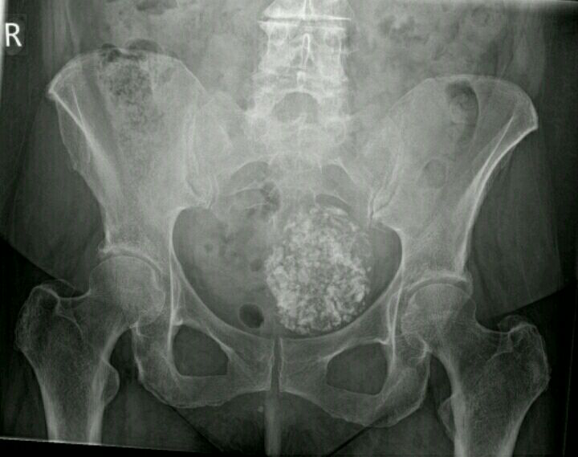

Slide 30
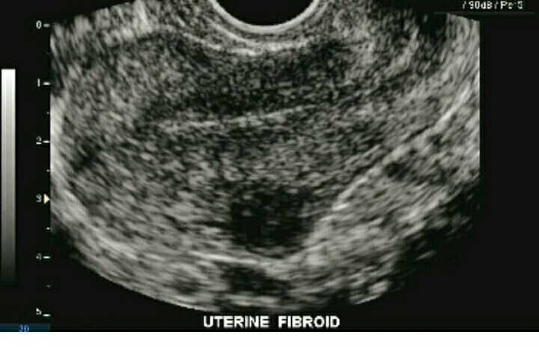
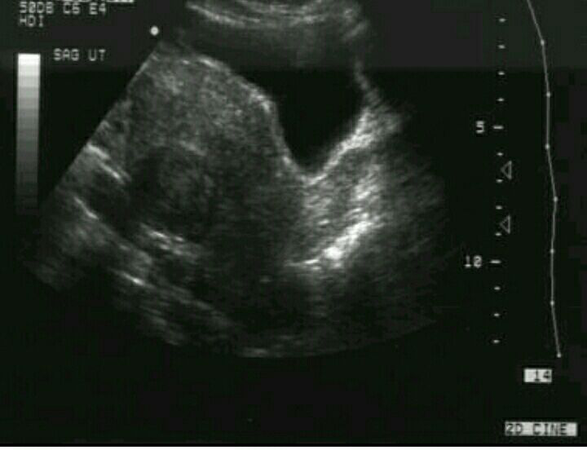

Slide 31
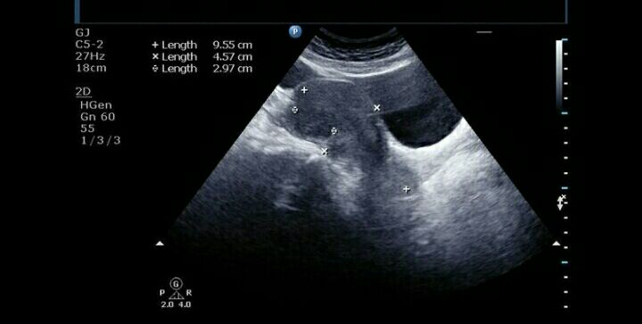
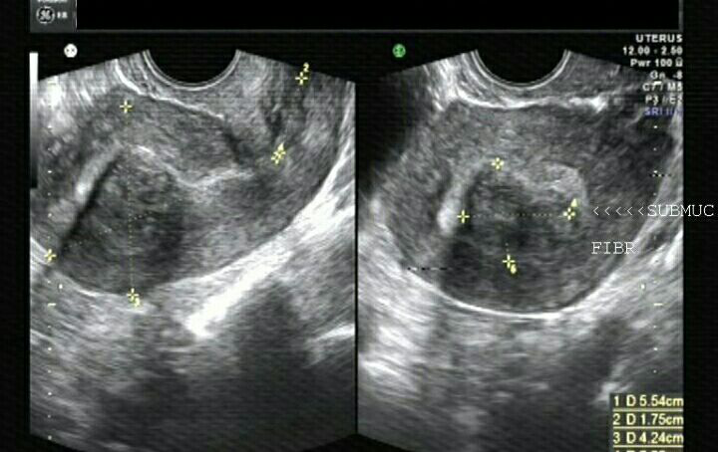

Slide 32
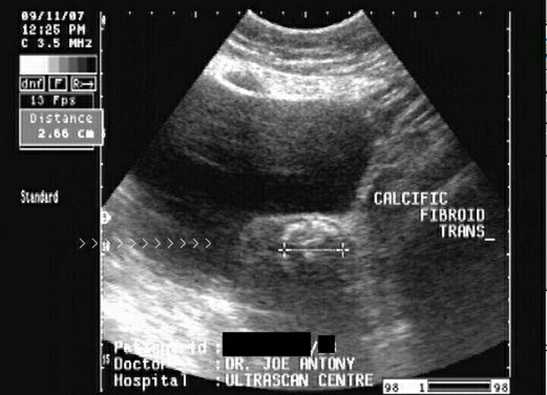

Slide 33
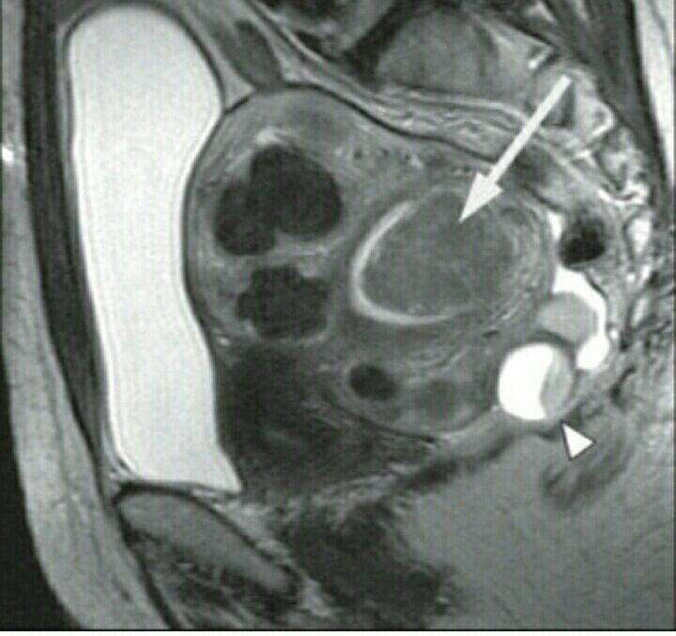
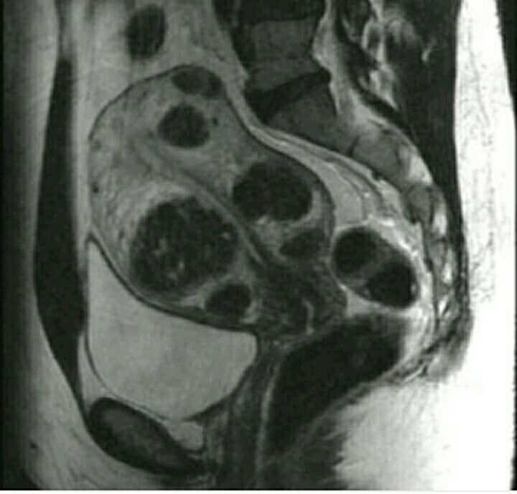

Slide 34
How do fibroid behave during pregnancy ?
fibroids are modified during pregnancy , They significantly increase in size during early pregnancy, and then decrease in the third trimester , however, the majority do not change in size . most women will have regular pregnancy but some may express complications ex. bleeding ,preterm labor and miscarriage.

