Slide 1
Plain abdominal radiography in infants and children
Dr Muna AGZ

Slide 2
The Aim In Pediatric Radiology
1. describe the normal pattern gaseous distribution
2 . Definite diagnostic tool in certain pathologies
3. early indicator to guide for further investigations

Slide 3
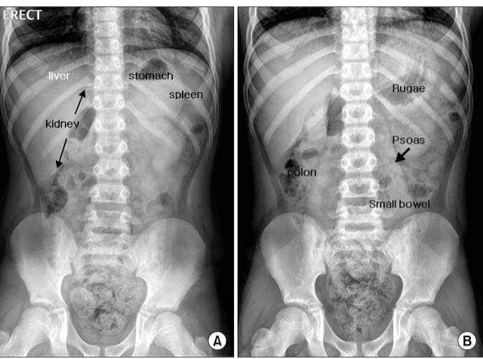
Normal appearance in children
The borders of the soft tissue structures can often be identified by the fat that surround them ,,,ex liver , spleen, kidneys, psoas, muscles , stomach gas, splenic flexure.
A. erect showing air in gastric fundus
B . Supine showing gas in gastric antrum

Slide 4
Normal appearance in the neonate
Gas filling of the small bowl seen within 6hrs after birth and In the large bowl within 12 – 14 hr. after meconium passage …seen as closely apposed multiple rounded or polyhedral lunacies …and can not differentiate between small and large bowl on frontal view

Slide 5
Abnormal appearance
Free peritoneal air
Ascites, calcification
Mural air (pneumatosis intestinali )
Organomegaly displacing bowl loops.
Mechanical obstruction (showing step ladder fluid level configuration )
Adynamic paralytic ileus ex. With GE , sepsis ,electrolyte imbalance

Slide 6
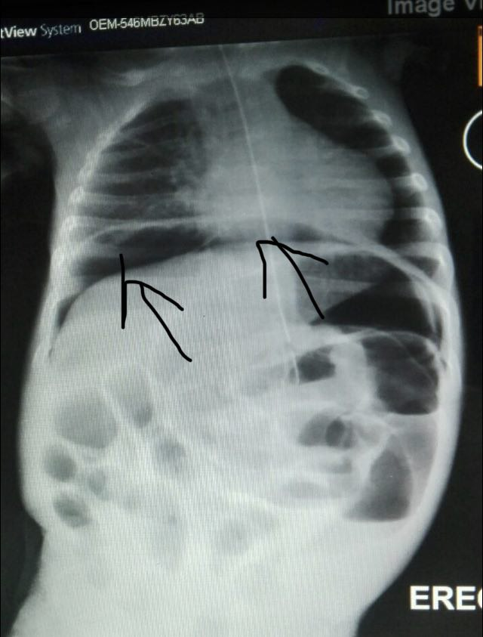
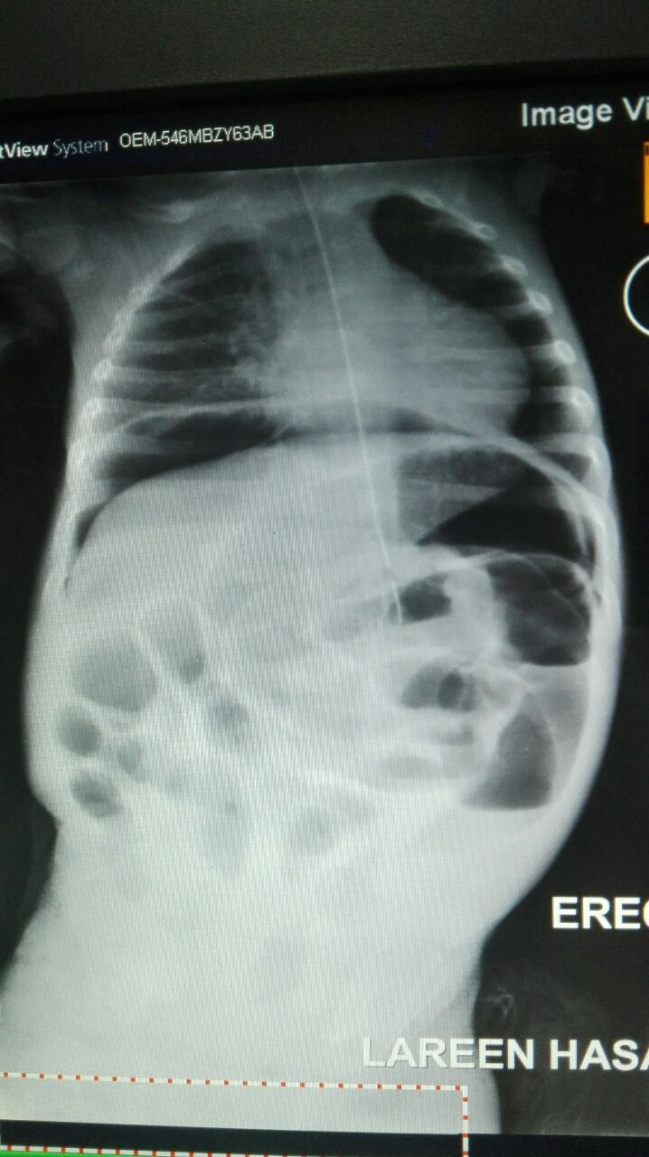

Slide 7
Free peritoneal air ( mainly under the Rt hemidiaphragm and Lt hypochondreal region
Ascites, calcification
Mural air (pneumatosis intestinal )
Organomegaly displacing bowl loops.
Mechanical obstruction (showing step ladder fluid level configuration )
Gastro enteritis causing Adynamic paralytic ileus

Slide 8
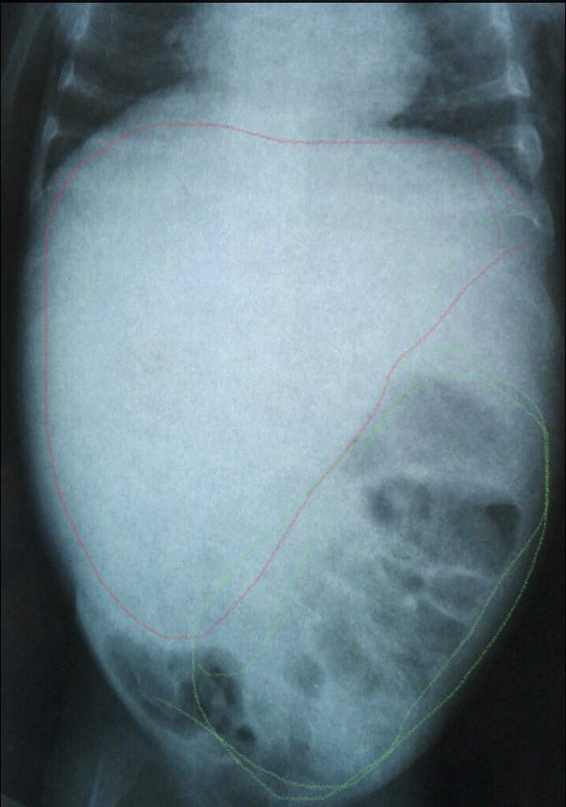
Free peritoneal air
Ascites, calcification
Mural air (pneumatosis intestinali )
Organomegaly displacing bowl loops.
Mechanical obstruction (showing step ladder fluid level configuration )
Gastro enteritis causing Adynamic paralytic ileus

Slide 9
Free peritoneal air
Ascites ( possible free peritoneal fluid existing U/S recommended please for further evaluation , calcification
Mural air (pneumatosis intestinali )
The RT para abdomen showing enlarged soft tissue mass displacing bowl loops to the Lt side inferiorly picture suggest possible hepatomegaly ,? RT.Renal mass?? For U/S evaluation please .
Mechanical obstruction (showing step ladder fluid level configuration )
Gastro enteritis causing Adynamic paralytic ileus

Slide 10
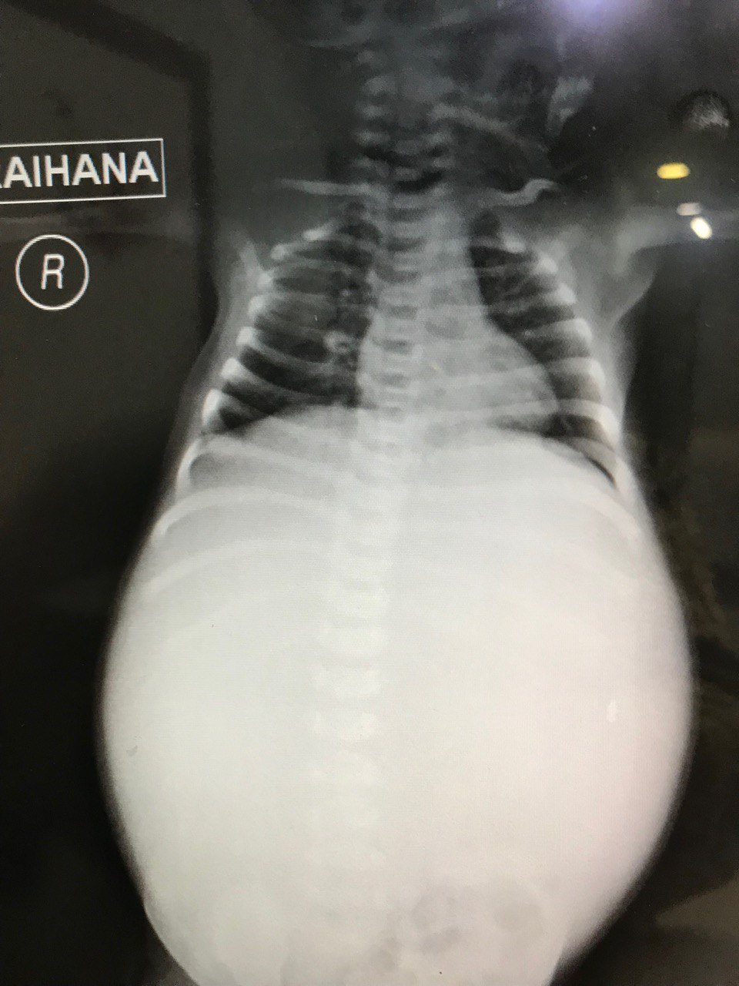
Gas less abdomen
distended abdomen manifested by rounded external contour with only faint gas seen in the lower pelvic cavity on the LT side suggestive of esophageal atresia
Other possibility severe hydrops fetalis with ascites

Slide 11
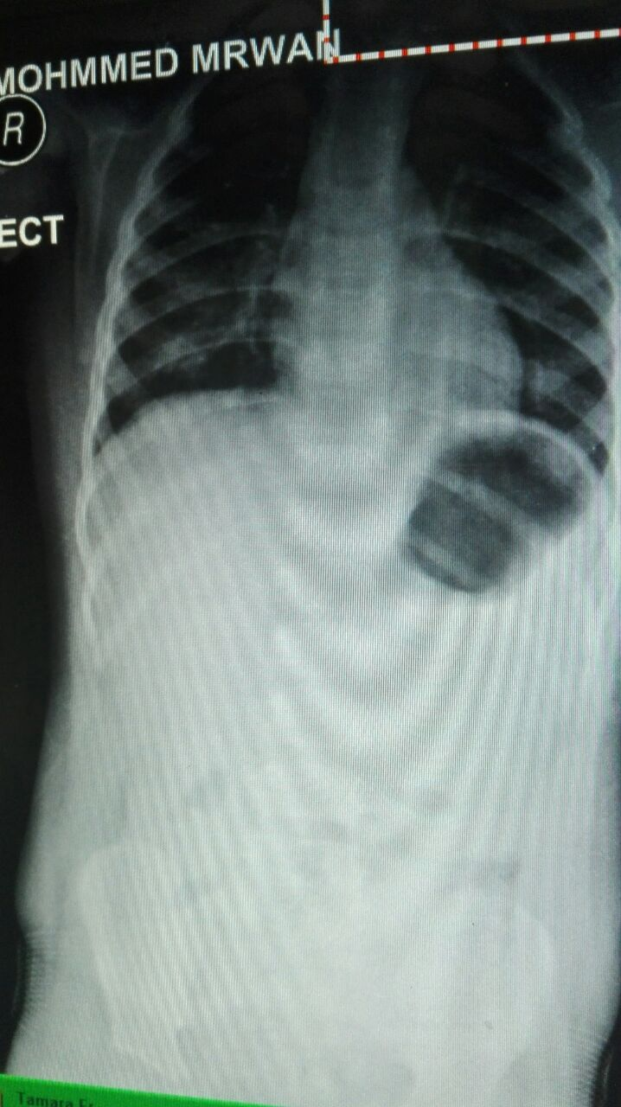
Single bubble sign with no distal gas suggest gastric outlet obstruction
Congenital hypertrophic pyloric stenosis
Other possibility
Gastric volvulus

Slide 12
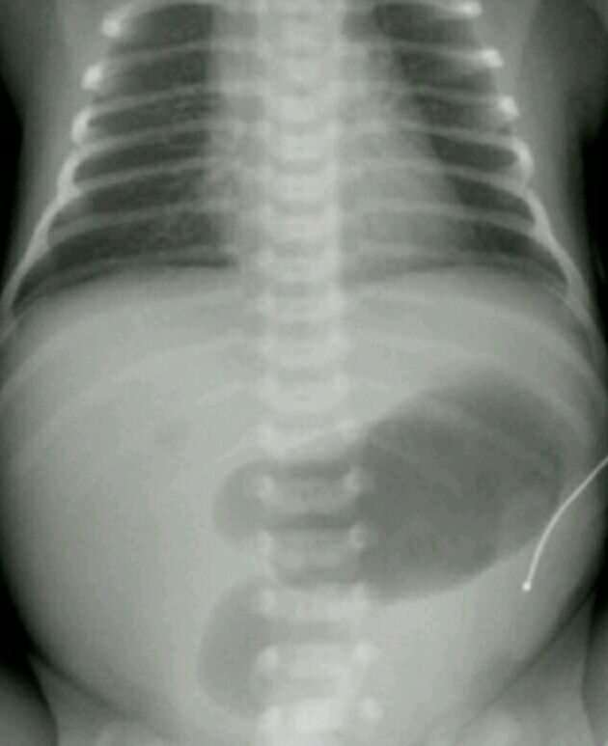
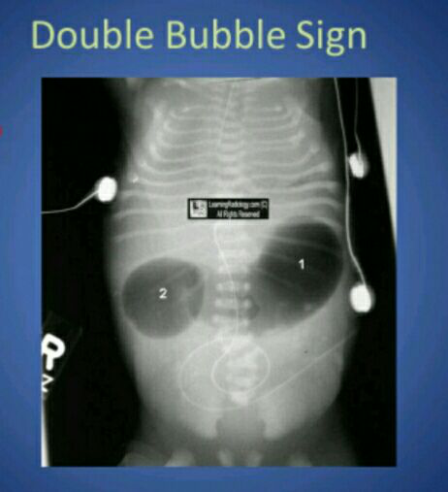
Duodenal atresia
Double bubble sign

Slide 13
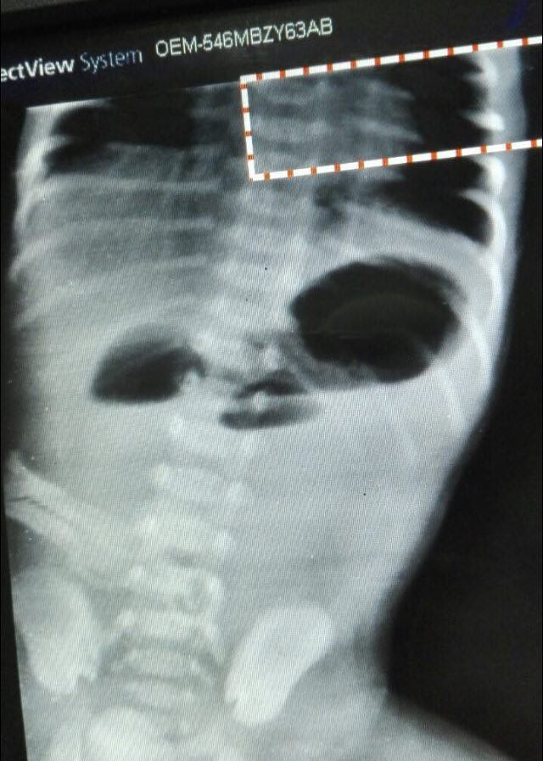
Triple bubble sign
Jejunal atresia

Slide 14
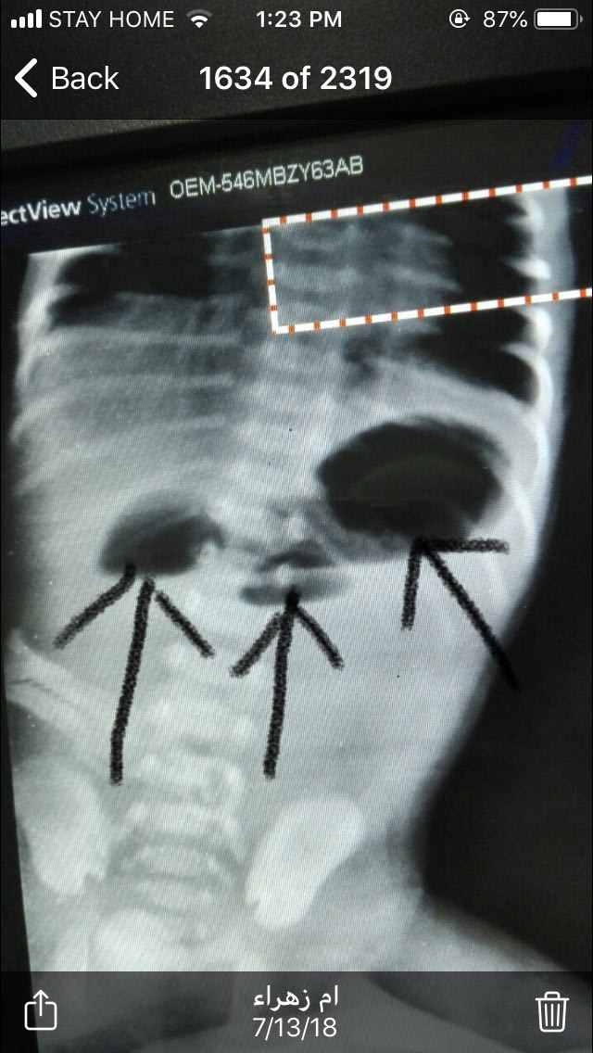

Slide 15
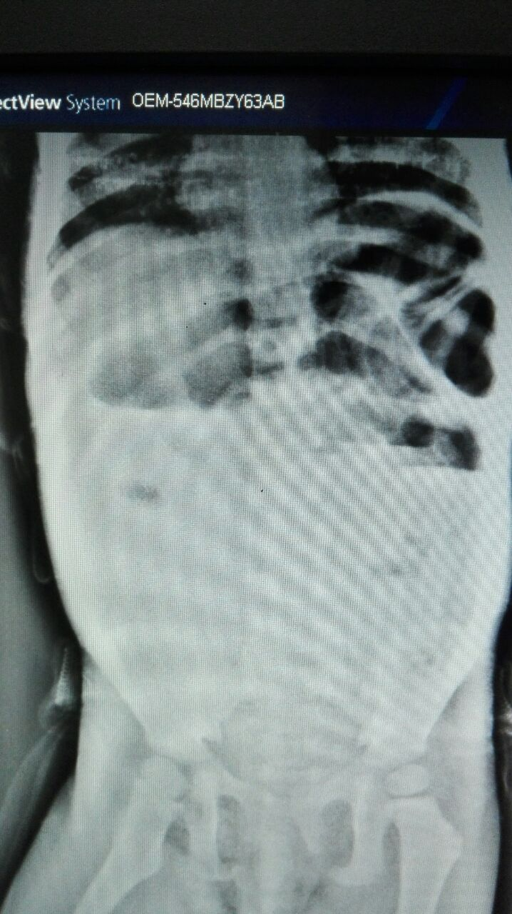
Free peritoneal air
Ascites, calcification
Mural air (pneumatosis intestinali )
Organomegaly displacing bowl loops.
Mechanical obstruction (showing step ladder fluid level configuration )
Gastro enteritis causing Adynamic paralytic ileus

Slide 16
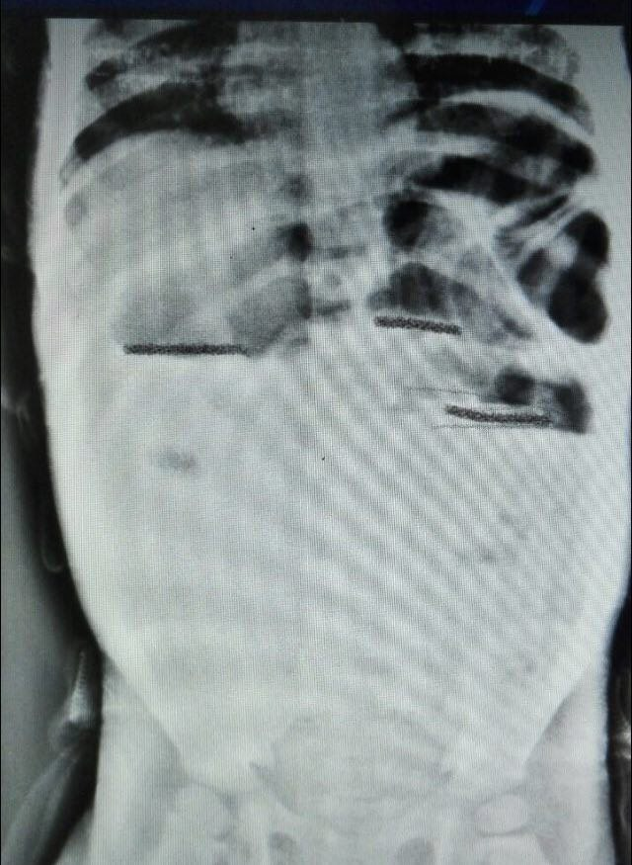

Slide 17
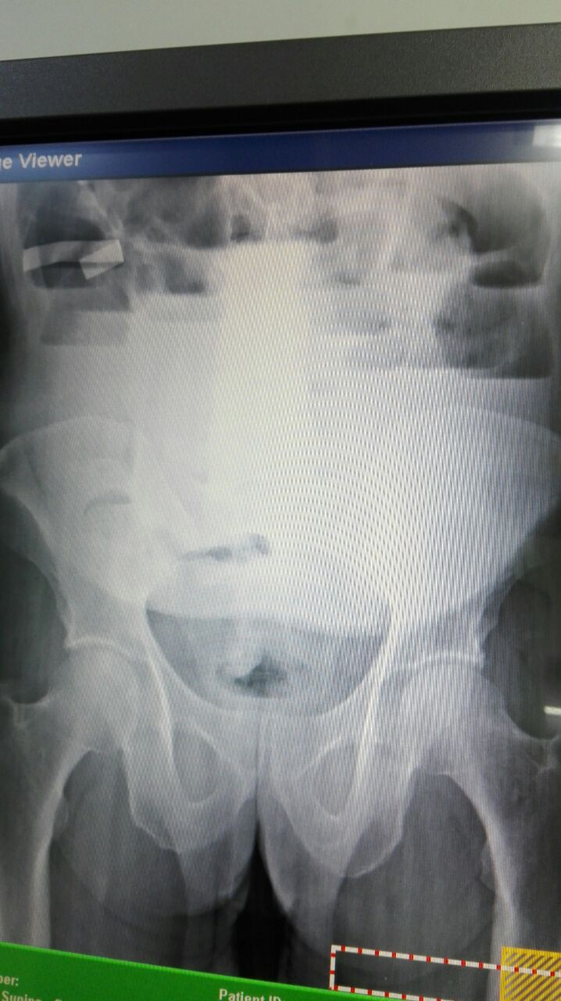
Free peritoneal air
Ascites, calcification
Mural air (pneumatosis intestinali )
Organomegaly displacing bowl loops.
Mechanical obstruction (showing step ladder fluid level configuration )
Gastro enteritis causing Adynamic paralytic ileus

Slide 18
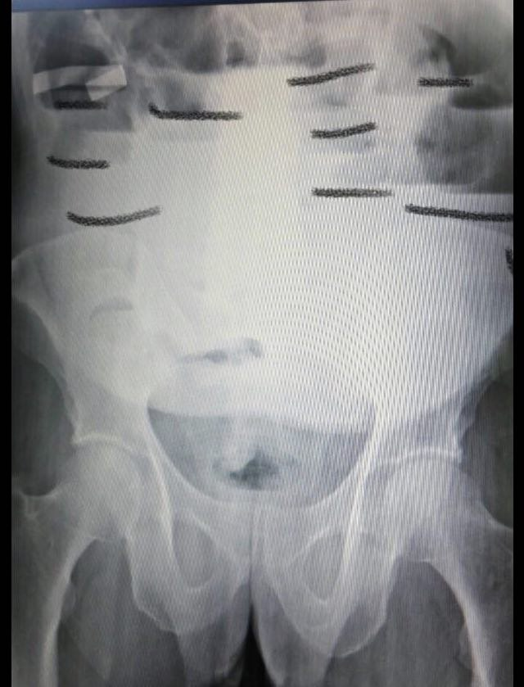
Erect film showing multiple short fluid level in the dilated small bowl loops with absent colon gas which reflect dilatation of loops proximal to point of obstruction

Slide 19
Adynamic obstruction
Clinical and radiological differentiation with mechanical obstruction is very difficult .
But history of medical disorders as sepsis, electrolyte imbalance may be present
Also more common with children with anterocolitis

Slide 20
intussusception
Classical traid clinical presentation is only seen in 20%
1 intermittent abdominal pain
2 vomiting
3 Right upper quad. Mass
With occult or gross blood seen with rectal examination
The majority are infants and young children

Slide 21
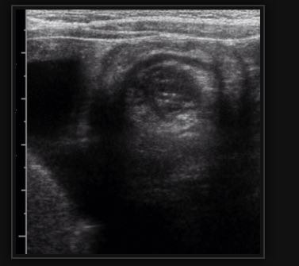
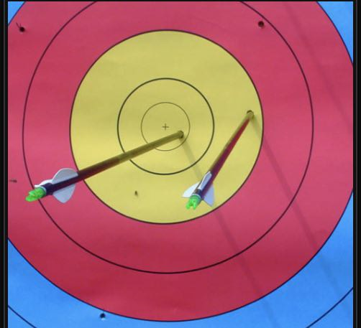
Ultrasonography is the first line imaging investigation
target sign

Slide 22
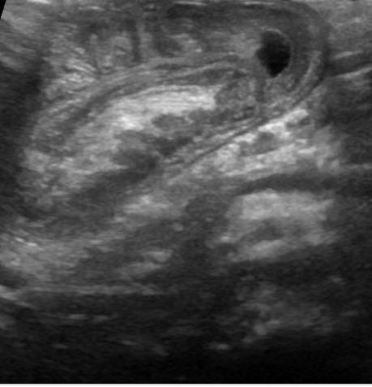
Pseudo kidney sign

