Slide 1
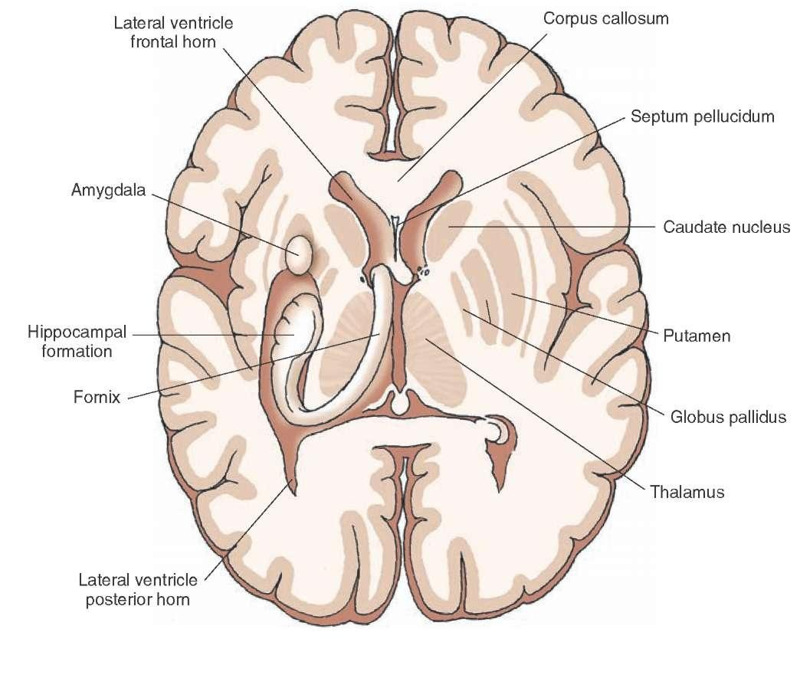
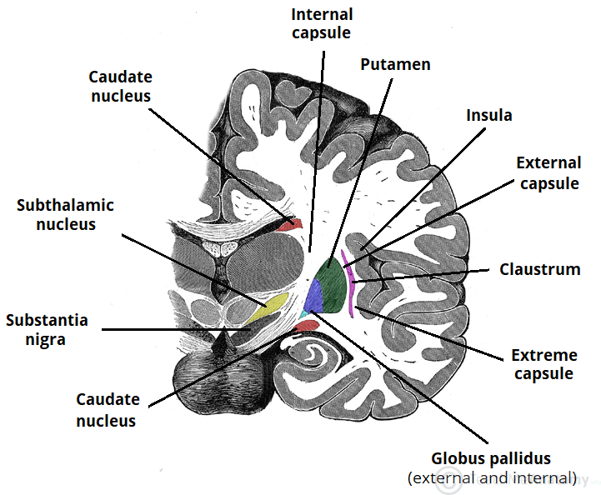
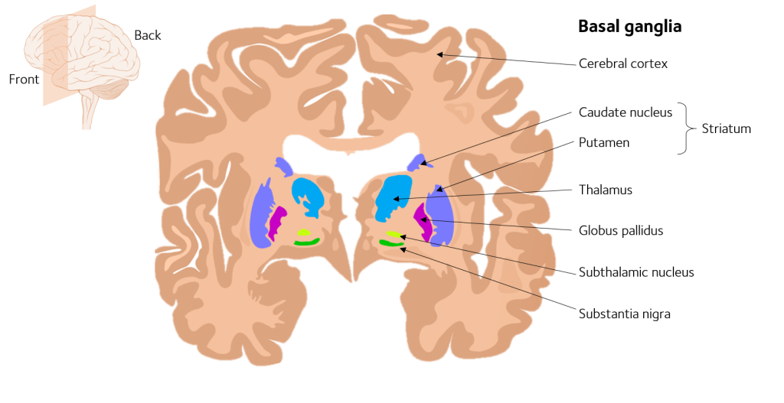
Basal ganglia:
There are large masses of gray matter inside the cerebrum and these include the thalamus and the basal ganglia.
The basal ganglia include the following nuclei:
The corpus striatum.
The amygdaloid body.
The claustrum.
The substantia nigra and the subthalamic nucleus are physiologically related to the basal ganglia, but anatomically they are not part from the basal ganglia group.

Slide 2
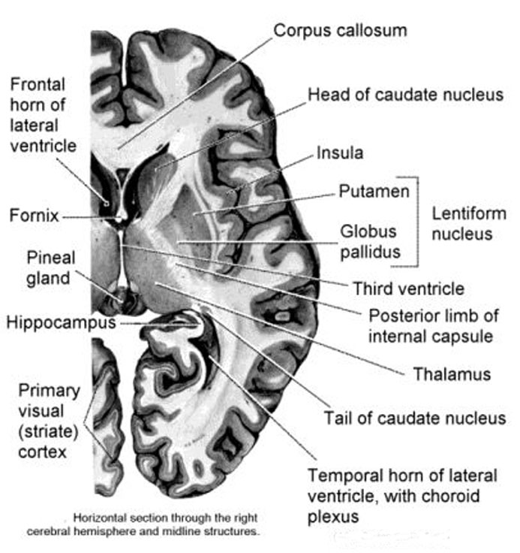
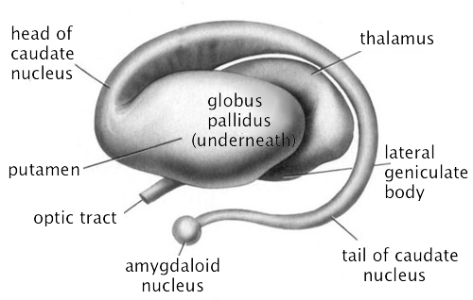
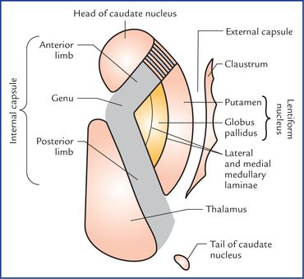
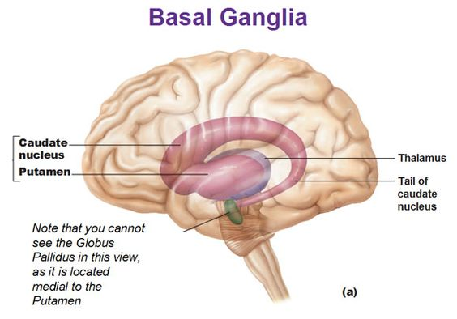
The corpus striatum:
It is made up of the following nuclei:
a- The caudate nucleus. This nucleus is comma shape has a head, body and tail (in front, above and behind the thalamus).
b- The lentiform nucleus is similar to lens and it is divided into an inner part called the globus pallidus which is pale part (pallidus means white) and an outer part which is dark part called the putamen.
There is a white matter bundle between the two parts of the globus pallidus called the medial medullary lamina, while the lateral medullary lamina is situated between the globus pallidus and the putamen. Thus, the corpus striatum is acquired its name the striatum from the interpositions of the gray masses and white bands.
• The external capsule is situated between the putamen and claustrum.
• The extreme capsule is situated between the claustrum and insula.

Slide 3
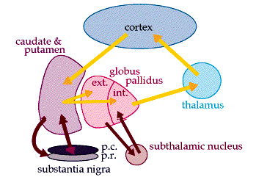
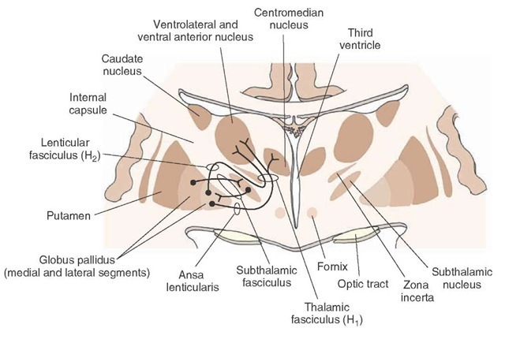
The neuronal circuit of the basal ganglia:
The cerebral cortex sends fibers to caudate and putamen, so the gate of entry to corpus striatum is through the caudate and putamen.
The caudate and putamen will sent the information to the globus pallidus (which is considered as the gate of exit from the corpus striatum). Fibers from globus pallidus will pass to the thalamus through:
Lenticular fasciculus (L.F.).
Ansa lenticularis (A.L.).
Then the fibers will go back from the thalamus to the cerebral cortex.
There are reciprocal connections between:
Globus pallidus and the subthalamic nucleus through the subthalamic fasciculus (S.F.).
Caudate and putamen with the substantia nigra.
This circuit is for motor control, but with no connections to the spinal cord. This control is done through the effect of basal ganglia on the cerebral cortex. Thus, the function of the basal ganglia is the motor control.
Damage or disorder of the basal ganglia will lead to appearance of new movement that is called dyskinesia.

Slide 4
Damage to nigro-strial pathway (which is between the corpus striatum and the substantia nigra) → Parkinson's disease that is due to decrease in dopamine level of the nigro-strial pathway.

Slide 5
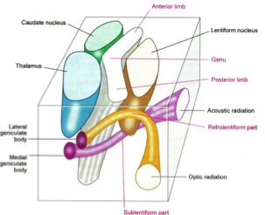
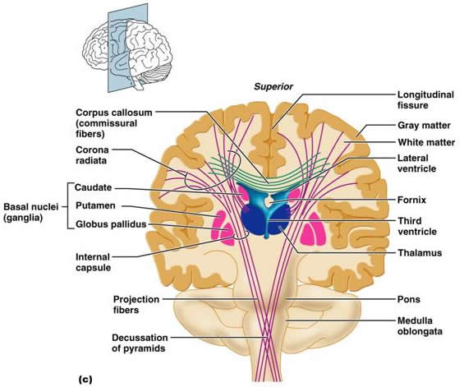
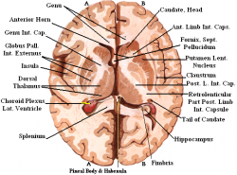
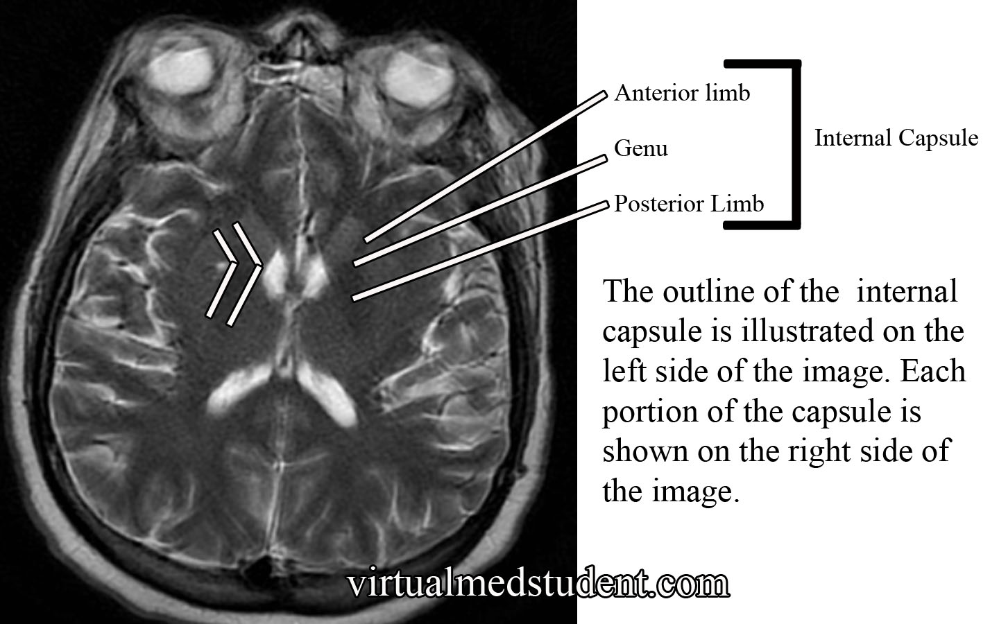
Internal capsule:
It is V- shaped bundle of white matter and it has the following parts:Anterior limb, genu, posterior limb, retrolentiform part and the sublentiform part.
The internal capsule anterior limb lies between the caudate nucleus medially and the lentiform nucleus laterally.
The genu or apex of the internal capsule is pointing medially. The posterior limb of the internal capsule lies between the thalamus medially and the lentiform nucleus laterally.

Slide 6
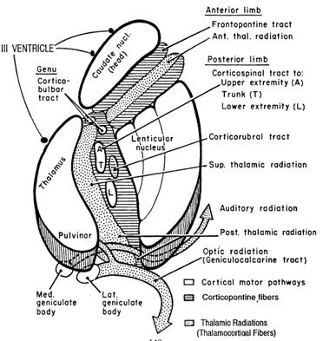
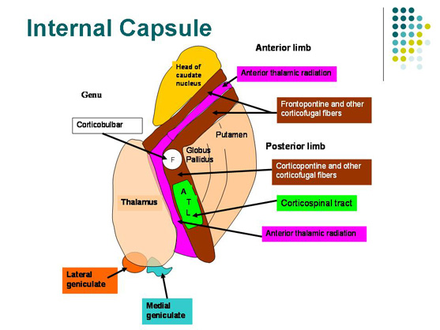
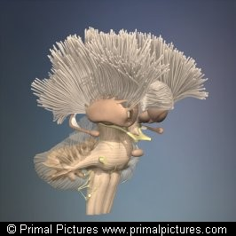
Superiorly, the fibers of the internal capsule will fan out to form the corona radiata of the internal capsule that interdigitate with the fibers of the corpus callosum.

Slide 7
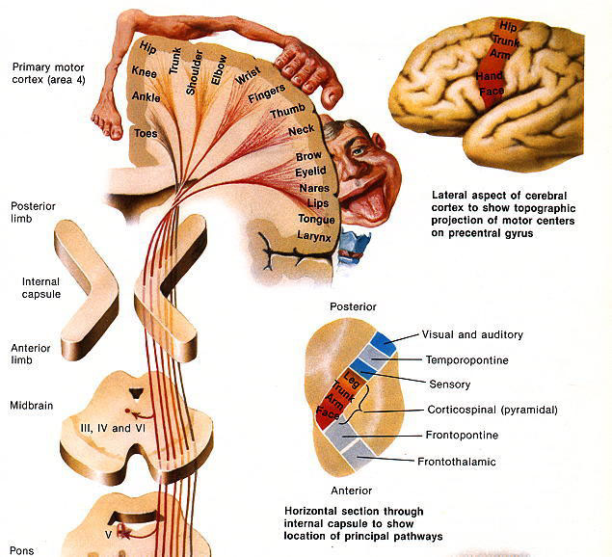
Types of the fibers of the internal capsule:
Thalamic radiation or thalamocortical fibers:
a- Anterior thalamic radiation or fibers in the anterior limb of the internal capsule.
b- Superior thalamic radiation in the posterior limb of the internal capsule.
c- Posterior thalamic radiation is in the retrolentiform part of the internal capsule which is connecting the lateral geniculate body to the visual cortex (the posterior thalamic radiation can also be called the optic radiation).
d- Inferior thalamic radiation lies in the sublentiform part of the internal capsule and it connects the medial geniculate body to the auditory cortex (the inferior thalamic radiation can also be called the auditory radiation).

Slide 8
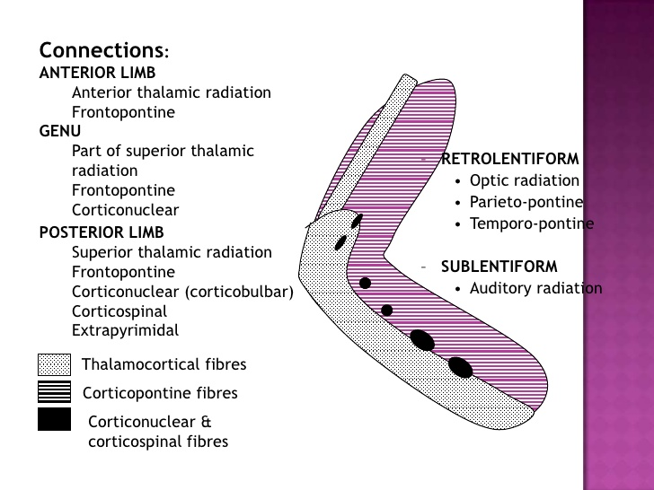
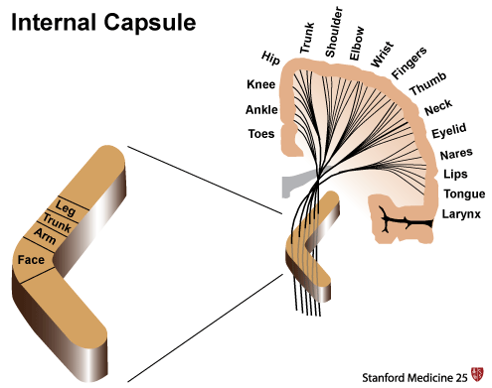
2- Corticopontine fibers that present in the anterior limb, genu and posterior limb of the internal capsule.
3- Corticonuclear fibers that connect the cerebral cortex to nuclei of the cranial nerves. These fibers only present in the genu of the internal capsule.
4- Corticospinal fibers that connect the cerebral cortex to motor nuclei of the spinal cord (anterior horn of the spinal cord) also only present in the posterior limb of the internal capsule.
Thus, the corticonuclear and corticospinal fibers are only present within the genu and the posterior limb of the internal capsule.
Anterior limb
Posterior limb
Posterior limb
Anterior limb

Slide 9
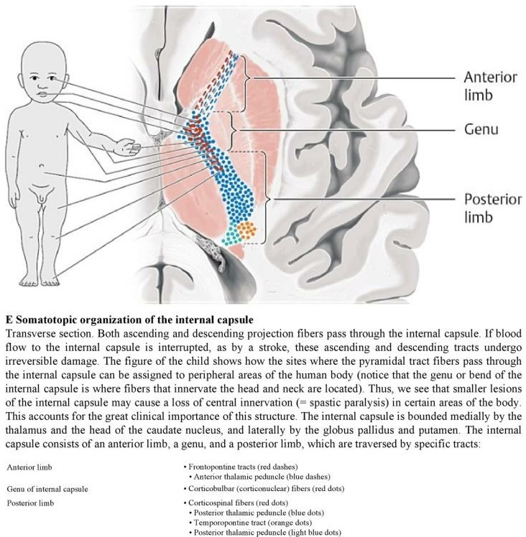
The somatotopic presentation or arrangement of the corticonuclear and corticospinal fibers in the genu and posterior limb of the internal capsule is as follow (from above downward): head – neck – upper limb – trunk and lower limb.

Slide 10
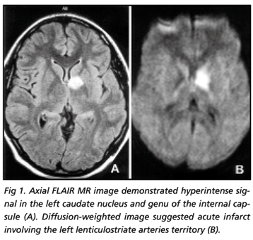
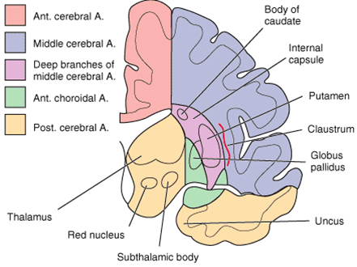
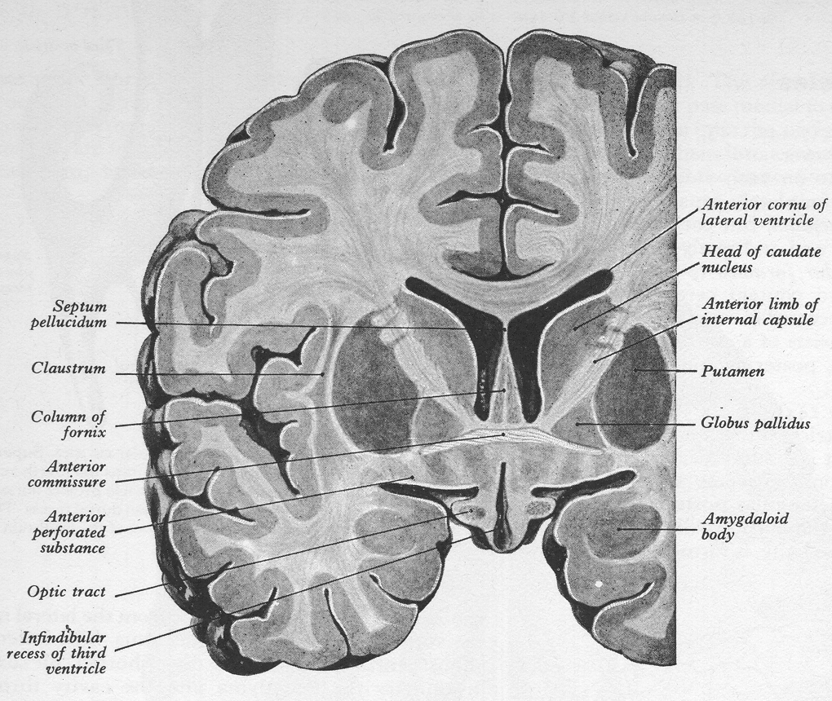
So any Intracerebral hemorrhage that occur in the genu and posterior limb of the internal capsule will lead to gradual paralysis of the contralateral part of the body, starting the paralysis from head, the neck, then upper limb, then trunk and then the lower limb. This gradual paralysis will occur rapidly, because this part of the internal capsule that contain the corticonuclear and corticospinal fibers is relatively small and thus any hemorrhage in this small area will lead to large effect, because of the presence of the fibers of the whole contralateral half of the body in this small area of the internal capsule.

