Slide 1
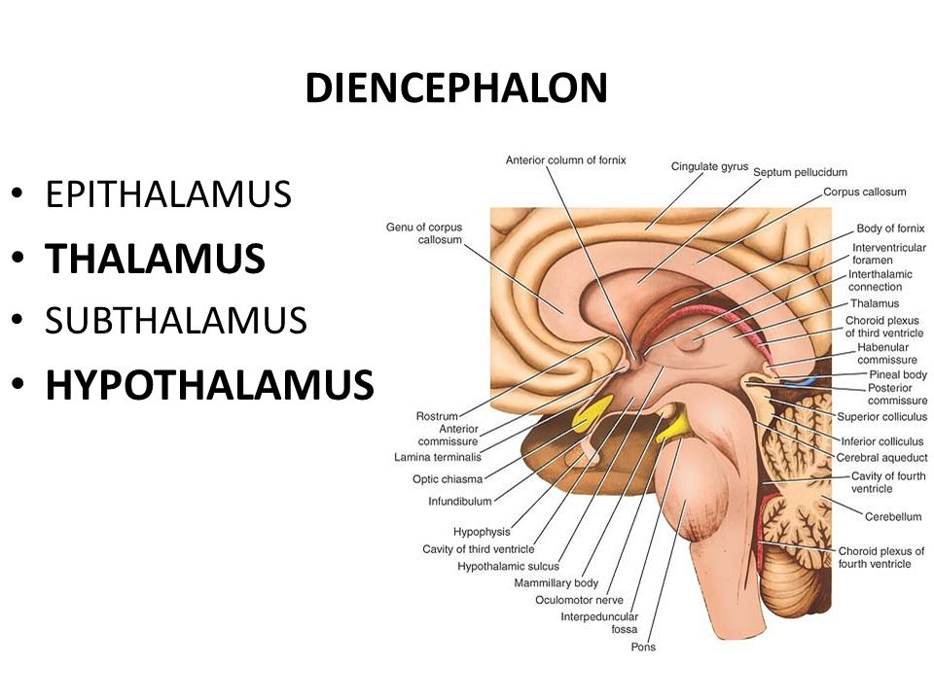
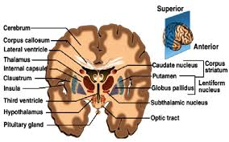
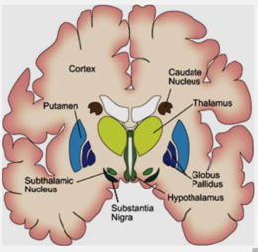
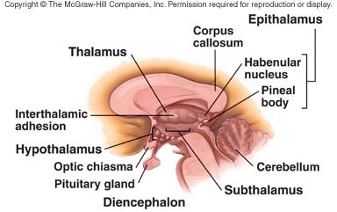
Diencephalon
Divisions of diencephalon:
Diencephalon
The diencephalon is an interbrain structure lies between the two cerebral hemispheres. The cavity of the diencephalon is the third ventricle.

Slide 2
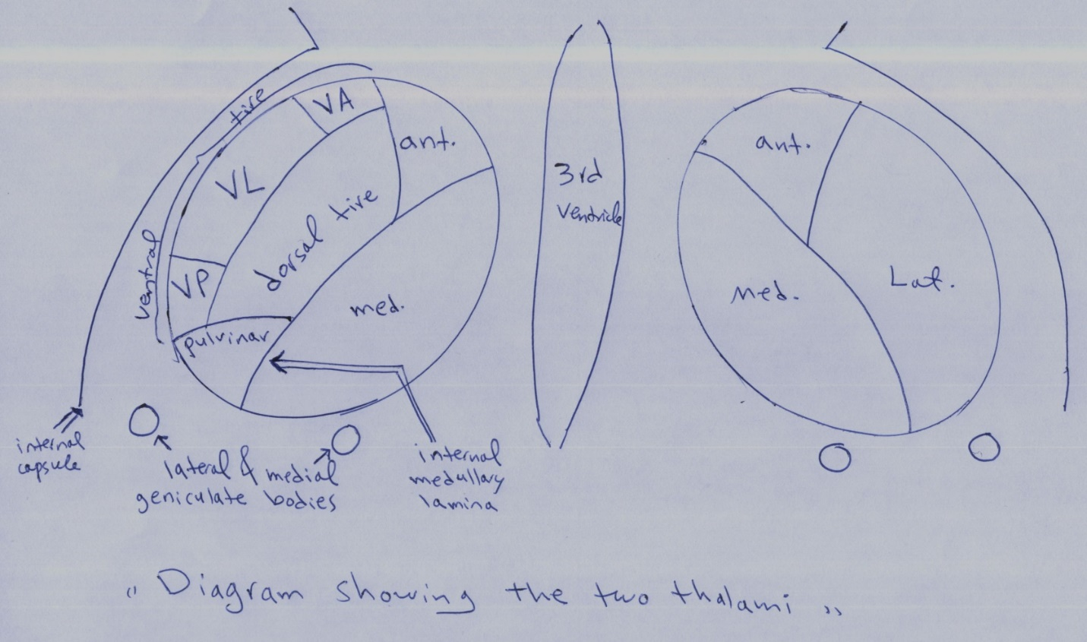
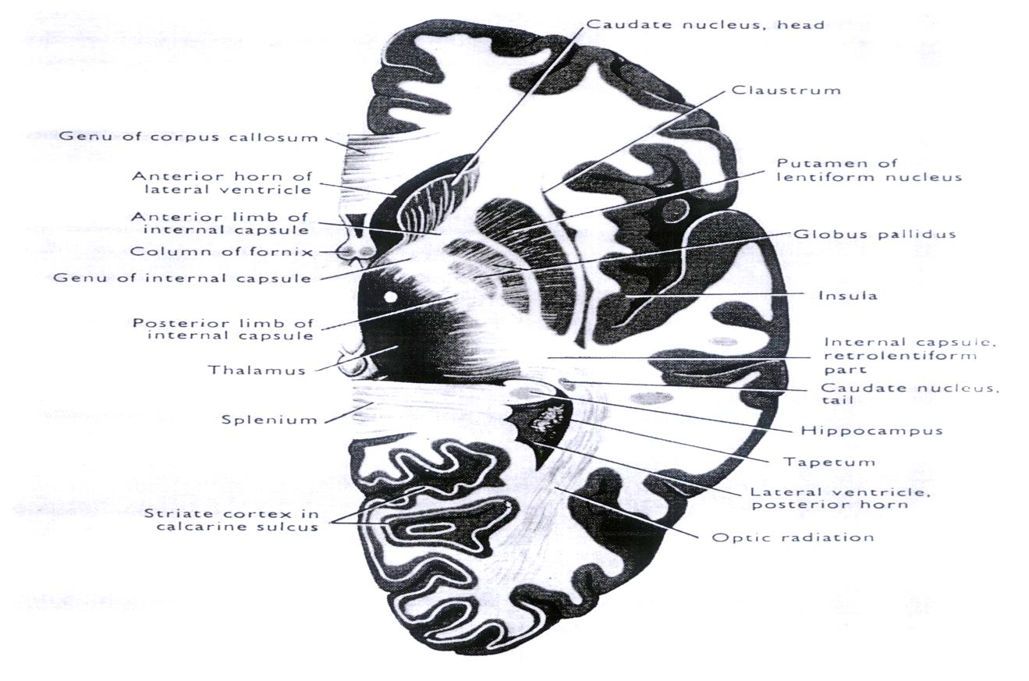
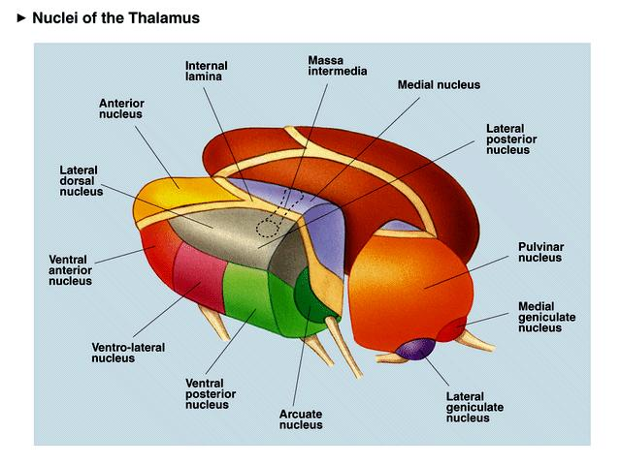
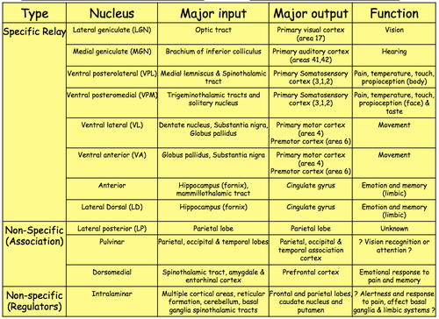
Thalamus:
It is an important relay station has an egg shaped and it represents a large mass of gray matter. The two thalami are situated on each side of the midline slit like cavity (the third ventricle). Lateral to each thalamus is the internal capsule (white matter).

Slide 3
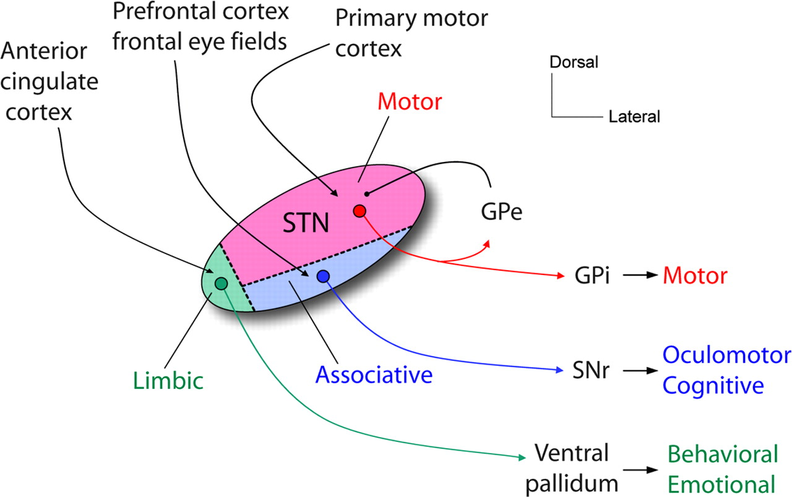
The subthalamus:
It is a transitory part of the diencephalon. It lies between the mid brain and the thalamus. The substantia nigra, red nucleus and superior colliculi have extensions inside the subthalamus.
The subthalamus has an important motor nucleus that has connection with the basal ganglia which is called the subthalamic nucleus of Luys.

Slide 4
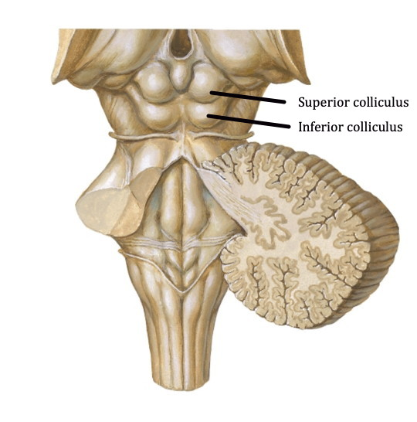
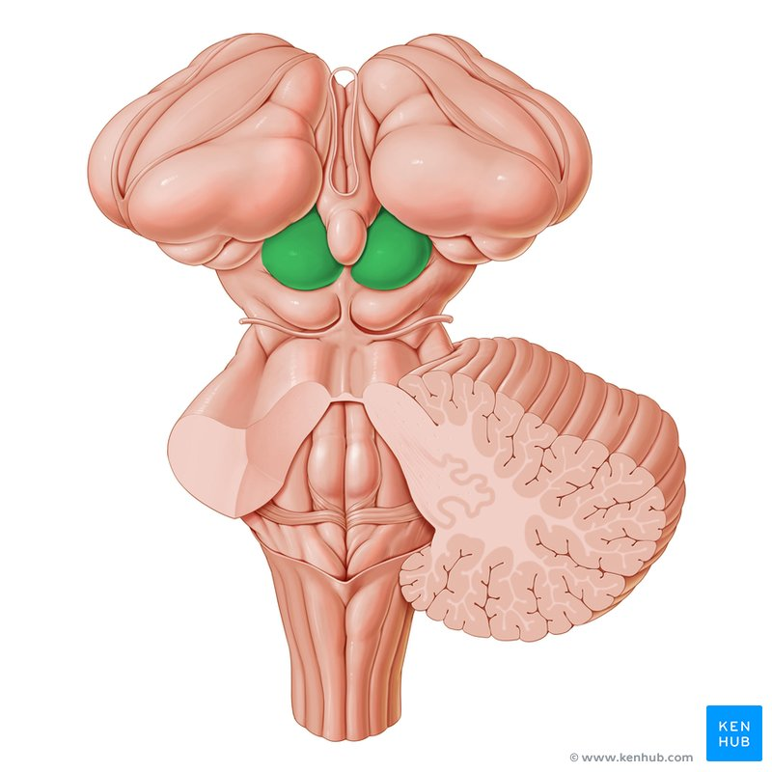
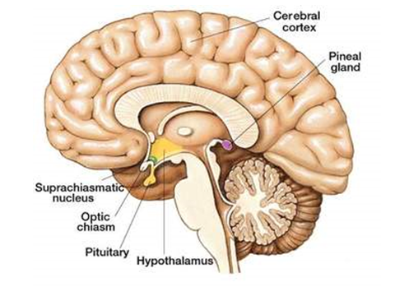
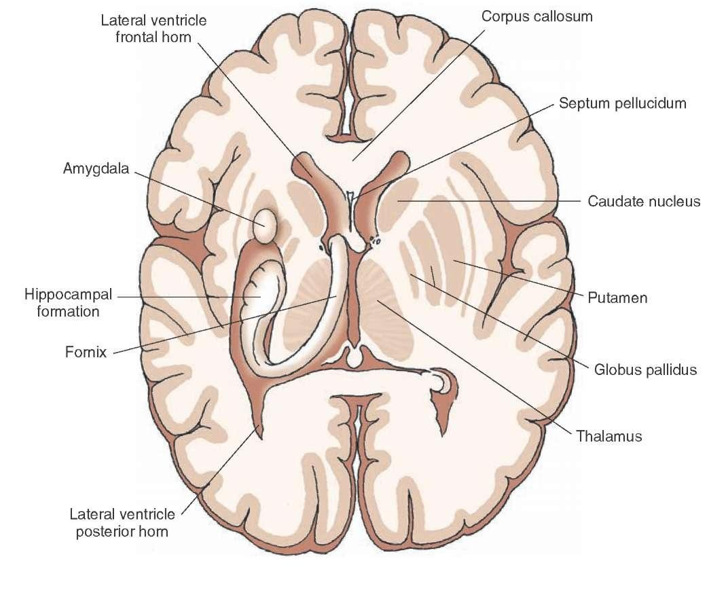
The epithalamus:
It has two parts:
1- Pineal gland.
2- Habenular nuclei.
The pineal gland:
It secrets the melatonin hormone that is secreted in response to darkness. It lies between the two superior colliculi. The pineal gland or body is frequently calcified with age and this calcification is a useful radiological landmark. Its displacement may indicate an intracranial space occupying lesion.
The habenular:
They are small nuclei that responsible for visceral and emotional response to smell.

Slide 5
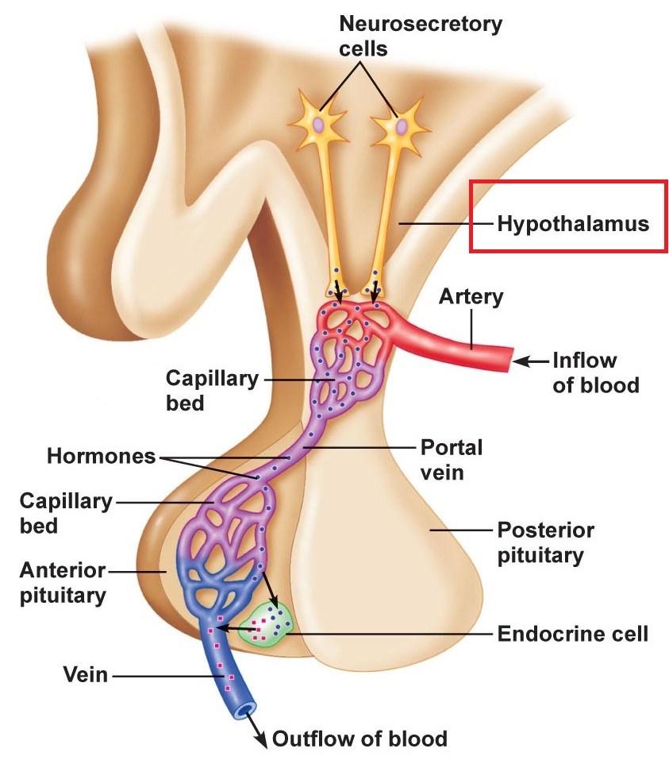
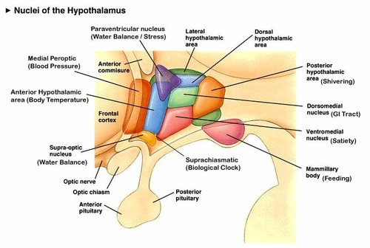
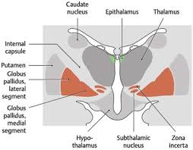
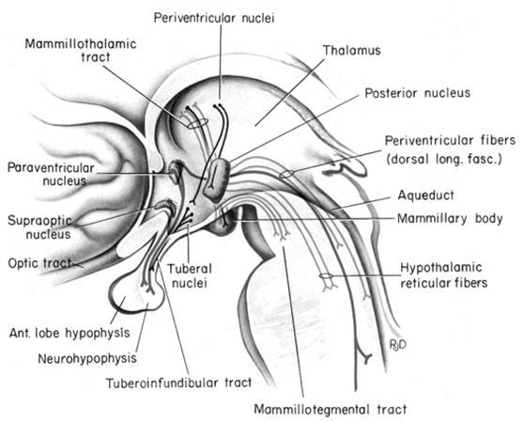
Hypothalamus:
It is a small area lies anterior-inferior to the thalamus.
The hypothalamus controls the endocrine functions through its connections with the pituitary gland (hypophysis cerebri).
The hypothalamus will control the pituitary gland through:
The hypothalamo-hypophyseal portal circulation, in which venous capillary bed in hypothalamus while the other venous capillary bed in the anterior lobe of the hypophysis cerebri (pituitary gland) to carry the stimulatory or inhibitory factors to pituitary gland.
2. The neural pathway to posterior lobe of the pituitary gland in which , the neuronal bodies (perikaryons) are situated within the hypothalamus and their axons are extended to end within the posterior lobe of pituitary gland. These nuclei will produce anti diuretic hormone (ADH) and oxytocin hormone.

Slide 6
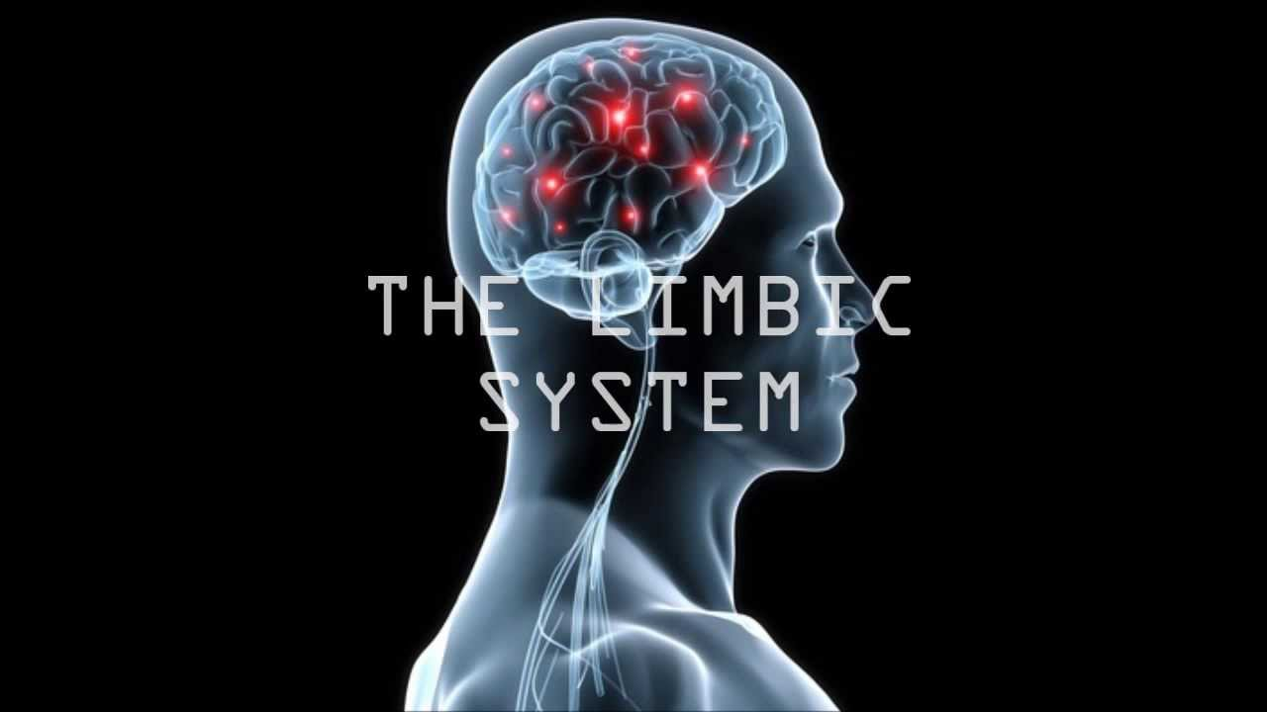
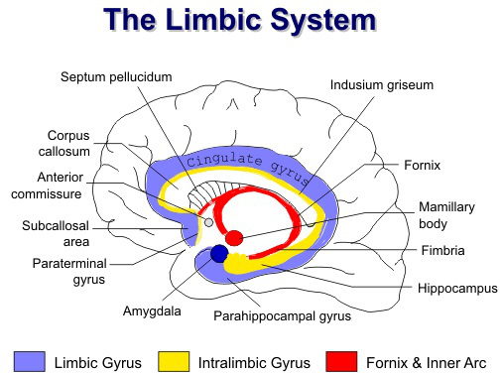
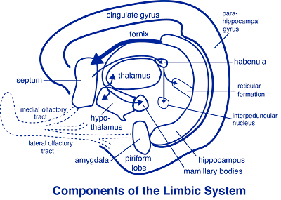
Limbic system (some consider it to be the sixth lobe)
This system controls the emotional aspect of behavior and it is composed of interconnected centers surrounding the regions where the two hemispheres join the diencephalon. The limbic system is divided into two major parts:
The limbic cortex.
The subcortical structures.
The limbic cortex: it includes: Cingulate gyrus, Parahippocampal gyrus, Hippocampal formation.
Subcortical structures: it includes:
Fornix and mamillary body, Amygdaloid body, Septal area, Habenular nuclei.

Slide 7
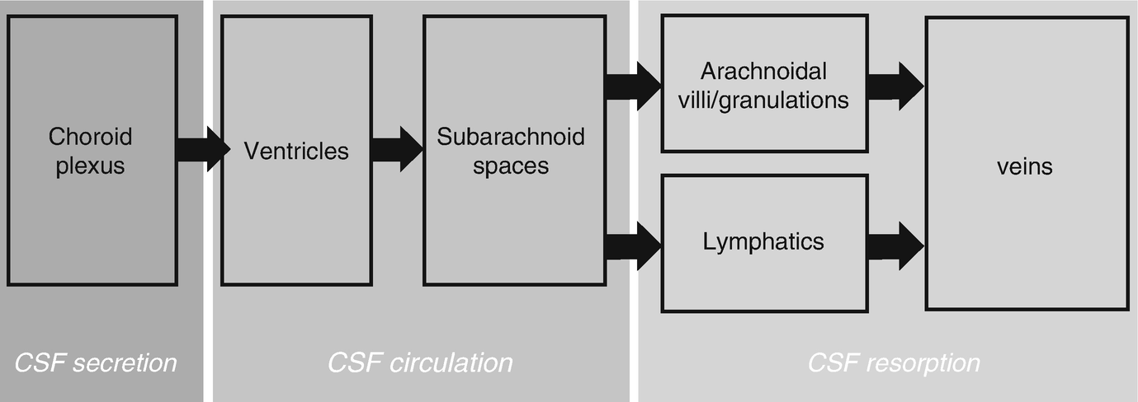
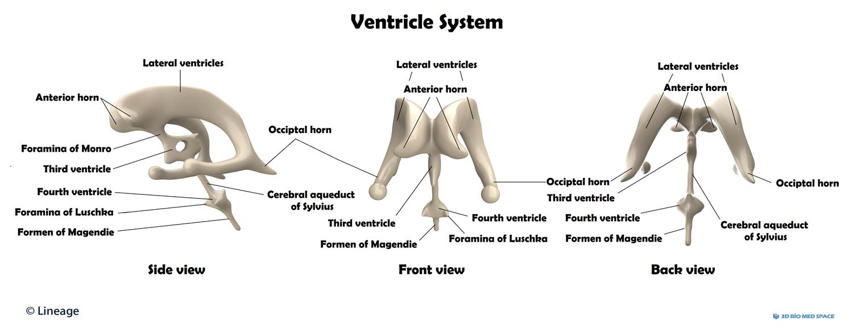
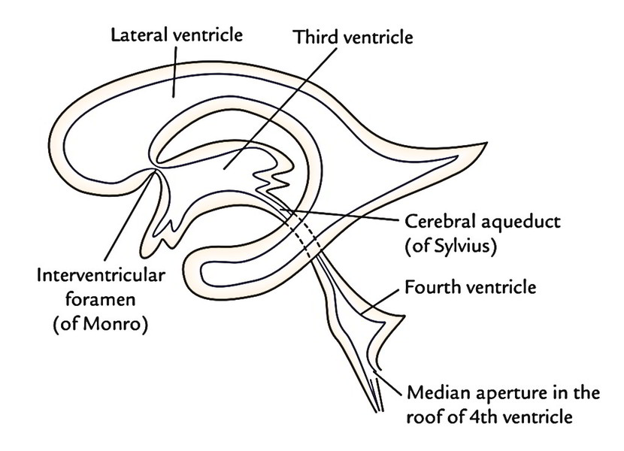
Cerebro-Spinal Fluid (CSF) circulation:
Firstly, there are four ventricles (cavities) within the brain, two lateral (represented first and second), third and fourth ventricles. Although the choroid plexuses located in every ventricle of the brain producing the CSF, but the majority of this fluid is formed in the two lateral ventricles. The CSF is found within the subarachnoid space and the ventricular system within the brain, it then drains into the superior sagittal sinus by the numerous arachnoid granulations to enter into the systemic circulation.

Slide 8
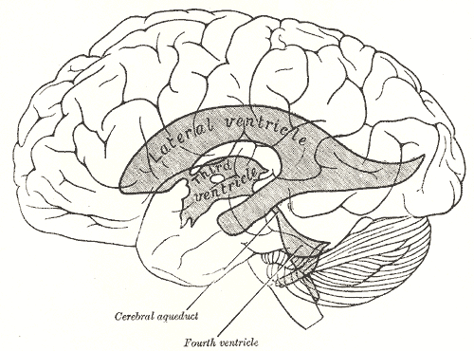
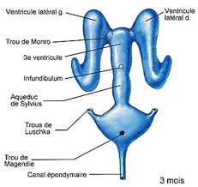
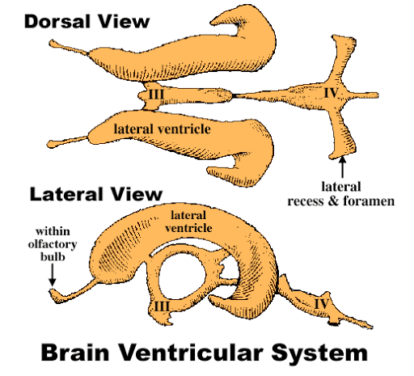
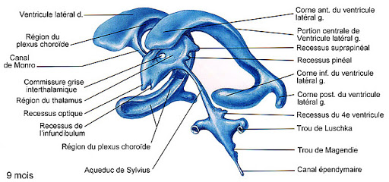
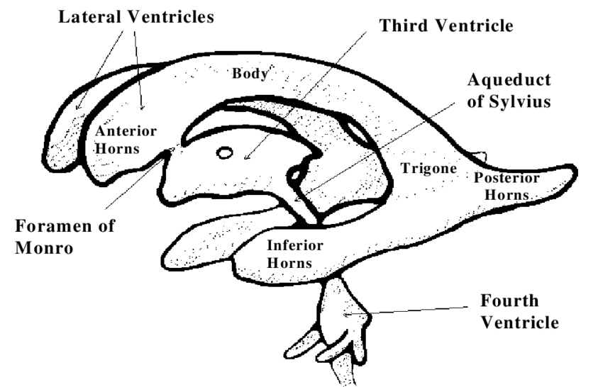
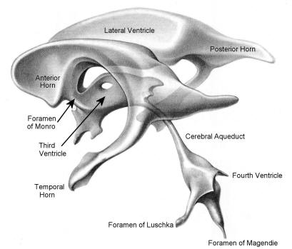
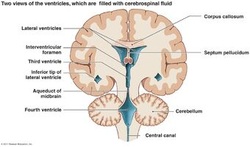
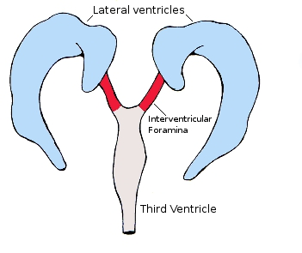
The largest ventricles, the paired lateral ventricles are horseshoe-shaped cavities separated from one another by the septum pellucidum, and are located in the right and left cerebral hemispheres. Each lateral ventricle has a body (located in parietal lobe) and the anterior (frontal), posterior (occipital), and inferior (temporal) horns. The choroid plexus of body and inferior horn are responsible of producing most of the CSF. The two lateral ventricles communicate with the third ventricle via the right and left interventricular foramina of Monro.

Slide 9
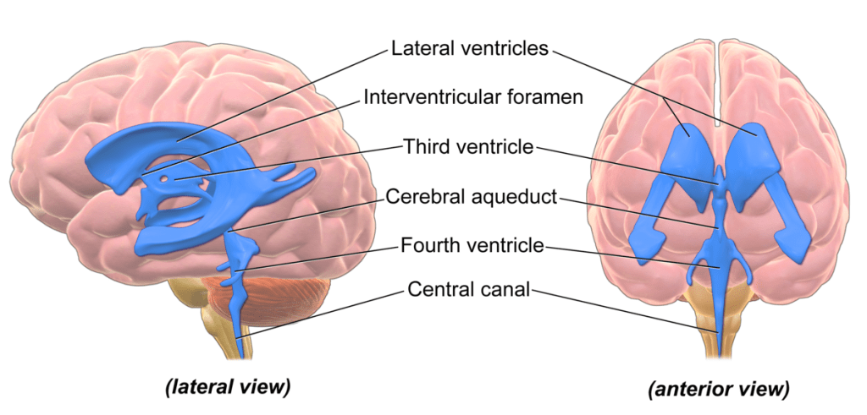
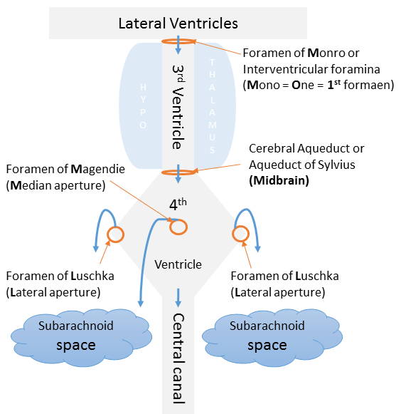
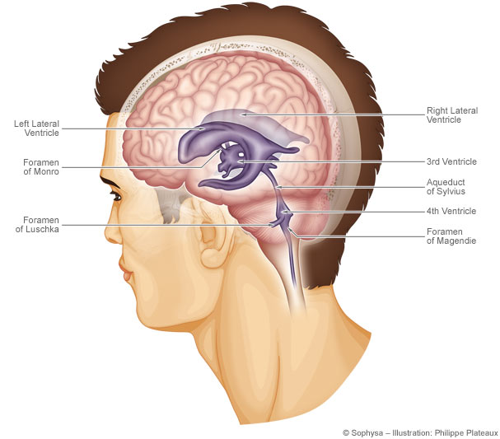
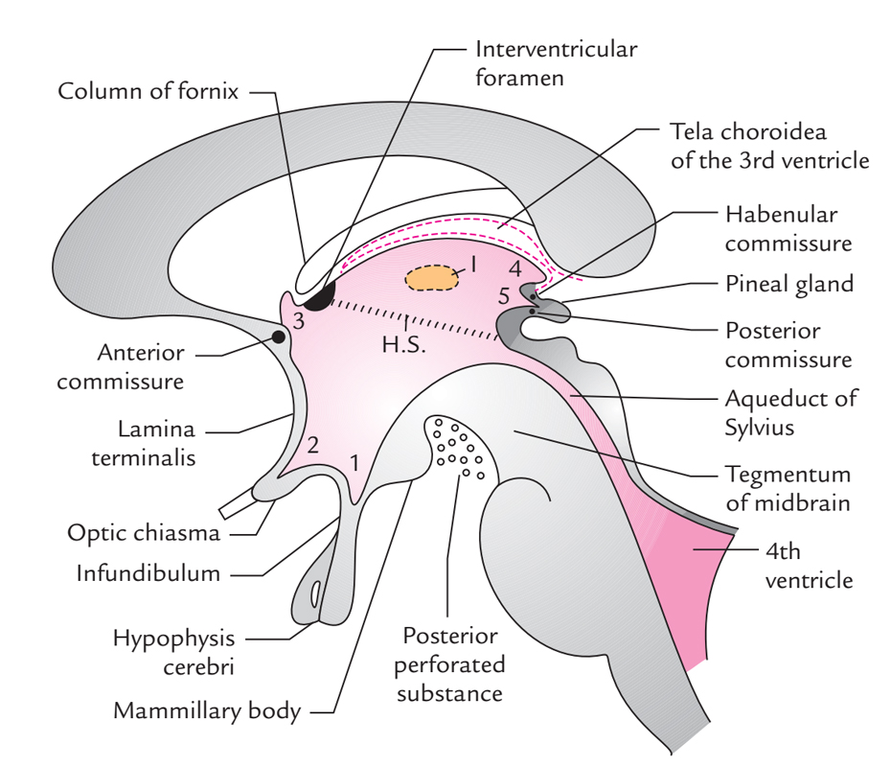
The third ventricle is a slit like, vertically positioned space, whose walls are formed by the right and left thalami, its cavity is interrupted by the interthalamic connection, the floor is formed by the hypothalamus, the roof is formed by the tela choroidea. The cerebral aqueduct of Sylvius connect the third ventricle to forth ventricle.

Slide 10
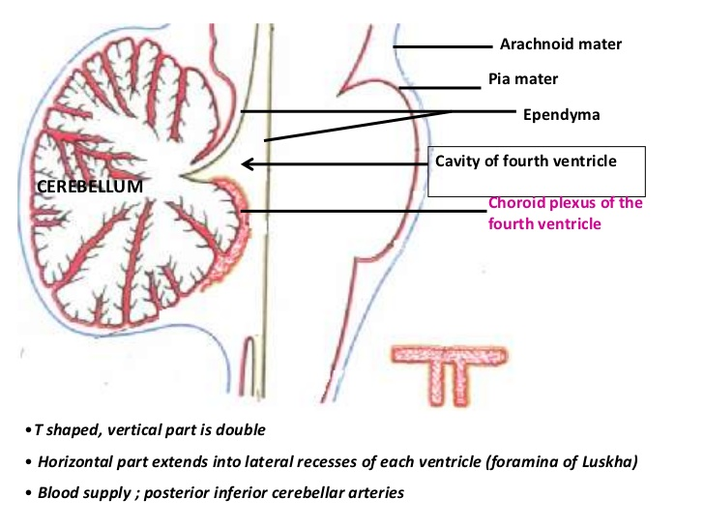
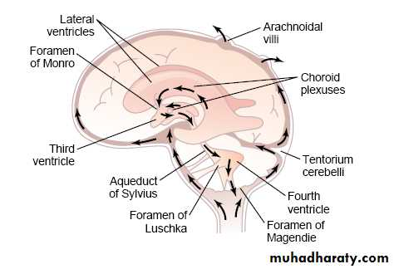
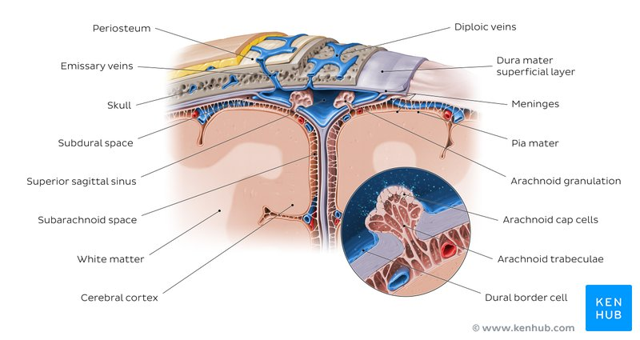
The fourth ventricle has an irregular shape and is continuous with the central canal of the spinal cord. the fourth ventricle has two lateral recesses (right and left) and each has lateral opening called foramina of Luschka, and there is single, median foramen of Magendie. All these three foramina drain the CSF from the 4th ventricle to the subarachnoid space, it then drains into the superior sagittal sinus by the numerous arachnoid granulations to enter into the systemic circulation.

