Slide 1
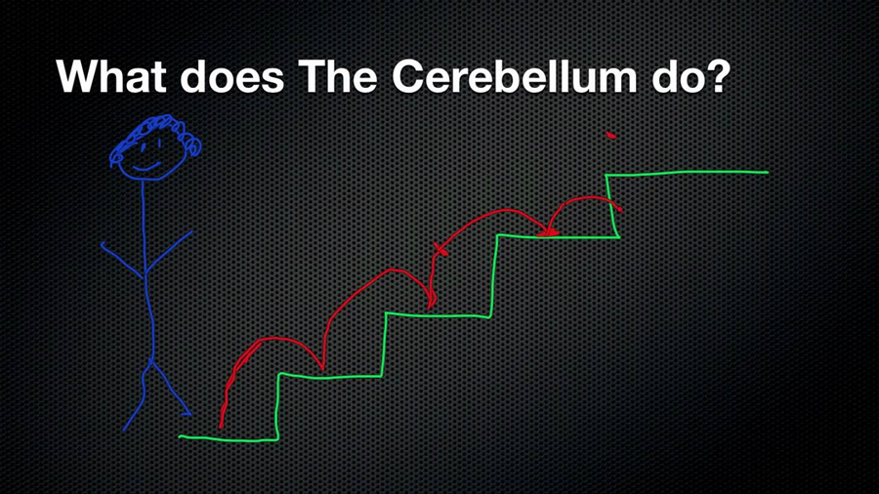
Cerebellum
(tree of life?)

Slide 2
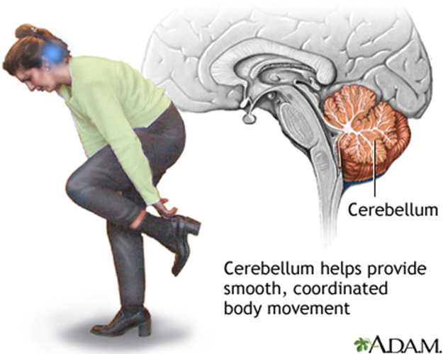

Slide 3
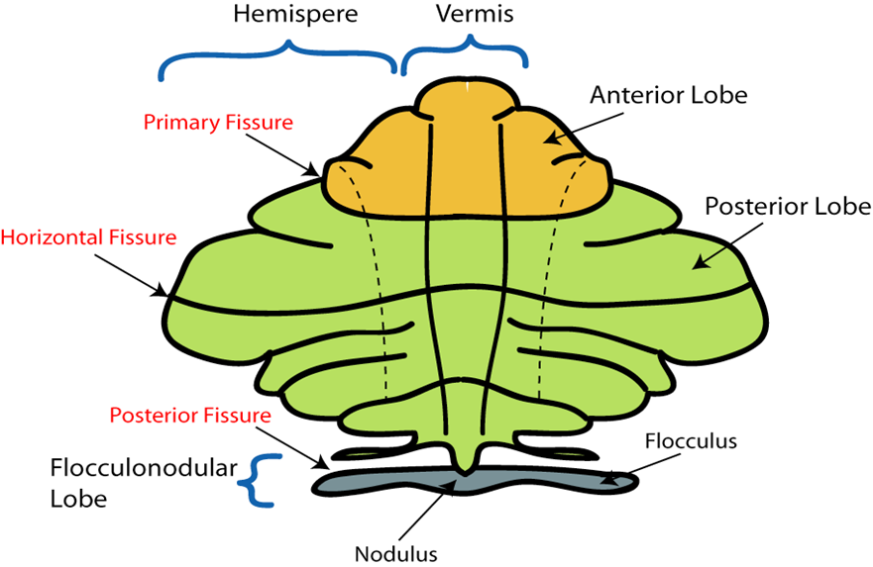
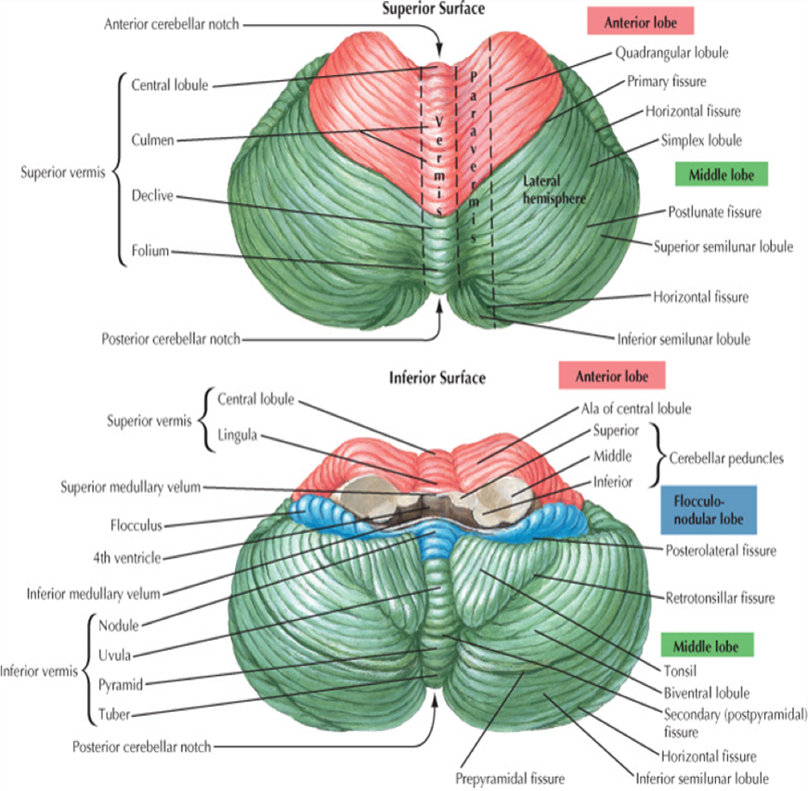
Its shape has attracted interest. It has two hemispheres join by the vermis in midline. The cerebellar surface has folds which are called folia (folium) and in between them there are the sulci.
The lobes and fissures of the cerebellum:
  The anterior lobe is that part of the cerebellum which is anterior to the primary fissure.
  The posterior (or middle) lobe of the cerebellum is posterior to the primary fissure and it is the largest lobe.
  The floculonodular lobe is that part of cerebellum which is surrounded by the dorsolateral or posterolateral fissure.
  The deep horizontal fissure separates the superior surface from the inferior surface of the cerebellum.
Note: ֍Tonsils: Protrusions on the inferior surface of cerebellum.

Slide 4
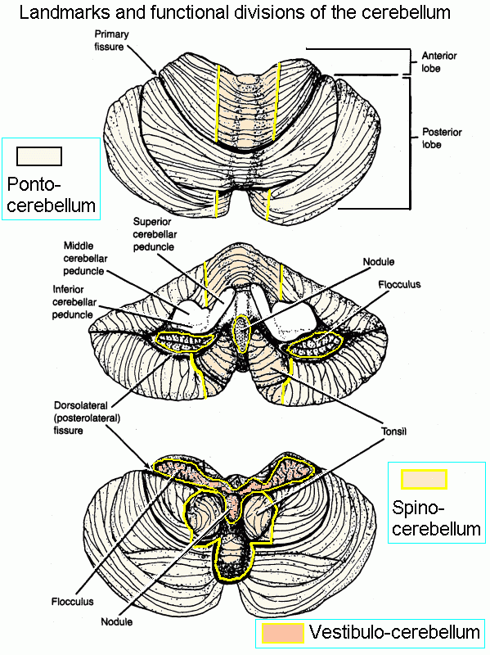
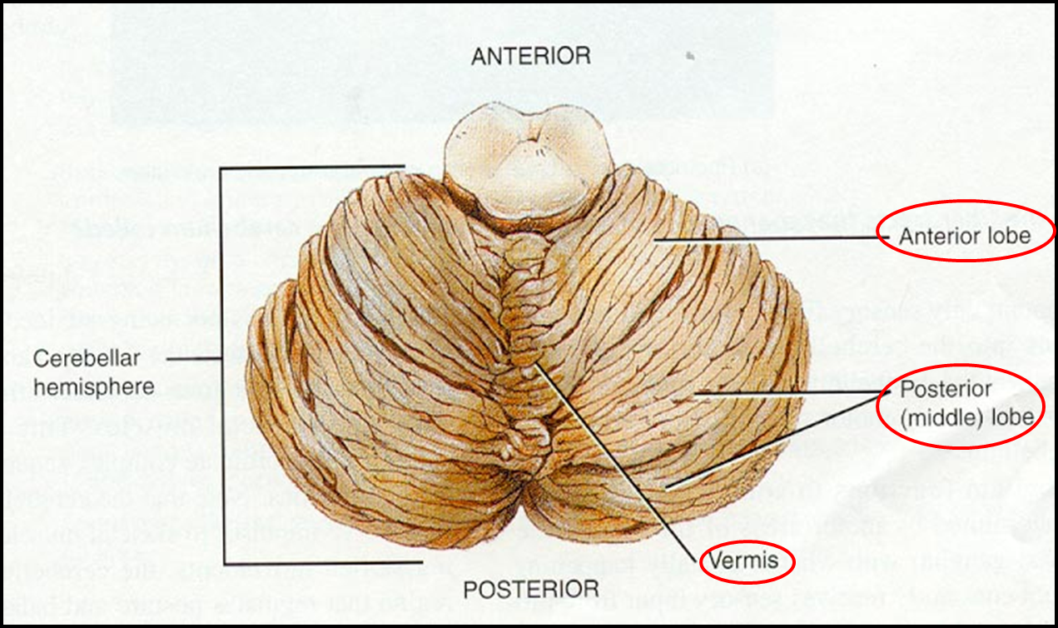
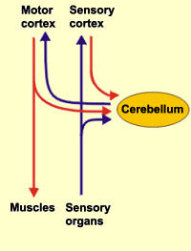
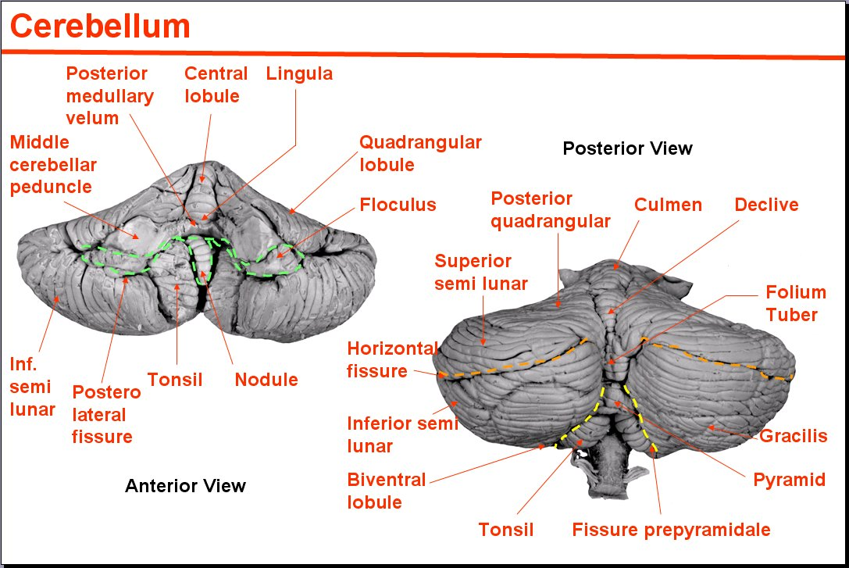

Slide 5
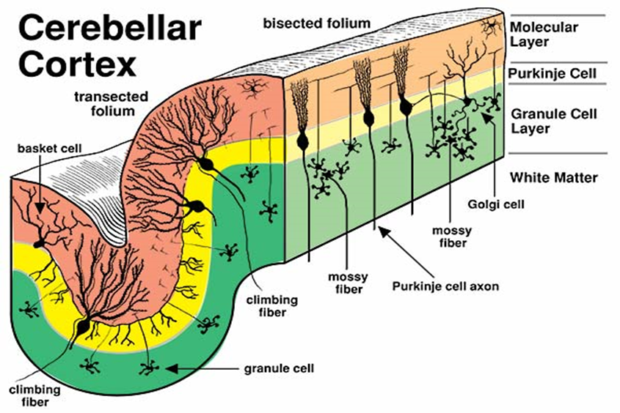
The gray matter of the cerebellum:
The cortex of the cerebellum is made up of the following layers:
The outer layer is the molecular layer.
The middle layer is the Purkinje cell layer.
The inner layer is the granular layer.
These layers of the cerebellar cortex are uniform all over the cerebellar cortex (not like the Broadman areas of the cerebral cortex).

Slide 6
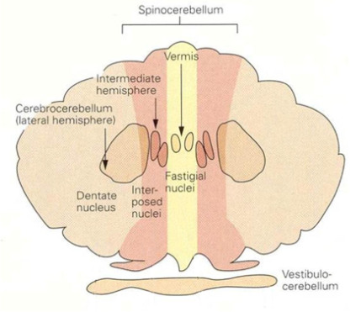
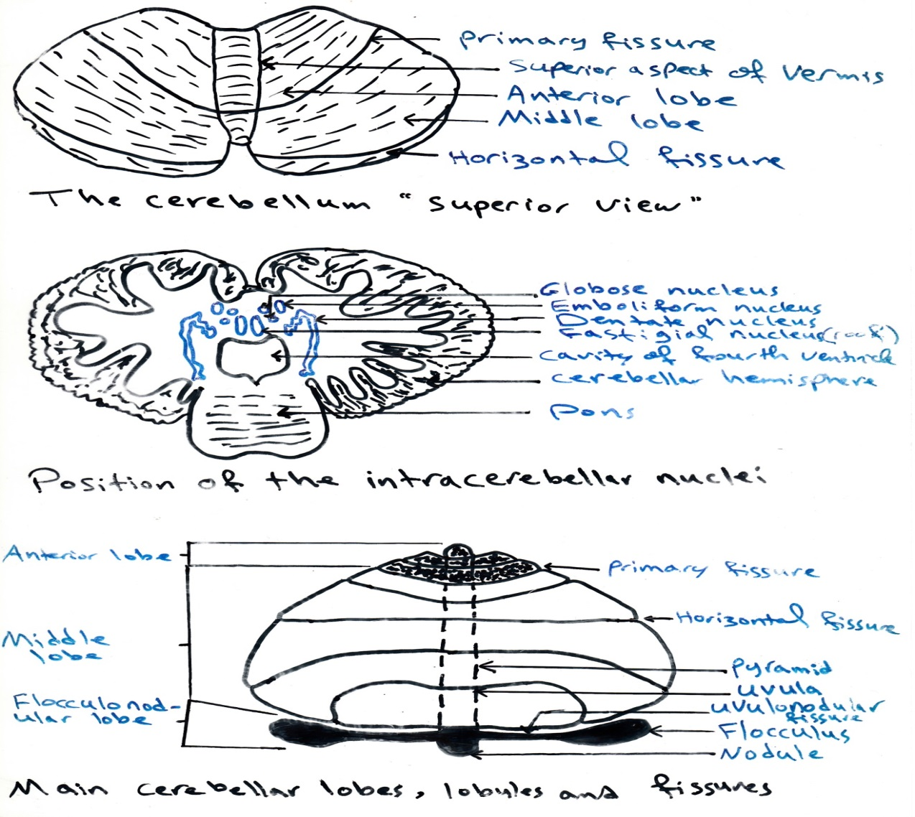
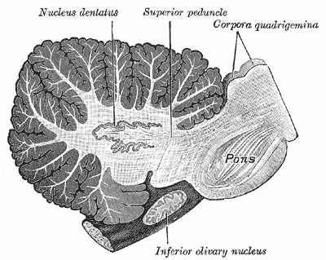
2. Intracerebellar nuclei:
Four masses of gray matter are embedded in the white matter of the cerebellum on each side of the mid line. From lateral to medial, these nuclei are:
Dentate, emboliform, globose and fastigial (or roof) nuclei.
The emboliform and globose nuclei are called together nucleus interpositum. The dentate nucleus is the largest nucleus of the cerebellum.

Slide 7
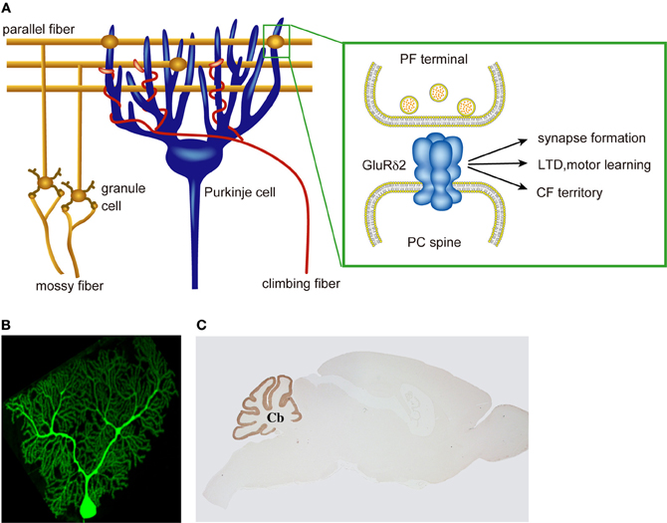
The white matter of the cerebellum:
There is a small amount of white matter in the midline vermis, while there is a large amount of white matter in each cerebellar hemisphere. The white matter is made up of three groups of fibers:
  Intrinsic fibers: connect different regions of the cerebellum.

Slide 8
  2. Afferent fibers: form the greater part of the white matter and end in the cerebellar cortex. These afferent fibers are of two groups:
Climbing fibers: these are afferent fibers to cerebellum. They are from the contralateral inferior olivary nucleus and go up to the cerebellar cortex winding around the dendrites of Purkinje cells (middle cell layer of the cerebellar cortex).
Mossy fibers: these afferent fibers end in the granular layer forming the cerebellar glomerulus.
  3. Efferent fibers of the cerebellum.

Slide 9
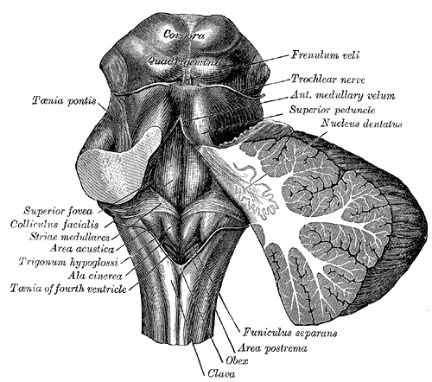
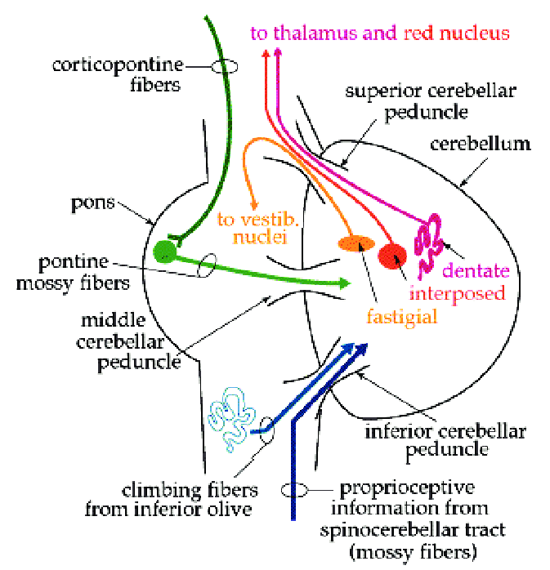
3. Efferent fibers of the cerebellum.
The peduncles:
They are the connections of the cerebellum with the brain stem.
  The inferior cerebellar peduncle connects the cerebellum to medulla oblongata.
  The middle cerebellar peduncle connects the cerebellum to pons.
  The superior cerebellar peduncle connects the cerebellum to mid brain.

Slide 10
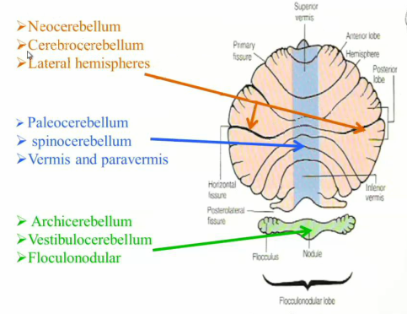
The functional divisions of the cerebellum:
Archicerebellum: it is represented by the floculonodular lobe. It receives input from vestibular nuclei and so can also be called the vestibulocerebellar system for balance (equilibrium). The size of the archicerebellum is small in human, but relatively large in fish.
pontocerebellum

Slide 11
2. Paleocerebellum: it is represented by the vermis and paravermis, it receives the spinocerebellar tracts. The anterior lobe is an intermediate in size. The function of the paleocerebellum is unconscious proprioception and muscle tone.
pontocerebellum

Slide 12
3. Neocerebellum: it is represented by the lateral hemispheres which form about 80% of the cerebellar size. It receives input from the pons and so can also be called the pontocerebellar system. The function of Neocerebellum is the coordination.
pontocerebellum

Slide 13
The neuronal circuit or connections of the Neocerebellum:
Fibers from motor area of the cerebral cortex to the pons (corticopontine fibers), then from pons, the fibers will pass to the contralateral side of the posterior lobe of the cerebellum (pontocerebellar fibers). These pontocerebellar fibers will pass to the deep nuclei of the cerebellum (especially the dentate nucleus), then the fibers will leave the cerebellum through the superior cerebellar peduncle (decussation fibers). Then fibers will cross to other side. Some of the fibers will end into the red nucleus and other fibers will end into the thalamus. The fibers from the thalamus will back to the motor area of the cerebral cortex.

Slide 14
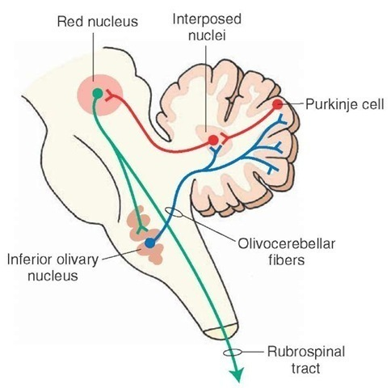
This above circuit is responsible for coordinate of the motor activity with each motor order of movement from the cerebral cortex, so the cerebellum can modify the pattern of movement to ensure maximum efficiency and minimum effort. Thus, the posterior lobe of the cerebellum can be considered as a motor center for coordination of the movement.

Slide 15
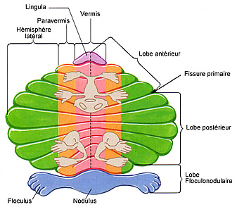
The functional aspects of the cerebellum:
  Ipsilateral control (coordinate the same side of the body movements).
  The somatotopic presentation:
The midline vermis coordinates the movement of trunk and head.
The cerebellar hemispheres are responsible for limbs.
  3. The cerebellar preserve and compensation: the uniform structure of the cerebellar cortex can compensate the damage to other cerebellar cortex, and so 80% damage to cerebellar cortex will lead to appearance of the cerebellar dysfunction (unlike cerebral cortex).

Slide 16
The features of cerebellar dysfunction:
Hypotonia: because of the damage to the spinocerebellar pathways that are responsible for muscle tone.
Ataxia.
Intension tremor (no tremor at rest).
Vertigo and nystagmus.
But no paralysis, and no sensory loss.

Slide 17
