Slide 1
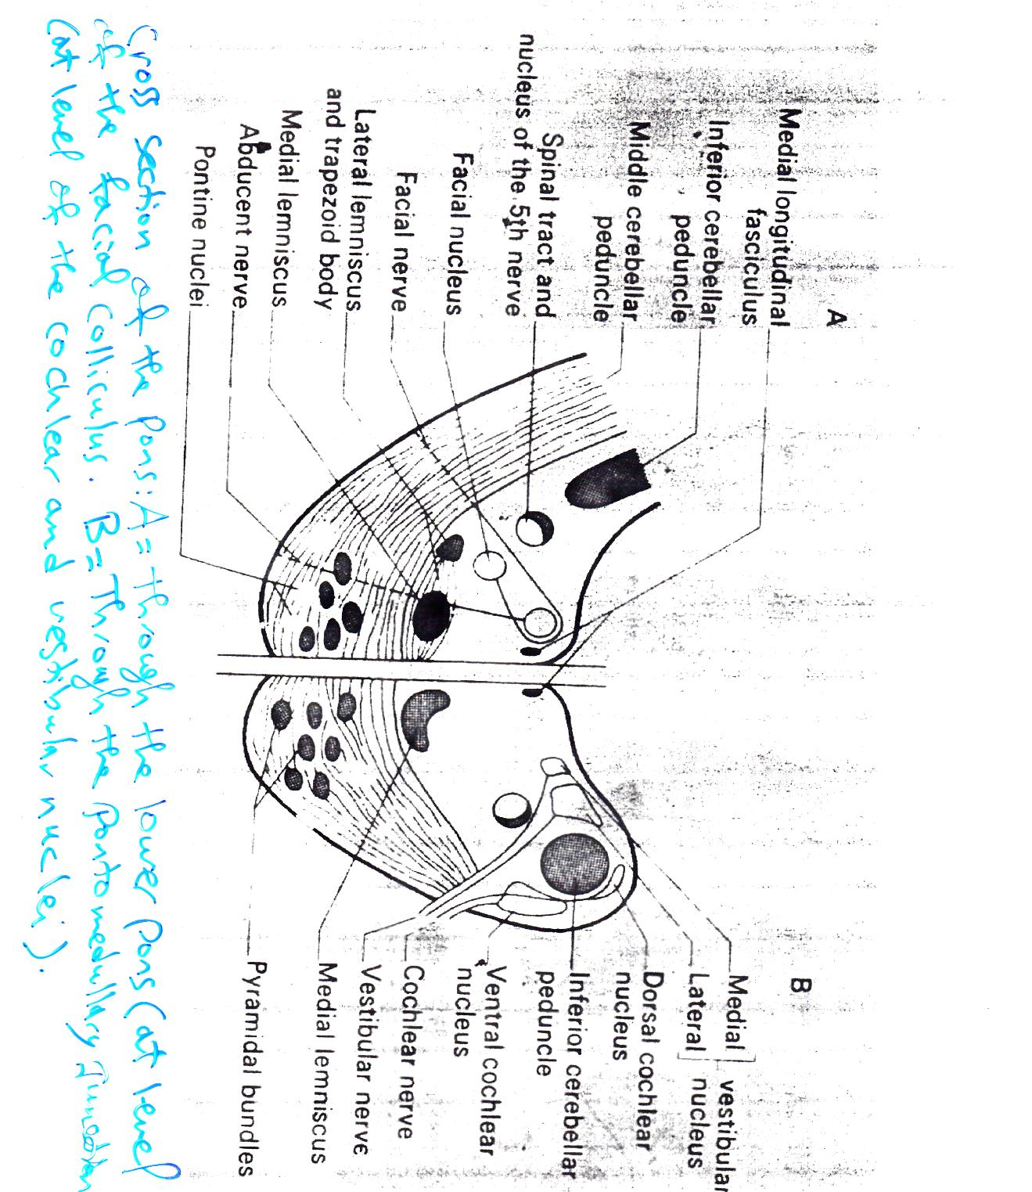
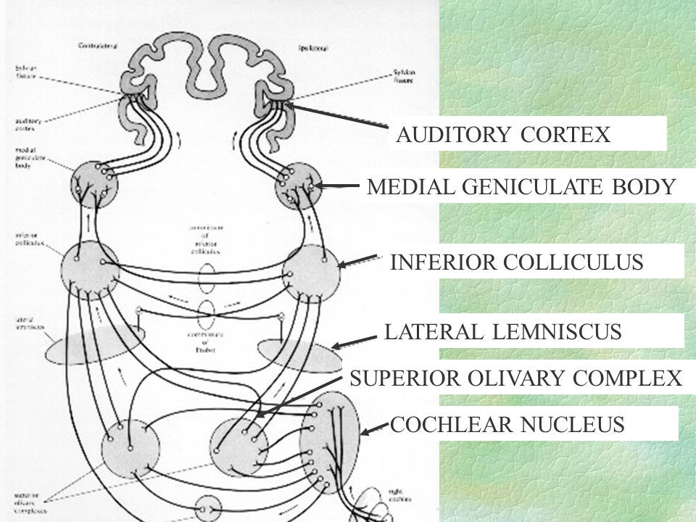
The crossed fibers (which crossing the midline) will form a mass of white matter called the trapezoid body that end into the superior olivary nucleus. The fibers from the superior olivary nucleus will ascend as a band called the lateral lemniscus.
The lateral lemniscus will end at the inferior colliculus of the mid brain, then to medial geniculate body of the thalamus that give output to the auditory cortex. The medial geniculate body receives auditory information from both ears but mainly from the opposite ear.
The above system is the auditory pathway.

Slide 2
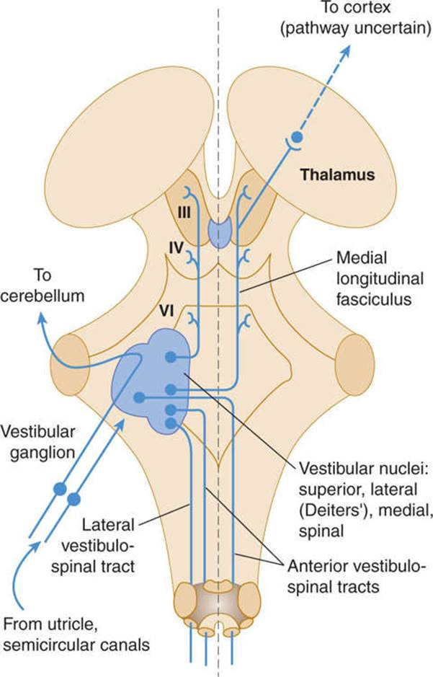
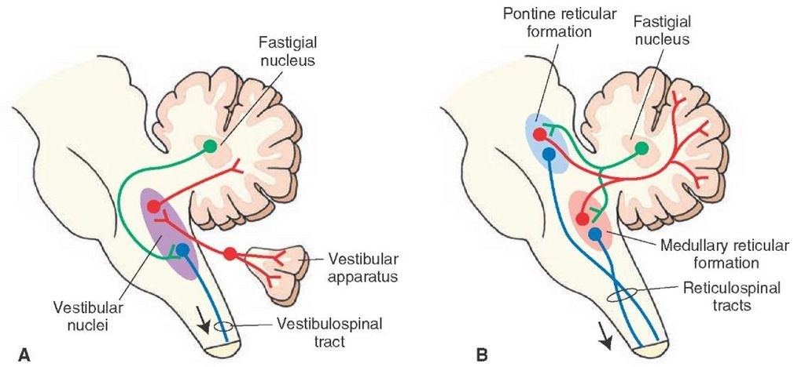
The vestibular nucleus:
It is divided into four parts:
The superior vestibular nucleus or part – inferior vestibular nucleus – medial vestibular nucleus – lateral vestibular nucleus which is the largest part of the vestibular nucleus.
The vestibular pathway begins from the semicircular cannels, utricle and saccule of the internal ear (the labyrinth) and these fibers will end into the vestibular nucleus.
The fibers from the vestibular nucleus will pass to the following:
The major fibers from the vestibular nucleus will enter the ipsilateral side of the cerebellum.
Some fibers pass to the thalamus then to the cerebral cortex.
The vestibular nuclei also have an important connection to the medial longitudinal fasciculus.

Slide 3
The medial longitudinal fasciculus is not considered as a part of the vestibular pathway, but it is important for control the position of the eye ball and head movements according to the vestibular stimuli or input.
The medial longitudinal fasciculus has the following connections:
To the vestibular nuclei.
To the spinal cord and especially the cervical segments of the spinal cord.
Nuclei of the 3rd, 4th and 6th cranial nerves that is responsible for the movements of the eye ball.
The damage of the medial longitudinal fasciculus like in multiple sclerosis or other lesion to brain stem, it will lead to a condition called the Doll's eye. ((Typically the doll's eyes reflex is elicited by turning the head of the unconscious patient while observing the eyes. The eyes will normally move as if the patient is fixating on a stationary object. If there is a negative doll's eyes reflex then the eyes remain stationary with respect to the head, i.e. positive reflex when the head moves to right while the eyes move to left and vice versa, as the figure below)).

Slide 4
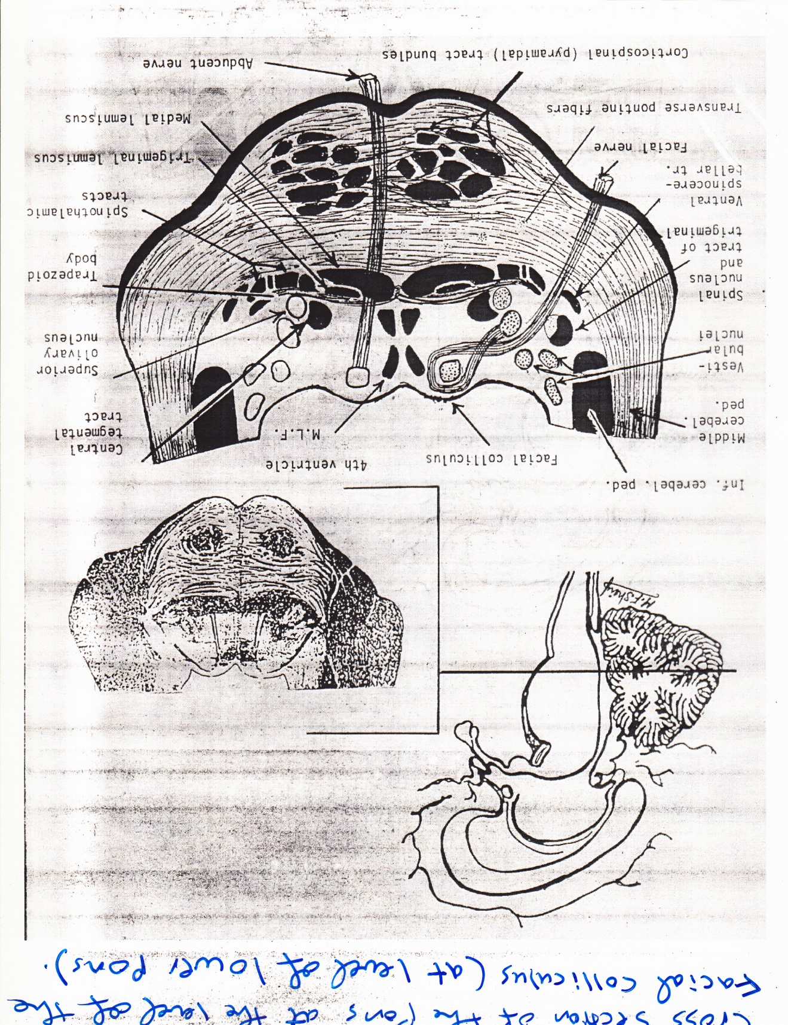
2- At level of the facial colliculus (lower pons).
Facial colliculus is the fibers of the facial nerve that emerge from facial nerve nucleus. These fibers pass posteriorly and medially, then hook around the Abducent nerve nucleus, then the fibers will pass laterally and then pass out from the pons.
The nucleus of the Abducent nerve is the main structure that forms the facial colliculus rather than the fibers of the facial nerve that emerge from the pons. Thus, the facial colliculus that situated as an elevation in the floor of the 4th ventricle is formed of two parts:
The superficial part that represented by the facial nerve fibers.
The deep part of the facial colliculus is represented by the nucleus of the 6th cranial nerve which supplies the lateral rectus muscle of the eye ball.

Slide 5
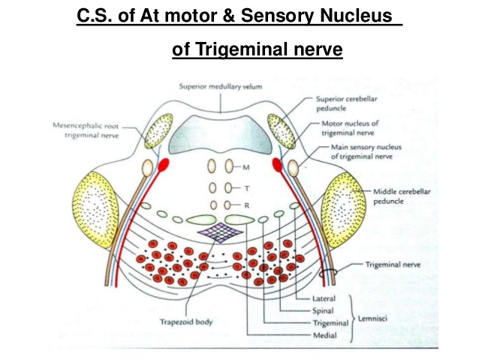
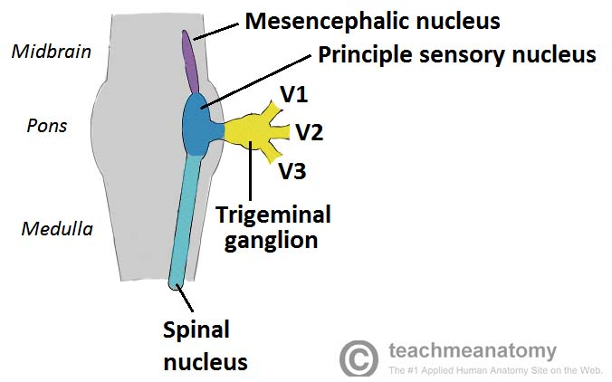
3- At level of the trigeminal nuclei (middle of the pons).
At this level, the four groups of trigeminal nuclei could be seen together, otherwise they could be seen separately (not together) at other parts of CNS.
The nuclei of the trigeminal nerve:
These are groups of nuclei that extend on a large area of the central nervous system.
The first group of nuclei of the trigeminal nerve is the main sensory nucleus and it receives the touch sensation from the same side of the face.
The second group of nuclei of the trigeminal nerve is the spinal nucleus of the trigeminal nerve that extends from the pons to the upper part of the cervical region of the spinal cord. It receives the pain and temperature from ipsilateral side of the face.

Slide 6
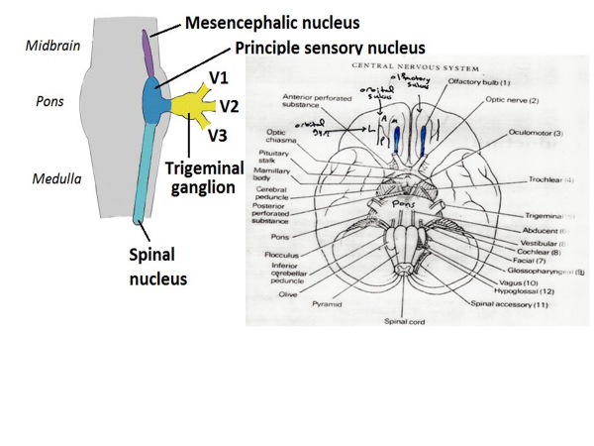
3. The third group of nuclei of the trigeminal nerve is the mesencephalic nucleus which extend from the pons to the mid brain and it is responsible for the proprioception sensation of the temporomandibular joint (TM joint).
The above three nuclei of the trigeminal nerve are sensory nuclei.
4. The fourth group of nuclei of the trigeminal nerve is the motor nucleus that is responsible for supplying the muscles of mastication (medial & lateral pterygoid muscles, masseter and temporalis muscles).
The sensory component of the trigeminal nerve has a ganglion at the tip of the petrous part of the temporal bone which is called the trigeminal or semilunar ganglia.

Slide 7
