Slide 1
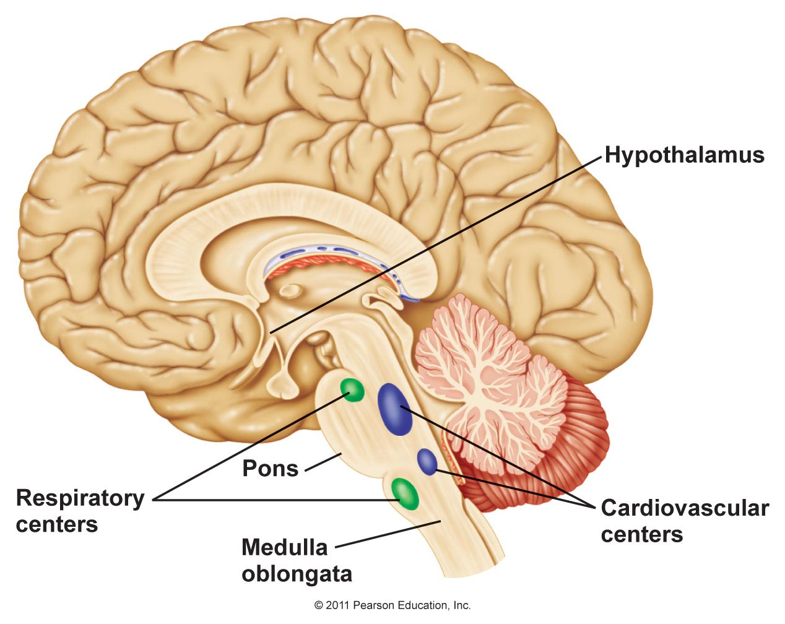
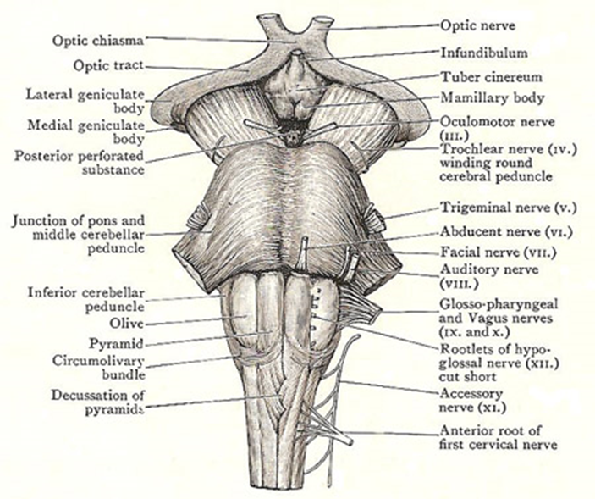
Pons
(It means transverse fibers)
The pons is part of the brain stem that continuous with the medulla oblongata inferiorly and mid brain superiorly, the lower half of the pons is related posteriorly to the floor of the 4th ventricle.
The basic structure of the pons:
The basal part.
The tegmental part.

Slide 2
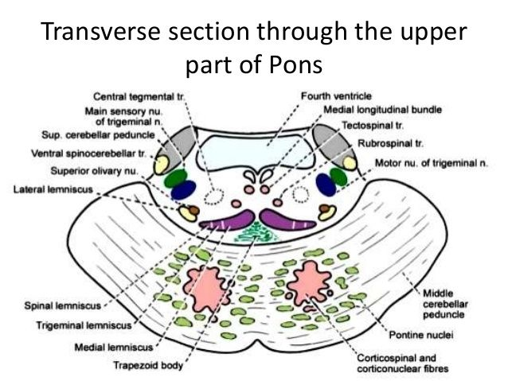
The pons has two parts; an anterior or ventral part called the basal part which has the same structure all over the pons. The basilar part is made up of: 1- Longitudinal fibers that are represented by the Corticospinal and corticonuclear fibers.
2- Transverse pontine fibers.
3- This basilar part also contains a number of masses of gray matter called the pontine nuclei. The basilar part is in continuity superiorly with the cerebral peduncles of the midbrain.

Slide 3
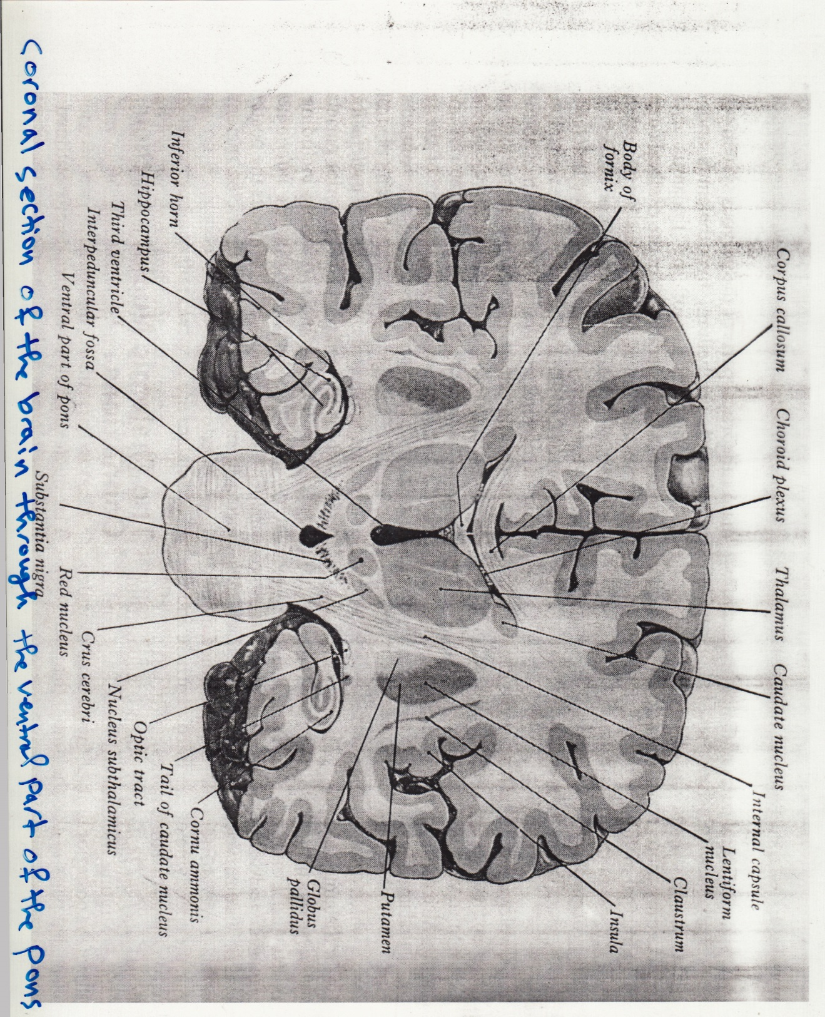

Slide 5
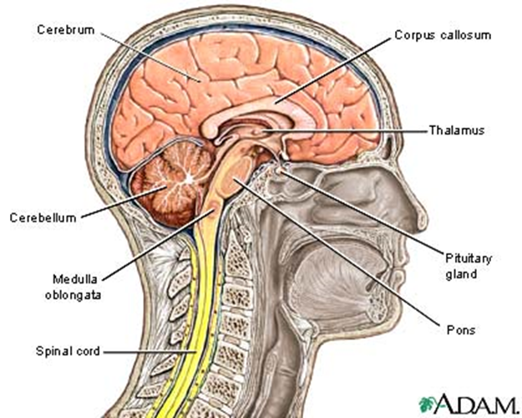
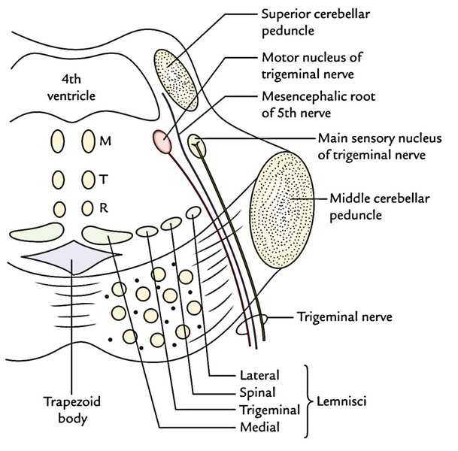
The tegmental part is the posterior part of the pons and it forms the upper part of the floor of the 4th ventricle, which separates the pons anteriorly from the cerebellum posteriorly.
This part is studied in three levels or sections:
1- At pontomedullary junction.
2- At level of the facial colliculus (lower pons).
3- At level of the trigeminal nuclei (middle of the pons).

Slide 7
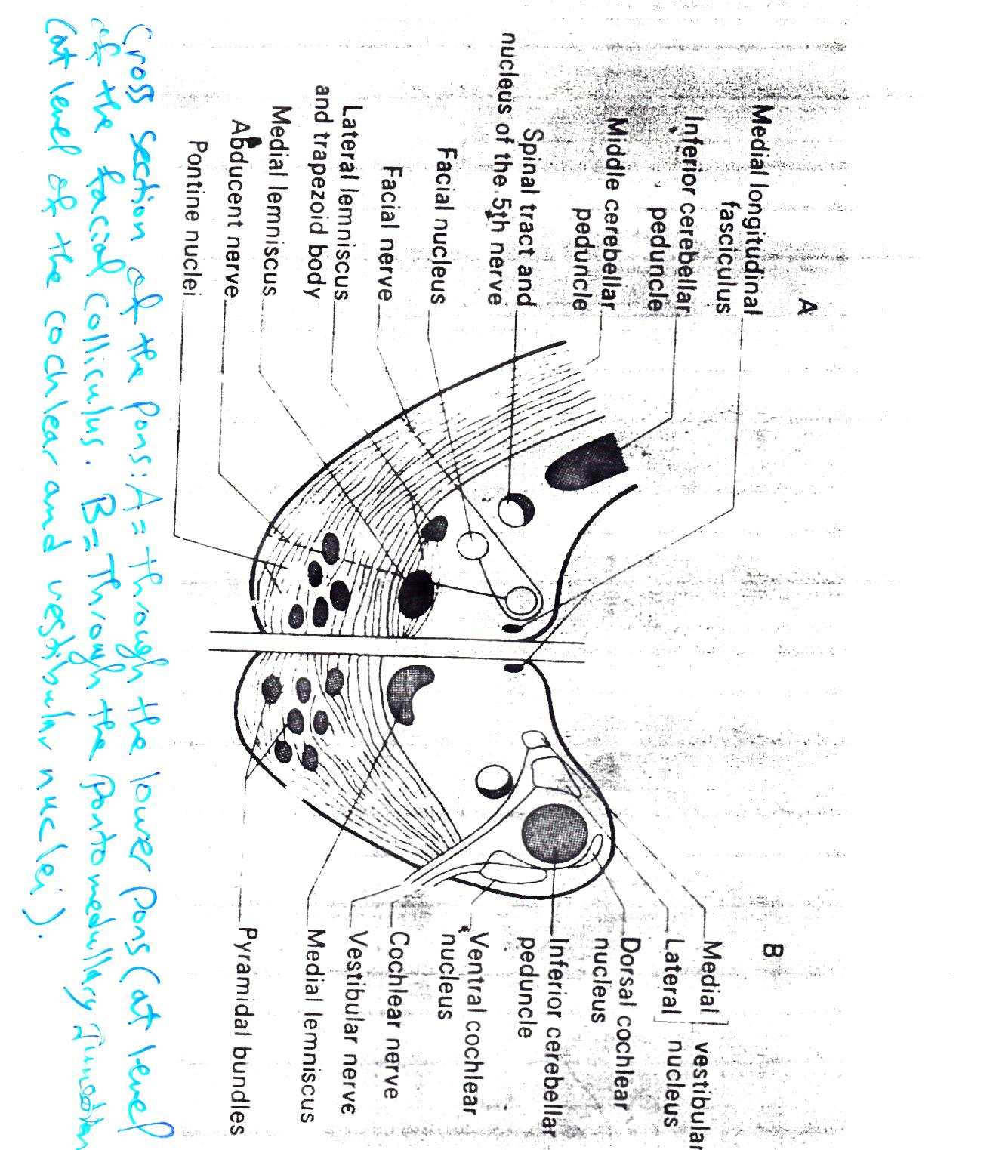
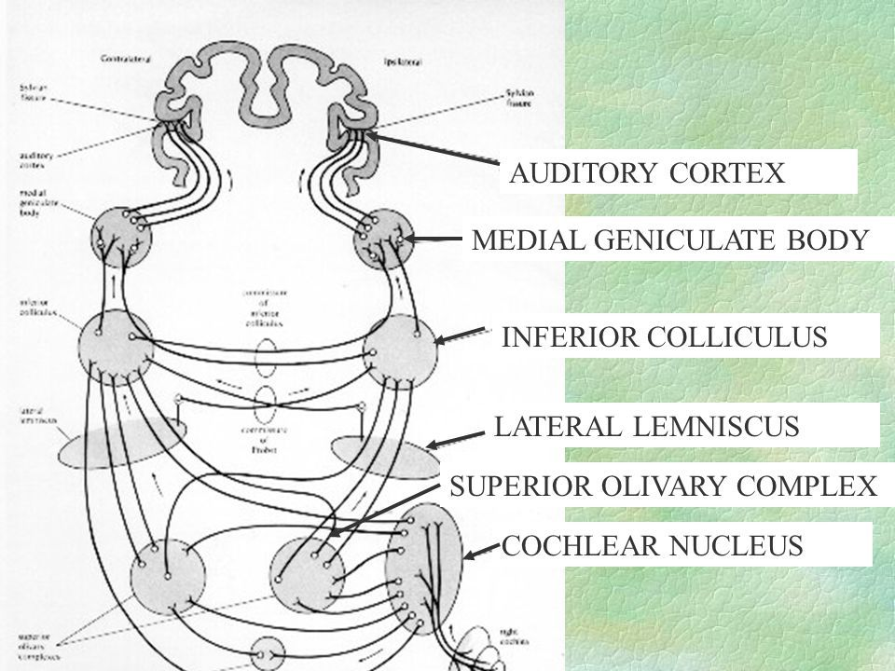
1- At pontomedullary junction.
There are group of nuclei at pontomedullary junction (i.e. part at pons and other part at medulla). These nuclei are:
1- Cochlear nuclei and
2- Vestibular nuclei.
The cochlear nuclei:
They are divided by the inferior cerebellar peduncle into:
Posterior (dorsal) cochlear nucleus and anterior (ventral) cochlear nucleus. These dorsal & ventral cochlear nuclei are receiving input from the inner ear through the cochlear nerve. The fibers from the cochlear nuclei will pass to both ipsilateral and contralateral superior olivary nucleus (considered as a sensory nucleus for hearing), so the auditory pathway has bilateral presentation, and thus, there is no complete hearing loss, but partial deafness.

