Slide 1
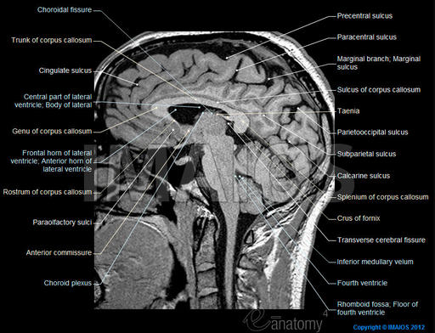
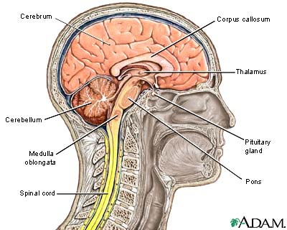
Medulla oblongata
It extends from the pons to the spinal cord at the foramen magnum. The upper part of the medulla oblongata is called the open medulla that forms the lower half of the floor of the fourth ventricle. The lower part of the medulla oblongata is called the closed medulla and the basic structure of it is similar to that of the spinal cord.

Slide 2
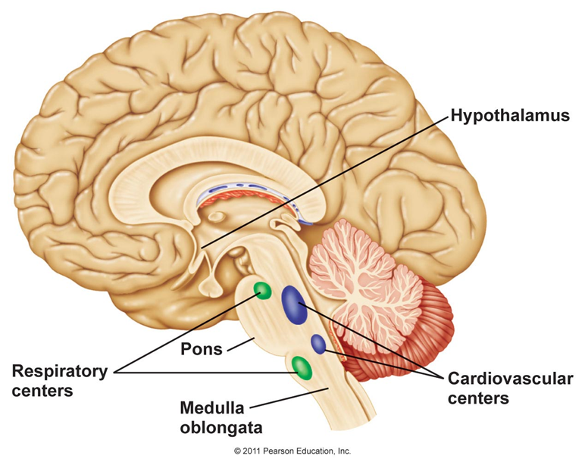

Slide 3
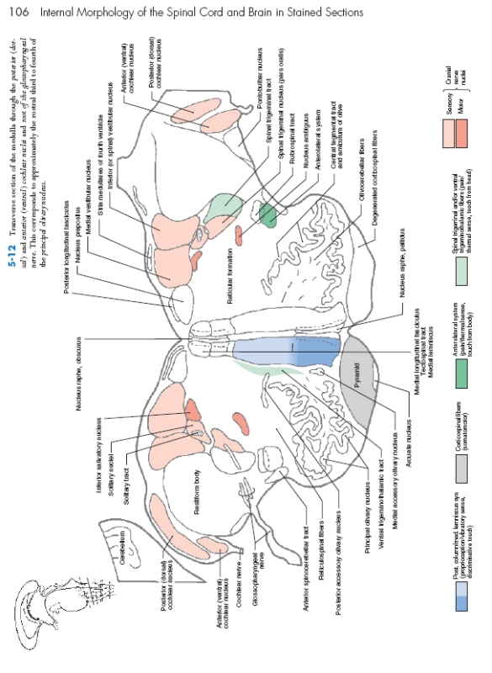
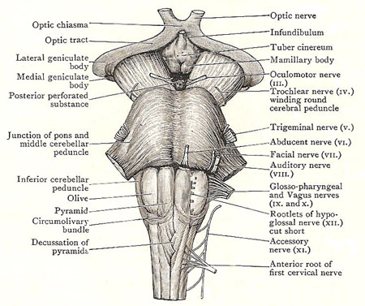
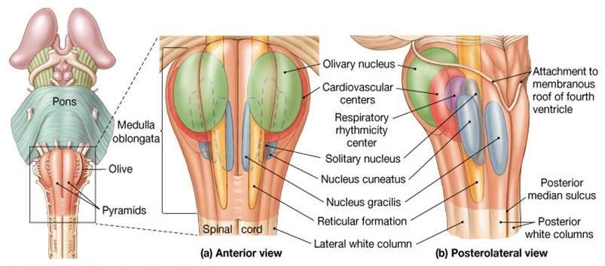

Slide 4
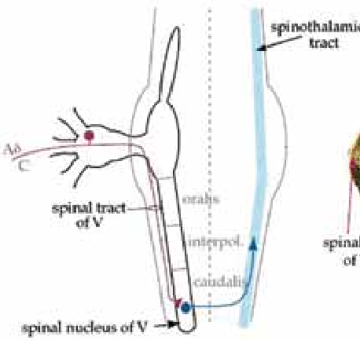
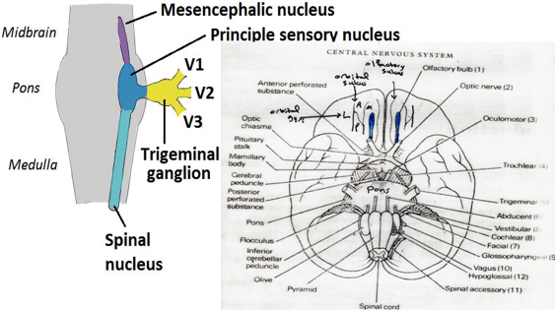
The nuclei:
The spinal tract and spinal nucleus of the trigeminal nerve:
It extends throughout the medulla and inferiorly it is continuous with the posterior horn of the spinal cord. The spinal tract of the trigeminal nerve is the pathway for the pain and temperature from ipsilateral side of the face.
The spinal nucleus of the trigeminal nerve has three parts: (from rostral to caudal parts).
oralis. II- interpolaris. III- caudalis.

Slide 5
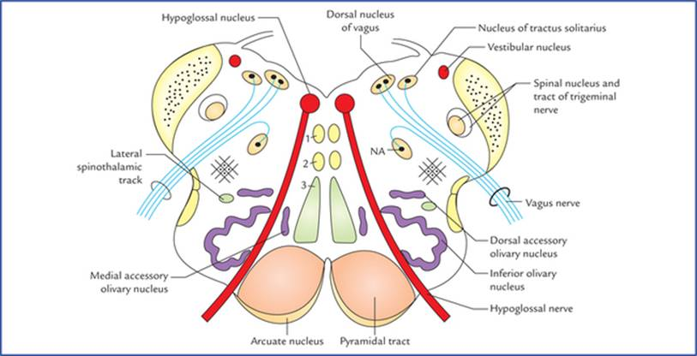
2- Hypoglossal nucleus (motor nucleus): it lies in the floor of the 4th ventricle (open medulla), near the midline and extends into the closed medulla. It supplies the muscles of the tongue.

Slide 6
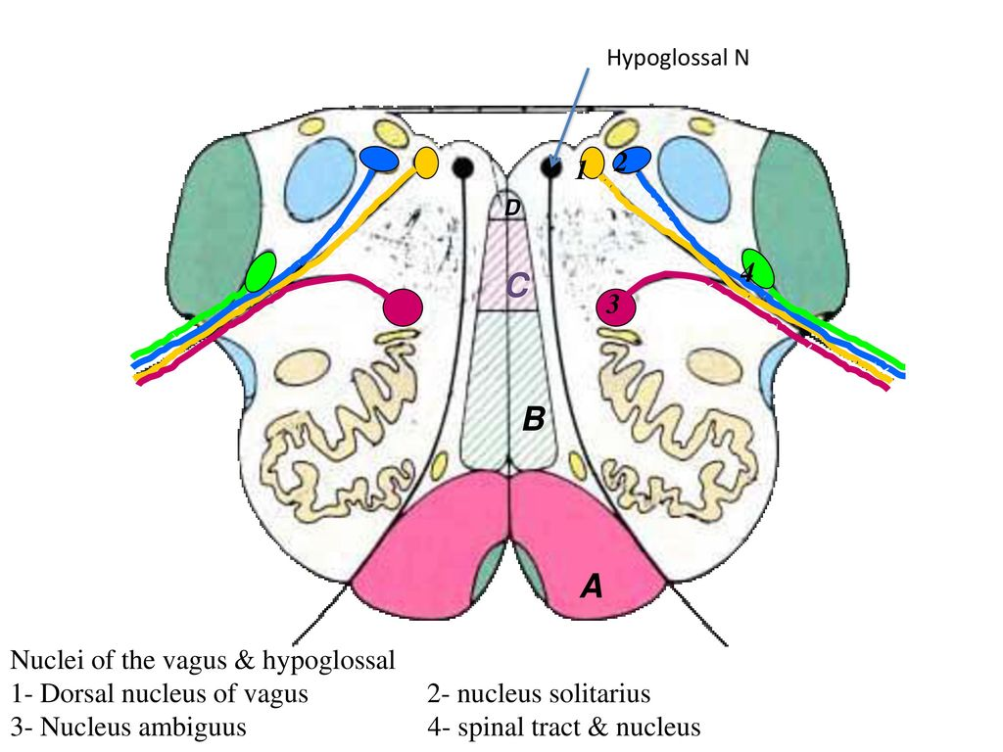
3- Dorsal nucleus of the vagus: it considered as a visceral efferent nucleus of parasympathetic activity. It has two important functions:
Motor action to the smooth muscles of the gastrointestinal tract and respiratory tracts (lead to contraction of these smooth muscles).
Secretomotor action to the glands (induce their secretion) of the GIT and respiratory tracts.
4- nucleus ambiguous (visceral efferent):
It is motor nucleus; it is responsible for supplying the striated muscles of the pharynx, larynx and the palate.
Nucleus ambiguous gives fibers to glossopharyngeal nerve, vagus nerve, cranial part of the accessory nerve and recurrent laryngeal nerve.

Slide 7
5- nucleus of tractus solitaries:
It is sensory nucleus made up of two parts; caudal part and rostral part.
The caudal part of this nucleus is considered as general visceral afferent nucleus that responsible for oral cavity general sensation.
The rostral part of the nucleus is considered as special visceral afferent nucleus that responsible for special sense of the oral region (taste or gustatory function).
Thus the nucleus of the tractus solitaries has a sensory input from the oral region.
Nucleus solitarius receives all of the following:
a. Taste sensation from the anterior two thirds of the tongue via the chorda tympani.
b. Taste sensation from the posterior third of the tongue via the glossopharyngeal nerve.
c. Taste sensation from the epiglottis via the vagus nerve.
d. General sensation from the oral cavity and viscera supplied by the vagus nerve.

Slide 8
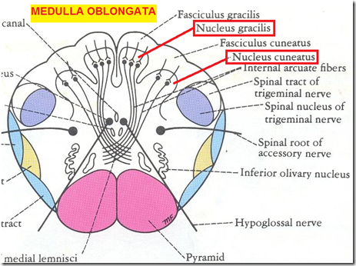
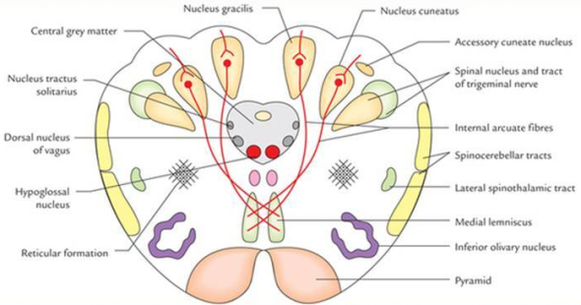
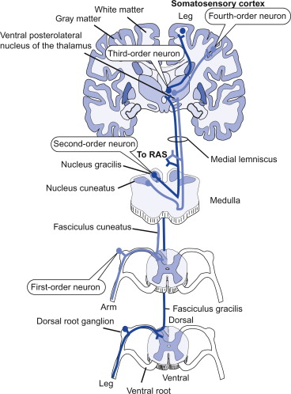
6- The gracile and cuneate nuclei:
They are situated posteriorly in the closed medulla, the gracile being the more medially placed, while the cuneate being the lateral one. Their efferents pass ventrally and cross the midline as the internal arcuate fiber and then they will form the medial lemniscus that passes upward to end in the ventroposterior nucleus of the thalamus.

Slide 9
7- Accessory cuneate nucleus:
It is situated more laterally and involved in the cuneocerebellum tract (for unconscious proprioception).
8- The olivary nucleus (inferior olivary nucleus):
It is motor nucleus and has a very characteristic shape as crumpled bag in open medulla. It is considered as the motor coordinate center.
The main afferent (input) to the inferior olivary nucleus is from:
Cerebral cortex, b- Basal ganglia, c- Red nucleus, d- Spinal cord.
The olivary nucleus will send efferent fibers (output) to the contralateral side of the cerebellum (as climbing fibers).
9- Lateral and medial reticular nuclei.

Slide 11
Reticular Formation Functions:
There are many functions of reticular formation due to its different afferent and efferent connections. Some of its important functions are the following:
1. Arousal and Consciousness:
it causes wakefulness. The more the activity of reticular formation, the more sensory signals would send to cerebral cortex and the person would be awake. the most potent sensations that activate the reticular formation and thus cause extreme consciousness of cerebral cortex is pain sensations.
2. Control of Somatic and Visceral sensations:
3. Control of Skeletal Muscles:
4. Biological Rhythms:
Due to its connections with hypothalamus, it has probably a role in biological clocks as well.
5. Control of Autonomic System:
6. Control of Endocrine System:
it probably influences hypothalamus activity by facilitating or inhibiting the secretion of releasing hormones.
7. Pain Modulation:

Slide 12
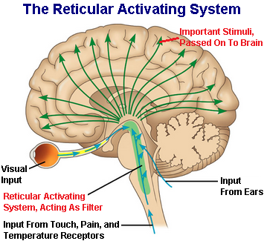
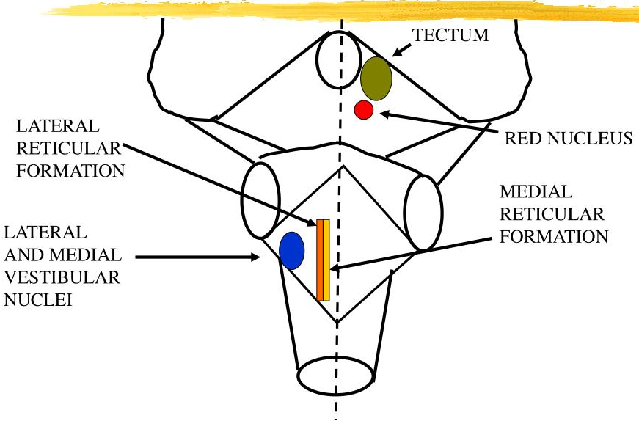

Slide 13
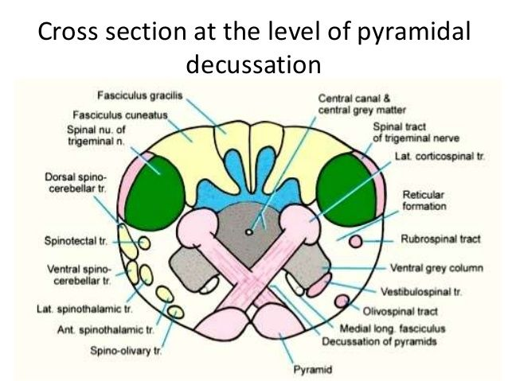
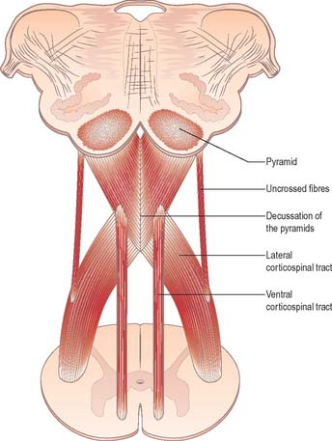
The 4th ventricle divides the medulla into an open medulla (forming the floor of the 4th ventricle) and a closed medulla that contain the central canal of CSF and continuous with that of the spinal cord.
At the closed medulla, there are two types of decussation:
1- The sensory or lemniscal decussation at the upper part of the closed medulla oblongata.
2- The motor or pyramidal decussation at the lower part of the closed medulla oblongata.
The following figures of the medulla oblongata are at the main features of the medulla oblongata (olivary nucleus, sensory and motor decussations): the three main levels of the medulla oblongata:
● at level of olivary nucleus (open medulla).
● at level of sensory decussation (upper part of closed medulla).
● at level of motor decussation (lower part of closed medulla).

Slide 14
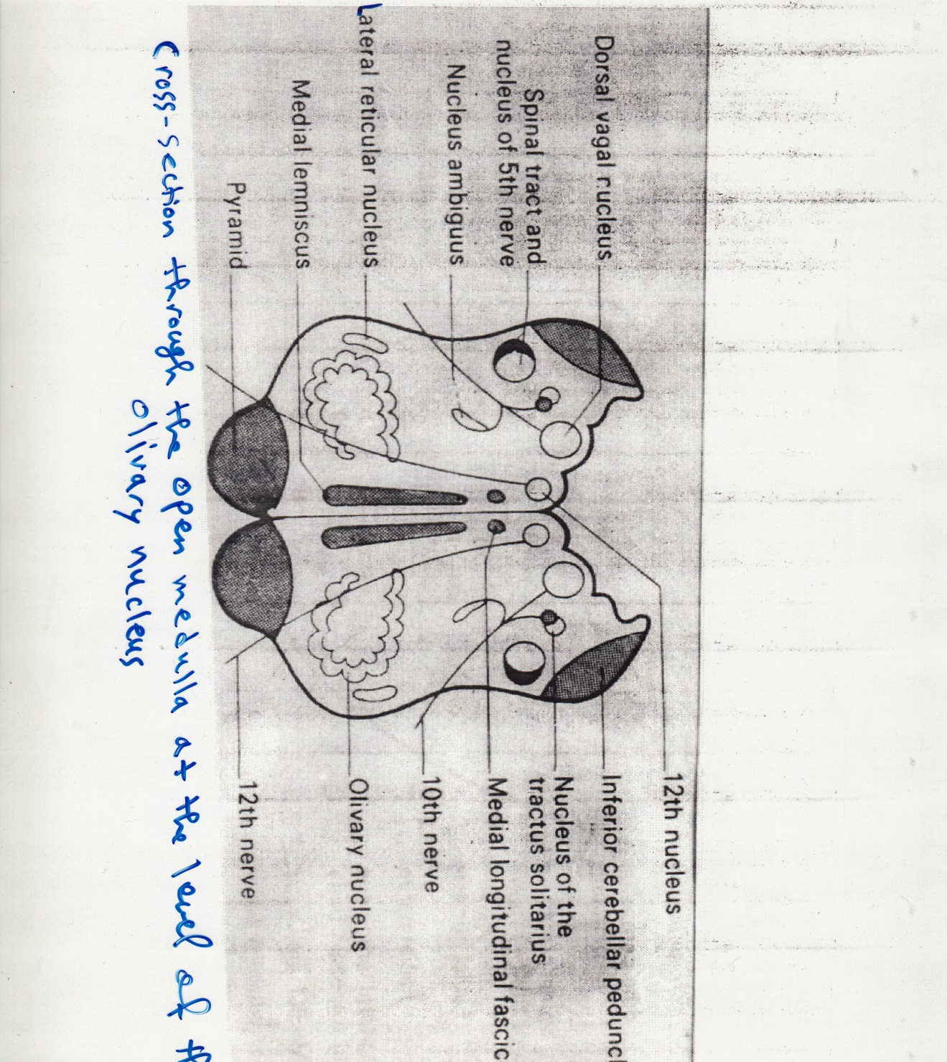

Slide 15
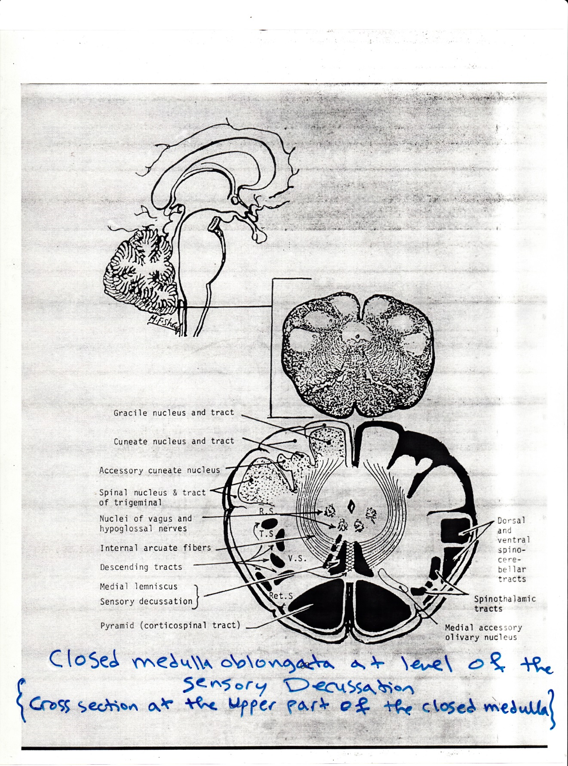

Slide 16
