Slide 2
The cortical domain of the anterior cerebral artery:
It supplies the whole medial surface of the cerebral hemisphere above the corpus callosum as far back as the parieto-occipital sulcus. It extends over the superior border to meet the area which is supplied by the middle cerebral artery.

Slide 5
The central arteries:
The inside parts of the cerebrum are supplied by the central arteries which are arising from the component of the circle of Willis. The insult to these central arteries can lead to intracerebral hemorrhage.
They are mainly of two groups:
1- The anterior group of the central arteries is coming from the anterior cerebral artery, anterior communicating artery, and the middle cerebral artery which gives the major central arteries of the anterior group.
This anterior group of the central arteries will enter to inside of the cerebrum through the anterior perforated substances which are present on each side of the optic chiasm.
2. The posterior group of the central arteries is coming from the posterior communicating artery and the posterior cerebral arteries. They enter to inside of the cerebrum through the posterior perforated substance which is present in the interpeduncular fossa.

Slide 6
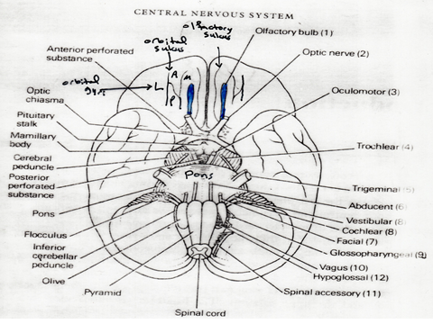

Slide 9
■ The insult to the blood vessels of the C.N.S. will lead to cerebro-vascular accident (C.V.A.).
■ The brain needs continuous arterial blood supply and if the blood supply interrupt (10) seconds will lead to loss of consciousness, and if continue till (5 ) minutes will lead to irreversible damage to C.N.S.
■ The vertebral arteries serve the cerebellum, occipital lobes, brainstem, and parts of the thalamus. The internal carotid artery supplies the blood to the rest of the brain.

Slide 11
II- The venous drainage of the brain:
All veins of the brain will drain into the intracranial venous sinuses.

