Slide 1
Blood supply of the C.N.S.
I- Arterial blood supply of the C.N.S.:
The brain is supplied by two systems:
Internal carotid system (right and left).
Vertebrobasilar system (right and left).
These two systems are joined together by the circle of Willis.

Slide 5
Vertebrobasilar system:
It is formed of two vertebral arteries (right and left). Each artery arises from the first part of the subclavain artery and passes through the foramen transversorum of the sixth cervical vertebra till the foramen transversorum of the first cervical vertebra (atlas), while the vertebral vein passes through the foramen transversorum of the seventh cervical vertebra. Then the vertebral arteries pass through the foramen magnum to enter the skull. These two vertebral arteries unit together at lower pons to form the basilar artery.

Slide 7
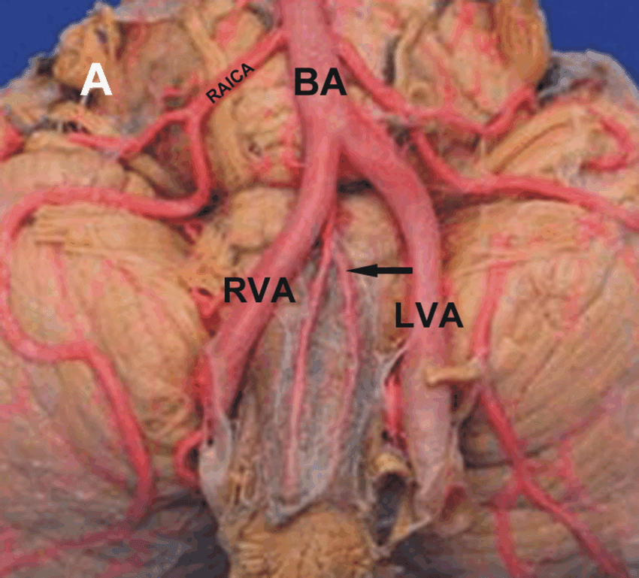
Branches of the vertebral arteries:
spinal arteries:
Single anterior spinal artery: this artery is formed by a branch from each vertebral artery. The ventral 2/3rd of spinal cord is supplied by the anterior spinal artery.

Slide 8
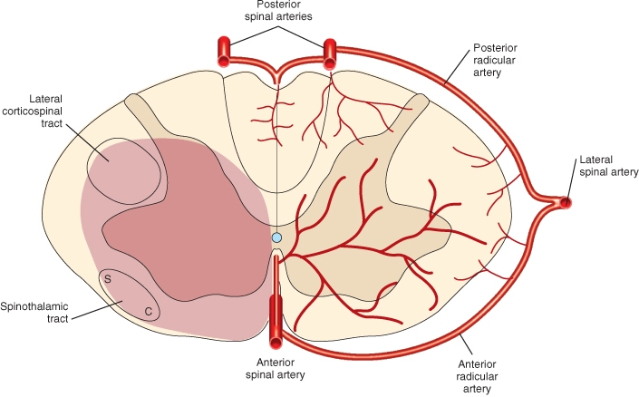
b. Pair of posterior spinal arteries: each vertebral artery gives a single posterior spinal artery.
So, the spinal cord is supplied by three arteries which are two posterior spinal arteries and one anterior spinal artery.
2. Posterior inferior cerebellar artery (PICA): It is large and tortuous artery to supply the posterior and inferior parts of the cerebellum.

Slide 9
Branches of the basilar artery:
Anterior inferior cerebellar arteries (AICA).
Pontine branches.
Labyrinthine arteries.
Superior cerebellar artery.
So, the cerebellum is supplied by three main arteries → PICA + AICA + Superior cerebellar arteries.
Posterior cerebral arteries.
The Vertebrobasilar system end into two posterior cerebral arteries.

Slide 11
Internal carotid system:
Internal carotid artery passes through the carotid canal and it has a bending course inside the carotid canal which is called the carotid siphon. Thus reducing both the pressure and the velocity of the blood that will pass through the thin-walled vessels of the brain. It pierces the roof of the cavernous sinus and it will give rise to its branches:
Branches:
Ophthalmic artery.
Posterior communicating arteries.
Hypophyseal artery (to pituitary gland).
Anterior choroidal artery to choroid plexus.
Anterior cerebral artery.
Middle cerebral artery.
So the cerebrum has three main arteries → anterior cerebral artery + middle cerebral artery + posterior cerebral artery.

Slide 15
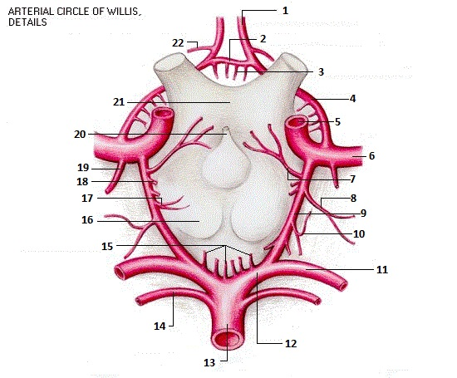
Circle of Willis:

Slide 16
It is composed of:
Anterior communicating artery, between two anterior cerebral arteries.
Anterior cerebral artery.
Internal carotid artery and middle cerebral artery.
Posterior communicating artery, between the posterior cerebral artery and the internal carotid artery.
Posterior cerebral artery.
This circle will help in controlling the balance of the blood flow in between the two systems, but it is insufficient balance. The circle is situated at the basilar part of the brain.

Slide 17
The circle of Willis gives cortical and central branches:
The cortical domain of the middle cerebral artery:
The middle cerebral artery is the largest and direct branch of the internal carotid artery. It passes within the lateral sulcus.
It supplies the lateral surface of the cerebral cortex except the periphery of about one gyrus breadth, so it supplies the contralateral part of the body with the speech and auditory areas, motor and somatosensory areas, except the leg, foot and perineum that is functionally responsible for defecation and micturition, which are supplied by the anterior cerebral artery. In addition, it also supplies the insula.

