Slide 1
Motor processing areas:
Primary somatic motor area: it is situated in precentral gyrus (Broadman 4) and it is responsible for giving final motor commands.
The body is represented in contralateral way.
2-The body is represented in upside down manner.
3-The representation of the body is according to the motor importance and fine movements performance rather than the muscle mass.
Damage of the primary motor area will lead to paralysis.
Unimodal somatic motor association area: it is usually termed as premotor area (Broadman 6) that is located on superior and middle frontal gyri. This area is responsible for:
1-association of motor activity.
2-preparation of programs for skill movements.
Damage of this area will lead to apraxia.
Apraxia is inability to perform previously learned movements in the absence of weakness or sensory defects.

Slide 5
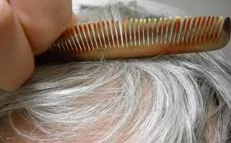
Apraxia is inability to perform previously learned movements in the absence of weakness or sensory defects.

Slide 6
Multimodal cortical association areas:
They are neither pure motor nor pure sensory, however there is sensory input and motor output to perform high mental processes.
The main multimodal cortical association areas are:
-Anterior multimodal cortical association area (prefrontal cortex that lies anterior to the precentral area) is responsible for personality and their related things.
-Posterior multimodal cortical association area (in junctional region of parietal, temporal and occipital lobes). There are two main important centers included in this area which are: the language centers (in the cerebral dominant) and the visual spatial localization centers (in non-cerebral dominant).
-Limbic system. This related to medial side of the cerebrum and concern with emotional behavior.

Slide 8
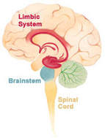

Slide 9
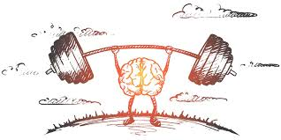
The laterality of the cerebral functions: (more or less it could be related to multimodal cortical association areas). There are certain functions present in one cerebral hemisphere rather than the other.
The dominant cerebral hemisphere has the main following functions or centers:
1- Language. 2- Handedness.
In general, 95% of human beings, the left cerebral hemisphere is the cerebral dominant. Whereas the right cerebral hemisphere is the non-dominant one.
The corpus callosum, which connects the two cerebral hemispheres, will complete its development at age of 2-3 years old age. Thus, before the age of 3 years old, the dominancy of the cerebral hemisphere can be changed from left to right cerebral hemisphere or vice versa.
But after 3 years old, there is usually no change in the cerebral dominancy of the brain.
-The left cerebral hemisphere is often responsible for: Language, mathematics and logics.
-The right cerebral hemisphere is often responsible for: Concept of pictures, music and spatial abilities.

Slide 10
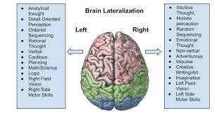

Slide 12
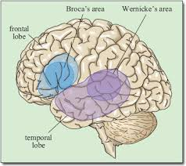
Language areas:
-Sensory speech area (Wernike's area) (receptive):
It is located on Broadman areas 40, 39, 22, 37 of the dominant cerebral hemisphere. It is responsible for:
-Comprehension of the language (spoken and written language).
-Syntax which is the sequences of words in a sentence.
Damage to Wernike's area will lead to sensory aphasia (not understand spoken or written language, which is called complete word deafness).
Partial damage to Wernike's area will lead to alexia (can understand spoken language, but not understand written language). In the non dominant cerebral hemisphere (usually the right cerebral hemisphere), this area is responsible for emotional response to language, when we hear someone speak, the person’s voice often reveals if he / she is happy, angry, etc.

Slide 13
-Motor speech area (Broca's area) (expressive):
It is located on pars triangularis and pars opercularis (Broadman area 45 and 44). It is responsible for initiation of complex movements to produce the sound of the speech.
Damage to Broca's area lead to motor aphasia which is difficulty to produce proper phonation in spoken language (the comprehension of language and syntax are not affected).

Slide 14
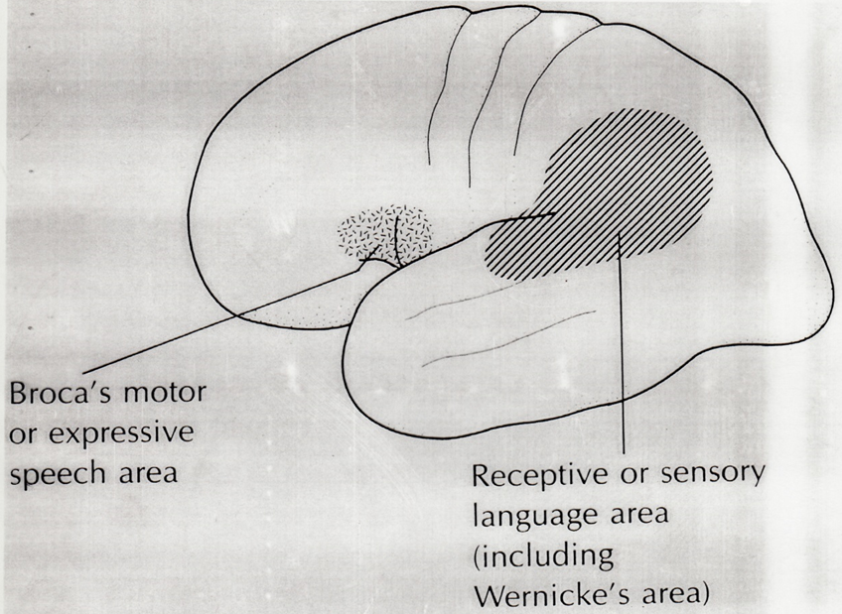
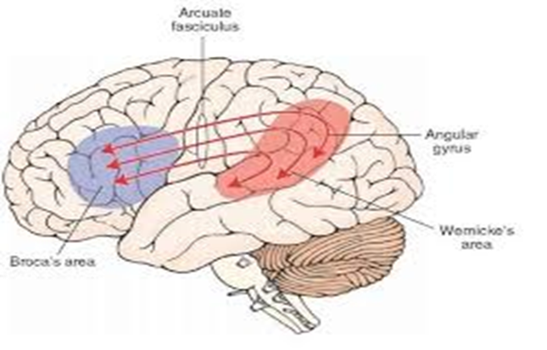
Wernike's and Broca's areas of speech are interconnected via the arcuate fasciculus, which is necessary for language and the ability to communicate.

