Slide 1
III- Olfactory sensory area or system:
This system is characterized by:
-Direct relay to cerebral cortex (not pass through the thalamus).
-Ipsilateral representation.
-Has the ability for regeneration. (adult neurogenesis occurs also in dentate gyrus of limbic system).
-These neurons are the only nerve cells that come in direct contact with the environment.
Primary olfactory sensory area (septal area, uncus and amygdaloid body).
Olfactory pathway:
Olfactory nerves → olfactory bulb → olfactory tract → end by division into two striae → medial stria end to septal area (which has connection to limbic system, therefore implicated in the emotional and visceral response to odors) while the lateral stria (which is the main central pathway of the olfactory system) end into uncus and amygdaloid body.
Damage to this pathway will lead to anosmia (unable to smell).
● Unimodal olfactory association area is located on the anterior part of the parahippocampal gyrus and this part is called entorhinal cortex.
The function of this area is for association of the smells.

Slide 2
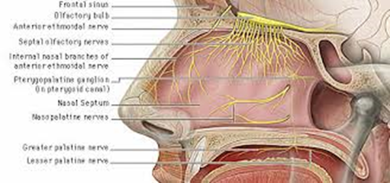

Slide 3
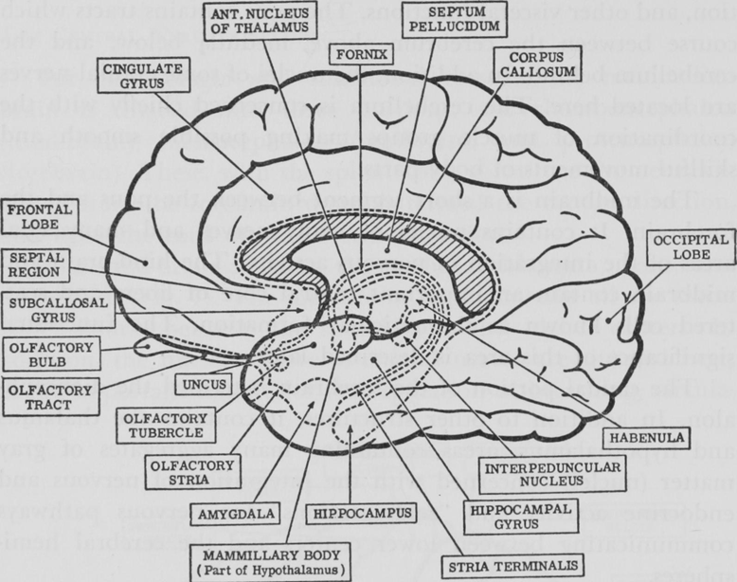

Slide 4
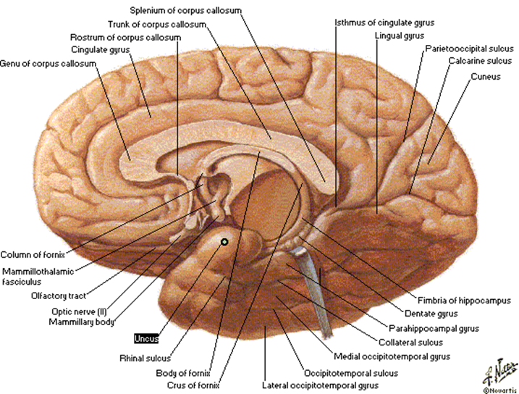

Slide 5


Slide 6
IV- Gustatory area (taste area) is located in the roof of the lateral fissure closely related to insula.

Slide 7
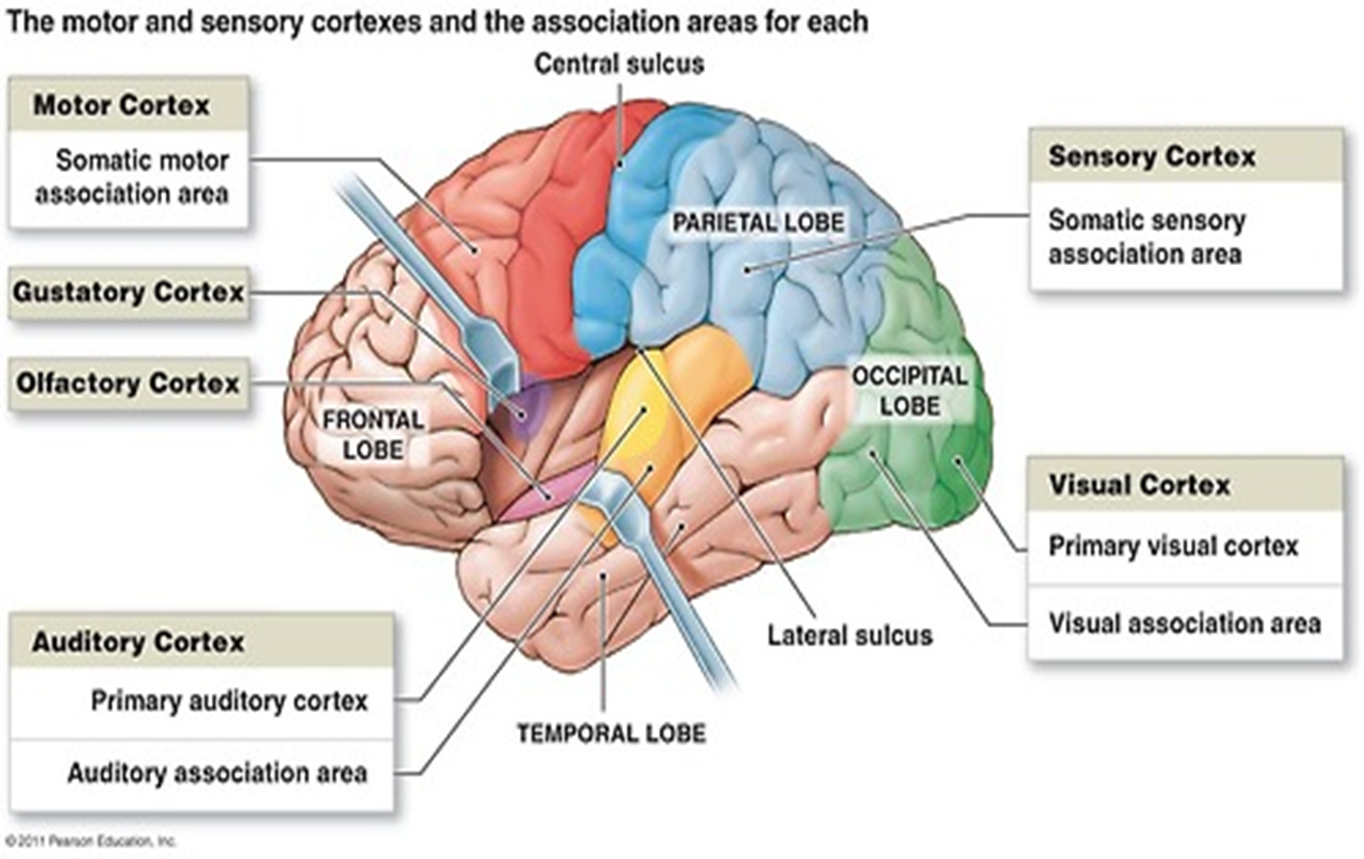

Slide 8
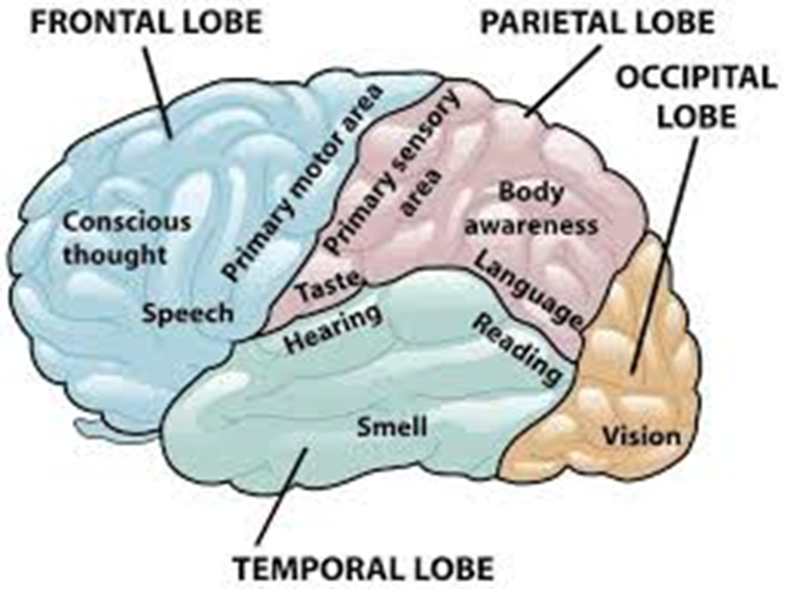

Slide 9
The gustatory cortical area is next to somatosensory cortical area of the tongue.

