Slide 1
Special senses
I- visual sensory area:
Primary visual sensory area is located in the occipital lobe around the calcarine sulcus (Broadman area 17) and it is called stria of Gennari or the striate cortex .
Damage to this area will lead to blindness.

Slide 5
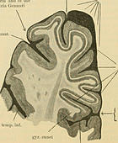
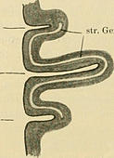

Slide 7
The representation of the visual field in the primary visual sensory area is as follow:
٭ the center of the visual field (macula) is represented in the posterior part of the primary visual area or cortex and it usually represents 1/3rd of the visual cortex and so the center of the visual field has the most perfect vision (high visual acuity of the macula).
٭ the peripheral part of the visual field is represented in the anterior part of the primary visual cortex.
٭ upper wall of calcarine sulcus represents the lower part of the visual field.
٭ lower wall of the calcarine sulcus represents the upper part of the visual field.
The primary visual cortex is the thinnest cortex of the entire brain.

Slide 8
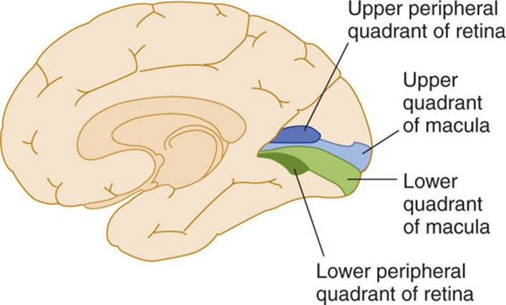
Macular visual field represent 1/3rd of primary visual cortex

Slide 9
Unimodal visual association area is located on each side of area 17 and is represented by area 18 & 19 that involve occipital lobe and extend to temporal lobe.
This area is responsible for:
Visual memory.
Visual recognition.
Color perception.
Damage to this area will lead to visual agnosia.

Slide 14
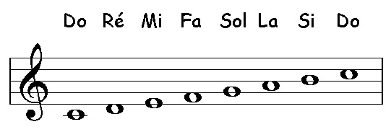
II auditory sensory area:
● Primary auditory sensory area is located on the superior temporal gyrus (Broadman areas 41 & 42) and this region is also called the gyrus of Heschel. Damage to this area will lead to deafness.
The tonotopic representation is as follow:
Low frequency tones are represented in the anterior part of the primary auditory cortex. دو DO
High frequency tones are represented in the posterior part of the primary auditory cortex. سي Si
● Unimodal auditory association area is located on the superior temporal gyrus on a flat area called planum temporale (part of Broadman area 42 and Broadman area 22).
The function of this area:
*Recognition of melodies.
*Understanding of the language.
Damage to this area will lead to auditory agnosia.
↑increase in frequency

Slide 17
