Slide 1
Neuroanatomy has two parts: the central and peripheral nervous system (which composed of cranial nerves, spinal nerves and ganglia).
The central nervous system is composed of brain and spinal cord.

Slide 2
The brain has the following parts: -Forebrain (prosencephalon) which is subdivided into: Telencephalon=cerebral hemispheres. Diencephalon=thalamus, hypothalamus, epithalamus and subthalamus.
-Midbrain (mesencephalon). -Hindbrain (rhombencephalon) which is subdivided into: Myelencephalon (medulla oblongata). Metencephalon which is composed of pons and cerebellum.

Slide 5
Functionally, the nervous system is divided into somatic (voluntary) nervous system and autonomic (involuntary) nervous system.
This autonomic nervous system is a motor system.
The nervous system has two components, sensory (afferent) and motor (efferent).

Slide 6
General facts:
֍glial cells are ten times more than neurons in the mammalian brain.
֍there is no connective tissue in the CNS.
֍The mid brain, pons and medulla oblongata will form the brain stem.
֍There are no two identical brains.
֍Cortex = grey matter = gyri and sulci.
֍medulla = White matter , it contains group of nuclei (grey matter) inside it.
֍ Adult brain weighs between 1.250 g to 1.450 g, brains of male weigh more than that of female, but no relation between brain weight and intelligence.

Slide 7
Topography of the telencephalon:
There are right and left cerebral hemispheres, they form the largest part of the brain. They are incompletely separated by the longitudinal cerebral fissure that contains the falx cerebri of the dura mater
each cerebral hemisphere possesses a central cavity called the lateral ventricle.

Slide 8
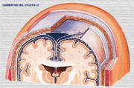

Slide 10
Each cerebral hemisphere has three surfaces:
-Superolateral surface
-medial surface
-inferior surface

Slide 12
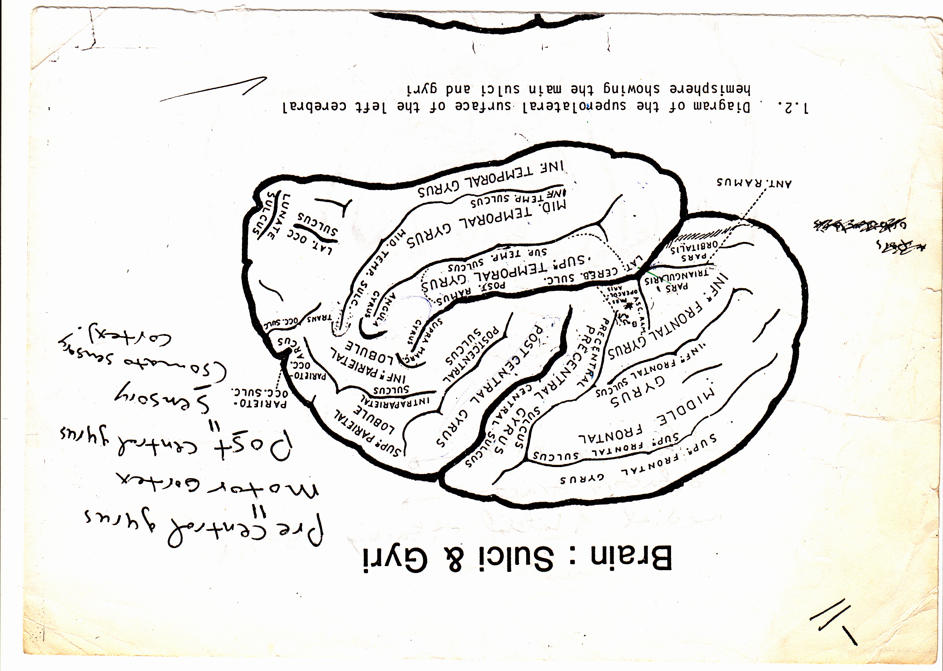

Slide 14
Superolateral surface:
The central sulcus: just behind the mid point of the superior border of the hemisphere, the fissure of Rolando (central sulcus) is start.

Slide 15
The lateral sulcus: (fissure of Sylvius) it is composed of anterior and posterior rami or parts. At the junction of the two parts, there are two ascending rami (V- shaped rami) arise toward the inferior frontal gyrus, and so this gyrus is further divided by this V- shaped ascending rami into pars orbitalis, pars triangularis and pars opercularis.

Slide 17
Insula (island of Reil) (fifth lobe): is situated deep in the floor of the lateral sulcus and is almost surrounded by a circular sulcus, and can only be seen when the lips of the lateral sulcus are widely separated. It involves parts from frontal, parietal and temporal lobes. The insula is composed of long and short gyri that almost completely surrounded by the circular sulcus. The insula is divided into two regions by a central sulcus, several short gyri lie in front of the central sulcus and one or two long gyri lie behind it.

Slide 18
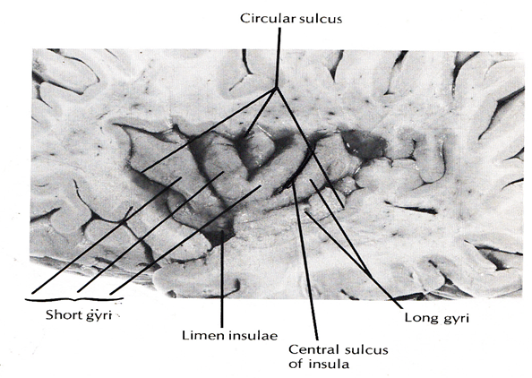

Slide 19
Lobes of the cerebral hemisphere:
Frontal lobe: it is situated in front of the central sulcus and above lateral sulcus.
Parietal lobe: it lies behind sulcus and above the lateral sulcus.
Temporal lobe: it is below the lateral sulcus.
Occipital lobe: it is situated below and behind the parieto-occipital sulcus. Pre-occipital notch is the land mark that delineates the occipital lobe from the temporal lobe.
insula

Slide 20
Medial surface of the cerebral hemisphere has the main following features:
The corpus callosum: the two cerebral hemispheres are joined by the corpus callosum which formed from rostrum anteriorly, genu, body and splenium posteriorly.
The calcarine sulcus: in which the visual cortex is around this sulcus.

