Slide 1
Nail Diseases
By
Dr. Salam Altemimi

Slide 2
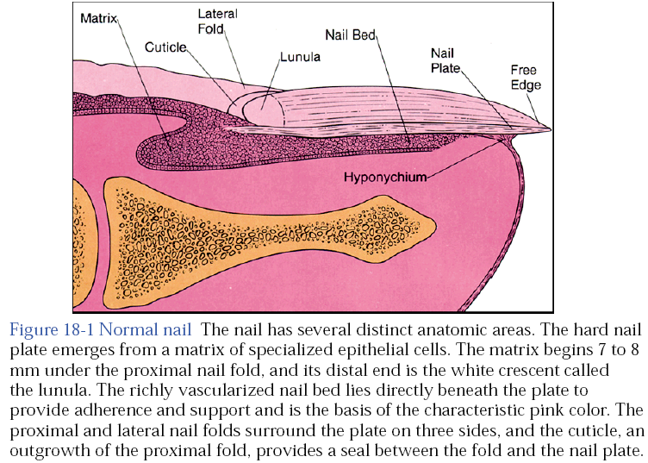

Slide 3
Chronic paronychia
Is infection of the nail fold and matrix by candida albicans. There is glazed and red swelling of the nail fold with loss of the cuticle. There is mild to moderate pain. Occasional bead of pus comes out from under the nail fold. Ridging and furrowing of nail plate may occur due to damage of the matrix. Dark brown pigmentation of nail plate occurs in direct invasion by monilia. The disease is occupational of housewives due to wetness, which lead to maceration of the cuticle then the entrance of the microorganism.

Slide 4
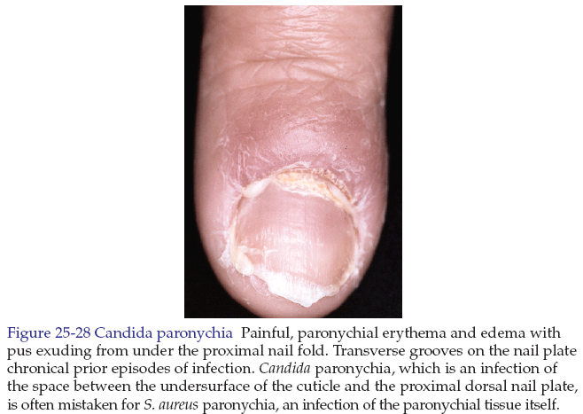

Slide 5
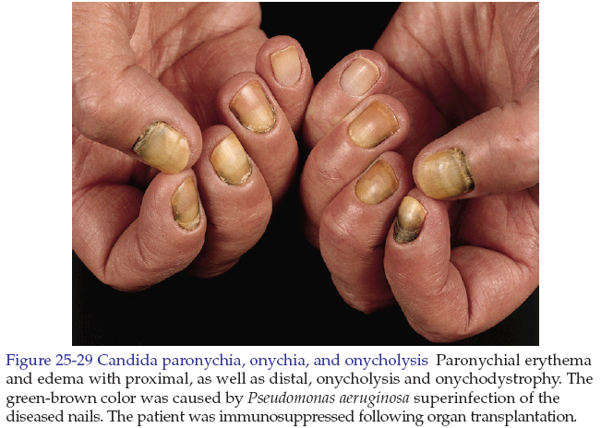

Slide 6
Differential diagnosis: acute paronychia is bacterial infection of the nail fold. There is bright red swelling of the nail fold. The inflammation is more severe, the condition is more painful.

Slide 7
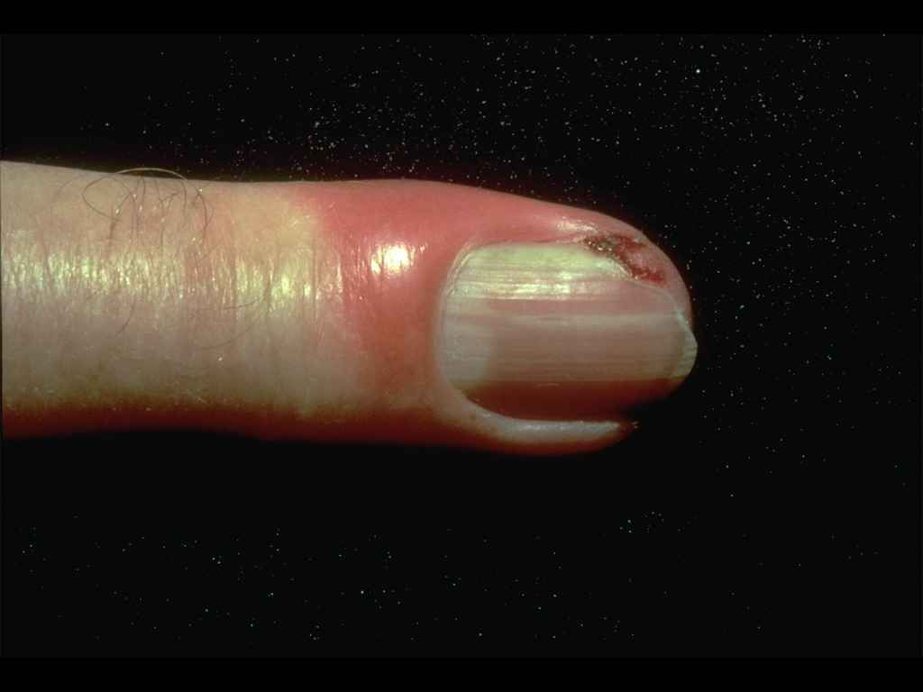
Acute paronychia

Slide 8
Treatment of Acute paronychia
Incision to evacuate the pus.
Oral antistaphylococcal antibiotics e.g. cephalexin 250 mg four times daily for 7 days.

Slide 9
Treatment of chronic paronychia
Maintain dryness.
Topical clotrimazol cream.
Oral choice is fluconazole 150 mg per week for 4 weeks.

Slide 10
Tinea unguium (onychomycosis)
It is the dermatophyte (ringworm) infection of the nails. Commonly caused by trichophyton and epidermophyton. The affected nail is roughing, opaque and friable. It has an accumulation of keratinous debris under it. The diagnosis can be confirmed by shaving of the nails to find fungus on 20% KOH microscopic exam. Also culture on Sabouraud medium can be performed.

Slide 11
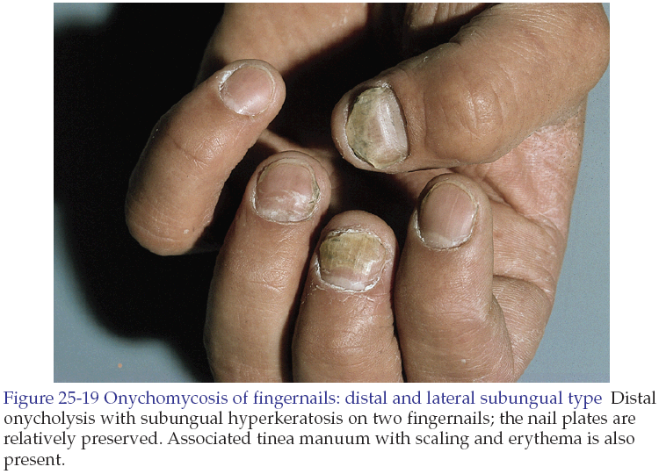

Slide 12
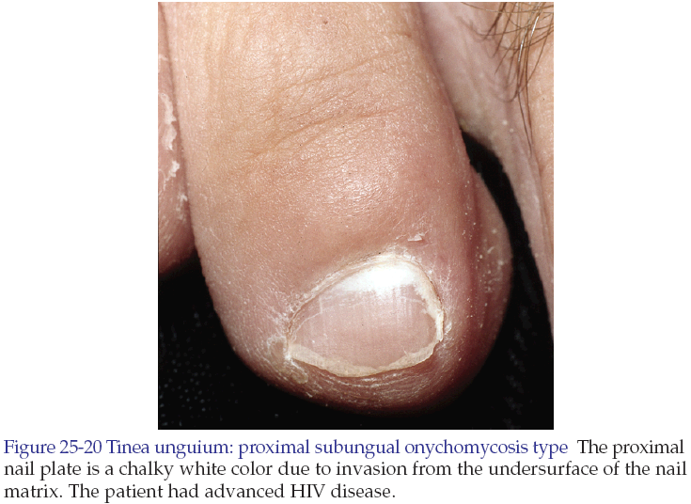

Slide 13
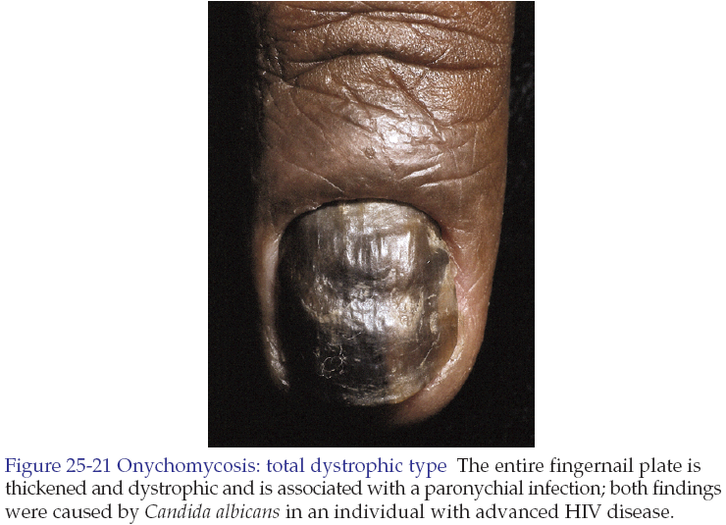

Slide 14
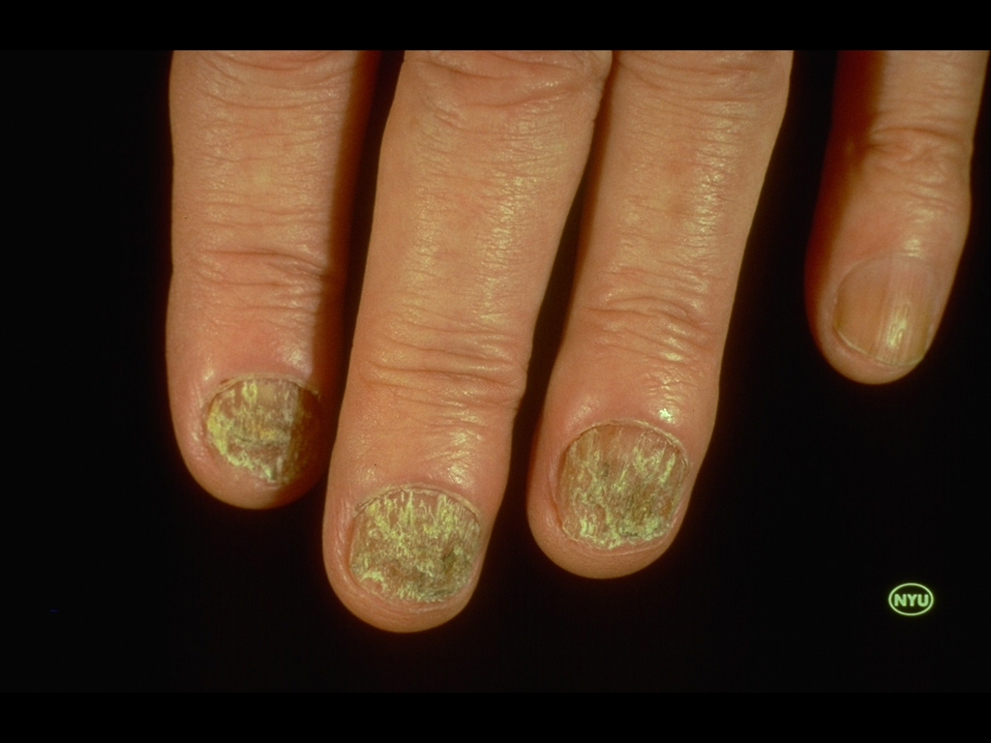
Tinea unguium

Slide 15
Treatment of tinea unguium
The treatment of choice is oral terbinafine 250mg daily for 6 weeks in fingernail infections and for 12 weeks in toenail infections.
Fluconazole 150 mg once a week for 9 months.
Itraconazole (100 mg capsule) given in pulse therapy. The pulse consists of 2 capsules twice daily for 1 week followed by 3 weeks of drug free interval. Two to 3 pulses is given for fingernail infections and 3-4 pulses for toenail infections.

Slide 16
Dermatosis associated with nail involvement
Psoriasis
  Pitting
  Onycholysis
  Discoloration
  Subungual thickening
  Malformed nails
  Splinter hemorrhages

Slide 17
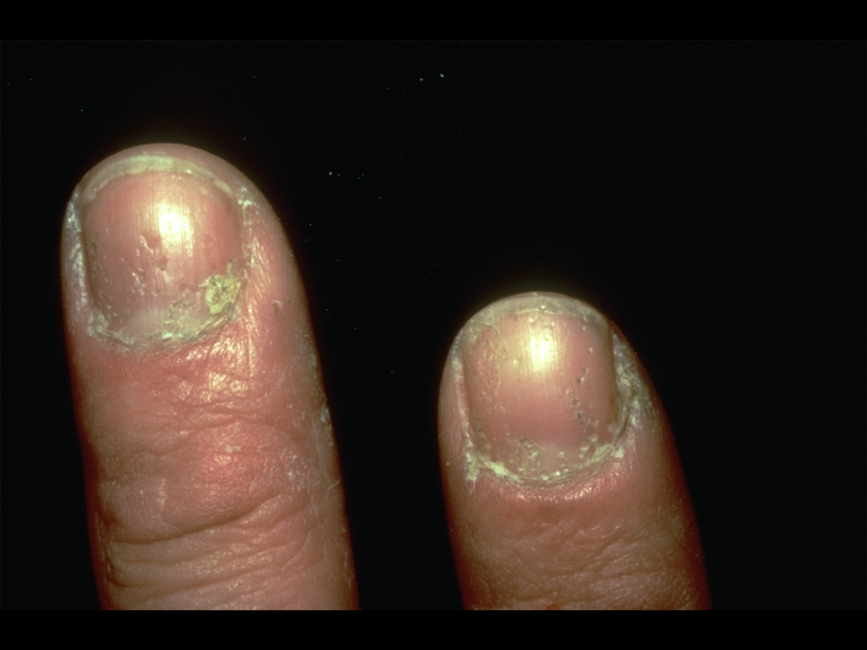
Psoriasis of the nails

Slide 18
Dermatosis associated with nail involvement
Lichen planus
  Longitudinal grooving and ridging
  Pterygium

Slide 19
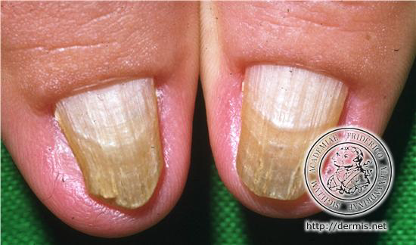
Lichen planus of the nails

Slide 20
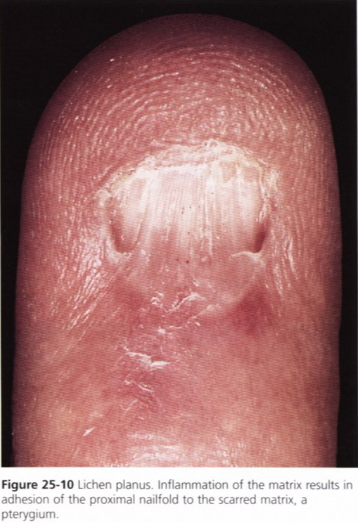
Lichen planus of the nail

Slide 21
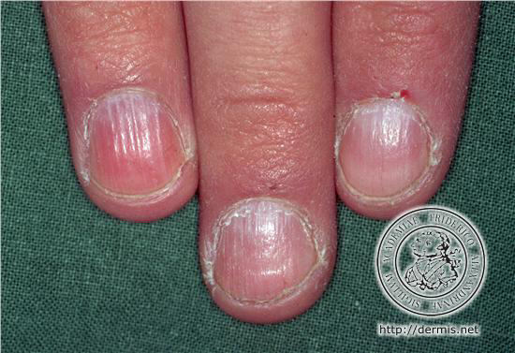
Alopecia areata-nails

Slide 22
Dermatosis associated with nail involvement
Alopecia areata
  Pitting
Norwegian scabies
  Nail plate dystrophy
Eczema and dermatitis
  Ridging, thickening and discoloration
Paronychia
  Ridging, thickening and discoloration

Slide 23
Onycholysis
It is the separation of the nail plate from the nail bed at distal and lateral margins.

Slide 24
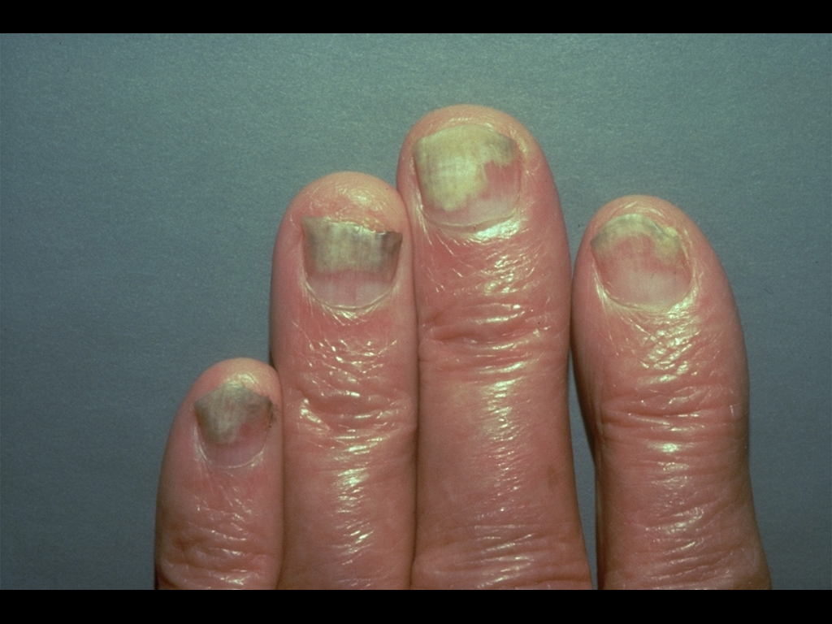
Onycholysis (from psoriasis)

Slide 25
Etiology of onycholysis
Idiopathic
Secondary
  Dermatosis: psoriasis, fungal infections.
  General medical conditions: like hyperthyroidism, Raynaud’s phenomenon.
  Trauma: like typing, long nails.
  Drugs: photo-onycholysis occurs with tetracycline or psoralin.

Slide 26
Nail pitting
It is a tiny, punched out or ices pick depressions of the nail plate. Common causes are psoriasis, alopecia areata, and sometimes a normal variant.

Slide 27
Koilonychia
The nail is flat or concave has spoon-shape. It is often thin and brittle. The condition associated with hypochromic iron deficiency anemia.

Slide 28
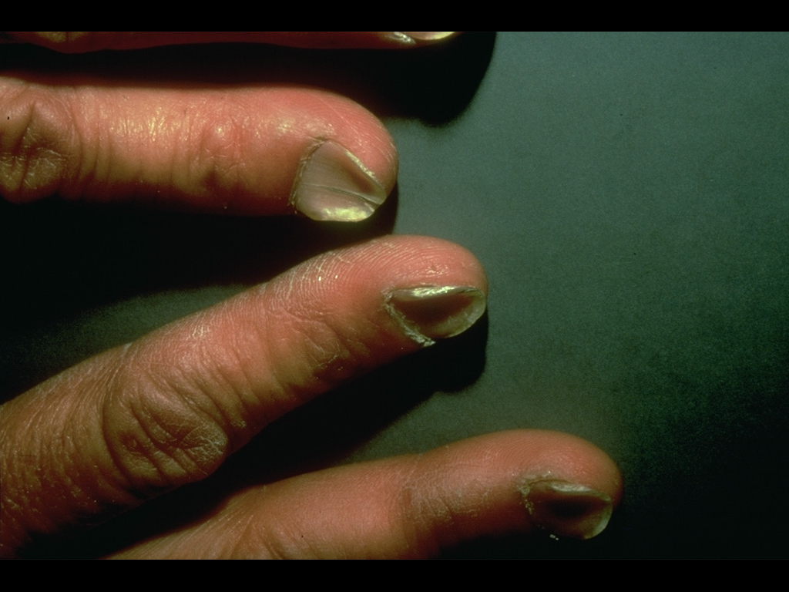
Koilonychia

Slide 29
Finger clubbing
It is increase in the size and curvature of nail plate with loss of the angle between the nail plate and the posterior nail fold. It is associated with many diseases e.g. carcinoma of the bronchus, heart diseases.

Slide 30
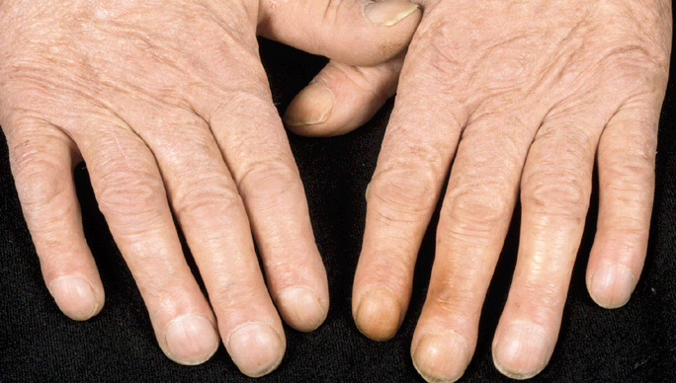
Finger clubbing

Slide 31
Ingrown toenail
It is the soft tissue of the side of the nail (lateral nail fold) is penetrated by the edge of the nail plate, resulting in pain, sepsis and later the formation of the granulation tissue. The great toe is often affected. The cause is compression of the toe by ill-fitting footwear and cutting of the toenail in a half-circle instead of straight across.

Slide 32
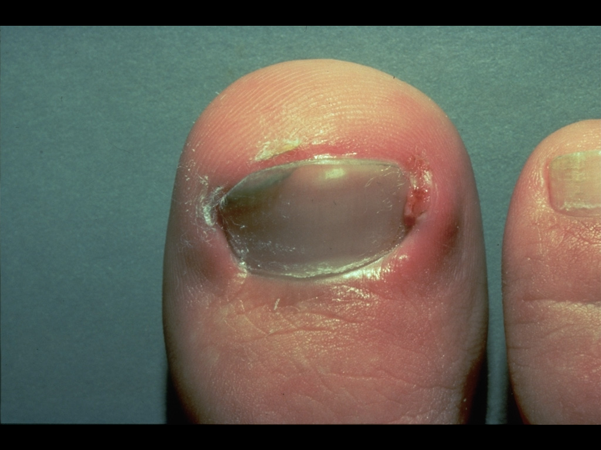
Ingrowing toenail

Slide 33
Treatment of ingrown toenail
Wearing wide and pliable shoes.
Antibiotics.
Cauterization of granulation tissues by silver nitrate sticks.
If yet no benefit, avulsion of nail plate or removal part of it in continuing cellulitis.

Slide 34
Good luck

