Slide 1
Aldehyde, Ketone, and Carboxylic acids.

Slide 2
Aldehyde, Ketone, and Carboxylic acids.
Functional Groups Reactivity :
Functional groups play a significant role in increasing organic compound reactivity, by controlling the direction of the reactions.

Slide 3
Alkyl chains (R₃ C - C R₃) are nonreactive, but when substituted gives unsaturated alkyl chains(R₂ C = C R₂), the presence of functional group (> C = C <) allow for relative increase in both reactivity and specificity.

Slide 4
The carbonyl group:
A group of organic molecules contains a carbon atom connected to an oxygen atom, by a double bond. This group is called a carbonyl group, and it has very different chemical properties than a double bond (> C = C <) in alkenes, because oxygen is more electronegative than carbon, the bond is polar.

Slide 5
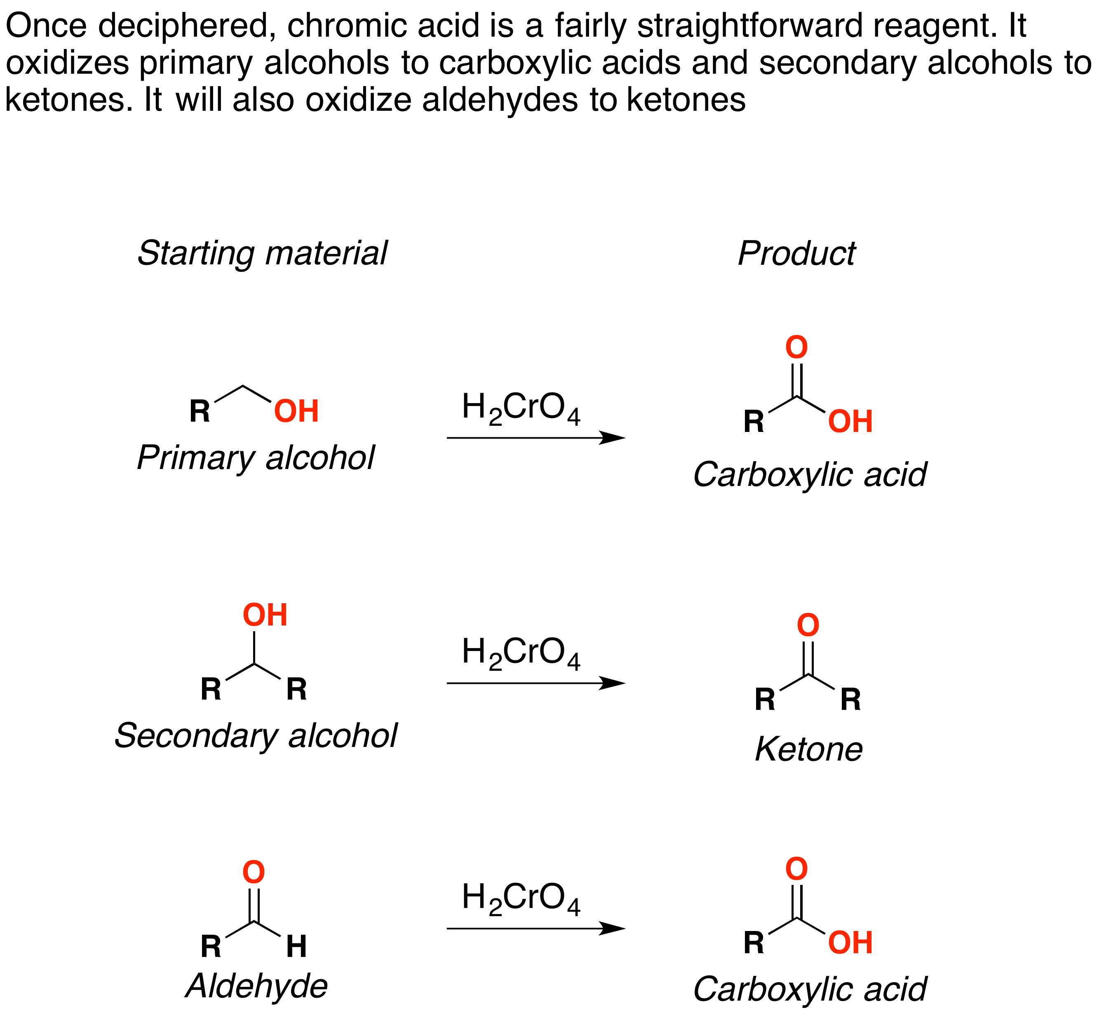
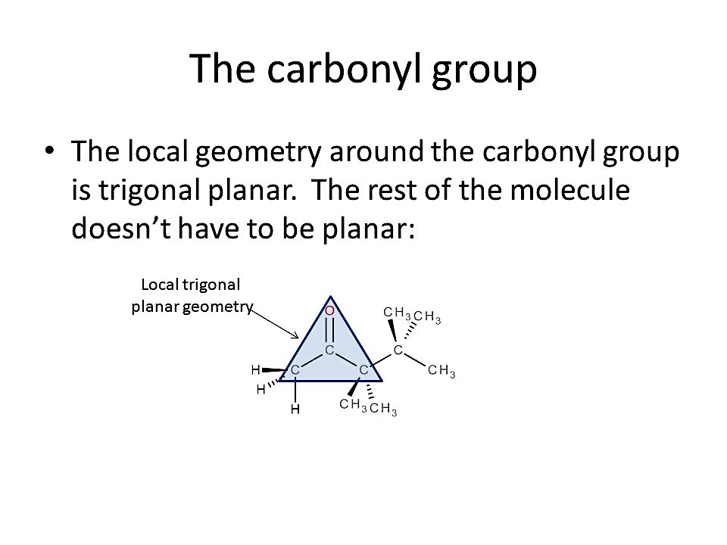
The local geometry around the carbonyl group is trigonal planar. The rest of the molecule doesn’t have to be planar.. The trigonal planar carbon in the carbonyl group can attach to two other substituents leading to several subfamilies (aldehydes, ketones, carboxylic acids and esters).

Slide 6
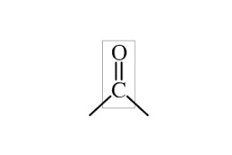
Carbonyl Compounds
Carbonyl Compounds are consist of carbon- oxygen double bounded (>C=O). Its polar or water soluble due to ability to form Hydrogen bonding, respectively. Aldehyde, Ketone, and carboxylic acids are all containing of carbonyl group, so they called Carbonyl Compounds.
Carbonyl group.

Slide 7
The carbonyl group in Aldehydes and Ketones are among the first examples of a class of compounds that possess (C = O )double bond that seen by oxidation of alcohols.

Slide 8
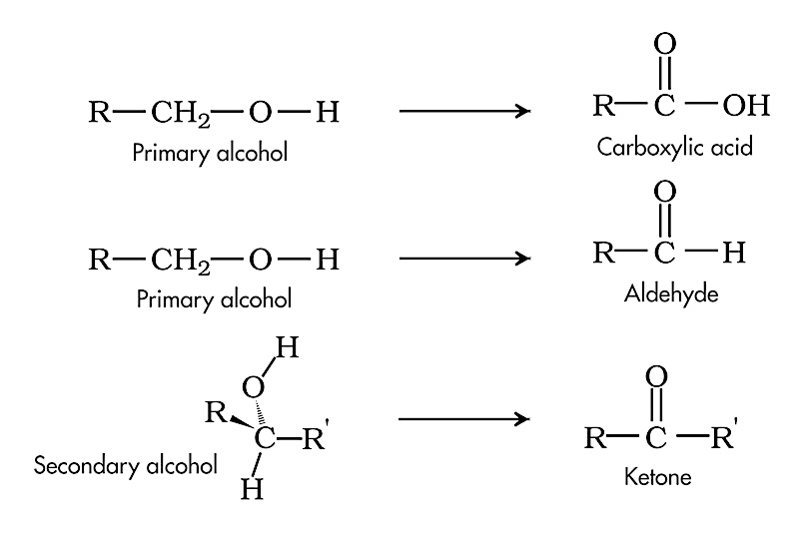
primary alcohol oxidized to aldehyde, and Carboxylic acid and its derivatives, while secondary alcohol oxidized into ketone.

Slide 9
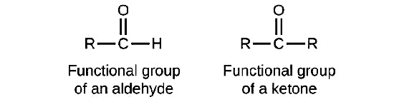
Aldehydes and Ketone
Both aldehydes and ketones contain a carbonyl group. In an aldehyde, the carbonyl group is bonded to at least one hydrogen atom. In a ketone, the carbonyl group is bonded to two carbon atoms. An aldehyde group is represented as –CHO; a ketone is represented as (>C=O) or –CO–.
Aldehyde. Ketone.

Slide 10
Biological Significance of Ketone Bodies:
Aldehydes, and ketones are critical in human body , they present in organic compound as carbohydrates, fats, proteins, nucleic acids, hormones, vitamins in human body, and Drugs.

Slide 11
One of the most important ketone is acetone (CH₃)₂C=O. Acetone is the most important ketone to your health, and present in less than 1 mg/100 mL of blood. An excess of acetone in the bloodstream is a common symptom of diabetes mellites DM.

Slide 12
Insulin is a hormone that allows glucose to enter cells from the bloodstream to reduce glucose level in circulation of blood.
Diabetes mellites is a common disease present in two types.

Slide 13
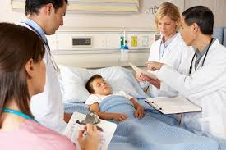
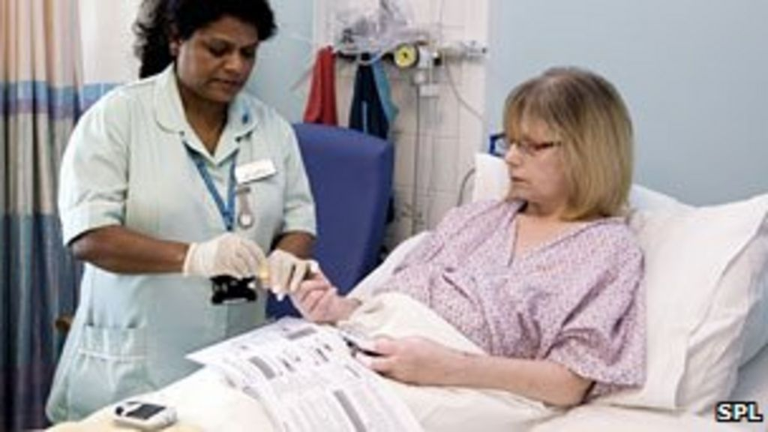
The first is type one diabetes caused by inherditary disorder, while type two diabetes appear in older ages due to Insulin hormone resistance or defect in Insulin hormone production.
Type 1 DM
Type 2 DM

Slide 14
Because there is no or low insulin hormone activity in the body,
a diabetic is forced lipids to break down into fatty acids, and proteins for energy, which produces a large quantity of ketone bodies.

Slide 15
This can be prevented by monitoring insulin levels within the body. However, if a diabetic's body is subjected to stress, such as an illness, disruption to insulin treatment, or surgery, a condition called diabetic ketoacidosis (DKA) can occur.

Slide 16
Symptoms of diabetes:
The main symptoms of Diabetes mellites are the followings:
Always thirsty.
Always tired.
Always hungry.
Blurry vision.
Systemic weight loss.
Frequent urination.
Wounds that will not heal.

Slide 17
Types of Diabetes mellites:
There are two types of elevation or depressed blood sugar level these conditions are Hypoglycemia (low blood sugar) and hyperglycemia (high blood sugar) each have different warning signs and symptoms, but can lead to the same result diabetic coma.

Slide 18
Types of Diabetes mellites:
“Warning signs are in danger because the blood sugar is dropping or is too low causing coma, some times this disease called the silent diabetes symptoms some one might miss.

Slide 19
When a diabetic's body is in a stressful situation, it produces hormones such as adrenaline, which increase the rate of converting fatty acids to energy. This causes ketone bodies to accumulate. When so much acetone builds up in the blood, the body attempts to eliminate it all by causing excessive urination.

Slide 20
In healthy humans, the body is continually making a small
amount of ketones to be used by the body for energy. But in case of fasting, even overnight while sleeping, the amount of ketone bodies in the blood increases by Ketogenesis process.

Slide 21
Symptoms of diabetic ketoacidosis (DKA) include dehydration, deficiencies in salts such as potassium, nausea, fatigue, confusion, abdominal cramping, excessive thirst, and decreased perspiration.

Slide 22
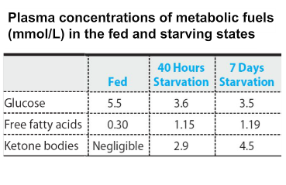
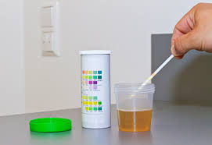
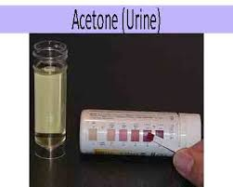
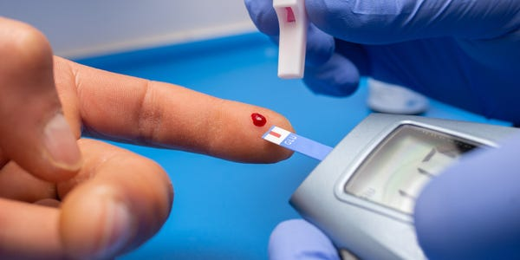
Although it is dependable way of determining ketone buildup, also ketone breathe excess is often associated with fruity smelling breath in diabetic patient.

Slide 24
The presence of Aldehyde, Ketone,
and carboxylic acids:
①-Monosaccharide's: Monosaccharide's are carbohydrates which can not be hydrolyzed to small molecules, contain carbons with functional aldehyde, or keto group are present in nature. Aldohexose is glucose,
Fructose is ketohexose respectively.
Glucose is present in our blood, and gives rise to energy on oxidation.

Slide 25
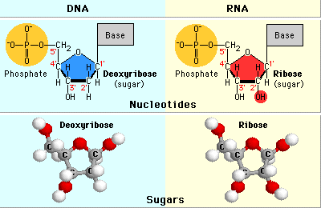
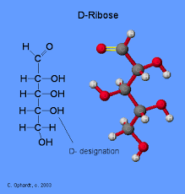
②- Aldopentose Ribose is constituent of nucleic acids monomer or nucleotides of DNA & RNA.

Slide 26
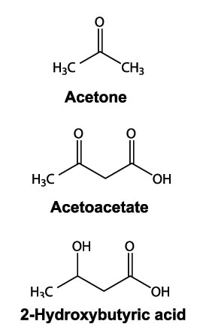
③ -Ketone Bodies: Ketone Bodies are :
acetone
acetoacetate
2-hydroxy butyric acid.
FOR SEEN ONLY EXCEPT ACETONE

Slide 27
Ketone Bodies are water soluble fuels normally exported by the liver, but overproduction during fasting or diabetes mellitus
Ketone Bodies are formed in times of fasting, even overnight while sleeping, so the amount of ketone bodies in the blood are increases. Ketone Bodies are converted in the hepatic mitochondria to be used as fuel for human activities.

Slide 28
The function of ketone bodies:
Glycogenolysis
The normal pathways to create energy involve either stored carbohydrate or non-carbohydrate substances( Fatty acids or Proteins). When carbohydrate stores are available, the main pathway used is glycogenolysis. This involves the breakdown of glycogen stores in muscle and liver.

Slide 29
Gluconeogenesis
Gluconeogenesis, is the production of glucose
from non-carbohydrate sources such as lactate . Lactate is often utilized as well as, especially in situations involving exercise. When carbohydrate stores are significantly decreased, or fatty acid concentration is increased, or Diabetes mellites, the ketogenesis metabolic pathway and production of ketone bodies are increased.

Slide 30
This can be seen in conditions such as type 1 diabetes, alcoholism, and starvation. Most organs and tissues can use ketone bodies as an alternative source of energy. The brain
uses them as a major source of energy during periods where glucose is not readily available.

Slide 31
The brain uses them as a major source of energy during periods where glucose is not readily available. This is because, unlike other organs in the body, the brain has an absolute minimum requirement of glucose.

Slide 32
The heart typically uses fatty acids as its source of energy, but also can use ketones. The liver, although the primary site that produces ketone bodies, does not use ketone bodies because it lacks the necessary enzyme beta ketoacyl-CoA transferase.

Slide 33
Carboxylic acid
Carboxylic acid is a class of organic carbonyl compounds
Have a carbonyl group ( >C=O ), attached to a hydroxyl
group (-OH ) to generate a carboxyl group(-COOH ).
The carboxyl group consisting of a carbonyl (C=O) with a hydroxyl group (O–H) attached to the same carbon atom and is usually written as –COOH or CO2H.

Slide 34
Carboxylic acids in nature:
Carboxylic acids are compounds occurring naturally in different stages of life cycles (living organism-Krebs cycle; fermentation processes, and geological processes) or can be produced in the laboratories or at large scale (synthesis) from oxidation reactions
of aldehydes , and primary alcohols.

Slide 35
Carboxylic acids in nature:
The organic acids play significant roles in our society as evidenced by multiple applications in the field of medicine, agriculture, pharmaceuticals, food, and other industries. Carboxylic acids are used in the production of pharmaceutical drugs, also can be used as solvents, food additives, antimicrobials.

Slide 36
The pH of carboxylic acid solutions
Organic acids are well-known as effective preservatives, and their antimicrobial action, depending on the environmental pH, making them effective antimicrobial agents.
An example, some organic salts (calcium and sodium propionate) prevent spoilage by inhibiting growth of bacteria and fungi.

Slide 37
Carboxylic acid is a weak acid. For example Acetic acid meaning Vinegar, the other example in human body is a fatty acid. Using the definition of an acid as a "substance which donates protons (hydrogen ions) to other things",

Slide 38
The carboxylic acids are acidic because of the hydrogen
in the -COOH group. In solution of water, a hydrogen ion is transferred from the ( -COOH ) group to a water molecule,
to get an acetate ion formed together with a hydroxonium
ion, H₃O⁺, by the following equation:
CH₃COOH + H₂O ↔ CH₃COO¯ + H₃O⁺.
Acetic acid. Acetate ion Hydroxonium ion.

Slide 39
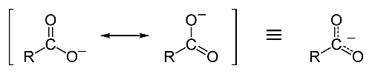
What makes a carboxylic acid more acidic?
Acidity of carboxylic acid is higher than alcohols. Carboxylate
ion, is stabilized by two equivalent resonance structures in which
the negative charge is effectively delocalized between two or more electronegative oxygen atoms.

Slide 40
Metabolic Acidosis
The pH of blood is usually between 7.35 and 7.45. A pH of less
than 7.0 is called acid and a pH greater than 7.0 is called basic (alkaline). So blood is slightly basic. At low pH the Arterial pH
cause Metabolic Acidosis, which refer to increase acid generation.

Slide 41
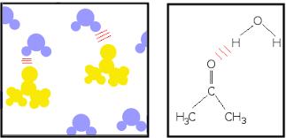
The Effect Of Metabolic Acidosis:
1- Ketoacidosis, when any one have diabetes and don't get enough insulin,& get dehydrated, body burns fats or proteins (leaving carbohydrates) as fuel, and that makes ketones accumulation in blood, so turn it acidic.

Slide 42
2- Alcoholism, People who drink a lot of alcohol for a long time and don't eat enough also build up ketones.

Slide 43
The Effect Of Metabolic Acidosis:
3- Renal tubular acidosis: For healthy Kidneys, Kidney take acids out of blood and get rid of them in pee. Kidney diseases as well as some immune system and genetic disorders can damage kidney so they leave too much acid in blood.

Slide 44
4- Ingestion Salicylates: It is a medical emergency. Intentional ingestion or accidental overdose can cause Salicylate poisoning causes a variety of metabolic disorders making treatment difficult.

Slide 45
The clinical Features:
The clinical Features evolved rapidly over 24 hours and early signs:
- Cause nausea.
- Vomiting.
- Abdominal pain.

Slide 46
The Carboxylic Acid Derivatives:
The Carboxylic Acid Derivatives
Carboxylic Acid Derivatives | Esters | amides
Examples in living systems | Acetyl coenzyme A | Paracetamol, Penicillin.

