Slide 1
TRACHEOSTOMY
assistant Proffesor Dr Haider Alsarhan
Mustansiriyah University
College of medicine

Slide 2
What is a Tracheostomy?
A tracheostomy is a artificial (usually) surgically created airway fashioned by making a hole in the anterior wall of the trachea and the insertion of a tracheostomy tube, which may or may not be permanent

Slide 3
Indications
Upper Airway obstruction secondary to –
trauma, burns
corrosive poisoning,
laryngeal dysfunction,
foreign body,
infections, inflammatory conditions, neoplasms,
Postoperatively , obstructive sleep apnea
Access for pulmonary toilet
Prolonged ventilatory support
Airway protection in head injured or comatose patient
and in postoperative neurosurgical patients

Slide 4
Contraindications
Relative
1. Unstable cervical spine
2. Uncorrected coagulopathy
3. Presence of neck mass or pervious neck surgery
4. History of mediastinal irradiation due to intrathoracic fibrosis
5. Previous history of surgical tracheostomy

Slide 5
Advantages of Tracheotomy
Increased patient mobility
More secure airway
Increased comfort
Improved airway suctioning
Early transfer of ventilator-dependent patients from the intensive care unit (ICU)
Less endo-laryngeal injury
Enhanced oral nutrition
Enhanced phonation and communication
Decreased airway resistance for promoting weaning from mechanical ventilation
Decreased risk for nosocomial pneumonia

Slide 6
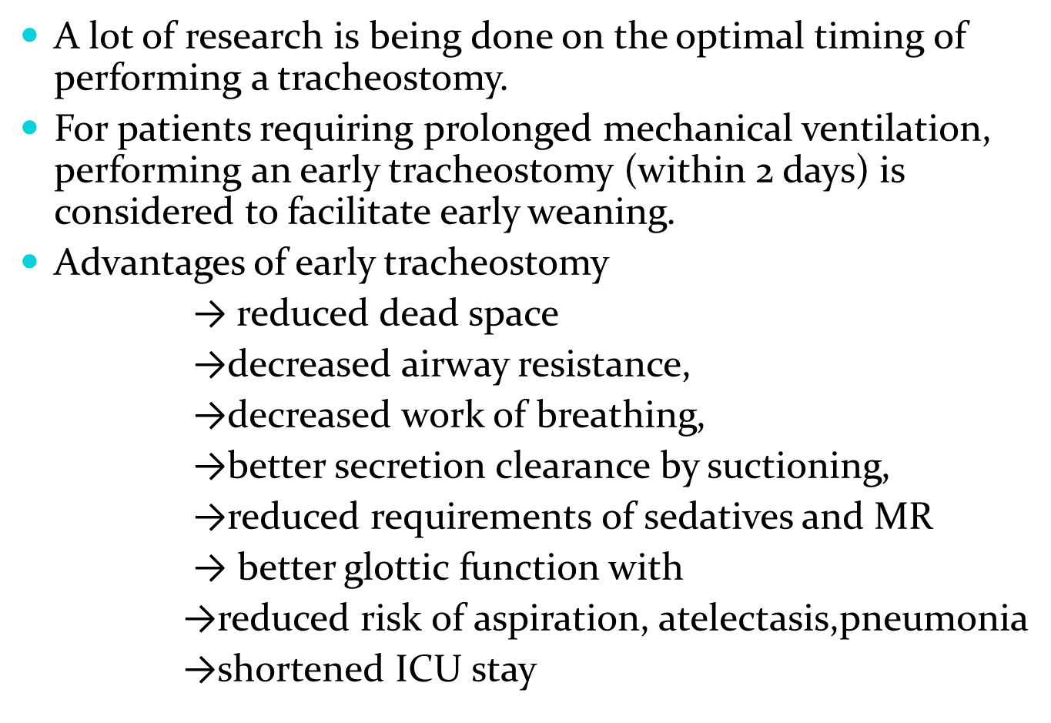

Slide 7
Surgical Tracheostomy
Surgical tracheostomy (ST) is usually performed in the operating room on a patient under general anesthesia, but it may be performed at the bedside in the intensive care unit.
The patient’s shoulders are elevated with head extension (unless cervical disease or injury is present), elevating the larynx and exposing more of the upper trachea.
Local anesthesia with a vasoconstrictor is usually infiltrated into the skin and deeper tissues

Slide 9
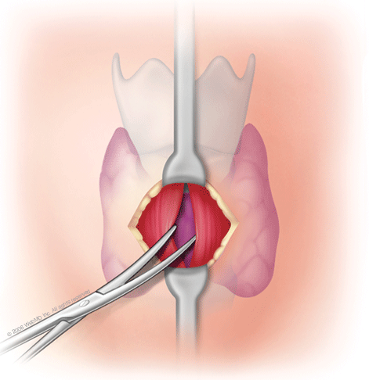
Procedure
The skin of the neck over the 2nd tracheal ring is identified, and a vertical
incision about 2–3 cm in length is created.
Sharp dissection following the skin incision is used to cut across the platysma muscle, and bleeding controlled by hemostats and ties or electocautery.

Slide 10
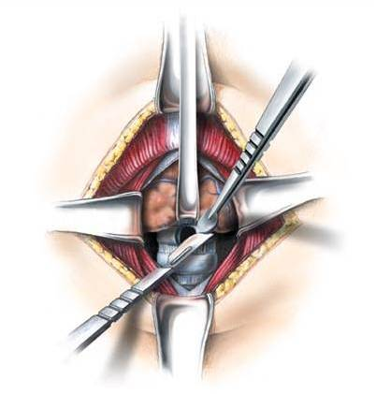
Blunt dissection parallel to the long axis of the trachea is then used to spread the submuscular tissues until the thyroid isthmus is identified
If the gland lies superior to the 3rd tracheal ring, it can be bluntly undermined and retracted superiorly to gain access to the trachea

Slide 11
There are 2 basic approaches
to tracheal entry.
the 2nd tracheal ring is divided laterally and the anterior portion removed.
Lateral sutures are used to provide counter traction during tracheostomy-tube insertion.
These are left uncut to provide assistance if the tube is accidentally dislodged later.

Slide 12
Tracheostomy Tubes
Tracheostomy tubes are available in a variety of sizes and styles, from several manufacturers.
Dimensions of tracheostomy tubes are given by their inner
diameter (ID), outer diameter (OD), length, and curvature.
Tracheostomy tubes can be angled or curved, a feature that can be used to improve the fit of the tube in the trachea.
Cuffs on tracheostomy tubes include high-volume low-pressure cuffs, tight-to shaft cuffs, and foam cuffs.
Tracheostomy tubes which have an inner cannula are called dual cannula tracheostomy tubes.

Slide 14
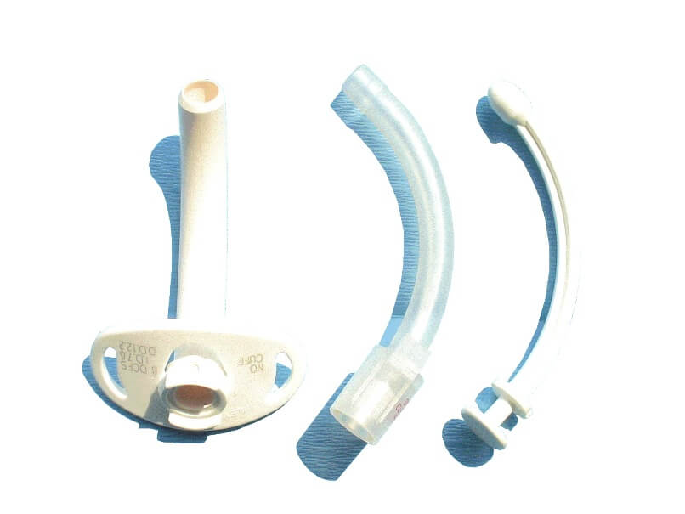

Slide 15
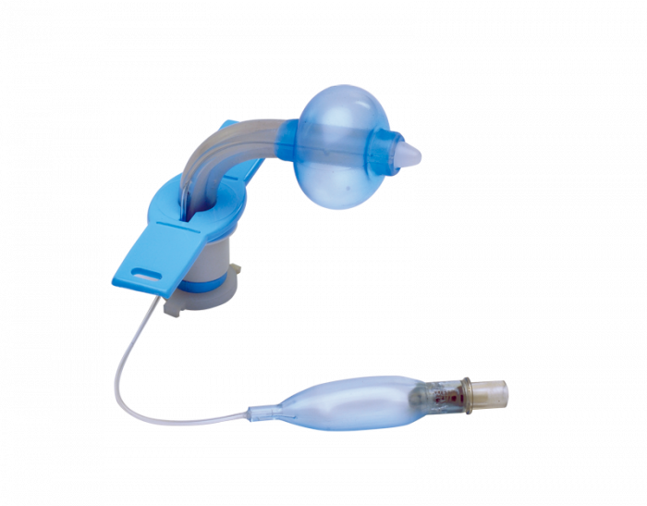

Slide 16
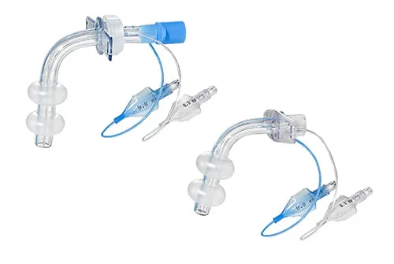

Slide 17
Metal versus Plastic tracheostomy tubes
Tracheostomy tubes can be of either metal or plastic.
Metal tubes are constructed of silver or stainless steel.
Metal tubes are not used commonly because they are
→ expenseive,
→ rigid construction
→ uncuffed
→lack a 15 mm connector for attachment
to a ventillator

Slide 18
Plastic tubes are most commonly used and are made from polyvinyl chloride or silicone.
Polyvinyl chloride softens at body temperature (thermolabile), conforming to patient’s tracheal anatomy and centering the distal tip in the trachea

Slide 19
Cuffed Tracheostomy tube
Cuffed tracheostomy tubes
→allow airway clearance,
→protection from aspiration
→ positive pressure ventilation
It is recommended that cuff pressure be maintained at 20–25 mmHg to minimize the risks for both tracheal wall injury and aspiration.

Slide 20
Fenestrated tracheostomy tubes
The fenestrated tracheostomy tube is similar in construction to standard tracheostomy tubes, with the addition of an opening in the posterior portion of the tube above the cuff.
With the inner cannula removed, the cuff deflated, and the tracheostomy air passage occluded, the patient can inhale and exhale through the fenestration and around the tube.

Slide 21
This allows for assessment of the patient’s ability to
breathe through the normal oral/nasal route
→ preparing the patient for decannulation
→ allowing phonation
Supplemental oxygen administration to the upper airway (eg, nasal cannula) may be necessary if the tube is capped.

Slide 22
EARLY COMPLICATIONS
Early bleeding: This is usually the result of increased blood pressure as the patient emerges from anesthesia and begins to cough.
Plugging with mucus
Tracheitis
Cellulitis
Tube displacement
Subcutaneous emphysema
Atelectasis

Slide 23
LATE COMPLICATIONS
Bleeding - Due to tracheoinnominate fistula
→ 0.4% with mortality rate of 85% to 90%.
→Major airway hemorrhage may occur within first several days or as long as 7 months after performance of a tracheostomy.
→Risk factors : excessive tube movement, low placement of the tracheostomy, sepsis, poor nutritional status, and corticosteroid therapy
Tracheo- and laryngomalatia
Stenosis It can develop from 1 to 6 months after decannulation
risk for tracheal stenosis ranges between 0% and 16%

Slide 24
Tracheoesophageal fistula
fewer than 1% of patients as a result of pressure necrosis of the tracheal and esophageal mucosa from the tube cuff
Risk factors : high cuff pressures, presence of a nasogastric tube, excessive tube movement, and underlying diabetes mellitus
Tracheocutaneous fistula
Granulation
Scarring
Failure to decannulate

Slide 25
Tracheotomy care
Humidification
Tube position To prevent decubitus of trachea
Suctioning
Skin care To prevent irritation and secondary
inflammation due to discharge
Inner tube care frequent remove and clean crusts

Slide 26
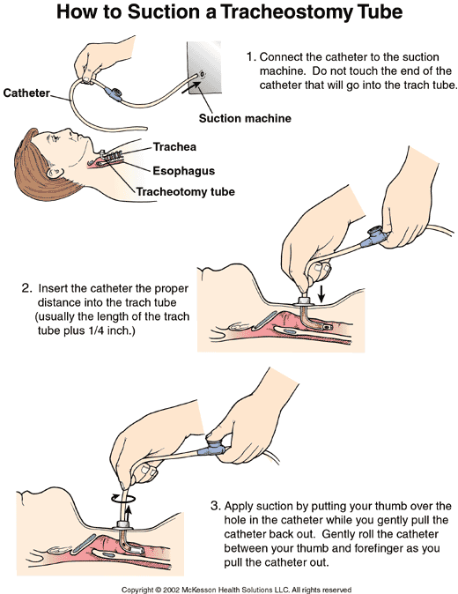

Slide 27
Speech with tracheotomy
Spontaneous breathers
Tolerate cuffless mech. ventilation
Conscious patient
For mechanically dependent patients that may tolerate cuff deflation
For unable to close the tube outlet with finger (quadriplegia)
(Passy-Muir valves)

Slide 28
A tracheostomy speaking valve is a one-way valve, allows air in, but not out
This forces air around the tracheostomy tube, through the vocal cords and the mouth upon expiration, enabling the patient to vocalize

Slide 29
Advantages of metallic tubes 1. can not be kinked 2. maintain lumen 3. easier insertion during surgery 4. shown by X Ray

Slide 30
Advantages of plastic tubes
More tissue friendly
Light weight
Connected to ventilator
Used during radiotherapy
It has a marker to be shown by X Ray
It has a cuff

