Slide 1
Urethra congenital anomaly & injuries
Dr. Ammar Fadil

Slide 2
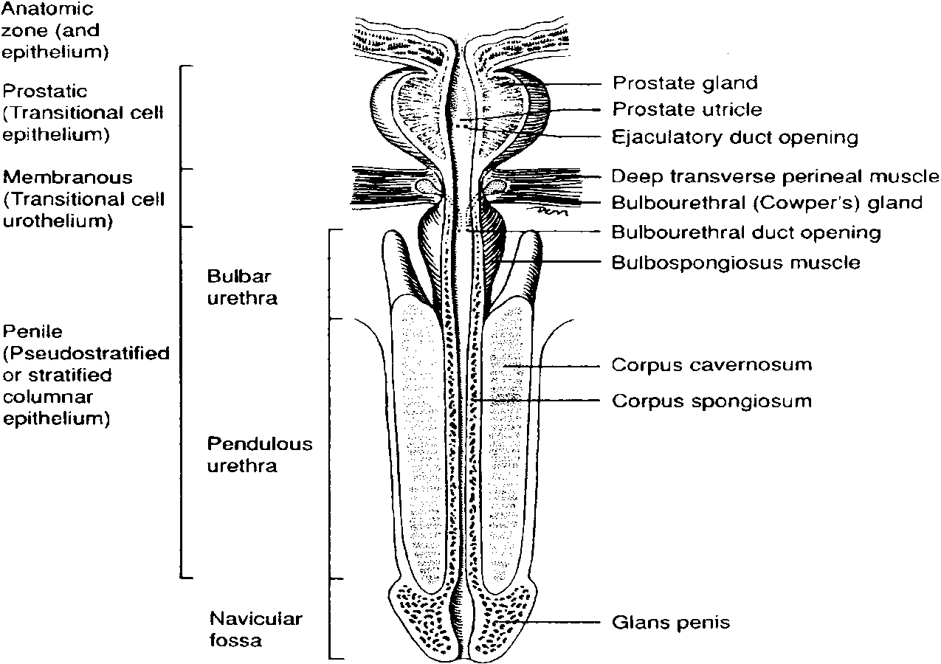
Anatomy
The male urethra is a tubular structure extending from the bladder neck to the external urinary meatus at the tip of the glans penis.

Slide 3
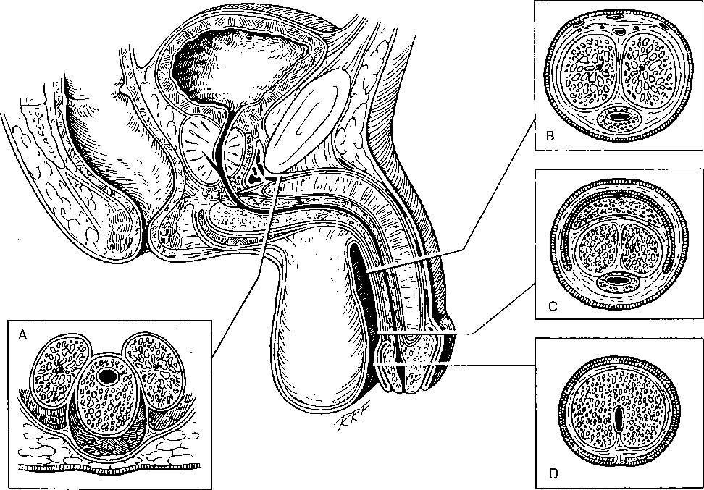
The male urethra divided into
  Posterior urethra (prostatic & membranous portions) is surrounded by the sphincter mechanisms & the prostate.
  anterior urethra ( Bulbar & penile (pendulous) segments , which is surrounded by the corpus spongiosum

Slide 4
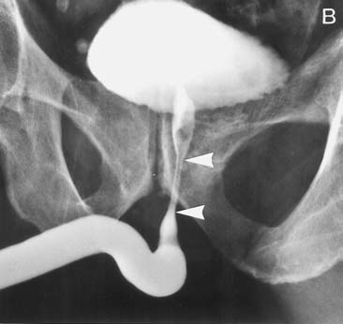
Imaging of urethra :Urethrogram

Slide 5
The penile urethra, is surrounded by the corpus spongiosum juxtaposed to the
two corpora cavernosa.
The distal part of the urethra which passes through the glans penis is named the navicular fossa. The penile urethra ends, is the external urethral meatus.

Slide 6
urethral length is between 17 and 20 cm
  the prostatic urethral length is 2–3 cm,
  the membranous urethra 1.5–2 cm, &
  the bulbous urethra 3–4 cm (the widest part)
  Penile urethral length depends on the length of the penis

Slide 7
Posterior urethral valves
Posterior urethral valves are the commonest congenital obstruction of the lower urinary tract.
They often have a poor, intermittent, dribbling urinary stream. Urinary infection and sepsis occur frequently
Posterior urethral valves occur only in males
Male fetus
  Bilateral hydroureteronephrosis
  distended full bladder

Slide 8
PUV

Slide 9
Imaging
Ultrasound
  hydroureteronephrosis, a thick-walled bladder
Micturating cystourethrography MCUG provides the deﬁnitive diagnosis,

Slide 10
Treatment
urine drainage with either
  urethral catheter (5 to 8Fr infant feeding tube) or
  a suprapubic catheter.
  Once stabilized valve ablation by endoscope
Most early infant mortality in posterior urethral valves is related to pulmonary hypoplasia

Slide 11
Hypospadias
is a congenital penile defect in which the urethra opens onto the underside of the penis, scrotum, or perineum
  occurs 1 in 200–300 boys
  most common congenital malformation of the urethra.
  It is the result of incomplete development of the urethra
  The exact etiology is unknown

Slide 12
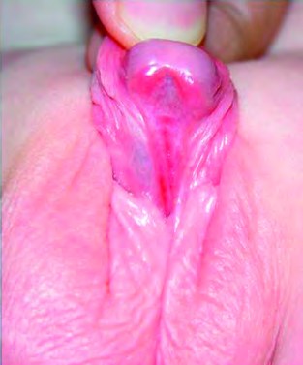
Hypospadias is an association of three anomalies:
  • an abnormal opening of the
  urethral meatus
  • curvature (chordee) of the penis
  • the prepuce is poorly developed ‘hooded prepuce”

Slide 13
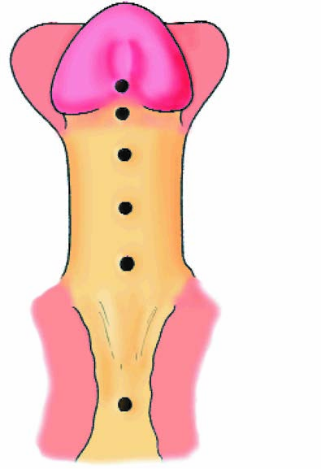
Hypospadias is classified dependent
on the position of the meatus
  Distal hypospadias 70 %
      • Glanular
      • Coronal
  Mid shaft 10 %
  • Penile
  Proximal hypospadias 20 %
  Penoscrotal
  This is the most severe abnormality. The scrotum is biﬁd and the urethra opens between its two halves. There may be undescended testes

Slide 14
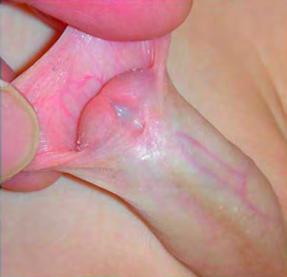
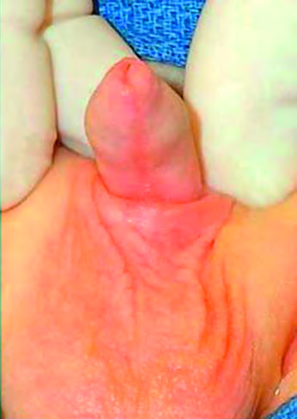
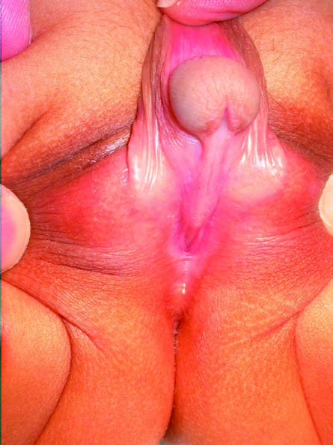

Slide 15
Diagnosis
clinical examination will make the diagnosis.
Look for associated abnormalities that will need treatment (meatal stenosis, undescended testes, inguinal hernias, & hydroceles).
Patients with absent testes and severe hypospadias should undergo chromosomal investigation to exclude intersex conditions

Slide 16
Treatment \Hypospadias repair
Surgery is indicated for hypospadias
  correction of curvature
  Re –sitting urethral meatus (creating new urethra)
A variety of plastic surgical procedures is described to correct the chordee and to re-site the urethral opening.
We need Preputial skin and so circumcision should be avoided
Timing varies: at age 1 yr or before 2 yrs

Slide 17
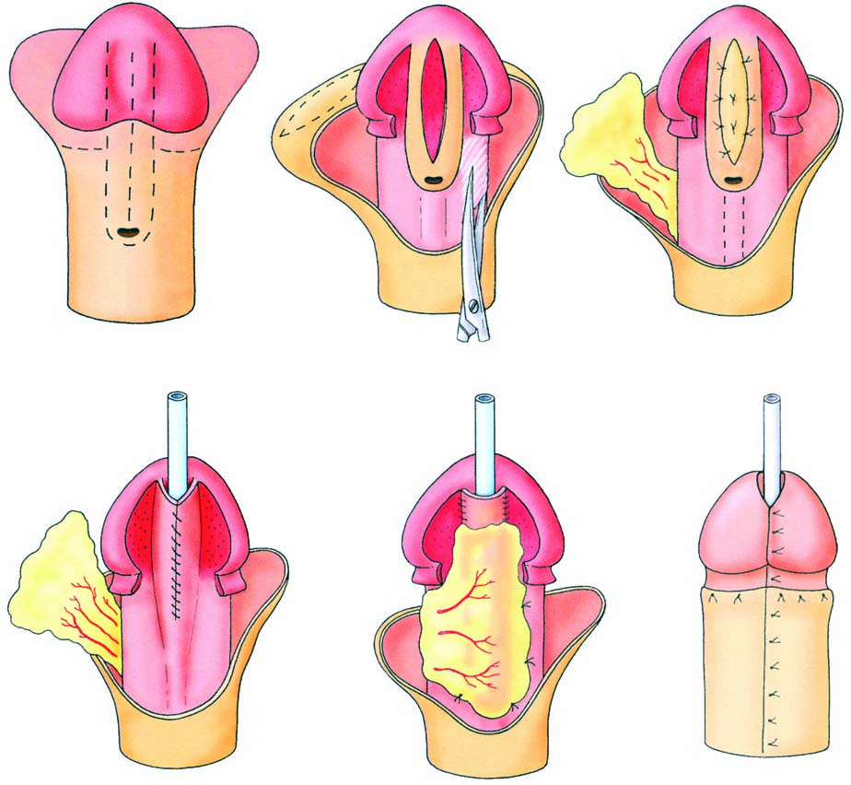
TIP (tabularized incised urethral plate)

Slide 18
Complications of surgery
Bleeding, infection, meatal stenosis, urethrocutaneous fistula, & failed procedures
Fistulae are the most common complications following hypospadias surgery,
Require re operation

Slide 19
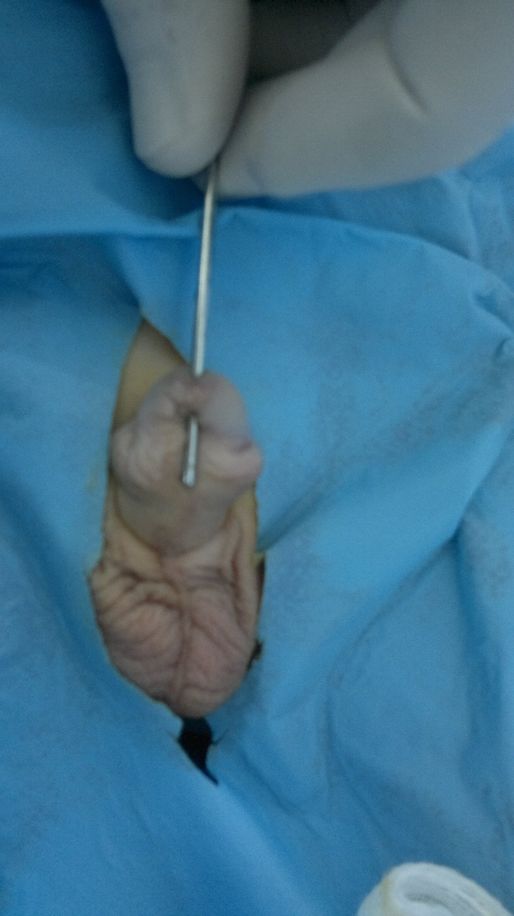
urethrocutaneous fistula,

Slide 20
Epispadias
Epispadias is rare.
the opening on the dorsum is associated with upward curvature of the penis.
Epispadias usually coexists with bladder exstrophy.

Slide 21
The male urethra divided into
  Posterior urethra (prostatic & membranous portions) is surrounded by the sphincter mechanisms & the prostate.
  anterior urethra ( Bulbar & penile (pendulous) segments , which is surrounded by the corpus spongiosum

Slide 22
Urethral injuries
Anterior urethral injury (rupture)
    usually occurs in conjunction with straddle injury to the perineum; the fixed bulbar urethra is crushed.
    The pendulous urethra is less susceptible to traumatic injury because of its mobility,
  Other causes include (e.g., traumatic catheterization), penile fracture, or penetrating trauma
Posterior urethral injuries
    occurring exclusively as a result of pelvic fracture
  Urological management differs depending on the location
  of injury.

Slide 23
Presentation
Findings that suggest urethral injury include
  blood at the urethral meatus ( cardinal sign)
  genital or perineal hematoma,
  pelvic fracture,
  penetrating penile injury,
  inability to void, &
  distended bladder.

Slide 24
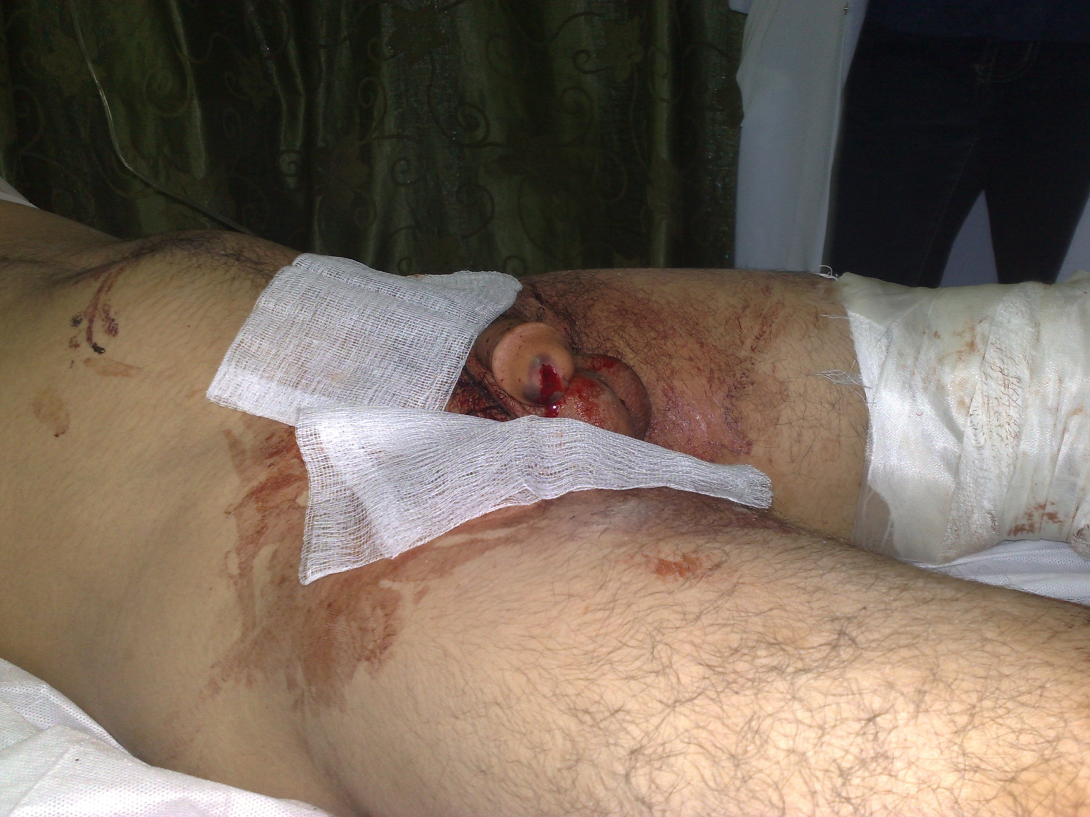

Slide 25
Diagnosis of urethral injury
All patients with a suspected urethral injury should undergo a retrograde
urethrogram (RUG)

Slide 26
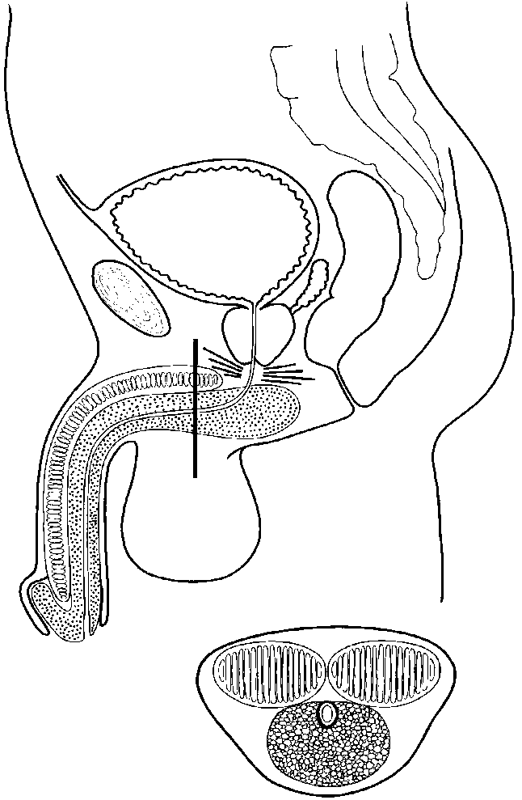
Classification of Urethral Injury
Classification based on t he extent of injury
  a. No urethral tear --urethral contusion
  b. Partial urethral tear
  c. Complete urethral transection
2. Classification based on location
  a. Anterior urethral injury--- bulbar
  b. Posterior urethral injury– pelvic #

Slide 27
An anterior urethral rupture is diagnosed when there is extravasation of contrast.
no extravasation of contrast = urethral contusion.
  extravasation of contrast, with contrast also present in the bladder =partial rupture of the anterior urethra.
  no filling of bladder = complete anterior urethral disruption

Slide 28
Anterior Urethral Injury
Bulbar urethral injury
  a. Usually caused by a straddle injury (falling astride onto a fence ) ,bicycle accidents, kicks to perineum or a direct blow to the perineum in which the urethra is crushed against the pubic bone.
  b. May present with a "butterfly" shaped hematoma on the perineum and a scrotal hematoma (blood confined to Colles' fascia attachments).

Slide 29
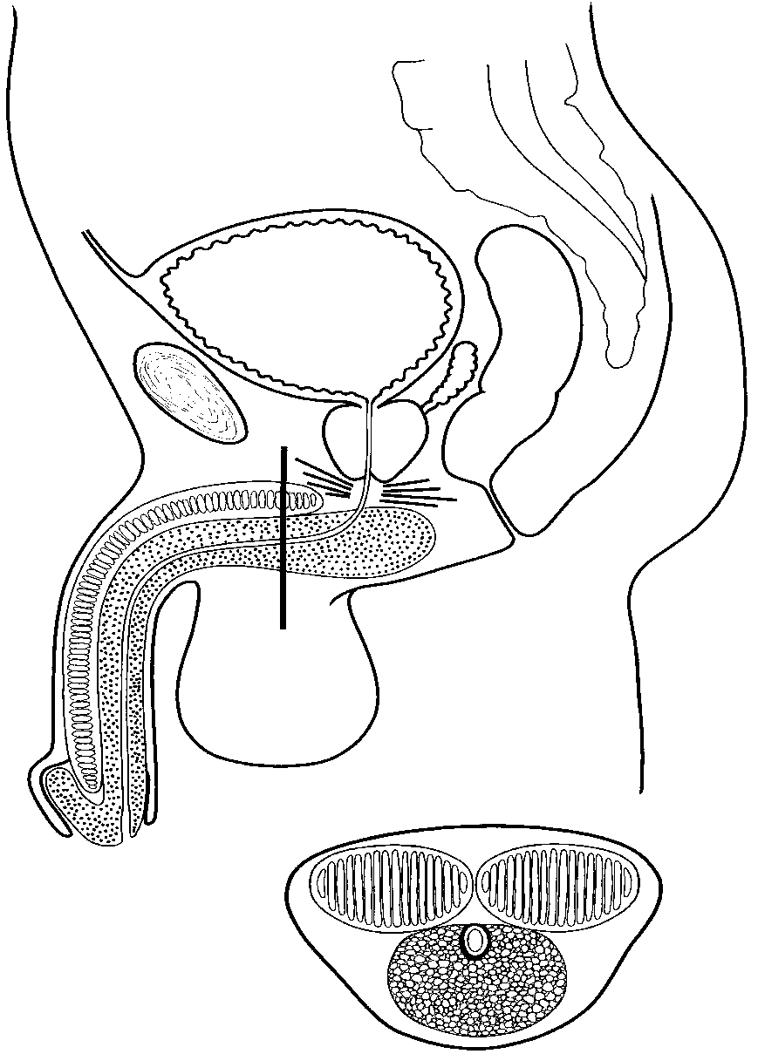
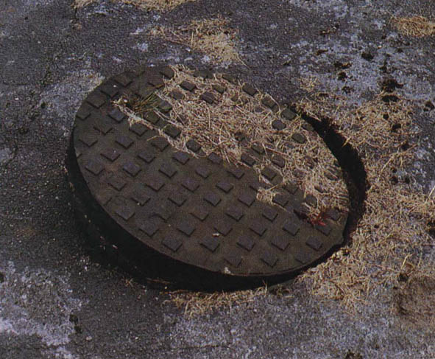

Slide 31
Treatment
Anterior urethral injuries are usually managed by bladder drainage (with
  trial to pass urethral catheter (single trial) or
  Suprapubic catheterization should be performed if urethral catheterization is not easily accomplished

Slide 32
Initial treatment
Anterior urethral injuries are usually managed by bladder drainage (with a suprapubic tube or urethral catheter

Slide 33
Treatment Partial Rupture of Anterior Urethra
antibiotics are given to prevent infection of extravasated urine & blood.
If a voiding cystogram 2 weeks later confirms urethral healing, remove the catheter
The majority of such injuries will heal without a functionally significant stricture.
minority will develop urethral stricture that need subsequent therapy.

Slide 34
Stricture following urethral injury management depends on location, severity, and extent of the stricture.
Options include
  internal urethrotomy
  urethroplasty

Slide 35
Complete Rupture of Anterior Urethra
Where the anterior urethra has been completely torn across, then if the patient is unstable, as a consequence of other injuries, a suprapubic catheter can be placed and repair delayed (urethroplasty) until the patient has recovered from the other injuries
excision with primary end-to-end anastomosis
Buccal mucosa augmentation urethroplasty

Slide 36
Posterior Urethral Injury
The posterior urethra consists of the prostatic and membranous urethra.
Almost all posterior urethral injuries are caused by pelvic fracture from blunt trauma. Urethral injury occurs in 10% of men with pelvic fractures.

Slide 37
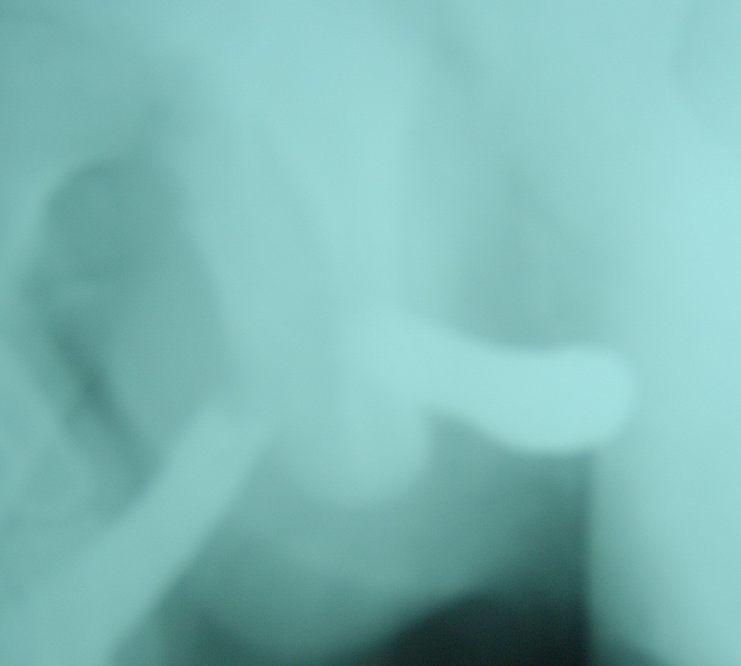
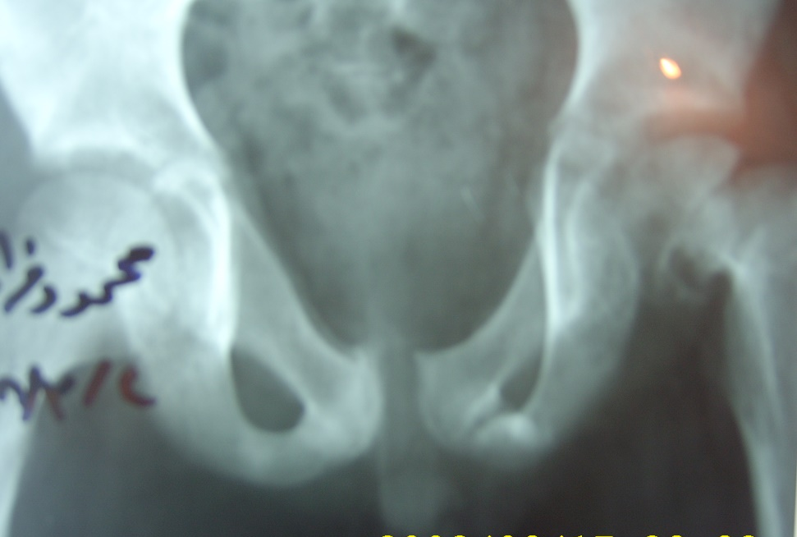
Pelvic fracture

Slide 38
DX
The diagnosis of posterior urethral injury is suggested by a history of pelvic fracture,
  Triad of pelvic fracture, blood at the meatus and inability to void are diagnostic of urethral injury
Urethrogram

Slide 39
Posterior Urethral Injury
The prostate and bladder are often pushed cephalad by hematoma, resulting in a high-riding prostate on rectal exam " pie in the sky" bladder on cystogram.
The continuity is disrupted by intervening scar tissue.

Slide 40
Initial treatment
Acute management of these patients should be directed at hemodynamic resuscitation, bony fixation, &
bladder drainage via suprapubic cystostomy catheter.
these patients almost always develop urethral obliteration
A period of urethral rest at least 3 months after injury to allow the edema and hematoma to completely resolve.
This defect is an obliterative stenosis, not a stricture.

Slide 41
Delayed treatment
The surgical approach is usually a perineal incision with excision of the scared area and end to end anastomosis. (urethroplasty)

Slide 42
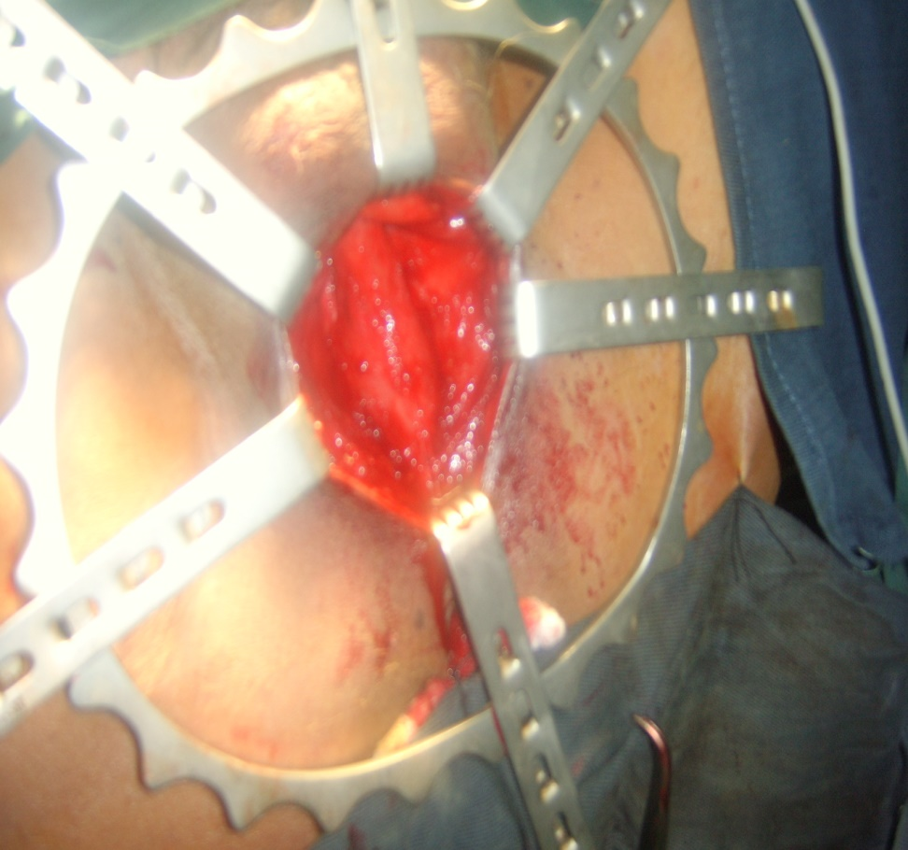
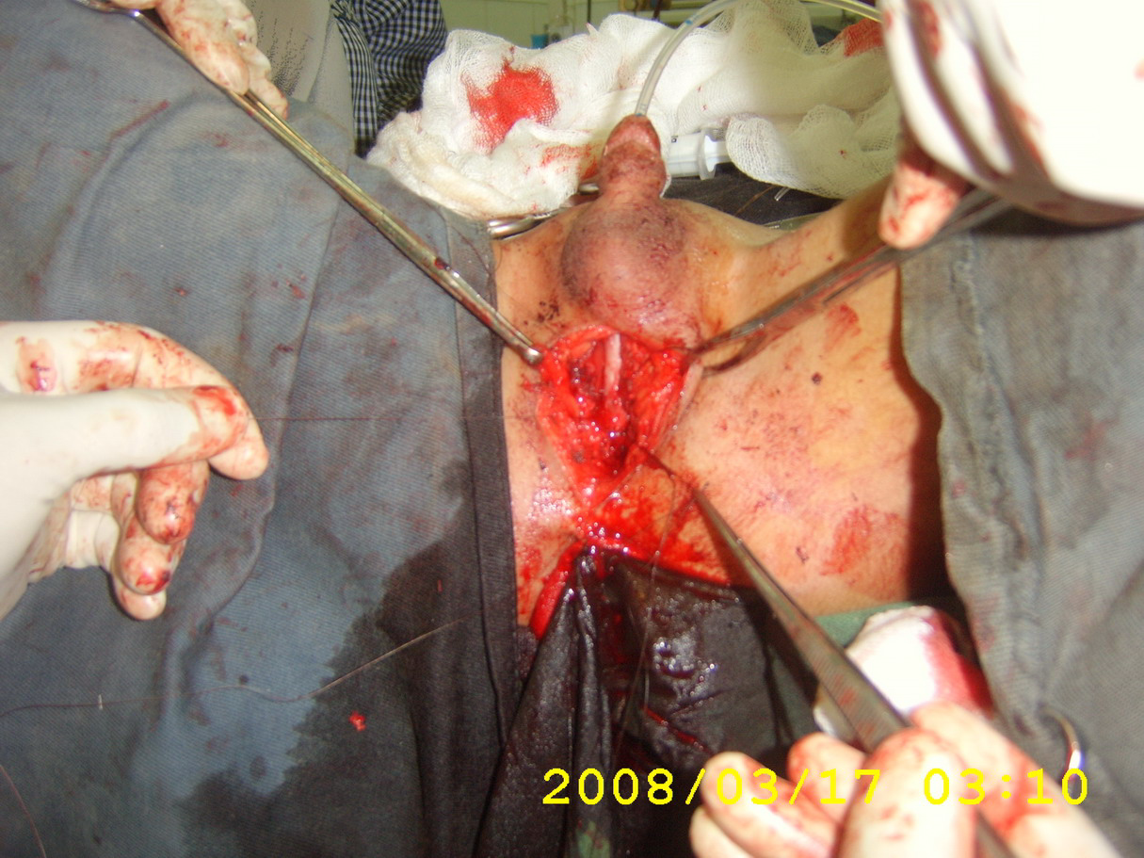
Urethroplasty

Slide 43
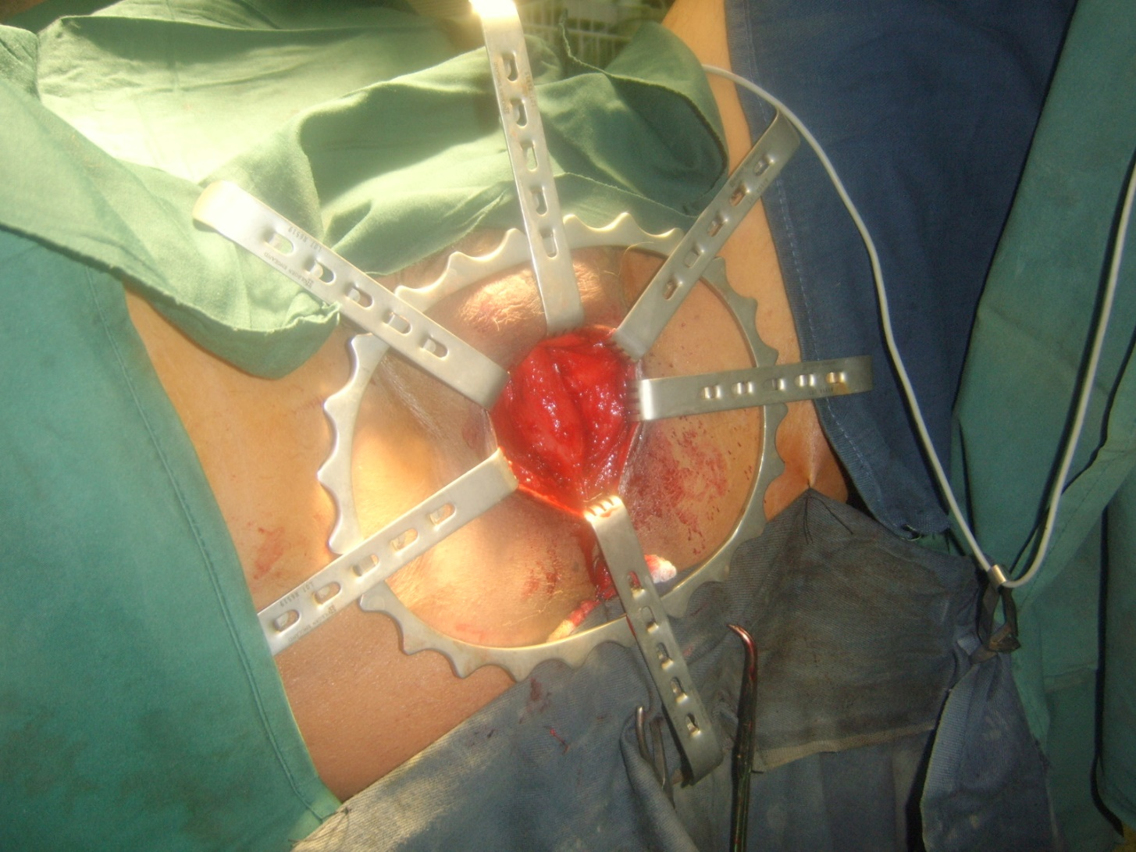

Slide 44
Iatrogenic urethral injury
Most commonly result from traumatic urethral instrumentation
Traumatic Foley catheter removal without prior balloon deflation.
Theses injuries usually result in minor contusion that heal with few sequalae.
Treatment by single trial of catheter insertion if failed suprapubic cystostomy

