Slide 1
Second trimester miscarriage
Zeena helmi

Slide 2
Definition
is defined as the loss of a pregnancy prior to viability, taken legally in the UK as a gestation date of 23 weeks 6 days. Beyond this, fetal demise is classified as stillbirth. second-trimester mis- carriage occurs after 12 weeks’ gestation and accounting for 1–4% of all miscarriages

Slide 3
causes
• Cervix: cervical injury from surgery, cone biopsy and large loop excision of the transformation zone
• Infection: may occur with or without ruptured mem- branes. May be local to the genital tract or systemic. • Thrombophilias. • Uterine abnormalities: submucous fibroids and con- genital distortion of the cavity (uterine septae) may be implicated.
• Chromosomal abnormalities: these too may not become apparent until the second trimester.

Slide 4
Management
Management options fall into three groups: medical, sur- gical or expectant. Factors to be taken into account when discussing these options with patients include the following.
• Type of miscarriage(same as classification for first trimester miscarriages)
• Gestation at which miscarriage is diagnosed
• Facilities available at individual units:
• Medical history: cardiac disease and sickle cell anaemia for example. The risks are increased in the presence of haemorrhage and so generally among these patients sur- gical evacuation, being associated with less blood loss, is the most appropriate choice.
• Patient choice.
• Cost.

Slide 5
Expectant management
Up to 85% of miscarriages will resolve spontaneously within 3 weeks of the diagnosis.
Patient satisfaction with expectant management depends on appropriate patient selection (earlier gesta- tion, singleton pregnancy, social circumstances) and counselling. Patients should be made aware of what to anticipate (pain and bleeding), be given advice regarding analgesia and what to do with the tissue passed. The advice should be backed up with written information and contact details in case of concern or complications.

Slide 6
Medical management
Following Mifepristone(pretreatment the patient is admitted for Misoprostol regimen
Vaginal Misoprostol 200 micrograms should be given in the posterior fornix every three hours x 5 doses. (New 2019)
The risk of uterine rupture with misoprostal, although small, is increased in women with a second trimester loss with a uterine scar. Staff should be vigilant to clinical features that may suggest uterine scar dehiscence or rupture e.g. maternal tachycardia, atypical pain
Side effects include nausea, vomiting and diarrhea.

Slide 7
Overall, the success rate of medical management (72– 93%) is similar to that of expectant management (75–85%) but medical management has the advantage that patients can control the course of events by timing medi- cation to allow the miscarriage to take place.Compared with surgical man- agement, there is significantly more associated blood loss but no increased requirement for blood transfusion. Reassuringly, rates of infection between the three options are similar

Slide 8
Surgical management
Surgical management involves evacuation of the uterus by dilatation and evacuation The procedure can be performed under general or local anaesthesia depending on local experience. Cervical dilatation can be assisted by cervical priming with a prostaglandin (e.g. misoprostol) a minimum of 1 hour prior to the procedure

Slide 9
Surgical management is usually safe but it is important to counsel women about the associated risks. These include the risk of general anaesthesia , the risk of infection or retained products (3–5%) and potential bleeding in association with this and the 0.5% risk of uterine perforation. Asherman’s syndrome, due to over-vigorous curettage

Slide 10
Rhesus status
The recommended dose of anti-D immunoglobulin for miscarriage is 250 units before 20 weeks’ gestation and 500 units after 20 weeks. It is further recommended that a Kleihauer test be performed to assess the quantity of feto-maternal haemorrhage after 20 weeks.

Slide 11
cervical incompetence
Definition: – Inability of the uterine cervix to retain a pregnancy in the absence of contractions or labor– “Painless cervical dilation” or Cervical insufficiency (CI), occurs in 1 in 50 to 1 in 2,000 gestations.

Slide 12
Risk factor
1-Congenital
Short cx
Mullerian duct abnormalities ( Bicornuate or unicornuate uteri )
DES exposure in utero
Connective tissue disorder reg: Marfan Syndrome

Slide 13
2-Aquired
Cervical laceration following NSVD
Cervical injury at time of CS
Cervical conization (LEEP/LLETZ, cold knife cone biopsy)
Cervical dilation (D&C; D&E)
Uterine overdistention – Multifetal gestations – Polyhydramnios
Infection/inflammation

Slide 14
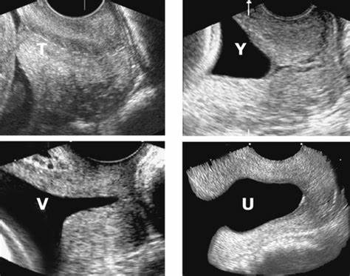
Diagnosis
• Painless cervical dilation • Transvaginal sonography – Cervical shortening – Cervical funneling

Slide 15
Pelvic rest, progesterone replacement, and cervical cerclage have been suggested to prevent repeated pregnancy loss from CI, but the evidence for their effectiveness is mixed.
McDonald or Shirodkar (prophylactic)cerclages are placed vaginally, usually at 12 to 14 weeks’ gestation; selection of technique depends on the available cervical length and surgeon experience/preference. Rescue cerclage for CI/ with bulging membranes as is associated with >50% risk of complications.

Slide 16
Abdominal cerclage is placed at laparoscopy in rare instances for women who have minimal to no residual cervical length (often due to large cone biopsies or trachelectomy). Subsequent cesarean section is necessary.
Cerclage is removed when the patient begins to labor, when membranes rupture, if there is evidence of uterine infection, or if the patient reaches 37 weeks’ gestation.

